Slide 1
CI/CD Using DevOps
Maven
By
B Manikyala Rao M.Tech(Ph.d)
Assistant Professor
Dept of Computer Science & Engineering
Aditya College of Engineering & Technology
Surampalem

Slide 2
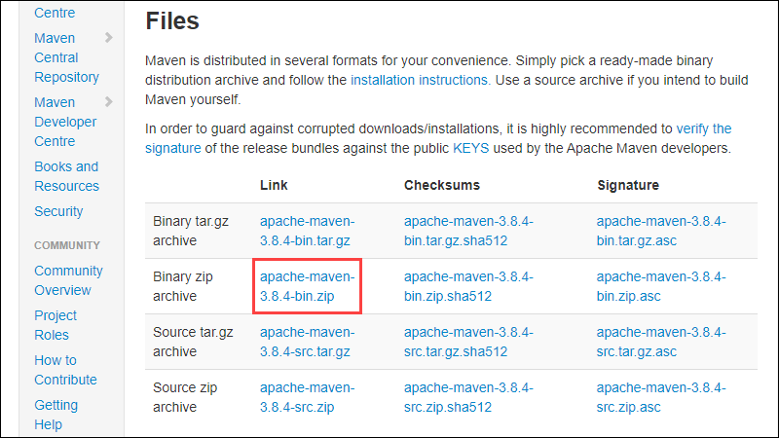
Maven Installation
Step 1: Download Maven Zip File and Extract
1. Visit the https://maven.apache.org/download.cgi and download the version of Maven you want to install. The Files section contains the archives of the latest version. Access earlier versions using the archives link in the Previous Releases section.
2. Click on the appropriate link to
download the binary zip archive
of the latest version of Maven.
that is version 3.8.4.

Slide 3
Maven Installation
3. Since there is no installation process, extract the Maven archive to a directory of your choice once the download is complete. For this tutorial, we are using C:\Program Files\Maven\apache-maven-3.8.4.
Step 2: Add MAVEN_HOME System Variable
1. Open the Start menu and search for environment variables.
2. Click the Edit the system environment variables result.
3. Under the Advanced tab in the System Properties window, click Environment Variables.
4. Click the New button under the System variables section to add a new system environment variable.
5. Enter MAVEN_HOME as the variable name and the path to the Maven directory as the variable value. Click OK to save the new system variable.

Slide 4
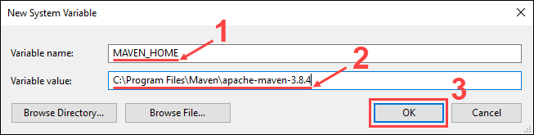
Maven Installation

Slide 5
Maven Installation
Step 3: Add MAVEN_HOME Directory in PATH Variable
Select the Path variable under the System variables section in the Environment Variables window. Click the Edit button to edit the variable.
Click the New button in the Edit environment variable window.
Enter %MAVEN_HOME%\bin in the new field. Click OK to save changes to the Path variable.
Click OK in the Environment Variables window to save the changes to the system variables.
Step 4: Verify Maven Installation
use the following command to verify the installation by checking the current version of Maven:
mvn -version

Slide 6
Creating Web Application using Maven Template
The easiest way to create a web project in maven is by using the maven archetype maven-archetype-webapp.
Just open the command prompt and navigate to the folder where the project needs to be created.(Create folder and navigate to it)
Run the below mentioned command, Maven will start executing the command and will create a complete project structure for a web based application.
mvn archetype:generate -DgroupId=com.sample.webproject -DartifactId=SampleWebApp -DarchetypeArtifactId=maven-archetype-webapp -DinteractiveMode=false
groupId – a unique base name of the company or group that created the project.
artifactId – a unique name of the project.

Slide 7
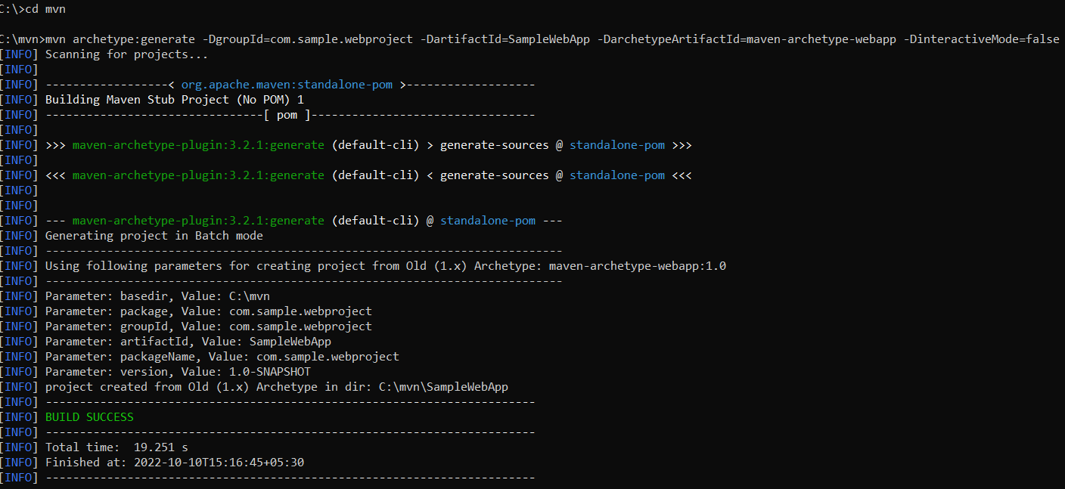
Maven

Slide 8
Maven
Below is the project structure for a web application generated by the maven by using the maven-archetype-webapp plugin.
Folder Structure Description
SampleWebApp Contains source folder and pom.xml file.
src/main/webapp Contains default index.jsp
src/main/webapp/WEB-INF Contains web.xml file. src/main/resources Contains resource files used. (images or properties files).

Slide 9
Default Files Generated by using maven-archetype-webapp plugin
pom.xml generated by the maven for the web application
maven generates a sample JSP file called index.jsp with the contents as shown below:
<html>
<body>
<h2>Hello World!</h2>
</body>
</html>

Slide 10
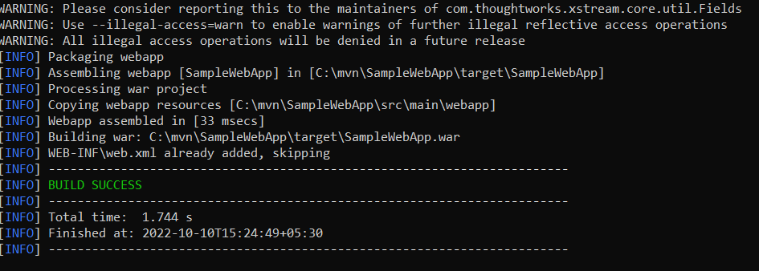
Building and Deploying the Web App
Just open the command prompt and navigate to the root folder of the web app and issue the command mvn clean package. This command will compile, test and generates a war file of the project.

Slide 11
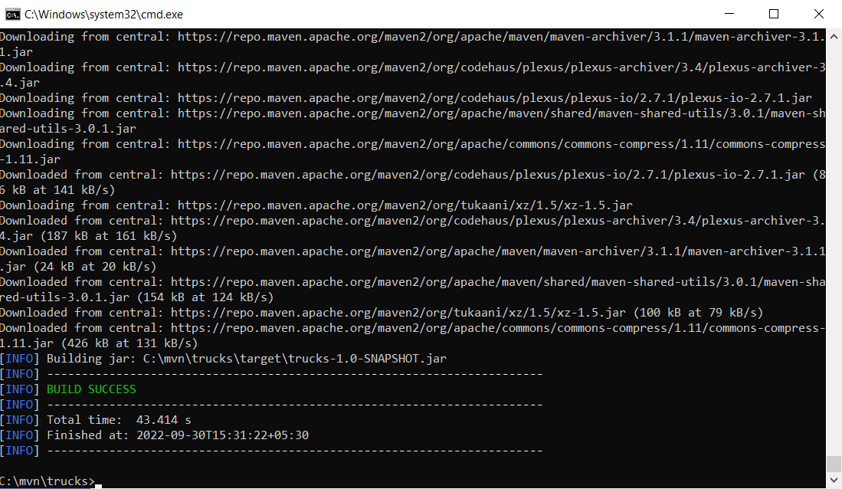
Maven

Slide 12
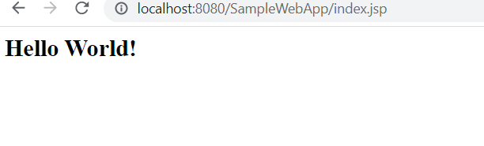
Maven
Once the war file is generated, copy the war file into the target folder of the Web Server(Any web server that you use) and start the server. You can test the application by invoking the web project's URL:
http:/localhost:8080/<projectname>/index.jsp
Before that run the Tomcat services.

Slide 13


