Slide 1
Predicting Hospital Mortality Using Machine Learning, Deep Learning and Natural Language Processing
By
Sritama Paul
AI 395T | AI In Healthcare
University of Texas at Austin
Spring 2026
Notes:
In this tutorial, we will learn how to build several AI models to predict hospital mortality using ICU patient data from the MIMIC-III dataset. We will compare the results from
Machine Learning model
Deep Learning model
NLP model
Multimodal model

Slide 2
What we will learn
01 | How to extract structured features from clinical data
02 | How to build Machine Learning models
03 | How to analyze clinical notes using NLP
04 | How to train a Deep Learning neural network
05 | How to combine structured data and text features
06 | How to compare model performance
Notes:
This tutorial demonstrates a complete healthcare AI pipeline from raw EHR data to predictive modeling.
We will build five models and compare their performance.

Slide 3
Dataset Used
We will be using MIMIC-III Clinical dataset in this tutorial which contains ICU patient records including:
Demographics
Admissions
Vital signs
Lab results
Clinical notes
Key tables used:
PATIENTS
ADMISSIONS
ICUSTAYS
CHARTEVENTS
LABEVENTS
NOTEEVENTS
Notes:
The MIMIC-III dataset is a publicly available ICU database developed by MIT. It contains over 50,000 ICU admissions, making it ideal for healthcare AI research. We will be using this dataset for this tutorial.

Slide 4
Outline
Load Clinical Data
↓
Feature Engineering
↓
Machine Learning Models
↓
NLP Model from Clinical Notes
↓
Deep Learning Neural Network
↓
Multimodal Model
↓
Performance Comparison
Notes:
This tutorial follows the typical workflow used in healthcare AI research.

Slide 5
Import Libraries
import pandas as pd
import numpy as np
import matplotlib.pyplot as plt
import seaborn as sns
from sklearn.manifold import TSNE
from sklearn.model_selection import train_test_split
from sklearn.preprocessing import StandardScaler
from sklearn.metrics import roc_auc_score, roc_curve
from sklearn.ensemble import RandomForestClassifier
from sklearn.linear_model import LogisticRegression
from sklearn.feature_extraction.text import TfidfVectorizer
from sklearn.feature_extraction.text import ENGLISH_STOP_WORDS
import torch
import torch.nn as nn
import torch.optim as optim
from sklearn.metrics import accuracy_score
rom sklearn.metrics import precision_recall_curve, average_precision_score
Notes:
These libraries support:
data manipulation
visualization
machine learning
deep learning

Slide 6
Load Clinical Data - Patients Admissions ICU Stays Clinical Notes
patients = pd.read_csv(data_location + "PATIENTS.csv.gz")
admissions = pd.read_csv(data_location + "ADMISSIONS.csv.gz")
icustays = pd.read_csv(data_location + "ICUSTAYS.csv.gz")
notes = pd.read_csv(data_location + "NOTEEVENTS.csv.gz",compression='gzip',
dtype={
'SUBJECT_ID': 'int32',
'HADM_ID': 'float32', # some rows missing
'CATEGORY': 'category',
'DESCRIPTION': 'category'
},
parse_dates=['CHARTDATE', 'CHARTTIME'],
low_memory=False
)
Notes:
Each dataset provides different information about the patient.
For example:
PATIENTS → demographics
ADMISSIONS → hospital admissions
ICUSTAYS → ICU stay information

Slide 7
Load Clinical Data - Chart Events for few critical vital indicators
chart = pd.read_csv(
data_location + "CHARTEVENTS.csv.gz",
usecols=["SUBJECT_ID","HADM_ID","ITEMID","VALUENUM","CHARTTIME"],
compression="gzip"
)
vital_ids = [
211, # Heart Rate
220045,# Heart Rate (Metavision)
220179,# Non-invasive BP systolic
220180,# Non-invasive BP diastolic
220210,# Respiratory Rate
223761 # Temperature
]
chart = chart[chart["ITEMID"].isin(vital_ids)]
vitals = chart.groupby(["SUBJECT_ID","HADM_ID","ITEMID"])["VALUENUM"].mean().unstack()
vitals.reset_index(inplace=True)
Notes:
Filter the chartevents data based on some critical vital indicators.

Slide 8
Load Clinical Data - Lab Events for few critical lab tests
labs = pd.read_csv(data_location + "LABEVENTS.csv.gz")
lab_ids = [
50882, # Bicarbonate for Acid-Base Balance
50868, # Anion Gap
50912, # Creatinine for Kidney Function
51301, # WBC for Infection/Inflammation
51222, # Hemoglobin for oxygen carrying capacity
51006, # BUN for Kidney Function
51265, # Platelet Count for Clotting
50931, # Glucose for Diabetes
50983, # Sodium for Electrolyte Balance
50971, # Potassium for Cardiac stability
50882 # Bicarbonate for Acid-Base Balance
]
labs = labs[labs["ITEMID"].isin(lab_ids)]
lab_features = labs.groupby(["SUBJECT_ID","HADM_ID","ITEMID"])["VALUENUM"].mean().unstack()
lab_features.reset_index(inplace=True)
Notes:
Filter the labevents data based on some critical lab tests.

Slide 9
Feature Engineering
Using these data, build a dataset which will provide the features based on which we can predict the hospital mortality risk using various machine learning, deep learning models.
Clinical Features Used
Age
Gender
Length of Stay
Admission Type
Admission Location
Vitals
Heart Rate
Respiratory Rate
Blood Pressure
Lab Values
Creatinine
BUN
WBC
Hemoglobin
Platelets
Sodium
Potassium
Notes:
Feature engineering is critical in healthcare AI.
These features represent patient physiological status and are useful for predicting hospital mortality.

Slide 10
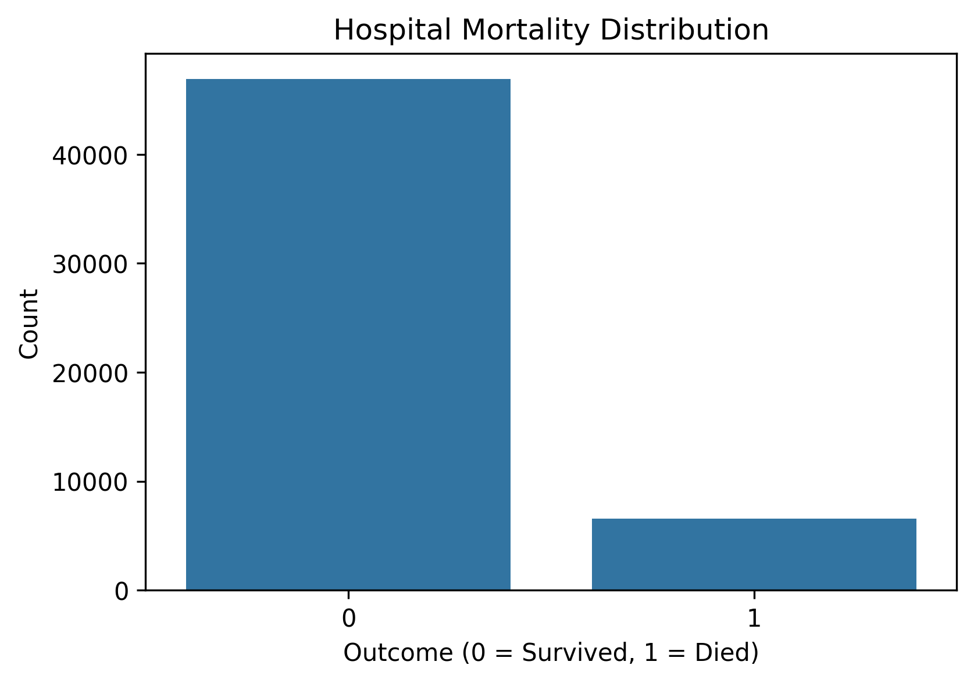
Visualization of the Dataset used
Mortality Distribution -
Most patients survive. The dataset is imbalanced, meaning death occurs less frequently.
Notes:
This dataset is imbalanced, meaning deaths occur less frequently.
This is why we use stratified train/test splitting.
The chart in the notebook confirms this distribution.

Slide 11
Training / Testing Data Split
Preparing Data -
X = features y = mortality outcome
We split:
80% training data
20% testing data
Because mortality datasets are imbalanced, we used stratification. Stratification ensures the mortality ratio remains consistent.
Python Code
X_train, X_test, y_train, y_test = train_test_split(
X,
y,
test_size=0.2,
random_state=42,
stratify=y
)
Notes:
This dataset is imbalanced, meaning deaths occur less frequently.
This is why we use stratified train/test splitting.

Slide 12
Machine Learning - Logistic Regression Model
Logistic regression is a statistical and machine learning method used for classification problems, especially when the outcome has two possible categories (e.g., death vs. no death in hospital).
Why Logistic Regression?
Simple baseline model
Interpretable coefficients
Widely used in healthcare
Python Code
scaler = StandardScaler()
X_train_scaled = scaler.fit_transform(X_train)
X_test_scaled = scaler.transform(X_test)
lr = LogisticRegression(max_iter=2000)
lr.fit(X_train_scaled, y_train)
lr_prob = lr.predict_proba(X_test_scaled)[:,1]
Notes:
Logistic regression helps us understand which features increase mortality risk.

Slide 13
Machine Learning - Random Forest Model
Random Forest is a supervised machine learning algorithm used for classification and regression tasks. It works by building many decision trees during training and combining their predictions to produce a more accurate and stable result.
Why Random Forest model?
Handles nonlinear relationships
Handles large datasets and many features well
Robust to noise
Provides estimates of feature importance
Python Code
rf = RandomForestClassifier(n_estimators=100)
rf.fit(X_train, y_train)
rf_pred_prob = rf.predict_proba(X_test)[:,1]
Notes:
Instead of relying on a single decision tree, Random Forest creates multiple trees using random subsets of the data and features (a method called bagging). Each tree makes a prediction, and the final output is determined by:
Majority vote for classification
Average prediction for regression
In a medical dataset, a Random Forest model could predict whether a patient has a high risk of mortality based on multiple features like age, blood pressure, heart rate, creatinine level etc.
Random forests often perform better than linear models.

Slide 14
Natural Language Processing (NLP) Model
Natural Language Processing (NLP) is a field of artificial intelligence that focuses on enabling computers to understand, interpret, and analyze human language in text or speech form. NLP combines techniques from linguistics, machine learning, and statistics to extract meaningful information from unstructured text data.
In the tutorial, textual data was converted into numerical features using TF-IDF (Term Frequency–Inverse Document Frequency). Machine learning algorithms cannot directly process raw text, so TF-IDF transforms the text into a vector representation that reflects how important each word is within a document relative to the entire dataset.
For this tutorial, we have used clinical notes from Nursing, Physician and Radiology categories as text corpus which is transformed into numerical vectors using a TfidfVectorizer package.
Notes:
TF-IDF has two main components:
Term Frequency (TF): Measures how frequently a word appears in a document.
Inverse Document Frequency (IDF): Reduces the weight of words that appear frequently across many documents and increases the importance of words that are more unique.
This approach helps the model focus on informative words rather than common words that carry little meaning.

Slide 15
NLP Model - Stop Words in TfidfVectorizer
Stop words are high-frequency, low-semantic value words (e.g., "the," "is," "and") removed during NLP pre-processing to reduce noise and enhance computational efficiency. The, typically, do not contribute meaningful information for classification tasks.
For this tutorial, we have customized the stop word list with commonly used clinical terms (such as capsule, doses etc.) and terms that directly indicate the expiry of the patients (such as expired, death etc.)
Python Code
vectorizer = TfidfVectorizer(
max_features=5000,
stop_words=stop_words,
ngram_range=(1,2),
min_df=5,
max_df=0.9
)
X_text = vectorizer.fit_transform(texts)
Notes:
Stop words are very common words such as “the”, “is”, “and”, “of” that typically do not contribute meaningful information for classification tasks.
In the vectorization step, stop words were removed because:
They appear in almost all documents and therefore provide little discriminatory value.
Removing them reduces noise in the dataset.
It improves computational efficiency by reducing the number of features.

Slide 16
NLP Model - Other parameters in TfidfVectorizer
ngram_range: Determines whether the model considers single words (unigrams) or combinations of words such as bigrams (e.g., “chest pain”). This helps capture meaningful phrases.
max_df: Removes words that appear in a very large proportion of documents. These words behave similarly to stop words and may not help differentiate documents.
min_df: Removes very rare words that appear in only a few documents, which helps reduce noise and dimensionality.
max_features: Limits the number of features (vocabulary size), helping control model complexity and computational cost.
Notes:
Together, these parameters help produce a balanced feature representation that captures important language patterns while reducing unnecessary noise.

Slide 17
NLP Model - TF-IDF + Logistic Regression
After vectorization of the corpus, Logistic Regression model is used to train the training dataset for NLP.
Why Logistic Regression?
Simple, efficient, and highly effective algorithm for text classification tasks.
Works well with high-dimensional sparse data, which is typical in TF-IDF representations.
Fast training and prediction, making it suitable for large text datasets.
Python Code
nlp_model = LogisticRegression(max_iter=2000)
nlp_model.fit(X_train_tfidf, y_train_text)
nlp_prob = nlp_model.predict_proba(X_test_tfidf)[:,1]
Notes:
Because TF-IDF produces linearly separable feature spaces in many text classification problems, Logistic Regression often performs very well as a baseline model in NLP pipelines.
Logistic regression also provides Interpretable coefficients, allowing us to identify which words contribute most strongly to predictions.
Provides probability estimates, which are useful for evaluating classification confidence.

Slide 18
Deep Learning (Neural Network Model)
Deep learning is a subset of machine learning that uses multi-layered neural networks to automatically learn complex patterns and representations from large amounts of data. It is particularly effective for tasks such as image recognition, natural language processing, and speech recognition, where traditional machine learning methods may struggle to capture complex relationships.
A neural network is a computational model inspired by the structure of the human brain. It consists of interconnected layers of nodes (neurons)—typically an input layer, one or more hidden layers, and an output layer. Each neuron processes input signals, applies a mathematical transformation, and passes the result to the next layer, allowing the network to learn patterns and make predictions from data.
Neural Network Architecture
Input Layer
↓
Dense Layer (32 neurons)
↓
ReLU Activation
↓
Dropout (0.3)
↓
Output Layer
Notes:
Deep learning can capture complex nonlinear patterns in clinical data.
ReLU (Rectified Linear Unit) is an activation function commonly used in neural networks and deep learning models. It introduces non-linearity into the network so the model can learn complex patterns in data.
The ReLU function outputs the input directly if it is positive, and returns zero if the input is negative.
Mathematically: $f\left(x\right)=max⁡\left(0 , x\right)$
Key characteristics:
If $x>0$, the output is $x$
If $x≤0$, the output is $0$
Why ReLU is widely used:
Computationally simple and efficient
Helps reduce the vanishing gradient problem
Allows neural networks to train faster
Example: If a neuron receives values $−3,−1,0,2,5$, the ReLU output becomes 0, 0, 0, 2, 5.

Slide 19
Deep Learning - Python Code for Neural Network Training Model
class MortalityNN(nn.Module):
def __init__(self,input_dim):
super().__init__()
self.net = nn.Sequential(
nn.Linear(input_dim,32), # Linear Layer - Transforms input features into a higher dimensional representation.
nn.ReLU(), # activation function that introduces non-linearity, allowing the model to learn complex patterns.
nn.Dropout(0.3), # Randomly drops neurons during training to prevent overfitting.
nn.Linear(32,1)
)
def forward(self,x): # Train network using forward pass + backpropagation
return self.net(x)
Notes:
Creates a custom neural network class.
Inherits from nn.Module, the base class for all PyTorch models.
input_dim represents number of input features.
nn.Sequential builds a layer-by-layer neural network pipeline.
nn.Linear(input_dim,32)
Fully connected layer.
Transforms input features → 32 hidden neurons.
Mathematically: $y=Wx+b$
Where:
$W$= weights
$b$= bias
Purpose:
Allows the network to learn weighted combinations of input features.
nn.Dropout(0.3)
Randomly turns off 30% of neurons during training.
Purpose:
Prevents overfitting
Forces network to learn more robust patterns
Works like regularization.
nn.Linear(32,1)
Converts 32 hidden neurons → 1 output neuron.
Purpose:
Predicts mortality probability for binary classification.

Slide 20
Deep Learning - Python Code for Neural Network Training
# Initialize model.
model = MortalityNN(X_train.shape[1])
criterion = nn.BCEWithLogitsLoss()
optimizer = optim.Adam(model.parameters(),lr=0.001)
import torch
import torch.nn as nn
import torch.optim as optim
scaler = StandardScaler()
X_train_scaled = scaler.fit_transform(X_train)
X_test_scaled = scaler.transform(X_test)
X_train_tensor = torch.tensor(X_train_scaled,dtype=torch.float32)
y_train_tensor = torch.tensor(
y_train.values,
dtype=torch.float32
).unsqueeze(1)
For more details , check the tutorial notebook.
Notes:
StandardScaler normalizes the features so they have:
Mean = 0
Standard deviation = 1
Neural networks train more efficiently when input features are on similar scales.
X_train_tensor = torch.tensor(X_train_scaled, dtype=torch.float32)
Converts the scaled NumPy array into a PyTorch tensor.
dtype=torch.float32 ensures the correct numeric type for neural networks.
PyTorch models operate on tensors rather than NumPy arrays.
criterion = nn.BCEWithLogitsLoss() # Binary Cross Entropy with Logits Loss, Used for binary classification.
optimizer = optim.Adam(model.parameters(),lr=0.001) # Optimizer updates the model weights to minimize loss.

Slide 21
Deep Learning - Summary of Training Pipeline
Scale features → StandardScaler
Input features are normalized so the neural network can learn efficiently.
Convert data → PyTorch tensors
The scaled data is converted into tensors so it can be used by PyTorch.
Build neural network → Linear + ReLU + Dropout
The architecture of the neural network is defined.
Define loss → BCEWithLogitsLoss
The loss function is specified to measure how far predictions are from the true labels.
Define optimizer → Adam
The optimizer is chosen to update the model parameters.
Train network using forward pass + loss computation + backpropagation + optimizer update

Slide 22
Deep Learning - Loss Function
The loss function evaluates how wrong the model's predictions are, and its output is used during backpropagation to adjust the model weights and improve learning.
For this tutorial, run training process for 50 epochs. An epoch means one full pass through the entire training dataset. Multiple epochs allow the neural network to gradually adjust its weights and improve predictions.
losses = []
for epoch in range(50):
optimizer.zero_grad()
outputs = model(X_train_tensor)
loss = criterion(outputs,y_train_tensor)
loss.backward()
optimizer.step()
losses.append(loss.item())
print(f"Epoch {epoch+1}, Loss: {loss.item():.4f}")
Notes:
A loss function is a mathematical function used in machine learning to measure the difference between the model’s predicted output and the actual target value.
It quantifies how well or poorly a model is performing. During training, the model adjusts its parameters (weights) to minimize the loss, which helps improve prediction accuracy.
Each epoch follows this sequence:
Reset gradients
Forward pass → model predicts outputs
Compute loss → measure prediction error
Backpropagation → compute gradients
Optimizer update → adjust model weights
Store and print loss

Slide 23
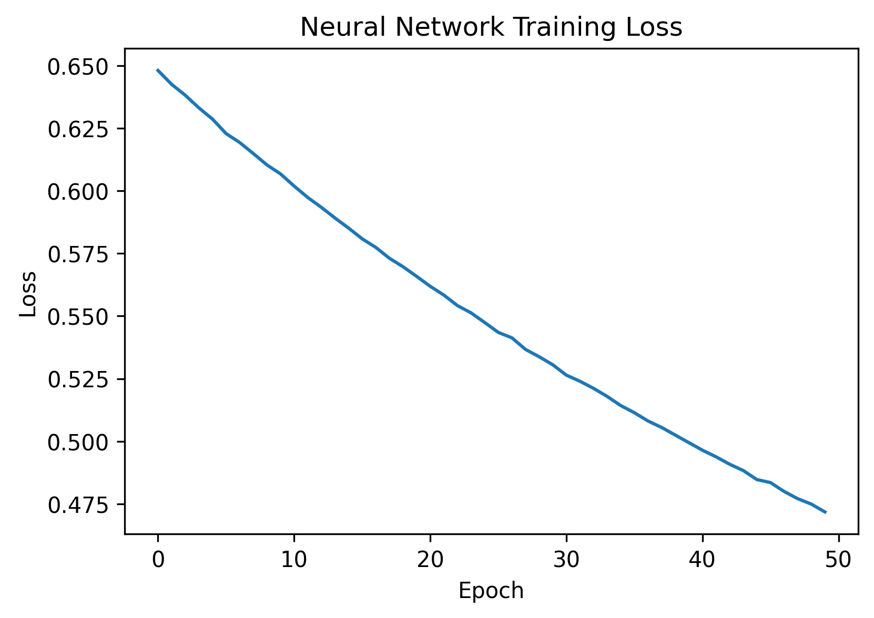
Deep Learning - Loss Curve
Notes:
Training loss decreases steadily across epochs, showing the model is learning.

Slide 24
Multimodal Model
Multimodal learning in the tutorial refers to a learning approach where multiple types of healthcare data are combined to improve prediction performance. Specifically, the model integrates structured clinical data (e.g., demographics, vitals, or lab values) with unstructured text data from clinical notes processed using NLP.
By learning from both structured features and text-derived features, the model can capture richer clinical information, leading to more accurate predictions of outcomes such as patient mortality.
X_struct = X
X_struct = pd.get_dummies(X_struct, drop_first=True)
# text features from NLP model
vectorizer = TfidfVectorizer(max_features=2000)
X_text = vectorizer.fit_transform(texts)
# convert text sparse matrix
X_text = pd.DataFrame(X_text.toarray())
# combine both
X_multi = pd.concat([X_struct.reset_index(drop=True),
X_text.reset_index(drop=True)], axis=1)
X_multi.columns = X_multi.columns.astype(str)
Notes:
By combining information from different sources, multimodal models can capture richer patterns and context than models trained on a single data type.
For this tutorial, we have used structured data with features like Age, Gender, Length of Stay, Admission Type, Admission Location, Heart Rate, Respiratory Rate, Blood Pressure, Creatinine, BUN, WBC, Hemoglobin, Platelets, Sodium, Potassium combined with unstructured data from clinical notes in Nursing, Physician and Radiology category.

Slide 25
Multimodal Model - TfidfVectorizer
We did not use the same TF-IDF vectorizer settings as the standalone NLP model.
In the multimodal setup, the structured clinical features already carried substantial predictive information. The purpose of the text component only needed to augment structured data, not to represent the entire dataset or fully capture linguistic patterns. Therefore, we limited the text features to keep the feature space smaller and computationally efficient. For the same reason, unigrams were sufficient and bigrams and aggressive filtering were not strictly necessary.
TfidfVectorizer(max_features=2000) automatically selects the top 2000 terms based on importance (TF-IDF score). Since the common stop words have very low TF-IDF scores because they appear in almost all documents, they are unlikely to be selected, making explicit stop word removal less critical.
Notes:
The full NLP vectorizer used:
5000 features
bigrams
stop word filtering
document frequency constraints
This produces many more text features.
If we used this in the multimodal model, the dataset would become extremely high dimensional.

Slide 26
Multimodal Model - TF-IDF + Random Forest
After building the dataset for multimodal model, Random Forest classifier is used to train the training dataset.
Why Random Forest classifier?
Random Forest classifiers perform well when the feature space is informative but not excessively sparse.
Besides, we already used Logistic Regression classifier in the NLP model.
X_multi_train, X_multi_test, y_train, y_test = train_test_split(
X_multi,
y,
test_size=0.2,
random_state=42
)
rf_multi = RandomForestClassifier(n_estimators=100)
rf_multi.fit(X_multi_train, y_train)
Notes:
Random Forest Handles Simpler Feature Spaces Better

Slide 27
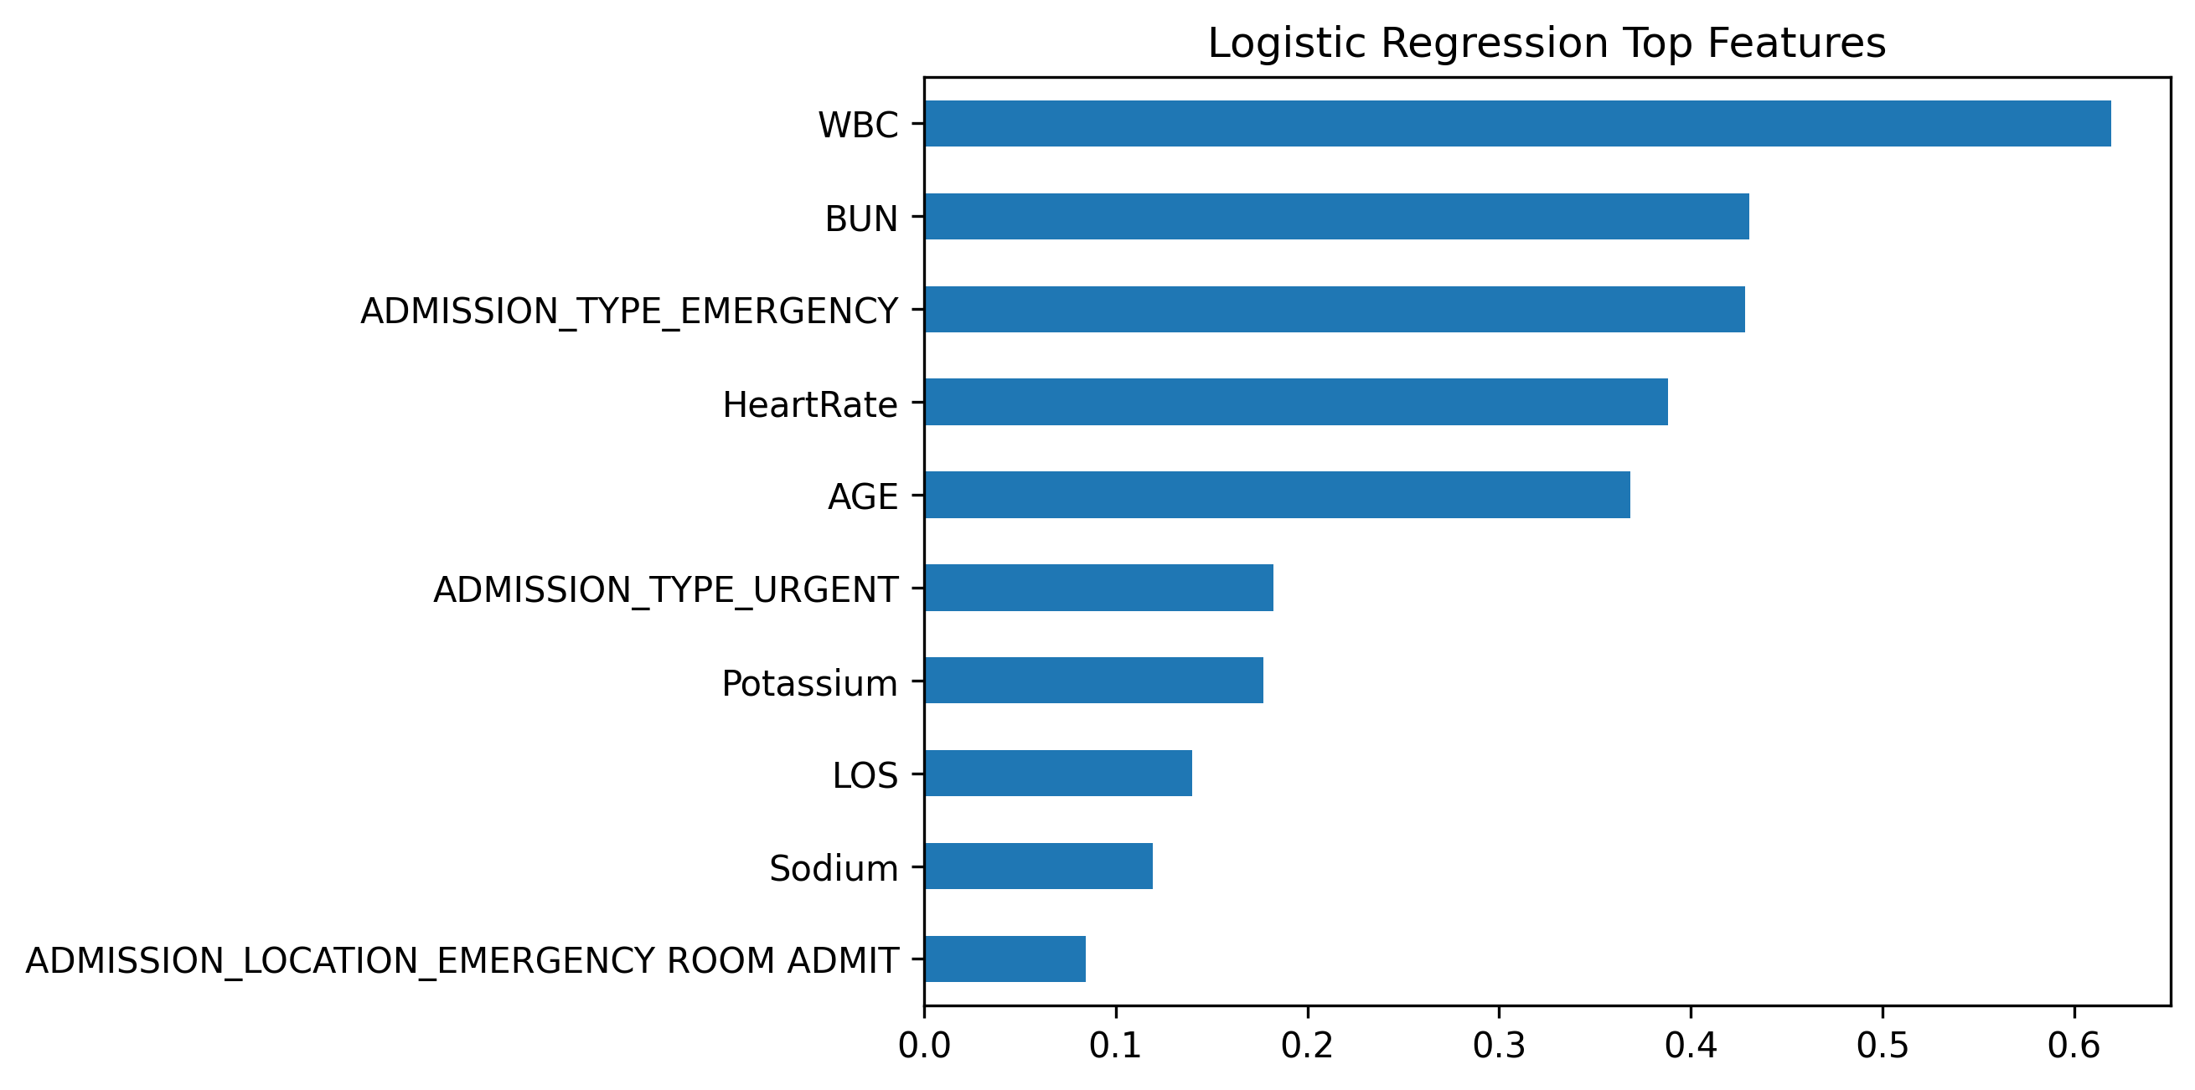
Top Features In Models - Logistic Regression
Notes:
Refer to Jupyter Notebook for code

Slide 28
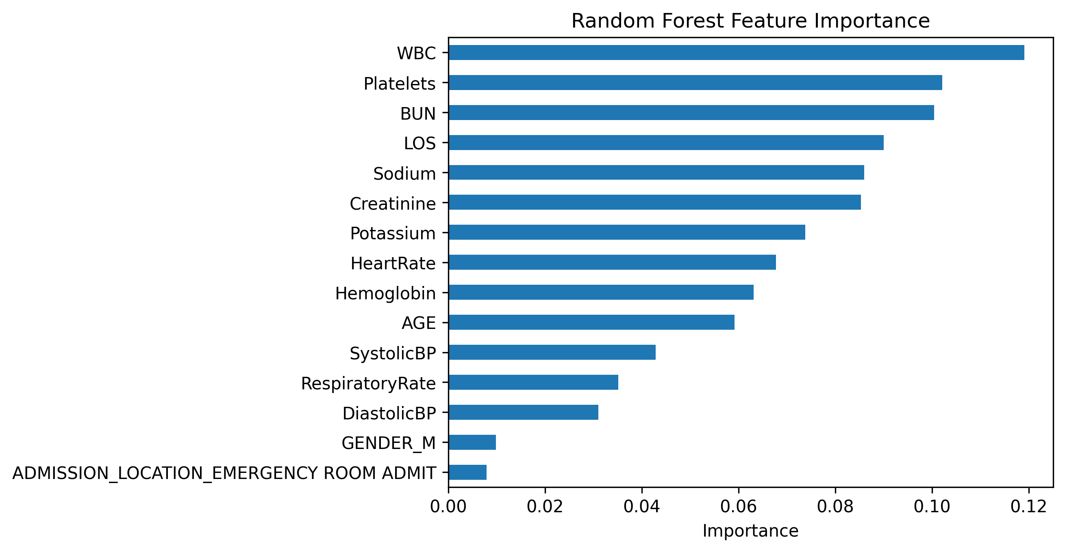
Top Features In Models - Random Forest
Notes:
Refer to Jupyter Notebook for code

Slide 29
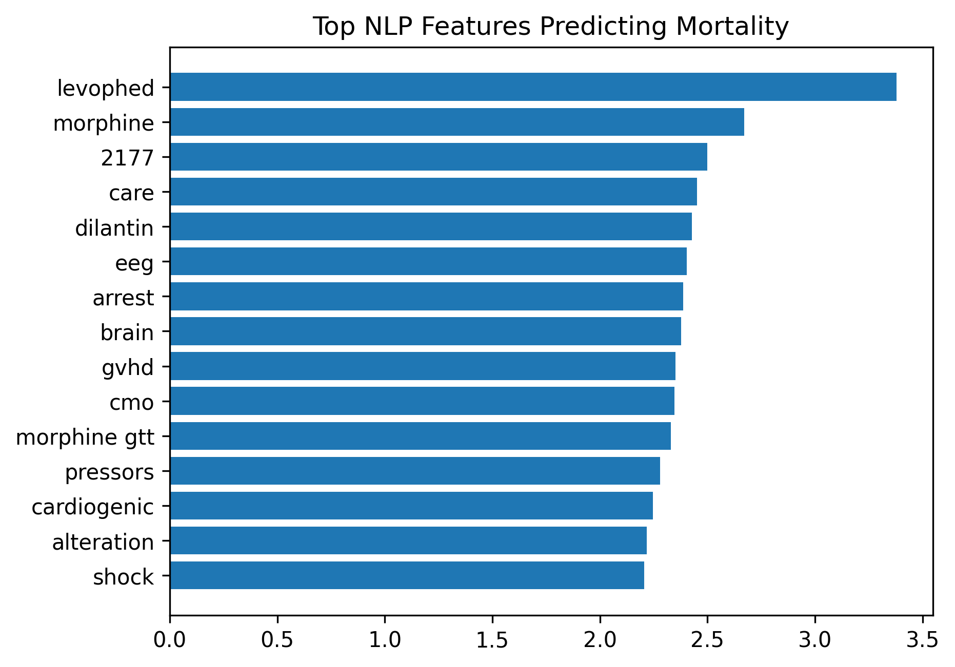
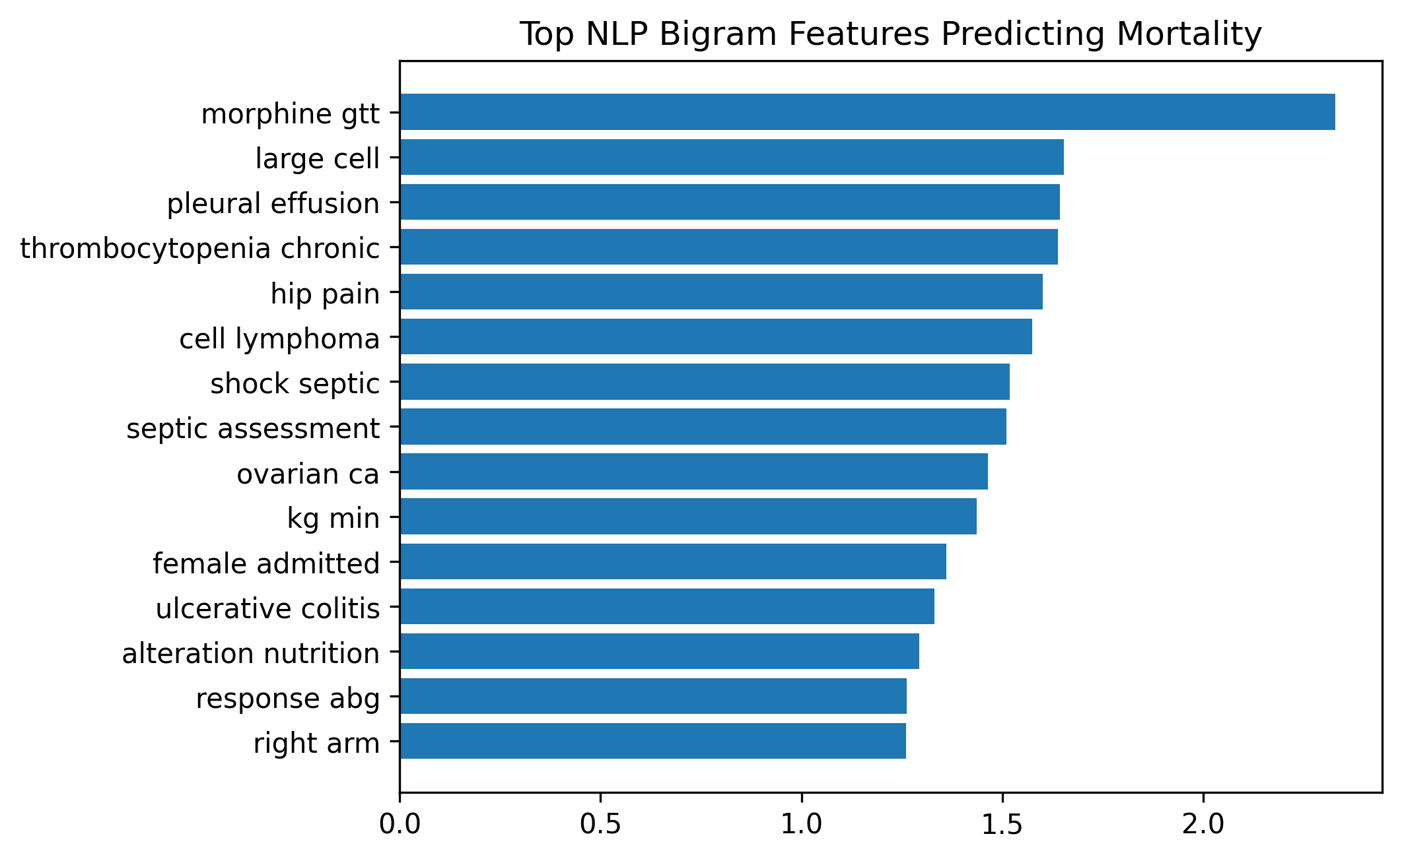
Top Features In Models - NLP
Notes:
These terms often appear in critically ill patients.
The notebook extracts top words using logistic regression coefficients.

Slide 30
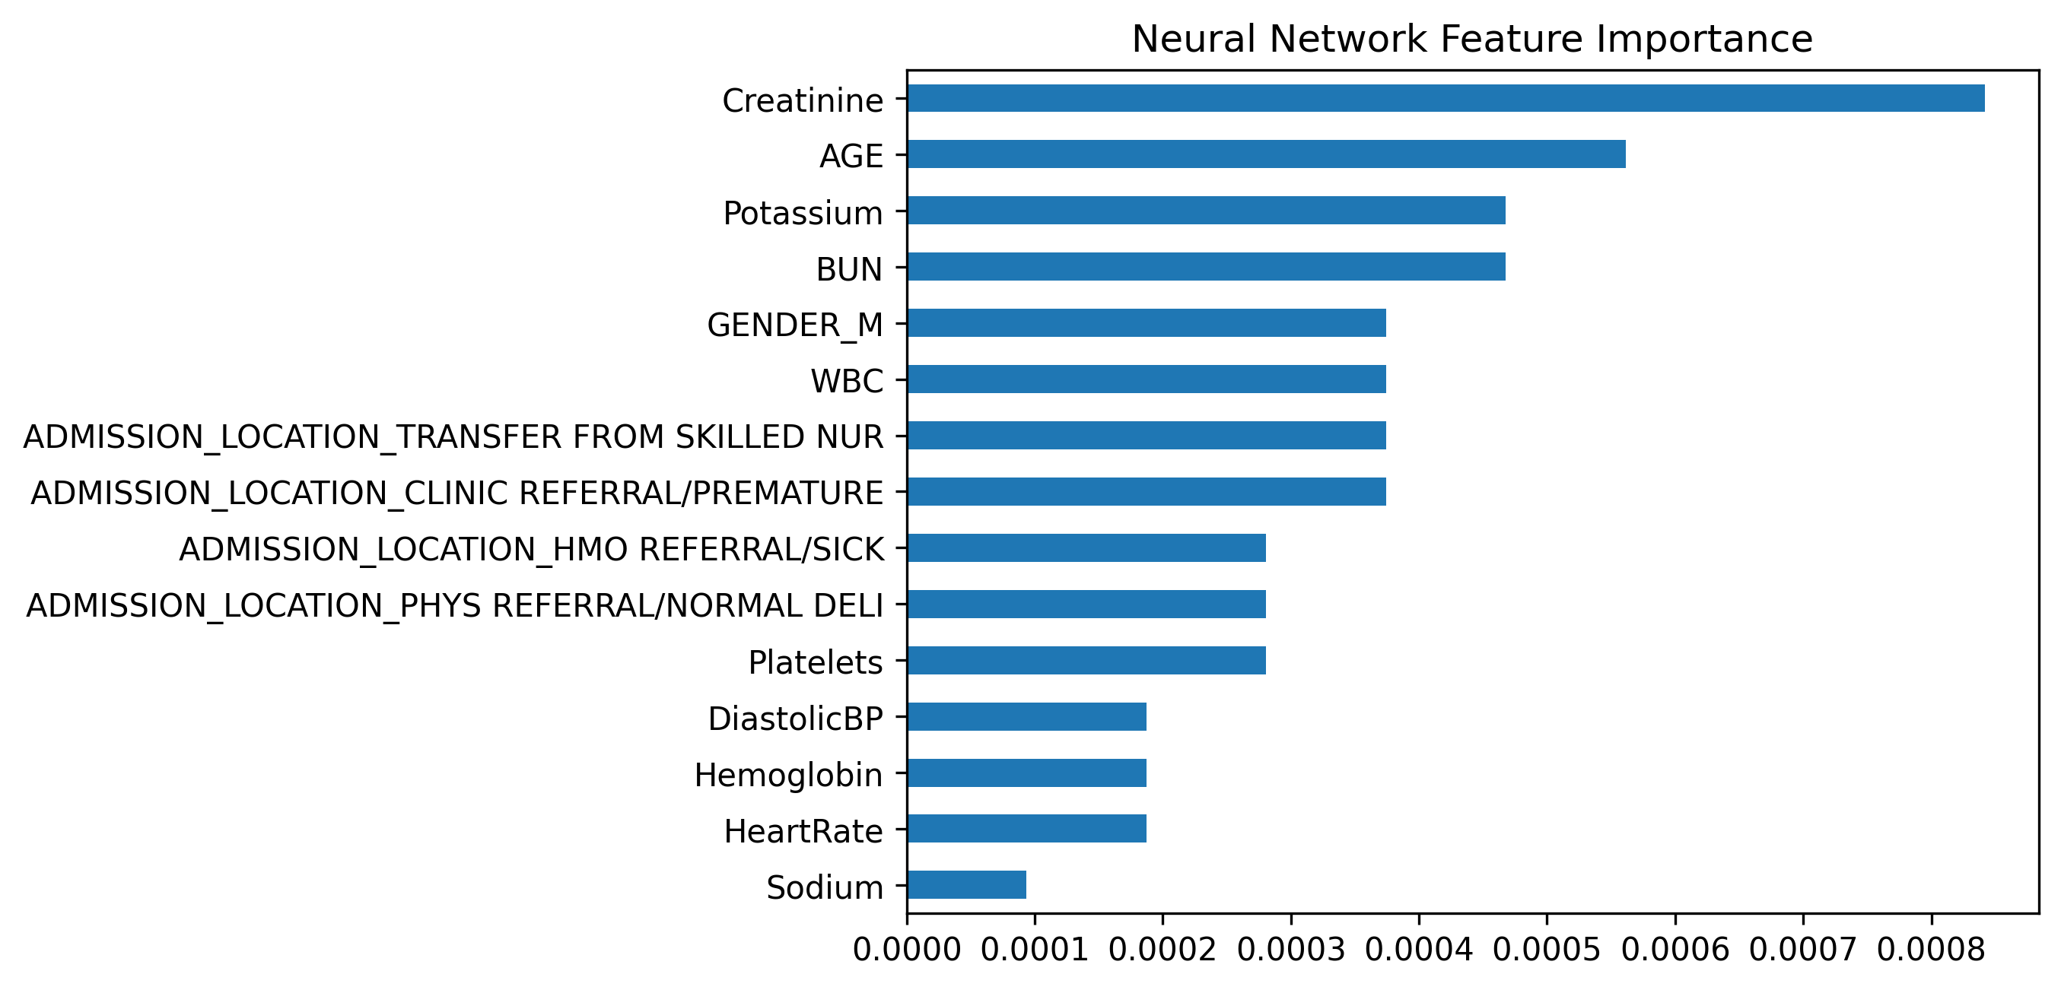
Top Features In Models - Neural Network

Slide 31
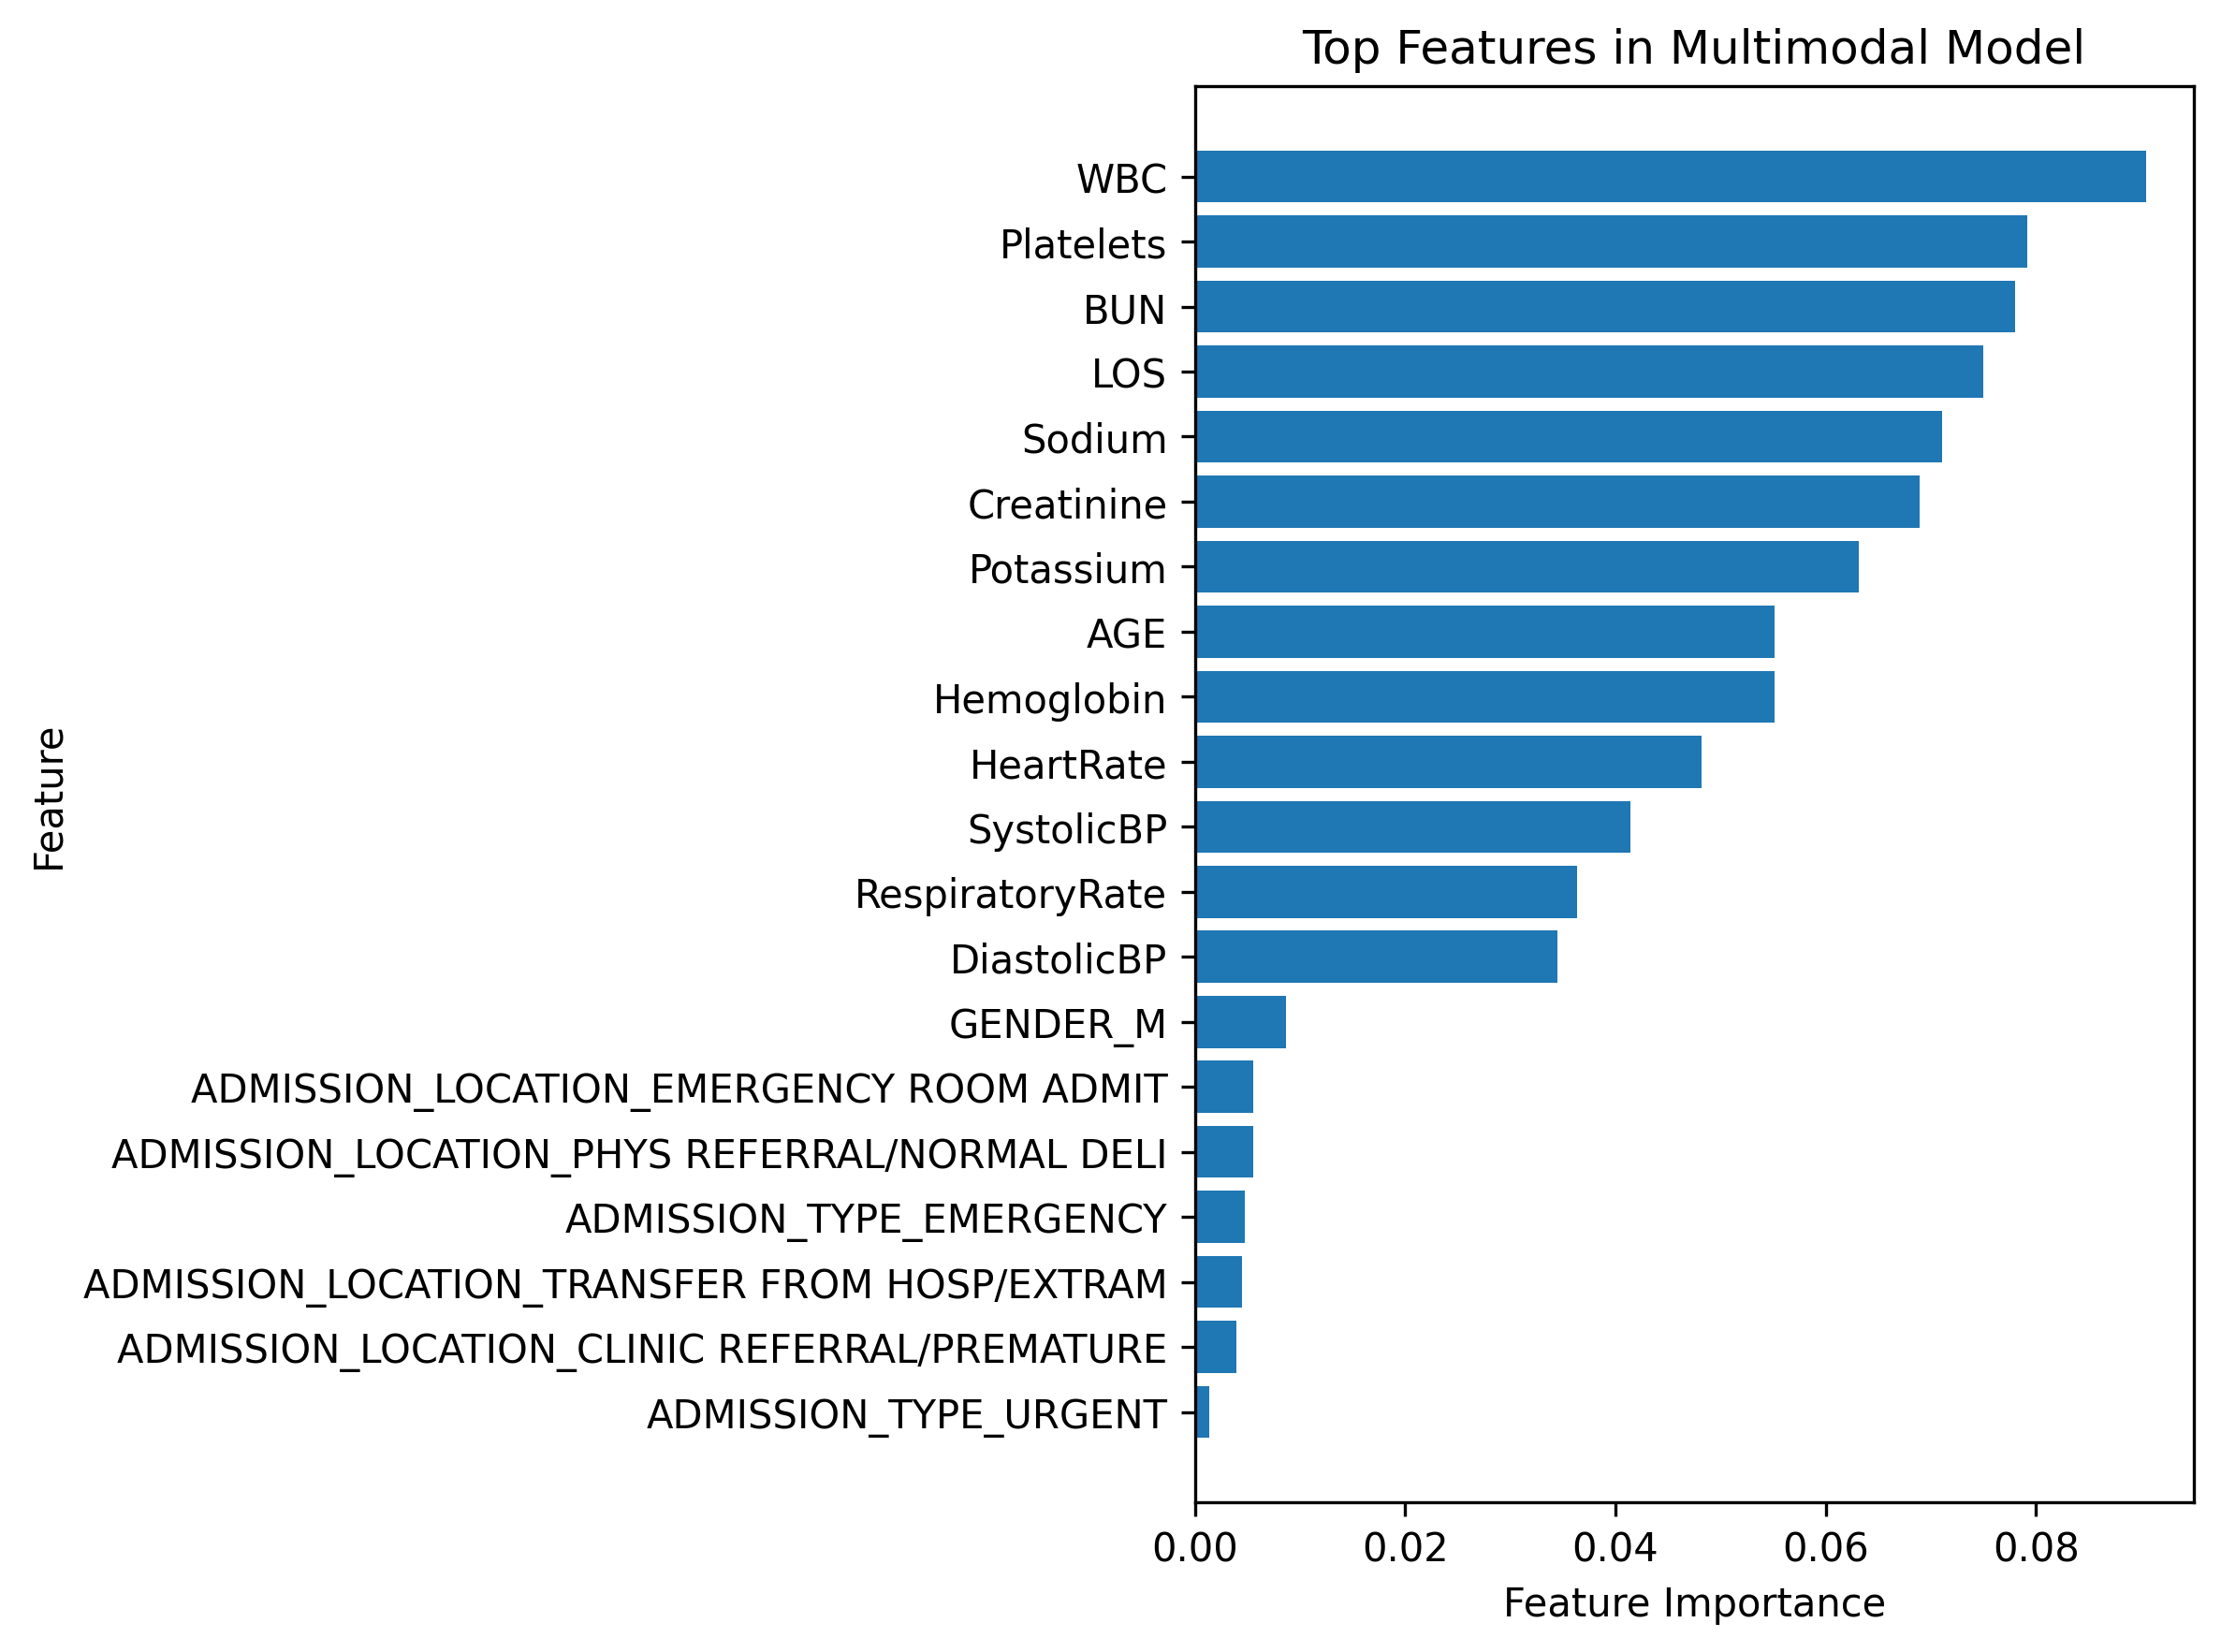
Top Features In Models - Multimodal

Slide 32
Key Predictive Features Identified Across Models
Across models, several clinical variables consistently appeared as strong predictors of mortality:
WBC (White Blood Cell Count) – strongest predictor in several models, indicating infection or systemic inflammation.
BUN (Blood Urea Nitrogen) – reflects kidney function and severity of illness.
Platelets – abnormal platelet counts can indicate bleeding disorders or severe illness.
Creatinine – marker of kidney dysfunction.
Sodium & Potassium – electrolyte imbalances associated with critical illness.
Hemoglobin – reflects anemia or blood loss.
Heart Rate, Blood Pressure, Respiratory Rate – vital signs indicating physiological instability.
Age – older patients generally have higher mortality risk.
Length of Stay (LOS) – longer hospitalization may reflect more severe disease.
Admission-related features also contributed to predictions:
Admission Type (Emergency / Urgent)
Admission Location (Emergency Room, Transfers from other facilities)
These variables capture patient severity, organ function, and physiological stability.
Notes:
Across models, mortality prediction was primarily driven by indicators of physiological instability and organ dysfunction, including:
infection/inflammation markers
kidney function indicators
electrolyte abnormalities
abnormal vital signs
critical care interventions described in clinical notes

Slide 33
Important NLP Features
The NLP model identified key medical terms associated with high mortality risk:
Clinical Conditions
shock
cardiogenic
brain
arrest
Gvhd
Medications / Interventions
levophed (vasopressor used in shock)
morphine
Pressors
Procedures / Monitoring
eeg

Slide 34
Important NLP Bigrams
Important two-word clinical phrases included:
pleural effusion
septic shock
septic assessment
morphine gtt
hip pain
ulcerative colitis
ovarian ca
These phrases capture clinical diagnoses, treatments, and disease states documented in physician notes.
Notes:
These terms often appear in notes describing critical care situations.

Slide 35
Multimodal Model Insights
The multimodal model combined structured clinical data and text-derived features.
The most important predictors were primarily:
Laboratory markers (WBC, Platelets, BUN, Creatinine)
Electrolytes (Sodium, Potassium)
Vital signs (Heart Rate, Blood Pressure, Respiratory Rate)
Demographics (Age)
Admission context
This suggests that structured physiological data played a dominant role, while text features contributed complementary clinical context.
Notes:
The NLP model captured contextual clinical signals, while structured features reflected measurable patient health status, demonstrating the value of combining both in multimodal learning.

Slide 36
Model Performance Comparison - ROC Curve
Finally, we compare results from all the models by checking ROC curves and AUC Scores from each model.
ROC Curve (Receiver Operating Characteristic Curve)
The ROC curve is a graphical tool used to evaluate the performance of a binary classification model (whether a patient survives based on predicted risks or not). The models predicted a probability of mortality for each patient. Instead of directly labeling predictions as 0 or 1, the ROC curve evaluates the model across many possible probability thresholds.
Axes of the ROC Curve
X-axis: False Positive Rate → Patients predicted as high mortality risk but actually survived
Y-axis: True Positive Rate (Sensitivity) → Patients correctly identified as high mortality risk
Each point on the ROC curve represents model performance at a different threshold.
Notes:
The ROC curve was used to evaluate how well the trained models could distinguish between patients who died and those who survived.

Slide 37
Model Performance Comparison - AUC Score
AUC Score (Area Under the ROC Curve)
The AUC score measures the area under the ROC curve and summarizes the model’s ability to distinguish between classes in a single number.
AUC = 1.0 → Perfect classifier
AUC = 0.5 → No predictive power (random guessing)
AUC < 0.5 → Worse than random
AUC = 0.70–0.80 → Moderate predictive performance
AUC > 0.80 → Strong ability to distinguish mortality risk
Higher AUC means the model is better at ranking positive cases higher than negative cases. This is important in clinical settings because it helps identify high-risk patients earlier for intervention.
In the tutorial, the AUC score helped determine which model performed best for predicting patient mortality i.e. model can effectively assign higher mortality risk scores to patients who died compared to those who survived.

Slide 38
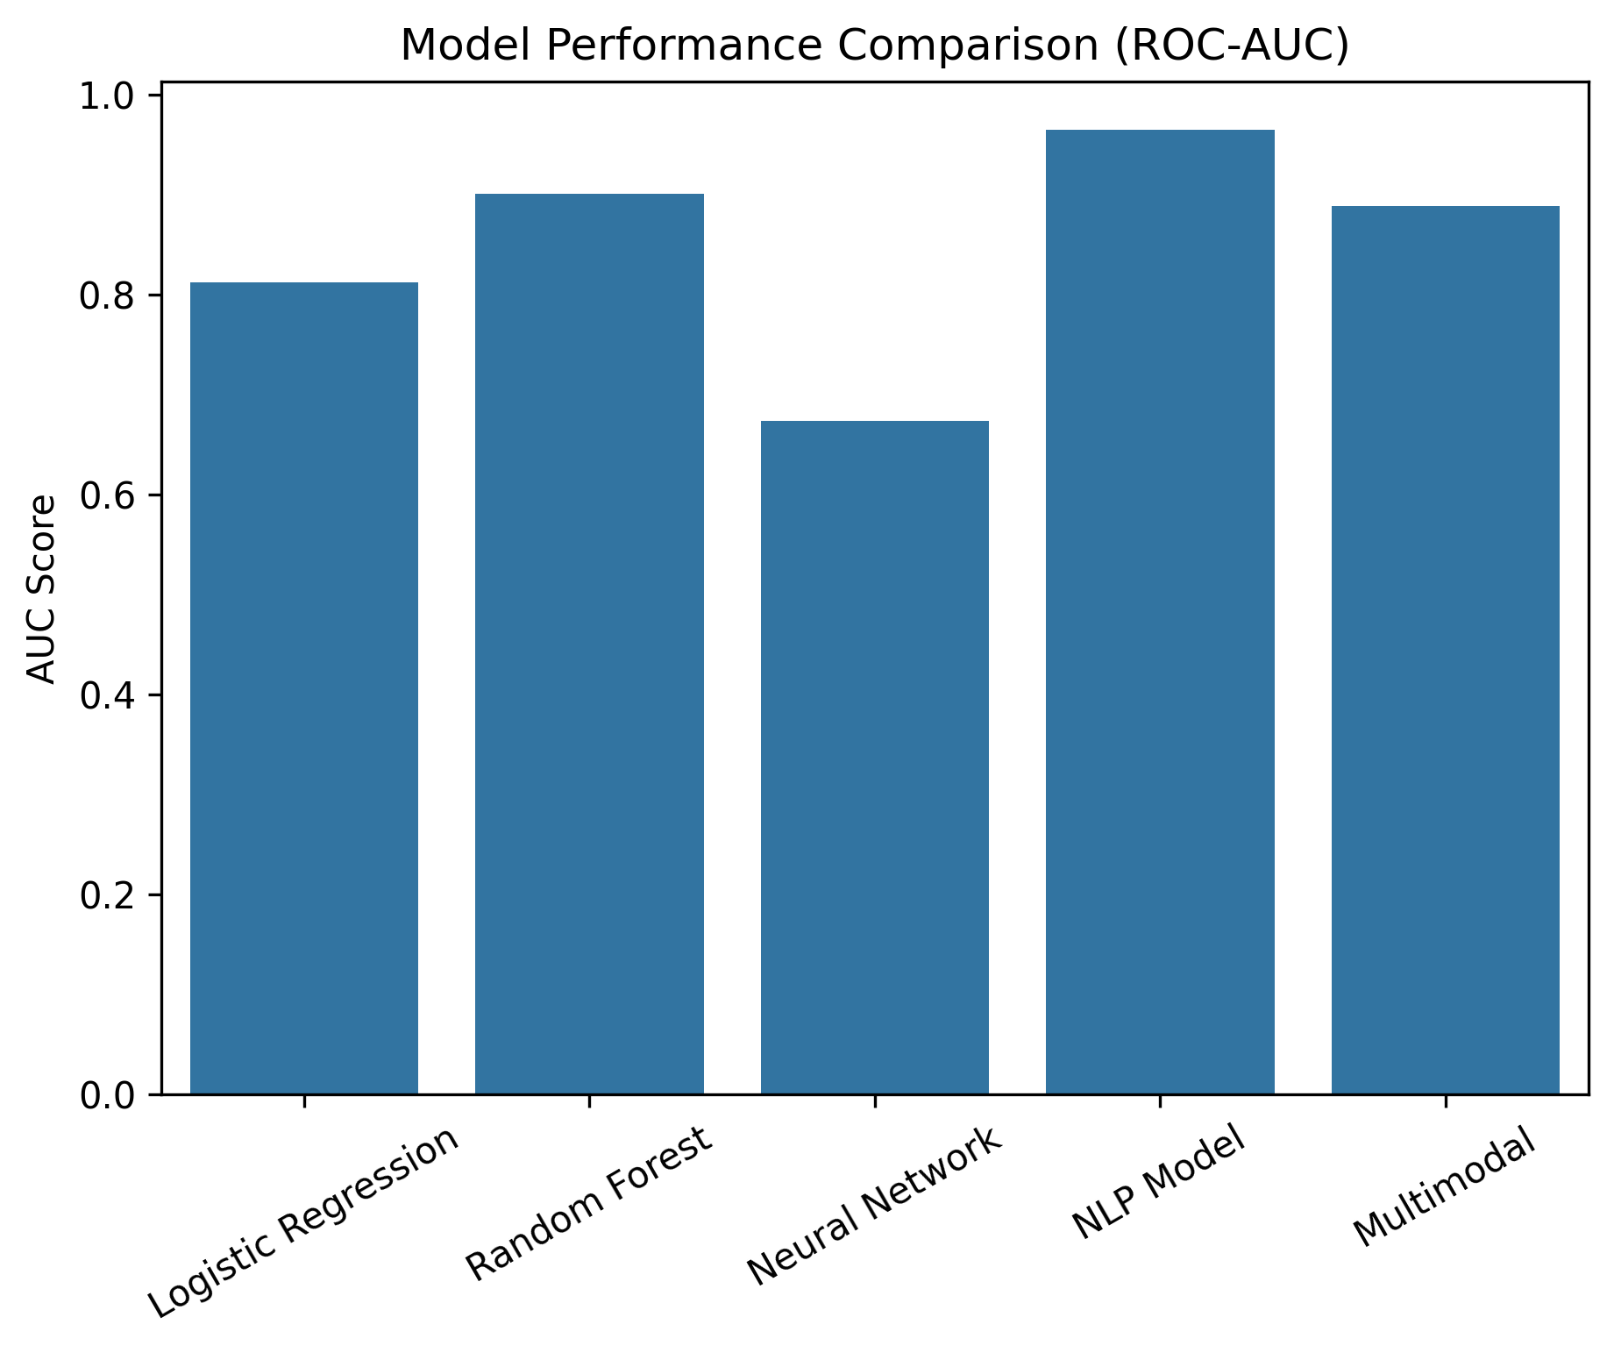
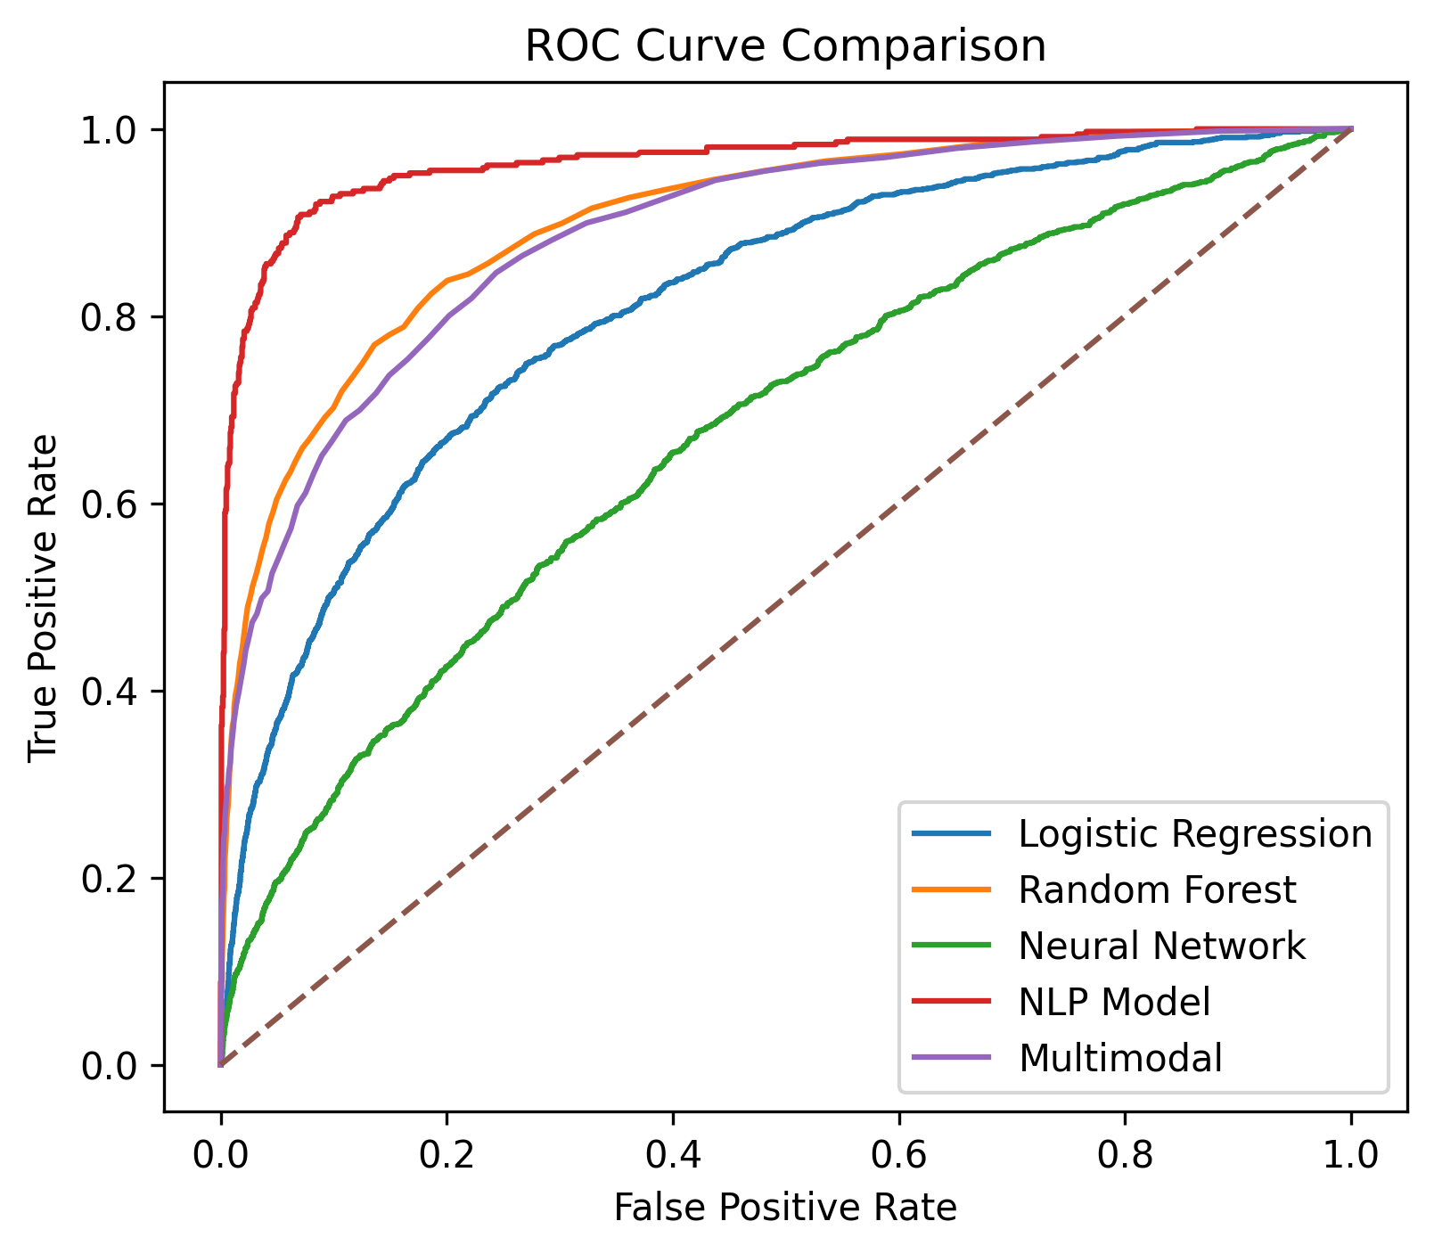
Model Performance Comparison - ROC Curve
Notes:
The diagonal dashed line represents random guessing (AUC = 0.5).
All models perform better than random, but their effectiveness varies.
Curves closer to the top-left corner indicate better discrimination ability.

Slide 39
Model Performance Comparison - Explanation
The ROC and AUC results show that the NLP model achieved the best predictive performance (AUC ≈ 0.96), indicating that clinical notes contain strong signals for mortality prediction. Random Forest and the multimodal model also performed well by capturing complex patterns in structured and combined data. Logistic regression provided a reasonable baseline, while the neural network underperformed, likely due to limited data and model complexity.
NLP Model (Highest AUC ~ 0.96)
The model uses clinical text features extracted with TF-IDF, which capture important clinical signals such as symptoms, diagnoses, or physician observations. Clinical notes often contain rich contextual information that structured variables may not capture.
Random Forest Model (AUC ≈ 0.90)
Random Forest performs well because it can model complex non-linear relationships and interactions in structured clinical data.
Notes:
The NLP model performs best because clinical language provides strong predictive signals for mortality risk.
Random Forest is an ensemble method that combines many decision trees.

Slide 40
Model Performance Comparison - Explanation
Multimodal Model (Structured + Text) (AUC ~ 0.89)
ROC curve is very close to Random Forest model. The model benefits from multiple data sources, but the simpler TF-IDF configuration (2000 features) may limit the contribution of text features.
Logical Regression Model (AUC ≈ 0.81)
Logistic regression assumes linear relationships between features and outcome. It cannot capture complex nonlinear interactions present in clinical data. Logistic regression provides reasonable baseline performance, but it is less powerful than ensemble methods.
Neural Network Model (AUC ≈ 0.67)
ROC curve much closer to the diagonal. The neural network underperforms because the dataset may not be large enough to fully leverage deep learning models. Model architecture may be too simple or undertrained
Structured clinical data often works better with tree-based models.

Slide 41
Questions?
References :
Access the Jupyter Notebook for detailed code and visualizations here.

