Slide 1
RAG-Powered Biomedical
Q&A with Semantic
Hallucination Detection
By Sritama Paul
AI In Healthcare | University of Texas in Austin | Spring 2026
Notes:
Welcome. This presentation covers my project on RAG-powered biomedical Q&A with semantic hallucination detection. We compare two embedding models — general-purpose OpenAI embeddings and biomedical-specific PubMedBERT — to evaluate how well RAG reduces hallucination in clinical question answering on the PubMedQA dataset.

Slide 2
What we
01
Healthcare problem — LLM hallucination in clinical AI
02
Dataset — PubMedQA, 890 passages, FAISS knowledge base
03
Methods — 6 conditions, dual embeddings, async pipeline
04
Results — accuracy, hallucination, ROUGE-L, LLM-as-Judge
will learn
05
Key finding — scorer disagreement reveals hidden hallucination
06
Future directions — what we'd improve and extend
2 / 15
Notes:
We'll cover the clinical problem, our dataset and methods, then dive into results including our most novel finding: that the choice of embedding model for hallucination scoring reveals dramatically different rates of clinical hallucination in free-reasoning outputs.

Slide 3
Healthcare Issue
LLM Hallucination in Clinical AI
Large language models are increasingly deployed in clinical decision support, yet they routinely generate plausible-sounding but factually incorrect medical information. This hallucination problem represents a direct patient safety risk.
Why is this critical?
Standard benchmarks only measure accuracy — not faithfulness to evidence
A model can reach the right answer through confabulation
No scalable, annotation-free method exists to detect clinical hallucination
Our approach
Use RAG to ground GPT-4 in retrieved PubMed evidence, and use embedding cosine similarity as an automated, scalable hallucination proxy — scored by both a general-purpose and a biomedical-specific model.
3 / 15
Notes:
LLM hallucination is one of the most urgent safety issues in healthcare AI. Models like GPT-4 will confidently state a drug dosage, a diagnostic threshold, or a treatment guideline that is simply wrong. Standard benchmarks only check whether the final yes/no answer is correct — they don't measure whether the reasoning is grounded in actual evidence. Our approach addresses this gap with an automated hallucination detection metric using embedding similarity.

Slide 4
PubMedQA — Biomedical Q&A Benchmark
Dataset Used
PubMedQA (Jin et al., 2019) — 1,000 expert-labelled biomedical Q&A pairs drawn from PubMed abstracts. Each record: research question + source abstract + expert answer + yes/no/maybe label.
Dataset configuration
890 records
Yes/No only — filtered from 1,000 for clean binary evaluation
100 questions
Stratified evaluation set — 50 yes / 50 no
890 passages
Full corpus used as FAISS knowledge base
HuggingFace
load_dataset('qiaojin/PubMedQA') — no credentials needed
4 / 15
Notes:
PubMedQA is ideal for our evaluation because questions were authored specifically about their paired abstracts — allowing us to measure whether RAG retrieves the correct evidence. We filter to yes/no questions for a clean binary ground truth. Crucially, we index all 890 passages as the knowledge base rather than just the evaluation set — earlier runs using the eval set as the corpus produced a trivially perfect Recall of 100% for the wrong reason.

Slide 5
General-Purpose vs Biomedical-Specific
OpenAI text-embedding-3-small
Two Embedding Models
General-purpose · API-based · 1,536 dimensions
Trained on large-scale web text. No domain-specific fine-tuning for biomedicine. Accessed via OpenAI API — costs ~$0.02 per 1M tokens.
NeuML/pubmedbert-base-embeddings
Biomedical domain-specific · Local · 768 dimensions
Based on Microsoft BiomedBERT, fine-tuned for semantic similarity on PubMed abstracts using sentence-transformers. Runs locally — zero API cost.
Both models used for: (1) FAISS knowledge base indexing · (2) hallucination scoring via cosine similarity
5 / 15
Notes:
We compare two fundamentally different embedding models. OpenAI's text-embedding-3-small is a general-purpose model — excellent across many tasks but not specialised for clinical language. PubMedBERT is fine-tuned specifically for semantic similarity on PubMed abstracts — the same source as our knowledge base. Both models serve dual roles: building the FAISS retrieval index and scoring hallucination by measuring cosine similarity between generated answers and source passages.

Slide 6
Knowledge Base Preparation
Building the FAISS Retrieval Index
Step 1
Embed all 890 PubMedQA abstracts using each model (separately)
Step 2
L2-normalise vectors — makes inner product = cosine similarity
Step 3
Add to FAISS IndexFlatIP — exact nearest-neighbour search
Step 4
Save embeddings to disk — avoid re-embedding on subsequent runs
Step 5
At query time: embed question → search index → return top-K=3 passages
6 / 15
Notes:
The knowledge base preparation is identical for both models — only the embedding model changes. FAISS IndexFlatIP performs exact inner-product search, which is equivalent to cosine similarity when vectors are L2-normalised. We save embeddings to disk so the expensive embedding step only runs once. At query time, each question is embedded and the top 3 most similar passages are retrieved to augment the GPT-4 prompt. Recall@3 is 100% for both models — reflecting PubMedQA's tight question-abstract coupling rather than trivially small corpus size.

Slide 7
Six Conditions
RAG × Prompting × Retriever
Condition
Retriever
Prompting
Description
No-RAG Zero-shot
None
Zero-shot
GPT-4 answers from parametric memory only
No-RAG CoT
None
CoT
3-step reasoning, no retrieved evidence
OpenAI RAG Zero-shot
OpenAI
Zero-shot
OpenAI-retrieved evidence, direct answer
OpenAI RAG CoT
OpenAI
CoT
OpenAI evidence + step-by-step reasoning
PubMedBERT RAG Zero-shot
PubMedBERT
Zero-shot
PubMedBERT-retrieved evidence, direct answer
PubMedBERT RAG CoT
PubMedBERT
CoT
PubMedBERT evidence + reasoning
7 / 15
Notes:
We test six conditions by crossing three design dimensions: whether retrieval is used at all, which embedding model does the retrieval (OpenAI or PubMedBERT), and whether Chain-of-Thought prompting is used. Zero-shot asks for a direct yes/no answer with brief justification. CoT asks GPT-4 to reason through three explicit steps — relevant mechanism, what evidence suggests, supported conclusion — before giving a verdict. This design lets us isolate the contribution of each factor.

Slide 8
Hallucination Scoring
Embedding-Based Automated Hallucination Metric
Core hypothesis: if GPT-4's answer is semantically close to the source abstract in embedding space, it is grounded (faithful). If it drifts far away, it has likely hallucinated content not present in the evidence.
Scoring procedure
Embed the generated answer using model X
Embed the true source abstract using model X
Compute cosine similarity between the two vectors
Flag answers with similarity < 0.75 as hallucinated
Scored twice — key innovation
The entire procedure runs once with OpenAI embeddings and once with PubMedBERT embeddings — on the same generated answers. This directly measures how sensitive each model is to clinical language drift.
8 / 15
Notes:
This is our core methodological contribution. The threshold of 0.75 was calibrated empirically — a threshold of 0.50 produced zero hallucinations universally, which wasn't useful. Running the scoring twice with different models is the key innovation: it reveals that the choice of scoring model significantly affects what you detect as hallucinated. The entire scoring pipeline requires no human annotation and scales to any dataset size.

Slide 9
Key Results at a Glance
3.2×
68%
0.277
4.02
Hallucination reduction
Best accuracy
Best ROUGE-L
Best grounding (J)
RAG vs No-RAG Zero-shot
OpenAI RAG CoT condition
PubMedBERT RAG Zero-shot
PubMedBERT RAG Zero-shot
Key finding:
PubMedBERT scorer rates No-RAG CoT at 86% hallucinated vs OpenAI's 38% — revealing that general-purpose embedders systematically underestimate clinical hallucination in free reasoning chains.
9 / 15
Notes:
Here are our four headline numbers. RAG reduces hallucination by 3.2 times in the best case. The best accuracy of 68% comes from OpenAI RAG CoT. PubMedBERT RAG Zero-shot achieves the best ROUGE-L and grounding scores. The key finding — highlighted at the bottom — is the dramatic disagreement between the two scoring models on No-RAG CoT outputs, which we'll explore in detail shortly.

Slide 10
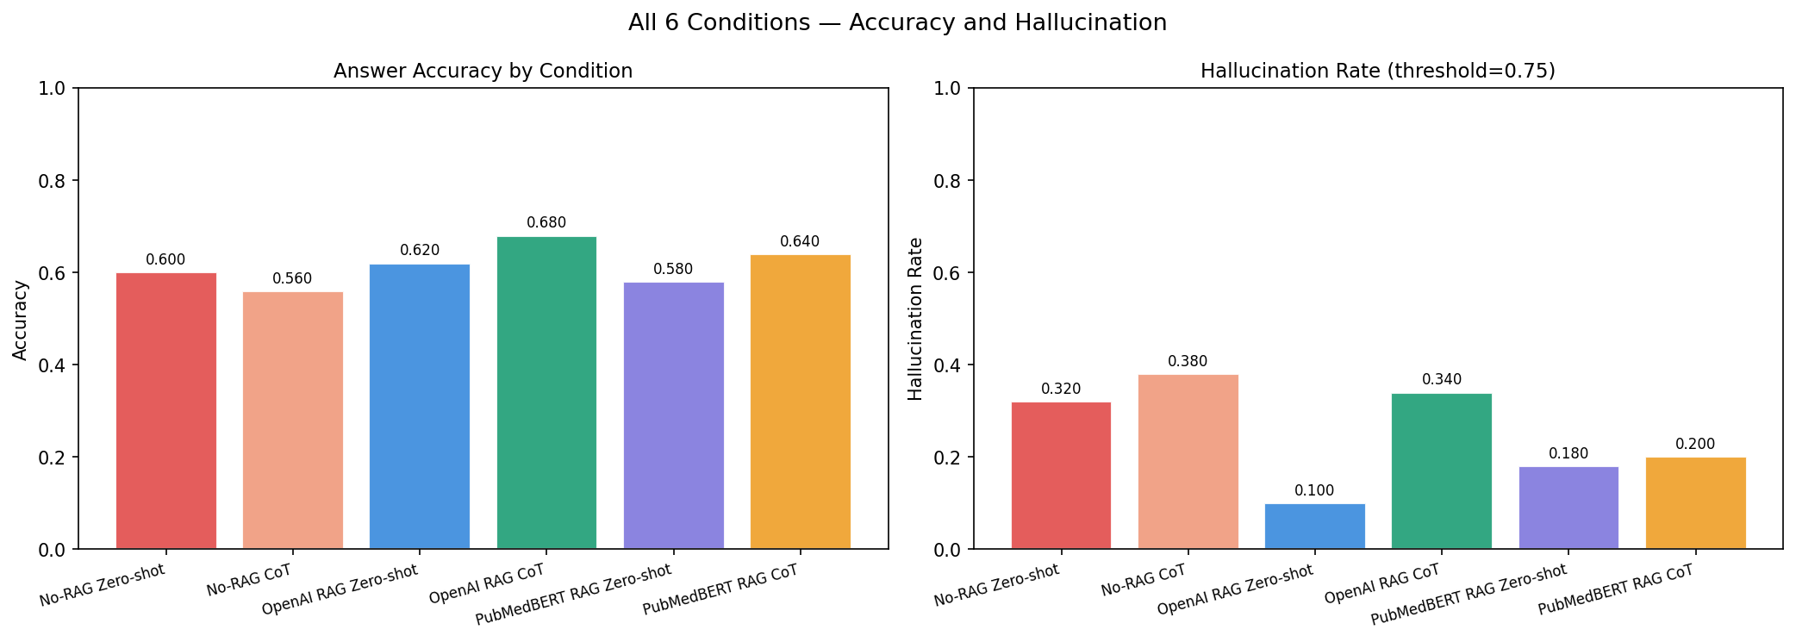
Accuracy
and Hallucination
RAG Reduces Hallucination 3.2% - At a Cost
OpenAI RAG CoT achieves 68% accuracy, the best across all conditions. The right chart shows hallucination rate — lower is better. OpenAI RAG Zero-shot hits just 10%, down from 32% for No-RAG Zero-shot. However, OpenAI RAG CoT achieves the best accuracy but a much higher hallucination rate (34%) than OpenAI RAG Zero-shot (10%). Chain-of-Thought reasoning helps reach correct conclusions but introduces more semantic drift from the source evidence — an accuracy-faithfulness trade-off with real clinical implications.
10 / 15
Notes:
The left chart shows accuracy — OpenAI RAG CoT achieves 68%, the best across all conditions. The right chart shows hallucination rate — lower is better. OpenAI RAG Zero-shot hits just 10%, down from 32% for No-RAG Zero-shot. That's a 3.2× reduction. The key tension: OpenAI RAG CoT achieves the best accuracy but a much higher hallucination rate (34%) than OpenAI RAG Zero-shot (10%). Chain-of-Thought reasoning helps reach correct conclusions but introduces more semantic drift from the source evidence — an accuracy-faithfulness trade-off with real clinical implications.

Slide 11
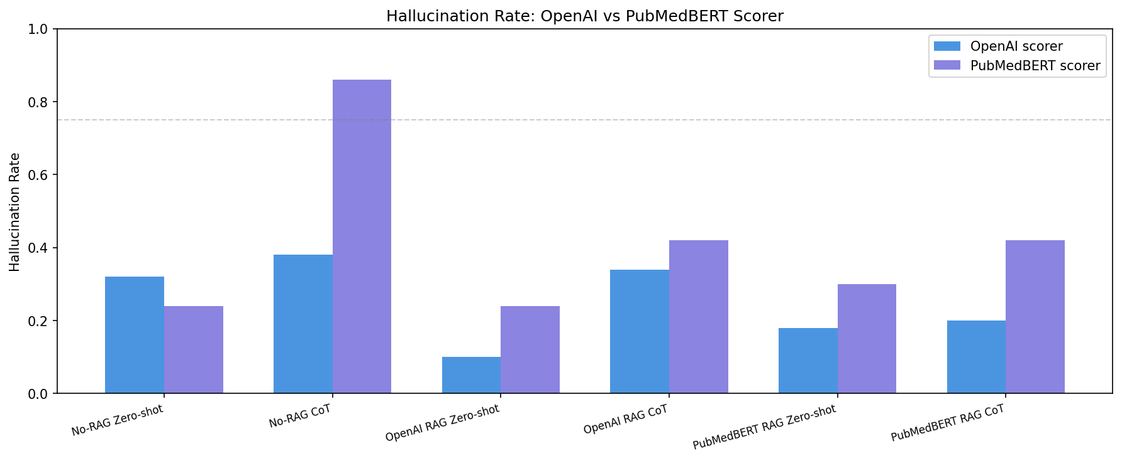
Scorer Disagreement
The Most Important Finding
No-RAG CoT
OpenAI scorer
38%
PubMedBERT scorer
86%
CoT without evidence produces fluent but clinically imprecise language. General embedders accept it; biomedical embedders detect the vocabulary drift.
11 / 15
Notes:
This is our most novel finding. The two scoring models rate the exact same generated answers very differently. For No-RAG CoT: OpenAI flags 38% as hallucinated, PubMedBERT flags 86% — a 48 percentage point gap. Why? Chain-of-Thought reasoning without retrieved evidence produces fluent, well-structured medical prose that sounds authoritative. OpenAI's general-purpose embeddings encode this as semantically similar to source text. PubMedBERT, trained exclusively on PubMed, has a more precise representation of clinical vocabulary and detects when GPT-4's free reasoning drifts from precise medical terminology. This implies that general-purpose embedders systematically underestimate clinical hallucination rates.

Slide 12
LLM as Judge
LLM-as-Judge &
ROUGE-L
Condition
Grounding
Reasoning
Safety
Overall
No-RAG ZS
3.10
3.80
3.90
3.60
No-RAG CoT
3.14
2.68
3.66
3.16
OpenAI RAG ZS
4.00
3.82
4.52
4.11
OpenAI RAG CoT
3.42
2.56
3.68
3.22
RAG Zero-shot achieves highest grounding (4.00–4.02) and safety (4.50–4.52) scores. CoT consistently reduces reasoning quality in RAG conditions.
ROUGE-L shows RAG conditions scoring 60% higher than No-RAG — around 0.27 vs 0.17. PubMedBERT RAG Zero-shot achieves the best ROUGE-L at 0.277.
PubMed RAG ZS
4.02
3.70
4.50
4.07
PubMed RAG CoT
3.54
2.64
3.72
3.30
Rouge - L Scores
No-RAG Zero-shot : mean ROUGE-L = 0.1735
No-RAG CoT : mean ROUGE-L = 0.1573
OpenAI RAG Zero-shot : mean ROUGE-L = 0.2751
OpenAI RAG CoT : mean ROUGE-L = 0.2406
PubMedBERT RAG Zero-shot : mean ROUGE-L = 0.2769
PubMedBERT RAG CoT : mean ROUGE-L = 0.2432
12 / 15
Notes:
ROUGE-L shows RAG conditions scoring 60% higher than No-RAG — around 0.27 vs 0.17. PubMedBERT RAG Zero-shot achieves the best ROUGE-L at 0.277. The LLM-as-Judge table reveals that RAG Zero-shot conditions dominate: grounding scores of 4.00 and 4.02, safety scores of 4.52 and 4.50. The most interesting pattern is that CoT consistently reduces reasoning quality in RAG conditions — OpenAI RAG CoT scores only 2.56 on reasoning vs 3.82 for OpenAI RAG Zero-shot. The judge appears to penalise CoT reasoning steps that don't flow cleanly from retrieved evidence.

Slide 13
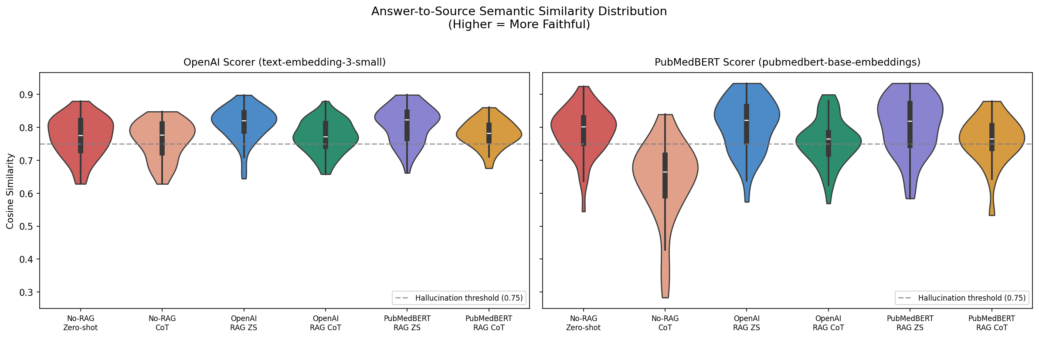
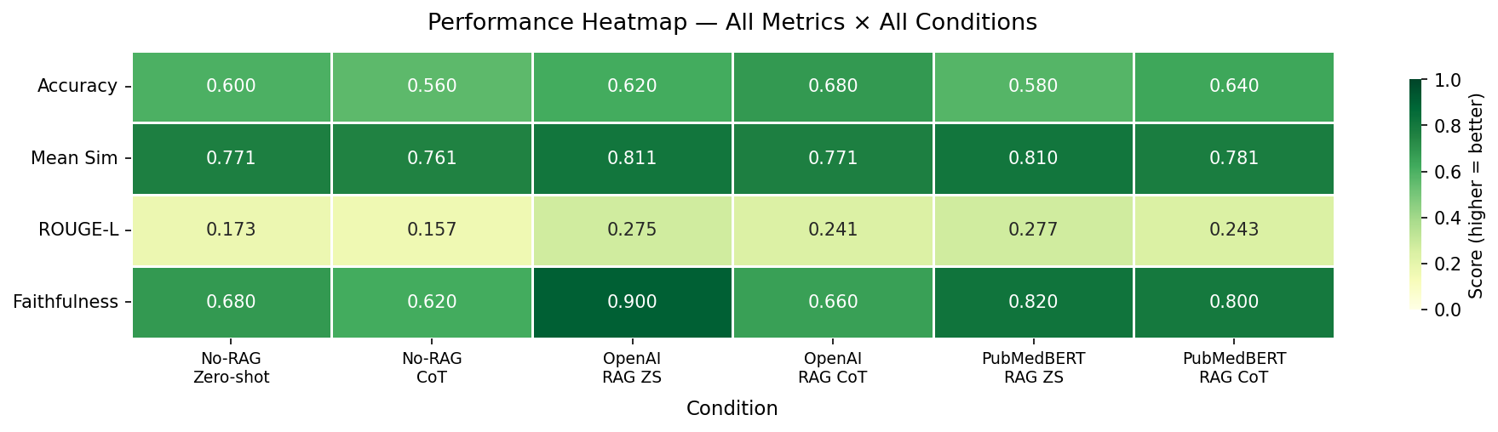
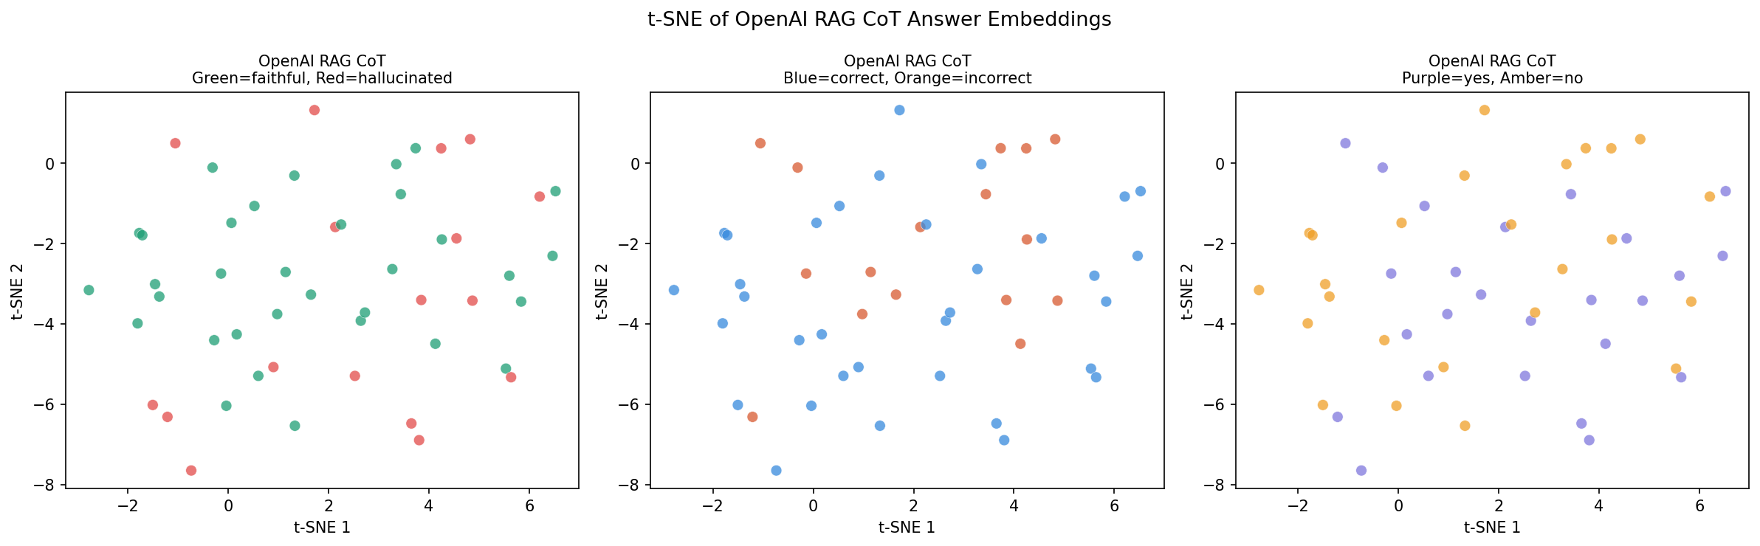
Visualization Guide
Similarity Distribution (Violin Plot)
Width = spread of cosine similarity scores. Dashed line = 0.75 threshold. Below the line = hallucinated. Key: No-RAG CoT violin drops sharply under PubMedBERT scoring — confirming the scorer disagreement finding visually.
Performance Heatmap
Rows = metrics, Columns = conditions. Darker green = better. Faithfulness = 1 − Hallucination Rate. No single condition dominates all metrics — reveals the accuracy-faithfulness trade-off at a glance.
t-SNE Embedding Visualization
Each dot = one answer embedding (1,536d → 2d via PCA + t-SNE). Three colour schemes: faithful/hallucinated, correct/incorrect, yes/no label. Hallucinated answers tend to cluster together — hallucination is systematic, not random.
13 / 15
Notes:
Three main visualisation charts are produced by the notebook. The violin plot is the most direct visual representation of our hallucination scoring — the dramatic drop of the No-RAG CoT violin under PubMedBERT scoring is immediately visible and compelling. The heatmap gives a bird's-eye view across all conditions and metrics simultaneously. The t-SNE plot is the most technically sophisticated — it projects high-dimensional answer embeddings to 2D to reveal whether hallucinated answers cluster spatially.

Slide 14
Work
Future Work
What I Would Do Differently
Fix now
• Increase to full 1,000-question PubMedQA set — n=50 gives wide confidence intervals
• Add 'maybe' class for realistic 3-way classification
• Report mean ± std across 3 random seeds to quantify LLM non-determinism
Extend the pipeline
• Expand corpus to all of PubMed Central via API (~35M papers)
• Add BM25 lexical retrieval as a third baseline
• Vary TOP_K (1, 3, 5, 10) to measure retrieval sensitivity
Research directions
• Clinician panel to validate LLM-as-Judge scores vs human evaluation
• RAGAS claim-level faithfulness alongside our embedding-based metric
• Fine-tune PubMedBERT on PubMedQA question-abstract pairs
14 / 15
Notes:
We organise future directions into three categories. Fix Now covers things we'd address given more time: larger sample size, the maybe class for harder classification, and multiple random seeds. Extend the Pipeline covers methodological additions: a much larger corpus to test real-world retrieval difficulty, BM25 as a lexical retrieval baseline, and TOP_K sensitivity analysis. Research Directions covers longer-term contributions: clinician validation of our automated metrics, RAGAS-style claim-level faithfulness, and domain-specific fine-tuning.

Slide 15
Questions?
3.2×
68%
+48pt
Hallucination reduction
Best accuracy
Scorer gap
(RAG vs No-RAG)
(OpenAI RAG CoT)
(No-RAG CoT)
References
Lewis et al. (2020) — RAG, NeurIPS · Singhal et al. (2023) — LLMs encode clinical knowledge, Nature · Es et al. (2023) — RAGAS, arXiv · Jin et al. (2019) — PubMedQA, EMNLP
Detailed code, report and video available at - https://github.com/sritama/ai-in-healthcare/tree/main/final_project
15 / 15
Notes:
Thank you. To summarise: RAG reduces hallucination by 3.2 times, our best accuracy is 68% with OpenAI RAG CoT, and the most important finding is the 48 percentage point gap between scorers on No-RAG CoT — revealing that general-purpose embedding models systematically underestimate clinical hallucination in free reasoning chains. Happy to take questions about any aspect of the methodology or results.

