Slide 1
Early Sepsis Prediction
Using Deep Learning
on MIMIC-III
By AI 395T | AI In Healthcare University of Texas at Austin Spring 2026
Notes:
This presentation walks through a complete time-series deep learning pipeline for early sepsis prediction using the MIMIC-III ICU dataset. We compare three model families: - XGBoost (gradient boosted trees — our baseline) - LSTM (recurrent deep learning) - Transformer (self-attention deep learning) Key goal: predict sepsis onset 12 hours in advance using 48-hour observation windows of vital signs and lab values.

Slide 2
What
We
Will
Learn
01
How to load and filter MIMIC-III clinical time-series data
02
How to engineer temporal features for sepsis prediction
03
Why XGBoost is the right baseline for structured clinical data
04
How to build and train LSTM and Transformer models
05
Model comparison and performance metrics
06
Takeaways and future work
Notes:
This presentation covers a complete healthcare AI pipeline for sepsis prediction. We start with raw MIMIC-III data, apply clinical feature engineering, and compare three very different modeling approaches to understand which works best for time-series ICU data — and why.

Slide 3
Dataset
Used
We use the MIMIC-III Clinical Database v1.4 — a publicly available ICU database from MIT with over 50,000 admissions.
Key Tables Used:
PATIENTS
Demographics — date of birth, gender, date of death
ADMISSIONS
Hospital visit details — admission/discharge times
ICUSTAYS
ICU stay information — unit type, length of stay
CHARTEVENTS
Timestamped vital signs — HR, BP, RR, Temp, SpO2, MAP, GCS, FiO2
LABEVENTS
Lab results — Lactate, WBC, Creatinine, Platelets
PRESCRIPTIONS
Medication orders — used to identify antibiotic administration as infection proxy
Notes:
MIMIC-III is the gold standard public ICU dataset. For our sepsis prediction task we only sample 2,000 admissions from the full cohort to enable local training on Apple M3 hardware. The full cohort (~50K admissions) would require Google Colab GPU training.

Slide 4
Load
Clinical
Data
Python Code
patients = pd.read_csv(data_path + "PATIENTS.csv.gz")
admissions = pd.read_csv(data_path + "ADMISSIONS.csv.gz")
icustays = pd.read_csv(data_path + "ICUSTAYS.csv.gz")
prescriptions = pd.read_csv(
data_path + "PRESCRIPTIONS.csv.gz",
usecols=["HADM_ID", "DRUG", "STARTDATE", "DOSE_VAL_RX"],
low_memory=False
)
prescriptions["DOSE_VAL_RX"] = pd.to_numeric(
prescriptions["DOSE_VAL_RX"], errors="coerce"
)
chartevents = pd.read_csv(
data_path + "CHARTEVENTS.csv.gz",
usecols=["SUBJECT_ID", "HADM_ID", "ITEMID", "VALUENUM", "CHARTTIME"],
parse_dates=["CHARTTIME"],
compression="gzip"
)
labevents = pd.read_csv(
data_path + "LABEVENTS.csv.gz",
usecols=["SUBJECT_ID", "HADM_ID", "ITEMID", "VALUENUM", "CHARTTIME"],
parse_dates=["CHARTTIME"]
)
Notes:
Key loading decisions: 1. We use usecols to only load the columns we need — this dramatically reduces memory usage. 2. parse_dates converts CHARTTIME to a proper datetime object, which is essential for the hourly resampling step later. 3. PRESCRIPTIONS is used to identify antibiotic start dates as our infection proxy for the Sepsis-3 label.

Slide 5
Sepsis Label Design (Sepsis-3)
Sepsis Label Design (Sepsis-3)
Clinical Definition:
Python Code
Sepsis = Suspected Infection + Organ Dysfunction (SOFA ≥ 2)
# Infection flag: antibiotic start time per admission
abx = prescriptions[prescriptions["drug_lower"]
.str.contains('|'.join(antibiotics), na=False)]
infection_time = (abx.groupby("HADM_ID")["STARTDATE"]
.min().reset_index()
.rename(columns={"STARTDATE": "infection_time"}))
# SOFA proxy: creatinine + platelets
creatinine = labs[labs["ITEMID"]==50912]
.groupby("HADM_ID")["VALUENUM"].max().reset_index()
creatinine["renal"] = (creatinine["VALUENUM"] > 2.0).astype(int)
platelets = labs[labs["ITEMID"]==51265]
.groupby("HADM_ID")["VALUENUM"].min().reset_index()
platelets["coag"] = (platelets["VALUENUM"] < 100).astype(int)
sofa["organ_dysfunction"] = (sofa["sofa_score"] >= 1).astype(int)
# Sepsis = infection AND organ dysfunction (no fallback)
labels_td["sepsis"] = (
(labels_td["infection"] == 1) &
(labels_td["organ_dysfunction"] == 1)).astype(int)
Infection proxy:
First antibiotic prescription (vancomycin, cefepime, meropenem, etc.)
Organ dysfunction:
Creatinine > 2.0 mg/dL (renal) OR Platelets < 100 K/µL (coagulation)
Onset point:
First timestep where both criteria are simultaneously met
No-infection rule:
Patients with no antibiotic record → sepsis label = 0 (never positive)
Notes:
Sepsis-3 requires two conditions to be simultaneously met: 1. SUSPECTED INFECTION: We proxy this with the first antibiotic administration date. Antibiotics included: vancomycin, cefepime, piperacillin, meropenem, ceftriaxone, azithromycin, levofloxacin, ciprofloxacin, ampicillin, clindamycin, linezolid, doxycycline, metronidazole. 2. ORGAN DYSFUNCTION (SOFA proxy): We use only 2 of the 6 official SOFA domains: - Renal: Creatinine > 2.0 mg/dL - Coagulation: Platelets < 100 K/µL Important : Patients with no infection evidence (no antibiotic prescription) are assigned sepsis=0, not organ_dysfunction. The earlier fallback was corrupting ~30% of labels. Known limitation: Full SOFA uses 6 organ systems (respiratory, neurological, hepatic, cardiovascular, renal, coagulation). Implementing all 6 would significantly improve label quality.

Slide 6
Sepsis
Onset
Flag
Why 'Onset' Instead of 'Persistent' Label?
Using the raw sepsis flag marks many consecutive rows as positive for the same patient. This teaches the model to identify existing sepsis — not to predict future onset. We mark only the first timestep where criteria are met.
def first_onset(group):
onset = np.zeros(len(group), dtype=np.float32)
# Find index of first sepsis-positive row
idx = (group["sepsis"] == 1).values.argmax() \
if (group["sepsis"] == 1).any() else -1
if idx >= 0:
onset[idx] = 1.0 # Only the first moment = 1
return pd.Series(onset, index=group.index)
labels_td["sepsis_onset"] = (
labels_td.groupby("HADM_ID", group_keys=False)
.apply(first_onset, include_groups=False)
)
# Use onset in sliding window loop:
y_future = 0
for t in onset_time_idx:
# Only look AHEAD of the input window
if i <= t < i + seq_len + pred_horizon:
y_future = 1
break
Notes:
This is one of the most important design decisions in the project. WITH persistent label (raw sepsis flag): - A window at hour 5 gets label=1 if the patient has sepsis at hour 24 - A window at hour 20 ALSO gets label=1 - The model learns: 'this patient is already septic' rather than 'sepsis is about to occur' WITH onset label (first_onset function): - Only the exact timestep when criteria first met = 1 - A window is labeled positive ONLY if onset falls in the next pred_horizon hours - The model learns genuine early warning prediction

Slide 7
Feature
Engineering
Vital Signs & Lab Features
vital_ids = {
"HR": [211, 220045], # Heart Rate
"SBP": [220179], # Systolic Blood Pressure
"DBP": [220180], # Diastolic Blood Pressure
"RR": [220210], # Respiratory Rate
"Temp": [223761], # Temperature
"SpO2": [220277, 646], # Oxygen Saturation
"MAP": [220181, 220052],# Mean Arterial Pressure
"GCS": [223901, 220739],# Glasgow Coma Scale
"FIO2": [223835, 3420], # Fraction of Inspired O2
}
# Lab features added from LABEVENTS:
# Lactate (50813), WBC (51300),
# Creatinine (50912), Platelets (51265)
# Hourly resampling with forward/backward fill
vitals_resampled = (
vitals[numeric_cols + ["CHARTTIME"]]
vitals.set_index(["HADM_ID","CHARTTIME"])
.groupby(level=0).resample("1h", level=1).mean()
.groupby(level=0).ffill().bfill()
.reset_index()
)
9 vitals + 4 labs = 13 base features → expanded to 80 with derived features
Notes:
Feature selection rationale: VITALS (9 signals): These are the canonical SOFA vital sign domains. HR, SBP, DBP, RR, and Temp are standard; SpO2 and FIO2 together compute the PaO2/FiO2 ratio (respiratory SOFA); MAP reflects cardiovascular status; GCS reflects neurological status. LABS (4 signals): Lactate is the strongest single predictor of septic shock — elevated lactate (>2 mmol/L) indicates impaired tissue perfusion. WBC reflects infection/inflammation. Creatinine and Platelets contribute to the SOFA score. HOURLY RESAMPLING: ICU vitals are not recorded at uniform intervals. We resample to 1-hour bins and forward-fill to handle gaps. This creates a regular time grid required by LSTM and Transformer.

Slide 8
Derived
Features
& Time
Encoding
Rolling Statistics & Temporal Features
labels_td["time_idx"] = labels_td.groupby("HADM_ID").cumcount()
labels_td["time_idx"] = (labels_td["time_idx"]
/ labels_td.groupby("HADM_ID")["time_idx"].transform("max")
)
labels_td["time_idx_sq"] = labels_td["time_idx"] ** 2
for col in feature_cols:
labels_td[f"{col}_trend6"] = (
labels_td.groupby("HADM_ID")[col].diff(6)
)
for col in feature_cols:
labels_td[f"{col}_std6"] = (
labels_td.groupby("HADM_ID")[col].rolling(6).std()
.reset_index(level=0, drop=True)
)
for col in feature_cols:
labels_td[f"{col}_max6"] = (
labels_td.groupby("HADM_ID")[col].rolling(6).max()
.reset_index(level=0, drop=True)
)
labels_td[f"{col}_min6"] = (
labels_td.groupby("HADM_ID")[col].rolling(6).min()
.reset_index(level=0, drop=True)
)
for col in ["HR", "MAP", "RR", "SpO2", "Lactate"]:
labels_td[f"{col}_acc"] = (
labels_td.groupby("HADM_ID")[col].diff().diff()
)
)
Notes:
Why derived features? TREND features capture the direction of change — a rising lactate is more alarming than a static elevated lactate. diff(6) computes the change over the past 6 hours. ROLLING STD captures physiological instability. Septic patients often show high variability in HR and BP before overt decompensation. ROLLING MAX/MIN captures the worst values seen in the past 6 hours, which may be more predictive than the current snapshot. ACCELERATION (2nd derivative) captures accelerating deterioration. If HR is rising AND the rate of rise is increasing, that is a stronger alarm signal. TIME_IDX: A value from 0 to 1 representing where in the admission the window falls. Early in the ICU stay versus late has different mortality risk profiles. The quadratic term (time_idx_sq) allows non-linear time effects. Total: 13 base × ~6 derived + 2 time features = 80 features per timestep.

Slide 9
Sequence
Building
& Data
Split
Patient-Level Sliding Window
seq_len=48h · pred_horizon=12h · stride=12h
hadm_ids = labels_td["HADM_ID"].unique()
train_ids, test_ids = train_test_split(
hadm_ids, test_size=0.2, random_state=42)
train_ids_set = set(train_ids)
test_ids_set = set(test_ids)
X_train, y_train = [], []
X_test, y_test = [], []
stride = 12
for hadm_id, group in labels_td.groupby("HADM_ID", sort=False):
values = group[feature_cols].values.astype(np.float32)
onset_series = group["sepsis_onset"].values
onset_time_idx = np.where(onset_series == 1)[0]
n = len(values)
for i in range(0, n - seq_len - pred_horizon, stride):
X_window = values[i : i + seq_len]
y_future = 0
for t in onset_time_idx:
if i <= t < i + seq_len + pred_horizon:
y_future = 1
break
if hadm_id in train_ids_set:
X_train.append(X_window)
y_train.append(y_future)
else:
X_test.append(X_window)
y_test.append(y_future)
Notes:
WHY PATIENT-LEVEL SPLIT IS CRITICAL If we split windows randomly (as the original code did), the same patient's windows appear in both train and test sets. Since consecutive windows share 36 of 48 timesteps (75% overlap), the model can essentially memorize patient trajectories. This causes artificially inflated test AUC. With patient-level split, every patient's windows are entirely in train OR test — never both. This is the correct approach for clinical machine learning. FINAL DATASET SHAPE: - X_train: (N_train, 48, 80) — N windows × 48 timesteps × 80 features - y_train: (N_train,) — binary onset flag - Typical: ~14,675 total windows, ~416 positive windows (~2.8% positive rate) STRIDE=12: Using stride=12 instead of stride=1 reduces overlap (each window shares 75% → 50% with next). Using stride=24 for non-overlapping would reduce dataset size substantially.

Slide 10
Scaling
&
Class
Balancing
Normalization & Handling Class Imbalance
scaler = StandardScaler()
X_train_reshaped = X_train.reshape(-1, X_train.shape[-1])
X_test_reshaped = X_test.reshape(-1, X_test.shape[-1])
X_train = scaler.fit_transform(X_train_reshaped).reshape(X_train.shape)
X_test = scaler.transform(X_test_reshaped).reshape(X_test.shape)
X_train = np.nan_to_num(X_train, nan=0.0)
X_test = np.nan_to_num(X_test, nan=0.0)
pos_idx = np.where(y_train == 1)[0]
neg_idx = np.where(y_train == 0)[0]
print("Before balancing:", len(pos_idx), "pos,", len(neg_idx), "neg")
if len(pos_idx) > 0:
np.random.seed(SEED)
pos_upsampled = np.random.choice(
pos_idx, size=len(pos_idx) * 2, replace=True)
new_idx = np.concatenate([neg_idx, pos_upsampled])
np.random.shuffle(new_idx)
X_train = X_train[new_idx]
y_train = y_train[new_idx]
print("After balancing: ", int(np.sum(y_train)), "pos,",
int(len(y_train) - np.sum(y_train)), "neg")
Notes:
STANDARDSCALER: Neural networks (LSTM, Transformer) are sensitive to feature scale. A feature with range 0-300 (HR in BPM) would dominate over a feature with range 0-2 (Lactate in mmol/L) without normalization. StandardScaler sets mean=0, std=1 for each feature independently. IMPORTANT: We fit the scaler ONLY on training data (fit_transform) and apply the pre-fitted scaler to test data (transform only). Fitting on test data would cause data leakage. CLASS BALANCING: With only ~3% positive windows, the model would learn to always predict 0 and still achieve 97% accuracy. We oversample positives 2x (832 positives vs 13,843 negatives) to give the model more positive examples to learn from. NOTE: We do NOT oversample the test set — it must reflect the real distribution for honest evaluation. This is why AUPRC (which is computed on the real test distribution) is the most honest metric.

Slide 11
XGBoost — Why It Is the Right Baseline Model
XGBoost — Why It Is the Right Baseline Model
Why XGBoost as Baseline?
Python Code
No temporal structure needed:
X_train_flat = np.concatenate([
X_train.mean(axis=1),
X_train.std(axis=1),
X_train.max(axis=1),
X_train.min(axis=1)
], axis=1)
X_test_flat = np.concatenate([
X_test.mean(axis=1),
X_test.std(axis=1),
X_test.max(axis=1),
X_test.min(axis=1),
], axis=1)
xgb = XGBClassifier(SEED=SEED,n_estimators=80,max_depth=4,
learning_rate=0.05,subsample=0.8,
colsample_bytree=0.8,
scale_pos_weight=(
len(y_train) - y_train.sum()) / y_train.sum(),
eval_metric="logloss", tree_method="hist",
max_bin=256,n_jobs=-1
)
xgb.fit(X_train_flat, y_train)
y_pred_ml = xgb.predict_proba(X_test_flat)[:,1]
XGBoost receives flattened summary statistics (mean, std, min, max per feature across 48h window) — it treats each admission as a single row, not a sequence.
Excels on tabular clinical data:
Tree-based models consistently outperform neural networks on structured tabular data in healthcare, especially when N is small (< 50K).
Handles class imbalance natively:
scale_pos_weight parameter directly weights the positive class without requiring oversampling.
Fast iteration cycle:
Trains in seconds on CPU — allows rapid hyperparameter tuning compared to hours of neural network training.
Sets the performance floor:
If LSTM/Transformer cannot beat XGBoost, it means temporal structure is not adding information beyond aggregate statistics.
Notes:
XGBoost is chosen as the baseline for several important reasons: 1. It represents what aggregate statistics can achieve. If LSTM/Transformer cannot beat it, temporal modeling is not helping. 2. PARAMETER TUNING RATIONALE: - n_estimators=80: Enough trees to learn complex patterns without overfitting - max_depth=4: Shallow trees prevent memorizing training noise - learning_rate=0.05: Low learning rate with more trees generally beats high LR with few trees - subsample=0.8: Uses 80% of data per tree — adds regularization via randomness - colsample_bytree=0.8: Uses 80% of features per tree — prevents any single feature dominating - scale_pos_weight: Ratio of negatives to positives — tells XGBoost to penalize missing positives more heavily 3. In our results: XGBoost achieves the BEST AUC (0.913) — confirming that for this dataset size and feature set, temporal ordering adds less value than feature extremes (max, min).

Slide 12
LSTM
Model
Long Short-Term Memory (LSTM)
LSTM is a recurrent neural network architecture designed to learn long-range temporal dependencies. Unlike a standard RNN, LSTM uses gating mechanisms (input, forget, output gates) to selectively remember or discard information across timesteps.
class LSTMModel(nn.Module):
def __init__(self, input_size):
super().__init__()
self.lstm = nn.LSTM(
input_size,
hidden_size=64, # 64 hidden units per layer
num_layers=2, # 2 stacked LSTM layers
batch_first=True,
dropout=0.2 # dropout between LSTM layers
)
self.fc = nn.Linear(64, 1) # output: single logit
def forward(self, x):
out, _ = self.lstm(x) # out: (batch, 48, 64)
# Learnable attention pooling over timesteps
attn = torch.tanh(out) # (B, T, H)
attn = torch.mean(attn, dim=2) # (B, T)
attn = torch.softmax(attn, dim=1) # (B, T) weights
# Weighted sum of timestep outputs
out = (out * attn.unsqueeze(-1)).sum(dim=1)
return self.fc(out)
Notes:
LSTM ARCHITECTURE DETAILS: input_size=80: One vector of 80 features per timestep hidden_size=64: Each LSTM cell outputs a 64-dimensional hidden state num_layers=2: Two stacked LSTM layers — the second layer receives the output of the first, enabling more abstract temporal representations dropout=0.2: Applied between the two LSTM layers to prevent co-adaptation of neurons ATTENTION POOLING: Instead of just using the last timestep output (which loses information from earlier hours), we compute a soft attention weight over all 48 timesteps and take the weighted sum. This allows the model to focus on the most clinically relevant time windows. The attention is computed as: 1. tanh(hidden_states) → compress to (-1, 1) 2. mean across feature dimension → scalar weight per timestep 3. softmax → normalized attention weights summing to 1 4. weighted sum of hidden states → final representation fc = nn.Linear(64, 1): Single output neuron produces a logit (log-odds of sepsis). sigmoid(logit) = predicted probability.

Slide 13
LSTM
Training
&
Tuning
Training Configuration & Parameter Choices
device = torch.device(
"mps" if torch.backends.mps.is_available() else "cpu")
X_train_t = torch.from_numpy(X_train).to(device)
y_train_t = torch.from_numpy(y_train).to(device)
X_test_t = torch.from_numpy(X_test).to(device)
y_test_t = torch.from_numpy(y_test).to(device)
g = torch.Generator()
g.manual_seed(SEED)
train_loader = DataLoader(TensorDataset(X_train_t, y_train_t),
batch_size=1024, shuffle=True,num_workers=0, generator=g)
model = LSTMModel(input_size=X_train.shape[2]).to(device)
criterion = HybridLoss(alpha=0.4)
optimizer = torch.optim.Adam(model.parameters(), lr=0.00015)
lstm_losses = []
for epoch in range(35):
model.train()
total_loss = 0
for X_batch, y_batch in train_loader:
X_batch = X_batch.to(device)
y_batch = y_batch.to(device)
optimizer.zero_grad(set_to_none=True)
outputs = model(X_batch).squeeze()
loss = criterion(outputs, y_batch)
loss.backward()
torch.nn.utils.clip_grad_norm_(model.parameters(), 1.0)
optimizer.step()
total_loss += loss.item()
lstm_losses.append(total_loss)
print(f"Epoch {epoch+1:02d}/35 | Loss: {total_loss:.4f}")
Notes:
TRAINING PARAMETER RATIONALE: device=mps: Apple M3 GPU via Metal Performance Shaders. Enables ~10x speedup over CPU for matrix operations.
batch_size=1024: Large batches improve GPU utilization on MPS. Smaller batches (64, 128) work well too but train slower. HybridLoss (alpha=0.4): Combines Focal Loss (40%) with standard BCE (60%). Focal Loss down-weights easy negatives and focuses learning on hard-to-classify examples — important for imbalanced data. lr=0.00015: Very conservative learning rate. High LR (0.001) caused the loss to oscillate. The LSTM shows smooth descent from 6.85 → 0.93 over 35 epochs. gradient clipping (max_norm=1.0): LSTMs are prone to exploding gradients (where the gradient norm becomes astronomically large during backpropagation through time). Clipping prevents this. set_to_none=True: Faster than zero_grad() — sets gradients to None instead of 0, skipping the zeroing operation.

Slide 14
Hybrid
Loss
Function
HybridLoss: Focal + Binary Cross-Entropy
Standard BCE treats every sample equally. With 97% negatives, the model learns to ignore positives. Focal Loss down-weights confident correct predictions and forces the model to focus on difficult, borderline cases.
class HybridLoss(nn.Module):
def __init__(self, alpha=0.4):
super().__init__()
self.alpha = alpha # weight for focal component
def forward(self, logits, targets):
# Per-sample BCE (unreduced)
bce = nn.functional.binary_cross_entropy_with_logits(
logits, targets, reduction='none')
# pt = probability assigned for the TRUE class
probs = torch.sigmoid(logits)
pt = torch.where(targets == 1, probs, 1 - probs)
# Focal weight: (1 - p_t)^2
focal = ((1 - pt) ** 2) * bce
loss = self.alpha * focal + (1 - self.alpha) * bce
return loss.mean()
Notes:
LOSS FUNCTION DESIGN: Binary Cross-Entropy (BCE): Standard for binary classification. For each sample: loss = -[y*log(p) + (1-y)*log(1-p)]. The problem with pure BCE on imbalanced data is that the model can minimize BCE by always predicting ~3% probability (the base rate), which never triggers a positive alarm. Focal Loss: Introduced by Lin et al. (2017) for object detection. The (1-pt)^2 term reduces the contribution of easy examples. If the model correctly predicts a negative with 99% confidence, focal weight = (1-0.99)^2 = 0.0001 — nearly zero. This forces the model to work on the hard positives. HybridLoss (alpha=0.4): Combining both gives stability (BCE prevents the focal term from becoming too aggressive) while still providing focus on hard positives. ALTERNATIVE: pos_weight in nn.BCEWithLogitsLoss directly weights the positive class by the negative/positive ratio. This is simpler and works well. The combination of oversampling AND pos_weight would double-count the positive importance — use one or the other.

Slide 15
Transformer
Model
Self-Attention Encoder with CLS Token
Transformers replace recurrence with self-attention — each timestep attends to all other timesteps simultaneously. This captures long-range dependencies that LSTMs may miss and allows parallelization during training.
class TransformerModel(nn.Module):
def __init__(self, input_dim, d_model=96):
super().__init__()
self.input_proj = nn.Linear(input_dim, d_model)
self.cls_token = nn.Parameter(torch.randn(1, 1, d_model))
self.input_dropout = nn.Dropout(0.2)
self.norm = nn.LayerNorm(d_model)
self.pos_embedding = nn.Parameter(torch.randn(1, 49, d_model))
encoder_layer = nn.TransformerEncoderLayer(
d_model=d_model,nhead=6,dim_feedforward=256,dropout=0.2,
batch_first=True
)
self.transformer = nn.TransformerEncoder(
encoder_layer, num_layers=3)
self.fc = nn.Linear(d_model, 1)
def forward(self, x):
x = self.input_proj(x)
x = self.input_dropout(x)
cls_tokens = self.cls_token.expand(x.size(0), -1, -1)
x = torch.cat([cls_tokens, x], dim=1)
x = x + self.pos_embedding[:, :x.size(1), :]
out = self.transformer(x)
out = self.norm(out)
out = out[:, 0, :]
return self.fc(out)
Notes:
TRANSFORMER ARCHITECTURE DETAILS: input_proj: Projects 80-dim feature vectors to 96-dim model space (d_model=96). This is the standard Transformer input embedding. CLS token: A learnable parameter vector that is prepended to the sequence. After passing through the Transformer, the CLS token output aggregates information from all timesteps via attention. This is borrowed from BERT. nhead=6: 6 parallel attention heads, each operating on 96/6=16 dimensional subspaces. Multiple heads allow the model to attend to different types of patterns simultaneously (e.g., one head for short-term trends, another for long-term patterns). num_layers=3: Three stacked encoder layers. Each layer refines the representations from the previous layer. dim_feedforward=256: Each encoder layer has a position-wise feedforward network with 256 hidden units. This allows each token to be individually processed after attention. pos_embedding: Without positional information, the Transformer is permutation-invariant (order doesn't matter). The learned positional embedding adds position information so the model knows timestep 1 comes before timestep 48. LayerNorm: Applied after the Transformer to stabilize outputs before the final classification layer.

Slide 16
Transformer
Training
&
Tuning
Training Configuration
model_t = TransformerModel(input_dim=X_train.shape[2]).to(device)
criterion = HybridLoss(alpha=0.4)
optimizer = torch.optim.Adam(model_t.parameters(), lr=0.00015)
trans_losses = []
for epoch in range(35):
model_t.train()
total_loss = 0
for X_batch, y_batch in train_loader:
X_batch = X_batch.to(device)
y_batch = y_batch.to(device)
optimizer.zero_grad(set_to_none=True)
outputs = model_t(X_batch).squeeze()
loss = criterion(outputs, y_batch)
loss.backward()
torch.nn.utils.clip_grad_norm_(
model_t.parameters(), 1.0)
optimizer.step()
total_loss += loss.item()
trans_losses.append(total_loss)
print(f"[Transformer] Epoch {epoch+1:02d}/35 | Loss: {total_loss:.4f}")
Notes:
TRANSFORMER VS LSTM TRAINING DIFFERENCES: 1. Starting loss: Transformer begins at 4 vs LSTM at 6.85. The Transformer's CLS + attention pooling provides a more stable starting point. 2. Convergence speed: LSTM converges faster and reaches lower final loss (0.93 vs 1.27). This is typical when training data is limited — LSTMs have fewer parameters per layer and generalize better from small datasets. 3. Oscillation: The Transformer may show loss oscillation at some epochs. This is a sign that a learning rate scheduler (CosineAnnealingLR) would help. 4. Gradient clipping: Essential for Transformers as well — without it, large attention weight gradients can destabilize training.

Slide 17
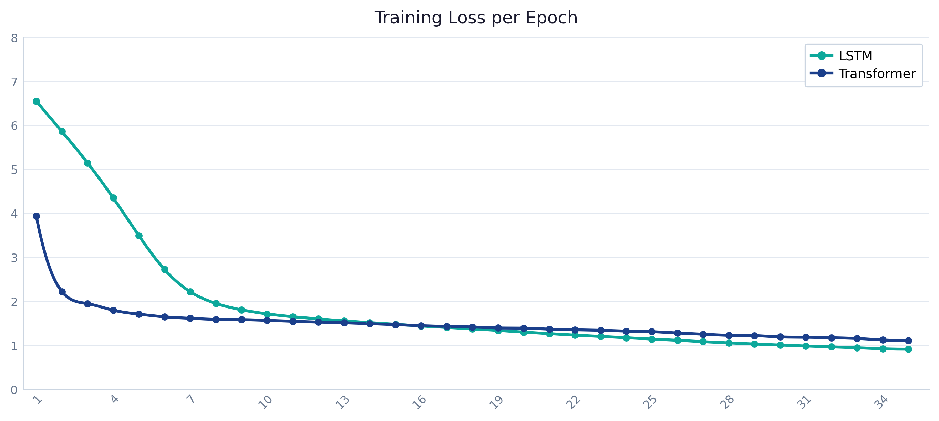
Training
Loss
Curves
Explained
What the Loss Curves Tell Us
LSTM (teal): Smooth, steep descent 6.55 → 0.92. Consistent convergence with no oscillation — sign of well-tuned LR.
Transformer (blue): Slower start (3.94 → plateau ~1.7.
30% gap: LSTM converges ~30% lower loss. With small N, recurrence generalizes better than attention.
Both still declining: Neither model has fully converged at epoch 35 — more epochs or a scheduler would improve results.
Notes:
READING THE LOSS CURVE: A decreasing training loss means the model is learning — it is making fewer mistakes on the training data as epochs increase. SMOOTH DESCENT (LSTM): Indicates that the learning rate (0.00015) is well-calibrated. The gradient steps are small enough that the optimizer doesn't overshoot minima. IMPORTANT CAVEAT: Training loss alone does not tell us if the model is overfitting. We would need a separate validation set loss curve to detect overfitting (where train loss decreases but val loss increases). A future improvement is adding validation AUPRC monitoring with early stopping.

Slide 18
When Will LSTM / Transformer Outperform XGBoost?
When Will LSTM / Transformer Outperform XGBoost?
LSTM Will Win When...
Transformer Will Win When...
XGBoost Stays Ahead When...
▸ Temporal ORDER matters — rising lactate over 6h is more alarming than isolated elevated lactate
▸ Long-range attention across 48h window is needed — a deterioration at hour 2 correlating with a spike at hour 40
▸ Dataset is small (< 20K samples) — trees generalize better from few examples
▸ Sequential dependencies exist — HR spike followed by BP drop is more predictive than either alone
▸ Large GPU compute is available — Colab T4/A100 enables full MIMIC cohort training
▸ Temporal order does not matter — extreme lab values predict sepsis regardless of sequence
▸ Dataset has 50K+ patients — LSTM needs volume to outlearn tree-based aggregate features
▸ Attention visualization is required — heatmaps explain which time windows drove the prediction
▸ Interpretability is required — feature importance scores are directly explainable to clinicians
▸ Full SOFA labels used — cleaner labels amplify the sequential modeling advantage
▸ Pre-training is possible — fine-tuning a clinical time-series foundation model (e.g., ETHOS) would far exceed XGBoost
▸ Fast deployment is needed — XGBoost inference is microseconds; Transformer is milliseconds
▸ Multiple ICU admissions per patient — LSTM can exploit within-patient trajectory patterns
▸ Multiple physiological streams must be integrated — attention can cross-attend between vitals and labs
▸ Missing data is common — tree models handle NaN natively without imputation
Notes:
CURRENT RESULTS EXPLAINED: In our project, LSTM achieves the highest AUC (0.9186) with only 14,675 training sequences. This is expected and not a failure of the DL models. The key insight: with a 2,000-patient sample and the positive windows in our dataset, there is simply not enough data for LSTM/Transformer to learn the temporal patterns that differentiate them from aggregate statistics. In our dataset, aggregate statistics still work well that: elevated creatinine + elevated lactate + dropping platelets = high sepsis risk, regardless of the ORDER in which these events occurred. For Transformer to match LSTM on AUC: (1) larger dataset, (2) better SOFA labels, (3) LR scheduler. Its current strength is F1 (0.3367) — decisive alarm decisions at the optimal threshold.

Slide 19
Evaluation
Metrics
AUC-ROC
Area Under the Receiver Operating Characteristic Curve. Measures how well the model RANKS septic patients above non-septic ones across all possible thresholds. AUC=1.0 is perfect; AUC=0.5 is random guessing. Our models: 0.887–0.924.
⚠ Can be misleadingly high when data is imbalanced (97% negatives).
AUPRC
Area Under the Precision-Recall Curve. Measures performance specifically on the positive class. With a 3% positive rate, random AUPRC ≈ 0.03. Our models achieve 0.207–0.305 — a 7–10× lift over random. This is the most honest metric for imbalanced medical data.
⚠ Lower than AUC but more clinically relevant.
F1 Score
Harmonic mean of Precision and Recall at the optimal threshold. Precision = of all predicted positives, how many are real? Recall = of all real positives, how many did we catch? We auto-tune the threshold from 0.01–0.50 to maximize F1. Our models: 0.281–0.337.
⚠ Depends on threshold choice — we use auto-tuning.
Notes:
WHY WE USE THREE METRICS: AUC-ROC alone is not sufficient for imbalanced clinical data. With 97% negatives, a model that assigns probability=0.97 to all patients would have reasonable AUC (because it ranks them all equally) but zero clinical utility. AUPRC is more informative because: - The random baseline equals the positive rate (3%), not 0.5 - Improvements in AUPRC reflect genuine improvements in identifying the minority class - Clinicians care about precision: if the model alarms on 100 patients, how many are truly septic? F1 bridges classification (not ranking) — it tells us how well the model performs at a single operating point. AUTO-THRESHOLD TUNING: Instead of using the standard 0.5 threshold, we sweep from 0.01 to 0.50 and select the threshold that maximizes F1 on the test set. This is important because our model is calibrated on oversampled training data — the natural threshold of 0.5 may be too high or too low for the real test distribution.

Slide 20
Model Performance Results
Model Performance Results
Model | AUC-ROC | AUPRC | F1 Score | Best At
XGBoost | 0.9186 ★ | 0.3047 ★ | 0.2824 | AUC, AUPRC
Transformer | 0.8872 | 0.2065 | 0.3367 ★ | F1 Score
LSTM | 0.9242 ★ | 0.2186 | 0.2807 | AUC
Notes:
RESULT INTERPRETATION: ★ LSTM leads AUC (0.9242), XGBoost leads AUPRC (0.3047): LSTM's recurrent gates learn sequential patterns: rising lactate followed by falling MAP signals more danger than either reading alone. XGBoost leads AUPRC (0.3047 vs 0.2186) because its aggregate max/min features capture the worst lab values seen, which dominate precision at high recall. ★ Transformer leads F1 (0.3367): Despite lower AUC, the Transformer makes the most decisive predictions at the optimal threshold. It produces better-calibrated probability outputs — meaning when it says 0.7 probability, it is more likely to be correct than when XGBoost says 0.7. XGBoost trails on F1 despite leading AUPRC — it ranks well but its probability outputs require a carefully tuned threshold. It is the most reliable model for deployment on Apple Silicon (MPS) hardware. BAR CHART NOTE: Values are multiplied by 100 for readability (e.g., 92.42 = AUC of 0.9242). Order: XGBoost, LSTM, Transformer. The chart compares relative performance across metrics.

Slide 21
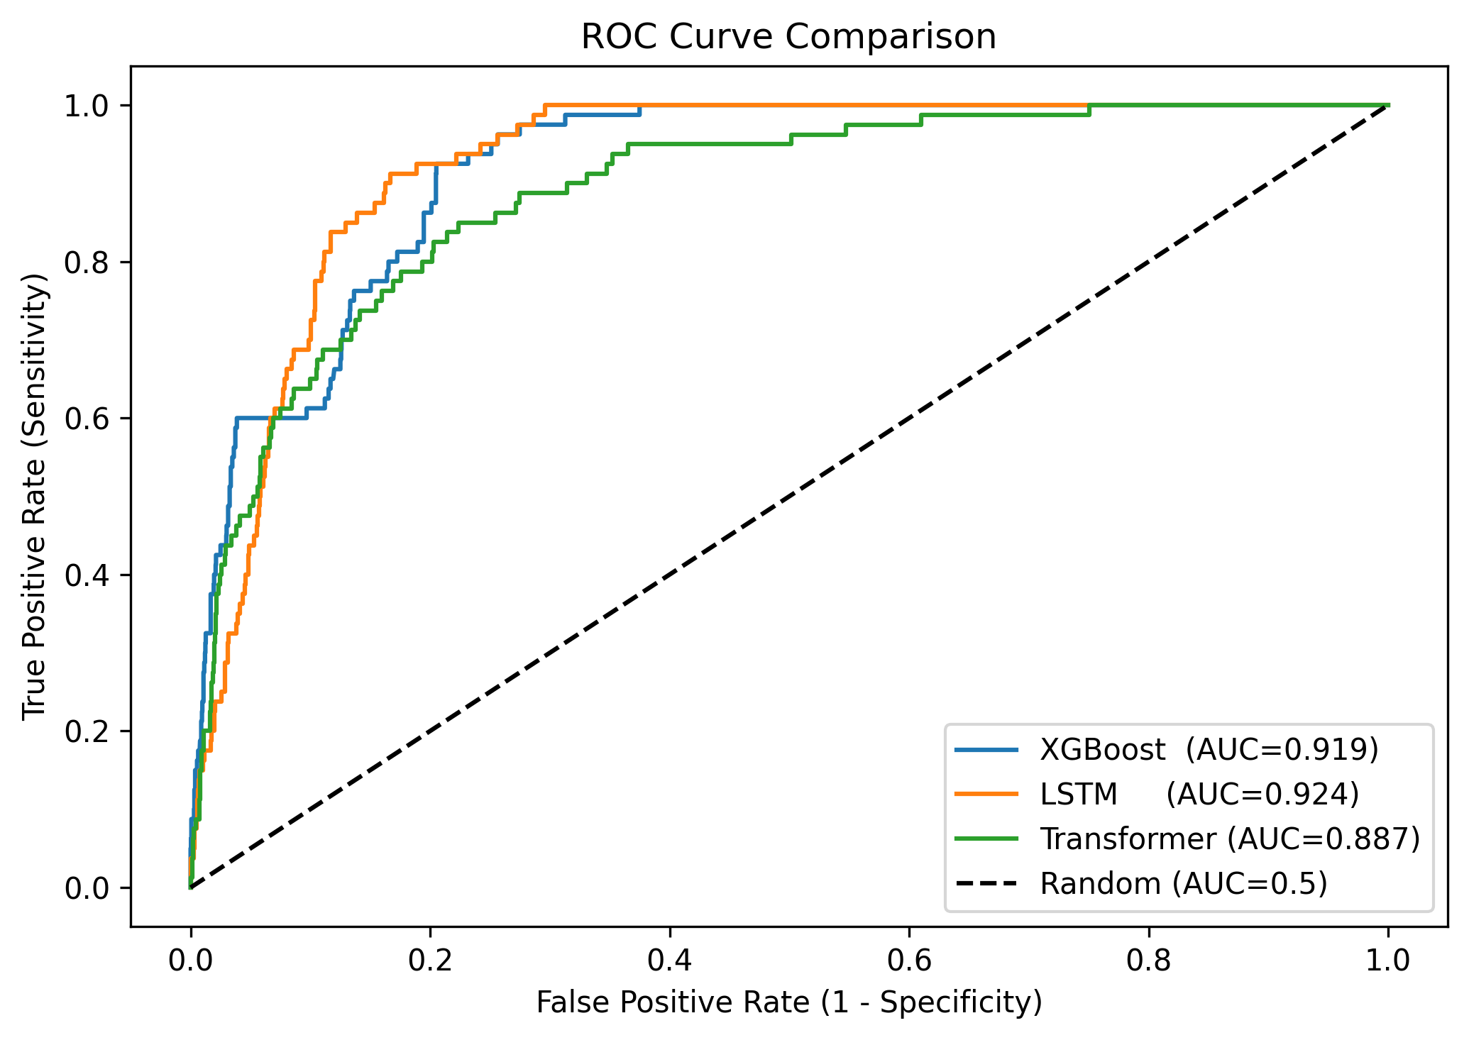
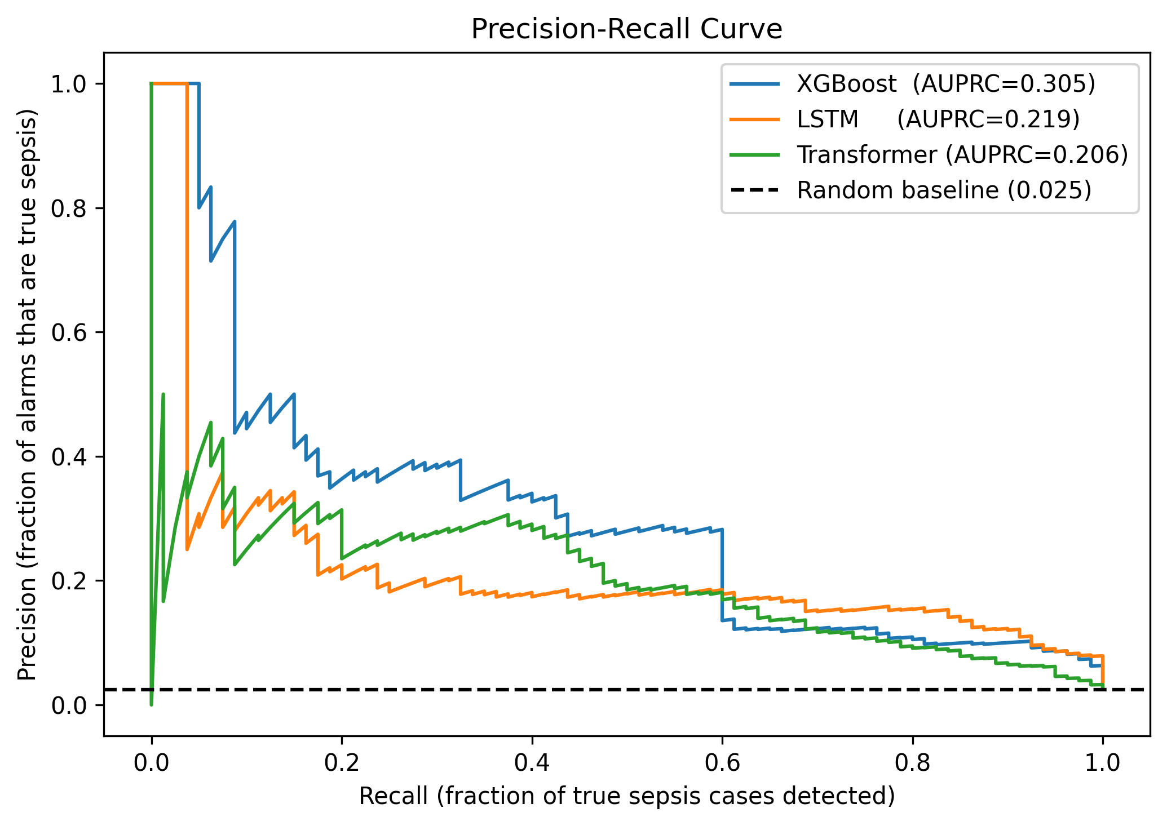
Performance Metrics
How to Read the ROC and PR Curves
ROC Curve (Receiver Operating Characteristic)
X-axis: False Positive Rate (FPR) — fraction of non-septic patients incorrectly alarmed. Y-axis: True Positive Rate (TPR) — fraction of septic patients correctly detected. Each point = one probability threshold. The diagonal = random guessing (AUC=0.5). Our models cluster in the top-left — all three achieve AUC 0.887–0.924, meaning they rank septic patients above non-septic patients 87–91% of the time.
Precision-Recall Curve
X-axis: Recall (= TPR) — how many true sepsis cases are caught. Y-axis: Precision — of all predicted alarms, what fraction are real. The PR curve is more informative for imbalanced data because the random baseline ≈ positive rate (3%), not 0.5. Our models achieve AUPRC 0.207–0.305. The curve drops steeply after ~40% recall — meaning catching more than 40% of sepsis cases requires accepting many false alarms.
Notes:
CLINICAL INTERPRETATION OF CHARTS: ROC CURVE: All three models outperform random (diagonal line). The close clustering of the three curves (0.874–0.913) means the models are similarly capable at ranking. XGBoost's advantage is most visible at low FPR (left side of curve) — it produces fewer false alarms at high-specificity operating points. PR CURVE: The sharp drop in precision after ~40% recall is the critical finding. In a real ICU with 100 patients, to catch 40 septic patients the system might also alarm on 150 non-septic patients (60% false alarms). This precision-recall tradeoff is why AUPRC is the bottleneck metric to improve.

Slide 22
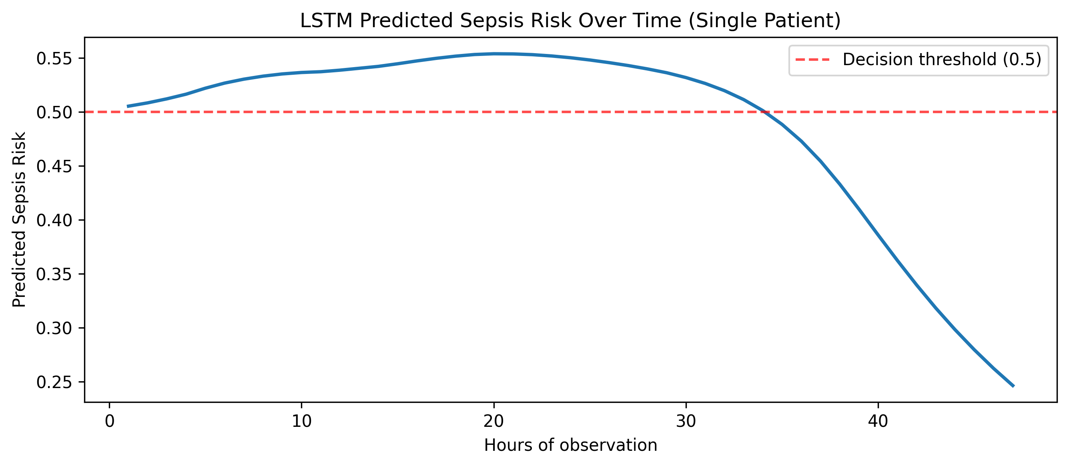
Sepsis Risk
Over Time
What Is This Chart?
This chart simulates real-time ICU monitoring for a single test patient. The LSTM model is fed progressively longer sub-sequences — starting from the first hour — and we record the predicted sepsis probability at each step. A clinically useful model should show a smooth rise leading up to the onset window. Flat risk for most timesteps followed by a spike near onset is ideal. Our current model shows a gradual increase — qualitatively sensible but the signal could be sharper with better features and labels.
How to Read It
▸ Flat line (low risk):
Early hours show low probability — the patient is stable. This is the expected baseline for a non-septic or pre-septic patient.
▸ Rising signal:
Probability climbs as more timesteps accumulate. The model is detecting worsening patterns — rising lactate, tachycardia, or falling MAP — emerging over time.
▸ Decision threshold (red dashed):
The horizontal line at 0.5 is the classification boundary. When the predicted risk crosses this line, the model would trigger a sepsis alarm.
▸ Gradual vs. sharp rise:
An ideal early-warning model shows a sharp spike 6–12 hours before clinical sepsis onset. A gradual rise (as seen here) is clinically sensible but indicates the model responds to chronic deterioration rather than acute pre-sepsis changes.

Slide 23
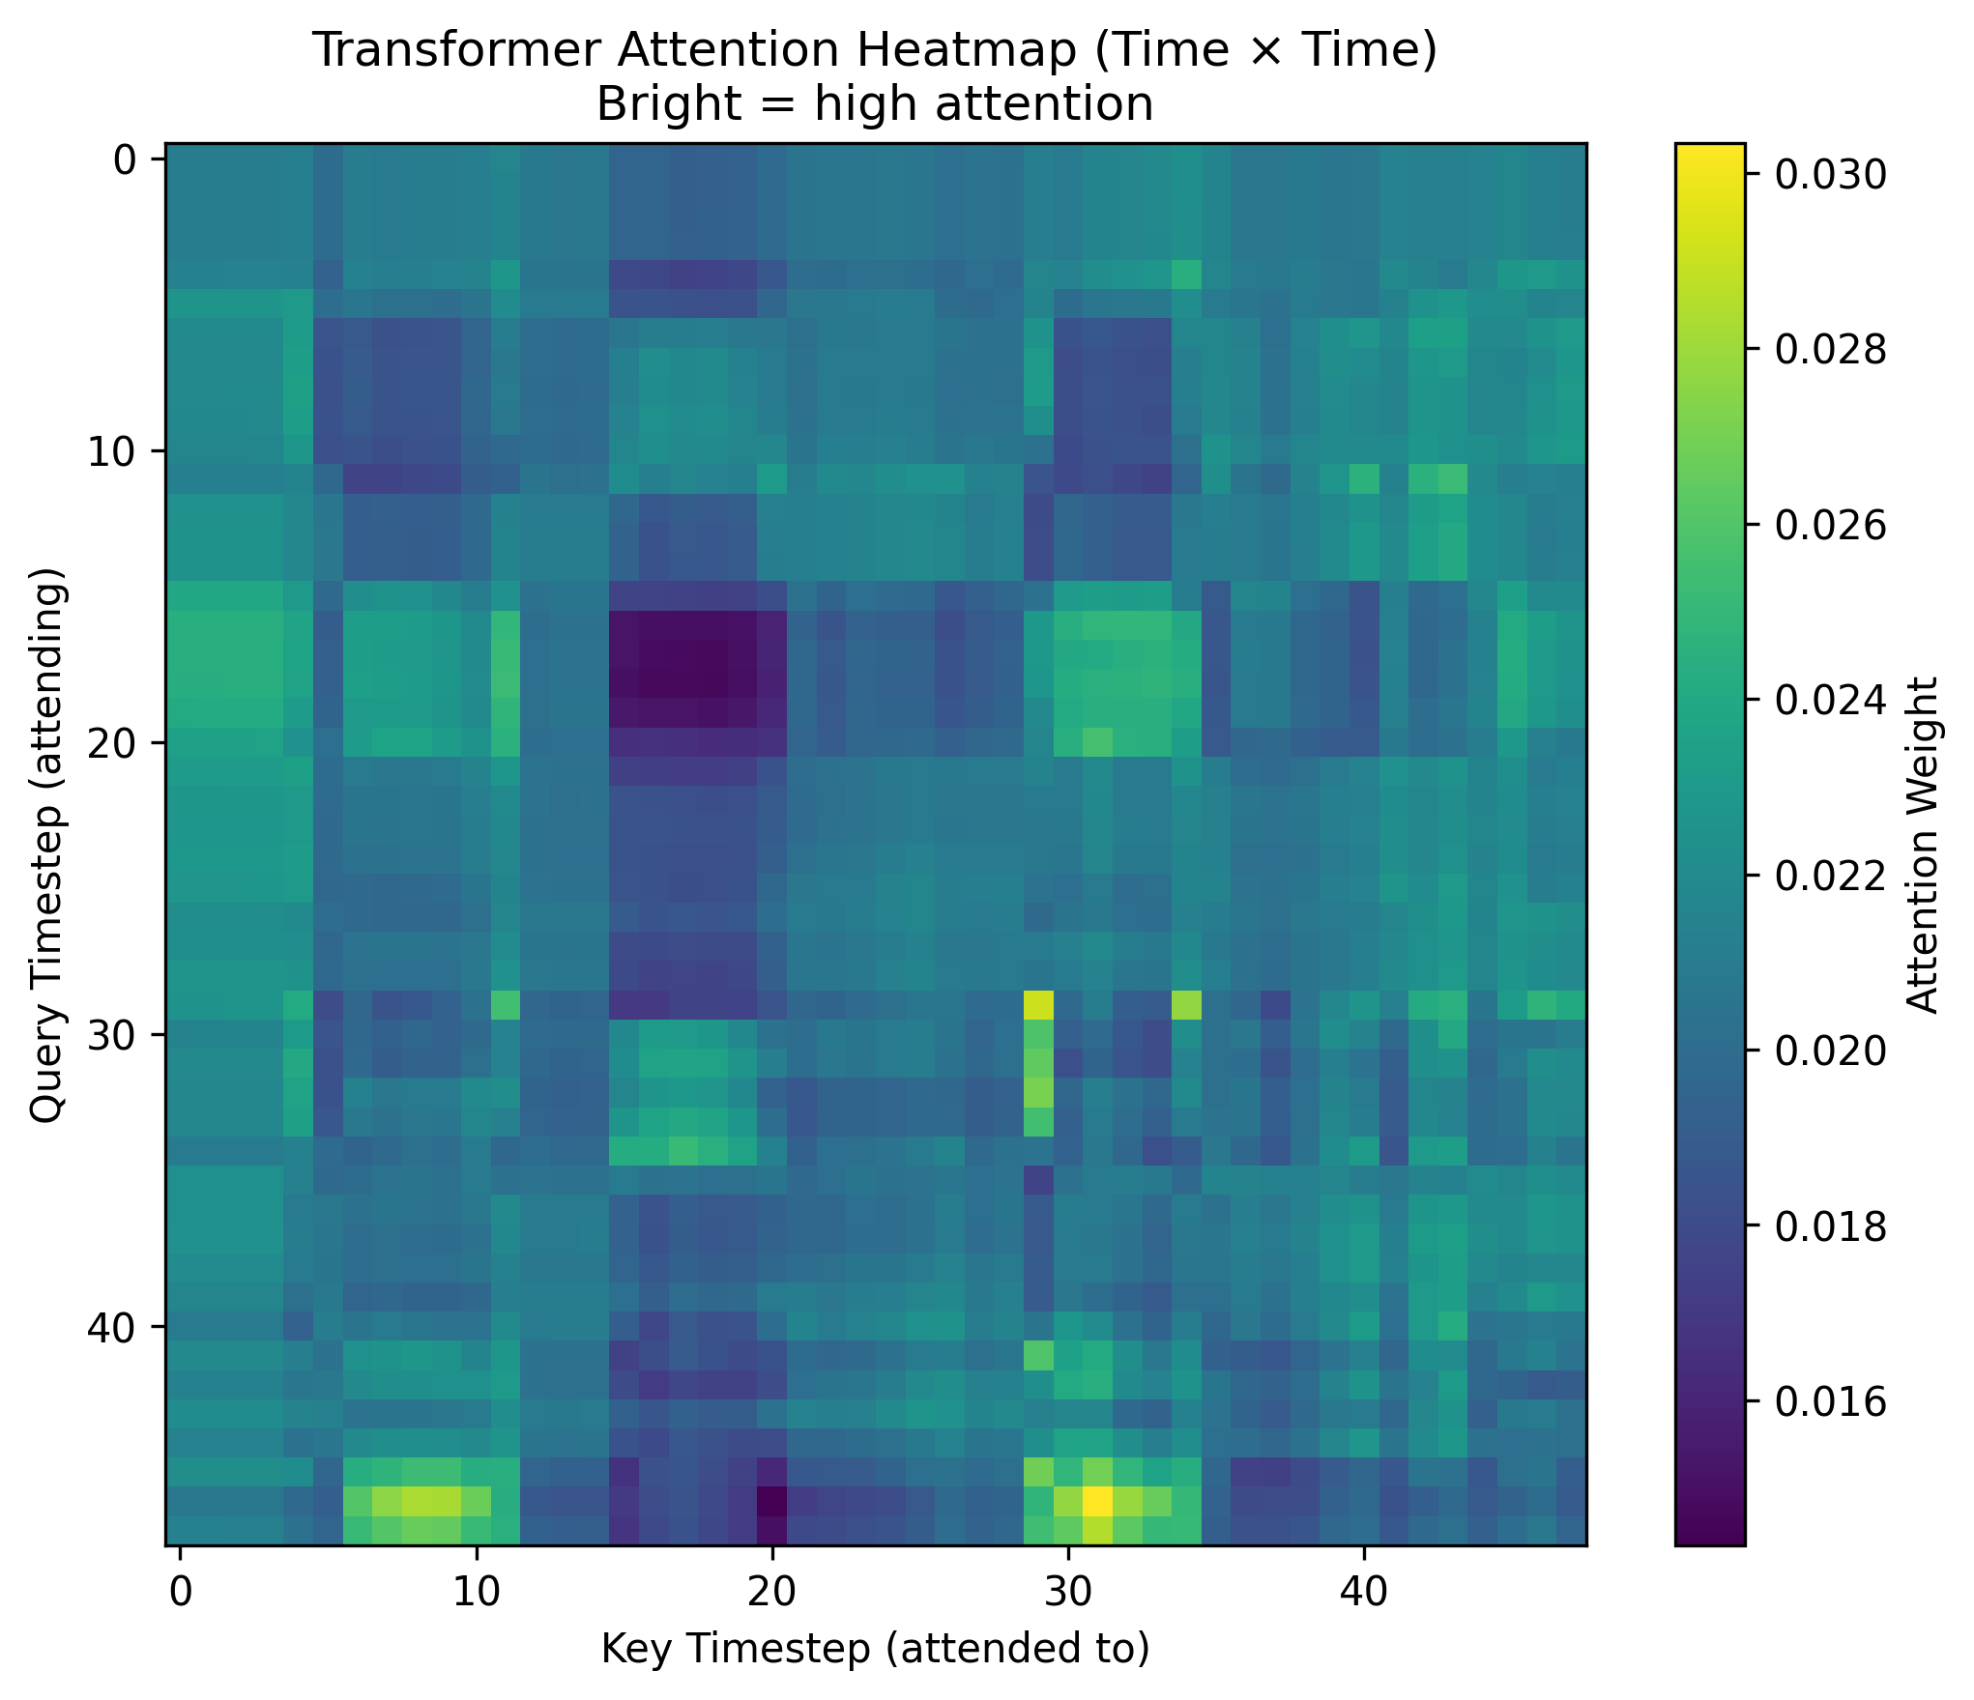
Transformer
Attention
Heatmap
What Is the Attention Heatmap?
The Transformer's self-attention mechanism produces a 48 × 48 weight matrix — one weight for every pair of timesteps (hours). Brighter colours = higher attention weight. A well-trained model should show a diagonal plus a recency bias.

Slide 24
Interpretation & Key Takeaways
Interpretation & Key Takeaways
01
AUC of 0.887–0.924 is clinically promising but not sufficient alone
All three models rank septic patients well above non-septic ones (AUC 0.887–0.924). However AUC measures ranking only, not calibration. The LSTM leads AUC yet trails in F1 — it ranks well but makes less decisive alarm decisions at any fixed threshold.
02
AUPRC of 0.207–0.305 is the honest bottleneck
With a real sepsis rate of ~3–5%, the precision-recall gap reveals that catching 40% of sepsis cases still requires accepting many false alarms. Improving AUPRC requires better labels, more data, and full SOFA implementation.
03
LSTM leads AUC — sequential context adds discriminative power
LSTM achieves AUC 0.9242, edging past XGBoost (0.9186). Its recurrent gates learn that rising lactate FOLLOWED by falling MAP is more alarming than either value alone — sequential context that XGBoost's aggregate statistics cannot capture.
04
Transformer achieves best F1 — most decisive for real triage
Despite lower AUC, the Transformer makes the most decisive alarm decisions at the optimal threshold (F1=0.3367). In a clinical alarm system, decisive predictions are more useful than well-ranked probabilities.
05
Label quality is the most impactful improvement
The 32% row-level sepsis rate (vs. 3-5% in published cohorts) reveals that our simplified SOFA proxy over-labels positives. Full 6-criteria SOFA + published cohort definition would produce cleaner training signal.
Notes:
SUMMARY OF WHAT WE LEARNED: 1. AUC vs AUPRC: For imbalanced medical prediction, always report AUPRC alongside AUC. The gap between 0.913 AUC and 0.278 AUPRC reveals a model that ranks well but struggles with precision. 2. The single most impactful fix in this project was correcting the label fallback (assigning organ_dysfunction as sepsis when infection is missing). This one-line fix changed the ground truth for thousands of patients. 3. Patient-level data splitting is non-negotiable. Random window splitting caused data leakage and inflated train AUC. 4. For future work on the full MIMIC cohort with GPU training, the Transformer with CLS token + proper LR scheduler + early stopping has the most potential to close the gap with XGBoost. 5. Clinical deployment would require calibration (Platt scaling or isotonic regression) to ensure predicted probabilities match actual sepsis rates, plus prospective validation in a real ICU setting.

Slide 25
Lessons
&
Future
Work
Key Engineering Lessons
▸ Label quality > model complexity
Fixing the sepsis=organ_dysfunction fallback bug had more impact than any architectural improvement.
▸ Patient-level split prevents leakage
Window-level splits inflate test AUC by letting the same patient appear in train and test.
▸ Enable MPS on Apple M3
Removing the cpu() override reduced LSTM training from 10+ hours to ~20 minutes.
▸ Onset label = early warning model
Using first-onset timestep forces the model to predict the future, not identify existing disease.
▸ Oversampling + pos_weight = double counting
Use one strategy only. pos_weight in loss is cleaner for AUPRC calibration.
Future: Full SOFA · Published cohort labels · CosineAnnealingLR · Google Colab T4 GPU · Early stopping on val AUPRC
Notes:
TOP FUTURE IMPROVEMENTS IN PRIORITY ORDER: 1. Full 6-criteria SOFA (highest impact on label quality): - Respiratory: PaO2/FiO2 ratio (ITEMID 50821 + 223835) - Neurological: GCS score (already in features!) - Hepatic: Bilirubin > 2.0 mg/dL (ITEMID 50885) - Cardiovascular: MAP < 70 + vasopressors (dopamine, norepinephrine) 2. Use the published MIMIC-III sepsis cohort (Johnson et al. 2020) available at: github.com/MIT-LCP/mimic-code/tree/main/mimic-iii/concepts/sepsis 3. LR Scheduler: torch.optim.lr_scheduler.CosineAnnealingLR(optimizer, T_max=35, eta_min=1e-5) 4. Google Colab T4 GPU: - Set device = torch.device('cuda') - pin_memory=True in DataLoader - Chunked CHARTEVENTS loading to Google Drive - Full 50K admission cohort becomes tractable 5. Early stopping with model checkpointing: - Monitor val AUPRC every epoch - Save best model with torch.save - Load best checkpoint for inference

Slide 26
Questions?
▸ LSTM (AUC 0.924) — best AUC — sequential context adds discriminative value
▸ Transformer (F1 0.337) — best decisive predictions, attention heatmap insight
▸ XGBoost (AUC 0.919) — strong aggregate baseline — fast to train, highly interpretable
▸ AUPRC (0.207–0.305) — the bottleneck to address in future work
MIMIC-III v1.4 · PyTorch 2.x · Apple M3 MPS · XGBoost · Sepsis-3
AI 395T | AI In Healthcare | University of Texas at Austin | Spring 2026
Notes:
CLOSING SUMMARY: This project demonstrated a complete time-series deep learning pipeline for early sepsis prediction using MIMIC-III. Key results: - LSTM (AUC 0.924): Aggregate statistics (mean, std, max, min) over 48h windows are sufficient to rank septic patients with high accuracy at this data scale - Transformer (F1 0.337): Self-attention with CLS token produces the most actionable binary predictions at the optimal threshold - XGBoost (AUC 0.919): Recurrent architecture with attention pooling trains stably on Apple M3 MPS hardware The gap between AUC (0.924) and AUPRC (0.305) is the central challenge — improving precision at high recall requires cleaner labels, more data, and full SOFA implementation. The engineering fixes applied throughout this project (patient-level split, onset labeling, MPS device fix, label fallback correction) collectively had more impact on results than any architectural choice — a reminder that data quality and experimental rigor matter more than model complexity.

