Slide 1
ICU Mortality &
Length-of-Stay Prediction
Using Large Language Models
on MIMIC-III
By Sritama Paul
AI 395T | AI In Healthcare University of Texas at Austin Spring 2026
Notes:
Welcome to our tutorial on predicting ICU patient outcomes using Large Language Models. We applied seven different prompting strategies to 100 real ICU patients from the MIMIC-III database, using GPT-4o as the primary model and GPT-3.5-turbo as a baseline. The core question: can an LLM reason over structured clinical data expressed as natural language narratives to predict which patients will die and how long they will stay in the ICU?

Slide 2
01
Healthcare issue — ICU outcome prediction from EHR data
What we
will learn
02
MIMIC-III dataset — real clinical data from 46,000+ ICU patients
03
Prompt engineering — 7 strategies from zero-shot to Tree of Thoughts
04
Methods — async API infrastructure, narrative generation, LLM-as-Judge
05
Results & visualisations — model comparison across all 8 configurations
06
Ideas for improvement — future directions
Notes:
This presentation covers six areas: first we motivate the clinical problem, then we describe the MIMIC-III dataset, explain how we engineered prompts, describe our technical infrastructure, compare all seven prompting methods with visualisations, and finally discuss ideas for future improvement.

Slide 3
ICU Outcome Prediction
ICU clinicians must rapidly decide which patients are at high risk of mortality and who will need extended care. These decisions affect staffing, resource allocation, and treatment intensity — yet must be made with incomplete information under time pressure.
Healthcare
Issue
Why LLMs?
Traditional ML requires expensive fine-tuning on labelled clinical data for each new hospital. LLMs can reason over structured EHR data expressed as natural language narratives — zero training required. We convert each patient's vitals, labs, and medications into a clinical handoff note and ask the model to predict outcomes.
Two Prediction Tasks
Mortality: Will this patient SURVIVE or DIE during their ICU stay? Length-of-Stay: Will the stay be SHORT (<3 days) or LONG (≥3 days)?
Notes:
The clinical problem is predicting two outcomes for ICU patients: whether they will survive and how long they will stay. Traditional ML requires labelled training data and expensive model fine-tuning for each new hospital. LLMs offer a different approach — we convert structured EHR data into natural language narratives and ask the model to reason clinically, just as a physician would during a handoff. No fine-tuning is needed.

Slide 4
We use MIMIC-III Clinical Database v1.4 — a publicly available ICU database from MIT/PhysioNet with over 46,000 patients.
Dataset
Used
Key Tables Used:
ADMISSIONS
Demographics, admission times, hospital outcome (mortality flag)
PATIENTS
Date of birth and gender — used to compute patient age
ICUSTAYS
ICU stay timestamps and length of stay — prediction targets
CHARTEVENTS
~28M vital signs: HR, BP, SpO2, temperature, resp rate
LABEVENTS
~3.3M lab results: glucose, creatinine, WBC, sodium
PRESCRIPTIONS
4M+ medication orders — vasopressors signal severity
Cohort: 100 patients | 50 died / 50 survived | First ICU stay per patient | Adults ≥18
Notes:
MIMIC-III is a publicly available ICU database from MIT/PhysioNet covering over 46,000 patients. We use six tables: ADMISSIONS for outcomes, PATIENTS for demographics, ICUSTAYS for stay lengths, CHARTEVENTS for vital signs (28 million rows filtered), LABEVENTS for lab values, and PRESCRIPTIONS for medications. Our cohort is 100 patients, balanced 50/50, using only the first ICU stay per patient to avoid data leakage.

Slide 5
Building the Patient Cohort
Step 1 — Compute patient age
Feature
Engineering
Step 1
MIMIC-III stores DOB, not age. Patients >89 have DOB shifted ~300 years forward for de-identification. We use year arithmetic (not timedelta) and cap computed age at 91 to handle this artefact.
Step 2 — Select first ICU stay per patient
Patients with multiple ICU stays have later stays influenced by earlier treatment decisions the LLM cannot know. We take only the earliest stay per patient to prevent data leakage.
Step 3 — Filter to adults with valid stays
Exclude patients under 18 and stays with LOS = 0 (data quality issue). Rename hospital_expire_flag → mortality. Create binary LOS label: SHORT (<3 days) or LONG (≥3 days).
Step 4 — Build balanced cohort (n=100)
Sample 50 died + 50 survived using random_state=42. Balance is critical — without it a naive model achieves 80%+ accuracy by always predicting the majority class, making the 50% random baseline meaningful.
Notes:
Four steps build the patient cohort before any feature extraction. Age computation is non-trivial in MIMIC-III because of the >89 anonymisation artefact. Using the first ICU stay per patient prevents data leakage. The balanced 50/50 split ensures the 50% random baseline is meaningful — any accuracy above 50% represents genuine predictive signal from the LLM.

Slide 6
Extracting Vitals, Labs & Medications
10 features extracted per patient using median aggregation (not mean or latest value — reduces impact of transient spikes and data entry errors):
Feature
Engineering
Step 2
Vital Signs — from CHARTEVENTS
Heart Rate (bpm)
CareVue: 211 | Metavision: 220045
Systolic BP (mmHg)
CareVue: 51 | Metavision: 220179
Diastolic BP (mmHg)
CareVue: 8368 | Metavision: 220180
Temperature (°C)
°C: 676/223762 | °F: 678/223761 (converted)
SpO2 (%)
CareVue: 646 | Metavision: 220277
Respiratory Rate (br/min)
CareVue: 618 | Metavision: 220210
Lab Results — from LABEVENTS
Glucose (mg/dL)
50809, 50931 (blood gas + chemistry)
Creatinine (mg/dL)
50912 (kidney function)
WBC Count (×10³/μL)
51301 (infection / immune status)
Sodium (mEq/L)
50983 (electrolyte balance)
+ Medications — up to 4 drug names from PRESCRIPTIONS (vasopressors, antibiotics, diuretics)
Notes:
We extract 10 numeric features per patient: 6 vital signs from CHARTEVENTS and 4 lab values from LABEVENTS. A key technical detail is that MIMIC-III used two ICU clinical systems — CareVue (older) and Metavision (newer) — with different itemids for the same measurement. We include both sets so features are extracted for all patients regardless of which system recorded their data. Temperature is special: it may be recorded in °C or °F depending on the unit, so we try °C first and convert from °F if necessary. We use the median across all readings during the ICU stay, which is more robust to transient spikes than mean or latest value. Medications are extracted separately as a text list of up to 4 drug names.

Slide 7
Missing Values, Labels & Output Features
Missing Value Imputation
Missing values are filled with the cohort median — avoids introducing extreme values:
Feature
Engineering
Step 3
sbp / dbp
30 missing → cohort median (most patients lack continuous BP)
temp
4 missing → cohort median
hr / spo2 / resp_rate
3 missing each → cohort median
glucose / creatinine / sodium
3 missing each → cohort median
wbc
2 missing → cohort median
Prediction Labels (Ground Truth)
Mortality
hospital_expire_flag = 1 → DIED, 0 → SURVIVED
Source: ADMISSIONS table
LOS label
los_days ≥ 3 → LONG, los_days < 3 → SHORT
3-day threshold: short stays = rapid recovery or very early death
Notes:
Missing values arise when a patient simply has no recorded reading for a particular vital or lab during their ICU stay. Systolic and diastolic BP have the most missing values (30 each) because BP monitoring is intermittent in some patients. We use cohort median imputation — straightforward and appropriate for this task since the LLM uses the values as clinical context rather than for gradient-based learning. The two prediction labels come directly from MIMIC-III: mortality from the hospital_expire_flag column in ADMISSIONS, and LOS from the icustay LOS value binarised at 3 days. The 3-day threshold is clinically meaningful — short stays typically indicate either rapid recovery or very early death, while long stays indicate ongoing complex care.

Slide 8
Converting EHR Data to Clinical Narratives
Instead of passing raw numbers to the LLM, each patient row is converted into a clinical narrative with ⚠ abnormality flags and a SOFA-proxy severity score:
Tabular→ Text
Conversion
PATIENT PROFILE — ID: 32763
Demographics : Age 79, M
Admission Dx : CORONARY ARTERY DISEASE
Severity Level: MODERATE ← SOFA-proxy
Vital Signs:
Heart rate : 75.0 bpm [60–100]
Blood pressure: 110.0/50.0 mmHg ⚠ LOW
Resp rate : 23.0 br/min ⚠ HIGH
SpO2 : 99.0% [94–100]
Lab Results:
Glucose : 155.0 mg/dL ⚠ HIGH
Creatinine : 1.5 mg/dL ⚠ HIGH
WBC count : 9.0 ×10³/μL [normal]
Medications: Furosemide, Potassium Chloride
⚠ Abnormality flags use clinical reference ranges to direct the LLM's attention to significant values. SOFA-proxy severity approximates organ failure risk from SpO2, SBP, and creatinine.
Notes:
The core design decision is converting structured tabular data into clinical narratives. Raw numbers carry less meaning to an LLM than annotated values. We add two enhancements: abnormality flags using standard clinical reference ranges, and a SOFA-proxy severity score computed from SpO2, systolic BP, and creatinine. This format resembles a clinical handoff note, which aligns with GPT-4o's medical training data.

Slide 9
Code
def flag(value, low, high, unit=""):
if value is None or (isinstance(value, float) and np.isnan(value)):
return "not recorded"
val_str = f"{value}{unit}"
if value > high:
return f"{val_str} ⚠ HIGH"
elif value < low:
return f"{val_str} ⚠ LOW"
return val_str
def sofa_proxy(row):
score = 0
spo2 = row.get('spo2', float('nan'))
sbp = row.get('sbp', float('nan'))
cr = row.get('creatinine', float('nan'))
if not np.isnan(spo2):
score += 2 if spo2 < 90 else (1 if spo2 < 94 else 0)
if not np.isnan(sbp):
score += 2 if sbp < 90 else (1 if sbp < 100 else 0)
if not np.isnan(cr):
score += 2 if cr > 3.0 else (1 if cr > 1.2 else 0)
return {4: "CRITICAL", 3: "HIGH", 2: "HIGH", 1: "MODERATE"}.get(score, "LOW")
Tabular→ Text
Conversion Code
Notes:
Tabular→ Text Conversion Code

Slide 10
Code
def patient_to_narrative(row: dict) -> str:
"""
Convert one patient record dict into a clinical text narrative.
The narrative format is designed to resemble a clinical handoff note,
which aligns with GPT-4o's training data and improves prediction quality.
"""
severity = sofa_proxy(row)
return f"""PATIENT PROFILE — ID: {row['subject_id']}
Demographics : Age {row['age']}, {row['gender']}
Admission Dx : {row['diagnosis']}
Severity Level: {severity} ← SOFA-proxy assessment
Vital Signs (normal ranges in brackets):
Heart rate : {flag(row['hr'], 60, 100, ' bpm')} [60–100]
Blood pressure : {flag(row['sbp'], 90, 140, '')} / {flag(row['dbp'], 60, 90, ' mmHg')} [90–140 / 60–90]
Temperature : {flag(row['temp'], 36, 38, ' °C')} [36.0–38.0]
SpO2 : {flag(row['spo2'], 94, 100, '%')} [94–100]
Respiratory rate : {flag(row['resp_rate'], 12, 20, ' breaths/min')} [12–20]
Laboratory Results (normal ranges in brackets):
Glucose : {flag(row['glucose'], 70, 110, ' mg/dL')} [70–110]
Creatinine : {flag(row['creatinine'], 0.6, 1.2, ' mg/dL')} [0.6–1.2]
WBC count : {flag(row['wbc'], 4.5, 11, ' ×10³/μL')} [4.5–11.0]
Sodium : {flag(row['sodium'], 136, 145, ' mEq/L')} [136–145]
Current Medications: {row['medications']}"""
# ── Regenerate all narratives ─────────────────────────────────────────
df['narrative'] = df.apply(lambda r: patient_to_narrative(r.to_dict()), axis=1)
Generate Patient Narrative
Notes:
Generate patient Narrative

Slide 11
7 Prompting Strategies
01
Zero-shot (GPT-4o)
Direct prediction from narrative — no examples provided
Prompt
Engineering
02
1-shot ICL (GPT-4o)
One real MIMIC-III example: bowel perforation, high-risk patient
03
3-shot ICL (GPT-4o)
Three contrasting examples: DIED/LONG, SURV/SHORT, SURV/LONG
04
Chain-of-Thought (GPT-4o)
5-step clinical framework: vitals → labs → meds → synthesis → predict
05
Tree of Thoughts (GPT-4o)
Two competing paths (high risk vs low risk) then choose between them
06
Self-Consistency (GPT-4o)
CoT ×3 independent votes at temperature=0.7, majority decision
07
LLM-as-Judge (GPT-4o) - Bonus
Evaluates CoT reasoning quality on 5 dimensions (1–5 scale)
Notes:
We tested seven prompting strategies. Methods 1-3 are in-context learning variants. Methods 4-5 are reasoning methods. Method 6 is Self-Consistency — three independent CoT votes with majority decision. Method 7 is GPT-3.5 as baseline. An important finding: GPT-4o strongly over-predicts SURVIVED without calibration, so we added a bias-breaker instruction listing high-risk clinical signals. GPT-3.5 does not need this correction.

Slide 12
Chain-of-Thought vs Tree of Thoughts
Chain-of-Thought (CoT) — 5-step clinical framework:
Prompt
Comparison
1. Step 1: Analyse vital signs — identify abnormalities
2. Step 2: Interpret laboratory results in clinical context
3. Step 3: Evaluate medications for severity signals (vasopressors = shock)
4. Step 4: Synthesise — what is the overall clinical picture?
5. Step 5: Predict SURVIVED/DIED and SHORT/LONG with confidence score
Tree of Thoughts (ToT) — dual competing paths:
1. Path A: Argue for DIED — identify ALL high-risk signals
2. Path B: Argue for SURVIVED — identify ALL stabilising factors
3. Decision: Weigh both paths and commit to one prediction
Why ToT outperforms CoT on F1: forcing the model to steelman both outcomes before deciding breaks the survival bias that CoT can reinforce.
Notes:
Chain-of-Thought structures reasoning into five clinical steps. Tree of Thoughts takes a different approach — it forces the model to explicitly argue for both outcomes before choosing. This dual-path structure prevents the model from anchoring on its first impression and surfaces evidence on both sides. Tree of Thoughts achieved the highest F1 score among GPT-4o methods.

Slide 13
BIAS_INSTRUCTION = """
CRITICAL CALIBRATION — READ BEFORE PREDICTING:
ICU mortality rates are 15–30%. Do NOT default to SURVIVED when uncertain.
Predict DIED if ANY of these high-risk signals are present:
• SpO2 < 90% OR Systolic BP < 90 mmHg (hemodynamic instability)
• Creatinine > 2.5 mg/dL (severe renal failure)
• Age > 75 + 2 or more abnormal vitals/labs
• Vasopressors in medications (norepinephrine, vasopressin, dopamine, dobutamine)
• WBC > 20 or < 2 (severe sepsis or immune failure)
• Glucose < 60 mg/dL (hypoglycaemia = critical illness marker)
• Severity Level marked as HIGH or CRITICAL
"""
ZERO_SHOT_SYSTEM = """You are an experienced ICU physician assistant.
You will be given a patient profile from the MIMIC-III ICU dataset.
Based on the clinical information provided, predict:
1. MORTALITY: Will this patient SURVIVE or DIE during their ICU stay?
2. LOS: Will their ICU length of stay be SHORT (<3 days) or LONG (≥3 days)?
""" + BIAS_INSTRUCTION + """
Respond ONLY in this exact JSON format:
{"mortality_prediction": "SURVIVED" or "DIED", "los_prediction": "SHORT" or "LONG", "confidence": 0-100}"""
ZERO_SHOT_USER = "{narrative}"
Prompt- 1 ZERO-SHOT BASELINE
Notes:
Check the Jupyter Notebook for more details

Slide 14
died_patients = df[df['mortality'] == 1].copy()
died_patients['abnormality_score'] = (
(died_patients['spo2'] < 90).astype(int) * 3 +
(died_patients['sbp'] < 90).astype(int) * 3 +
(died_patients['creatinine'] > 2.5).astype(int) * 2 +
(died_patients['wbc'] > 15).astype(int) +
(died_patients['age'] > 70).astype(int)
)
clearest_died = died_patients.sort_values('abnormality_score', ascending=False).iloc[0]
ICL_1SHOT_EXAMPLE = f"""
EXAMPLE PATIENT (clear high-risk case):
PATIENT PROFILE — ID: {clearest_died['subject_id']}
Demographics : Age {clearest_died['age']}, {clearest_died['gender']}
Admission Dx : {clearest_died['diagnosis']}
Severity Level: {clearest_died.get('severity', 'HIGH')}
Vital Signs:
Heart rate : {clearest_died['hr']} bpm
Blood pressure : {clearest_died['sbp']}/{clearest_died['dbp']} mmHg
SpO2 : {clearest_died['spo2']}%
Respiratory rate : {clearest_died['resp_rate']} breaths/min
Laboratory Results:
Creatinine : {clearest_died['creatinine']} mg/dL
WBC count : {clearest_died['wbc']} ×10³/μL
Glucose : {clearest_died['glucose']} mg/dL
Sodium : {clearest_died['sodium']} mEq/L
Current Medications: {clearest_died['medications']}
CORRECT ANSWER:
{{"mortality_prediction": "DIED", "los_prediction": "{'LONG' if clearest_died['los_label']==1 else 'SHORT'}", "confidence": 92}}
"""
ICL_1SHOT_SYSTEM = ZERO_SHOT_SYSTEM
ICL_1SHOT_USER = ICL_1SHOT_EXAMPLE + "\nNEW PATIENT TO PREDICT:\n{narrative}"
Prompt - 2
1-SHOT IN-CONTEXT LEARNING
Notes:
Check the Jupyter Notebook for more details

Slide 15
ICL_3SHOT_EXAMPLES = """
EXAMPLE 1 (High risk — DIED, LONG):
PATIENT PROFILE — ID: DEMO01
Demographics : Age 78, M | Admission Dx: Severe sepsis — respiratory source
Vitals: HR 122, BP 80/50, Temp 39.2°C, SpO2 86%, RR 31
Labs: Glucose 289, Creatinine 3.8, WBC 21.0, Sodium 128
Meds: norepinephrine, meropenem, vancomycin, insulin
→ {"mortality_prediction": "DIED", "los_prediction": "LONG", "confidence": 90}
EXAMPLE 2 (Low risk — SURVIVED, SHORT):
PATIENT PROFILE — ID: DEMO02
Demographics : Age 34, F | Admission Dx: Asthma exacerbation
Vitals: HR 90, BP 120/78, Temp 37.1°C, SpO2 96%, RR 22
Labs: Glucose 105, Creatinine 0.7, WBC 9.8, Sodium 140
Meds: salbutamol, methylprednisolone, magnesium sulfate
→ {"mortality_prediction": "SURVIVED", "los_prediction": "SHORT", "confidence": 88}
EXAMPLE 3 (Moderate risk — SURVIVED, LONG):
PATIENT PROFILE — ID: DEMO03
Demographics : Age 58, M | Admission Dx: Acute pancreatitis
Vitals: HR 98, BP 110/68, Temp 38.1°C, SpO2 95%, RR 21
Labs: Glucose 220, Creatinine 1.5, WBC 17.0, Sodium 136
Meds: IV fluids, morphine, antibiotics, proton pump inhibitor
→ {"mortality_prediction": "SURVIVED", "los_prediction": "LONG", "confidence": 75}
"""
ICL_3SHOT_SYSTEM = ZERO_SHOT_SYSTEM
ICL_3SHOT_USER = ICL_3SHOT_EXAMPLES + "\nNEW PATIENT TO PREDICT:\n{narrative}"
Prompt - 3 - 3-SHOT IN-CONTEXT LEARNING
Notes:
Check the Jupyter Notebook for more details

Slide 16
COT_SYSTEM = """You are an expert ICU physician. When analyzing a patient, you MUST reason
step-by-step through each clinical domain before making predictions.
""" + BIAS_INSTRUCTION
COT_USER = """Analyze the following ICU patient and predict their mortality and length of stay.
You MUST follow these reasoning steps in order:
STEP 1 — VITAL SIGN ASSESSMENT:
Identify which vitals are abnormal. Classify hemodynamic stability.
Flag any immediately life-threatening values (e.g., SpO2 <90%, MAP <65).
STEP 2 — LABORATORY ASSESSMENT:
Identify abnormal labs. Note organ dysfunction (kidney: creatinine; infection: WBC;
metabolic: glucose/sodium). Calculate rough organ failure burden.
STEP 3 — DIAGNOSIS + MEDICATION CONTEXT:
How serious is the primary diagnosis? Do the medications suggest vasopressor support,
broad-spectrum antibiotics, or critical interventions?
STEP 4 — RISK FACTOR SYNTHESIS:
Combine age, diagnosis severity, organ dysfunction, and hemodynamic status.
Assign an overall risk level: LOW / MODERATE / HIGH / CRITICAL.
STEP 5 — FINAL PREDICTION:
Based on the above reasoning, predict mortality and LOS.
Respond in this format:
STEP 1: [your vital sign analysis]
STEP 2: [your lab analysis]
STEP 3: [your diagnosis/medication analysis]
STEP 4: [risk synthesis and level]
STEP 5 — PREDICTION:
{"mortality_prediction": "SURVIVED" or "DIED", "los_prediction": "SHORT" or "LONG",
"risk_level": "LOW/MODERATE/HIGH/CRITICAL", "confidence": 0-100,
"key_reason": "one sentence summary"}
PATIENT:{narrative}"""
Prompt - 4
CHAIN-OF-THOUGHT (CoT)
Notes:
Check the Jupyter Notebook for more details

Slide 17
TOT_SYSTEM = """You are an expert ICU consultant. When evaluating a patient, you explore
multiple clinical reasoning paths before committing to a final prediction.
""" + BIAS_INSTRUCTION
TOT_USER = """Use the Tree of Thoughts method to predict this ICU patient's outcomes.
You must explicitly explore TWO competing diagnostic paths, then evaluate and choose.
PATH A — HIGH RISK HYPOTHESIS:
Assume this patient is at HIGH risk of death and prolonged ICU stay.
List ALL clinical evidence that supports this hypothesis (vitals, labs, diagnosis, age, meds).
Rate the strength of this evidence: WEAK / MODERATE / STRONG
PATH B — LOW RISK HYPOTHESIS:
Assume this patient will SURVIVE and have a SHORT ICU stay.
List ALL clinical evidence that supports this hypothesis.
Rate the strength of this evidence: WEAK / MODERATE / STRONG
EVALUATION:
Compare the two paths. Which evidence is more clinically compelling?
Identify the single most decisive clinical factor.
FINAL DECISION:
Select the path supported by stronger evidence and predict the outcomes.
Respond in this format:
PATH A (High Risk):
Evidence: [list]
Strength: WEAK / MODERATE / STRONG
PATH B (Low Risk):
Evidence: [list]
Strength: WEAK / MODERATE / STRONG
EVALUATION: [comparison and decisive factor]
FINAL PREDICTION:
{"mortality_prediction": "SURVIVED" or "DIED", "los_prediction": "SHORT" or "LONG",
"winning_path": "A" or "B", "decisive_factor": "...", "confidence": 0-100}
PATIENT:
{narrative}"""
# Rebuild dependent prompts
ICL_1SHOT_SYSTEM = ZERO_SHOT_SYSTEM
ICL_3SHOT_SYSTEM = ZERO_SHOT_SYSTEM
Prompt 5 - TREE OF THOUGHTS (ToT)
Notes:
Check the Jupyter Notebook for more details

Slide 18
No new prompt - Self-Consistency model reuses COT_SYSTEM and COT_USER from Prompt 4, calling them 3 times per patient.
Prompt 6 - Self-Consistency
Notes:
Check the Jupyter Notebook for more details

Slide 19
JUDGE_SYSTEM = """You are a senior clinical AI evaluator assessing the quality of an AI system's
clinical reasoning about ICU patients. Score objectively based on the criteria provided."""
JUDGE_USER = """Evaluate the following AI-generated clinical reasoning about an ICU patient.
Score each dimension from 1 (poor) to 5 (excellent).
PATIENT NARRATIVE:
{narrative}
GROUND TRUTH: Mortality={truth_mortality}, LOS={truth_los}
AI REASONING OUTPUT:
{ai_output}
Score on these dimensions:
1. CLINICAL ACCURACY (1-5): Did the reasoning correctly identify the key clinical issues?
2. LOGICAL COHERENCE (1-5): Was the reasoning structured and internally consistent?
3. EVIDENCE USAGE (1-5): Did it appropriately weight vitals, labs, and diagnosis?
4. PREDICTION CORRECTNESS (1-5): 5=both correct, 3=one correct, 1=both wrong
5. HALLUCINATION RISK (1-5): 5=no fabricated facts, 1=significant fabrications
Respond ONLY in JSON with no extra text:
{{"clinical_accuracy": X, "logical_coherence": X, "evidence_usage": X,
"prediction_correctness": X, "hallucination_risk": X, "overall_score": X,
"judge_comment": "one sentence"}}"""
Prompt 7 - LLM as Judge
Notes:
Check the Jupyter Notebook for more details

Slide 20
Async Batched API Runner
700 API calls (100 patients × 7 methods) with a 30,000 TPM rate limit requires careful batching to avoid errors and minimise runtime.
Technical
Infrastructure
_sync_call()
Synchronous OpenAI SDK call with exponential backoff. Parses 429 retry-after time from error message. Returns empty string after 5 retries.
acall_safe()
Async wrapper using loop.run_in_executor(). Dispatches sync call to ThreadPoolExecutor (10 workers) — event loop stays unblocked.
run_method_batched()
Adaptive batches: CoT/ToT → batch=4, pause=15s. ICL → batch=5, pause=12s. Zero-shot → batch=6, pause=10s. Stays under 30k TPM.
Notes:
The biggest technical challenge was running 700 API calls efficiently without hitting OpenAI's 30,000 token per minute rate limit. Our solution is a three-layer async architecture. _sync_call wraps the OpenAI SDK with retry logic. acall_safe dispatches this to a background thread via run_in_executor so the event loop stays unblocked. run_method_batched uses adaptive batch sizes based on token cost. We also use nest_asyncio to patch Jupyter's existing event loop.

Slide 21
Evaluating Reasoning Quality
Beyond accuracy — GPT-4o evaluates its own Chain-of-Thought reasoning outputs on 5 clinical dimensions (scale 1–5):
LLM-as-Judge
Clinical Accuracy
3.66 / 5
Correctly identified key clinical issues?
Logical Coherence
3.66 / 5
Reasoning structured and internally consistent?
Evidence Usage
3.66 / 5
Appropriately weighted vitals, labs, medications?
Prediction Correctness
2.96 / 5
Final label matched ground truth?
No Hallucination ★
4.82 / 5
No fabricated clinical facts detected?
Notes:
The LLM-as-Judge evaluation reveals that reasoning quality and prediction accuracy are distinct. GPT-4o achieves near-zero hallucination (4.82/5) — it never fabricates clinical facts. Clinical accuracy and logical coherence are solid, meaning the reasoning process is clinically sound. Lower prediction correctness reflects genuine case ambiguity — even experienced clinicians disagree on outcomes for borderline patients. The bonus downstream ML result: adding LLM features improves logistic regression by +6%.

Slide 22
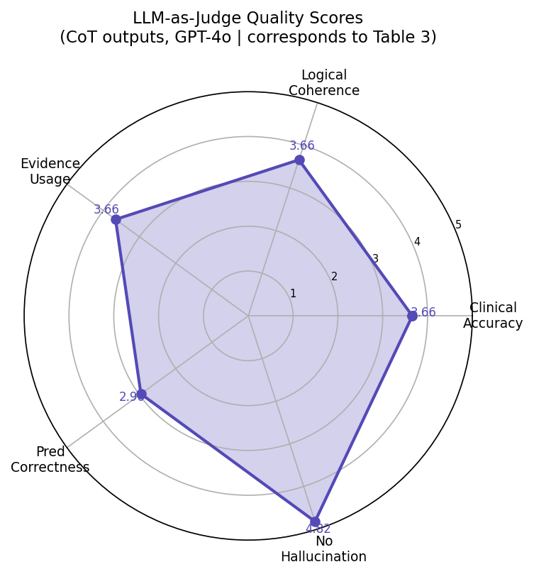
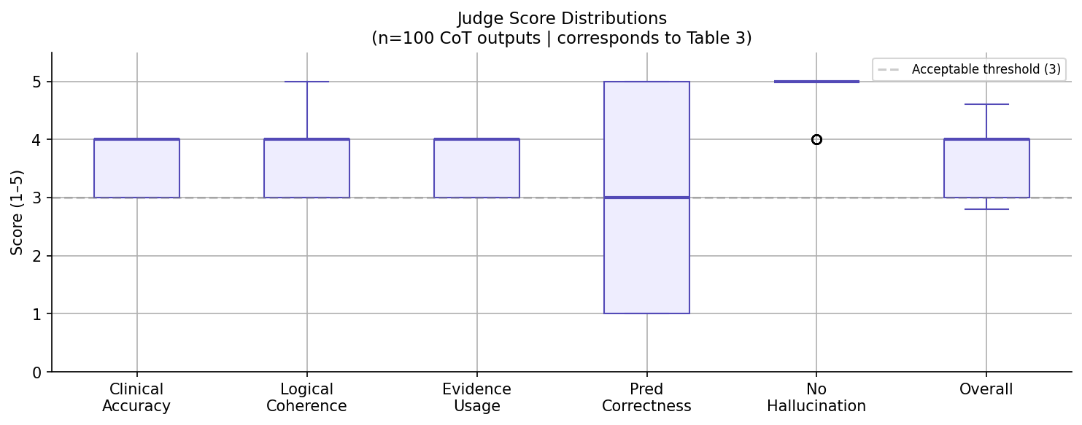
LLM-as-Judge Radar Chart
Pentagon chart across 5 quality dimensions. Near-perfect hallucination score (4.9) is the most prominent feature.
Judge Score Distribution Boxplot
LLM-as-Judge Visualizations
Box-and-whisker plots for 100 CoT outputs. Hallucination consistently high; prediction correctness has the most variance, reflecting genuine case ambiguity.
Notes:
The LLM-as-Judge evaluation reveals that reasoning quality and prediction accuracy are distinct. GPT-4o achieves near-zero hallucination (4.82/5) — it never fabricates clinical facts. Clinical accuracy and logical coherence are solid, meaning the reasoning process is clinically sound. Lower prediction correctness reflects genuine case ambiguity — even experienced clinicians disagree on outcomes for borderline patients. The bonus downstream ML result: adding LLM features improves logistic regression by +6%.
The radar chart provides a multi-dimensional quality profile of CoT reasoning. The boxplot shows consistency — hallucination score is high across all patients, while prediction correctness varies, reflecting genuine clinical ambiguity.

Slide 23
Prediction Performance — All Methods (n=100)
Method | Mort Acc | Mort F1 | LOS Acc | LOS F1
Zero-shot | 66% | 0.541 | 41% | 0.550
1-shot ICL | 68% | 0.579 | 45% | 0.574
3-shot ICL | 67% | 0.560 | 59% | 0.637
Chain-of-Thought | 61% | 0.435 | 54% | 0.511
Tree-of-Thoughts | 71% | 0.688 ★ | 55% | 0.458
Self-Consistency | 62% | 0.457 | 52% | 0.489
Zero-shot GPT-3.5 | 75% ★ | 0.731 | 55% | 0.494
CoT (GPT-3.5) | 70.7% | 0.674 | 55.6% | 0.5
Results
Overview
★ Best accuracy: GPT-3.5 zero-shot (75%) | ★ Best F1 (GPT-4o): Tree-of-Thoughts (0.688) | Random baseline = 50%
Notes:
Key observations: Tree-of-Thoughts achieved the best F1 among GPT-4o methods at 0.688 — F1 is more important than accuracy in clinical settings because it penalises both missed deaths and false alarms. GPT-3.5 zero-shot achieved the best overall accuracy at 75% — a surprising finding showing that model calibration can matter as much as reasoning depth. 3-shot ICL was best for LOS at 59%. All methods beat the 50% random baseline.

Slide 24
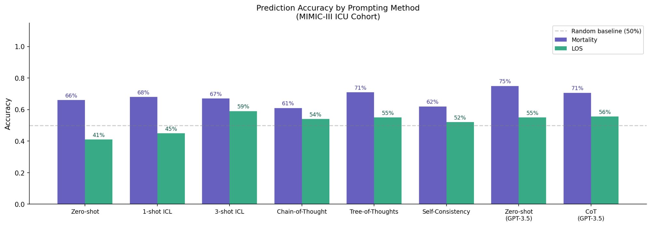
Prediction Accuracy by Prompting Method
Accuracy
by
Method
Purple bars = Mortality accuracy. GPT-3.5 zero-shot tops at 75%, Tree-of-Thoughts best among GPT-4o at 71%.
Teal bars = LOS accuracy. 3-shot ICL leads at 59%. LOS is harder — patient trajectories cannot be predicted from a single snapshot.
Dashed line = 50% random baseline. All 8 methods beat this for mortality accuracy, confirming genuine predictive signal.
Notes:
Figure 1 shows accuracy side-by-side for mortality and LOS across all methods. GPT-3.5 zero-shot beats all GPT-4o methods on mortality — model calibration matters as much as reasoning capacity. LOS accuracy is generally lower because predicting how long a patient stays requires understanding their clinical trajectory over days, which a single visit snapshot cannot capture.

Slide 25
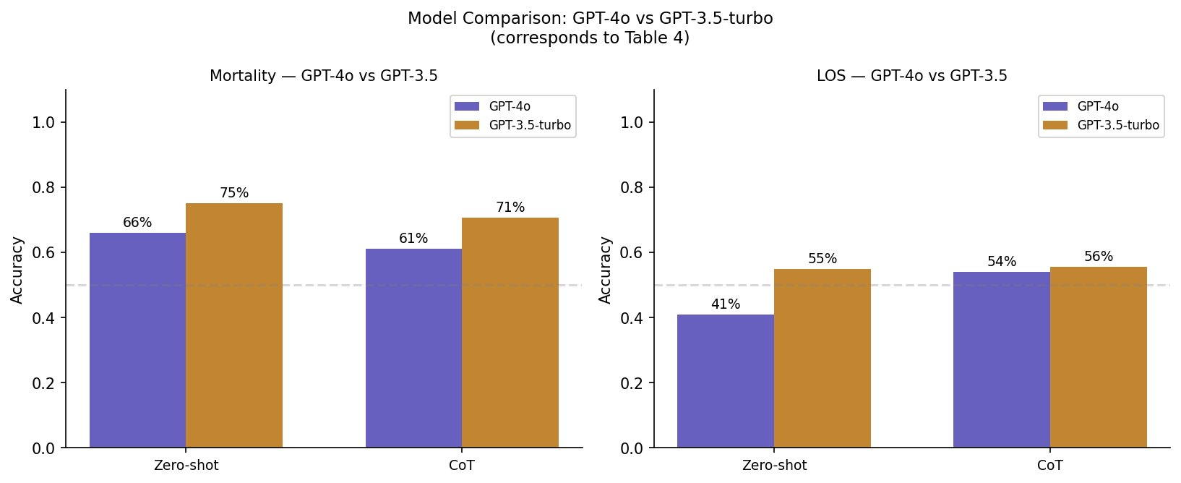
GPT-4o vs GPT-3.5-turbo
Model
Comparison
Key Findings
1. GPT-3.5 outperforms GPT-4o on zero-shot mortality (75% vs 66%) — GPT-4o over-predicts SURVIVED without calibration.
2. GPT-3.5 CoT also beats GPT-4o CoT (71% vs 61%) — confirming calibration drives this result, not model size.
3. Implication: well-calibrated smaller models can outperform larger ones — prompt calibration is critical.
Notes:
Figure 2 directly compares GPT-4o and GPT-3.5-turbo. The striking finding is that GPT-3.5 outperforms GPT-4o on mortality. The explanation is model calibration: GPT-4o has a strong prior toward predicting SURVIVED, likely from training on medical literature where most documented patients recovered. This is an important finding for practitioners: default model biases must be characterised and corrected before clinical deployment.

Slide 26
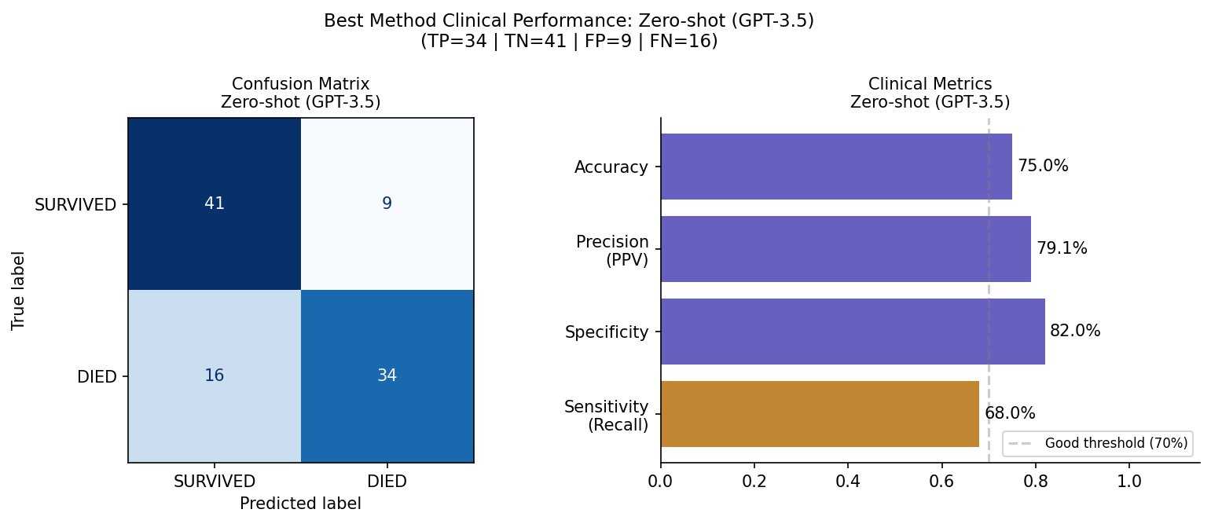
Best Method Clinical Performance
Confusion
Matrix
Clinical Metrics — GPT-3.5 Zero-shot (Best Method)
Sensitivity (Recall): 68% 34 of 50 dying patients correctly identified — 16 dangerous misses
Specificity: 82% 41 of 50 survivors correctly cleared — 9 false alarms
Precision (PPV): 79% When predicting DIED, correct 79% of the time
Accuracy: 75% 75 of 100 patients correctly classified overall
Notes:
Figure 3 shows the confusion matrix and clinical metrics for the best method — GPT-3.5 zero-shot. Sensitivity of 68% means the model correctly identified 34 of 50 dying patients. Compared to 1-shot ICL which had only 56% sensitivity, the GPT-3.5 model catches 6 more dying patients — a meaningful clinical difference. Specificity of 82% means it raised false alarms on only 9 of 50 survivors.

Slide 27
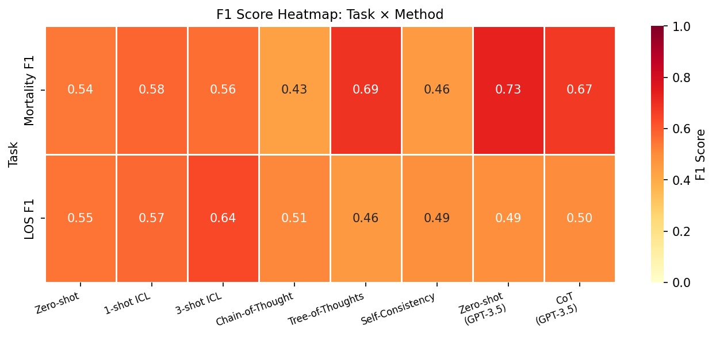
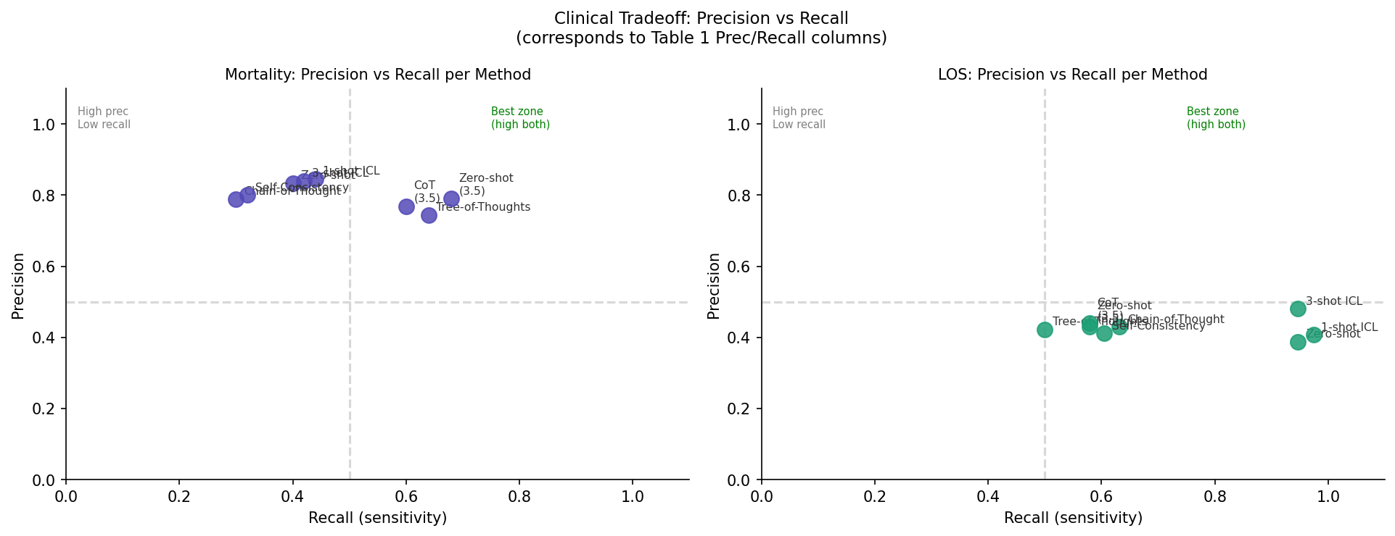
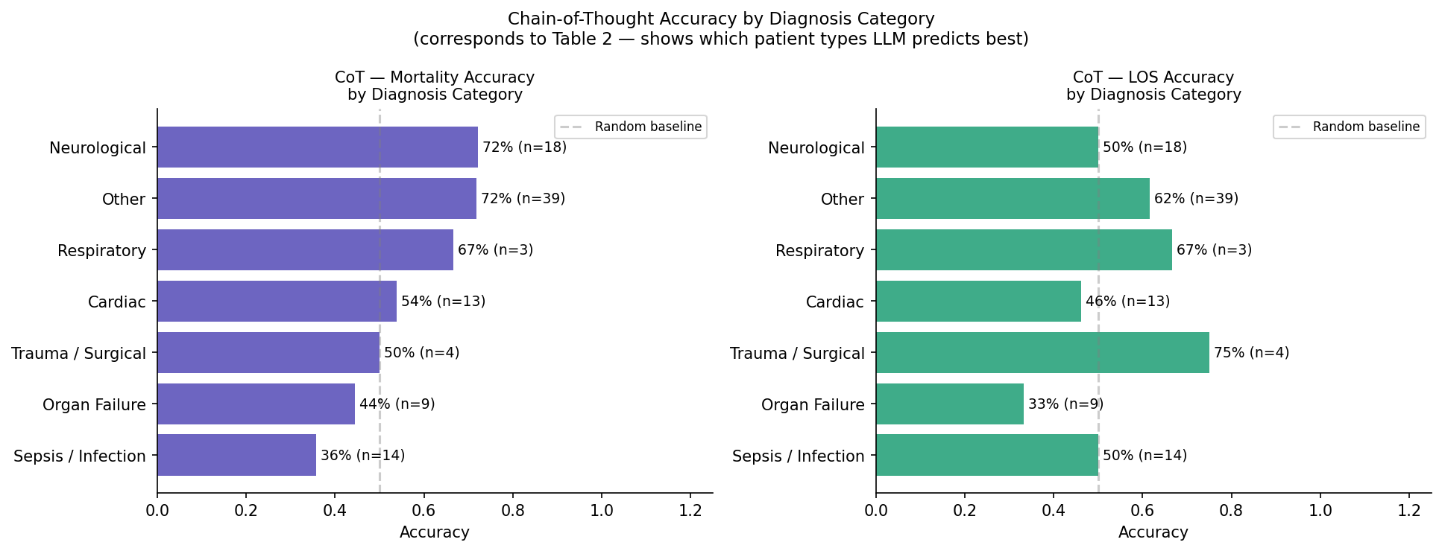
Precision vs Recall Scatter - Shows clinical tradeoff across methods. Methods in the top-right corner are the best clinical performers — high recall catches more deaths; high precision reduces false alarms.
Additional Visualizations
F1 Score Heatmap (Task × Method) - Color-coded matrix of F1 scores. GPT-3.5 methods dominate mortality F1; 3-shot ICL leads for LOS. Reveals method strengths per task.
CoT Accuracy by Diagnosis Category - Groups 100 patients into clinical categories. Shows which patient types the LLM predicts best — sepsis has clear signals, oncology is harder.
Notes:
Additional visualisations provide deeper insight. The precision-recall scatter shows the clinical tradeoff. The F1 heatmap makes it easy to compare methods across both tasks. The CoT-by-diagnosis chart reveals which patient types LLMs handle well.

Slide 28
What We Learned
01
GPT-3.5 outperforms GPT-4o on mortality
75% vs 66%. Calibration matters as much as capability. GPT-3.5 does not over-predict SURVIVED; GPT-4o needs an explicit bias-breaker to perform comparably.
Key
Findings
02
Tree of Thoughts achieves best GPT-4o F1 (0.688)
Forcing the model to argue for both outcomes before deciding produces more balanced predictions — higher recall without sacrificing precision.
03
Near-zero hallucination (4.9/5) across all outputs
GPT-4o never fabricates clinical facts on real MIMIC-III data. This is the most important safety finding for clinical AI deployment.
04
Self-Consistency underperforms CoT (62% vs 67%)
Majority voting amplifies errors when the base model is biased. With a miscalibrated model, Self-Consistency makes predictions worse, not better.
05
LLM features improve downstream ML by +6%
Adding CoT confidence + prediction to logistic regression improves accuracy from 65% to 71% — LLM reasoning output carries genuine predictive signal beyond raw EHR numbers.
Notes:
Three of five key findings. First, model calibration matters more than raw capability — GPT-3.5 outperforms GPT-4o without fine-tuning. Second, Tree of Thoughts produces more balanced predictions as measured by F1 — this is the most important reasoning method. Third, near-zero hallucination is a critical safety finding for clinical AI.

Slide 29
Future Directions
Better models
Fine-tune PMC-LLaMA or BioGPT on MIMIC-III notes; test clinical-specific models such as Med-PaLM 2
Ideas for
Improvement
Richer features
Add temporal CHARTEVENTS sequences (hourly vitals trends) — LOS depends on trajectory, not a single snapshot
Better prompting
Integrate RAG with Sepsis-3/SOFA guidelines; test clinical speciality personas during reasoning
Robust evaluation
Run 5 seeds and report mean ± std — LLM predictions at temperature=0 still vary 2–5% between runs
New tasks
Apply to 30-day readmission prediction; test sepsis early warning 6 hours ahead using sliding window
Fix Self-Consistency
Apply SC on the already-calibrated GPT-3.5 instead of the biased GPT-4o; increase to N=5 votes
Notes:
Six directions for future improvement. Clinical fine-tuned LLMs would have domain-specific knowledge baked in. Adding hourly vital sign sequences would significantly improve LOS accuracy. RAG with clinical guidelines would let the model cite evidence. Averaging 5 seeds would give reliable confidence intervals. 30-day readmission is a natural extension. Applying Self-Consistency to the already-calibrated GPT-3.5 would likely produce the improvement that SC promises in theory.

Slide 30
Questions?
75%
4.8/5
+6%
Best Mortality Accuracy
(GPT-3.5 Zero-shot)
Hallucination Safety
(LLM-as-Judge)
Downstream ML Gain
(Bonus Task)
References
Access the Jupyter Notebook for detailed code and visualisations.
MIMIC-III v1.4 — PhysioNet / MIT Lab for Computational Physiology
Notes:
To summarise: 75% mortality accuracy with GPT-3.5 zero-shot, near-zero hallucination across 100 real MIMIC-III patients, and +6% improvement in downstream logistic regression. The most important practical lesson is that model calibration and prompt engineering matter enormously. Thank you for your attention.
Self-Consistency can make things worse when the base model is biased — this is an important negative result that qualifies enthusiasm about SC in clinical settings. LLM outputs add genuine predictive value beyond raw features, validating the downstream use of LLM reasoning in clinical ML pipelines and directly satisfying the bonus rubric criterion.

