Slide 1
CS229 Python & Numpy
Jingbo Yang, Andrey Kurenkov

Slide 2
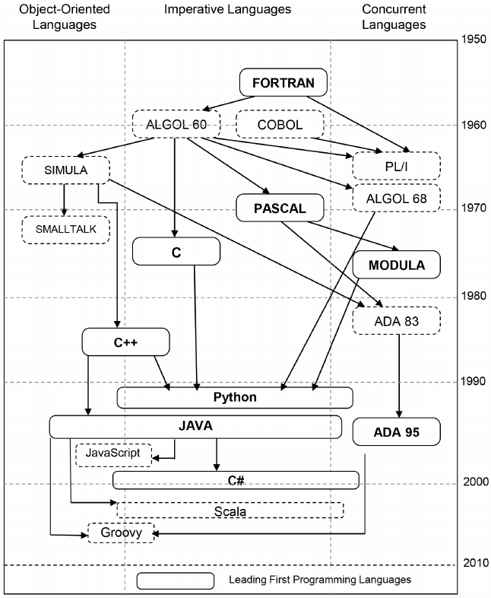
How is python related to with others?
Python 2.0 released in 2000
(Python 2.7 “end-of-life” in 2020)
Python 3.0 released in 2008
(Python 3.6 for CS 229)
Can run interpreted, like MATLAB
https://www.researchgate.net/figure/Genealogy-of-Programming-Languages-doi101371-journalpone0088941g001_fig1_260447599
Notes:
Show Python on command line

Slide 3
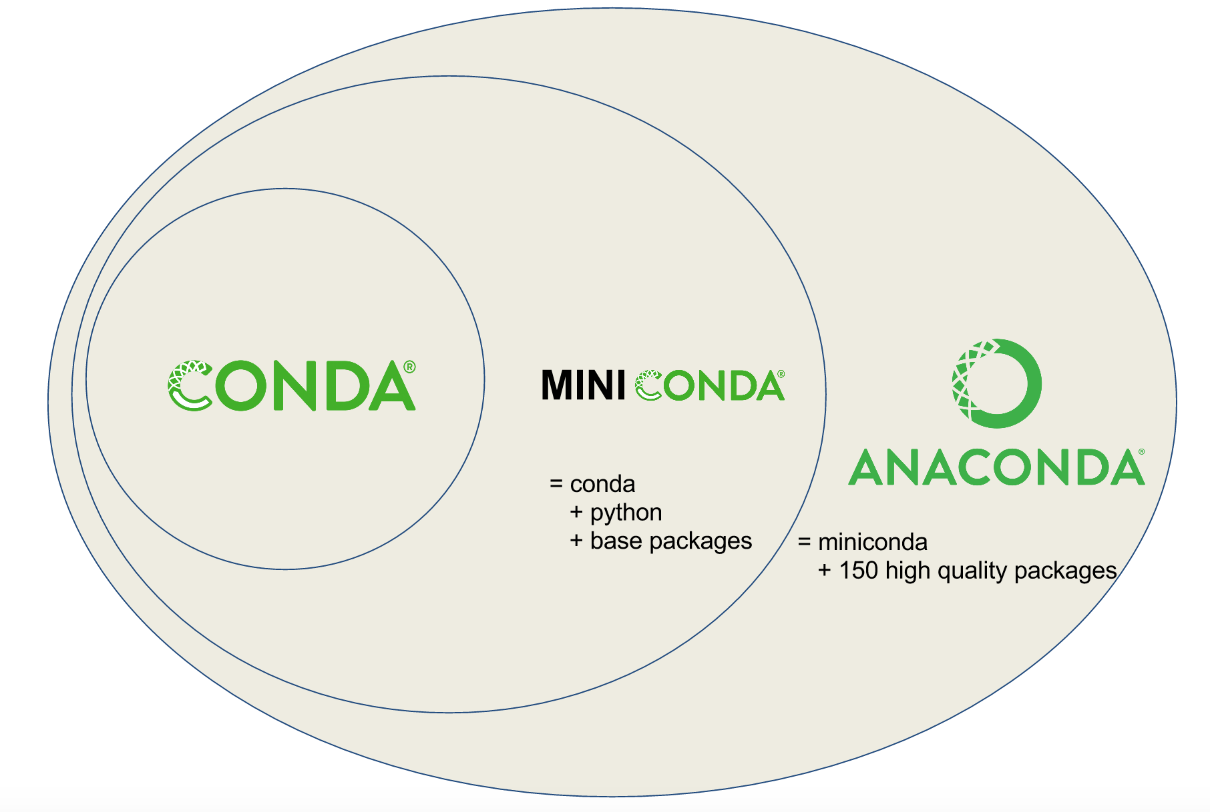
Before you start
Use Anaconda
Create an environment (full Conda)
conda create -n cs229
Create an environment (Miniconda)
conda env create -f environment.yml
Activate an environment
conda activate cs229
Notes:
Download from Anaconda then should have latest Python

Slide 4





Notepad is not your friend …
Get a text editor/IDE
PyCharm (IDE)
Visual Studio Code (IDE??)
Sublime Text (IDE??)
Notepad ++/gedit
Vim (for Linux)
Notes:
We also have instruction on Pycharm

Slide 5
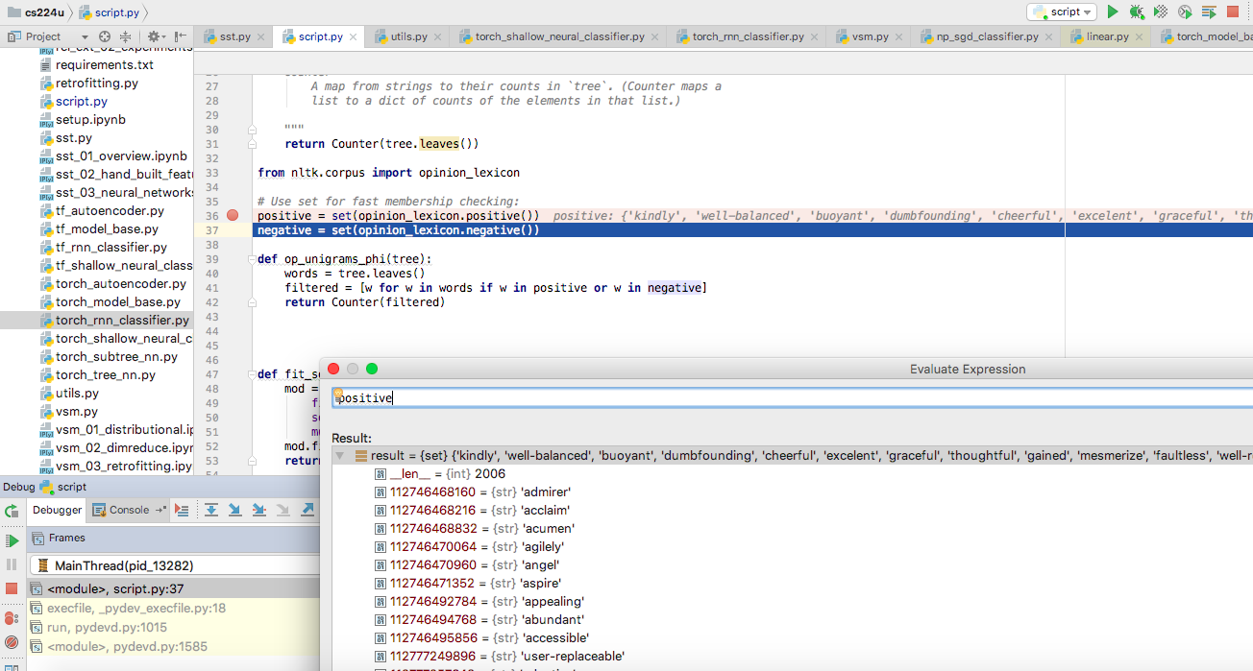
To make you more prepared
PyCharm magic:
FYI, professional version free for students: https://www.jetbrains.com/student/
Notes:
We also have instruction on Pycharm

Slide 6
Basic Python

Slide 7
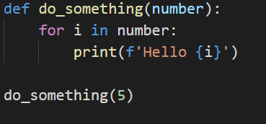
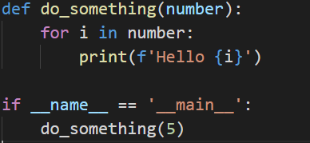
Where does my program start?
It just works
Properly
A function

Slide 8
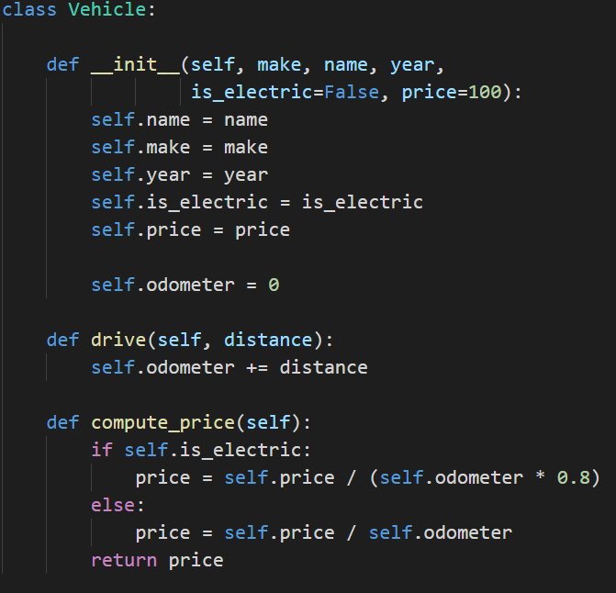
What is a class?
Initialize the class to get an instance using some parameters
Instance variable
Does something with the instance

Slide 9
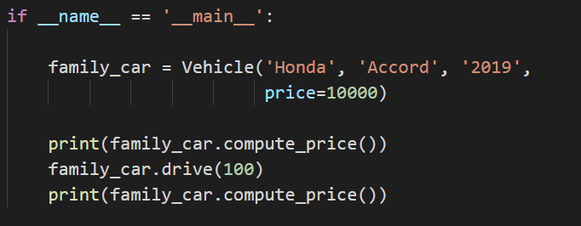
To use a class
Instantiate a class,
get an instance
Call an instance method

Slide 10
HW1 with random classifier

Slide 11
Data Structures

Slide 12
Basic data structures
List
example_list = [1, 2, '3', 'four’]
Set (unordered, unique)
example_set = set([1, 2, '3', 'four’])
Dictionary (mapping)
example_dictionary =
{
'1': 'one',
'2': 'two',
'3': 'three'
}

Slide 13
More on List
2D list
list_of_list = [[1,2,3], [4,5,6], [7,8,9]]
List comprehension
initialize_a_list = [i for i in range(9)]
initialize_a_list = [i ** 2 for i in range(9)]
initialize_2d_list = [[i + j for i in range(5)] for j in range(9)]
Insert/Pop
my_list.insert(0, ‘stuff)
print(my_list.pop(0))

Slide 14
More on List
Sort a list
random_list = [3,12,5,6]
sorted_list = sorted(random_list)
random_list = [(3, ‘A’),(12, ’D’),(5, ‘M’),(6, ‘B’)]
sorted_list = sorted(random_list, key=lambda x: x[1])

Slide 15
More on Dict/Set
Comprehension
my_dict = {i: i ** 2 for i in range(10)}
my_set = {i ** 2 for i in range(10)}
Get dictionary keys
my_dict.keys()

Slide 16
Numpy & Scipy

Slide 17
What is Numpy? What is Scipy?
Numpy – package for vector and matrix manipulation
Scipy – package for scientific and technical computing
How do “those guys” make things run faster?
Read on AVX instruction set (SIMD) and structure of x86 and RISC
Read on OpenMP and CUDA for multiprocessing
Read on assembly-level optimization, memory stride, caching, etc.
Or even about memory management, virtualization
More bare metal FPGA, TPU

Slide 18
Some numpy usage

Slide 19
Popular usage, read before use!
Python Command | Description
scipy.linalg.inv | Inverse of matrix (numpy as equivalent)
scipy.linalg.eig | Get eigen value (Read documentation on eigh and numpy equivalent)
scipy.spatial.distance | Compute pairwise distance
np.matmul | Matrix multiply
np.zeros | Create a matrix filled with zeros (Read on np.ones)
np.arange | Start, stop, step size (Read on np.linspace)
np.identity | Create an identity matrix
np.vstack | Vertically stack 2 arrays (Read on np.hstack)

Slide 20
Your friend for debugging
Python Command | Description
array.shape | Get shape of numpy array
array.dtype | Check data type of array (for precision, for weird behavior)
type(stuff) | Get type of a variable
import pdb; pdb.set_trace() | Set a breakpoint (https://docs.python.org/3/library/pdb.html)
print(f’My name is {name}’) | Easy way to construct a message

Slide 21
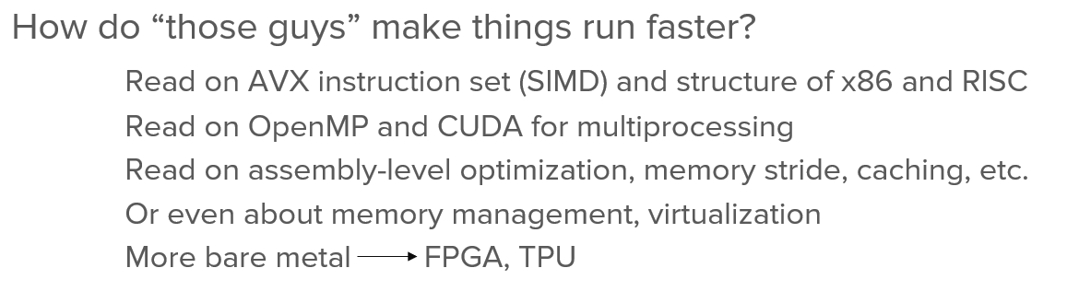
So many things to remember
Why can’t I just write loops?
Remember all the fancy low-level stuff?

Slide 22
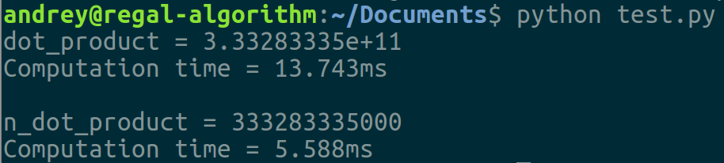
Power of vectorization
a = [i for i in range(10000)];
b = [i for i in range(10000)];
tic = time.clock()
dot = 0.0;
for i in range(len(a)):
dot += a[i] * b[i]
toc = time.clock()
print("dot_product = "+ str(dot));
print("Computation time = " + str(1000*(toc - tic )) + "ms")
n_tic = time.clock()
n_dot_product = np.array(a).dot(np.array(b))
n_toc = time.clock()
print("\nn_dot_product = "+str(n_dot_product))
print("Computation time = "+str(1000*(n_toc - n_tic ))+"ms")

Slide 23
Plotting

Slide 24



Matplotlib is your friend
Scatter plot
Line plot
Duo y-axis
Log-log
Bar plot (Histogram)
3D plot
Jupyter Notebook is another friend
And if you want to get fancy:

Slide 25
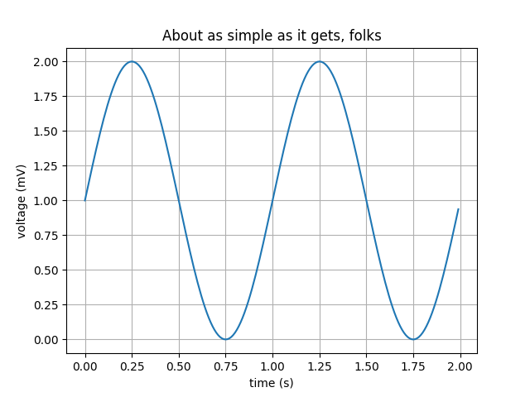
Example plots
https://matplotlib.org/3.1.1/gallery/index.html
Import
import matplotlib
import matplotlib.pyplot as plt
import numpy as np
# Data for plotting
t = np.arange(0.0, 2.0, 0.01)
s = 1 + np.sin(2 * np.pi * t)
fig, ax = plt.subplots()
ax.plot(t, s)
ax.set(xlabel='time (s)', ylabel='voltage (mV)',
title='About as simple as it gets, folks')
ax.grid()
fig.savefig("test.png")
plt.show()
Create data
Plotting
Format plot
Save/show

Slide 26
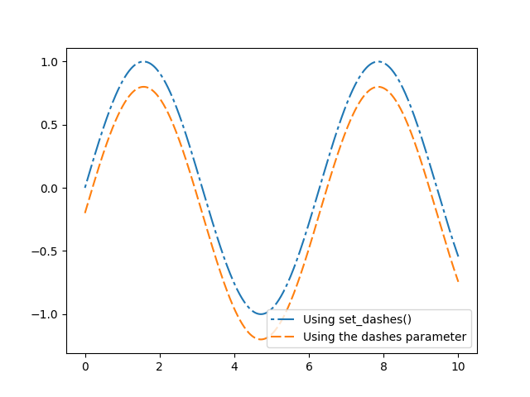
Plot with dash lines and legend
https://matplotlib.org/3.1.1/gallery/index.html
import numpy as np
import matplotlib.pyplot as plt
x = np.linspace(0, 10, 500)
y = np.sin(x)
fig, ax = plt.subplots()
line1, = ax.plot(x, y, label='Using set_dashes()')
line1.set_dashes([2, 2, 10, 2]) # 2pt line, 2pt break, 10pt line, 2pt break
line2, = ax.plot(x, y - 0.2, dashes=[6, 2], label='Using the dashes parameter')
ax.legend()
plt.show()

Slide 27
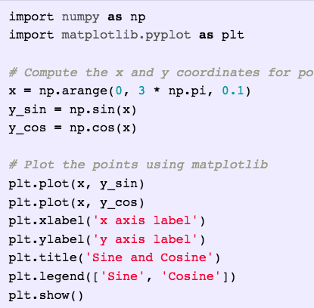
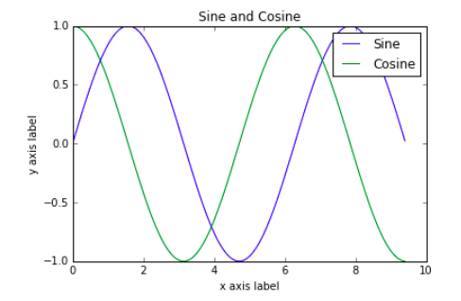
Another way for legend

Slide 28
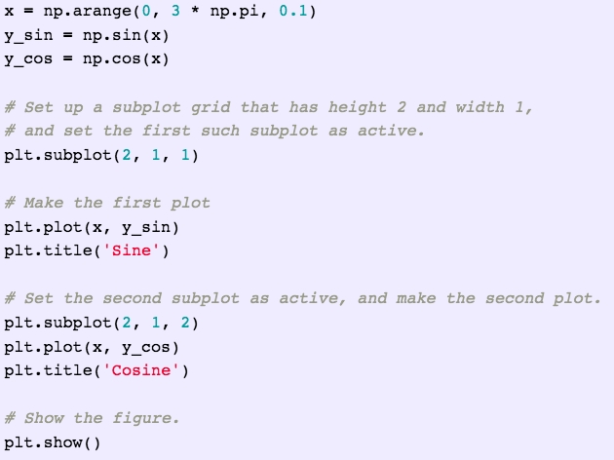
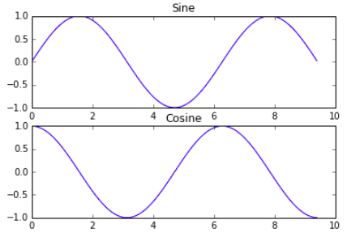
Using subplot

Slide 29
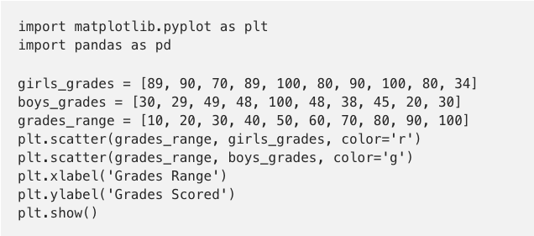
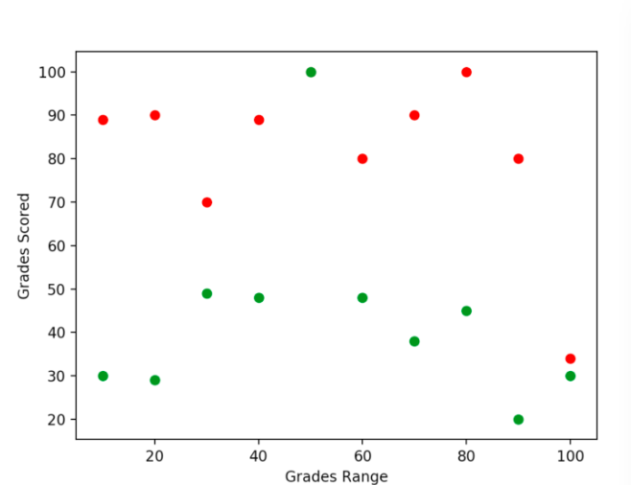
Scatter plot

Slide 30
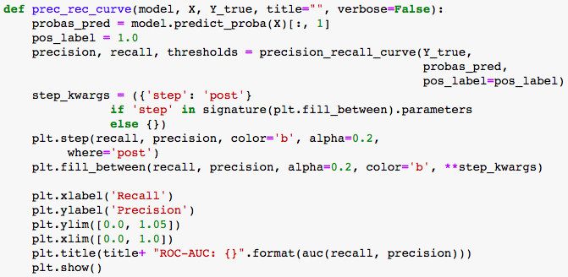
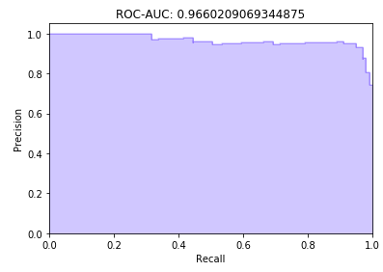
Plot area under curve

Slide 31
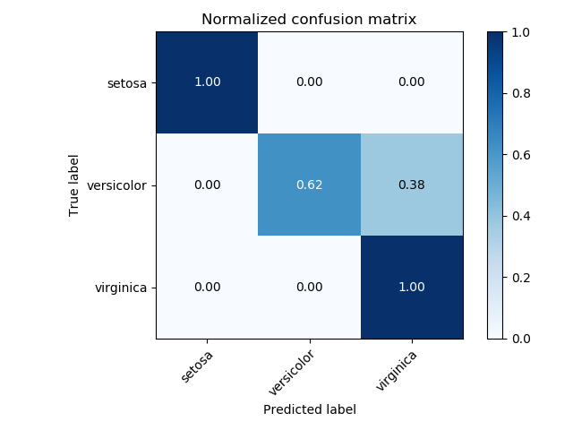
Confusion matrix
https://scikit-learn.org/stable/auto_examples/model_selection/plot_confusion_matrix.html
fig, ax = plt.subplots()
im = ax.imshow(cm, interpolation='nearest', cmap=cmap)
ax.figure.colorbar(im, ax=ax)
# We want to show all ticks...
ax.set(xticks=np.arange(cm.shape[1]),
yticks=np.arange(cm.shape[0]),
xticklabels=classes, yticklabels=classes,
title=title, ylabel='True label', xlabel='Predicted label')
# Rotate the tick labels and set their alignment.
plt.setp(ax.get_xticklabels(), rotation=45, ha="right", rotation_mode="anchor")
# Loop over data dimensions and create text annotations.
fmt = '.2f' if normalize else 'd'
thresh = cm.max() / 2.
for i in range(cm.shape[0]):
for j in range(cm.shape[1]):
ax.text(j, i, format(cm[i, j], fmt),
ha="center", va="center",
color="white" if cm[i, j] > thresh else "black")
fig.tight_layout()

Slide 32
Numpy & Scipy

Slide 33
What is Numpy? What is Scipy?
Numpy – package for vector and matrix manipulation
Scipy – package for scientific and technical computing
How do “those guys” make things run faster?
Read on AVX instruction set (SIMD) and structure of x86 and RISC
Read on OpenMP and CUDA for multiprocessing
Read on assembly-level optimization, memory stride, caching, etc.
Or even about memory management, virtualization
More bare metal FPGA, TPU

Slide 34
Power of vectorization
a = [i for i in range(10000)];
b = [i for i in range(10000)];
tic = time.clock()
dot = 0.0;
for i in range(len(a)):
dot += a[i] * b[i]
toc = time.clock()
print("dot_product = "+ str(dot));
print("Computation time = " + str(1000*(toc - tic )) + "ms")
n_tic = time.clock()
n_dot_product = np.array(a).dot(np.array(b))
n_toc = time.clock()
print("\nn_dot_product = "+str(n_dot_product))
print("Computation time = "+str(1000*(n_toc - n_tic ))+"ms")

Slide 35
Popular usage, read before use!
Python Command | Description
scipy.linalg.inv | Inverse of matrix (numpy as equivalent)
scipy.linalg.eig | Get eigen value (Read documentation on eigh and numpy equivalent)
scipy.spatial.distance | Compute pairwise distance
np.matmul | Matrix multiply
np.zeros | Create a matrix filled with zeros (Read on np.ones)
np.arange | Start, stop, step size (Read on np.linspace)
np.identity | Create an identity matrix
np.vstack | Vertically stack 2 arrays (Read on np.hstack)

Slide 36
Your friend for debugging
Python Command | Description
array.shape | Get shape of numpy array
array.dtype | Check data type of array (for precision, for weird behavior)
type(stuff) | Get type of a variable
import pdb; pdb.set_trace() | Set a breakpoint (https://docs.python.org/3/library/pdb.html)
print(f’My name is {name}’) | Easy way to construct a message

Slide 37
Links
CS 231N Python Tutorial

Slide 38
Good luck on your HW/Project! Questions?

