Slide 1

Self-Supervised Learning for
Speech Recognition using wav2vec 2.0
Presenters:
Sri Teja Muthangi (W862g253)
Kavya Sri Modepu (N572v597)
Wichita state University, Wichita, USA.

Slide 2
Presentation Outline
Introduction
Objectives
Related work
Methodology
Results
Conclusions
Our Proposed Work
References

Slide 3
Introduction
Automatic Speech Recognition (ASR) converts spoken audio into text.
Traditional ASR models depend on thousands of hours of labeled speech.
Labeling speech is expensive and time-consuming.
Self-supervised learning (SSL) uses unlabeled data to learn audio representations.
wav2vec 2.0 by Facebook AI (2020) applies SSL directly on raw waveforms to learn powerful speech features.

Slide 4
Objectives
Learn contextualized speech representations from raw waveforms.
Fine-tune with small labeled subsets to reach state-of-the-art performance.
Demonstrate results better than fully supervised baselines.
Show that pretraining on unlabeled audio improves recognition accuracy.

Slide 5
Related Work
wav2vec (2019): CNN encoder trained with contrastive loss.
vq-wav2vec (2020): Introduced quantization to learn discrete units.
Contrastive Predictive Coding (CPC): Predicted future representations from past context.
wav2vec 2.0 unified these ideas with transformers and masking like BERT.

Slide 6
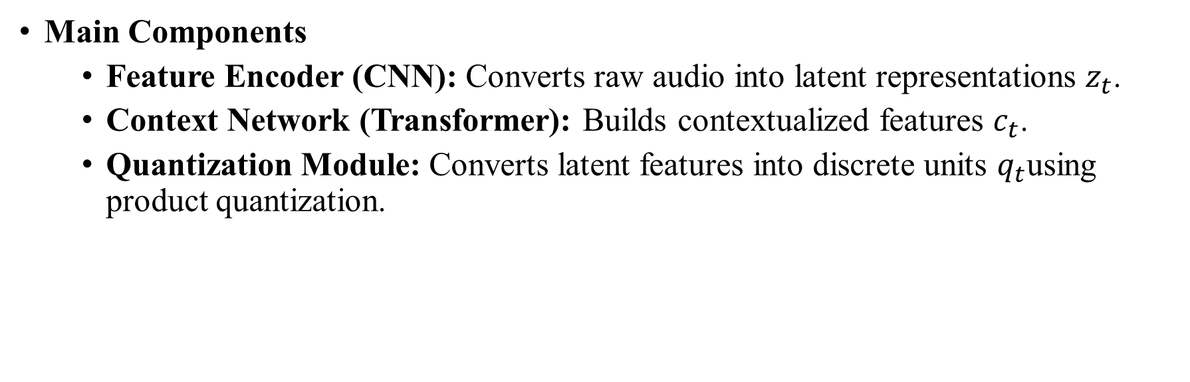
Methodology
Main Components
  Feature Encoder (CNN): Converts raw audio into latent representations $z_{t}$.
  Context Network (Transformer): Builds contextualized features $c_{t}$.
  Quantization Module: Converts latent features into discrete units $q_{t}$using product quantization.
Notes:
Face detection(AdaBoost classifier) and extraction of facial landmarks(68) were done using the face-alignment method available in PyTorch package.

Slide 7
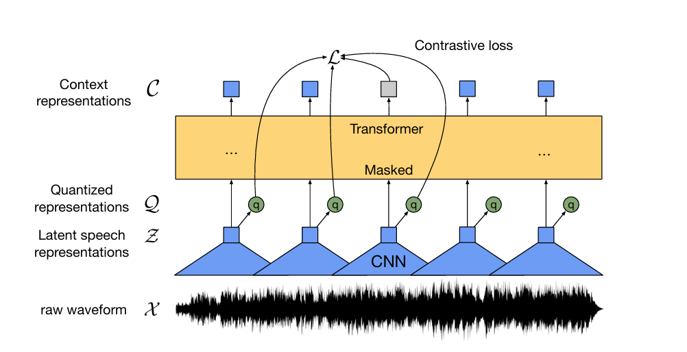
Methodology
Illustration of framework which jointly learns contextualized speech representations and an inventory of discretized speech units.

Slide 8
Methodology
Training Strategy
  Masking: Random segments of latent features are masked.
  Contrastive Learning: Model predicts correct quantized units among negatives.
  Loss Function:
    Contrastive loss - encourages accurate prediction.
    Diversity loss - ensures codebook usage.
  Fine-Tuning:
    Added linear layer + CTC loss for transcription.
    Used small labeled datasets.

Slide 9
Methodology
Type | Dataset | Hours | Purpose
Unlabeled | LibriSpeech | 960h | Pretraining
Unlabeled | LibriVox | 60,000h | Large-scale SSL
Labeled | LibriSpeech subsets | 10m / 1h / 10h / 100h / 960h | Fine-tuning
Model Variants
Base: 12 transformer layers (~95M params)
Large: 24 layers (~317M params)
Evaluation Metric
Word Error Rate (WER) = (Substitutions + Deletions + Insertions) / Total words
Lower WER means better transcription accuracy.

Slide 10
Results
Training Data | Test-Clean (wer %) | Test-Other(wer %)
10 min labeled | 4.8 % | 8.2 %
1 h labeled | 2.9 % | 5.8 %
960 h labeled | 1.8 % | 3.3 %

Slide 11
Conclusions
Even with 10 min of labeled data, wav2vec 2.0 performs close to fully supervised systems.
Larger unlabeled datasets improve downstream results.
Fine-tuning is lightweight and efficient.

Slide 12
Our Proposed Work
Title: State-of-the-Art Speech Recognition Model Comparison
Goal
Extend wav2vec 2.0 work by comparing it with other leading ASR models.
Focus on performance across accuracy, speed, and memory

Slide 13
Models Compared
Model | Type | Key Feature
wav2vec2-base-100h | SSL | Fast, small pretrained model
wav2vec2-base-960h | SSL | Baseline for comparison
whisper-small | SSL | Multilingual encoder-decoder
xlsr-english | SSL | xlsr-53 fine-tuned for English

Slide 14
Datasets and Metrics
Datasets
CommonVoice 2 (from kaggle)
LJSpeech (from kaggle)
Metrics
Word Error Rate (WER)
Character Error Rate (CER)
Processing time
Memory usage

Slide 15
Expected Outcome
Identify which model offers the best balance between accuracy and efficiency
Validate wav2vec 2.0 as an effective self-supervised baseline for speech recognition

Slide 16
From wav2vec 2.0 -> Our Proposed Work
Base Paper (wav2vec 2.0) | Our Proposed Extension
Focused on English-only (LibriSpeech) | Includes multiple datasets - CommonVoice2, LJSpeech
Studied self-supervised pretraining | Performs state-of-the-art model comparison
Evaluated only wav2vec 2.0 | Compares wav2vec2-base, Whisper-small, XLSR-53
Metric: Word Error Rate (WER) | Metrics: WER, CER, speed, memory usage
Aimed at learning from unlabeled data | Aims to analyze cross-model performance
Required large GPU training | Runs on optimized CPU setup for evaluation

Slide 17
References
Baevski et al. (2020) – wav2vec 2.0: A Framework for Self-Supervised Learning of Speech Representations.
Radford et al. (2023) – Whisper: Robust Speech Recognition via Large-Scale Pretraining.
Schneider et al. (2019) – wav2vec: Unsupervised Pre-Training for Speech Recognition.
Devlin et al. (2018) – BERT: Pre-Training of Deep Bidirectional Transformers.
Park et al. (2019) – SpecAugment: A Simple Data Augmentation Method for Speech Recognition.

Slide 18

Thank You

