Slide 1
Unix Operating System
Unix is considered one of the greatest achievements in computer science
Designed by programmers for programmers
Unix is a true multi-user operating system
The primary user interface with Unix is through a command line interface (terminal console)
It has several GUI interfaces available, all built on X-windows
Integrated networking capabilities
Attributes: stability, portability, security

Slide 2
Lineage
Unix was conceived at AT&T Bell Labs by Dennis Ritchie and Ken Thompson in the late 60’s
The C language was developed shortly thereafter to support Unix
AT&T made Unix available to universities in mid-70’s
UC Berkeley created a new variant that included networking in the late 70’s, known as BSD
In early 80’s Sun became the dominant commercial force behind Unix
In 80’s the GNU free software movement begins
In early 90’s Linux was developed as a Unix look-a-like and several BSD based systems appeared

Slide 3
Unix / Linux
Commanlities
  Linux is Unix clone
  POSIX compliant
Differences
  Source code
  Linux kernel + GNU utilities, management tools, compilers, editors, applications (openOffice, FireFox) – all from different source
  Open source/Propriety
  Installation (flexibility and cost)
  Command Line and GUI interfaces
  Distributions
- Linux: Ubuntu, Redhat, Suse,Debian, Fedora
- Unix: BSD (MacOS), HP-UX, IRIX, IBM-AIX, SUN-Solaris

Slide 4
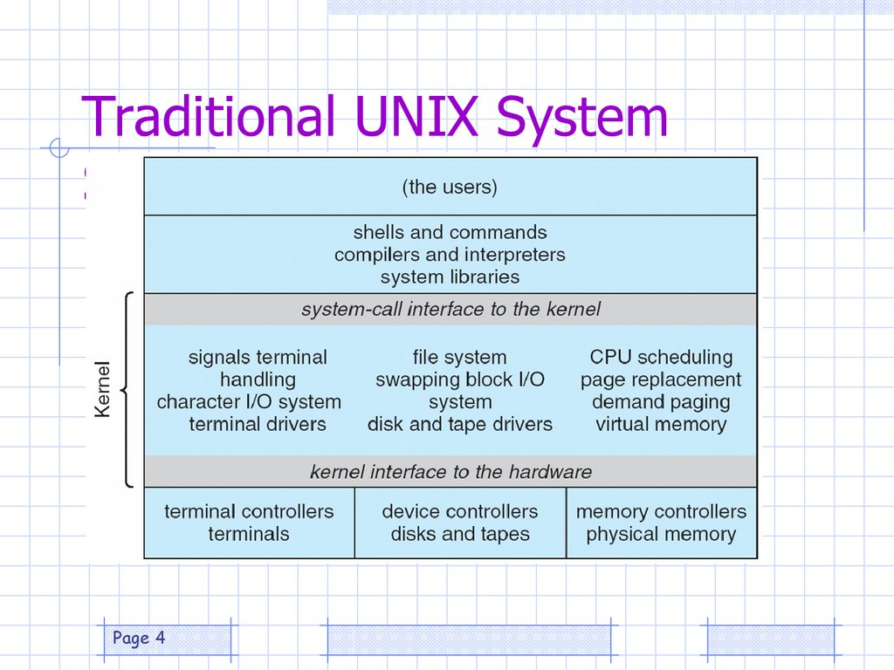
Elements of Unix
Processes GUI Networks FileSystem shells

Slide 5
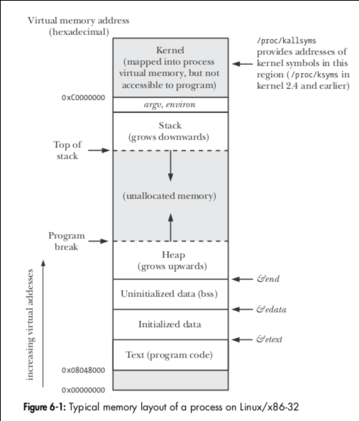
Processes
A process is a “unit” of executable code
Everything that runs in a Unix system occurs within the context of a process
Each process created is assigned a unique id
Only one process/CPU can be executing at any time, each process receives “fair” access to the CPU
Switching between processes is a context change

Slide 6
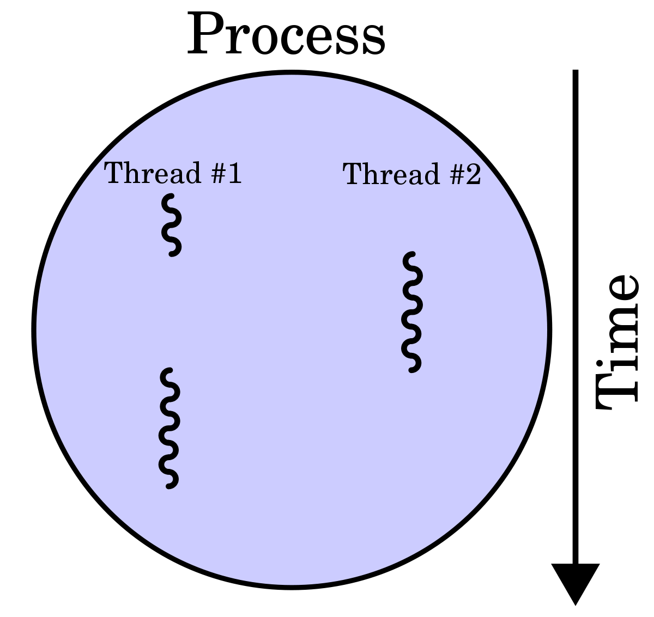
Processes - Threads
A thread is also called a light-weight process, a thread executes within the context of its parent process
A thread is one of many execution streams sharing the same address space of a process
Switching between threads does not require a context change
Using threads requires careful programming
In Linux each thread uses an entry in the process table but they are not full fledged processes

Slide 7
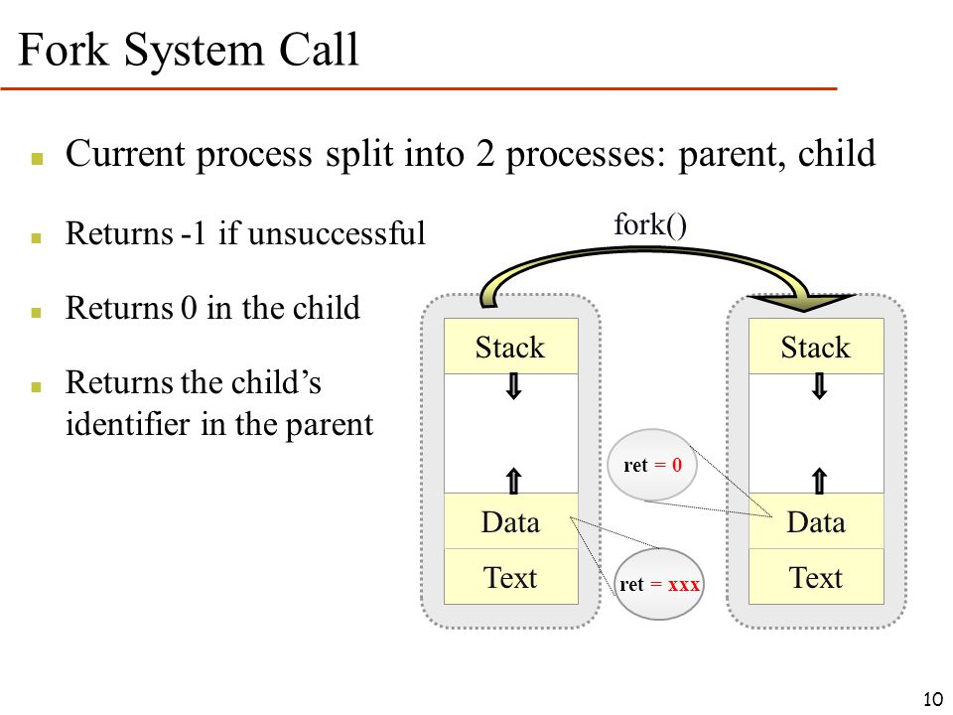
Processes - Programming

Slide 8
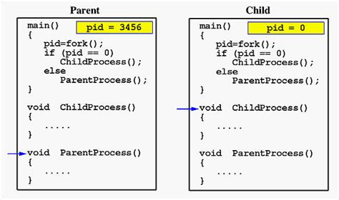
Processes - Programming
fork system call
  Creates a new process
  The child process is a copy of the calling parent process
    The parent process returns from the fork call with the process ID of its child process
    The child process begins life as a return from the same fork call with a process ID of zero
  The parent and child are now scheduled independently

Slide 9
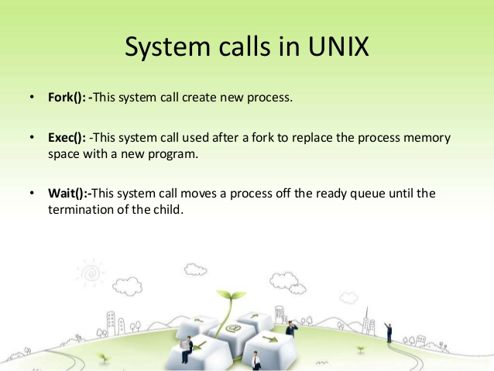
Processes - Programming

Slide 10
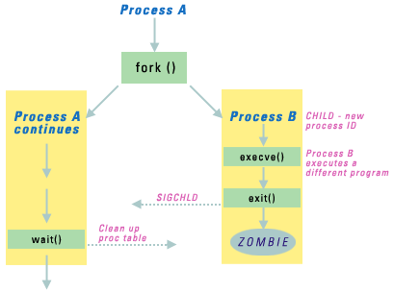
Processes - Programming
exec system call
Overlays the calling program with a new program and starts execution of the new program
The calling program does not return from this call unless there is an error
This all occurs within a single process

Slide 11
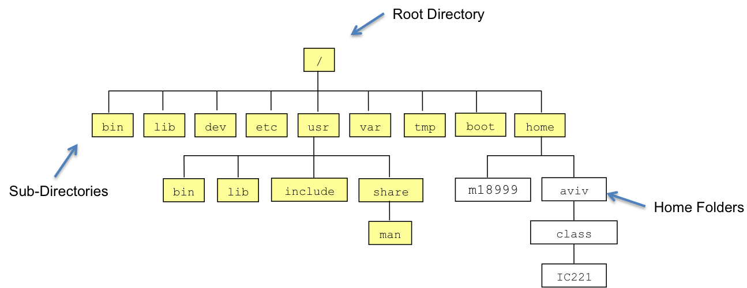
File System
Basic purpose is to impose a file structure on the computer disks
The computer’s I/O system is mapped to the file system
The file system has a hierarchical organization starting at the root directory ‘/’

Slide 12
File System - File Types
Regular
  This is the normal file type: text, binary, programs, …
Directory
  Contains the name of other files of any type
  ‘.’ and ‘..’ are always present, current and parent directories
Special
  Connected to devices, printers, terminals, etc
  Normally located in /dev
Symbolic links
  Provides an alias for an existing file
Named pipes and sockets
  Implement pipes and network connections

Slide 13
File Systems - Pathnames
In Unix case is significant (in Windows case is retained but insignificant: abc == Abc)
Filenames can contain almost any character but some, such as space, require quoting - avoid doing this
A file is associated with a unique file pathname
A pathname is either absolute or relative to the current working directory
  absolute path: /dir1/dir2/dir3/filename
  relative path: ../dir2/dir3/filename

Slide 14
File Systems - Protection
The basic Unix protection system consists of
  File ownership, user and group
  File access permissions by user, group, and other
The ownership of a file is set when it is created, many systems do not allow a user to change it
The access permissions are set at creation to a default and can be changed at any time
Assess permissions are frequently presented as a 3 digit octal number
  First octal digit is owner access
  Second octal digit is group access
  Third octal digit is other access

Slide 15
File Systems - Protection
Each bit of the octal digit represents, from left to right,
  read access
  write access
  execute access
Examples
  711 => rwx--x--x
  644 => rw-r--r--
  755 => rwxr-xr-x
  700 => rwx------
Use chmod command to change permissions
Use ls -l command to view permissions

Slide 16
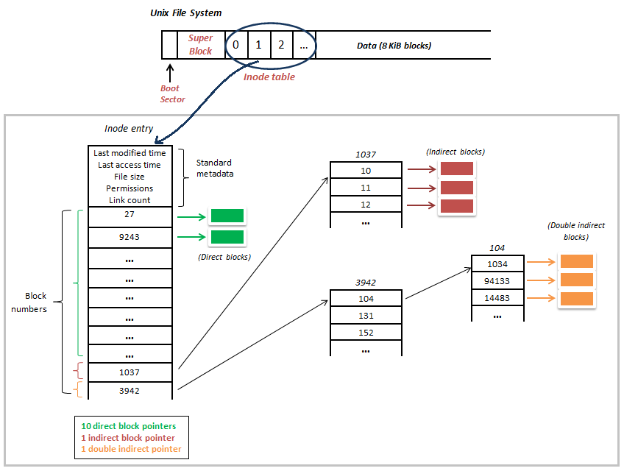
File Systems - Types
treat the disk (partition) as a series of blocks (4K) that are allocated to files as needed
specific file related data is kept on the disk in an i-node
the directory entry maps a path name to an i-node
multiple directory entries can map to a single i-node (hard link)
Linux is able to access several types of foreign file systems, the native types are ext2 and ext3

Slide 17
File Systems - Mount
File systems are “mounted” at an existing directory on the current tree, if there are any files in that directory they are inaccessible until the file system is un-mounted
Both local and remote file systems can be mounted in the same way, this makes access to networked file systems transparent
Network support for file system:- NFS, SMB,AppleShare, and Novell
Unix can serve as both a server and client for network file system access

Slide 18
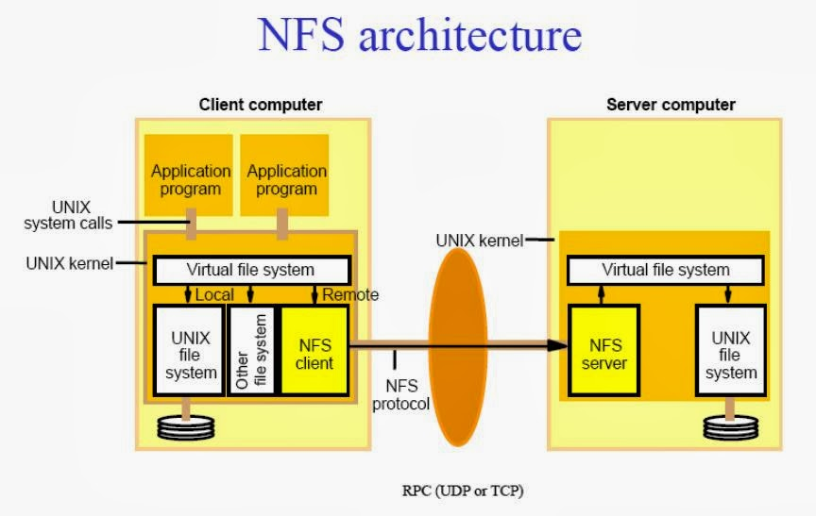
File Systems - Mount

Slide 19
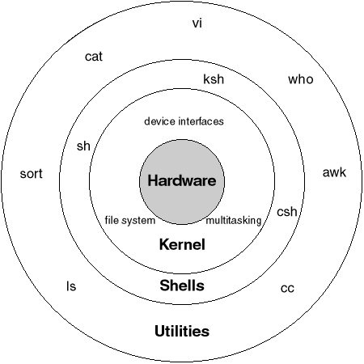
Shells
Using a shell is still the primary means of interacting with a Unix system
At login a process is started running the shell program and attached to your “terminal”
most common available shells are-
  sh - Bourne shell
  csh - C shell
  ksh - Korn shell
  bash - Bourne Again shell
A shell is a program that provides an environment for entering commands

Slide 20
Shells - Variables
The shell maintains a set of user accessible and settable variables
Local variables
  Used only by the shell, most frequently in scripts
  Usually lower case
  Set value
    var = “value” (sh,ksh,bash)
    set var = “value” (csh)
  Access value
    echo $var
    echo ${var}

Slide 21
Shells - Variables
Environment variables
  Maintained and used by the shell but are also passed to any child processes created
  Child process cannot affect the parents environment variables
  Usually upper case
  Set value
    VAR = “value” ; export VAR (sh,ksh,bash)
    export VAR = “value” (ksh,bash)
    setenv var “value” (csh)
  Access value
    echo $var
    echo ${var}

Slide 22
Shells - Environment Variables
Common environment variables
  PATH - Used to set the list of directories to search when a program is executed
    export PATH=$PATH:/usr/local/bin
      add /usr/local/bin to the search path
    export PATH=/usr/bin:/usr/local/bin
      set path to only /usr/bin and /usr/local/bin
  HOME - Set to your home directory path
  LD_LIBRARY_PATH - Used by Linux and Solaris to list directories to search for shared libraries

Slide 23
Shells - I/O Control
Every shell has 3 open file descriptors
  0 - stdin standard input
  1 - stdout standard output
  2 - stderr standard error
The shell by default connects these to the terminal
I/O Re-direction syntax
  ls > foo
  ls –l |sed –e ‘s/Jan/January/’ (pipe)
  find . -name ‘foo’ . 2>errfile

Slide 24
Shells - Running a Program
To run a program type its filename or pathname
  > ls
To run two programs sequentially separate by a ‘;’
  > cd $HOME ; ls
To run a program in a sub-shell enclose in ‘(‘ and ‘)’
  > (cd $HOME ; ls)
To run a program in the background append ‘&’
  > ls / &

Slide 25
Shells - Starting a Program
The steps a shell takes to run a program
  shell reads the command name
  shell executes a fork system call, clones itself
  the parent shell waits for the child process to terminate
  the child shell locates the program file
  the child shell uses the exec system call to load the program over itself
  the loaded program starts executing
  when the program terminates the child process terminates
  the kernel informs the waiting parent process
  the waiting shell program resumes execution and prints a prompt

Slide 26
Shells - Scripting
Each of the shells has a scripting capability, combining commands into a single unit
The details, syntax and command options, depend on which shell is being used
Shell scripts can be run from the command line in several ways
  sh < script
  bash script
  script
    uses #! convention in line , e.g., #!/bin/bash, which identifies the shell to use to execute the script

Slide 27
Shells – Scripting Example
#!/bin/bash
for file in *
do
echo –n $file
if [ -f $file ]
then
echo “ is a file”
elif [ -d $file ]
then
echo “ is a directory”
else
echo “ is special”
fi
done
Takes the list of files in the current directory and prints out a message that depends on the type of the file; regular, directory, or other

Slide 28
GUI
Unix based GUI systems are built on top of X-windows
Range from basic window managers to complete systems (Gnome and KDE)
Even with GUI, Unix is still a command line based system

Slide 29
Networks
Since the introduction of the BSD variant of Unix networking has been an integral part
Unix operates as both client and server
Linux and many Unix systems are capable of operating in several protocol domains
  TCP/IP
  AppleTalk
  Novell IPX
Programming interface is known as Sockets

Slide 30
Common Unix Commands
Unix commands consist of a filename followed by a series of options and parameters
  ls –al /etc
The options or switches are usually preceded by a ‘-’ or ‘-’’-’
The parameters are things like filenames or pathnames
Historically Unix commands are short and cryptic, 10 character/second teletype machines were the means of communication with early Unix systems
Unix commands typically do one thing, they are intended to work together, filtering output from previous command

Slide 31
Help Commands
To display the manual page for a command
  man man
  man cp
  man –k copy
Use an Internet search engine (eg, google.com)

Slide 32
File Commands
List files
  ls list files in the current directory
  ls –l expanded list of files in current directory
  ls –al expanded list, include ‘.’ files
  ls –lL expanded list, used when viewing symbolic link to directory
Change current directory
  cd pathname
Remove (delete) a file
  rm pathname
  rm –r pathname recursive deletion
  Be especially wary of using ‘rm *’, it will delete everything

Slide 33
File Commands
Copy a file
  Copies the contents of a file to a new file
  cp source_pathname destination_filename
  cp –r source_pathname destination_filename
Move/rename a file
  Moves a file from one path to another, the contents of the file are untouched, only the directory entries are modified
  mv source_pathname destination_filename
Make a new directory
  Create a new directory
  mkdir pathname
Remove a directory\
  It must be empty except for ‘.’ and ‘..’
  rmdir pathname
  rm –r pathname (recursive deletion)

Slide 34
File Commands
Catenate
  Send file contents to stdout
  cat pathname
  cat pathname > output_file
Paged output
  Display a text file one page at a time
  more pathname
  ls | more
Display current directory
  pwd
Find files containing a string
  grep ‘text’ pathname

Slide 35
File Commands
Find files with certain characteristics
  find . –name ‘*abc*’ –print
    Searches the current directory for files containing ‘abc’ somewhere in the name and prints a list to stdout
  find . –name ‘*.txt’ –exec cat {} \;
    Searches the current directory for files ending with ‘.txt’ and prints their contents to stdout, it executes the cat command with the name of each files as it is found
Change file permissions
  chmod modes pathname
    chmod ugo+rx filename
    chmod u+w filename
    chmod 755 filename
  chmod –R modes pathname

Slide 36
Process Commands
List processes
  ps
    Lists all processes belonging to the user that executes the command
  ps –elf
    Lists all process in expanded form
  top
    Lists process in order of their CPU usage, updated periodically
Send a process a signal
  kill –HUP process_id
    Terminates a process unconditionally
Start a disconnected background process
  nohup program_path &
  Disown –h process_id (bash)

Slide 37
More Unix
Remote Access
  Terminal access using ssh
  X-Windows
  File Transfer
  Command Execution
Programming in Unix
  Editing
  Compiling
  Code management

Slide 38
Remote Terminal Access
Terminal access is the most basic method for accessing Unix
  telnet
    Unencrypted, password and data are transmitted in clear text
    Almost all operating systems have telnet client
    Many systems with telnet servers (daemons) have disabled or severely restrict access
  ssh – Secure Shell
    All traffic is encrypted
    There are two versions of the protocol, use Version 2 when possible
    There are ssh clients available for most operating systems
    In addition to terminal access, ssh can execute remote commands, transfer files, and tunnel other protocols

Slide 39
Remote Terminal Access
Usual form when executed from a Unix system
  ssh gt0000a@prism.gatech.edu
This opens a console window on the remote system
Depending on how it is configured it can open an encrypted channel back to your system over which a X window can be opened
There are several clients that run in Windows
  putty
  f-secure
  See http://www.freessh.org/

Slide 40
Remote X-Windows Access
All modern Unix-like systems support X-Windows for network communication
  X-Windows is the basis of Gnome, KDE, CDE
  X-Windows is a client/server paradigm
    The designation for the client and server is opposite of what most think it should be
    The XServer runs on your workstation and displays windows that are controlled by the remote application
    The XClient is the remote application
  A Unix system can host multiple XClients to multiple remote hosts
  A Unix system’s XServer can display windows generated by multiple remote XClients

Slide 41
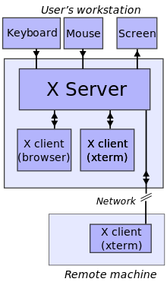
Remote X-Windows Access
ssh can tunnel X-Windows connections for secure communications or through a firewall

Slide 42
Remote File Transfer
FTP – File Transfer Protocol
  Clients and daemons for ftp are available for everything
  The ftp server is frequently disabled for security reasons
SSH –Secure Shell
  Clients and Servers are available for the major OS’s
  The data transfer is secure
  Can be difficult to get a server working on Windows
HTTP - Hyper Text Transfer Protocol
  Clients and servers are available for everything
  Most useful for downloading files
  Can be made secure, but not the default

Slide 43
Remote Command Execution
Unix has 3 modes for remote execution
  rsh
  rexec
  ssh
rsh, remote shell - standard but rarely available due to security
rexec, remote execution - almost never available due to security
ssh, secure shell
  Is the preferred way to execute commands remotely
  Can be used with Windows
  Data stream is encrypted
  Example – remote command, output to local file
ssh gt0000a@acme.gatech.edu ls –al > list.txt

Slide 44
Unix Programming Environment
Programming in Unix
  Edit
  Compile
  Run
  Source Management

Slide 45
Editing Source
There are two major text editors in the Unix world
  emacs one of the first large GNU projects
  vi developed for BSD Unix
There are several variations of both editors, most Linux systems use vim
Both have X-windows enabled versions for Unix
There are Windows versions of both available
Choose one as your primary editor and learn to use it well

Slide 46
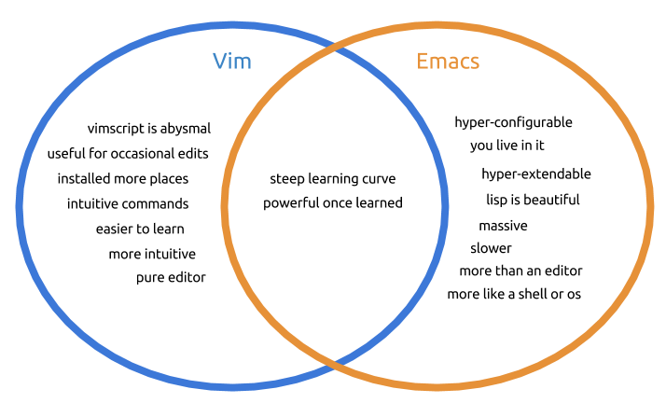
Editing - Emacs
emacs is an extremely capable text editor
emacs can do more than editing
Can be extended by writing eLisp code
Normally operates in text insert mode
Move around screen using cursor keys
Has a complex keyboard command structure

Slide 47
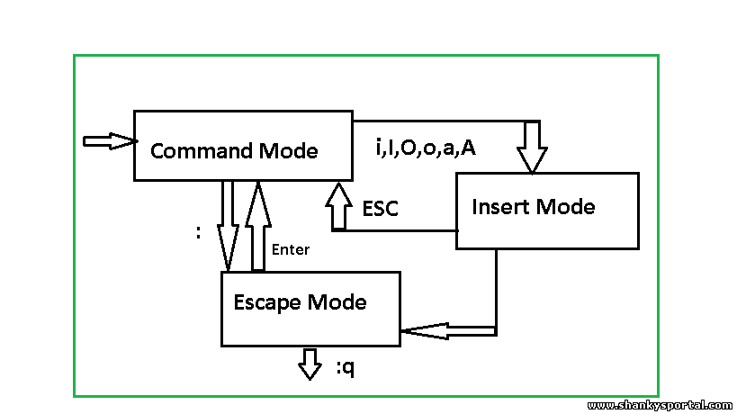
Editing - vi
Normally operates in 3 modes (insert text, command, escape)
Move around screen using cursor keys
Case-sensitive

Slide 48
Compiling
By convention source files in Unix have specific endings that depend on what they contain
  file.f Fortran
  file.c C language
  file.cpp C++ language
These suffixes are traditional and not enforced
Normally source files related to a particular project are grouped together into a directory

Slide 49
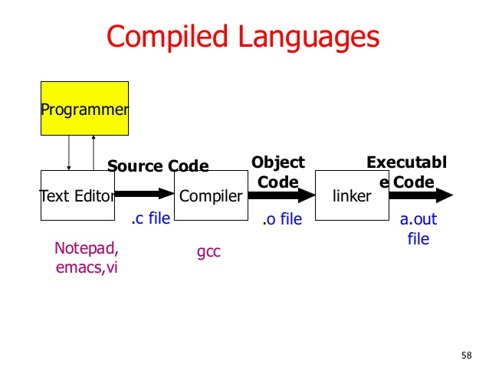
Compiling
The C language is the standard language of Unix
  Most vendors have proprietary compilers
  GNU gcc is available on almost all Unix-like systems and many other OS’s
There are numerous other compilers available for Unix systems; C++, Fortran, Java

Slide 50
Compiling Example
Given a source file name code1.f, compile and run
Create code1.f:
program code1
integer i, j
j = 0
do i=1,10
j = j + i
end do
write(*,*) j
end
Compile:
$ g77 code1.f
Run:
$ a.out
10

Slide 51
Compiling Example
Given a source file name code1.f, compile and run
Create code1.f:
program code1
integer i, j
j = 0
do i=1,10
j = j + i
end do
write(*,*) j
end
Compile:
$ g77 code1.f
Run:
$ a.out
10

Slide 52
Compiling Example
Given a two source files named code2.f and code3.f, compile and run
Create code2.f:
program code2
integer j
j = 0
call code3(j)
write(*,*) j
end
Create code3.f:
subroutine code3(j)
integer i, j
do i=1,10
j = j + i
end do
return
end
Compile:
$ g77 –o code2.o code2.f
$ g77 –o code3.o code3.f
Link:
$ g77 –o code code2.o code3.o
Run:
$ code
10

Slide 53
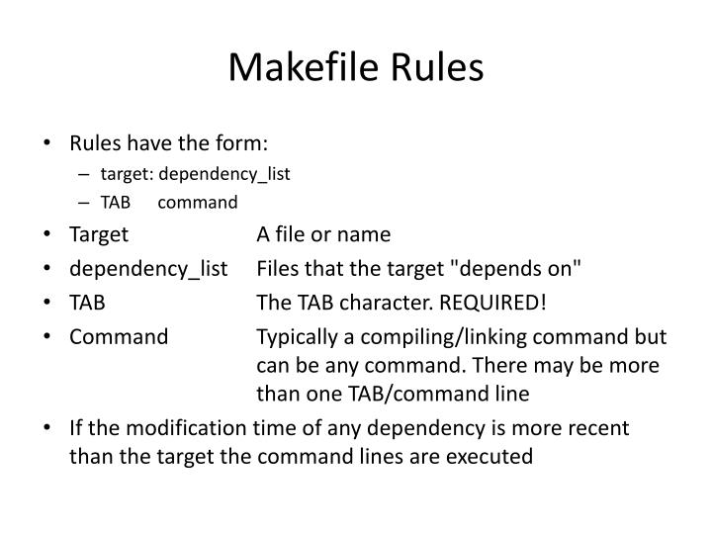
Makefile
Given a two source files named code2.f and code3.f, compile and run using makefile
code: code2.o code3.o
g77 – o code code2.ocode3.o
code2.o: code2.f
g77 –o code2.o code2.f
code3.o: code3.f
g77 –o code3.o code3.f

Slide 54
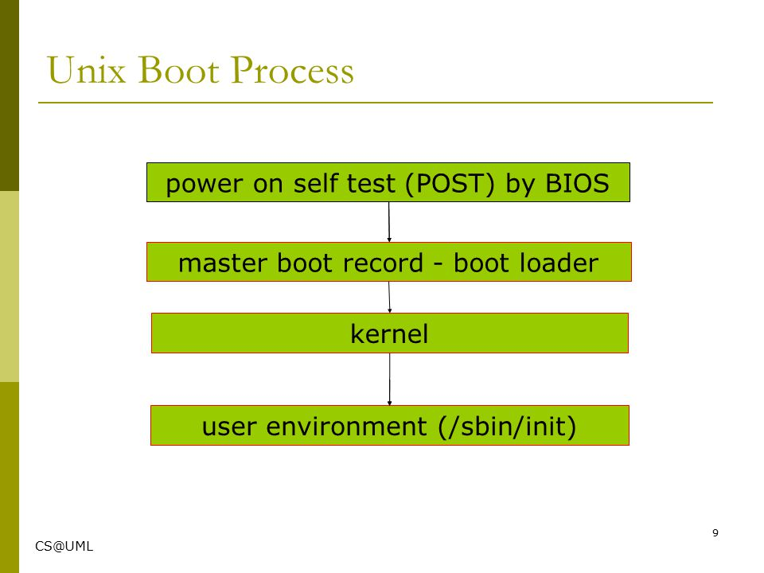
Boot Process

Slide 55
Quick Recap

