Slide 1
Quiz 4: Rules
- For each question you need to present
an explanation if confident of giving a clear explanation OR a psuedocode.
the time and space complexity of your method.
For each question you can assume that
the query vertices are present in the tree and are distinct
the labels of the nodes in the tree are distinct.
In the solutions treat data structures you have used as black box.
Example : Find Euler tour, use segment tree, etc

Slide 2
The Lowest Common Ancestor
In a rooted tree T, a node u is an ancestor of a node v if u is on the unique path from the root to v.
In a rooted tree T, the Lowest Common Ancestor (LCA) of two nodes u and v is the deepest node in T that is the ancestor of both u and v.

Slide 3
For example…
1
2
3
4
5
6
Node 3 is the LCA of nodes 4 and 6.
Node 1 is the LCA of node 2 and 5.

Slide 4
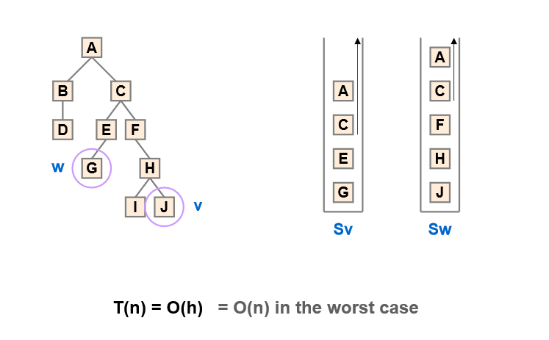
Question 1 10:15
Consider using two stacks to find the LCA(v,w).
Hint:
The first stack stores the ancestors of w while the second stores the ancestors of v.
Note: nodes v and w need not be present in the tree.

Slide 5
LCA for BT-Question1

Slide 6
Solution1
1) Find n1 and then path from n1 to root and store it in a stack.
2) Similarly for n2 in a different stack.
3) Traverse both stacks till the values in arrays are same. Return the common element just before the mismatch.
Three tree traversals needed.
One tree traversal to find n1 and n2.
Second and third tree traversal to find path from n1 to root and n2 to root.

Slide 7
Question 2 10:35
Assumes that the nodes v, w are present in the tree.
Hint:
Traverse the tree starting from root. If any of the given keys (v or w) matches with the root, then you could stop there to
report the appropriate LCA.
If the root doesn’t match with any of the keys, we recur to the left and right subtree.
The node which has one key present in its left subtree and the other key present in right subtree is the LCA.

Slide 8
Solution 2
struct Node *findLCA(struct Node* root, int n1, int n2)
{
if (root == NULL) return NULL;
if (root->key == n1 || root->key == n2) // one is ancestor of other
return root;
Node *left_lca = findLCA(root->left, n1, n2);
Node *right_lca = findLCA(root->right, n1, n2);
if (left_lca && right_lca) return root; //both found on either sides of root so root is the LCA
return (left_lca != NULL)? left_lca: right_lca; //both found on same side of root so continue search on the single side.
}

Slide 9
11:00am
Question 3
Hint: Preprocess the tree to find
the post order and in order traversal of the binary tree
Question 4
Given a binary search tree, how can you find the LCA.
Mention the space and time complexity of the method given by you.

Slide 10
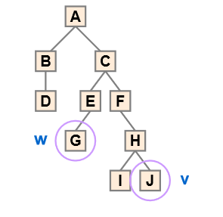
Solution 3
Inorder: . B D A G E C F I H J
PostOrder: D B G E I J H F CA
Inorder: B D A G E C F I H J
Position in PostOrder: 2 1 10 3 4 9 8 5 7 6
Max in range is the LCA

Slide 11
Solution 4
struct node *lca(struct node* root, int n1, int n2)
{
if (root == NULL) return NULL;
// If both n1 and n2 are smaller than root, then LCA lies in left
if (root->data > n1 && root->data > n2)
return lca(root->left, n1, n2);
// If both n1 and n2 are greater than root, then LCA lies in right
if (root->data < n1 && root->data < n2)
return lca(root->right, n1, n2);
return root;
}

Slide 12
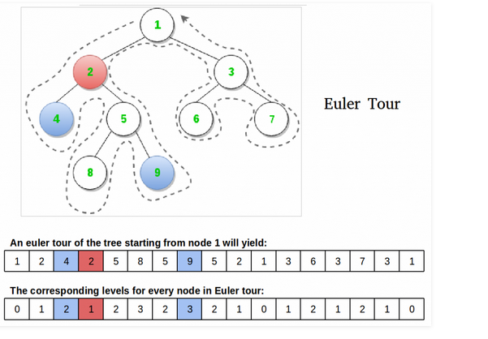
Question 5 11:30am
Hint:
Preprocess the tree to find
the nodes as seen in the euler
Tour (restricted DFS where you
always pick left child when
given a choice)
The euler order of the nodes
with some additiona
l information can help find the
LCA.

Slide 13

Solution 5
http://www.geeksforgeeks.org/find-lca-in-binary-tree-using-rmq/
ooooo
Tour
Level
First
Occurrence

Slide 14
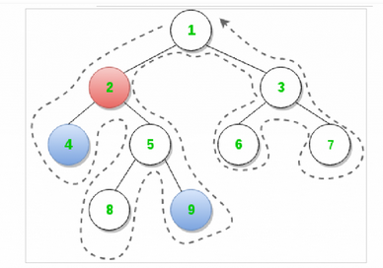
http://www.geeksforgeeks.org/find-lca-in-binary-tree-using-rmq/
---LCA has the minimum level among elements between first occurrence of two input elements
--- Look at LevelArray. Element 2 has min level among elements between first occurrence of 4 and 9.
ooooo
Algorithm LCA(u,v)
{
a=FirstOccurrence(u)
b=FirstOccurrence(v)
Let min_index be the index of the minium element in the array Level[] in the range (a,b).
Tour[min_index] gives the LCA(u,v)
}

