Slide 1

Indexed Search Tree (Trie)
Nelson Padua-Perez
Chau-Wen Tseng
Department of Computer Science
University of Maryland, College Park

Slide 2

Trie datastructure applications
--auto completion
--search engines
--IP routing

Slide 3

Types of Tries
Standard
  Single character per node
Compressed
  Eliminating chains of nodes
Compact
  Stores indices into original string(s)
Suffix
  Stores all suffixes of string

Slide 4
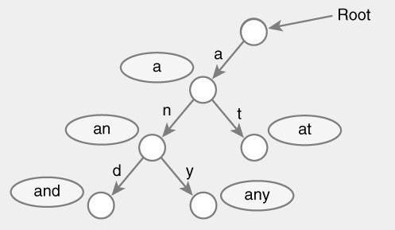
Standard Trie Example
For strings
  { a, an, and, any, at }

Slide 5
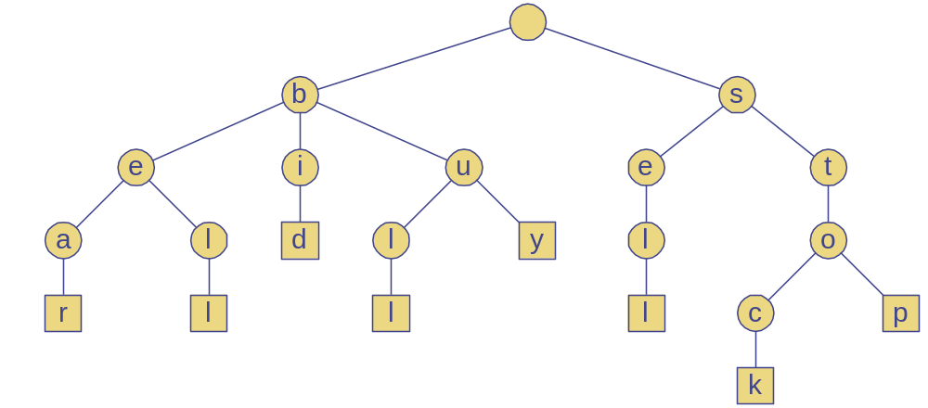
Standard Trie Example
For strings
  { bear, bell, bid, bull, buy, sell, stock, stop }

Slide 6
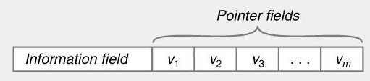

Standard Tries
Node structure
  Value between 1…m
  Reference to m children
    Array or linked list
Example
  Class Node {
    Letter value; // Letter V = { V₁, V₂, … V_{m} }
    Node child[ m ];
  }

Slide 7
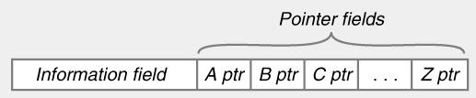
Standard Tries
Efficiency
  Uses O(n) space
  Supports search / insert / delete in O(d×m) time
  For
    n total size of strings indexed by trie
    d length of the parameter string
    m size of the alphabet

Slide 8
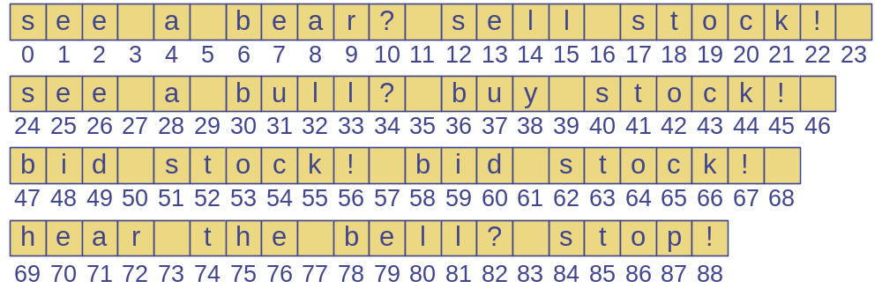
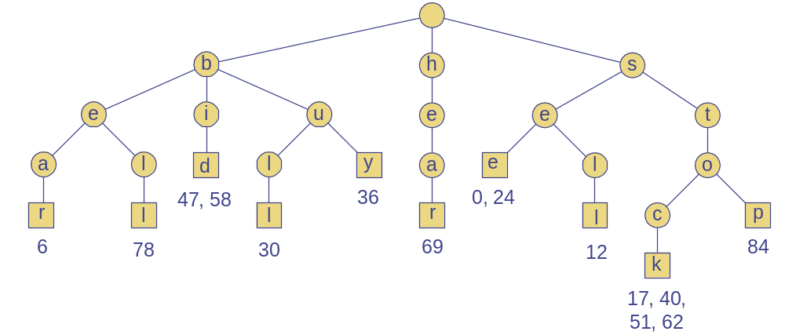
Word Matching Trie
Insert words into trie
Each leaf stores occurrences of word in the text
Deletion?

Slide 9
Compressed Trie
Observation
  Internal node v of T is redundant if v has one child and is not the root
Approach
  A chain of redundant nodes can be compressed
    Replace chain with single node
    Include concatenation of labels from chain
Result
  Internal nodes have at least 2 children
  Some nodes have multiple characters

Slide 10
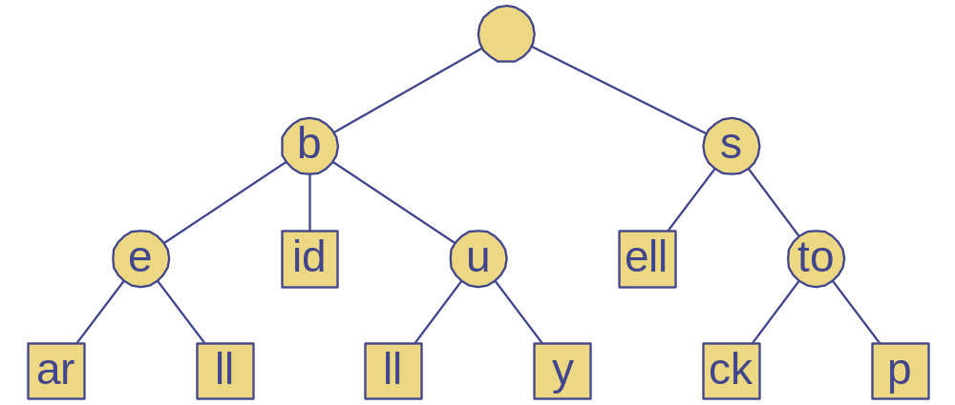
Compressed Trie
Space same?
Since number of letters is
same as ealier?

Slide 11
Compact Tries
Compact representation of a compressed trie
Approach
  For an array of strings S = S[0], … S[s-1]
  Store ranges of indices at each node
    Instead of substring
  Represent as a triplet of integers (i, j, k)
    Such that X = s[i][j..k]
  Example: S[0] = “abcd”, (0,1,2) = “bc”
Properties
  Uses O(s) space, where s = # of strings in the array
  Serves as an auxiliary index structure

Slide 12
A tree with L leaf nodes in which every node has at least 2 children except the leaf nodes has atmost L-1 internal nodes.

Slide 13
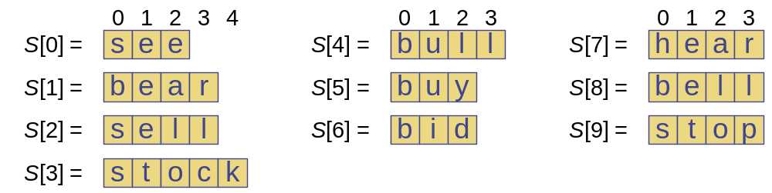
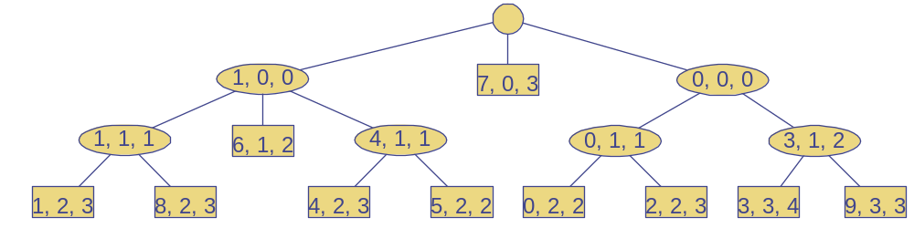
Compact Representation
Example

Slide 14


Slide 15
Suffix Trie
Compressed trie of all suffixes of text
Example: “IPDPS”
  Suffixes
    IPDPS
    PDPS
    DPS
    PS
    S
Useful for finding pattern in any part of text
  Occurrence ⇒ prefix of some suffix
  Example: find PDP in IPDPS
D
I
P
P
P
S
D
D
P
S
P
S
S
S

Slide 16
Suffix Trie
Properties
  For
    String X with length n
    Alphabet of size m
    Pattern P with length d
  Uses O(n) space (since we have O(n) leaves)
  Can be constructed in O(n) time
  Find pattern P in X in O(d×m) time
    Proportional to length of pattern, not text

Slide 17
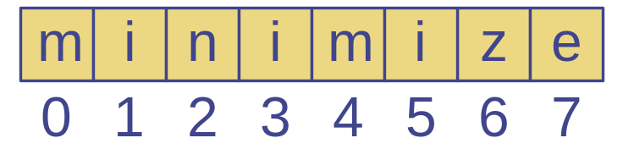
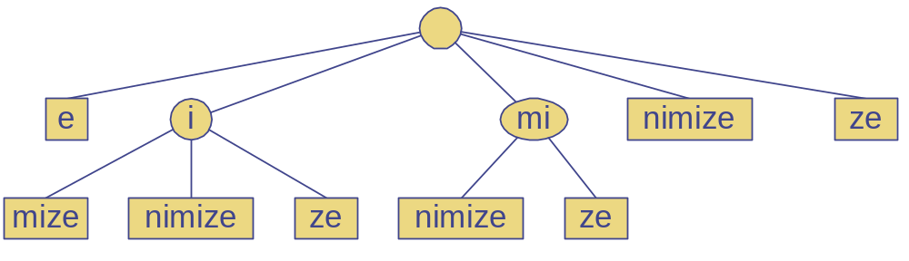
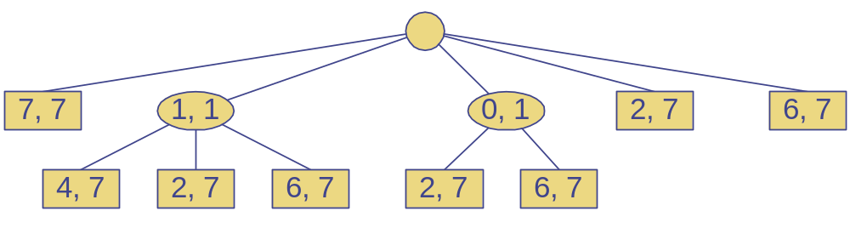
Suffix Trie Example

Slide 18
Tries and Web Search Engines
Search engine index
  Collection of all searchable words
  Stored in compressed trie
Each leaf of trie
  Associated with a word
  List of pages (URLs) containing that word
    Called occurrence list
Trie is kept in memory (fast)
Occurrence lists kept in external memory
  Ranked by relevance

