Slide 1
The Evolutionary Impact of Web 3.0 on Learning Applications
Team Tritechies

Slide 2



E-Learning system or LMS
Self-Paced Learning.
Interactive Features.
Scalability.
Cost-Effective.
Adaptive Learning
E-learning systems typically deliver educational content over the internet. This can include text, videos, audio, animations, and interactive simulations

Slide 3
E-learning and Its Application Characteristics
Lifelong Learning.
Global Reach.
Pandemic Preparedness.
Interactivity.
Multimedia Content.
Personalization.
Accessibility.

Slide 4
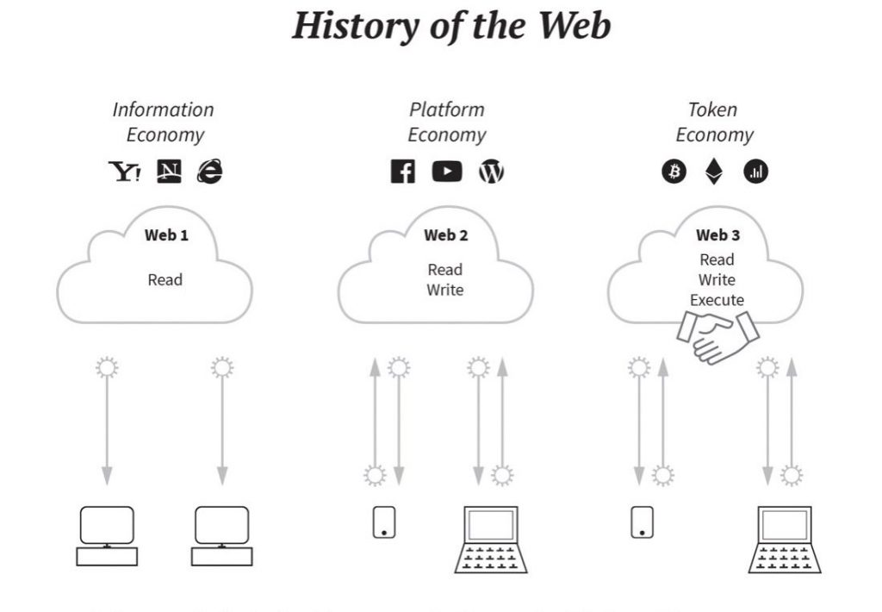
History of the Web
Web1 – Static
Web2 – Dynamic
Web3: –Decentralized

Slide 5
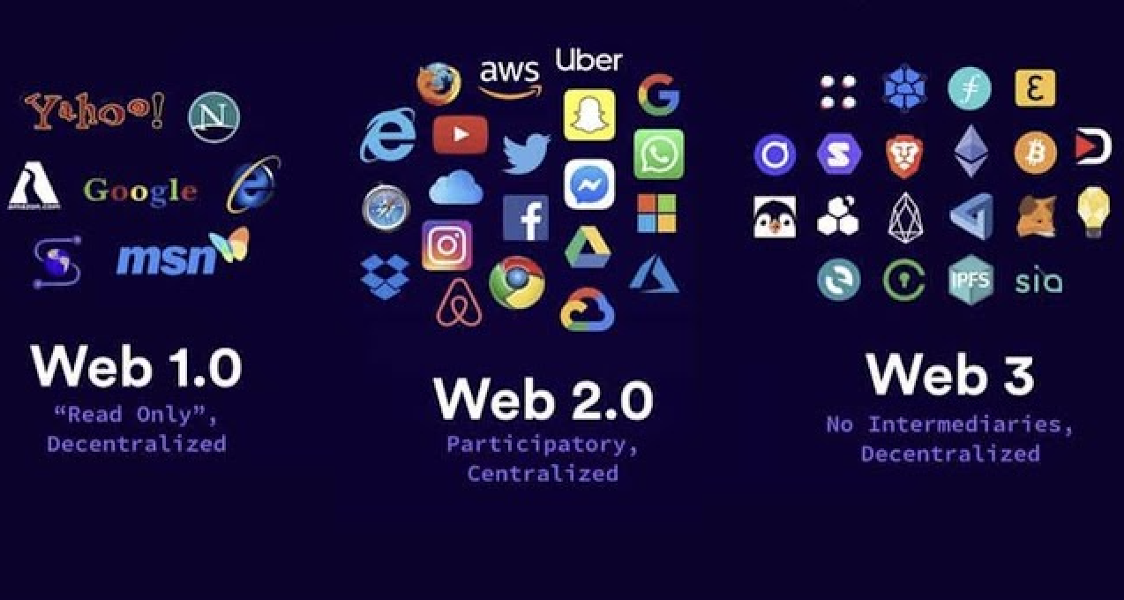
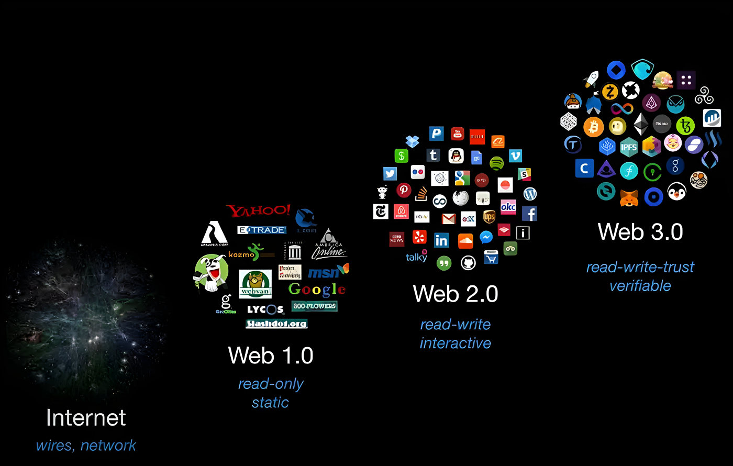
Web 2.0 and Web 3.0 in the context of e-learning systems and LMS
WEB 2.0
User-Generated Content.
Social Collaboration.
Rich Multimedia.
Personalization.
WEB 3.0
Semantic Web
AI and Machine Learning.
Interoperability
Blockchain
Decentralization
AR and VR Integration

Slide 6
Technical Characteristics of Web3.0
Semantic Data.
Linked Data.
Ontologies and Taxonomies
Machine Learning and AI
Natural Language Processing (NLP)
Knowledge Graphs
Privacy and Security

Slide 7
Current E-learning Problems in web2
Lack of semantic understanding.
Centralized control.
Data Privacy and Security.
Integration Issues.
Authenticity verification.
Lack of interactivity and engagement.
Lack of transparancy.

Slide 8
E- Learning optimization with web3
Decentralisation and data ownership
Semantic Understanding and Personalization
Interoperability and Linked Data
Trust and Integrity of Credentials
Real-Time Collaboration and Immersive Learning
Gamification and Microlearning
Data Privacy and Security

Slide 9
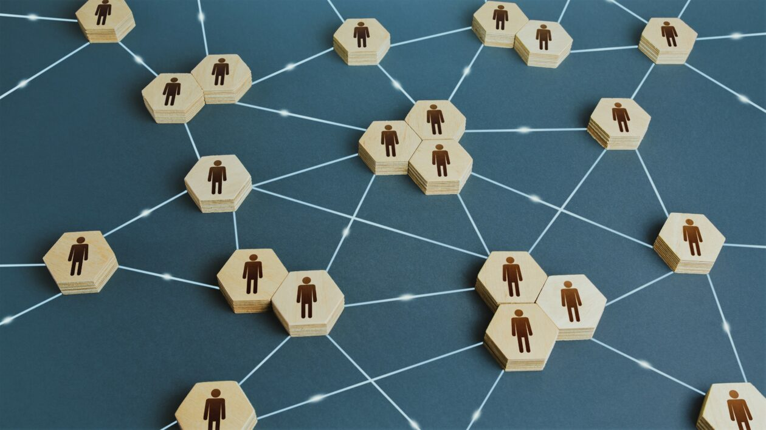
Decentralization
Data Control
Blockchain Technology
Peer-to-Peer (P2P) Learning
Reduced Dependence on Centralized Authorities

Slide 10
Semantic Understanding and Personalization
RDF and Triple.
Ontologies.
Linked Data.
Inference and Reasoning.
Knowledge Graphs.
User Profiles.
Context Awareness.
Semantic Recommendations.
Personalized Learning Paths.

Slide 11
Interoperability and Linked Data
Data standards
Open APIs
Ontologies and Vocabularies
Linked Data
Semantic Web
Cross-Domain Compatibility
Use of URLS
HTTP for data access.
Resource Descriptions
Link between data
Open standards

Slide 12
Trust and Integrity of Credentials
Immutable records
Decentralization
Transparency
Smart Contracts
Digital Signatures
Digital Representation
Digital Signatures
Decentralized Identifiers (DIDs)
Selective Disclosure
Third-Party Verification
Interoperability
Open Standards and Ecosystems
Consent and Control

Slide 13
Real-Time Collaboration and Immersive Learning
Live Communications
Cooperative Activities
Instant Feedback
Problem Solving
Virtual Classroom
Immersive Learning
Gamification
Collaborative VR and AR
Virtual Study Group
Real time feedback
Collaborative educational games
Creative problem solving

Slide 14
Gamification and Microlearning
Points and Rewards
Badges and Achievements
Leaderboards
Challenges and quests
Narrative Storytelling
Focused Content
Quick consumption
Retention
Increased engagement
Progress tracking
Motivation
Reinforcement
Sense of achievement

Slide 15
Data Privacy and Security
Data Encryption
User authentication
Access control
Data minimization
Privacy Policies and Consent
User data portability
Regular audits
Secure storage
Data Anonymization and Pseudonymization
Incident Response Plan
Compliance with data protection laws
Consent and Data Rights Management
Secure communication
Training and awareness
Vendor security assesment

Slide 16
Learning Management System

Slide 17
Maintaining user information
Core Component
Personalization and Timely Access
Cost-Effective Information Delivery
Centralized Content Management
Collaborative Content Creation
Cost Saving
Flexibility and Accessibility
Efficiency for Large Companies

Slide 18
Personalized learning activities
Assessment Data
Adaptive Learning
Feedback Mechanisms
Progress Tracking
Notifications and Reminders
Gamification
Social Learning
Content Recommendations
Competency-Based Learning
Analytics

Slide 19

Questions?

Slide 20
Thank You

