Slide 1
Data Analyst Internship Project Report
Drug Side Effects Analysis
Prepared by: Sri Tharun Kollu
Company: Unified Mentor
Internship Duration: May 15, 2025 – June 05, 2025

Slide 2
Executive Summary - During my internship at Unified Mentor, I worked on a project focused on analyzing and visualizing data related to drug side effects. The goal was to provide actionable insights that could help medical professionals better understand both the positive and negative impacts of various drugs. Through exploratory data analysis (EDA), visualization, and interactive dashboard creation, I identified key trends in drug ratings, medical conditions, and patient feedback. The findings offer valuable guidance for healthcare decision-making and patient safety.
Company Overview - Unified Mentor is a professional training and mentorship organization that provides industry-driven projects to help learners gain practical skills. The project simulated a real-world healthcare analytics scenario using an authentic dataset, enabling me to apply data analysis tools in a business context.
Project Objective - To analyze a dataset of drug reviews and ratings to uncover patterns, identify high-performing and low-performing drugs, and highlight potential side effects. The analysis aimed to assist medical experts in evaluating drug effectiveness and safety.
Data Overview - Source: Unified Mentor datasets Key Variables: Drug Name, Medical Condition, Rating, Reviews Data Size: Multiple records covering various drugs and conditions Challenges in Data: Missing values, inconsistent formatting, and messy text in reviews
Tools & Technologies Used - Python Libraries: NumPy, Pandas, Matplotlib, Seaborn Data Visualization Tool: Tableau Analysis Environment: Google Colab

Slide 3
Methodology
1.Data Cleaning – Handled missing values, removed irrelevant entries, and standardized text fields
2. EDA – Summary statistics, distributions, outlier detection
3. Visualization Created Python visualizations and an interactive Tableau dashboard
4. Insights Generation – Extracted patterns to support healthcare decision-making
Key Insights - Top Drugs by Rating – Identified medications with the highest average ratings - Top Medical Conditions by Number of Drugs – Highlighted health issues with the widest range of drug options - Rating vs. Activity – Explored correlation between drug effectiveness and activity levels - Average Rating by Medical Condition – Ranked treatments for specific illnesses - Drug Popularity by Reviews – Measured engagement and feedback volume
Results & Business Impact - The analysis enables medical experts to assess drug effectiveness and safety before prescribing, helps pharmaceutical companies identify improvement areas based on patient feedback, and supports patients in making informed treatment decisions.

Slide 4
Challenges Faced - Missing Data – Required imputation or exclusion - Messy Text Fields – Reviews contained typos, slang, and mixed formatting
Learning Outcomes - Strengthened EDA and visualization skills in Python - Learned dashboard creation in Tableau - Improved ability to convert raw data into business-relevant insights
Conclusion - This project not only improved my technical skills in Python and Tableau but also enhanced my ability to interpret healthcare data for practical applications. The resulting insights can support safer prescribing practices and better patient outcomes.

Slide 5
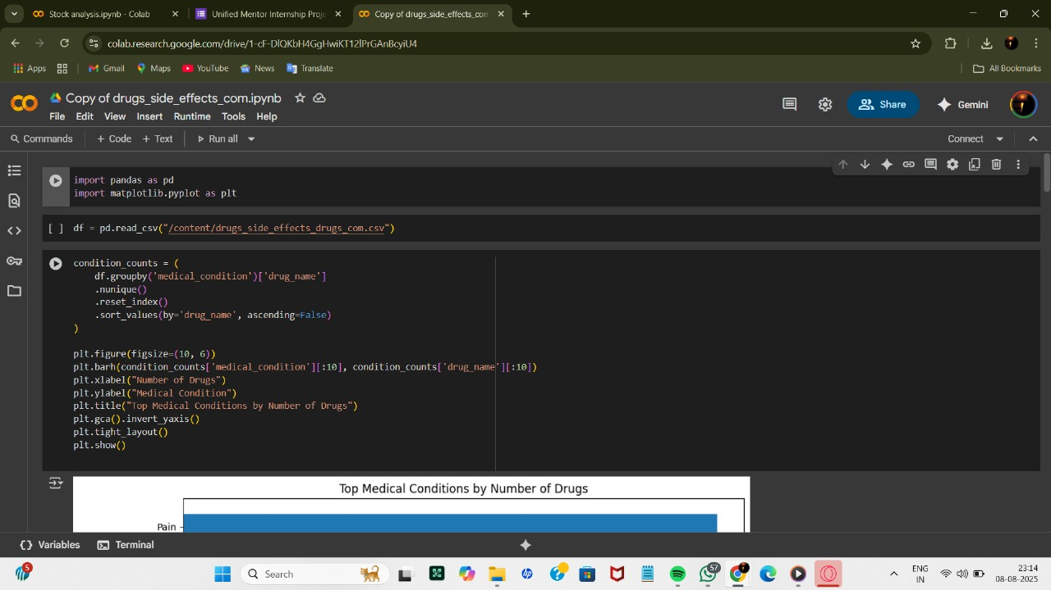

Slide 6
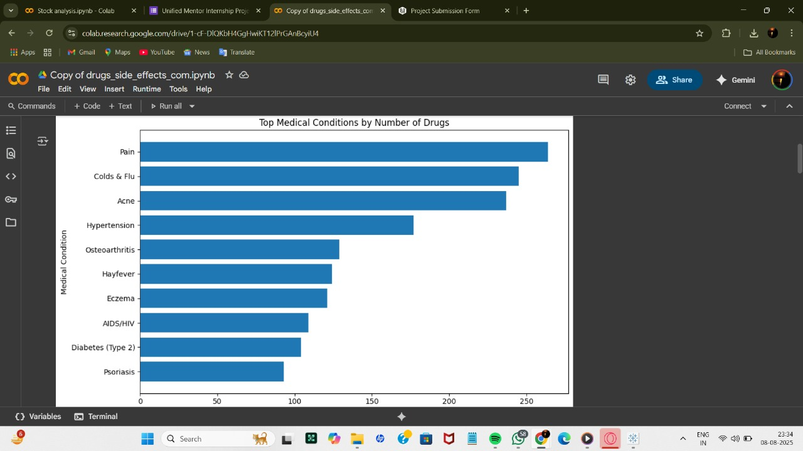

Slide 7
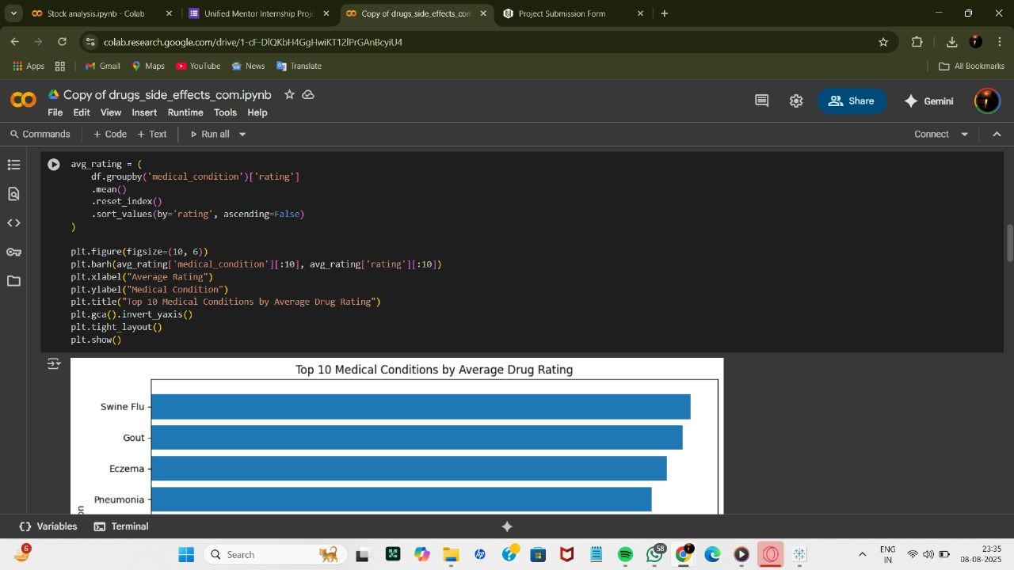

Slide 8
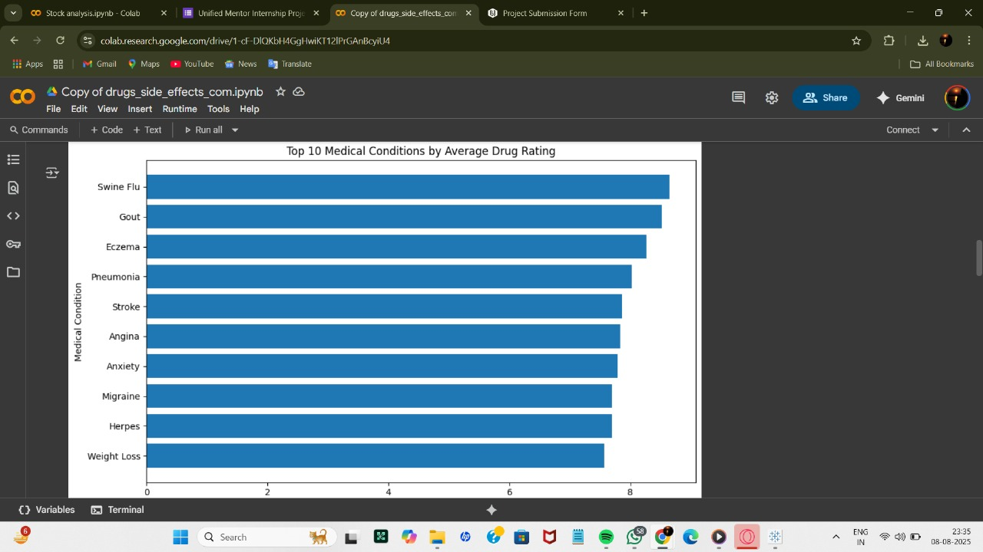

Slide 9
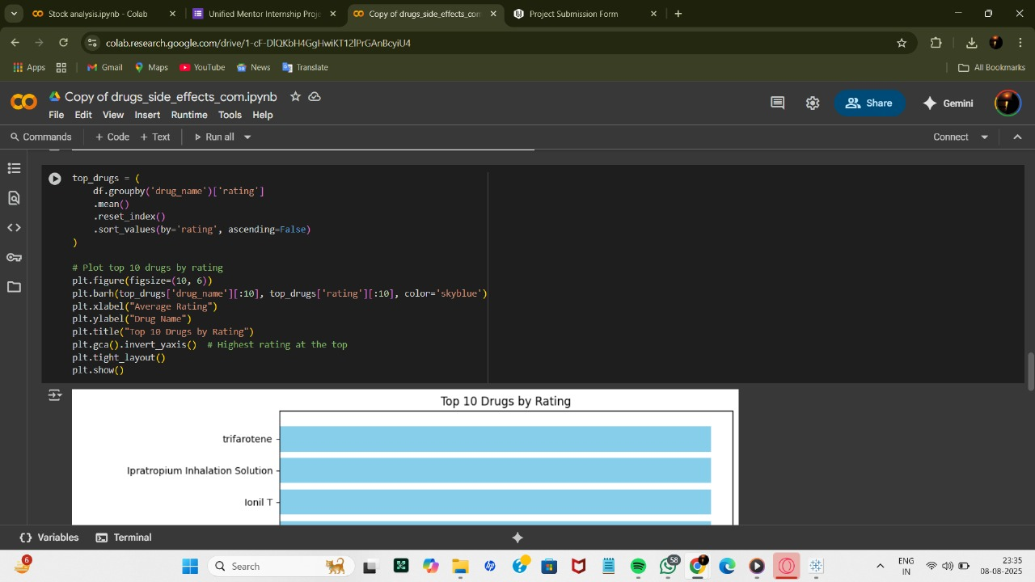

Slide 10
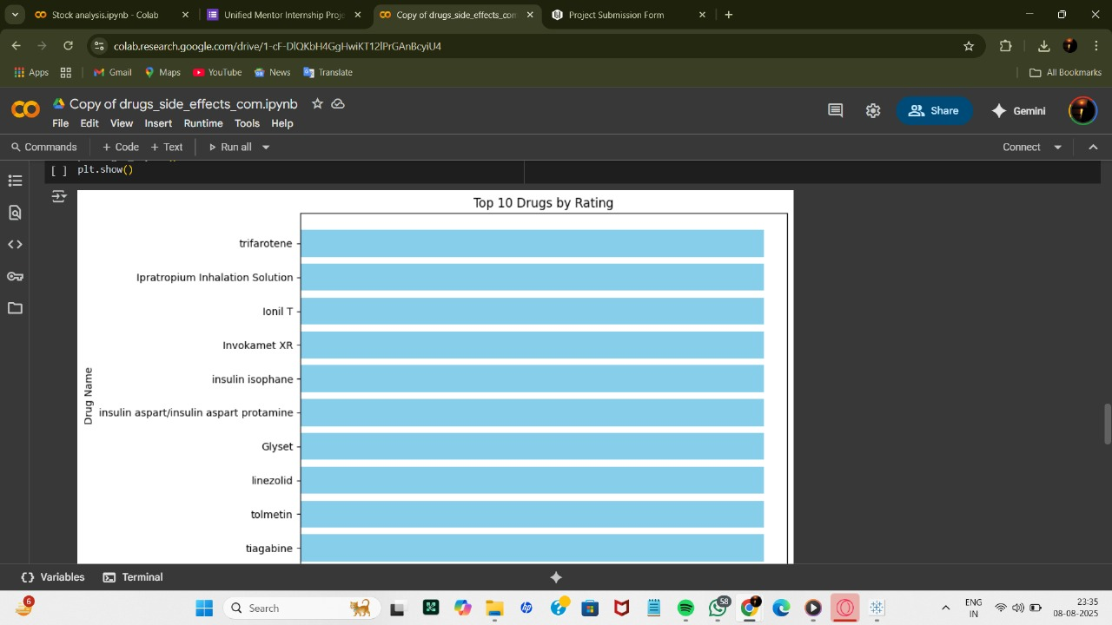

Slide 11
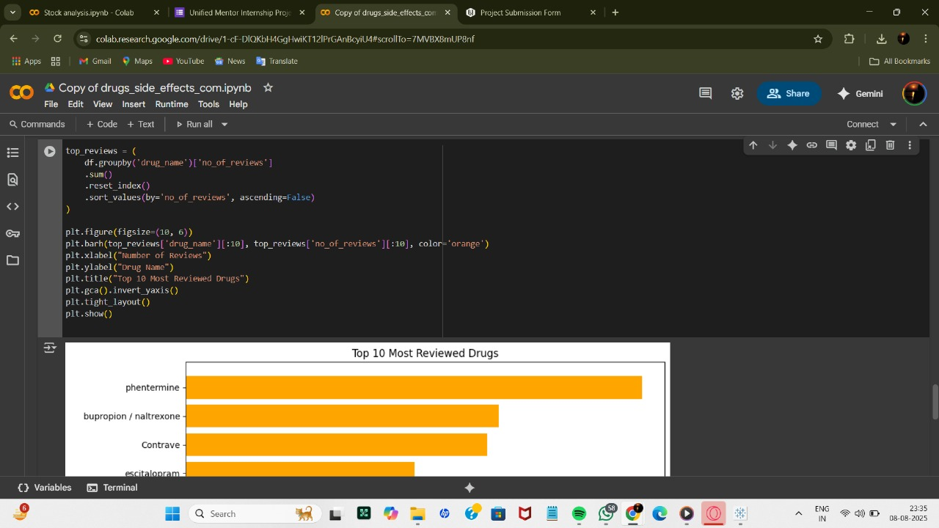


Slide 12
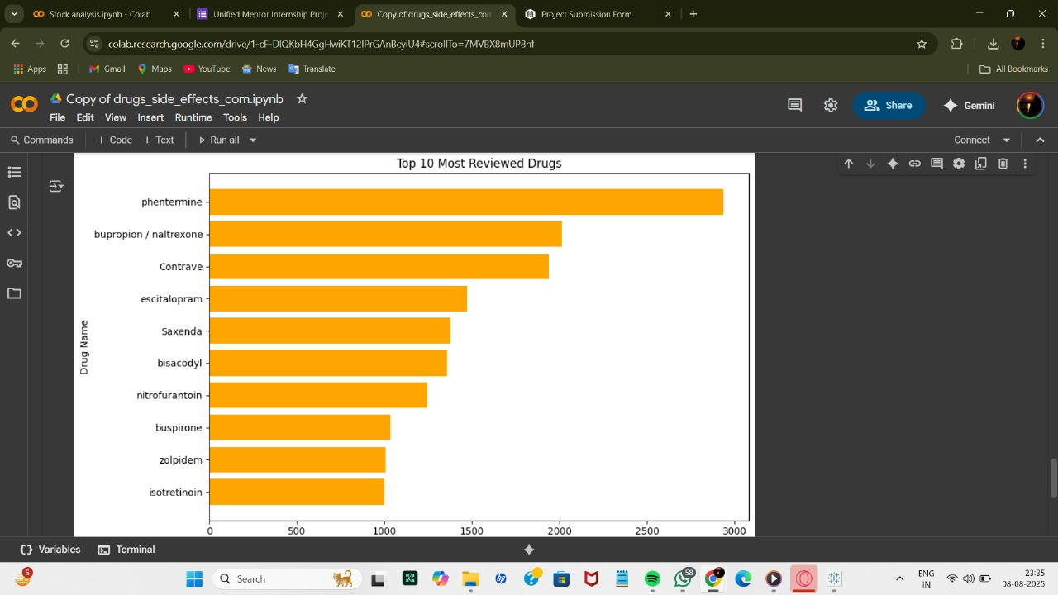

Slide 13
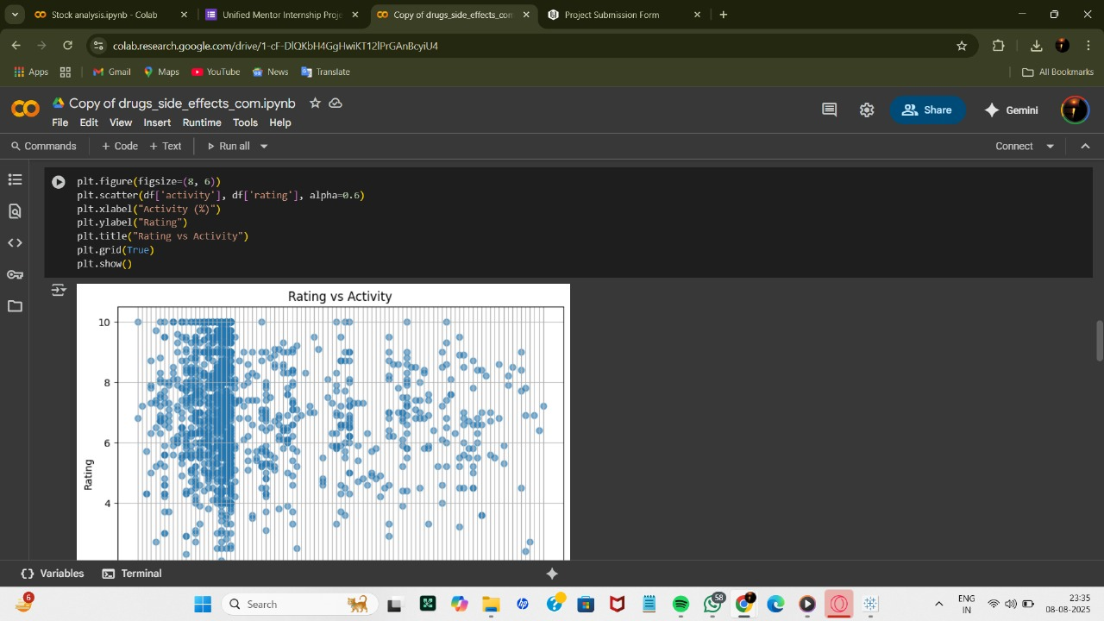


Slide 14
