Slide 1



HR
View in Power BI
Last data refresh:
3/26/2023 4:36:23 PM UTC
Downloaded at:
3/26/2023 4:41:33 PM UTC

Slide 2

Home
Notes:
Total Jobs
No alt text provided
Total Companies
No alt text provided
pageNavigator
No alt text provided

Slide 3
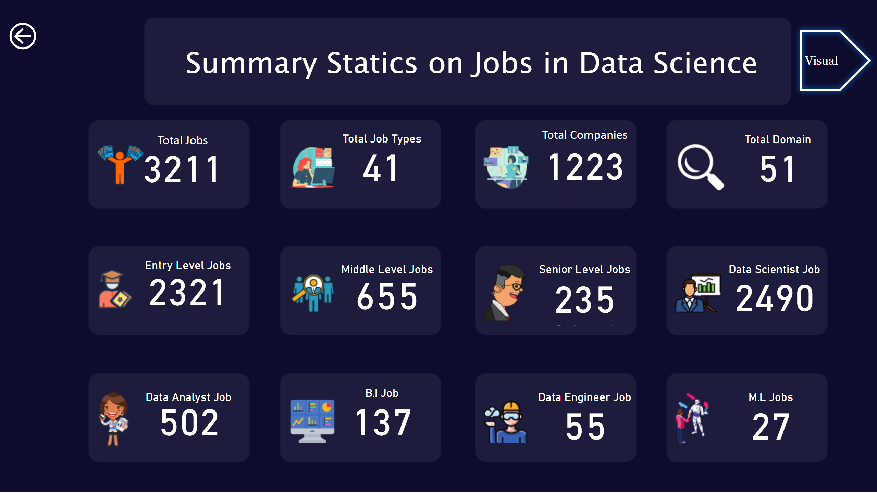
Statistics
Notes:
Total Jobs
No alt text provided
Total Companies
No alt text provided
Total Job Types
No alt text provided
Total Domain
No alt text provided
Entry Level Jobs
No alt text provided
Middle Level Jobs
No alt text provided
Senior Level Jobs
No alt text provided
Data Analyst Job
No alt text provided
B.I Job
No alt text provided
Data Engineer Job
No alt text provided
Data Scientist Job
No alt text provided
M.L Jobs
No alt text provided
textbox
No alt text provided
Visual
No alt text provided
actionButton
No alt text provided

Slide 4
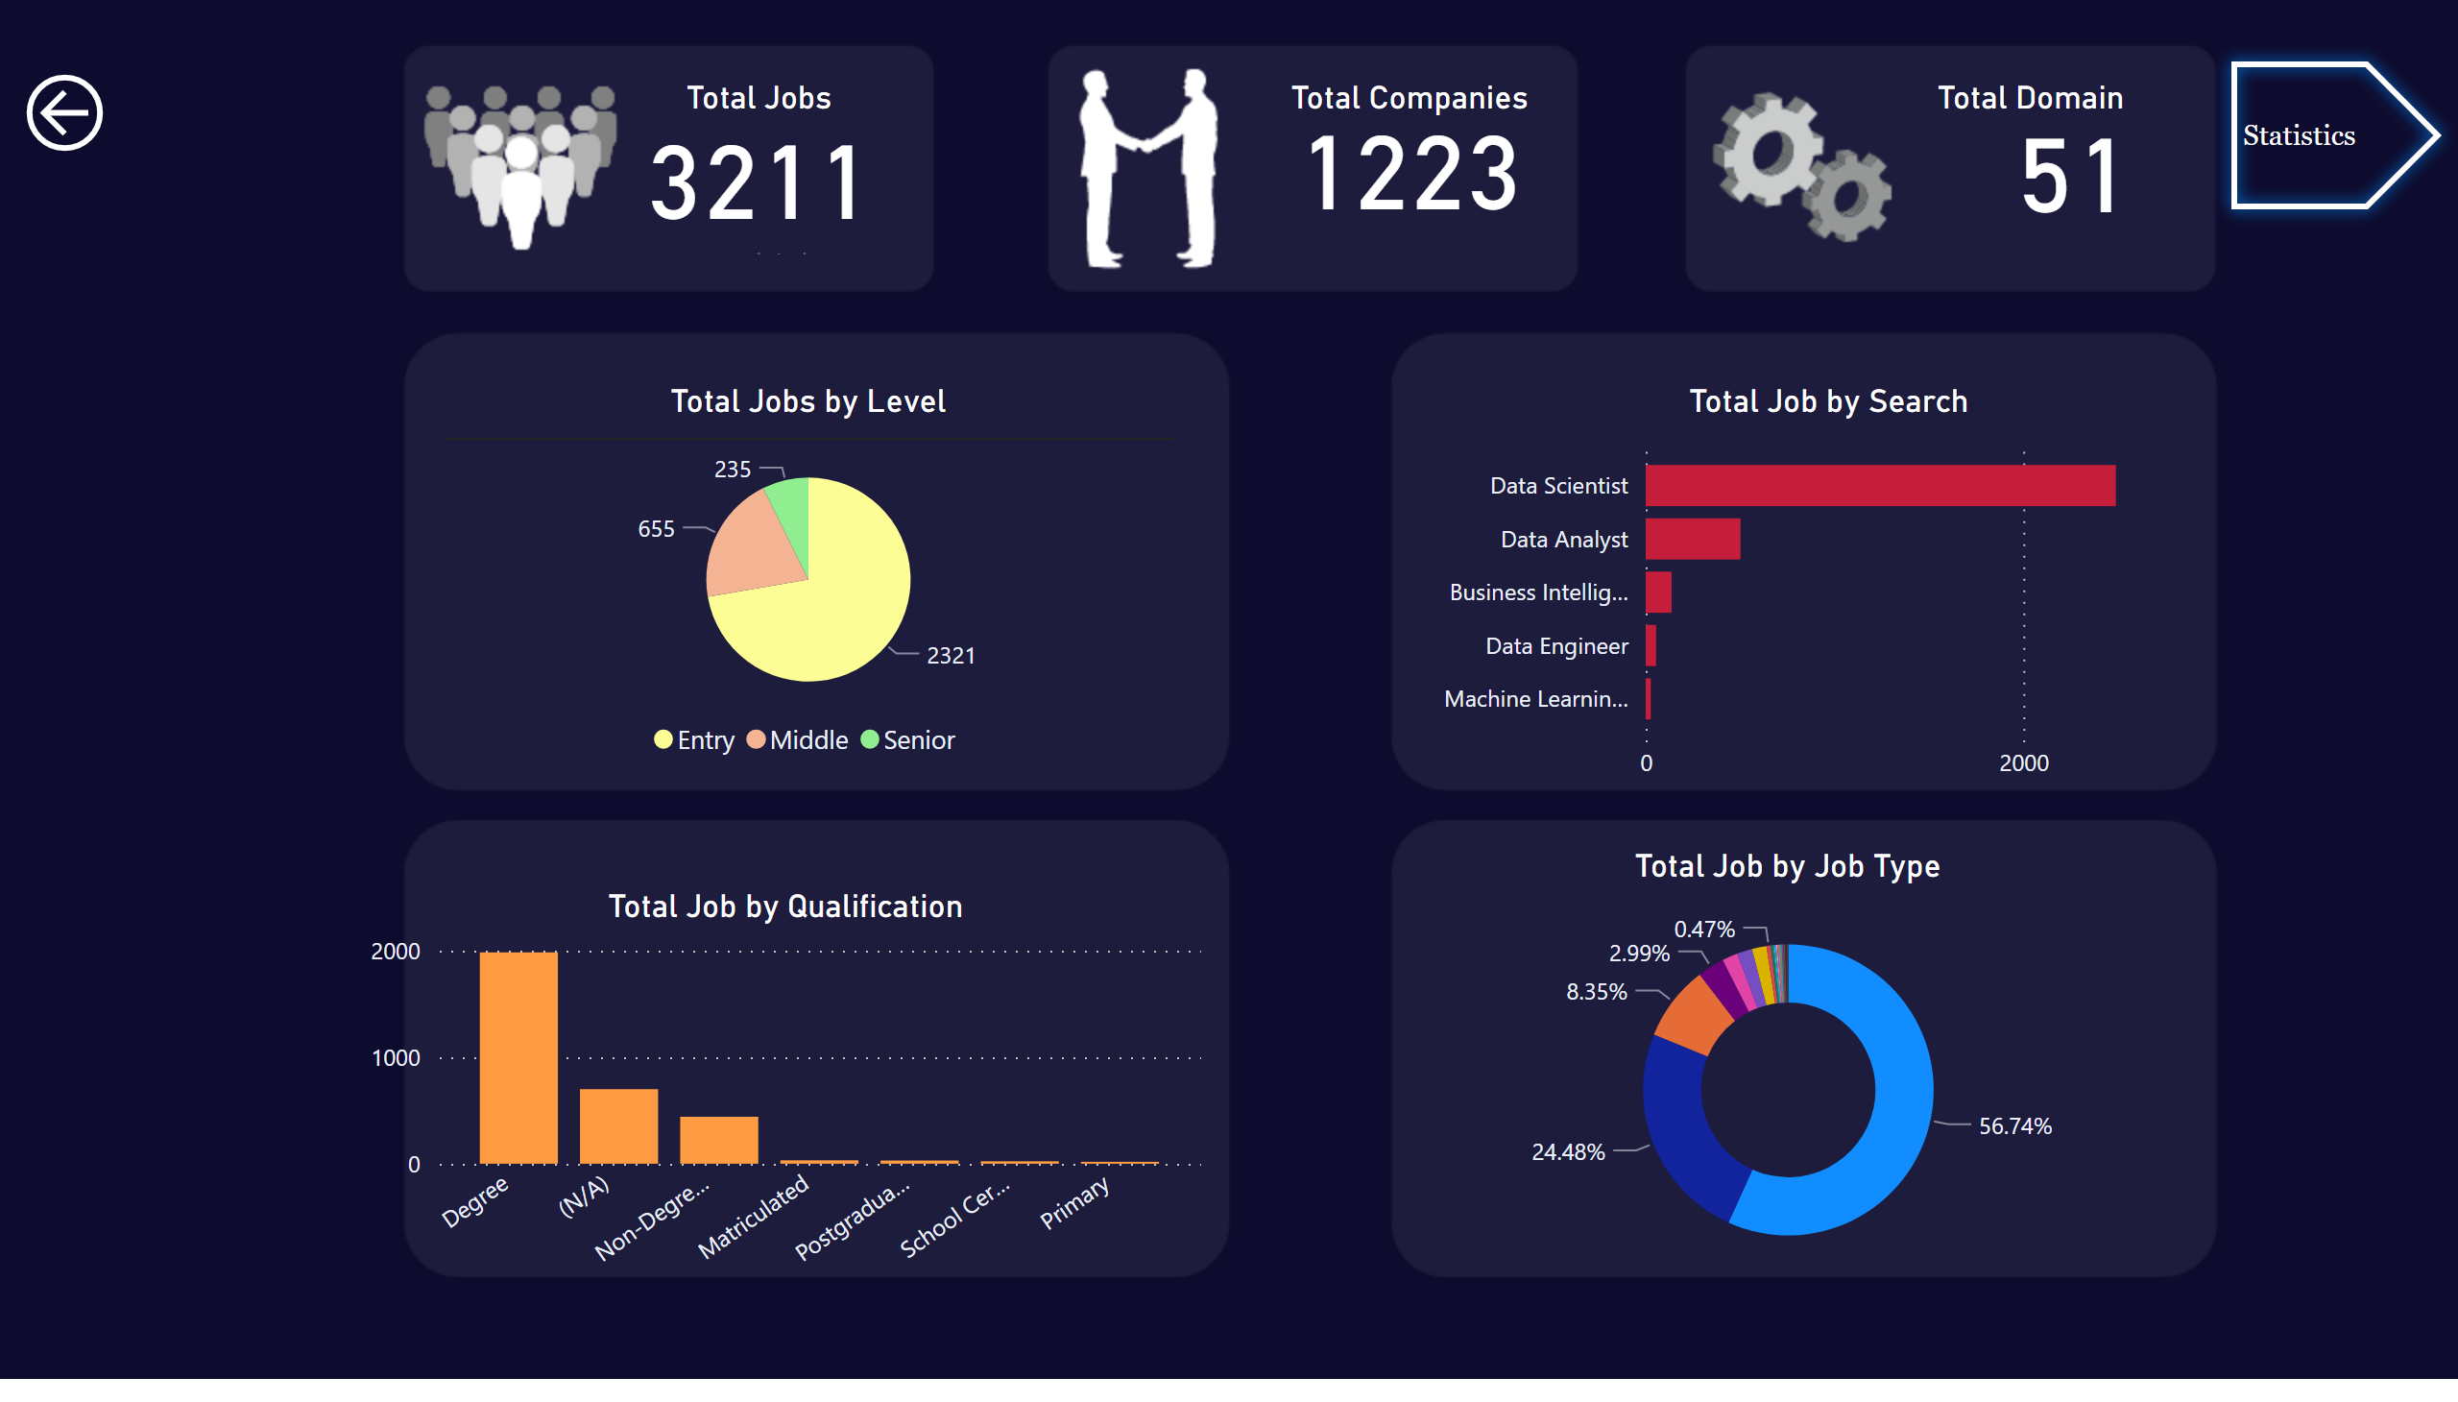
Visual
Notes:
Total Jobs
No alt text provided
Total Companies
No alt text provided
Total Domain
No alt text provided
Total Jobs by Level
No alt text provided
Total Job by Search
No alt text provided
Total Job by Qualification
No alt text provided
Total Job by Job Type
No alt text provided
actionButton
No alt text provided
actionButton
No alt text provided

