Slide 1


Group 3
Badminton Shop
Notes:
Title slide. Introduce the project: an online badminton shop built with Laravel and MySQL.

Slide 2
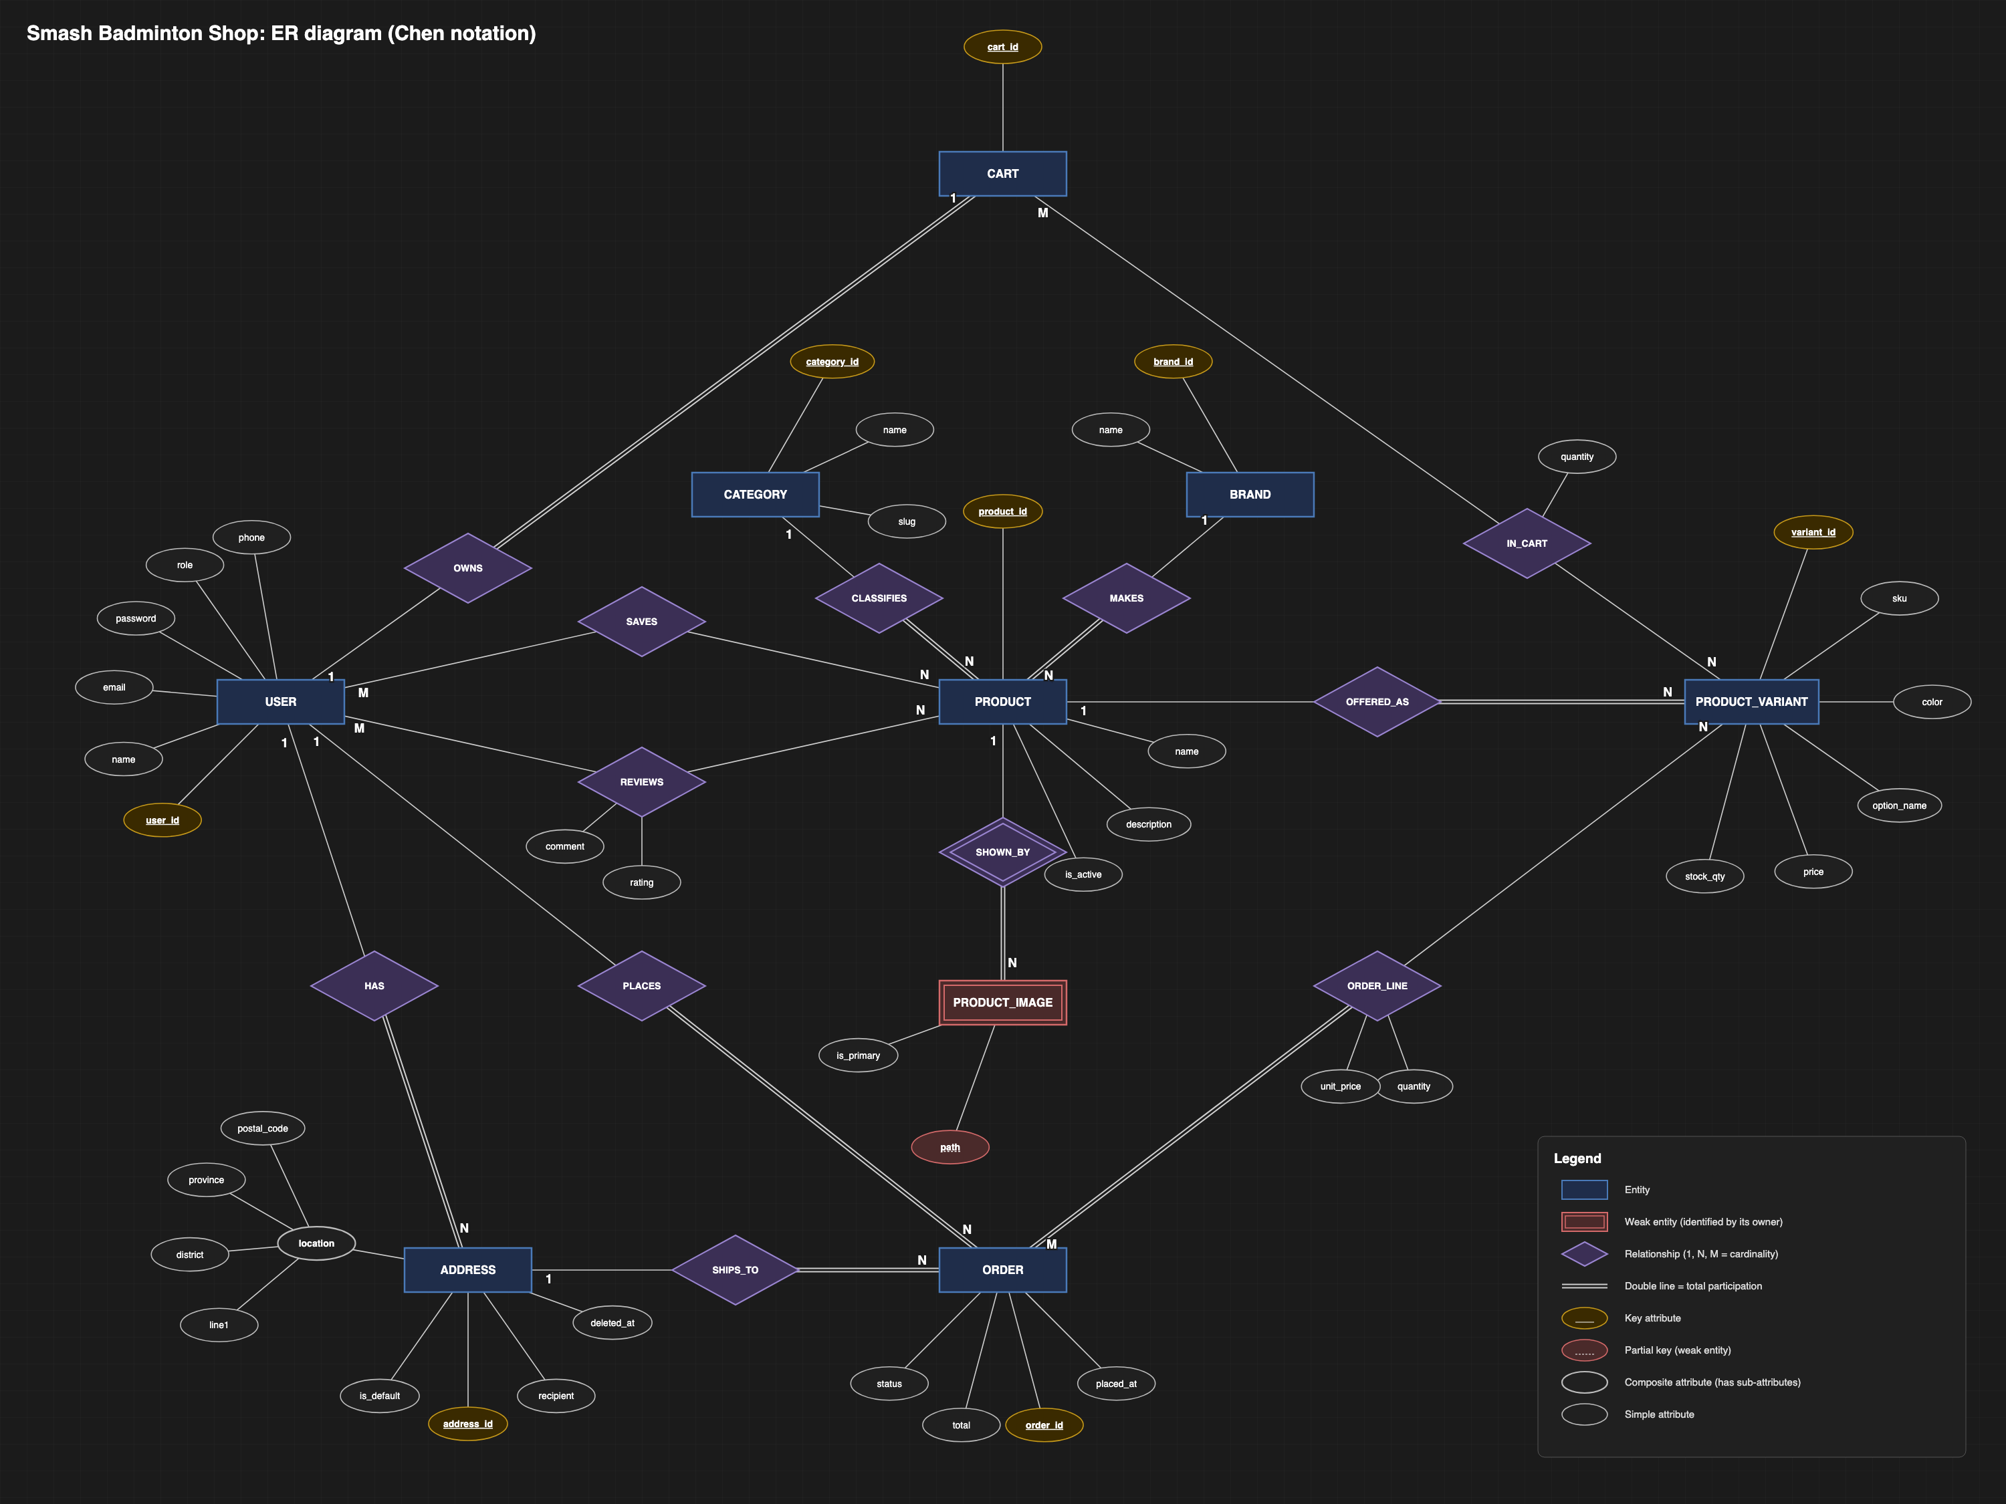
ER diagram
Conceptual model: entities, relationships and cardinalities
13 entities: users, addresses, categories, brands, products, variants, images, carts, orders and more
1:N links: user to addresses and orders, brand and category to products, product to variants and images
M:N links resolved through cart items, order items, wishlists and reviews
Prices and stock live on variants, so one product can have many colours and options
Notes:
Explain the central entities: User, Product, Variant, Order. M:N relationships become junction relations.

Slide 3
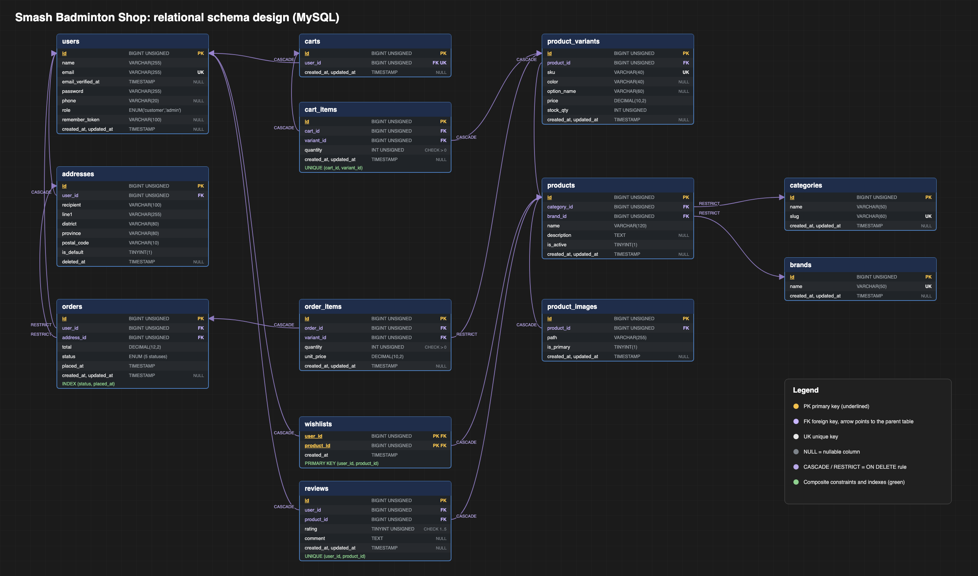
Schema design
Tables, keys and foreign keys of badminton_shop
PK on every table; composite PK on wishlists
FK arrows point to the parent id
UNIQUE: email, sku, brand name, one cart per user, one review per user and product
Index on orders (status, placed_at)
Notes:
Gold = primary key, purple = foreign key. Composite constraints shown under the tables.

Slide 4
Relational mapping
How each ER construct became relations
ER construct | Rule | Used in
Strong entity | Own relation; key attribute becomes PK | all entities
1:N relationship | FK on the N side | addresses, products, variants, images, orders
1:1 relationship | FK plus UNIQUE | carts.user_id
M:N relationship | New relation with both FKs and its own attributes | cart_items, order_items, wishlists, reviews
Enumerated attribute | ENUM column | users.role, orders.status
13 relations, e.g. orders(#id, user_id, address_id, total, status, placed_at)
Notes:
Mapping rules applied from the ER model to the 13 relations. Full column types are in docs/relational-mapping.md.

Slide 5
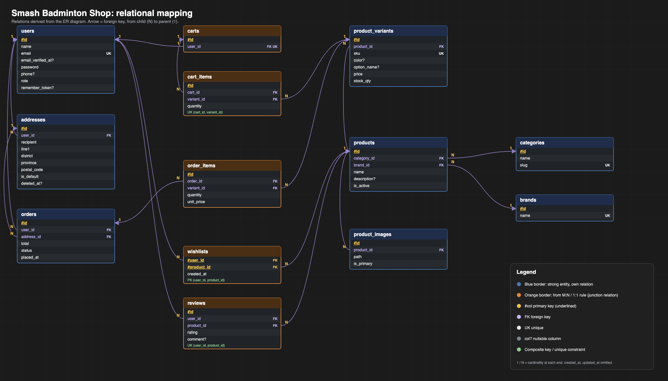
Mapped relations
Every relation with its keys

Slide 6
Data integrity rules
The schema protects history and cleans up personal data
RESTRICT
CASCADE
UNIQUE
Order history is protected: orders and order items cannot lose the user, address or variant they reference.
Child data follows its parent: addresses, carts, cart items, wishlists, images, variants.
One cart per user, one review per user and product, one variant per cart, unique SKU and email.
Soft delete
Stock and price
Addresses use deleted_at, so a removed address still resolves on old orders.
stock_qty and price live on variants; order items copy unit_price at purchase time.
Notes:
Explain why order history uses RESTRICT while personal data cascades.

Slide 7
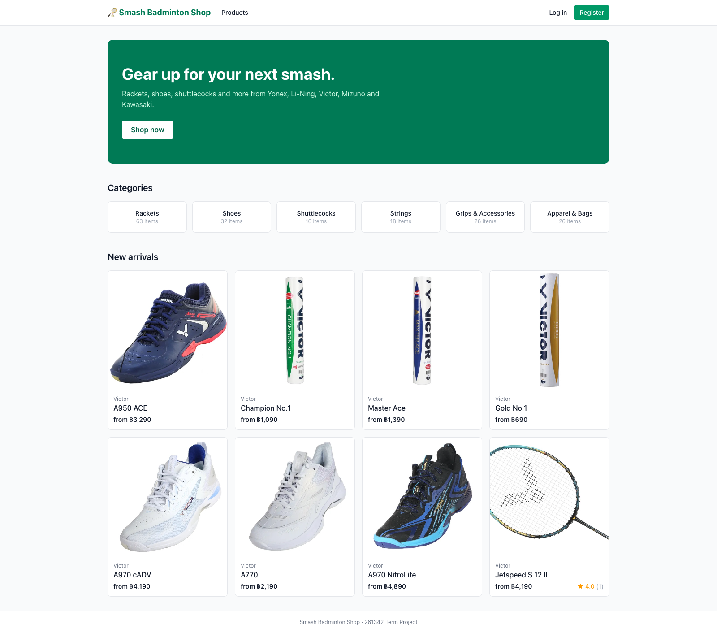
Home page

Slide 8
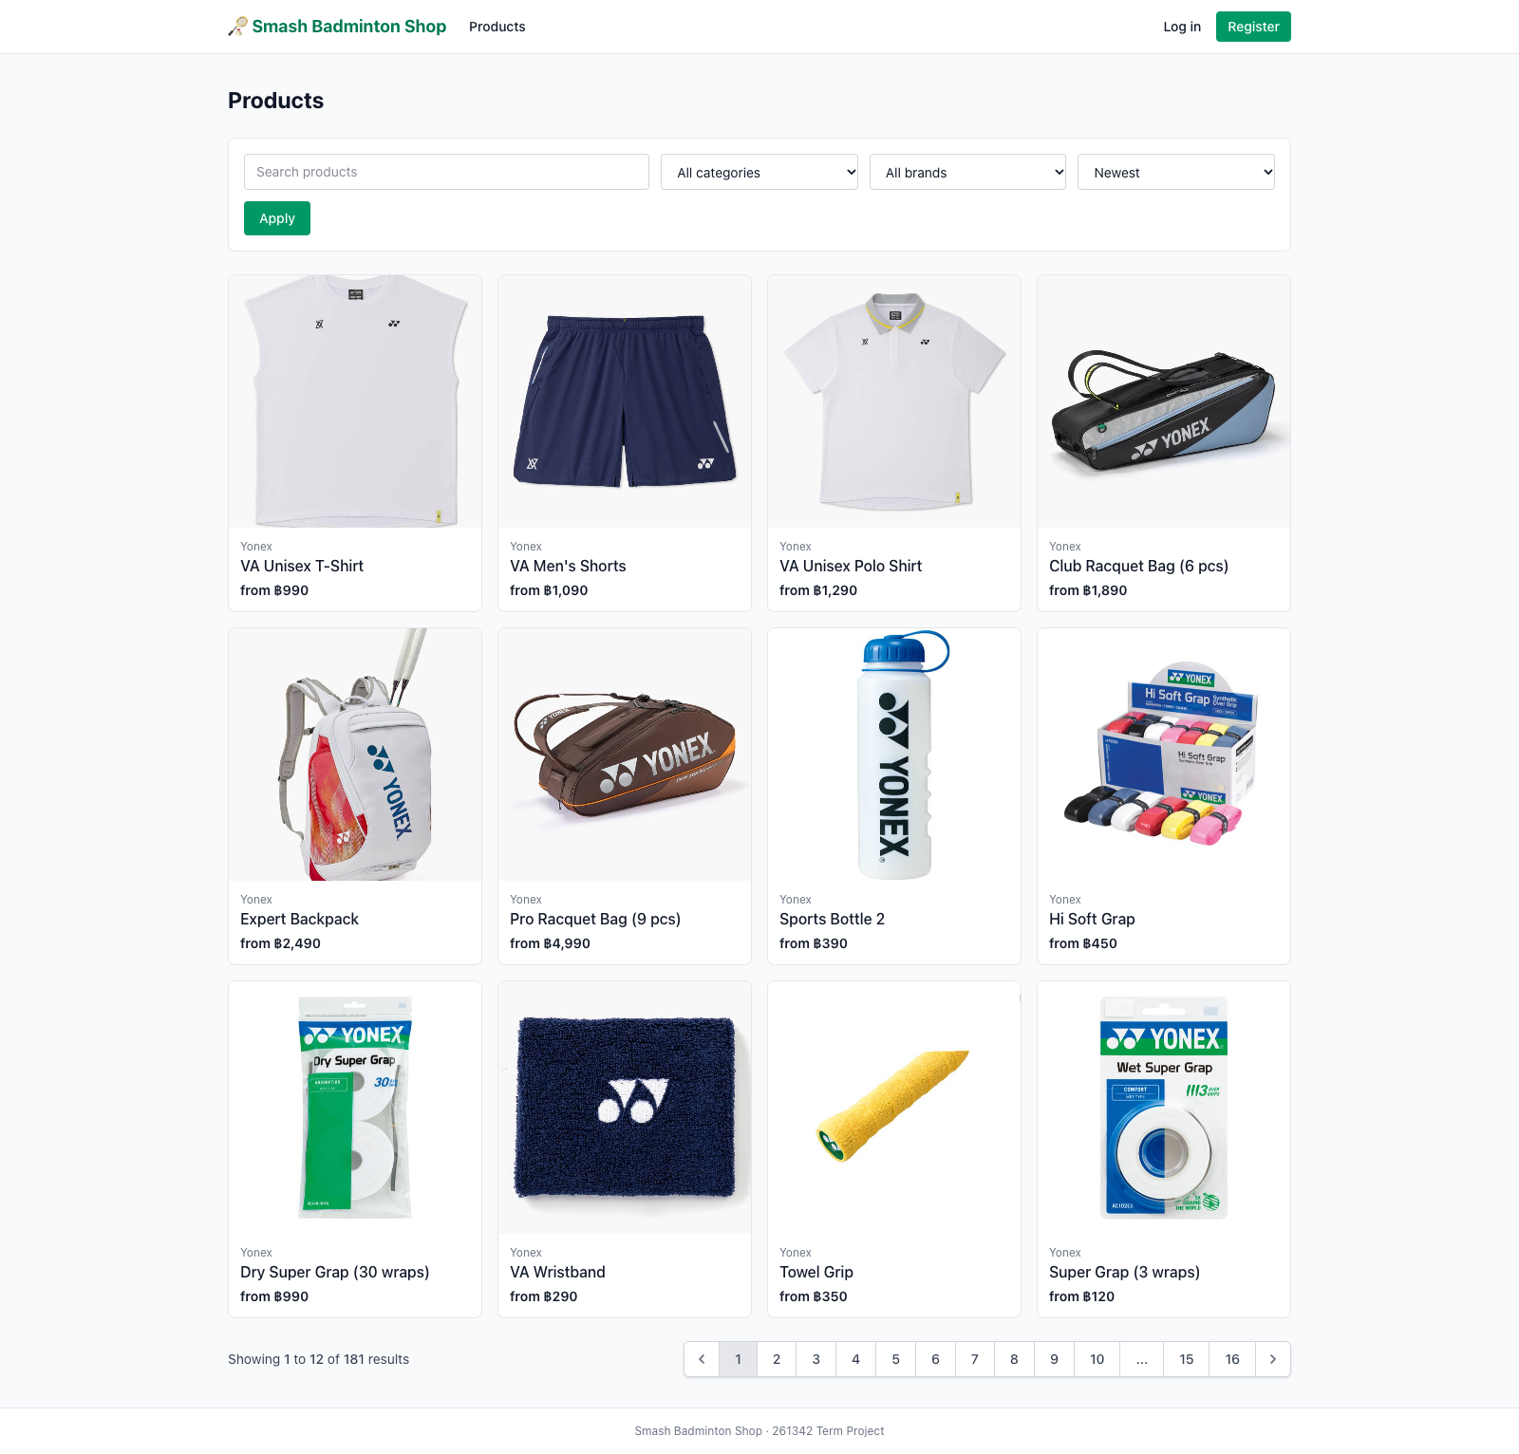
Products Page
Search by keyword
Filter by category and brand
Sort by newest, price or rating
Product cards with price and rating

Slide 9
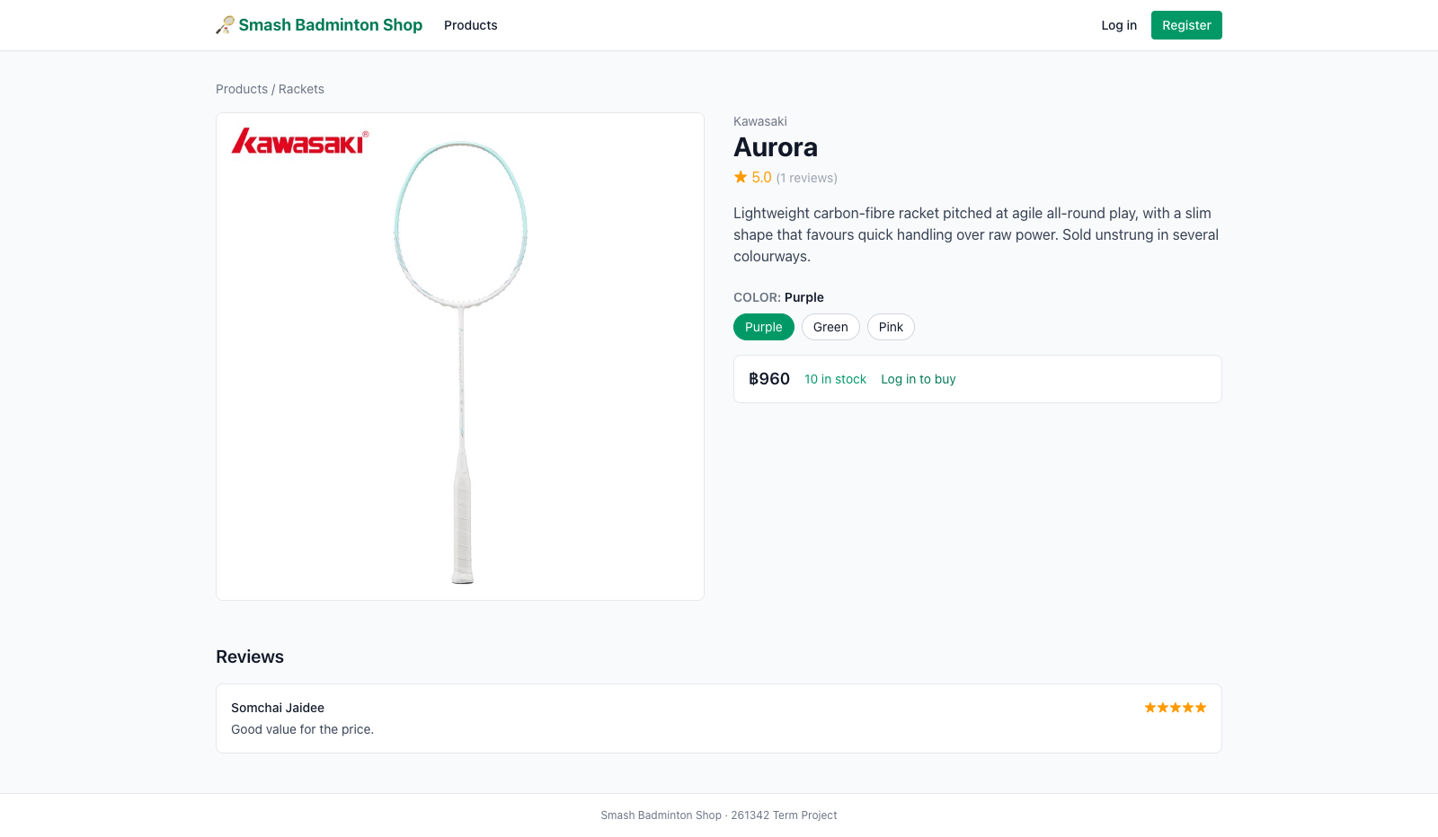
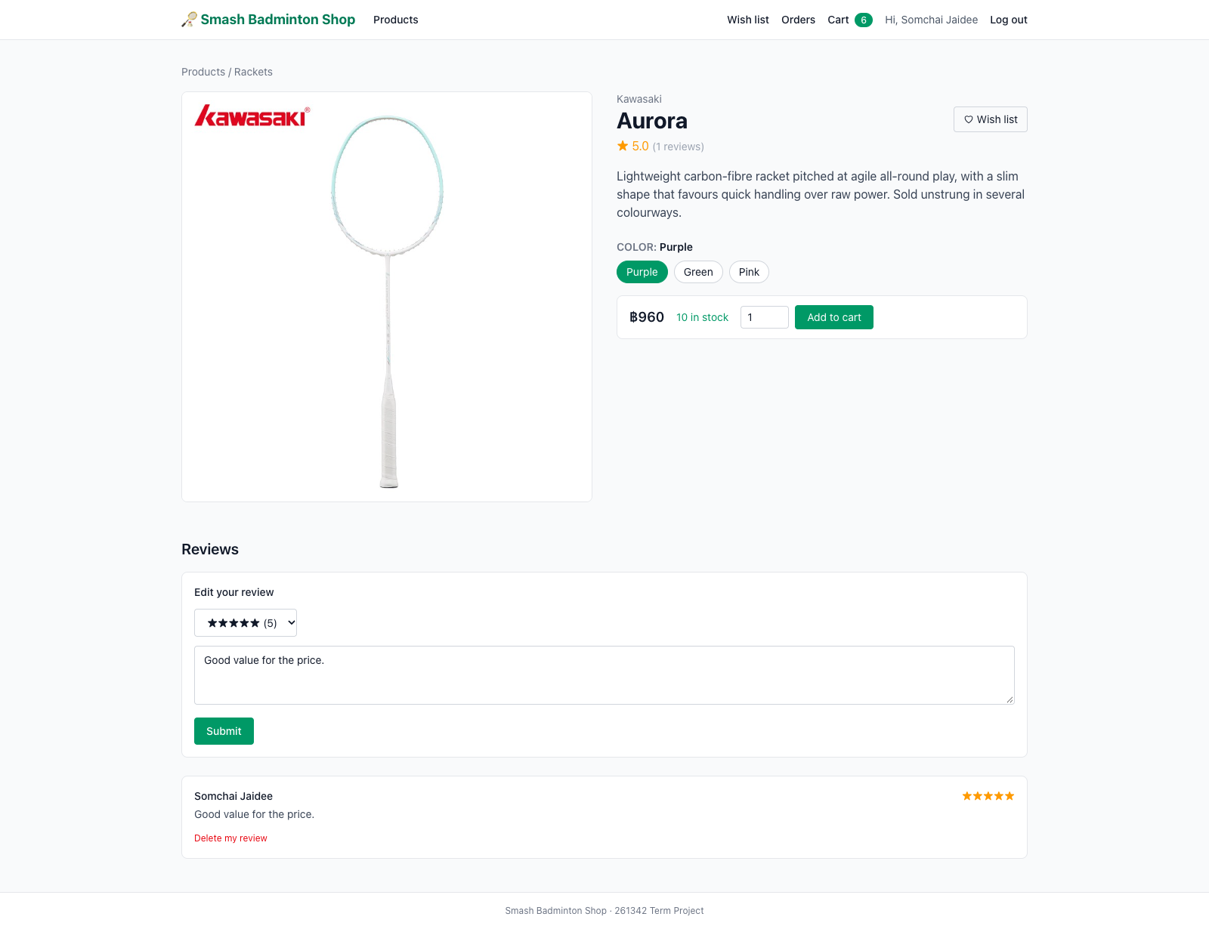
Product detail Page
Public (not logged in)
Logged in

Slide 10
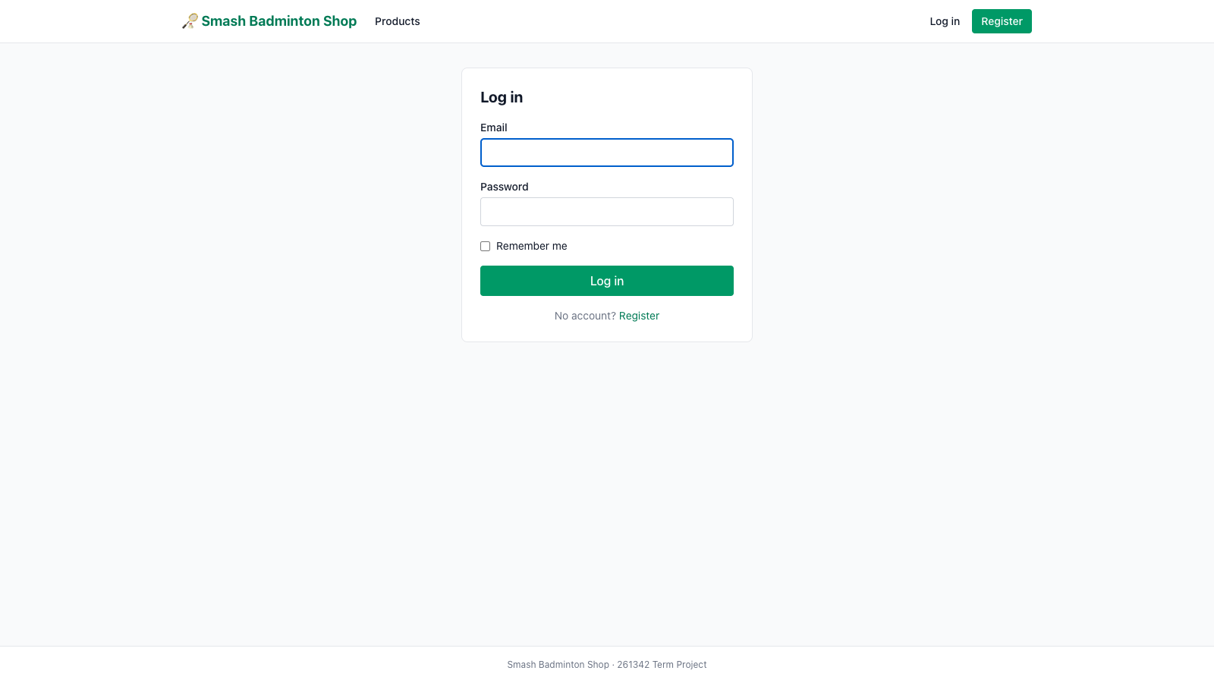
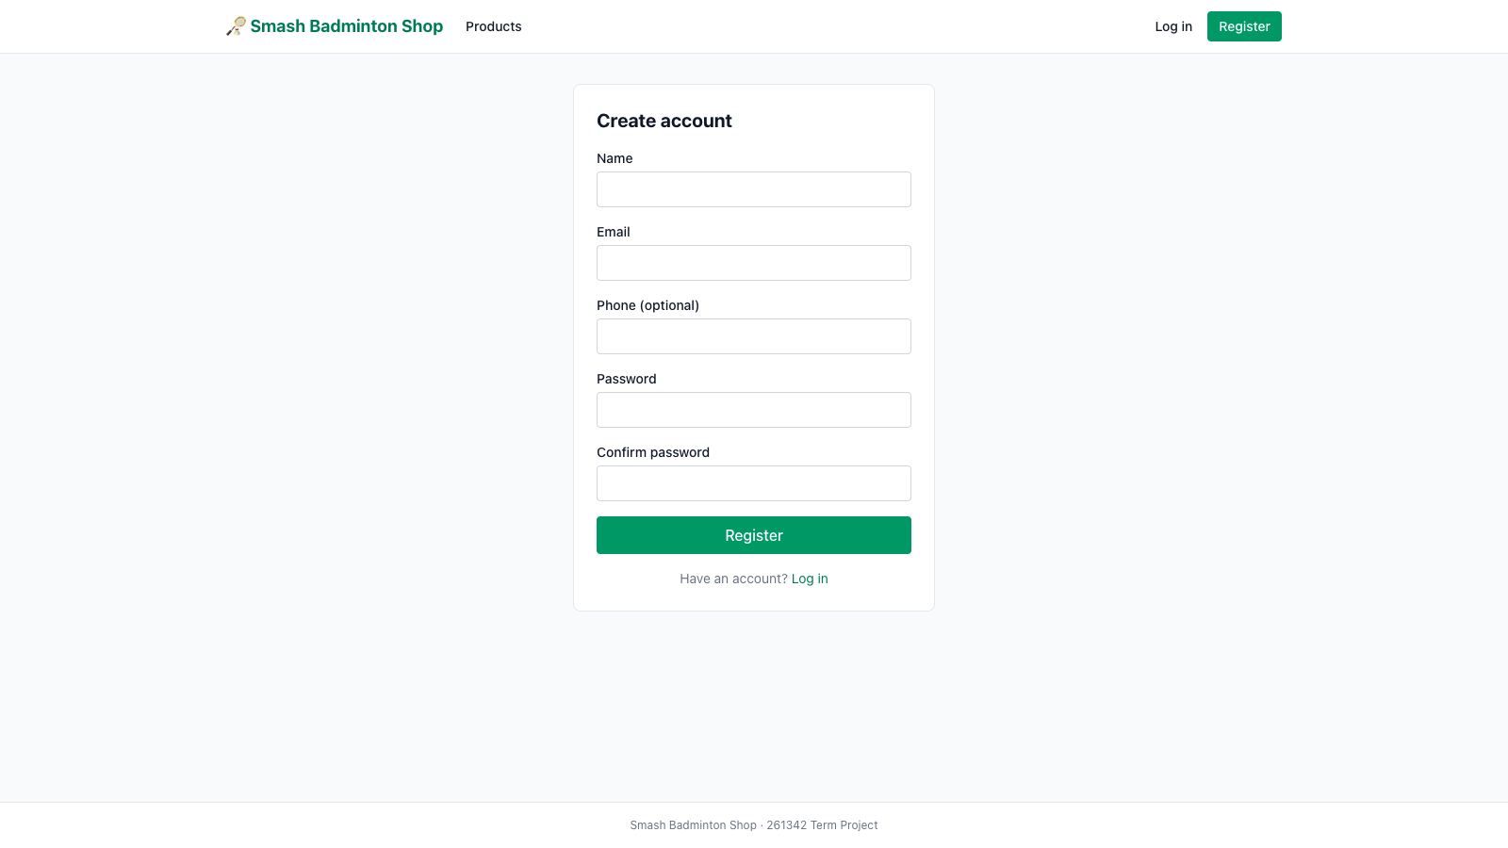
Log in & Register Page
Login
Register

Slide 11
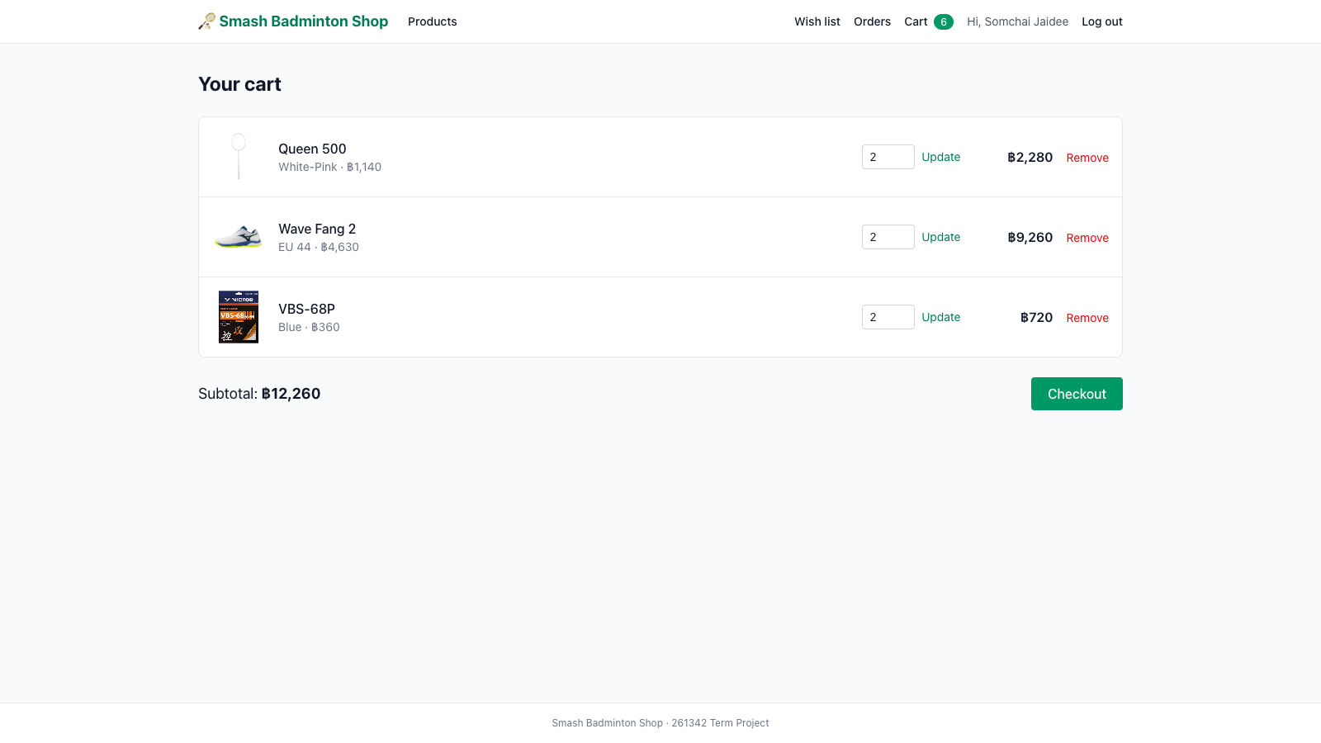
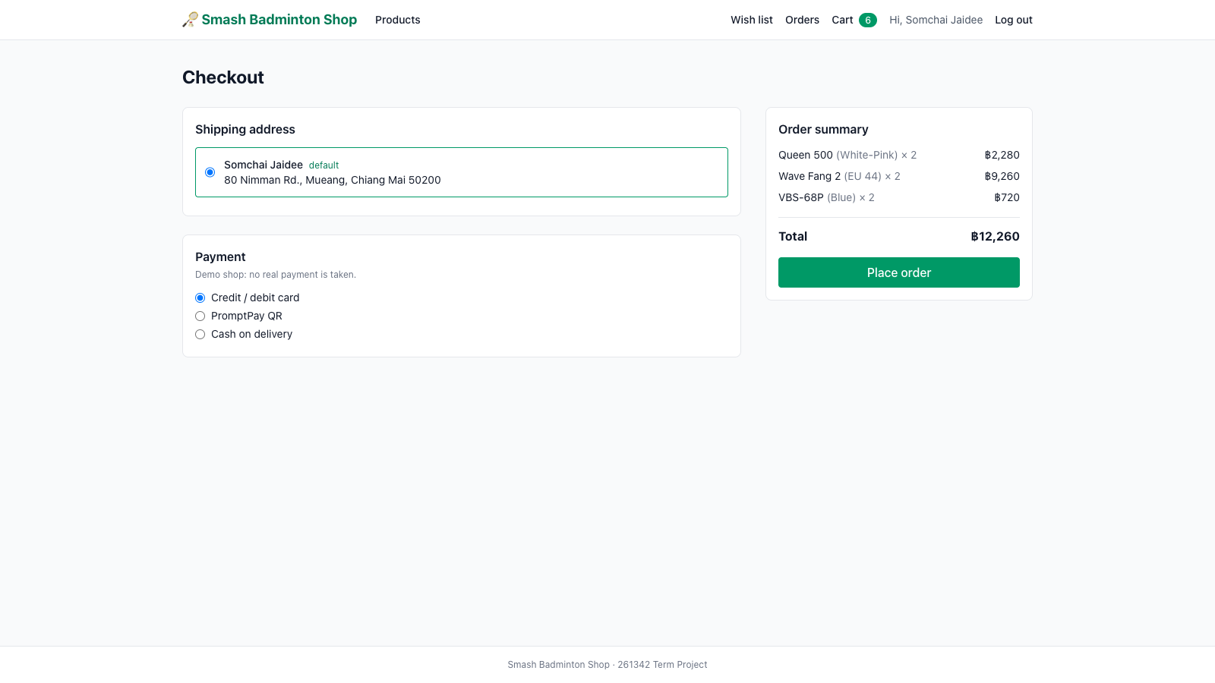
Cart & checkout Page
Cart
Checkout

Slide 12
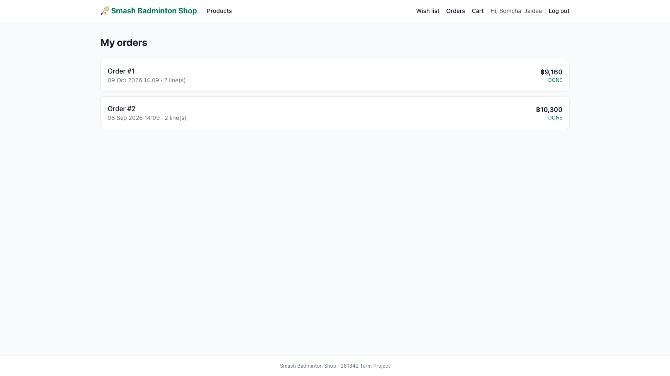
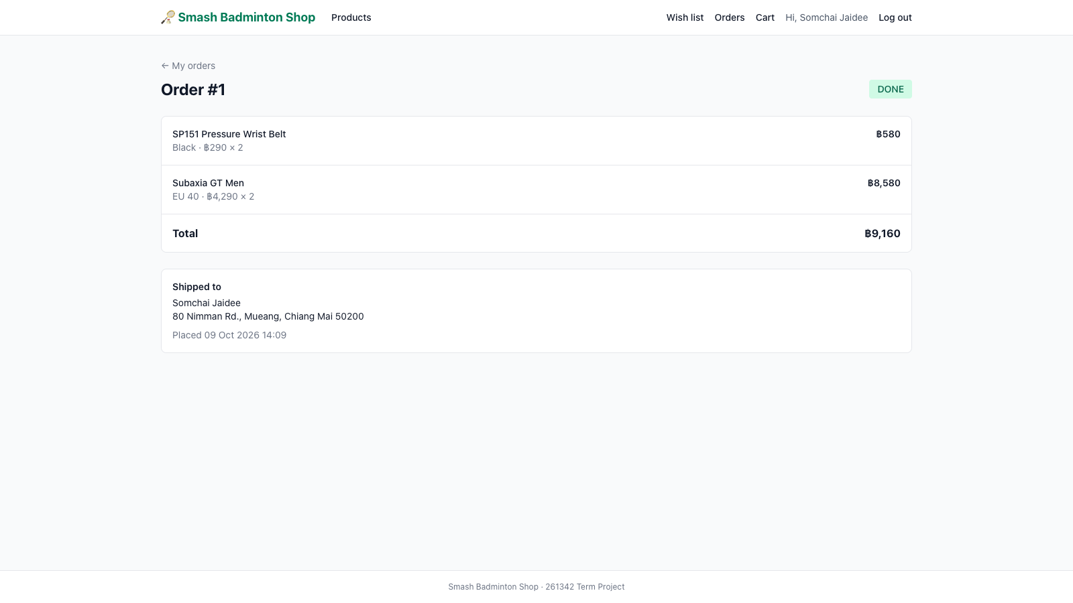
Order history
My orders
Order detail

Slide 13
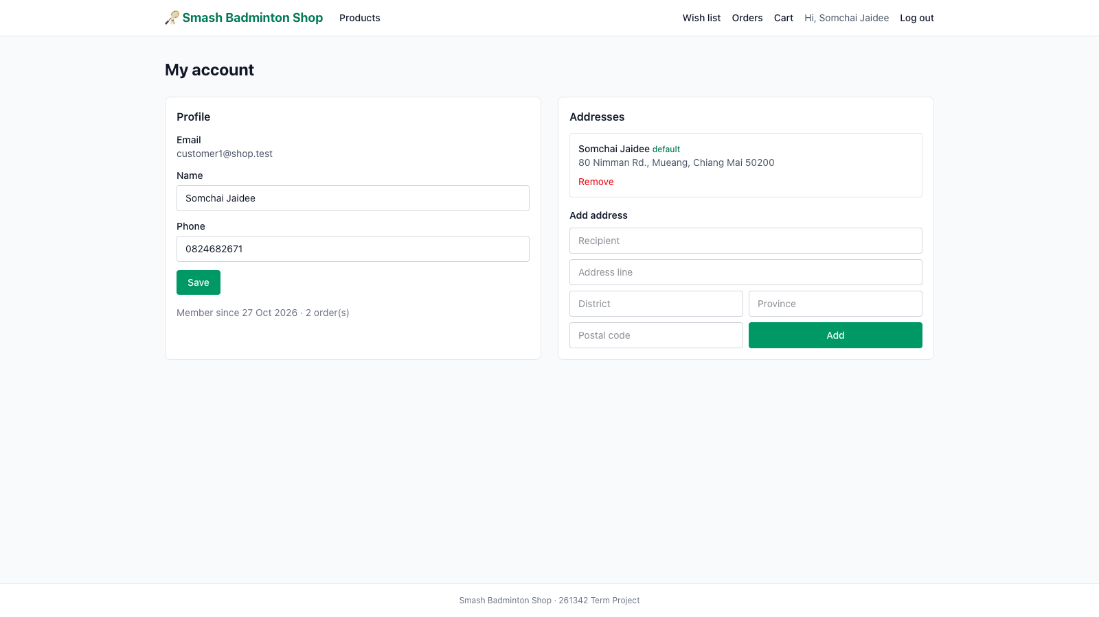
Account Page

Slide 14
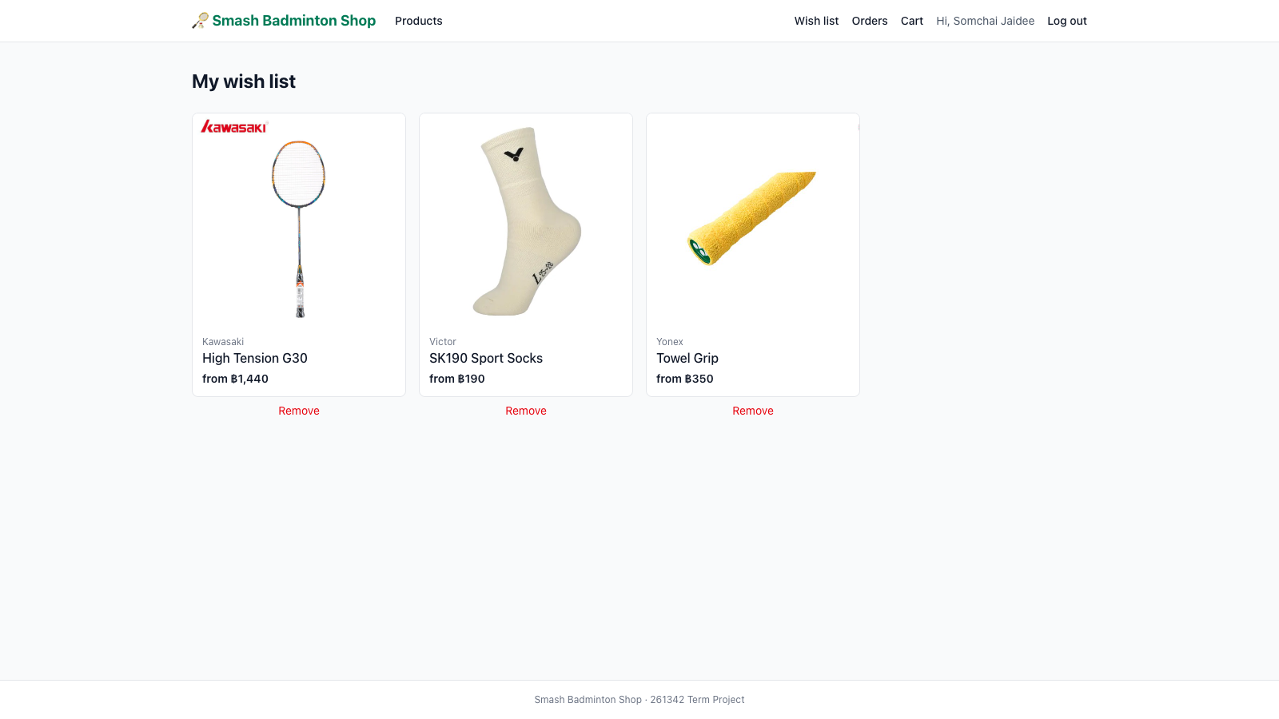
Wishlist Page

Slide 15
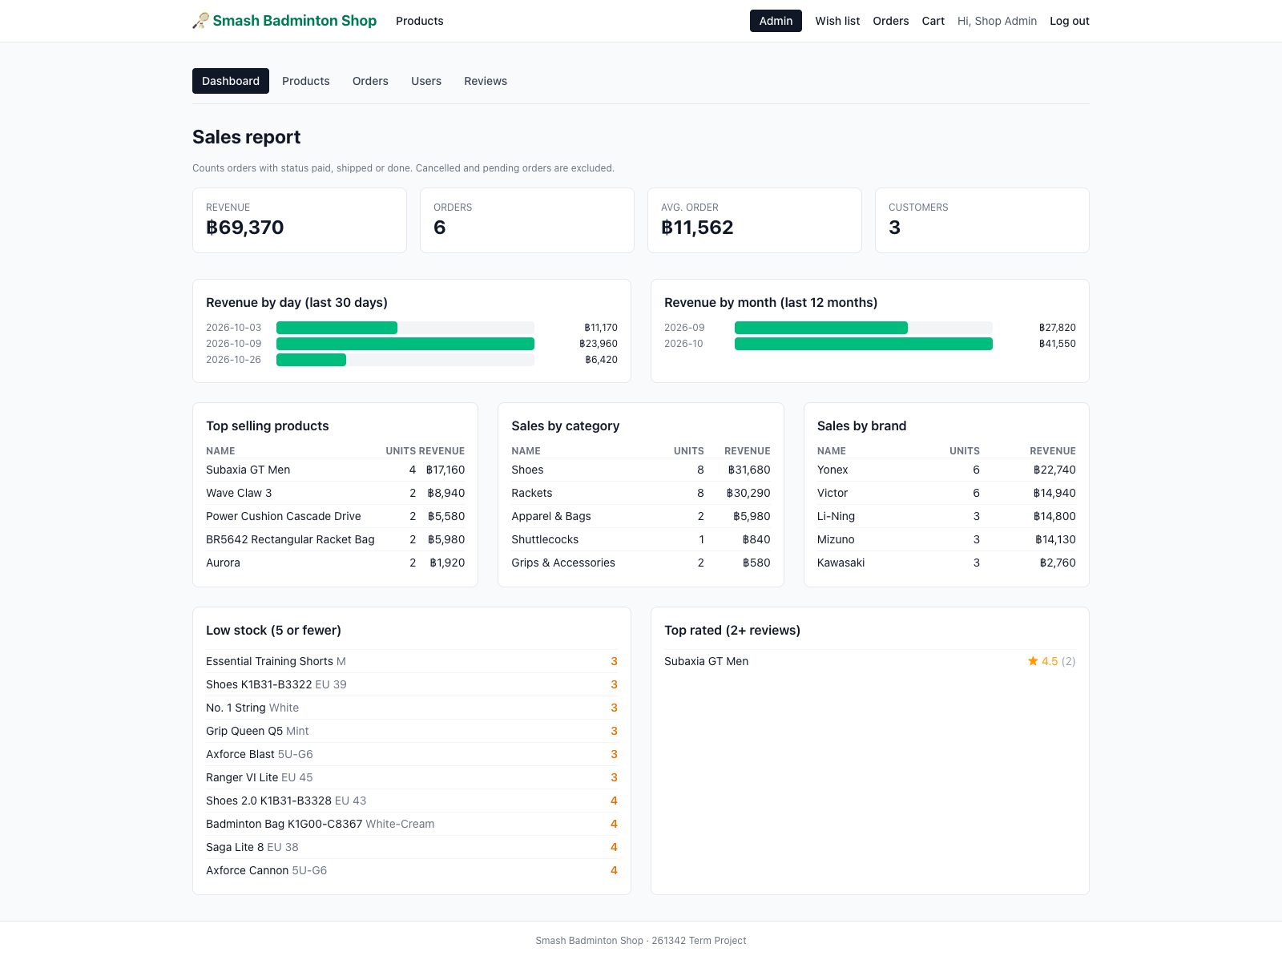
Admin dashboard
Sales report with revenue charts
Pending orders shortcut
Top-selling products by units and revenue
Low and out-of-stock variants
Top-rated products

Slide 16
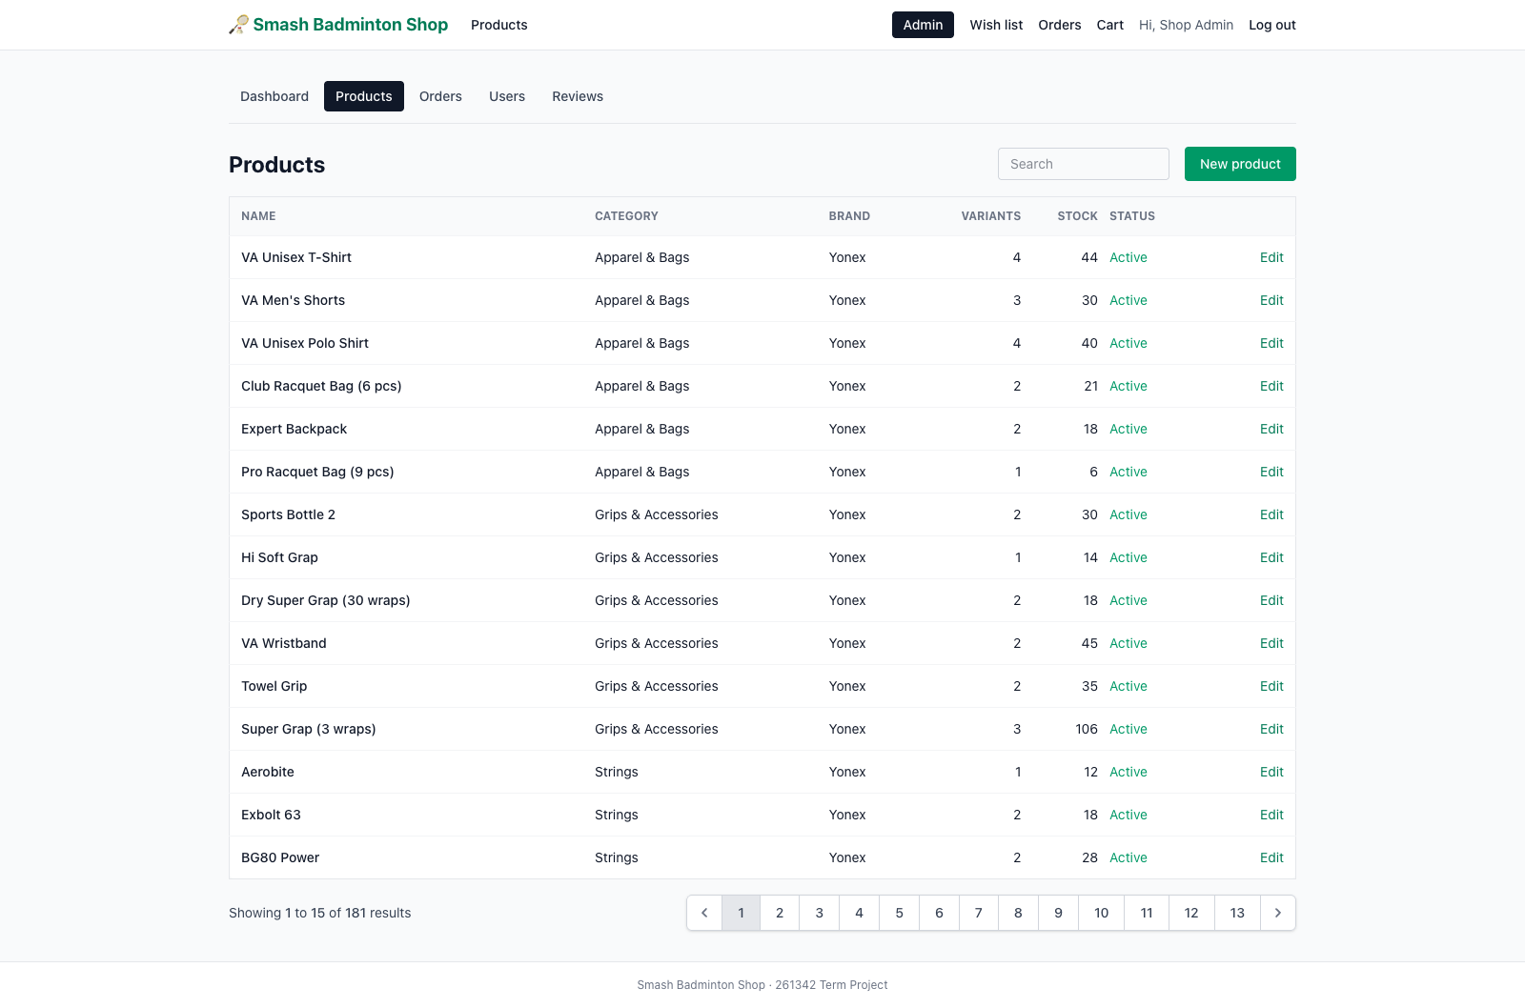
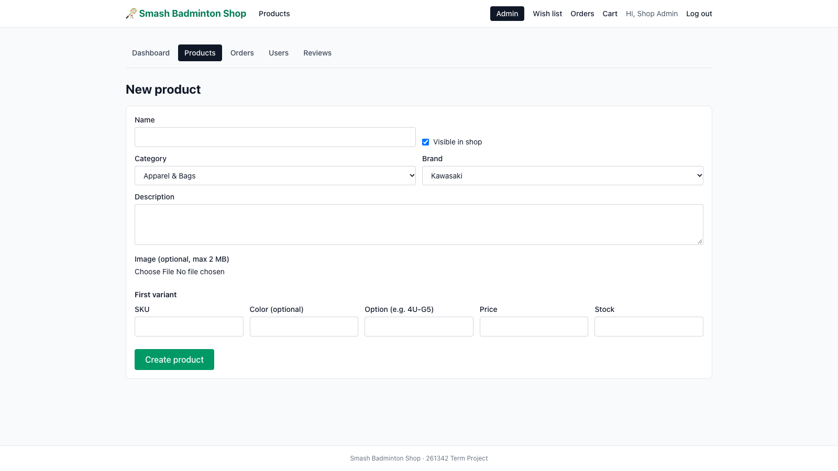
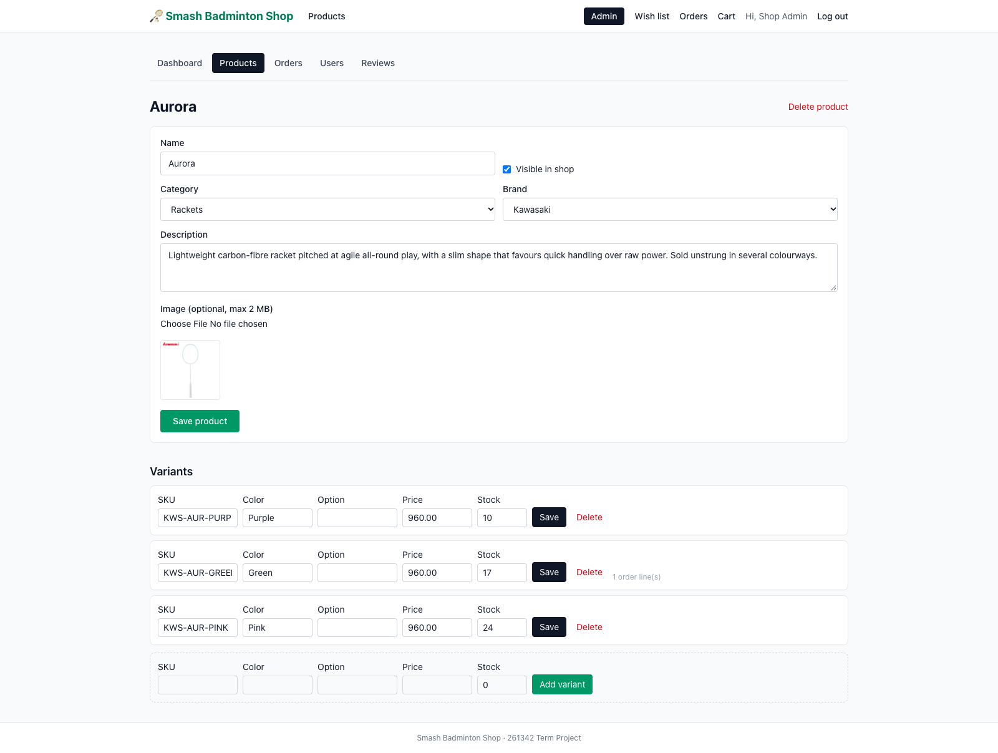
Admin: products
Product list
Create product
Edit product and variants

Slide 17
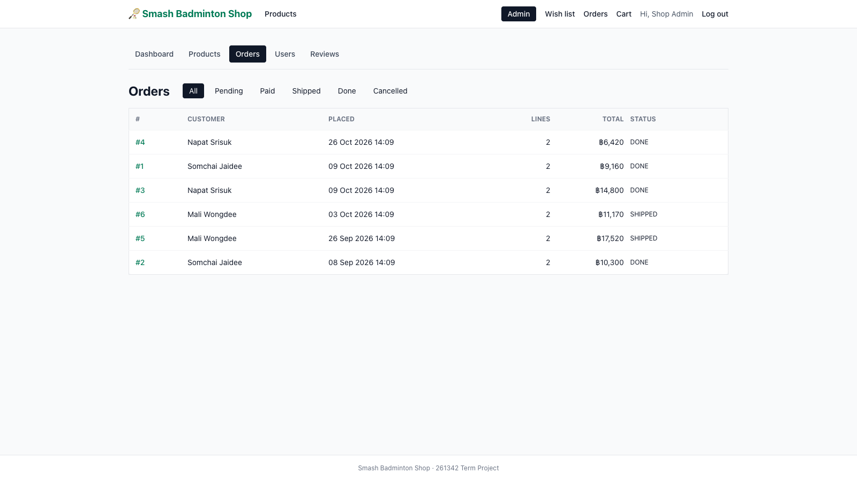
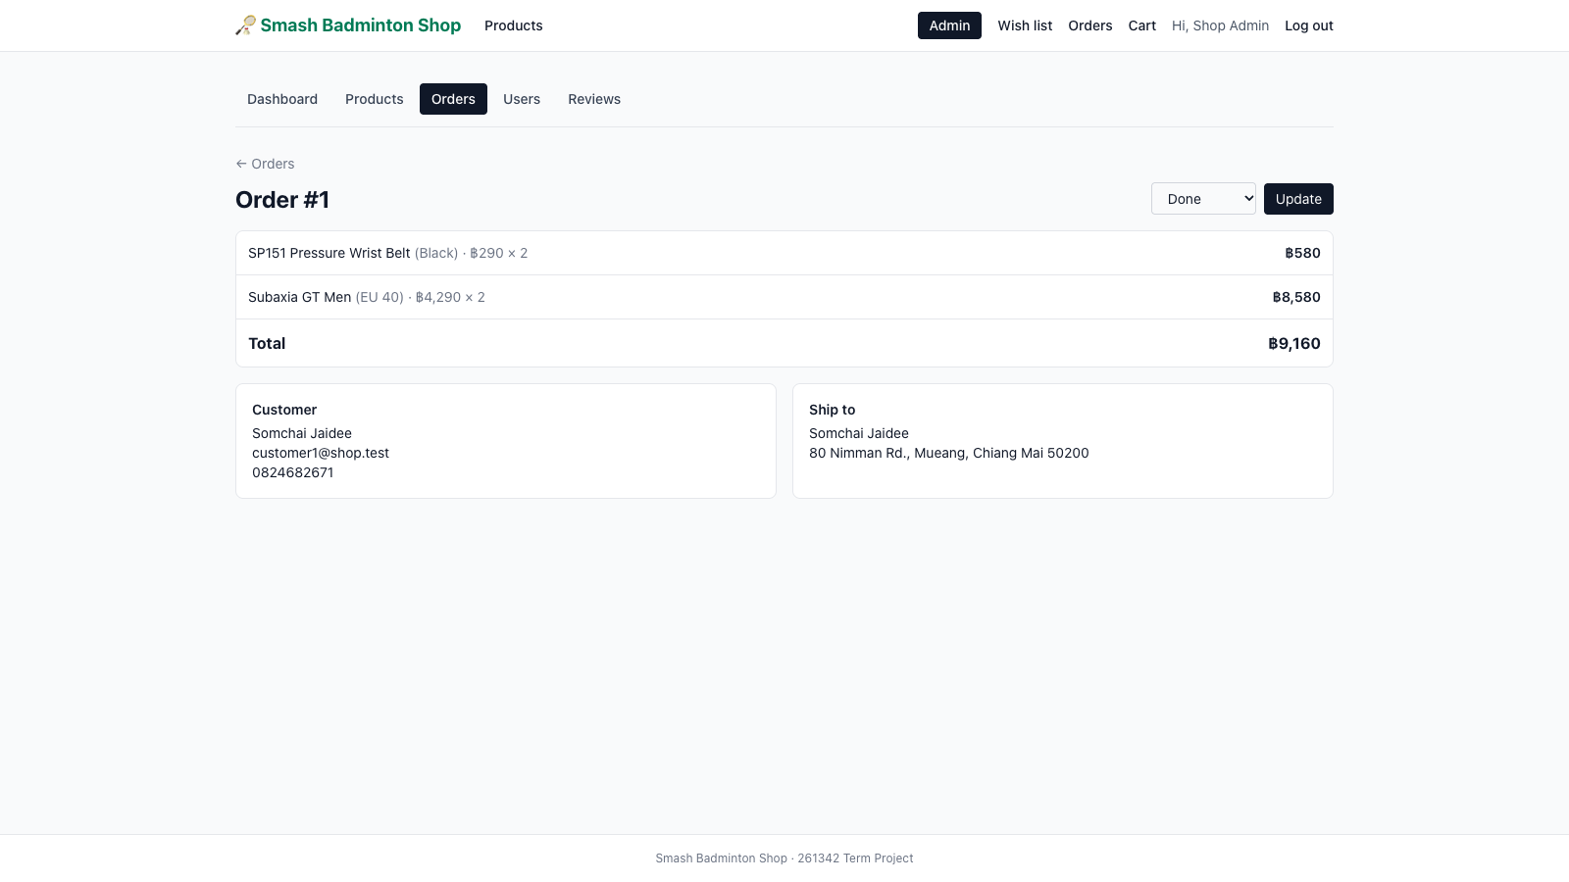
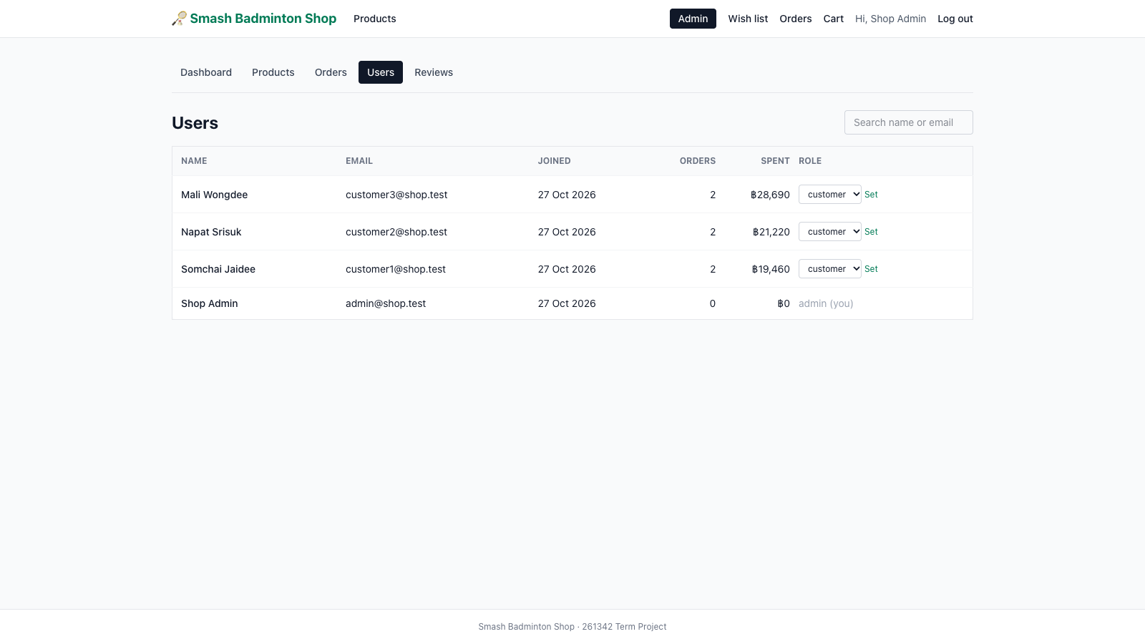
Admin: orders and users
Orders
Order detail and status
Users and roles

Slide 18
Group 3

