Slide 1

Real-Time Traffic Sign Recognition with Open-Set Rejection and Temporal Consensus
by
ADARSH B
Roll No. 234G5A3201
SATHEESH REDDY J
Roll No. 234G5A3208
SRI VAISHNAVI B
Roll No. 234G5A3214
SANDHYA S
Roll No. 224G1A3284
Under the guidance of
Mr. Dr. G. Hemanth Kumar Yadav _{M. Tech, PhD}
Associate Professor
Department of Computer Science and Engineering (Data Science)
Srinivasa Ramanujan Institute of Technology
(Affiliated to JNTUA & Approved by AICTE) (Accredited by NAAC with ‘A’ Grade & Accredited by NBA (EEE, ECE & CSE)
Rotarypuram Village, B K Samudram Mandal, Ananthapuramu – 515701.
2025 - 2026
Dept. of Computer Science and Engineering (Data Science) Srinivasa Ramanujan Institute of Technology
B - 03

Slide 2
Contents
Real-Time Traffic Sign Recognition with Open-Set Rejection and Temporal Consensus.
Abstract
Introduction
Literature survey
Proposed Work
References
GitHub Link
Queries
B - 03

Slide 3
Abstract
Real-Time Traffic Sign Recognition with Open-Set Rejection and Temporal Consensus.
The project is a system that can find and understand traffic signs in real time using video from a moving car.
This task is challenging because traffic signs can be:
  Small
  Hidden behind objects
  Similar in appearance to other objects
The system is designed to be fast, using:
  A simple detector to locate traffic signs
  A detailed classifier to interpret their meaning
To avoid confusion with objects that only look like signs, the system includes a special feature that rejects fake signs by checking their shape and color.
The system uses temporal consensus, which means it tracks signs across multiple video frames to:
  Make predictions more stable and accurate
  Handle cases where signs are blurry or temporarily out of sight
The project is designed to run efficiently on small computers, such as those typically found in cars.
Testing on real video data has shown the system to be both fast and accurate.
This work provides a solid foundation for future projects in:
  Driver assistance
  Smart transportation
B - 03
3

Slide 4
Introduction
Real-Time Traffic Sign Recognition with Open-Set Rejection and Temporal Consensus.
The Problem
Our project tackles a big challenge for self-driving cars: recognizing traffic signs in real time. This is hard because signs can be tiny, hidden, or look like other objects, and our system has to be super fast to keep up with the car's speed.
The Solution
To solve this, we're building a special system that has two main parts. One part is a simple, fast detector that finds all the possible signs in a video. The second part is a smarter classifier that looks at what's been found and figures out exactly what kind of traffic sign it is.
Our Unique Approach
Our system has two key features. First, it can reject fake signs—things that look like traffic signs but aren't—by checking their shape and color. Second, it uses a temporal consensus module that tracks a sign across multiple video frames. This makes our predictions more reliable, especially if a sign is blurry or briefly hidden.
The Goal
The main goal of our project is to create a high-performing system that runs quickly on a small computer. We want to show that our approach is a solid foundation for building practical and safe driver assistance systems.
B - 03

Slide 5
Real-Time Traffic Sign Recognition with Open-Set Rejection and Temporal Consensus.
Literature Survey
No | Title | Author | Journal Name & Year | Methodology Adapted | Key Findings | Gaps
1. 2. | Towards Real-Time Traffic Sign Detection and Classification A Real-Time Traffic Sign Recognition Method Using a New Attention-Based Deep Convolutional Neural Network for Smart Vehicles | Yi Yang, Hengliang Luo, Fuchao Wu Hana, B. F., Amani, C., Jamel, B. H., Chokri, S. | ResearchGate Journal MDPI & 2023 | A fast detection module based on a color probability model and a color HOG. It also uses a Convolutional Neural Network (CNN) to classify detected signs into subclasses. Combines the Haar cascade technique with a deep CNN model classifier to recognize 43 types of signs. | Achieved comparable performance to state-of-the-art methods with significantly improved computational efficiency. The detection module is 20 times faster than the existing best detection module. Achieved high accuracy (99.91%) and F1-measure rates (99%). The system was validated on a Raspberry Pi 4 board, demonstrating its viability for embedded systems. | This paper focuses on a closed-set problem (known traffic signs). Your project, however, is addressing the open-set problem to handle unknown signs and distractors. While this paper mentions a system for smart vehicles, it does not specifically address the problem of open-set rejection or the use of temporal consensus to handle unknown objects or improve stability in a video stream.
3. 4. | Temporal-Guided Label Assignment for Video Object Detection Video Object Detection via Object- level Temporal Aggregation | Jiahui Guo, Guohao Li, Shuo Chen, Guofa Li, Yuxin Chen Xingyi Zhou, Deva Ramanan | MDPI & 2022 European Computer Vision Association & 2020 | Proposed a temporal-guided label assignment framework for a Region Proposal Network (RPN). It uses a feature instructing module to establish relationships among labels over time. Proposes temporal aggregation modules that integrate object detection and tracking at the object or bounding box level. It applies detection on sparse keyframes and uses real-time trackers to propagate object status. | This method improves video object detection by stabilizing the learning process and correcting erroneous labels by using temporal information from other frames. Achieved a competitive speed-accuracy trade-off by reducing redundant computation while maintaining temporal consistency. | This paper focuses on general video object detection. Your project adapts this concept specifically for traffic sign recognition, where signs are tiny and their appearance can be challenging due to occlusions and motion blur. This is a foundational approach to using tracking for temporal aggregation in video object detection. Your project will apply this concept specifically to traffic signs, which have a unique set of challenges, and will combine it with an open-set rejection component, which is not the focus of this paper.
B - 03

Slide 6
Proposed System
Real-Time Traffic Sign Recognition with Open-Set Rejection and Temporal Consensus.
System Overview
  Processes video to detect and understand traffic signs in real time.
  Uses a fast detector to spot possible signs and a detailed classifier to identify their meaning.
  Includes features to reject fake signs and track signs across frames for reliability.
Fast Detection
    Based on a single-stage detector (AI model) that works in one quick step.
    Ensures real-time response (important for cars).
    Handles small traffic signs efficiently.
Smart Classification & Filtering
    A fine-grained classifier distinguishes between similar-looking signs.
A shape-and-color filter (e.g., circles, triangles, red, blue) rejects objects that aren’t real traffic signs.
  Stability & Goals
      Temporal tracking across frames improves stability by handling motion blur and temporary obstructions.
      Target performance: 50 ms per frame for real-time use in cars.
      Success measured by accuracy in detection, classification, and rejection of fake signs.
B - 03

Slide 7
Reference
Real-Time Traffic Sign Recognition with Open-Set Rejection and Temporal Consensus.
[1]. Yi Yang, Hengliang Luo and Fuchao Wu, "Towards Real-Time Traffic Sign Detection and Classification," ResearchGate Journal.
[2]. Hana, B. F., Amani, C., Jamel, B. H., and Chokri, S., "A Real-Time Traffic Sign Recognition Method Using a New Attention-Based Deep Convolutional Neural Network for Smart Vehicles," MDPI, 2023.
[3]. Jiahui Guo, Guohao Li, Shuo Chen, Guofa Li, and Yuxin Chen, "Temporal- Guided Label Assignment for Video Object Detection," MDPI, 2022.
[4]. Xingyi Zhou and Deva Ramanan, "Video Object Detection via Object-level Temporal Aggregation," European Computer Vision Association, 2020.
B - 03

Slide 8
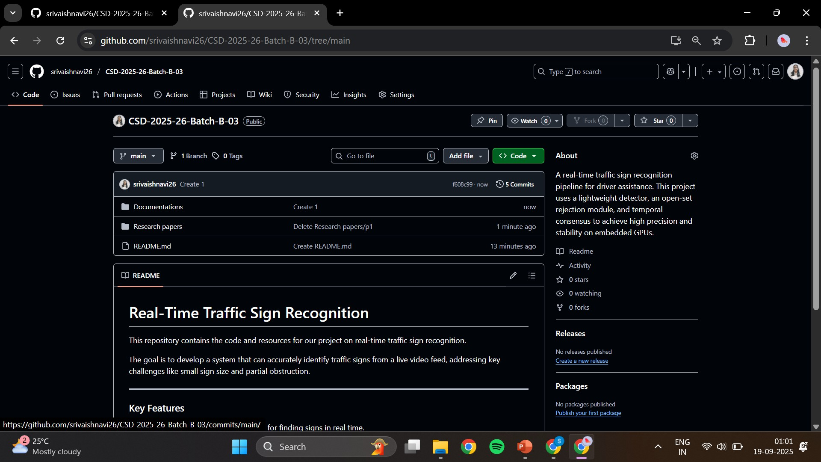
Git Hub Dashboard
Real-Time Traffic Sign Recognition with Open-Set Rejection and Temporal Consensus.
Repository Name : CSD 2025 – 26 Batch: B – 03
b - 03

Slide 9
Real-Time Traffic Sign Recognition with Open-Set Rejection and Temporal Consensus.
Any Queries?
B - 03

Slide 10
Real-Time Traffic Sign Recognition with Open-Set Rejection and Temporal Consensus.
Thank You!!!
B – 03

