Slide 1

Real-Time Traffic Sign Recognition with Open-Set Rejection and Temporal Consensus
by
Adarsh B
Roll No. 234G5A3201
Satheesh Reddy J
Roll No. 234G5A3208
Sri Vaishnavi B
Roll No. 234G5A3214
Sandhya S
Roll No. 224G1A3284
Under the guidance of
Dr. G. Hemanth Kumar Yadav _{M. Tech, PhD}
Associate Professor
Department of Computer Science and Engineering (Data Science)
Srinivasa Ramanujan Institute of Technology
(Affiliated to JNTUA & Approved by AICTE) (Accredited by NAAC with ‘A’ Grade & Accredited by NBA (EEE, ECE & CSE)
Rotarypuram Village, B K Samudram Mandal, Ananthapuramu – 515701.
2025 - 2026
Dept. of Computer Science and Engineering (Data Science)
Srinivasa Ramanujan Institute of Technology

Slide 2
Contents
Abstract
Problem Statement
Introduction
Objectives of Project
Literature survey for objectives
Existing System
Proposed System
Planning
Requirements
UML Diagrams
Data Flow Diagram
Sample Code
Screenshots (Project Output)
References
GitHub Link

Slide 3
Review-0 Remarks
Review-0 Comments:
Project steps clarity
Clear project approach
Explain existing systems
Comparison between existing & proposed system
Action Taken:
Clearly defined pipeline stages
Added existing vs proposed comparison
Detailed implementation workflow
Quantitative evaluation metrics included

Slide 4
Review-1 Remarks
Review-1 Comments:
Team roles and responsibilities need clearer definition.
Individual workflows should align clearly with project modules.
Preliminary research paper draft required.
Action Taken:
Explicitly assigned roles and responsibilities to each team member.
Mapped individual workflows to corresponding system modules.
Prepared and submitted an initial research paper draft covering abstract, methodology, and early results.

Slide 5
Abstract
Traffic sign recognition in real-world driving videos is challenging due to tiny sign sizes, occlusions, motion blur, and visually similar non-traffic objects.
This project presents a real-time Traffic Sign Recognition (TSR) pipeline that integrates a lightweight YOLO-based detector with a fine-grained Res Net-based classifier.
To handle unknown objects, an open-set rejection mechanism using confidence thresholds is applied.
Temporal consensus across video frames stabilizes predictions and reduces flickering.
The system is evaluated using classification metrics and open-set AUROC, demonstrating robust and reliable performance suitable for intelligent transportation system

Slide 6
Problem Statement
Objectives in existing systems
Existing TSR systems assume closed-set Recognition
High false positives due to sign-like objects
Frame-wise prediction causes unstable labels
Real-time performance is difficult with heavy models
Problem:
Design a real-time TSR system that is accurate, stable, and robust to unknown objects in video streams

Slide 7
Introduction
Real-Time Traffic Sign Recognition with Open-Set Rejection and Temporal Consensus
Transparency & privacy The Role of Explainable AI &Federated Learning in Financial Fraud Detection
Introduction
Traffic Sign Recognition is a critical component of Advanced Driver Assistance Systems (ADAS).
Accurate and stable recognition ensures driver safety and supports autonomous navigation.
Our system focuses on real-world deployment challenges such as unknown objects and video instability.
The proposed approach improves reliability by combining detection, classification, and temporal consistency across video frames.
Dept. of Computer Science and Engineering (Data Science)
Srinivasa Ramanujan Institute of Technology

Slide 8
Objectives of the Project
Detect traffic signs accurately in road videos
Classify detected signs into fine-grained categories
Reject unknown / non-traffic objects (open-set)
Stabilize predictions across frames
Maintain real-time performance

Slide 9
Literature Survey for Objectives defined
Detection &Classification
Yi Yang et al. - CNN-based traffic sign recognition (closed-set only)
Hana B. F. et al. - Haar cascade + CNN (no open-set handling)
Limitation: Closed-set assumption and lack of robustness in real-world scenes.
Temporal Stability & Open-Set
Jiahui Guo et al. - Temporal guided label assignment
Xingyi Zhou et al. - Detection + tracking aggregation
Limitation: Not designed for tiny traffic signs, no open-set rejection

Slide 10
Existing System & Proposed System
Existing System:
Closed-set recognition only
Misclassifies non-traffic objects
Poor stability under motion blur
Limited real-time feasibility
Proposed System:
YOLO-based detection for small traffic signs
Crop extraction from detected regions
ResNet18 for sign classification
Confidence-based open-set rejection
Temporal consensus using sliding window voting
End-to-end real-time video pipeline

Slide 11
Planning
Phase-wise Plan:
Dataset preparation (GTSRB + video crops)
YOLO detection
Classifier training
Open-set rejection
Temporal consensus
Evaluation & results

Slide 12
Requirements
System Requirements :
Hardware Processor: Intel i5 or equivalent
RAM: 8 GB
Storage: 20 GB free space
Software:
Operating System: Windows 10 / 11
IDE: PyCharm
Command Line: Ubuntu (WSL)
Programming Language: Python 3.8+Libraries: Py Torch, OpenCV
Runtime:
CPU-based execution
Offline video processing

Slide 13
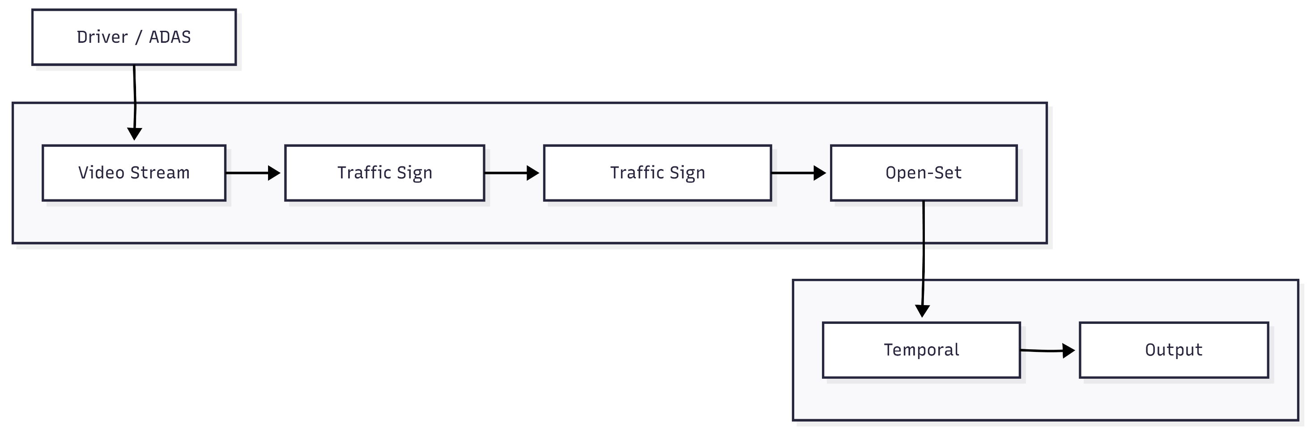
UML Diagrams
Fig: UML - Use Case Diagram
This use case diagram shows how the system processes a live video stream to detect, classify, reject unknown signs, and produce stable outputs.

Slide 14
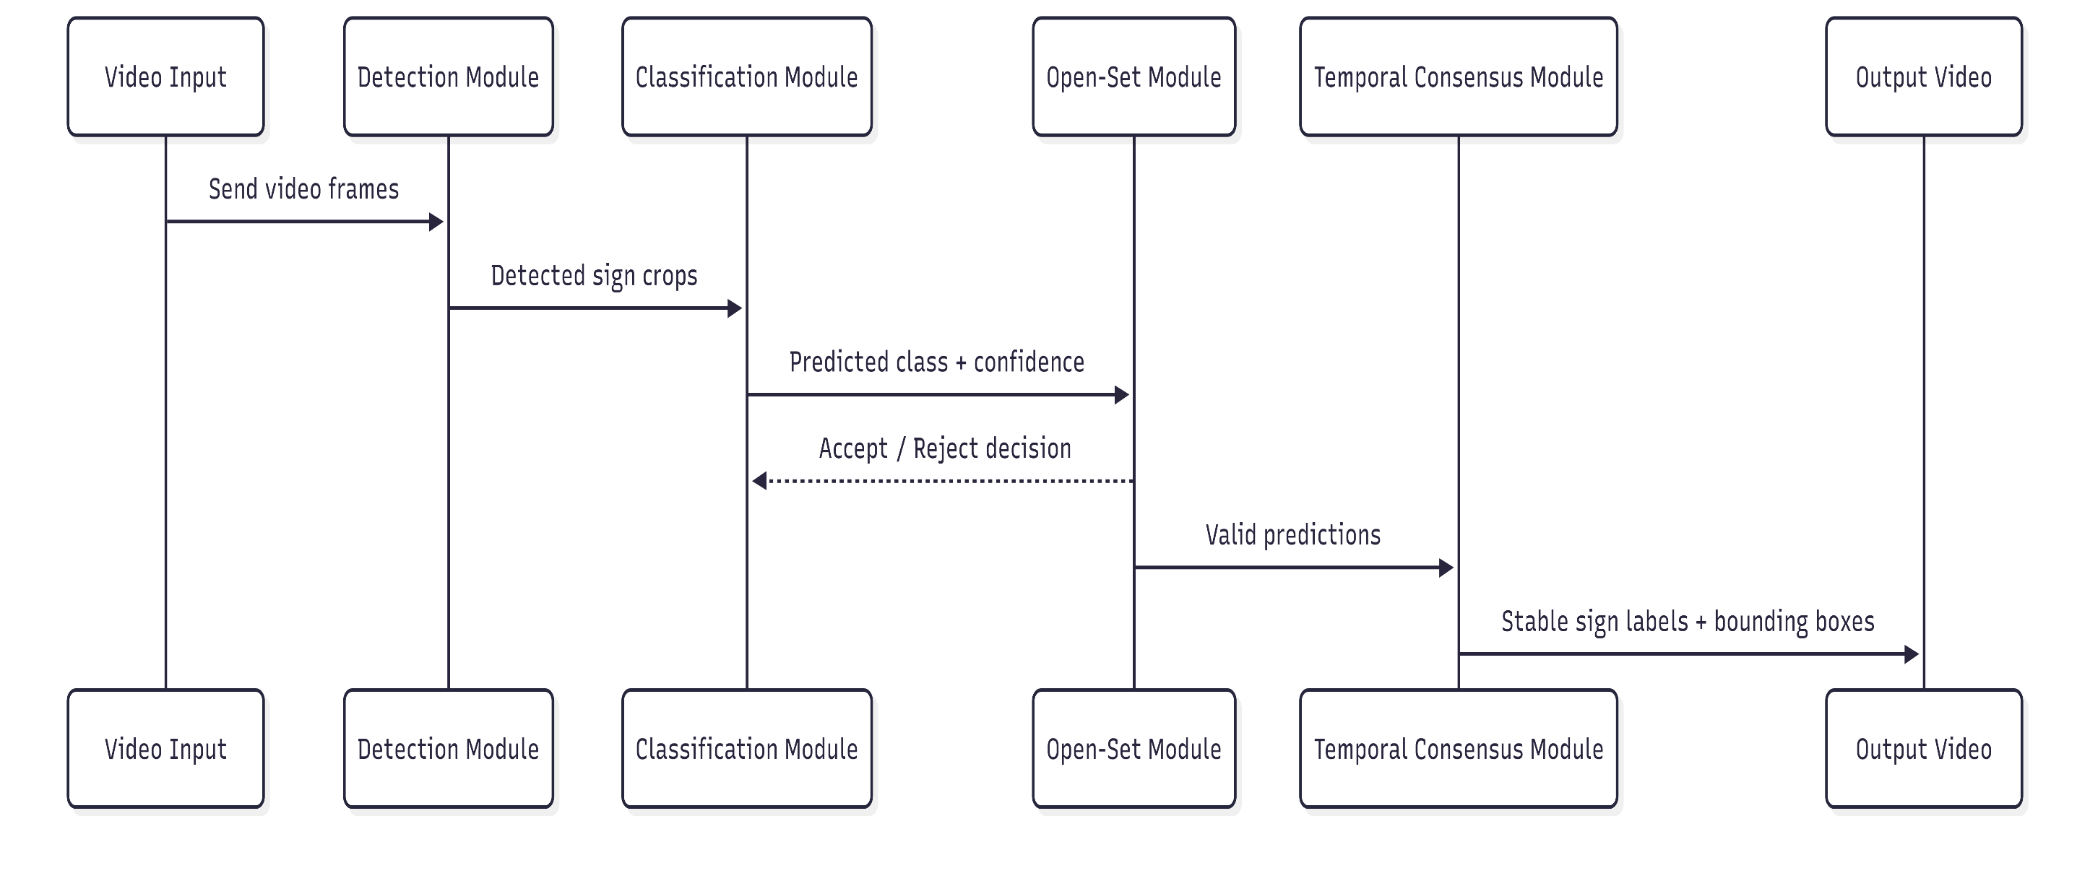
UML Diagrams
Fig: UML - Sequence Diagram
The sequence diagram captures the real-time interaction between modules for each video frame

Slide 15
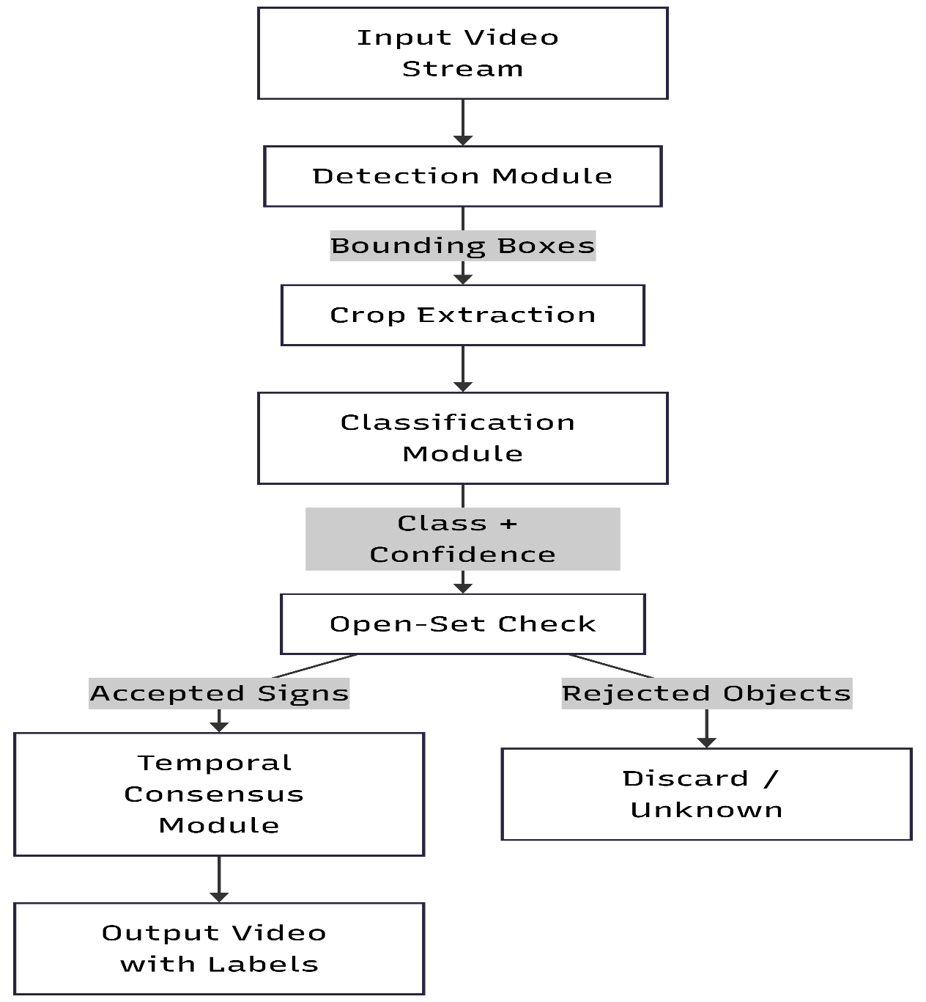
Data Flow Daigram

Slide 16
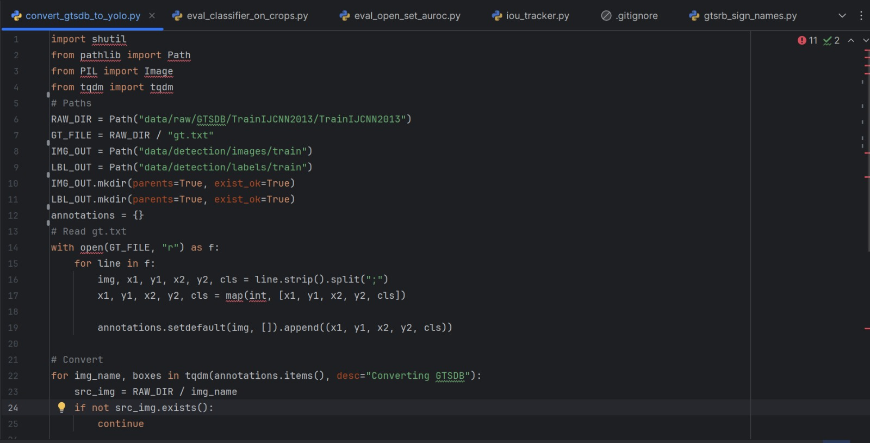
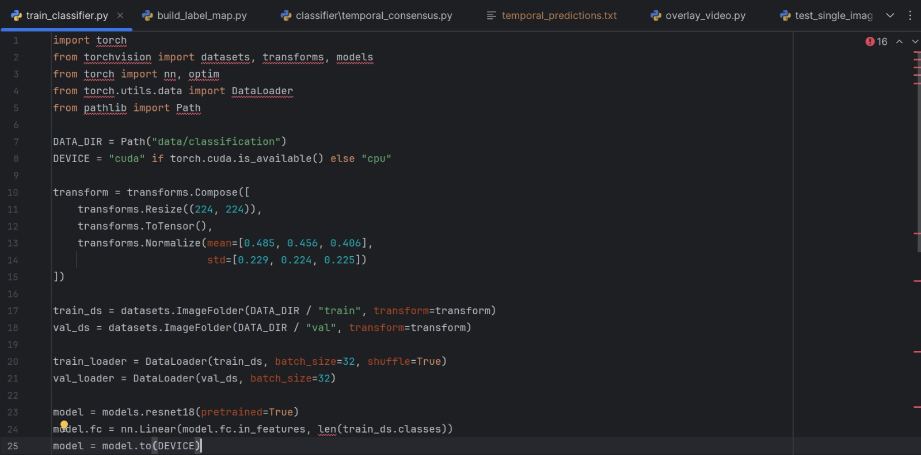
Sample Source Code
YOLO Detector Sample Code
RestNet18 Classifier Sample Code

Slide 17
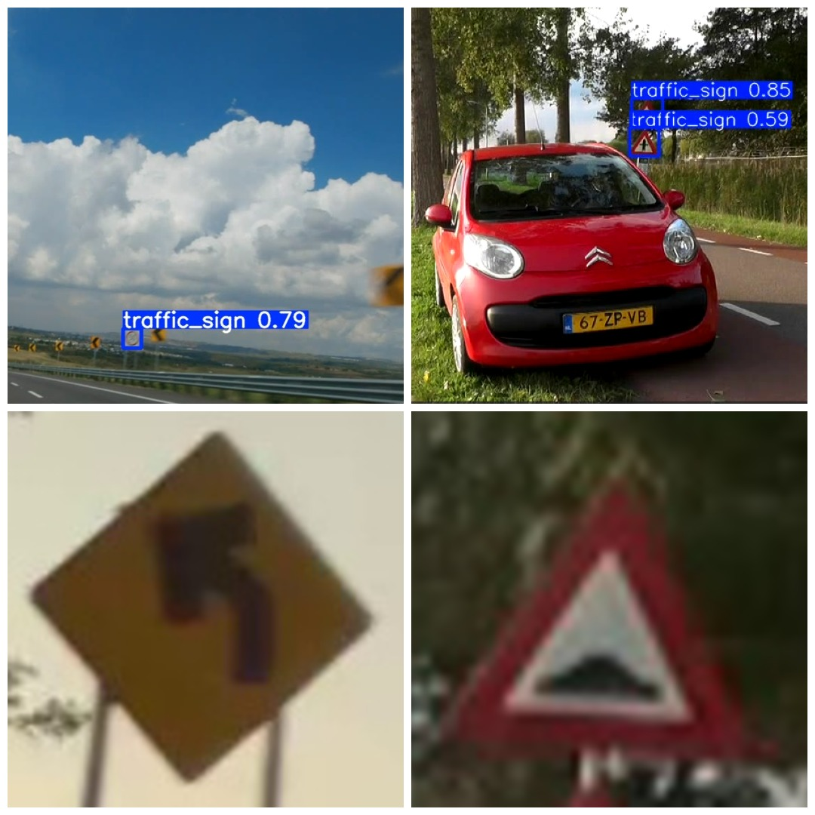
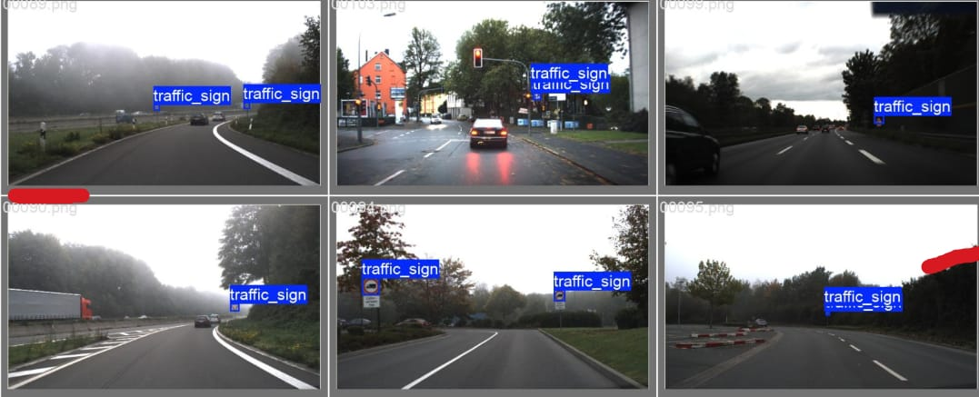
Project Execution
Fig: Detection output
Fig: Classification Output

Slide 18
References
Real-Time Traffic Sign Recognition with Open-Set Rejection and Temporal Consensus
[1] Yi Yang, Hengliang Luo, Fuchao Wu, “Towards Real-Time Traffic Sign Detection and Classification,” ResearchGate.
[2] Hana B. F., Amani C., Jamel B. H., Chokri S., “A Real-Time Traffic Sign Recognition Method Using a New Attention-Based DCNN,” MDPI, 2023.
[3] Jiahui Guo, Guohao Li, Shuo Chen, Guofa Li, Yuxin Chen, “Temporal-Guided Label Assignment for Video Object Detection,” MDPI, 2022.
[4] Hassanpour et al., “Paper Currency Recognition Based on Size, Color, and Texture,” Journal XYZ, 2020
Dept. of Computer Science and Engineering (Data Science)
Srinivasa Ramanujan Institute of Technology

Slide 19
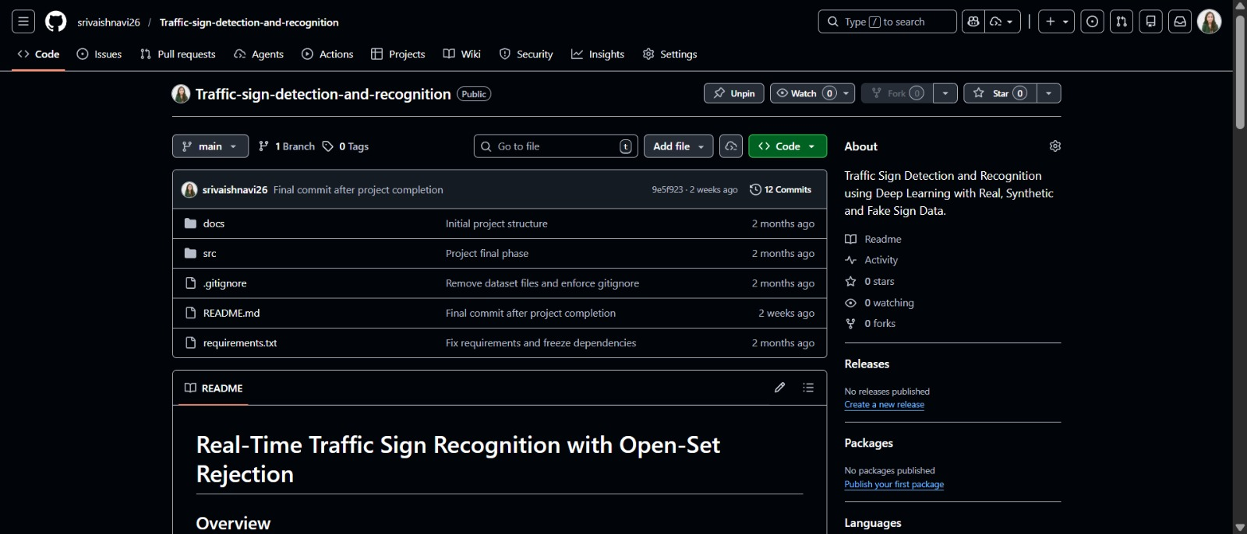
GitHub Link
🔗 GitHub Repository:
https://github.com/srivaishnavi26/Traffic-sign-detection-and-recognition
Dept. of Computer Science and Engineering (Data Science)

Slide 20
Real-Time Traffic Sign Recognition with Open-Set Rejection and Temporal Consensus
Thank You!!!
Dept. of Computer Science and Engineering (Data Science)
Srinivasa Ramanujan Institute of Technology

