Slide 1
oops in perl
by
Tulasi Naga Durga Jana

Slide 2
Object-oriented programming
The main aim of OOP is to bind together the data and the functions that operate on them so that no other part of the code can access this data except that function.
OOPs Concepts:
Class
Object
Method
Polymorphism
Inheritance
Encapsulation
Abstraction

Slide 3
what is a class?
A class is an expanded concept of data structures.
It defines a prototype blueprint of objects comprising of data.
And an object is an instance of a class. A class comprises of the data members and data functions and it is a pre-defined data type made as per the user’s requirements which can be accessed and used by creating an instance of that class.

Slide 4
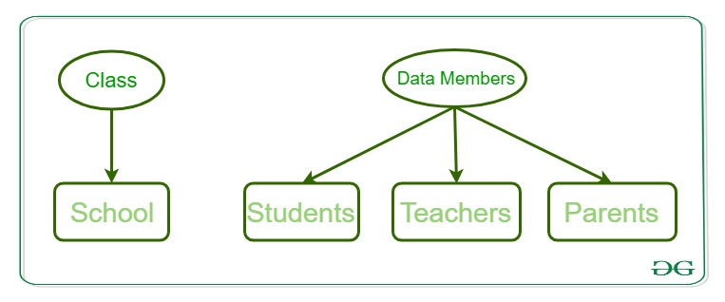
Class Example:
Consider a class of School. There may be schools with different names and structure but all of them share some common characteristics like students, teachers, staff, etc.
So here school is the class with teachers, students, and Parents as the data members
and the member functions can be calculate_students_marks(), calculate_teachers_salary() and Parents_Database().

Slide 5
What is an Object?
Perl is an Objected Oriented, dynamic and interpreter based programming language.
In object-oriented programming, we have three main aspects, which are, object, class, and methods.
An object is a data type which can be specifically called as an instance of the class to which it belongs.
It can be a collection of data variables of different data types and as well as a collection of different data structures. Methods are functions which work on these objects of the class.

Slide 6
Creating Class and Using Objects
A class in Perl can be created by using the keyword package but to create an object, a constructor is called.
A constructor is defined in a class as a method.
Creating an instance of a class:
A class name and a constructor name can be as per user’s requirement.
Most of the programmers prefer to use ‘new’ as a constructor name for their programs as it is easy to remember and is more feasible to use than any other complex constructor name.

Slide 7
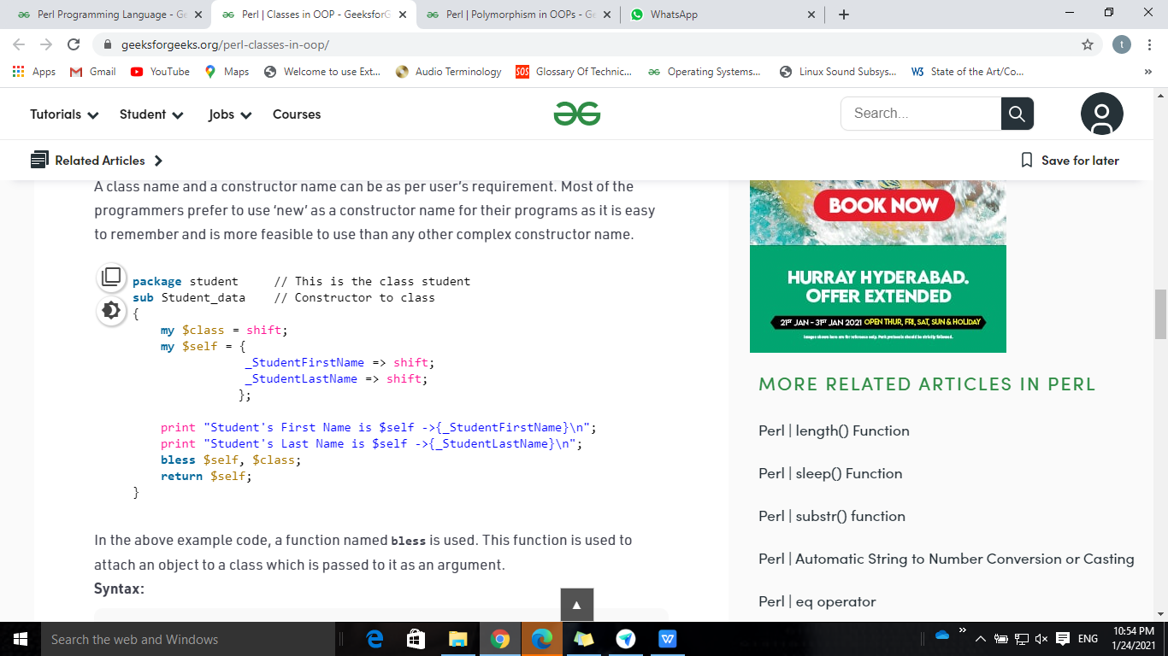
Creating an instance of a class
In the example code, a function named bless is used.
This function is used to attach an object to a class which is passed to it as an argument.
This program name should match with class name it should end with .pm extension
Ex: student.pm

Slide 8
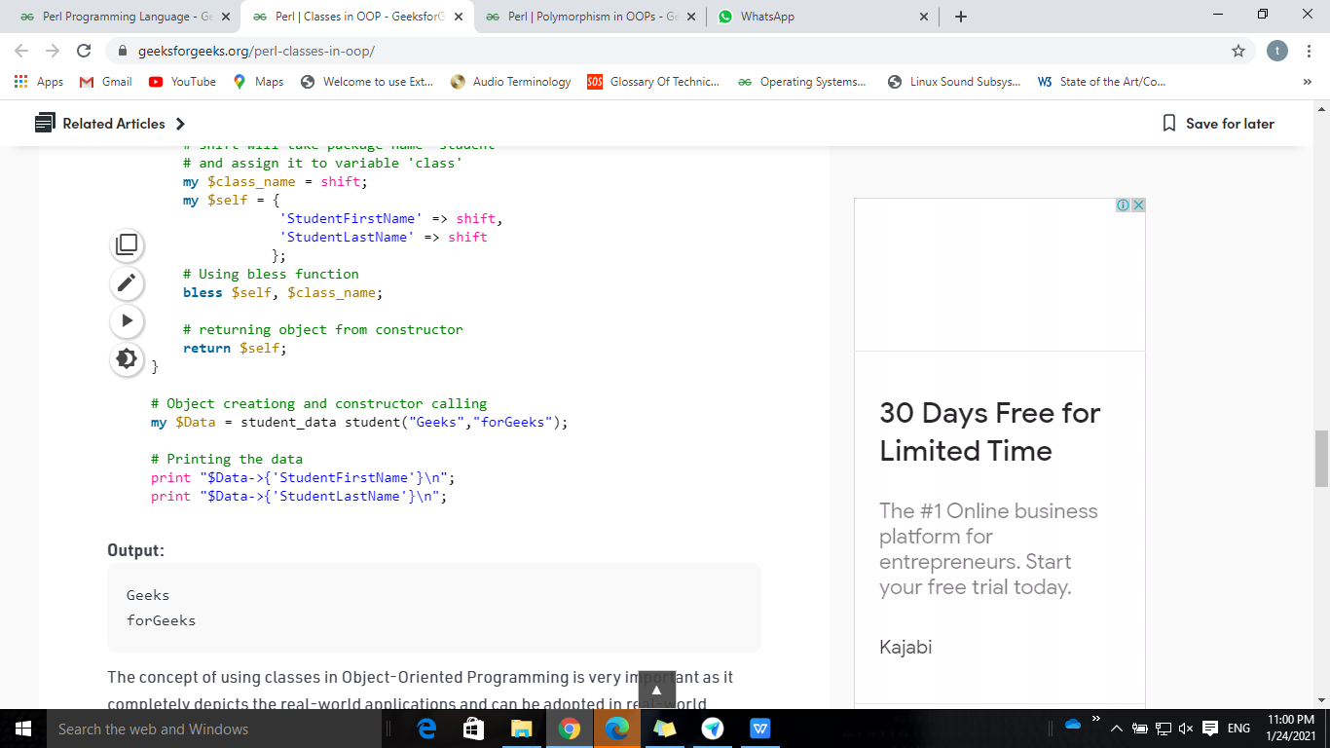
Creating an Object
Output:
Geeks
forGeeks

Slide 9
Methods
Methods are used to access and modify the data of an object.
These are the entities which are invoked with the use of objects of a class or a package itself.
Methods are basically a subroutine in Perl, there is no special identity of a method.
OOPs uses these methods to manipulate the object’s data and not interact with the object directly, this is done to maintain the security of data to prevent the programmer from changing the data of an object directly.

Slide 10
Types of Methods in Perl:
Based on the arguments passed, methods can be classified into two types- static method and virtual method.
A static method is one in which the first argument passed to the method is the class name.
Functionalities of a static method are applied to the whole class because it takes the name of the class as an argument.
These methods are also called class methods. Since most of the methods are in the same class and hence, there is no need to pass the class name as an argument.
Example: Constructors of a class are considered to be static methods.

Slide 11
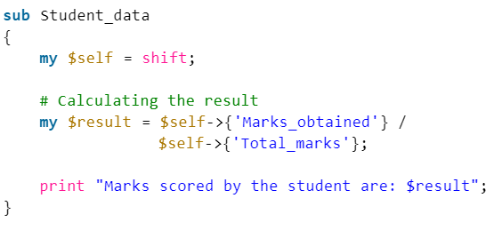
Types of Methods in Perl Cont..:
A virtual method is one in which the reference to the object is passed as the first argument to the function.
In a virtual function, the first argument is shifted to a local variable and then this value is used as a reference.

Slide 12
get-set Methods:
Methods are used to provide security to the object’s data and hence used with either the object’s reference or the value is stored in some other variable and then used.
get-set methods are used in the OOPs to provide this data security to the objects.
get-method helps to get the current value of the object and the set value method is used to set a new value to the object.

Slide 13
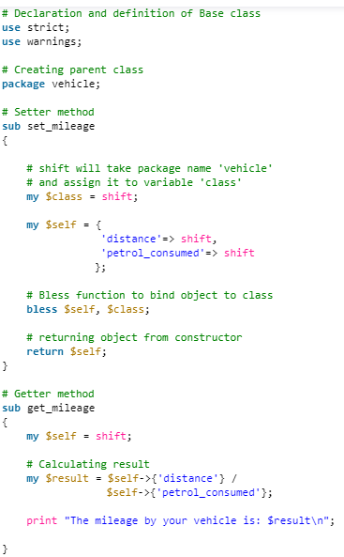
get-set Methods Example :
Output:
The mileage by your vehicle is: 15

Slide 14
Constructors and Destructors
Constructors
Constructors in Perl subroutines returns an object which is an instance of the class.
In Perl, the convention is to name the constructor “new”.
Unlike many other OOPs, Perl does not provide any special syntax for constructing an object.
The constructor uses the “bless” function on a hash reference and the class name (the name of the package).

Slide 15
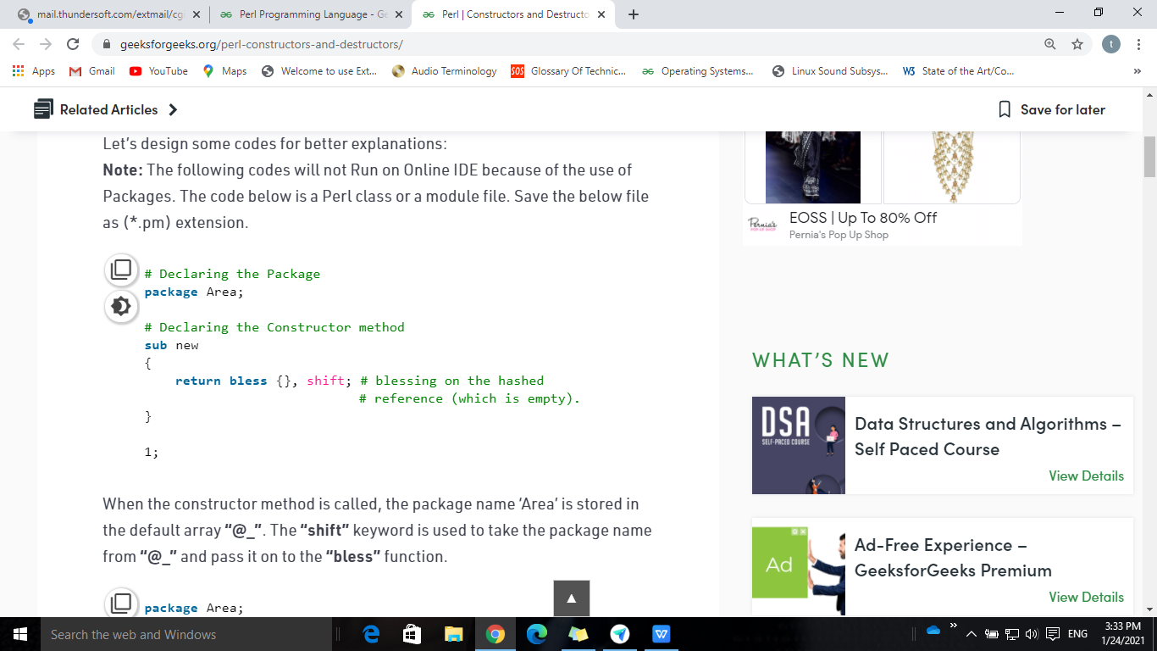
Constructor:
When the constructor method is called, the package name ‘Area’ is stored in the default array “@_”.
The “shift” keyword is used to take the package name from “@_” and pass it on to the “bless” function.

Slide 16
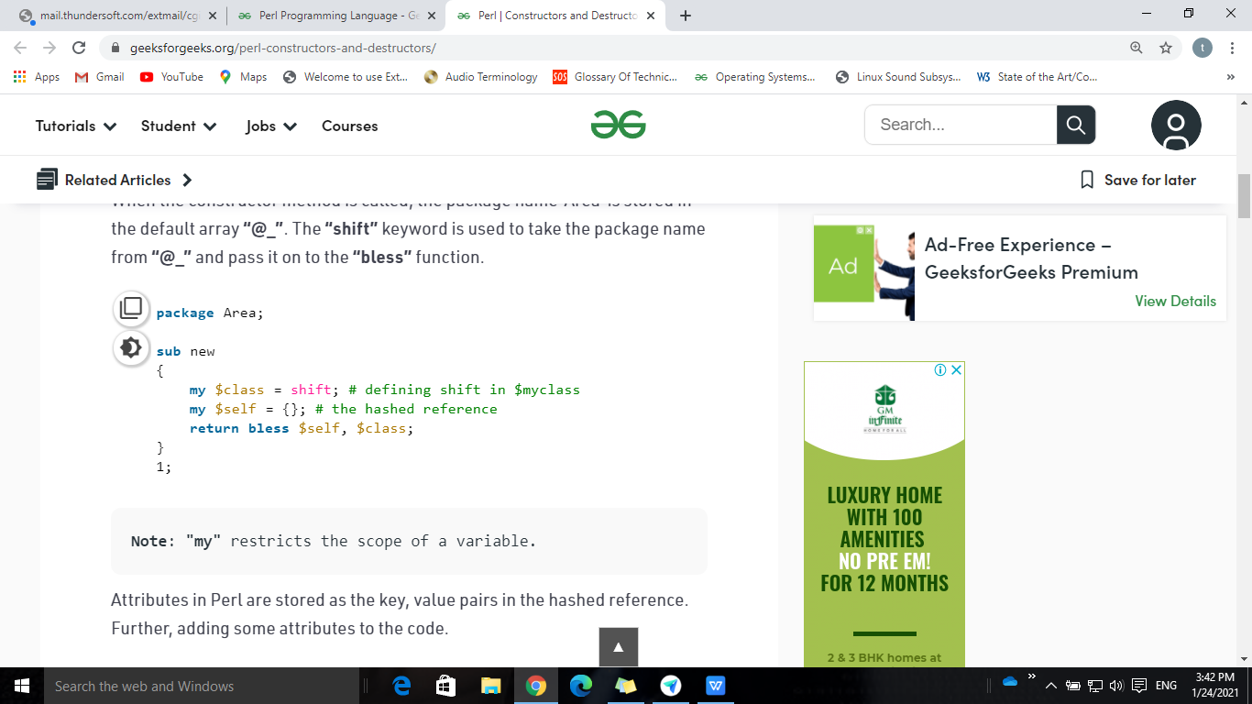
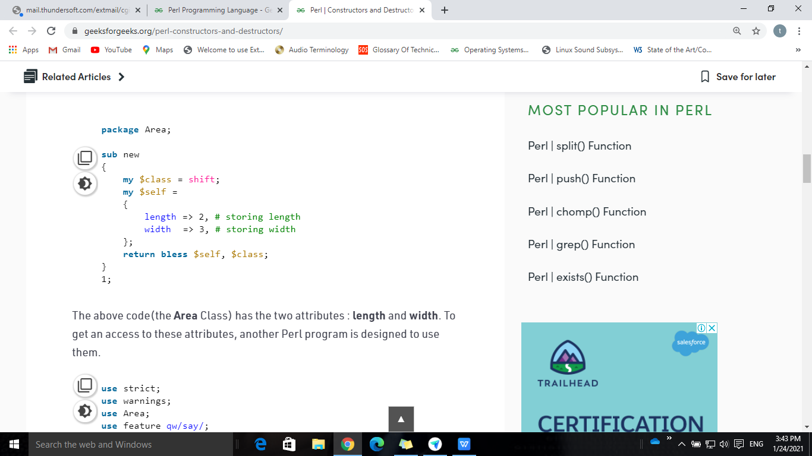
Constructor
Attributes in Perl are stored as the key, value pairs in the hashed reference.
Save the Program with Package Area in a text file named as Area.pm
Note: Name of the file should always be same as the name of the package.
Class with empty attributes
Class with length and width as attributes

Slide 17
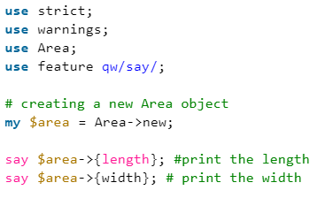
Accessing attributes of a class
Output:
2
3
save the program that is used to get access to the attributes defined in the package by the name *.pl. Here, * can be any name(here it is test)
Run the code saved as test.pl in the Perl command line by using the command
perl test.pl

Slide 18
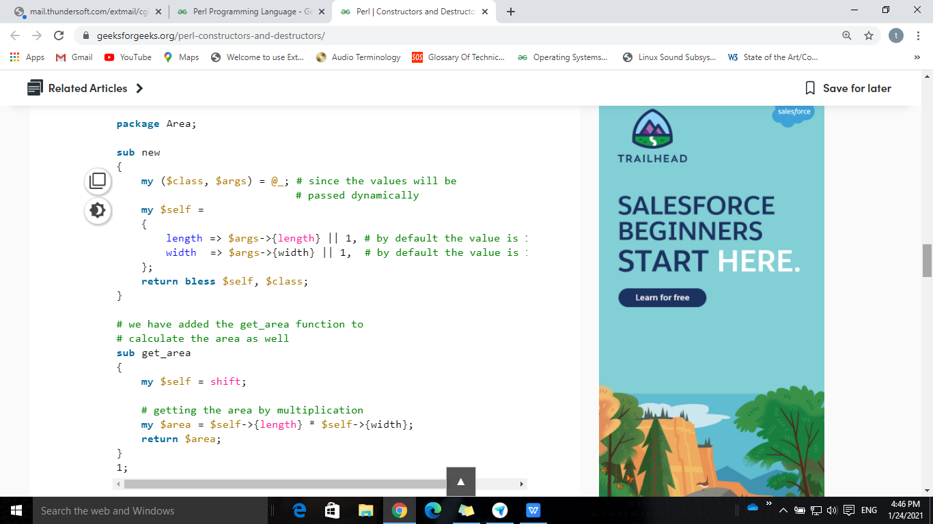
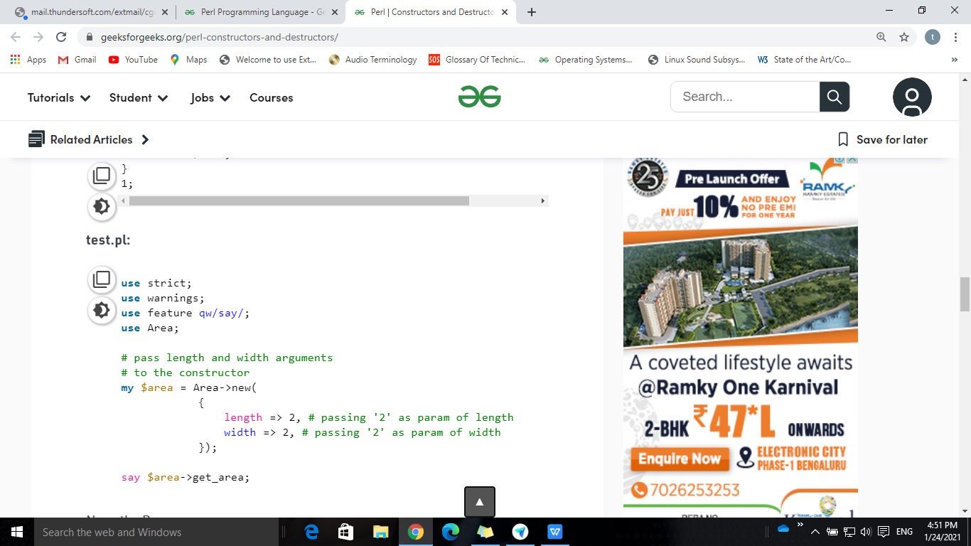
Class & Object Creation
Area.pm
test.pl

Slide 19
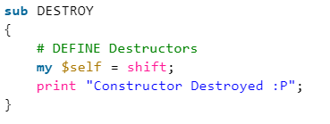
Destructors
Perl automatically calls the destructor method when all the references to an object go out of scope.
Destructor methods are of use if the class creates threads or temporary files that need to be cleaned up if the object gets destroyed.
Perl contains a special method name, ‘DESTROY’ for the destructor, that must be used at the time of destructor declaration.

Slide 20
Method Overriding in OOPs
In any object-oriented programming language, Overriding is a feature that allows a subclass or child class to provide a specific implementation of a method that is already provided by one of its super-classes or parent classes.
When a method in a subclass has the same name, same parameters or signature and same return type(or sub-type) as a method in its super-class, then the method in the subclass is said to override the method in the super-class.
Method Overriding means that the code comprises of two or more methods with the same name but each of them has a special task and that to differ from each other.
Thus taking the literal meaning of the name itself it means that one method has to override another.
This concept stands for redefining a base class method in its derived class with the exact same method signature.
Method overriding is one of the ways by which Perl achieves Run Time Polymorphism.

Slide 21
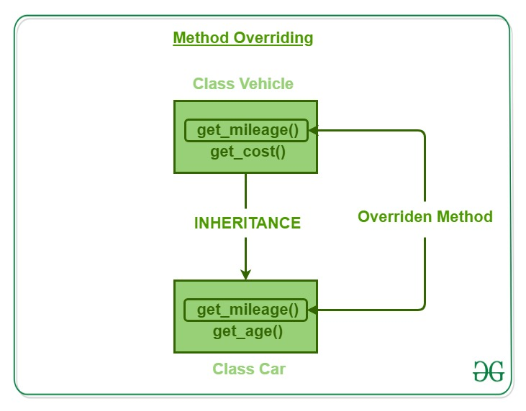
Method Overriding Cont..

Slide 22
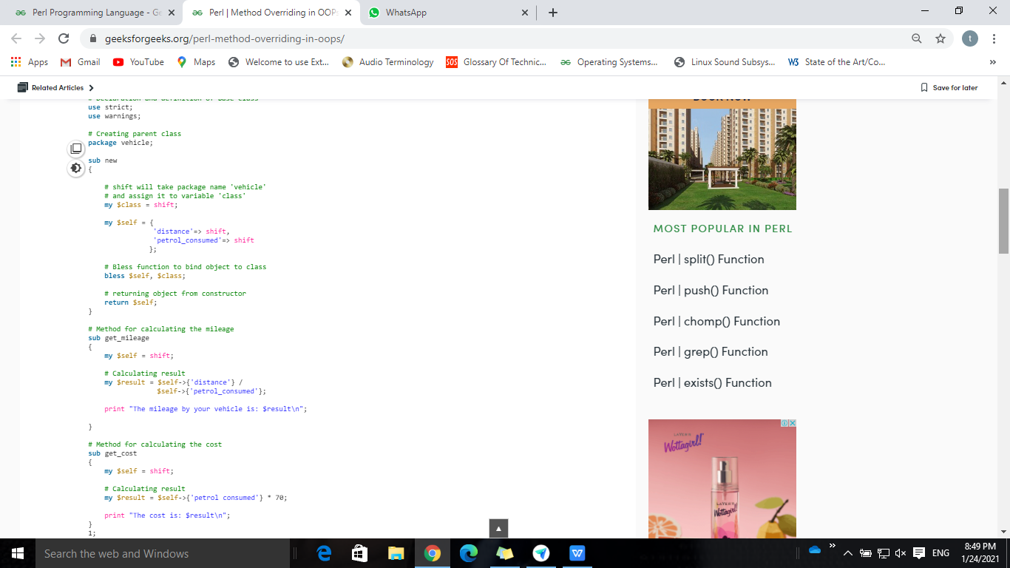
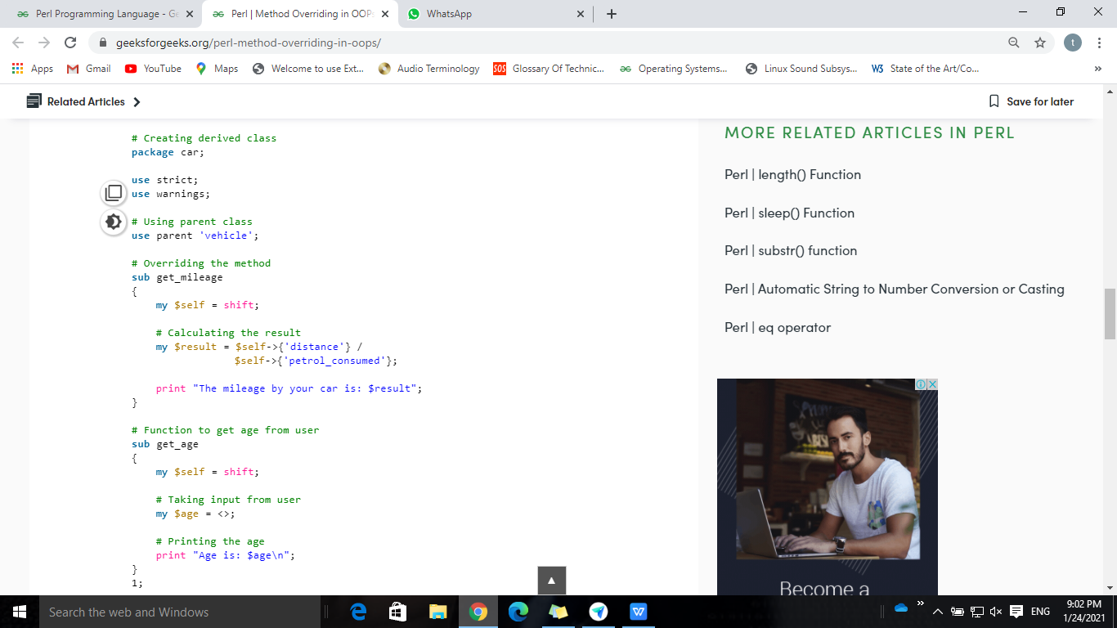
Creation of Derived Class
Creation of Base Class
Creation of Derived Class

Slide 23
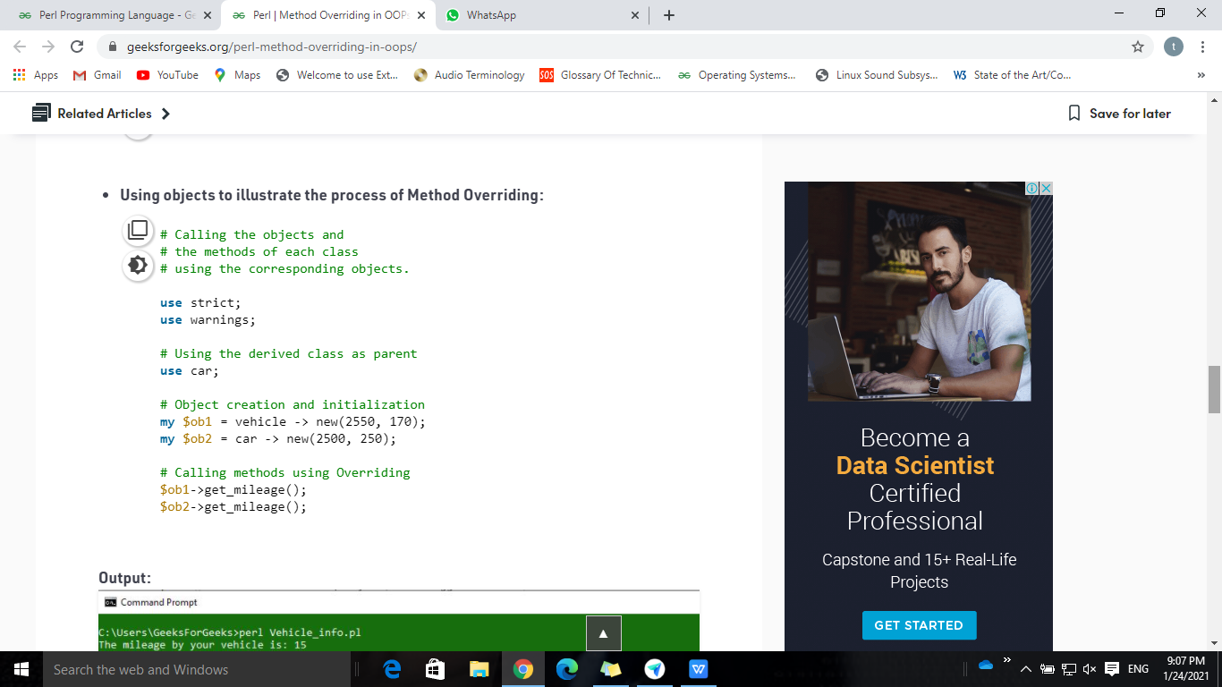
Objects to illustrate the process of Method Overriding
Output:
The mileage by your vehicle is: 15
The mileage by your car is: 10
Why Method Overriding?
It allows a general class to specify methods that will be common to all of its derivatives while allowing subclasses to define the specific implementation of some or all of those methods

Slide 24
Inheritance in OOPs
Inheritance is the ability of any class to extract and use features of other classes.
It is the process by which new classes called the derived classes are created from existing classes called Base classes.
The basic concept here is that the programmer is able to use the features of one class into another without declaring or defining the same thing again and again in different classes.
The most basic concept of inheritance is Creating or Deriving a new class using another class as a base.
Sub Class: The class that inherits properties from another class is called Sub class or Derived Class.
Super Class: The class whose properties are inherited by sub class is called Base Class or Super class

Slide 25
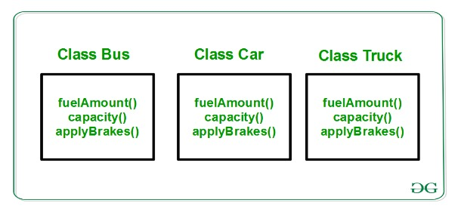
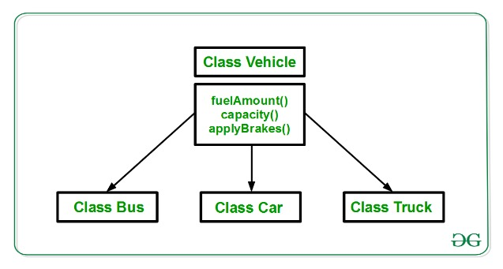
Inheritance Cont..
Without Inheritance
With Inheritance
There can be multiple derived classes from a single base class, such type of inheritance is called Hierarchical Inheritance.These derived classes share a single Parent class or Base class.
If a derived class shares multiple Parent classes and inherit its features from multiple parent classes then such kind of inheritance is called Multiple Inheritance.

Slide 26
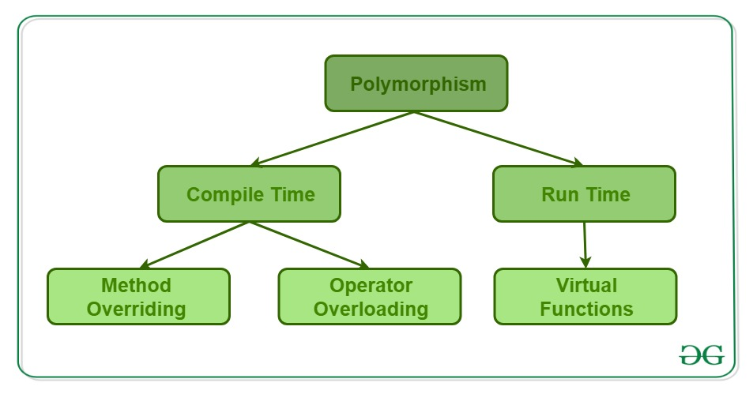
Polymorphism in OOPs
Polymorphism is the ability of any data to be processed in more than one form.
The word itself indicates the meaning as poly means many and morphism means types.
It is the ability of an object or reference to take many forms in different instances.
It implements the concept of function overloading, function overriding and virtual functions.

Slide 27
Polymorphism
This means that polymorphism is the method in an object-oriented programming language that does different things depending on the class of the object which calls it.
For example, $square->area() will return the area of a square, but $triangle->area() might return the area of a triangle.
On the other hand, $object->area() would have to calculate the area according to which class $object was called.

Slide 28
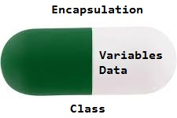
Encapsulation in OOPs
Encapsulation in Perl is the process of wrapping up of data to protect it from the outside sources which need not have access to that part of the code.
It is used to bind the data and the subroutines that are used to manipulate that data.
As in encapsulation, the data in a class is hidden from other classes, so it is also known as data-hiding.
Encapsulation can be achieved by: Declaring all the variables in the class as local and fetching methods of the class by importing packages to set and get the values of variables.

Slide 29
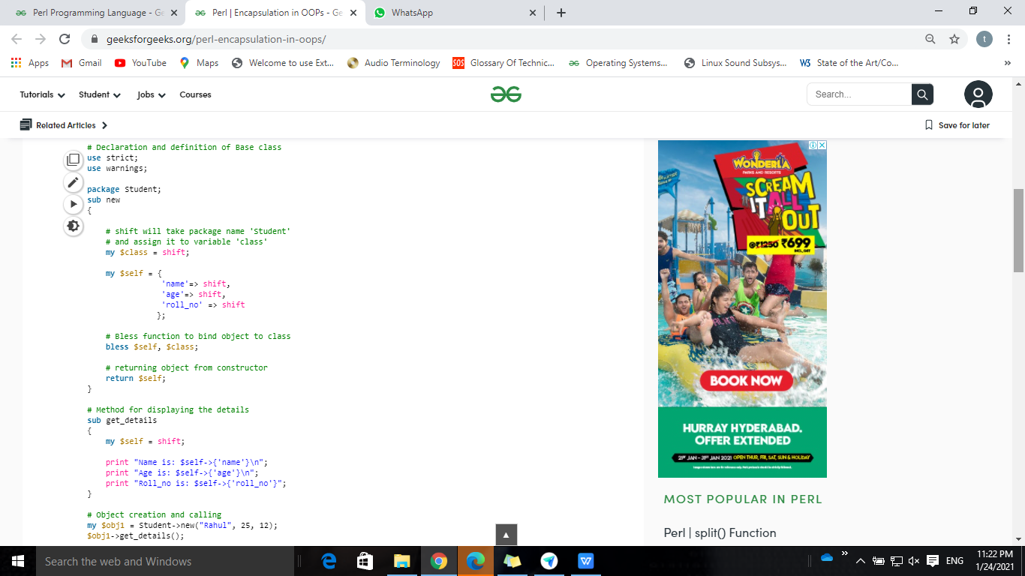
Encapsulation Example
Output:
Name is: Rahul
Age is: 25
Roll_no is: 12
If there is a need to access the data of the class for any modifications or just to print the data of the class then it can not be done directly.
There is a need to create an object of that class and then access the data using the get_details() method.
This process is termed as Data Encapsulation.

Slide 30
Advantages of Encapsulation:
Data Hiding: The user will have no idea about the inner implementation of the class. It will not be visible to the user that how the class is stored values in the variables. He only knows that we are passing the values to accessors and variables are getting initialized to that value.
Increased Flexibility: We can make the variables of the class as read-only or write-only depending on our requirement. If we wish to make the variables as read-only then we have to only use Get Accessor in the code. If we wish to make the variables as write-only then we have to only use Set Accessor.
Reusability: Encapsulation also improves the re-usability and easy to change with new requirements.
Testing code is easy: Encapsulated code is easy to test for unit testing.

