Slide 1

Perl Programming

Slide 2
Introduction
Perl is a general-purpose, high level interpreted and dynamic programming language. It was developed by Larry Wall, in 1987.
There is no official Full form of the Perl, but still, the most used expansion is “Practical Extraction and Reporting Language“. Some of the programmers also refer Perl as the “Pathologically Eclectic Rubbish Lister” Or “Practically Everything Really Likable“.
Perl supports both the procedural and Object-Oriented programming. Perl is a lot similar to C syntactically and is easy for the users who have knowledge of C, C++.
It was originally developed for the text processing like extracting the required information from a specified text file and for converting the text file into a different form.
The latest version of Perl is 5.28.

Slide 3
Features
Open Source.
Platform independent
Easy to start
Text-Processing

Slide 4
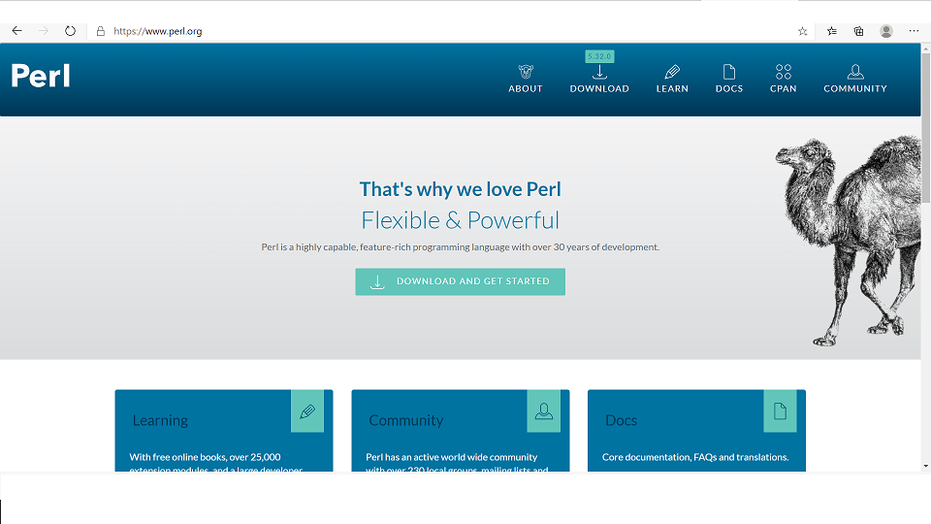
Downloading and Installing Perl

Slide 5
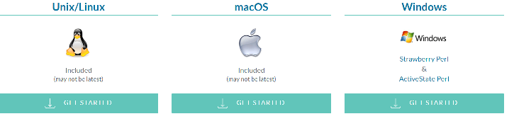
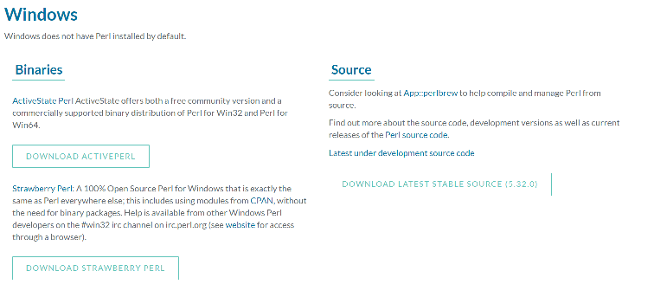
Downloading and Installing Perl

Slide 6
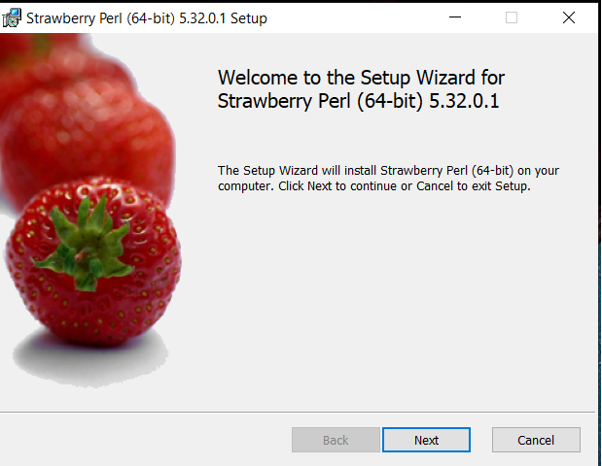
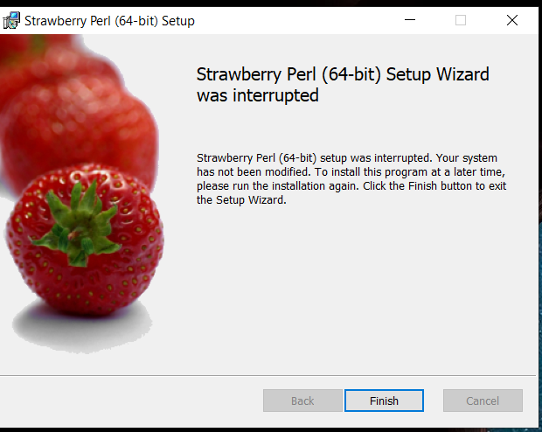
Downloading and Installing Perl in windows

Slide 7
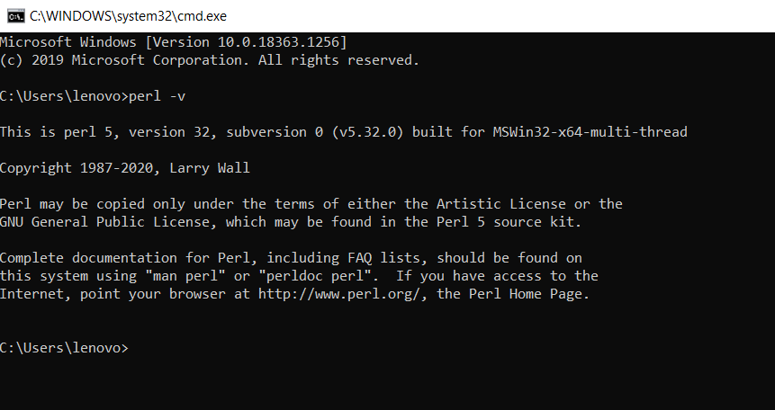
Downloading and Installing Perl in windows

Slide 8
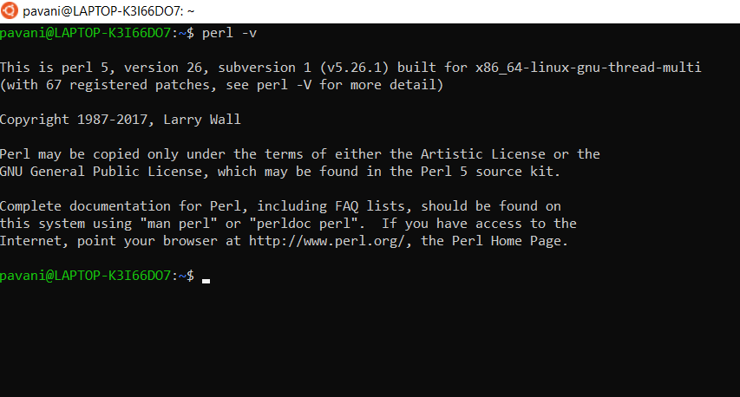
Downloading and Installing Perl in linux
In Linux/Unix OS it has become a standard package installed.
Download from perl.org
Move to perl directory and run command sh install.sh

Slide 9
Programming in perl
Perl is a lot similar to other widely used languages syntactically, it is easier to code and learn in Perl.
Programs can be written in Perl in any of the widely used text editors like Notepad++, gedit etc.
After writing the program save the file with the extension .pl or .PL To run the program use perl file_name.pl on the command line.

Slide 10
Modes of programming
Interactive Mode
Script Mode
One-Liner Mode

Slide 11
Interactive mode
Interactive mode of writing a Perl code means the direct interaction with the interpreter.
Interactive mode is a good way to get started as it helps to check the flow of code line by line and makes the debugging process easier.
Interactive Mode in Perl can be used on the Command line with the use of Perl Debugger.
Command: perl -de1

Slide 12
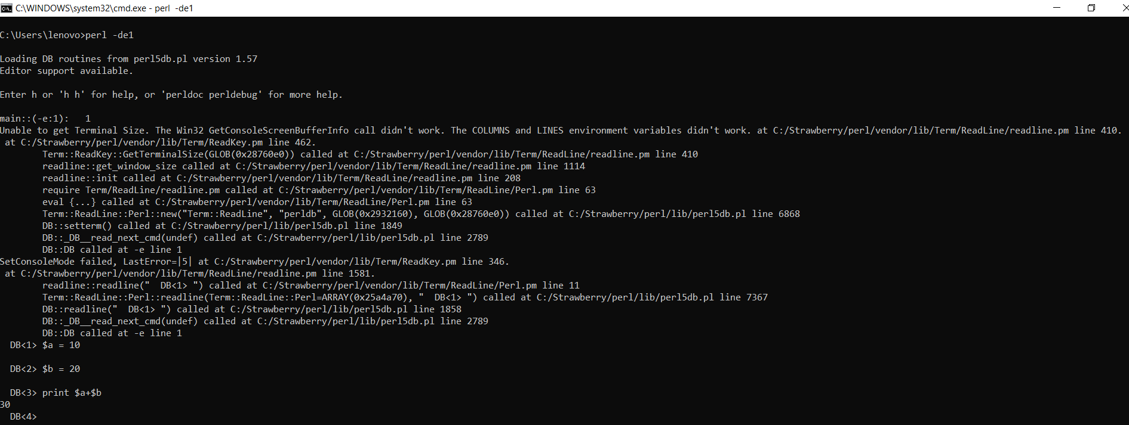
Interactive mode
To exit from interactive mode use“exit”.

Slide 13
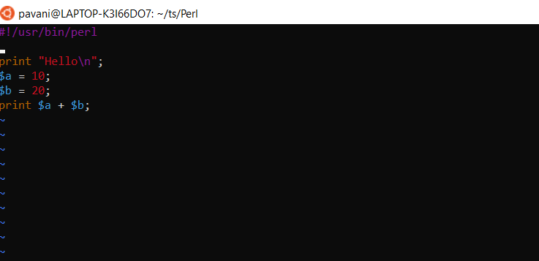
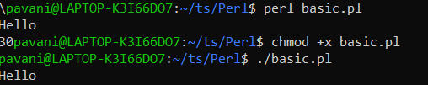
Script mode
Script Mode in Perl is used to write Perl programs which have more than a few lines of code and are a bit complex for the Interactive mode.

Slide 14
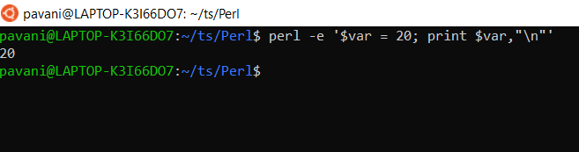
One-line mode
Perl also provides a one-liner mode, which allows to type and execute a very short script of code directly on the command line.
This is done to avoid the creation of Files to store the script for codes which are not very lengthy.
perl –e “print ‘Hello World’”
Perl –e “$var = 20 ; print $var”
Output: Hello World

Slide 15
Variables
Variables are user-defined words that are used to hold the values passed to the program which will be used to evaluate the Code.
Every Perl program contains values on which the Code performs its operations.
A value is the data passed to the program to perform manipulation operation. This data can be either number, strings, characters, lists, etc.
  $a = 5;
  $b = "geeks";
  $c = 15;

Slide 16
Number and its Types
A notational symbol that represents a number is termed as a numeral.
    Integers
    Floating Numbers
    Hexadecimal Numbers
    Octal Numbers
    Binary Numbers

Slide 17
code
#!/usr/bin/perl
# Perl program to illustrate
# the use of numbers
# Integer
$a = 20;
# Floating Number
$b = 20.5647;
# Scientific value
$c = 123.5e-10;
# Hexadecimal Number
$d = 0xc;
# Octal Number
$e = 074;
# Binary Number
$f = 0b1010;
# Printing these values
print("Integer: ", $a, "\n");
print("Float Number: ", $b, "\n");
print("Scientific Number: ", $c, "\n");
print("Hex Number: ", $d, "\n");
print("Octal number: ", $e, "\n");
print("Binary Number: ", $f, "\n");
Integer: 20 Float Number: 20.5647 Scientific Number: 1.235e-08 Hex Number: 12 Octal number: 60 Binary Number: 10

Slide 18
Comments
Perl developers often make use of the comment system as, without the use of it, things can get real confusing, real fast.
Comments are useful information that the developers provide to make the reader understand the source code.
Single line comments # and Multi line comments (= and =cut)
#single line comments
#!/usr/bin/perl
$b = 10; # Assigning value to $b
$c = 30; # Assigning value to $c
$a = $b + $c; # Performing the operation
print "$a"; # Printing the result
# Multi line comments
#!/usr/bin/perl
=Assigning values to
variable $b and $c
=cut
$b = 10;
$c = 30;
=Performing the operation
and printing the result
=cut
$a = $b + $c;
print "$a“;

Slide 19
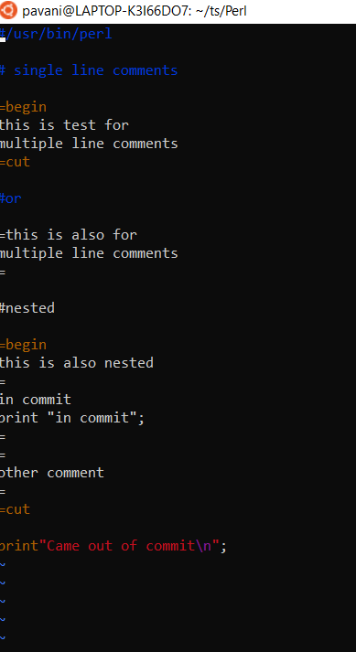
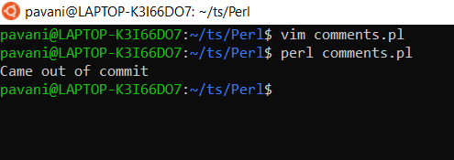
Comments

Slide 20
Operators
Operators are the main building block of any programming language.
Operators allow the programmer to perform different kinds of operations on operands.
Arithmetic Operators
Relational Operators
Logical Operators
Bitwise Operators
Assignment Operators
Ternary Operator

Slide 21
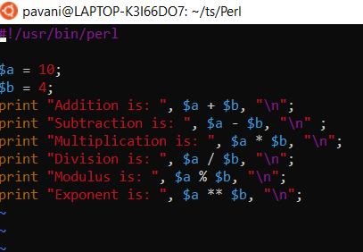
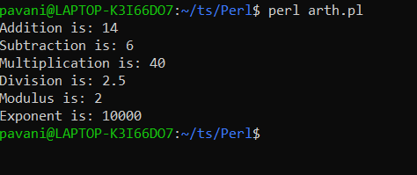
Arithmetic Operators

Slide 22
Relational Operators
else
{
print "Greater Than Equal To Operator is False\n";
}
if ($a <= $b)
{
print "Less Than Equal To Operator is True\n";
}
else
{
print "Less Than Equal To Operator is False\n";
}
if ($a <=> $b)
{
print "Comparison of Operator is True\n";
}
else
{
print "Comparison of Operator is False\n";
}
else
{
print "Not Equal To Operator is False\n";
}
if ($a > $b)
{
print "Greater Than Operator is True\n";
}
else
{
print "Greater Than Operator is False\n";
}
if ($a < $b)
{
print "Less Than Operator is True\n";
}
else
{
print "Less Than Operator is False\n";
}
if ($a >= $b)
{
print "Greater Than Equal To Operator is True\n";
}
$a = 10;
$b = 60;
# using Relational Operators
if ($a == $b)
{
print "Equal To Operator is True\n";
}
else
{
print "Equal To Operator is False\n";
}
if ($a != $b)
{
print "Not Equal To Operator is True\n";
}

Slide 23
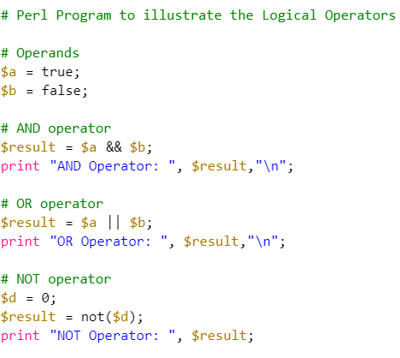
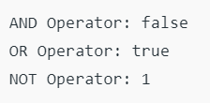
Logical Operators

Slide 24
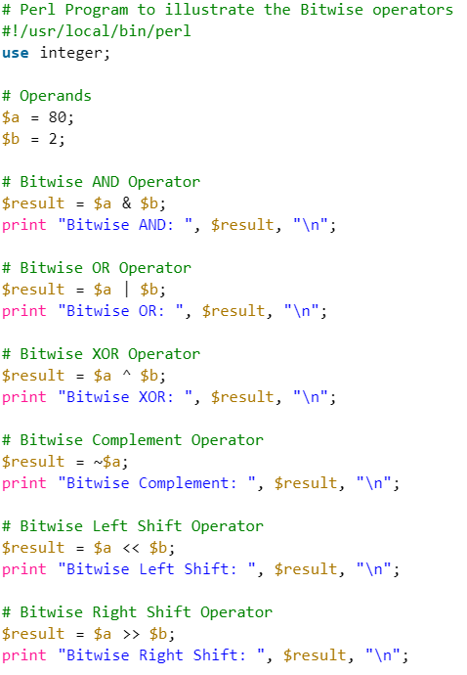
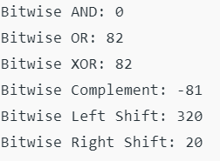
Logical Operators

Slide 25
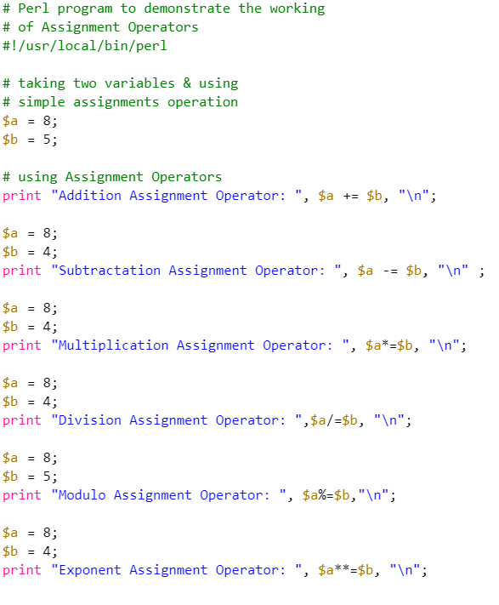
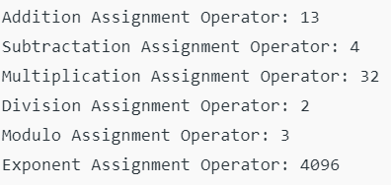
Assignment operators

Slide 26
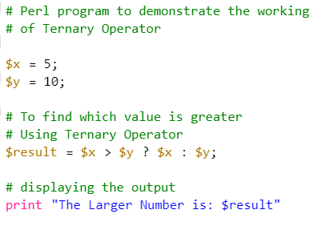

Ternary Operators
condition ? first_expression : second_expression;

Slide 27
Statements
A statement in Perl holds instructions for the compiler to perform operations.
These statements perform the operations on the variables and values during the Run-time. every statement in Perl must end with a semicolon(;).
Multi-Line Statements:
Statements in Perl can be extended to one or more lines by simply dividing it into parts.
Unlike other languages like Python, Perl looks for a semicolon to end the statement. Every line between two semicolons is considered as a single statement.
$x = $a + $b + $c + $d +
$e + $f;

Slide 28
Block
A block is a group of statements that are used to perform a relative operation.
In Perl, multiple statements can be executed simultaneously (under a single condition or loop) by using curly-braces ({}).
{
$x = 15;
$x = $x + 25;
print($x);
}

Slide 29
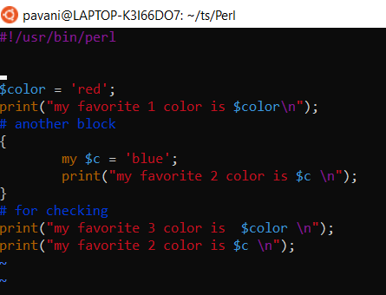
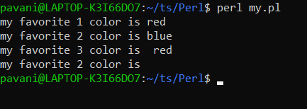
My and our variables

Slide 30
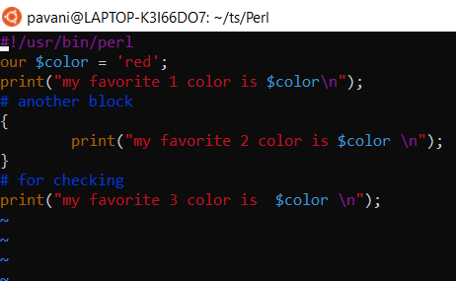
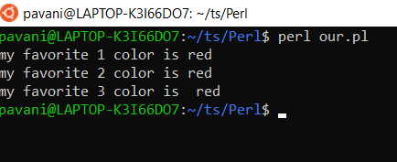
My and our variables

Slide 31
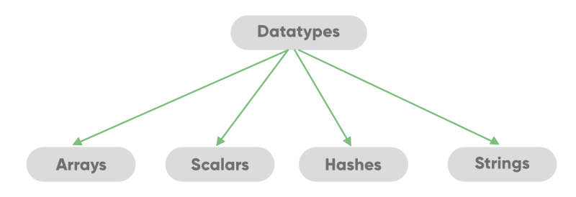
DataTypes

Slide 32
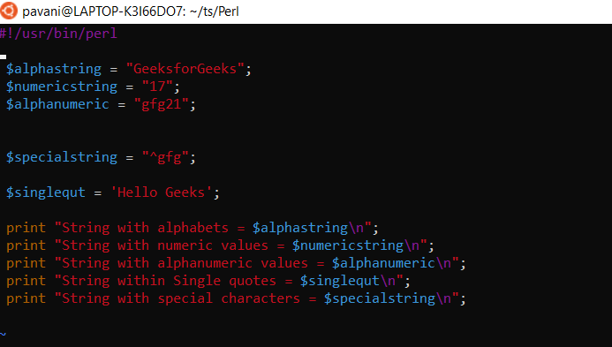
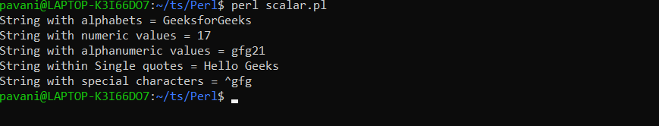
Scalars
It is a single unit of data which can be an integer number, floating-point, a character, a string, a paragraph, or an entire web page.

Slide 33
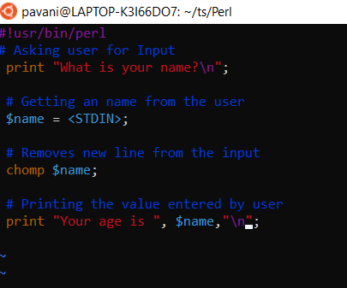
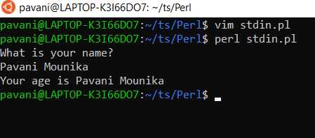
STDIN
STDIN in Perl is used to take input

Slide 34
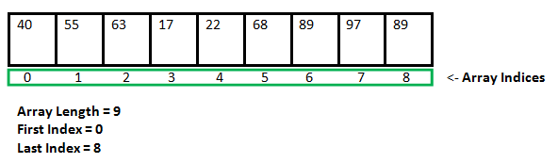
Arrays
An array is a variable that stores the value of the same data type in the form of a list. To declare an array in Perl, we use ‘@’ sign in front of the variable name.
@number = (40, 55, 63, 17, 22, 68, 89, 97, 89)

Slide 35
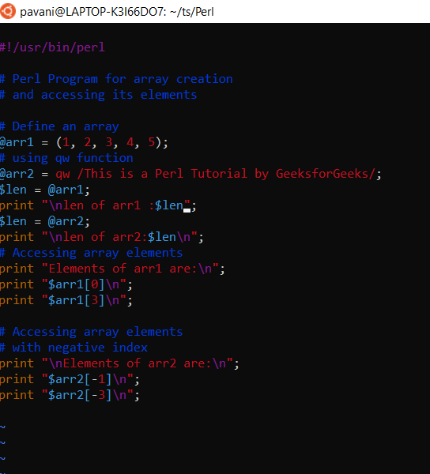
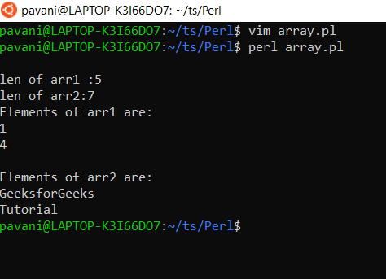
Arrays

Slide 36
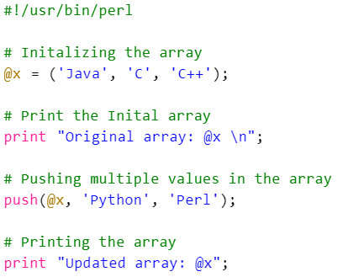

Push operation

Slide 37
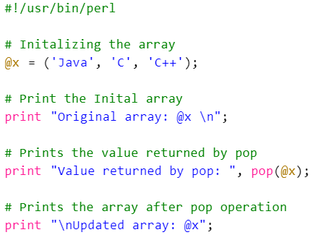
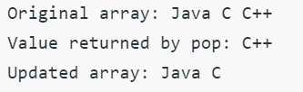
Pop operation

Slide 38
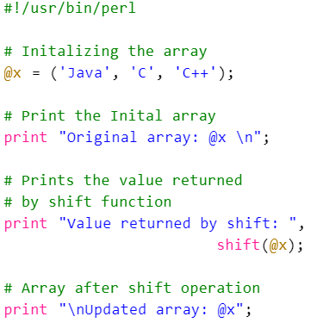
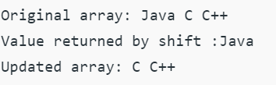
shift operation

Slide 39
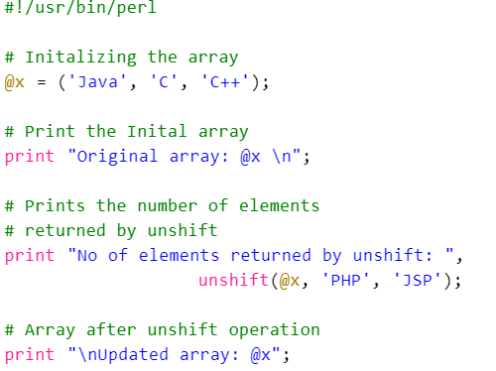
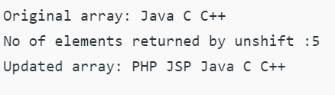
unshift operation

Slide 40
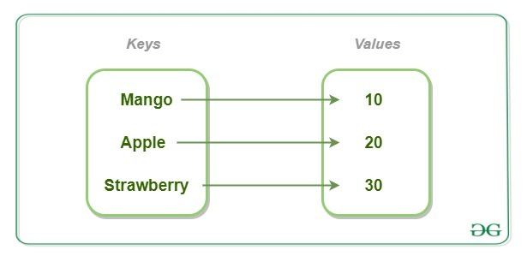
Hashes(Associative Arrays)
It is a set of key-value pairs. It is also termed as the Associative Arrays.
To declare a hash in Perl, we use the ‘%’ sign.
To access the particular value, we use the ‘$’ symbol which is followed by the key in braces.

Slide 41
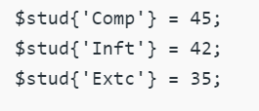

Hashes(Associative Arrays)

Slide 42
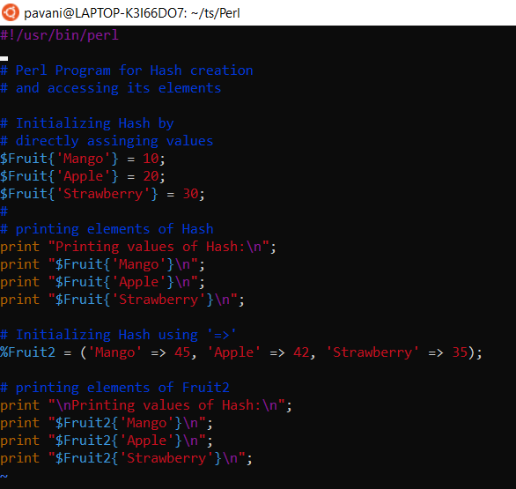
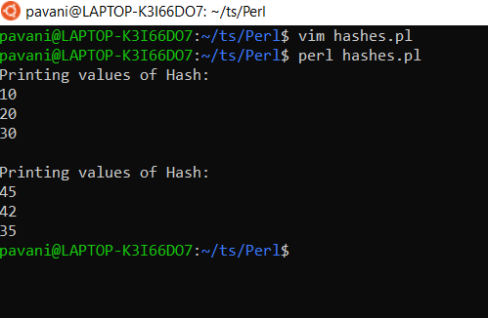
Hashes(Associative Arrays)

Slide 43
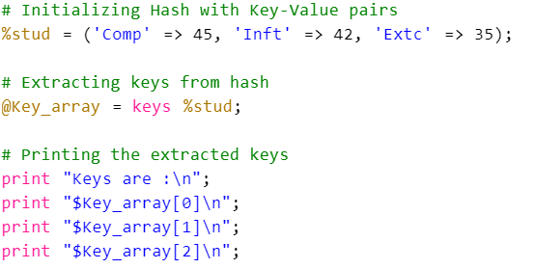
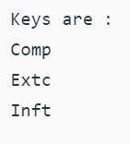
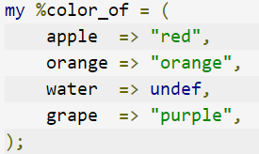
Hashes(Associative Arrays)

Slide 44
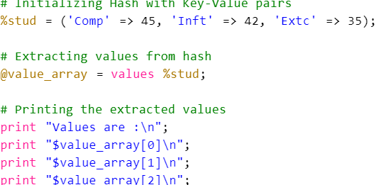
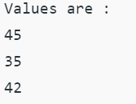
Hashes(Associative Arrays)

Slide 45


Strings
A string in Perl is a scalar variable and starts with a ($) sign and it can contain alphabets, numbers, special characters.
The string can consist of a single word, a group of words or a multi-line paragraph.
The String is defined by the user within a single quote (‘) or double quote (“).

Slide 46


Strings escape character

Slide 47



strict and warnings

Slide 48
Control flow
In programming, a certain block of code needs to be executed when some condition is fulfilled.
A programming language uses control statements to control the flow of execution of the program based on certain conditions.
These are used to cause the flow of execution to advance and branch based on changes to the state of a program.
  if
  if – else
  Nested – If
  if – elsif ladder
  Unless
  Unless – else
  Unless – elsif

Slide 49

if statement
The if statement is same as in other programming languages.
It is used to perform basic condition based task.
It is used to decide whether a certain statement or block of statements will be executed or not i.e if a certain condition is true then a block of statement is executed otherwise not.
Syntax :
if(condition)
{
# code to be executed
}

Slide 50


Code

Slide 51

if-else
The if statement evaluates the code if the condition is true but what if the condition is not true, here comes the else statement. It tells the code what to do when the if condition is false.
Syntax :
if(condition)
{
# code if condition is true
}
else
{
# code if condition is false
}

Slide 52


if-else

Slide 53

nested if statement
if statement inside an if statement is known as nested if.
if statement in this case is the target of another if or else statement.
When more then one condition needs to be true and one of the condition is the sub-condition of parent condition, nested if can be used.
Syntax :
if (condition1)
{
# Executes when condition1 is true
if (condition2)
{
# Executes when condition2 is true
}
}

Slide 54


nested if statement

Slide 55

if – elsif – else ladder Statement
The if statements are executed from the top down.
As soon as one of the conditions controlling the if is true, the statement associated with that get executed, and the rest of the ladder is bypassed.
If none of the conditions is true, then the final else statement will be executed.
Syntax :
if(condition1)
{ # code to be executed if condition1 is true
}
elsif(condition2)
{
# code to be executed if condition2 is true
}
elsif(condition3)
{ # code to be executed if condition3 is true
}
...
else
{ # code to be executed if all the conditions are false
}

Slide 56


if – elsif – else ladder Statement

Slide 57

unless statement
In this case if the condition is false then the statements will execute.
The number 0, the empty string “”, character ‘0’, the empty list (), and undef are all false in a boolean context and all other values are true.
Syntax :
unless(boolean_expression)
{
# will execute if the given condition is false
}

Slide 58


unless statement

Slide 59

unless-else Statement
Unless statement can be followed by an optional else statement, which executes when the boolean expression is true.
Syntax :
unless(boolean_expression)
{
# execute if the given condition is false
}
Else
{
# execute if the given condition is true
}

Slide 60


unless-else Statement

Slide 61

unless – elsif Statement
Unless statement can be followed by an optional elsif…else statement, which is very useful to test the various conditions using single unless…elsif statement.
Points to Remember :
Unless statement can have zero to many elsif’s and all that must come before the else.
Unless statement can have zero or one else’s and that must come after any elsif’s.
Once an elsif succeeds, then none of remaining elsif’s or else’s will be tested.
Syntax :
unless(boolean_expression 1)
{
# Executes when the boolean expression 1 is false
}
elsif( boolean_expression 2)
{
# Executes when the boolean expression 2 is true
}
else
{
# Executes when the none of the above condition is met
}

Slide 62


unless – elsif Statement

Slide 63
loops
Looping in programming languages is a feature that facilitates the execution of a set of instructions or functions repeatedly while some condition evaluates to true.
Loops make the programmer’s task simpler.
Perl provides the different types of loop to handle the condition based situation in the program.
  for loop
  Foreach loop
  While loop
  Do-while
  Until loop

Slide 64


For loop

Slide 65


Foreach loop

Slide 66


While loop

Slide 67


do-while loop

Slide 68
Thank you

