Slide 1
Perl OOPS
By: Santhoshi Manasa

Slide 2
Object-oriented programming (OOP) is a method of structuring a program by bundling related properties and behaviours into individual objects.
Following are OOPs concepts
Class
Object
Method
Polymorphism
Inheritance
Encapsulation
Abstraction

Slide 3
CLASS
A class is a user defined blueprint or prototype from which objects are created. It represents the set of properties or methods that are common to all objects of one type.It includes these components
Class name: The name should begin with a initial letter (capitalized by convention).
Superclass(if any): The name of the class’s parent (superclass), if any, preceded by the keyword ‘use’.
Constructors(if any):Constructors in Perl subroutines returns an object which is an instance of the class. In Perl, the convention is to name the constructor “new”.
Body: The class body surrounded by braces, { }.

Slide 4
A class comprises of the data members and data functions
It is a pre-defined data type made as per the user’s requirements.
It can be accessed and used by creating an instance of that class.
Data members are the data variables and member functions are the functions used to manipulate these variables.
These data members and member functions define the properties and behaviour of the objects in a Class.

Slide 5
How to Define a Class
In Perl, a Class corresponds to a package.
To define a class we first build a Package.
A Package is a pre-contained unit of user-defined variables and subroutines, which can be used throughout the program.
ex:
package class_name

Slide 6
Creating class
A class in Perl can be created by using the keyword package but to create an object, a constructor is called. A constructor is defined in a class as a method.
A class name and a constructor name can be as per user’s requirement.
Most of the programmers prefer to use ‘new’ as a constructor name for their programs as it is easy to remember

Slide 7
package student // This is the class student
sub Student_data // Constructor to class
{
my $class = shift;
my $self = {
_StudentFirstName => shift;
_StudentLastName => shift;
};
print "Student's First Name is $self ->{_StudentFirstName}\n";
print "Student's Last Name is $self ->{_StudentLastName}\n";
bless $self, $class;
return $self;
}
Bless function is used to attach an object to a class which is passed to it as an argument.
Syntax: bless Object_name, Class Name

Slide 8
OBJECT
An object is a data type which can be specifically called as an instance of the class to which it belongs.
It can be a collection of data variables of different data types and as well as a collection of different data structures.
Methods are functions which work on these objects of the class.

Slide 9
use strict;
use warnings;
# class with the name Employee
package Employee;
# constructor with the name new
sub new
{
# shift will take package name
# and assign it to variable 'class'
my $class = shift;
# defining the hash reference
my $self = {
_serialNum => shift,
_firstName => shift,
_lastName => shift,
};

Slide 10
# Attaching object with class
bless $self, $class;
# returning the instance of class Employee
return $self;
}
# Object creation of the class
my $object = new Employee(1, "Geeks", "forGeeks");
# object here is a hash to a reference
print("$object->{_firstName} \n");
print("$object->{_serialNum} \n");
Output:
Geeks
1

Slide 11
In the constructor we are defining a simple hash reference $self to design our object.
The my keyword is an access specifier which is localizing $class and $self to be within the enclosed block. It acts like a static.
shift keyword takes the package name from the default array “@_” and pass it on to the bless function.
bless function is used to return a reference which ultimately becomes an object. And in the end, the constructor will finally return the instance of the class
$object is a scalar variable which is a reference to the hash defined in the constructor.

Slide 12
Methods
Methods are used to access and modify the data of an object. These are the entities which are invoked with the use of objects of a class or a package itself.
Methods are basically a subroutine in Perl, there is no special identity of a method. Syntax of a method is the same as that of a subroutine.
Types of Methods in Perl:
Based on the arguments passed, methods can be classified into two types- static method and virtual method.

Slide 13
static -
A static method is one in which the first argument passed to the method is the class name.
Functionalities of a static method are applied to the whole class because it takes the name of the class as an argument.
These methods are also called class methods.
Since most of the methods are in the same class and hence, there is no need to pass the class name as an argument.
Ex: Constructors of a class are considered to be static methods.

Slide 14
Virtual –
A virtual method is one in which the reference to the object is passed as the first argument to the function.
In a virtual function, the first argument is shifted to a local variable and then this value is used as a reference.

Slide 15
get-set Methods:
Methods are used to provide security to the object’s data and hence used with either the object’s reference or the value is stored in some other variable and then used.
get-set methods are used in the OOPs to provide this data security to the objects.
get-method helps to get the current value of the object
set value method is used to set a new value to the object.

Slide 16
# Declaration and definition of Base class
use strict;
use warnings;
# Creating parent class
package vehicle;
# Setter method
sub set_mileage
{
# shift will take package name 'vehicle'
# and assign it to variable 'class'
my $class = shift;
my $self = {
'distance'=> shift,
'petrol_consumed'=> shift
};

Slide 17
# Bless function to bind object to class
bless $self, $class;
# returning object from constructor
return $self;
}
# Getter method
sub get_mileage
{
my $self = shift;
# Calculating result
my $result = $self->{'distance'} /
$self->{'petrol_consumed'};
print "The mileage by your vehicle is: $result\n";
}
# Object creation and method calling
my $ob1 = vehicle -> set_mileage(2550, 170);
$ob1->get_mileage();
Output: The mileage by your vehicle is: 15

Slide 18
constructors
Constructors in Perl subroutines returns an object which is an instance of the class. In Perl, the convention is to name the constructor “new”.
It uses Data structures(hashes, arrays, scalars) that have been explicitly associated with that particular class.
The constructor uses the “bless” function on a hash reference and the class name (the name of the package).

Slide 19
Area.pm (Perl class or a module file)
package Area;
sub new
{
my $class = shift;
my $self =
{
length => 2, # storing length
width => 3, # storing width
};
return bless $self, $class;
}
1;

Slide 20
When the constructor method is called, the package name ‘Area’ is stored in the default array “@_”. The “shift” keyword is used to take the package name from “@_” and pass it on to the “bless” function.
Attributes in Perl are stored as the key, value pairs in the hashed reference.
Area class has two attributes length and width.
To get an access to these attributes, another Perl program is designed

Slide 21
Test.pl
use strict;
use warnings;
use Area;
use feature qw/say/;
# creating a new Area object
my $area = Area->new;
say $area->{length}; #print the length
say $area->{width}; # print the width
Output:
2
3

Slide 22
Passing dynamic attributes
Area.pm
package Area;
sub new
{
my ($class, $args) = @_; # since the values will be
# passed dynamically
my $self =
{
length => $args->{length} || 1, # by default the value is 1 (stored)
width => $args->{width} || 1, # by default the value is 1 (stored)
};
return bless $self, $class;
}

Slide 23
# we have added the get_area function to
# calculate the area as well
sub get_area
{
my $self = shift;
# getting the area by multiplication
my $area = $self->{length} * $self->{width};
return $area;
}
1;

Slide 24
Test.pl
use strict;
use warnings;
use feature qw/say/;
use Area;
# pass length and width arguments
# to the constructor
my $area = Area->new(
{
length => 2, # passing '2' as param of length
width => 2, # passing '2' as param of width
});
say $area->get_area;
Input:
length = 2, width = 2
Output:
4
The arguments are contained in the default array variable @_ when any subroutine
is called

Slide 25
destructors
Perl automatically calls the destructor method when all the references to an object go out of scope.
Destructor methods are of use if the class creates threads or temporary files that need to be cleaned up if the object gets destroyed.
Perl contains a special method name, ‘DESTROY’ for the destructor, that must be used at the time of destructor declaration.

Slide 26
sub DESTROY
{
# DEFINE Destructors
my $self = shift;
print "Constructor Destroyed :P";
}
Once this snippet is added to existing file Area.pm output will be
4
Constructor Destroyed :P

Slide 27
Method overriding
Method Overriding means that the code comprises of two or more methods with the same name but each of them has a special task and that to differ from each other.
This concept stands for redefining a base class method in its derived class with the exact same method signature.
The version of a method that is executed will be determined by the object that is used to invoke it.

Slide 28
BASE CLASS
# Declaration and definition of Base class
use strict;
use warnings;
# Creating parent class
package vehicle;
sub new
{
# shift will take package name 'vehicle'
# and assign it to variable 'class'
my $class = shift;
my $self = {
'distance'=> shift,
'petrol_consumed'=> shift
};

Slide 29
# returning object from constructor
return $self;
}
# Method for calculating the mileage
sub get_mileage
{
my $self = shift;
# Calculating result
my $result = $self->{'distance'} /
$self->{'petrol_consumed'};
print "The mileage by your vehicle is: $result\n";
}

Slide 30
# Bless function to bind object to class
bless $self, $class;
# Method for calculating the cost
sub get_cost
{
my $self = shift;
# Calculating result
my $result = $self->{'petrol consumed'} * 70;
print "The cost is: $result\n";
}
1;

Slide 31
DERIVED CLASS
# Declaring and defining derived class
# Creating derived class
package car;
use strict;
use warnings;
# Using parent class
use parent 'vehicle';
# Overriding the method
sub get_mileage
{
my $self = shift;

Slide 32
# Calculating the result
my $result = $self->{'distance'} /
$self->{'petrol_consumed'};
print "The mileage by your car is: $result";
}
# Function to get age from user
sub get_age
{
my $self = shift;
# Taking input from user
my $age = <>;
# Printing the age
print "Age is: $age\n";
}
1;

Slide 33
ILLUSTRATION OF OVERRIDING
# Calling the objects and
# the methods of each class
# using the corresponding objects.
use strict;
use warnings;
# Using the derived class as parent
use car;
# Object creation and initialization
my $ob1 = vehicle -> new(2550, 170);
my $ob2 = car -> new(2500, 250);

Slide 34
# Calling methods using Overriding
$ob1->get_mileage();
$ob2->get_mileage();
OUTPUT:
The mileage by your vehicle is: 15
The mileage by your car is: 10
The execution of the ‘get_mileage’ method on the object vehicle prints ‘The mileage by your vehicle is: 15’ through the method which was declared in the class vehicle.
when executing the ‘get_mileage’ on the object of car we get the output ‘The mileage by your car is: 10’ through the method in the class car.

Slide 35
POLYMORPHISM
Polymorphism is the ability of any data to be processed in more than one form.
The word itself indicates the meaning as poly means many and morphism means types.
Real life example of polymorphism, a person at the same time can have different roles to play in life.
So the same person has to have many features but has to implement each as per the situation and the condition.

Slide 36
Polymorphism is the key power of object-oriented programming. It is so important that languages that don’t support polymorphism cannot advertise themselves as Object-Oriented languages.
It is the ability of an object or reference to take many forms in different instances.
It implements the concept of function overloading, function overriding and virtual functions.
Polymorphism is a property through which any message can be sent to objects of multiple classes, and every object has the tendency to respond in an appropriate way depending on the class properties.

Slide 37
use warnings;
# Creating class using package
package A;
# Constructor creation
sub new
{
# shift will take package name 'vehicle'
# and assign it to variable 'class'
my $class = shift;
my $self = {
'name' => shift,
'roll_no' => shift
};
sub poly_example
{
print("This corresponds to class A\n");
}
};

Slide 38
package B;
# The @ISA array contains a list
# of that class's parent classes, if any
my @ISA = (A);
sub poly_example
{
print("This corresponds to class B\n");
}
package main;
B->poly_example();
A->poly_example();
OUTPUT:
This corresponds to class B
This corresponds to class A

Slide 39
For the first output, the method poly_example() defined in class B overrides the definition that was inherited from class A and vice-versa for the second output.
This enables to add or extend the functionality of any pre-existing package without re-writing the entire definition of the whole class again and again.

Slide 40
inheritance
Inheritance is the ability of any class to extract and use features of other classes.
It is the process by which new classes called the derived classes are created from existing classes called Base classes.
The basic concept here is that the programmer is able to use the features of one class into another without declaring or defining the same thing
There are two types of classes derived/sub class and base/super class.

Slide 41
Base/Super Class:
The class whose properties are inherited by sub class is called Base Class or Super class.
There can be multiple derived classes from a single base class, such type of inheritance is called Hierarchical Inheritance.
These derived classes share a single Parent class or Base class.
If a derived class shares multiple Parent classes and inherit its features from multiple parent classes then such kind of inheritance is called Multiple Inheritance.

Slide 42
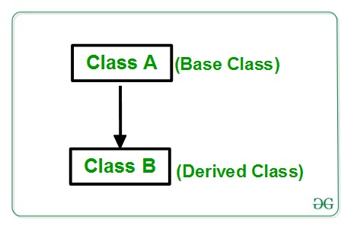
Hierarchical Inheritance

Slide 43
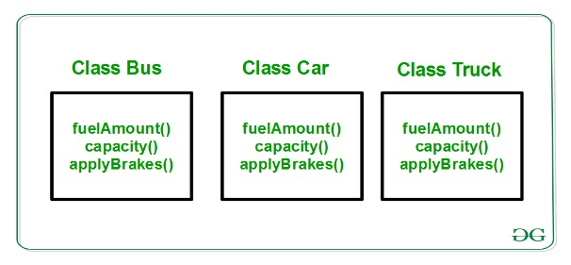
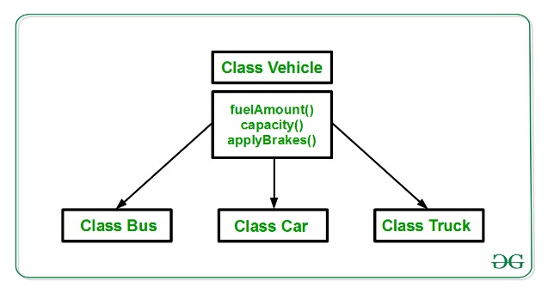
Example
Without using Inheritance
With Hierarchical Inheritance

Slide 44
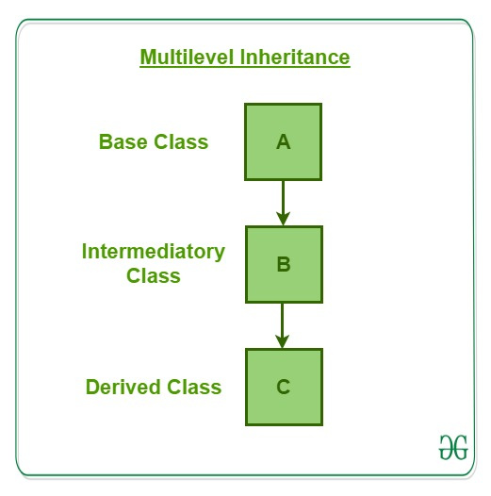
Multilevel inheritance
Multilevel inheritance is one in which there is a chain of the base class and derived classes.
In Multilevel Inheritance, a derived class will be inheriting a base class and as well as the derived class also act as the base class to other class.

Slide 45
Implementing inheritance
Inheritance in Perl can be implemented with the use of packages.
Packages are used to create a parent class which can be used in the derived classes to inherit the functionalities.
A Perl module must end with a true value or else it is considered not to have loaded. By convention this value is usually 1 though it can be any true value. A module can end with false to indicate failure but this is rarely used and it would instead die() (exit with an error).

Slide 46
use strict;
use warnings;
# Creating parent class
package Employee;
# Creating constructor
sub new
{
# shift will take package name 'employee'
# and assign it to variable 'class'
my $class = shift;
my $self = {
'name' => shift,
'employee_id' => shift
};
# Bless function to bind object to class
bless $self, $class;
# returning object from constructor
return $self;
}
1;

Slide 47
The code is the definition of the base class.
This code for parent class needs to be saved as *.pm, here we will save it as employee.pm.
Following is the derived class saved as Department.pm.
# Creating derived class
package Department;
use strict;
use warnings;
# Using class employee as parent
use parent 'employee';
1;

Slide 48
Derived file(data.pl)
use strict;
use warnings;
# Using Department class as parent
use Department;
# Creating object and assigning values
my $a = Department->new("Shikhar",18017);
# Printing the required fields
print "$a->{'name'}\n";
print "$a->{'employee_id'}\n";
Output:
Shikhar
18017

Slide 49
Encapsulation
Encapsulation in Perl is the process of wrapping up of data to protect it from the outside sources which need not have access to that part of the code.
As in encapsulation, the data in a class is hidden from other classes, so it is also known as data-hiding.
Encapsulation can be achieved by: Declaring all the variables in the class as local and fetching methods of the class by importing packages to set and get the values of variables.
If there is a need to access the data of the class for any modifications or just to print the data of the class then it can not be done directly. There is a need to create an object of that class and then access the data using the get_details() method.

Slide 50
# Declaration and definition of Base class
use strict;
use warnings;
package Student;
sub new
{
# shift will take package name 'Student'
# and assign it to variable 'class'
my $class = shift;
my $self = {
'name'=> shift,
'age'=> shift,
'roll_no' => shift
};

Slide 51
# Bless function to bind object to class
bless $self, $class;
# returning object from constructor
return $self;
}
# Method for displaying the details
sub get_details
{
my $self = shift;
print "Name is: $self->{'name'}\n";
print "Age is: $self->{'age'}\n";
print "Roll_no is: $self->{'roll_no'}";
}
# Object creation and calling
my $obj1 = Student->new("Rahul", 25, 12);
$obj1->get_details();
Output:
Name is: Rahul
Age is: 25
Roll_no is: 12

Slide 52
advantages
Data Hiding: The user will have no idea about the inner implementation of the class. It will not be visible to the user that how the class is stored values in the variables. He only knows that we are passing the values to accessors and variables are getting initialized to that value.
Increased Flexibility: We can make the variables of the class as read-only or write-only depending on our requirement. If we wish to make the variables as read-only then we have to only use Get Accessor in the code. If we wish to make the variables as write-only then we have to only use Set Accessor.
Reusability: Encapsulation also improves the re-usability and easy to change with new requirements.
Testing code is easy: Encapsulated code is easy to test for unit testing.

