Slide 1

PERL Programming

Slide 2
Introduction
Perl is a general-purpose, high level interpreted and dynamic programming language. It was developed by Larry Wall, in 1987.
There is no official Full form of the Perl, but still, the most used expansion is “Practical Extraction and Reporting Language“. Some of the programmers also refer Perl as the “Pathologically Eclectic Rubbish Lister” Or “Practically Everything Really Likable“.
Perl supports both the procedural and Object-Oriented programming. Perl is a lot similar to C syntactically and is easy for the users who have knowledge of C, C++.
It was originally developed for the text processing like extracting the required information from a specified text file and for converting the text file into a different form.
The latest version of Perl is 5.28.

Slide 3
Features
Open Source.
Platform independent
Easy to start
Text-Processing

Slide 4
Downloading and Installing Perl
Before starting with the installation process, you need to download it. For that, all versions of Perl for Windows, Linux, and MacOS are available on perl.org

Slide 5
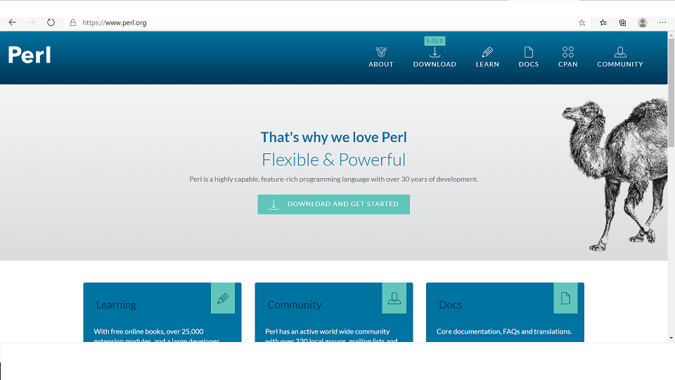
Downloading and Installing Perl

Slide 6
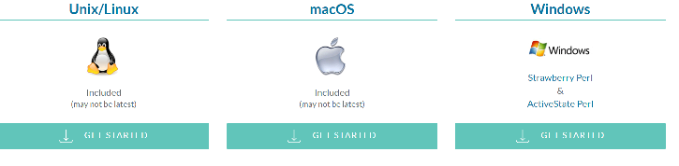
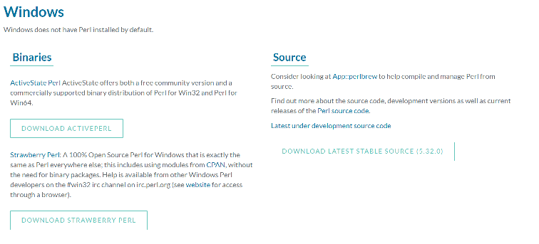
Downloading and Installing Perl

Slide 7
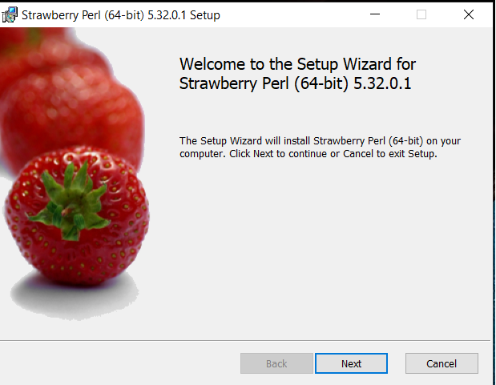
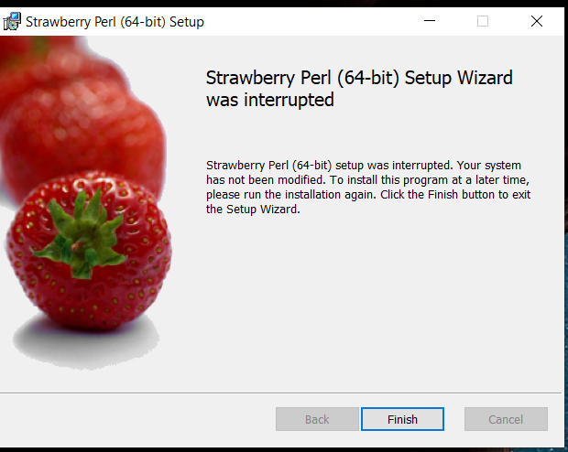
Downloading and Installing Perl in windows

Slide 8
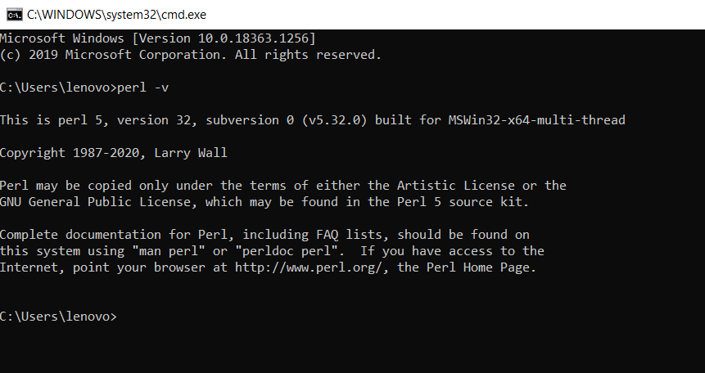
Downloading and Installing Perl in windows

Slide 9
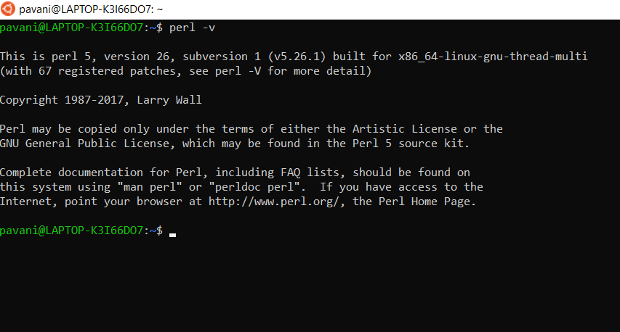
Downloading and Installing Perl in linux
In Linux/Unix OS it has become a standard package installed.
Download from perl.org
Move to perl directory and run command sh install.sh

Slide 10
Programming in perl
Perl is a lot similar to other widely used languages syntactically, it is easier to code and learn in Perl.
Programs can be written in Perl in any of the widely used text editors like Notepad++, gedit etc.
After writing the program save the file with the extension .pl or .PL To run the program use perl file_name.pl on the command line.

Slide 11
Modes of programming
Interactive Mode
Script Mode
One-Liner Mode

Slide 12
Interactive mode
Interactive mode of writing a Perl code means the direct interaction with the interpreter.
Interactive mode is a good way to get started as it helps to check the flow of code line by line and makes the debugging process easier.
Interactive Mode in Perl can be used on the Command line with the use of Perl Debugger.
Command: perl -de1

Slide 13
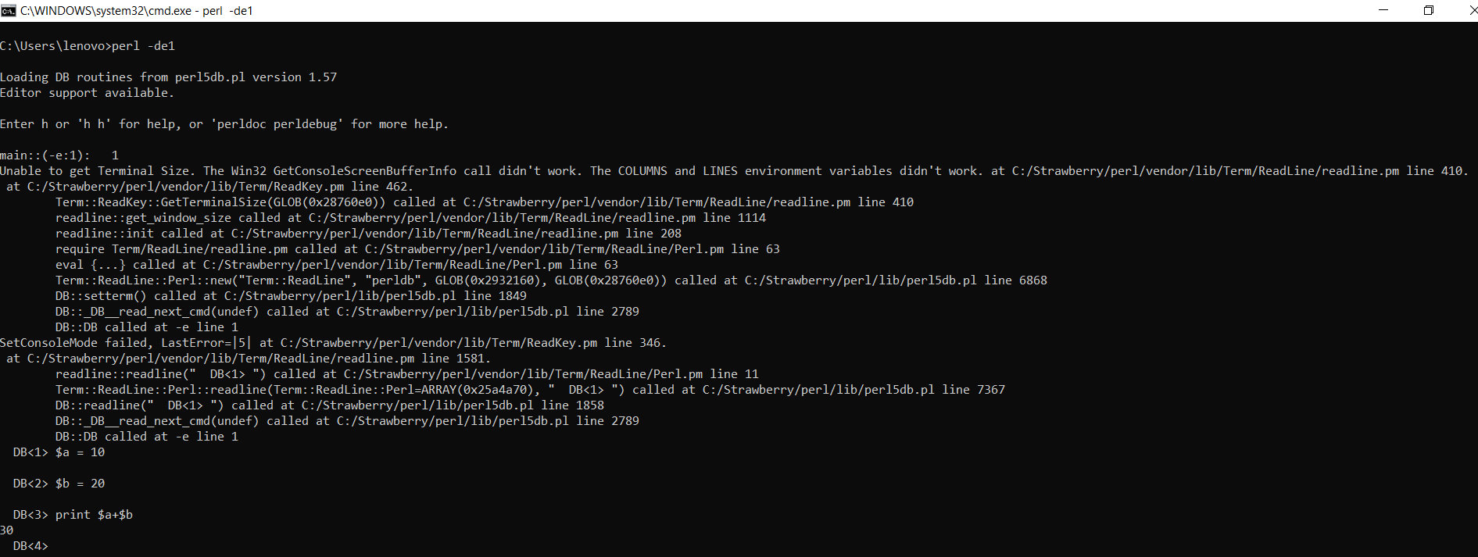
Interactive mode
To exit from interactive mode use“exit”.

Slide 14
Script mode
Script Mode in Perl is used to write Perl programs which have more than a few lines of code and are a bit complex for the Interactive mode.

Slide 15
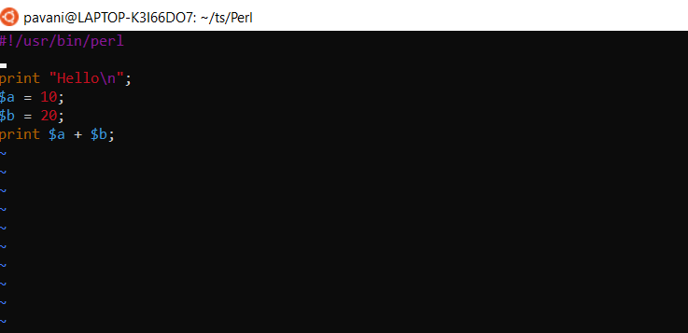
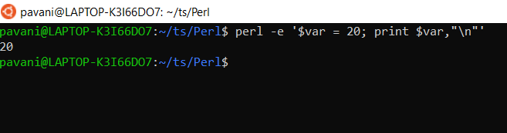
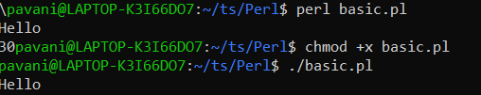
Script mode

Slide 16
One-line mode
perl –e “print ‘Hello World’”
Perl –e “$var = 20 ; print $var”
Output: Hello World

Slide 17
Variables
Variables are user-defined words that are used to hold the values passed to the program which will be used to evaluate the Code.
Every Perl program contains values on which the Code performs its operations.
A value is the data passed to the program to perform manipulation operation. This data can be either number, strings, characters, lists, etc.
$a = 5;
$b = "geeks";
$c = 15;

Slide 18
Number and its Types
A notational symbol that represents a number is termed as a numeral.
Integers
Floating Numbers
Hexadecimal Numbers
Octal Numbers
Binary Numbers

Slide 19
code
#!/usr/bin/perl
# Perl program to illustrate
# the use of numbers
# Integer
$a = 20;
# Floating Number
$b = 20.5647;
# Scientific value
$c = 123.5e-10;
# Hexadecimal Number
$d = 0xc;
# Octal Number
$e = 074;
# Binary Number
$f = 0b1010;
# Printing these values
print("Integer: ", $a, "\n");
print("Float Number: ", $b, "\n");
print("Scientific Number: ", $c, "\n");
print("Hex Number: ", $d, "\n");
print("Octal number: ", $e, "\n");
print("Binary Number: ", $f, "\n");
Integer: 20 Float Number: 20.5647 Scientific Number: 1.235e-08 Hex Number: 12 Octal number: 60 Binary Number: 10

Slide 20
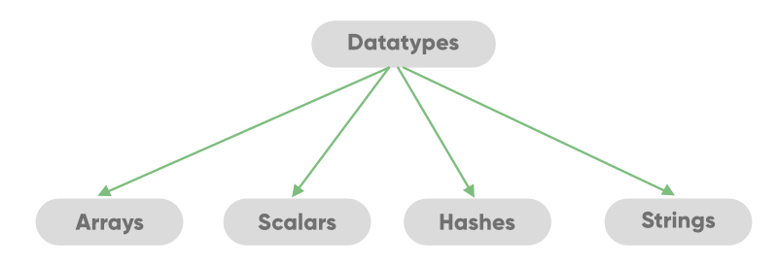
DataTypes

Slide 21
Thank you

