Slide 1

BRINDAVAN COLLEGE OF ENGINEERING
DEPARTMENT OF MASTER OF COMPUTER APPLICATIONS
INTERNAL GUIDE:
MRS. JABEEN TAJ M K
ASST. PROFESSOR, DEPT OF MCA
EXTERNAL GUIDE:
MRS. KASTHURI K
TECHCITI SOFTWARE CONSULTING PVT LTD

Slide 2




STUDENT WELLBEING ALERT SYSTEM
(S.W.A.S)

Slide 3



About Us
We recognize the importance of implementing the right solution for your business. We offer a wide range of services to build a solution that is right for your business needs. Every business, no matter the size, needs advice and support. We have several years of technical experience and have accumulated a wealth of IT infrastructure knowledge. Our free consultation service helps you to establish your requirements. We will be with you every step of the way, from product selection through to configuration and installation.
TECHCITI SOFTWARE CONSULTING PRIVATE LIMITED

Slide 4
ABOUT PROJECT
The mental stress detection project aims to develop a system that accurately identifies signs of
stress in individuals using physiological and behavioral data. This system will utilize sensors
and wearable devices to collect real-time data such as heart rate, skin conductance, and activity
levels. Algorithms for machine learning will examine the data to detect stress patterns and
provide timely feedback. The project's scope includes designing a user-friendly interface,
ensuring data privacy and security, and conducting extensive testing for reliability. It also
involves cooperation with medical specialists for validation and potential integration into
wellness programs. The ultimate goal is to offer an effective instrument for early stress
identification and management.

Slide 5
EXISTING SYSTEM AND PROPOSED SYSTEM
EXISTING SYSTEM:
Thus far, the majority of research has focused on finding ways to provide a reliable stress gauge. This might be achieved by studying the differences in lifestyle between urbanites and those living in rural areas, or by detecting brain activity. Nevertheless, a previous detection was not included in the plan. These research papers offer a wealth of details on the various methods that can be applied to increase the precision of these brain assessments. Some of these techniques include monitoring brain signals in various environments, while others involve collecting signals from the brain as the subject does specific tests.
PROPOSED SYSTEM:
We used machine learning (ML) to track the pupils' increasing stress levels and predict future stress levels; this allowed us to intervene prior to their possibly being severe damage. to their lives. In the course of the test, students are assessed in many scenarios. After considering the degree of stress, the undertaking execution decided it was appropriate. The proposed model includes PSS gathering of datasets, feature extraction, preprocessing, and machine learning method application (Random Forest, SVM, NB, and KNN). It also compares these algorithms to each other based on three performance metrics.

Slide 6
HARDWARE AND SOFTWARE REQUIREMENT
SOFTWARE REQUIREMENTS
Technology: Python Django
IDE : Pycharm/Atom
Client Side Technologies: HTML, CSS, JavaScript , Bootstrap
Server Side Technologies: Python
Data Base Server: Sqlite
OperatingSystem:Microsoft Windows/Linux
HARDWARE REQUIREMENTS
Processor: Pentium-III (or) Higher
Ram: 64MB (or) Higher
Hard disk: 80GB (or) Higher

Slide 7

FUNCTIONAL REQUIREMENTS
Detection of Fake Reviews
Implement a model that can classify reviews as spam (fake) or not spam (genuine) based on text content and other features
Use machine learning classifiers like Stochastic Gradient and Extreme Gradient Boosting Descent, and Support Vector Classifier for analysis.
Integration of Social Relationships
Develop a trust-based rating prediction model using proximity as a trust weight.
Calculate user-specific and overall trustworthiness scores based on rating variance to detect spammers.
Data Handling and Processing
Collect and preprocess datasets from sources like Yelp.com and Kaggle.
Apply data transformation applications such as Latent Dirichlet Allocation (LDA) to model the process and identify unique aspects of fake reviews.
Evaluation and Testing
Evaluate the model's performance using balanced and imbalanced datasets with oversampling and under sampling techniques.
Compare the proposed model’s accuracy against standard Collaborative Filtering (CF) methods.
System Framework and Architecture
Design and implement the system framework using Python and Django.
Utilize libraries such as NumPy, Pandas, and Scikit-learn for data manipulation and machine learning tasks.

Slide 8
NON-FUNCTIONAL REQUIREMENTS
Performance
Ensure quick response times with minimal lag.
Efficiently process and classify reviews for large datasets.
Reliability
Maintain high reliability in detecting fake reviews.
Ensure high availability and minimal downtime.
Security
Secure user data and prevent unauthorized access.
Implement secure login mechanisms.
Usability
Design an intuitive, user-friendly interface.
Ensure accessibility for both technical and non-technical users.
Adaptability
Ensure compatibility with different screen sizes, resolutions, and operating environments.
Ensure compatibility with various web browsers and devices.

Slide 9
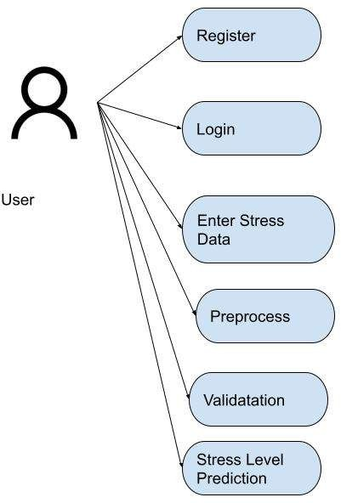
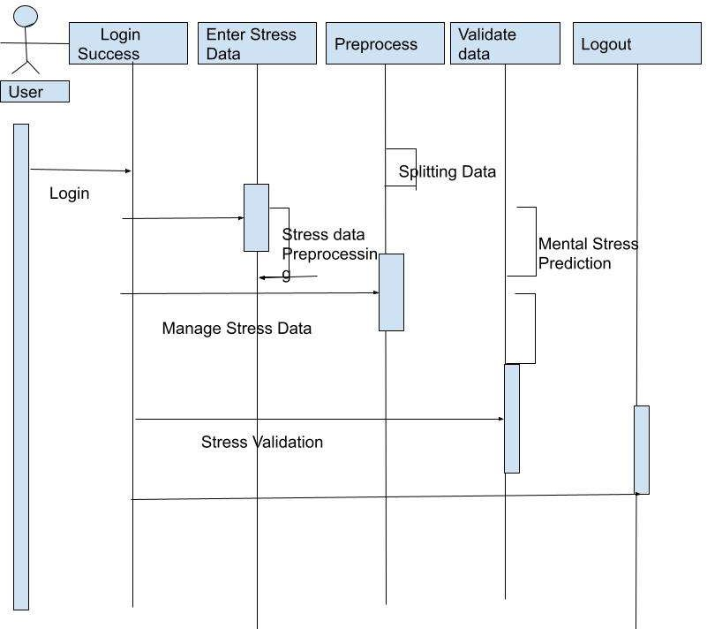
DIAGRAMS
USECASE DIAGRAM BETWEEN ADMIN AND SYSTEM
USE CASE DIAGRAM

Slide 10
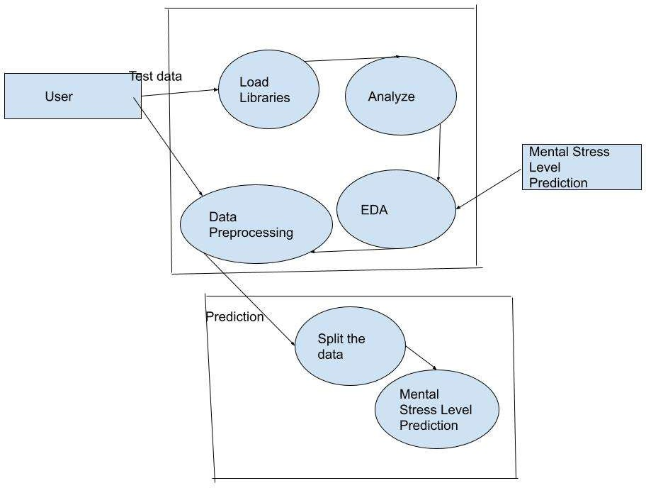
DIAGRAMS
ACTIVITY DIAGRAM

Slide 11

SCREEN SHOTS
Starting Page

Slide 12
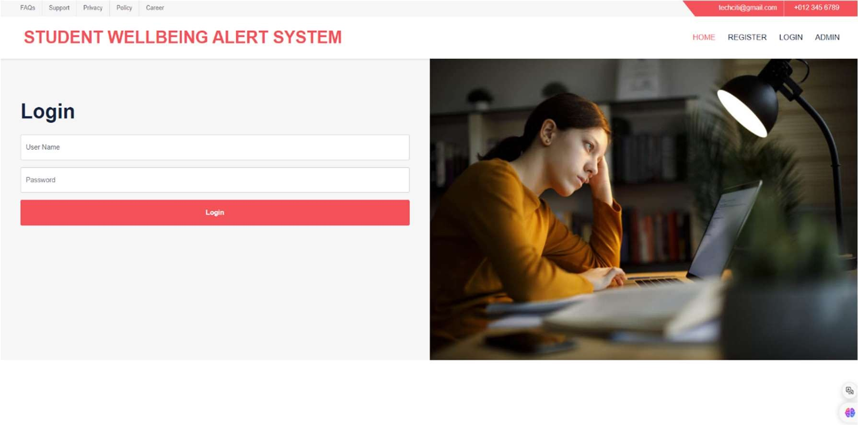
SCREEN SHOTS
Login page

Slide 13
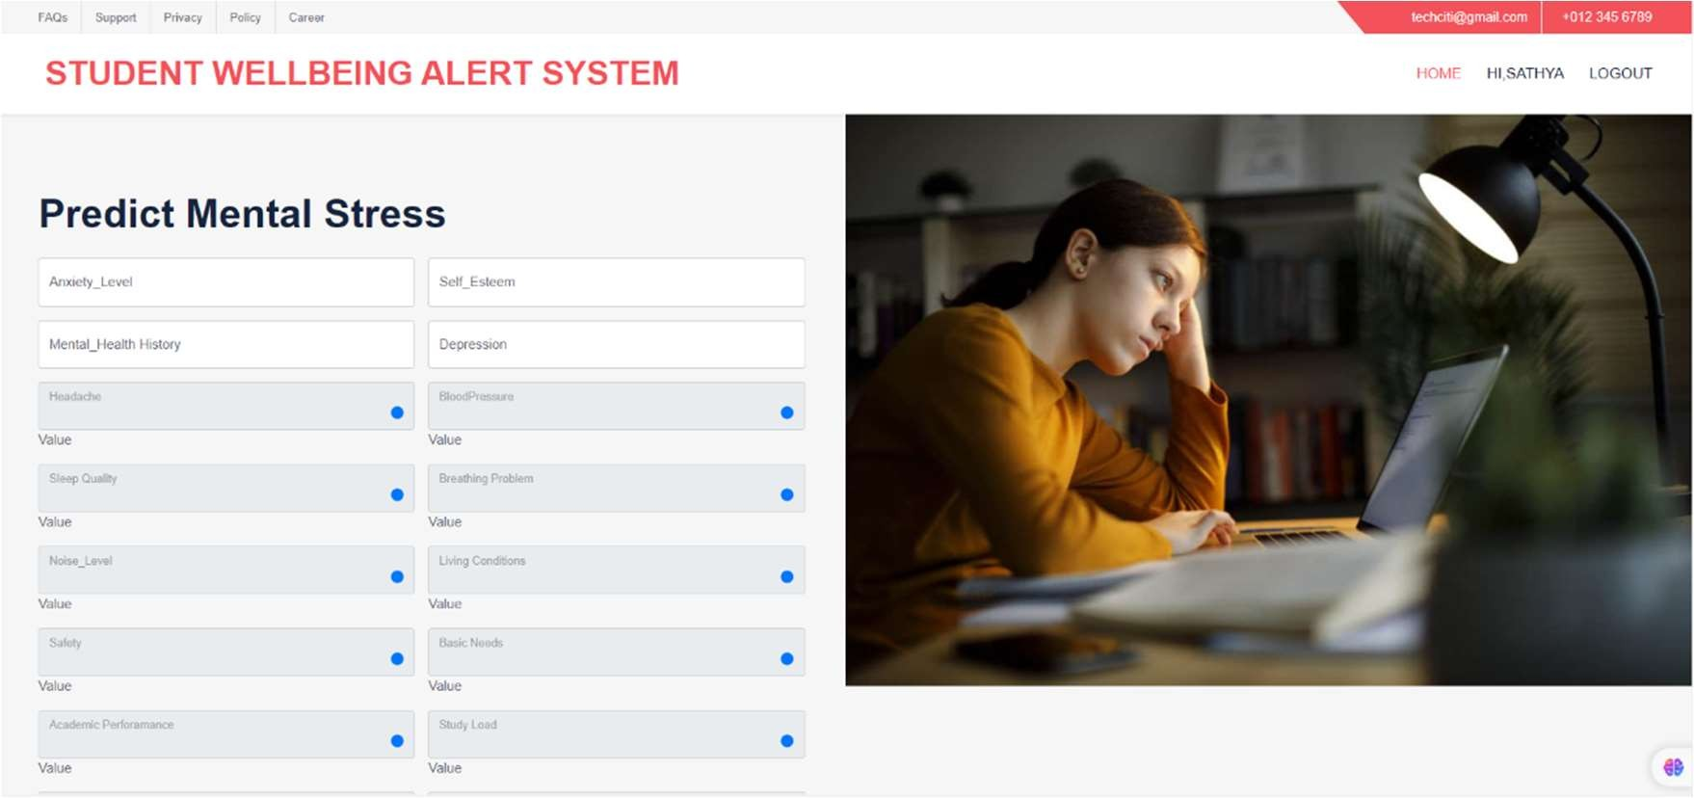
SCREEN SHOTS
Client page

Slide 14
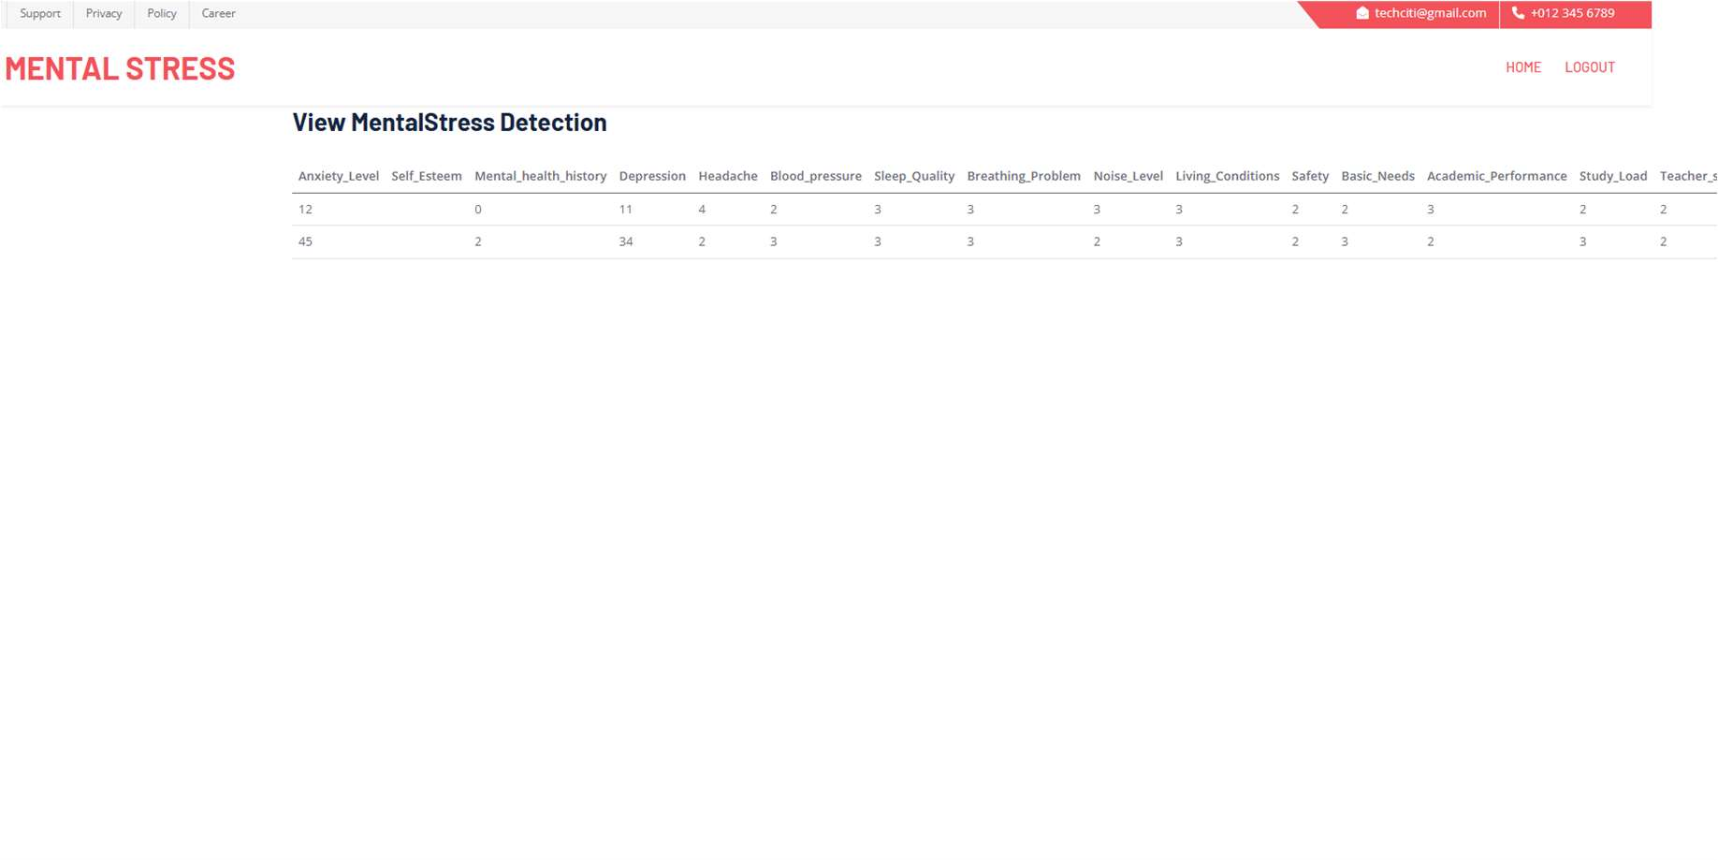
SCREEN SHOTS
ADMIN PAGE

Slide 15
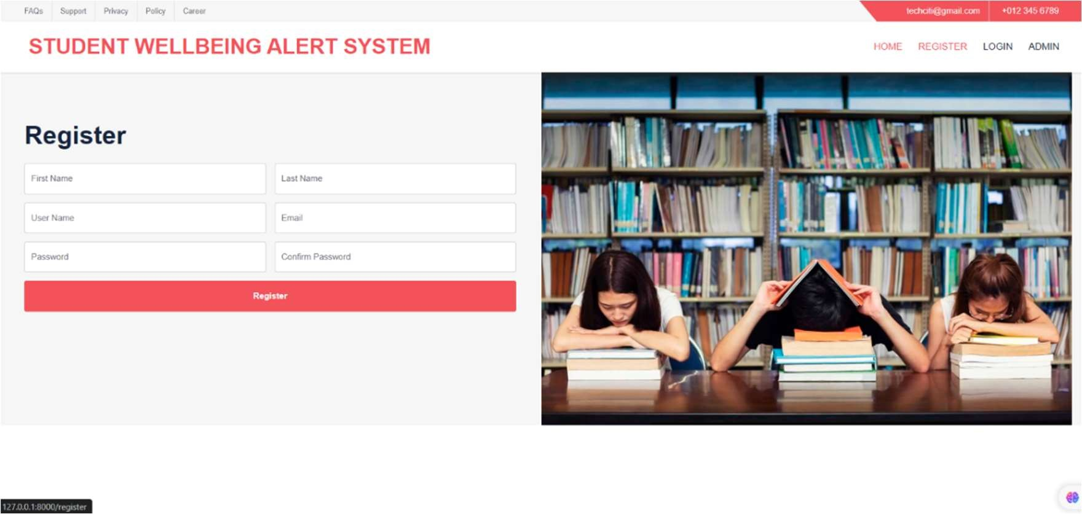
SCREEN SHOTS
REGISTER PAGE

Slide 16
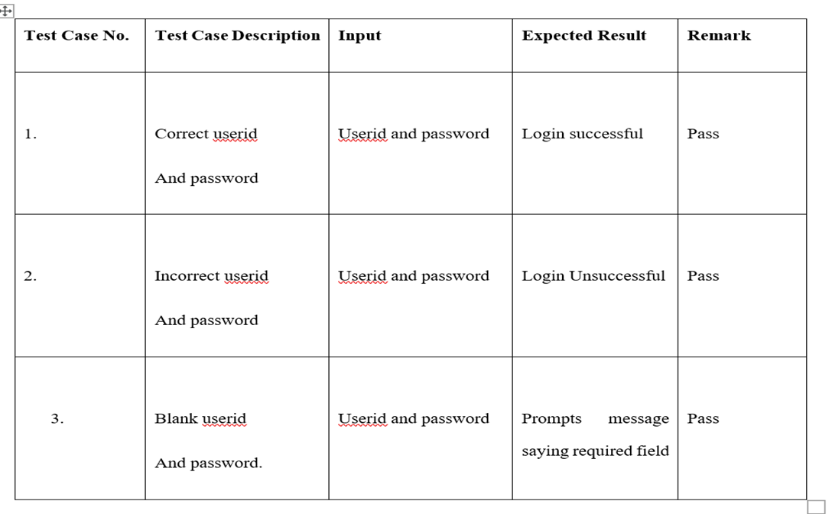
TEST CASES
USER LOGIN

Slide 17
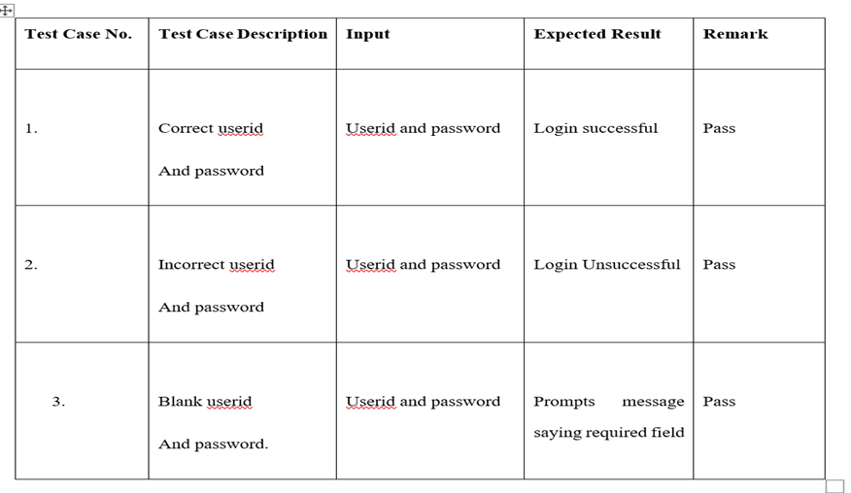
TEST CASES
ADMIN LOGIN

Slide 18
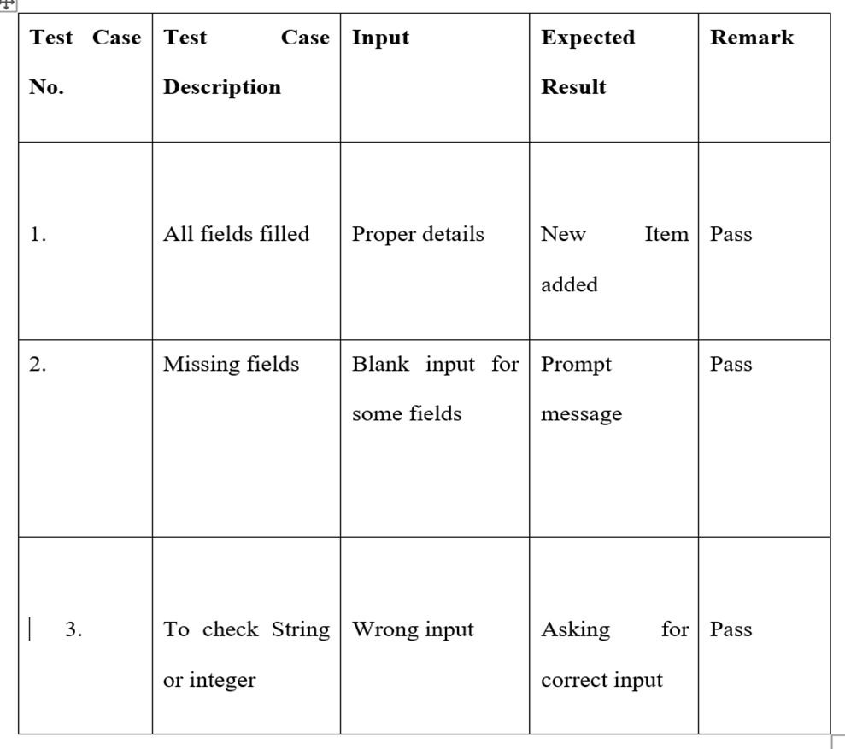
TEST CASES
FORM INPUT UNIT TESTING

Slide 19

FUTURE SCOPE
Electrocardiograms, electromyography, heart rates, breathing rates, galvanic skin reactions in the hands and feet, and other comparable tests each been given consideration for the future enhancement. We've also thought about statistics information. Numerous methods have been employed. to get accuracy based on the values, including Decision Tree, K-Nearest Nearby, and Naïve Bayes. For the simple reason that using more approaches leads to best results. It divides the data into training and testing sets before comparing them with threshold values. The threshold values indicate whether or not an individual is under stress.

Slide 20
Conclusion
We could discover how much stress there is by taking the PSS, or Perceived Stress Scale exam. In the early stages of a person's stress, when mental stress is at its peak, an initial analysis might be conducted to help. With the person's help, this can be accomplished. Using a dataset consisting out of 206 pupils from JIIT Noida, this study aims to analyse the performance of four classification algorithms: Random Forest, Naively K-, Bayes, and Support Vector MachineNearest Neighbour. A set of parameters for accuracy, sensitivity, and specificity were used to apply these algorithms. Because the datasets are small, we have also used 10-fold cross validation. Based on its geometric classification approach and reduced data requirement, we found that the SVM algorithm outperformed the other three methods. We may be able to help improve people's mental health and train them to be mentally healthy through research and the development of technologies like PSS that provide cheaper, more accurate results.

Slide 21

References
* In the 2017 edition of Multimedia Tools and Applications, volume 76, number 9, pages 11305-11317, the authors Jung.Yuchae, and Yong Ik Yoon presented a paper with the title "Multi-level assessment model for wellness service based on human mental stress level."
* Sulaiman Norizam comes in at number two. Application of nonparametric analysis to EEG data for the purpose of determining and classifying human stress index. My dissertation was completed in 2015 at the University of Technology Malaysia.
* The material may be accessed at this URL: www.mindgarden.com/documents/PerceivedStressScale.pdf.
* " The stress level and brainwave balance index of university students were compared at the beginning and conclusion of the semester." the paper was published by Adnan, Nadia, and colleagues. The IEEE Student Research and Development Conference (SCOReD) 2012, which was held in 2012.
* Here is the link to the article: https://www.hindustantimes.com/health-and-fitness/every- hour-one-student-commits-suicide-in-india/story-7UFFhSs6h1HNgrNO60FZ2O. as reported in the Hindustan Times.
* Take the paper " "Association between video games and mental stress" by Subahni, Aamir Saeed Malik, Ahmad Rauf, and Likun Xia as an example. In Volume 1 of the 2012 IEEE Intelligent and Advanced Systems (ICIAS) Conference, https://www.deccanchronicle.com/nation/in-other-news/190916/stress-depression-leads-to- suicides.html presents the proceedings of the conference. National Statistics on Deaths by Suicide
* "A Khosrowabadi, Reza, Chai Quek, Kai Keng Ang, Sau Wai Tung, and Michel Heijnen published one such paper titled "Brain-Computer Interface for classifying EEG correlates of chronic mental stress." in 2011, volume 7, issue 6, pages 757–762.

Slide 22
THANK YOU

