Slide 1
AI-Driven Cloud Resource Allocation System
Major Project | Vasavi College of Engineering Department of IT
1602-22-737-102 Prudhvikanth 1602-22-737-123
Srivan kumar

Slide 2
Objectives
01
02
Intelligent Workload Prediction
Dynamic Resource Allocation
Develop a time-series forecasting model using XGBoost to accurately predict future cloud workload demand from historical CPU and memory utilization data.
Design a real-time allocation system combining XGBoost predictions with online SGD corrections to provision the right number of servers at the right time.
.
03
Continuous Learning System
Implement an online learning loop where the model incrementally updates itself with every new data point, improving accuracy without full retraining.
.

Slide 3
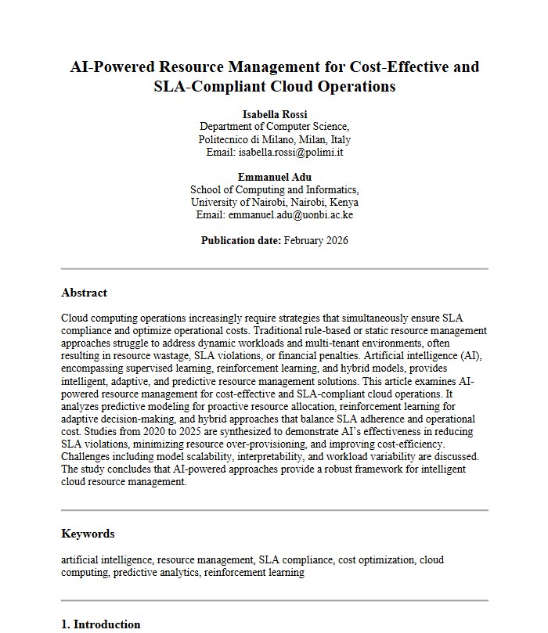
Base Paper
Key Reference for our Methodology
Our methodology is based on the AI-powered predictive resource management framework proposed for SLA-compliant and cost-efficient cloud operations . The base paper applies supervised learning for workload forecasting and adaptive scaling to maintain SLA while reducing cost.
Building on this, our work uses regression-based predictive modeling to forecast CPU and memory utilization, enabling proactive and intelligent cloud resource allocation.
Access the full paper here: Link to base paper

Slide 4
Insights from Foundational Research & Identified Gaps
Our methodology is based on the AI-powered predictive and reinforcement learning framework proposed for cost-effective and SLA-compliant cloud operations. The paper demonstrates how supervised learning and reinforcement learning can proactively optimize cloud resource allocation while balancing SLA adherence and operational cost.
Key Research Gaps Identified
1
2
No Real-Time Learning
Existing models are trained offline and deployed statically — they cannot incorporate new workload patterns without a full retraining cycle.
No Continuous Model Updating
Once deployed, models drift as traffic patterns evolve. No mechanism exists to update weights incrementally on live production data.
3
4
Lack of Lightweight Systems
Most proposed AI-based solutions rely on heavy deep-learning architectures that are impractical for edge or cost-constrained cloud environments.
No Practical Dashboard
Academic proposals rarely include a real-time monitoring interface, leaving a gap between research prototypes and deployable systems.

Slide 5
Literature Review:
From [1] 2024 IEEE study: Deep Reinforcement Learning improves adaptive scaling but lacks mathematical optimization integration.
From [2] Predictive Autoscaling (2023–2024): XGRegressor-based workload forecasting reduces latency but does not optimize cost constraints formally.
From [3] Energy-Aware Cloud Scheduling (2024): Green scheduling reduces power usage but ignores SLA-performance trade-offs.
Research Gap Identified → Need for an integrated Prediction + Optimization + RL architecture.
→ Need for joint optimization of SLA, cost, and energy efficiency.
→ Need lightweight, low-latency models for real-time deployment.
→ Need explainable and trustworthy cloud resource allocation mechanisms.

Slide 6
Problem Statement
The project aims to design an intelligent and adaptive AI-driven cloud resource allocation framework that optimizes cost and ensures SLA compliance while eliminating the inefficiencies of traditional rule-based and reactive scaling mechanisms through predictive modeling and reinforcement learning techniques.

Slide 7
Introduction
Cloud computing has become the backbone of modern enterprise applications, delivering scalable and on-demand services across diverse industries. However, cloud environments face highly dynamic and unpredictable workloads, which often lead to resource over-provisioning, SLA violations, and increased operational costs. Traditional resource management approaches rely on static thresholds and reactive scaling policies that are inefficient in handling real-time fluctuations in demand.
Recent advances in Artificial Intelligence, particularly predictive modeling and reinforcement learning, have enabled intelligent and adaptive resource allocation strategies in cloud systems. Despite achieving improvements in SLA compliance and cost efficiency, many existing AI-based models lack unified optimization frameworks and transparent decision-making mechanisms.
Our project addresses this critical challenge by introducing an advanced AI-driven cloud resource allocation framework that proactively predicts workload demand, optimizes resource distribution, and ensures cost-effective, SLA-compliant cloud operations.

Slide 8
Scope of the Project
This project focuses on the development of an AI-driven intelligent cloud resource allocation framework specifically designed to optimize cost and ensure SLA compliance in dynamic cloud environments.
Predictive Workload Forecasting
Multi-Objective Resource Optimization
The system implements time-series forecasting models (such as GRU/XGBoost) to anticipate future workload demand and enable proactive resource scaling.
The framework jointly optimizes SLA adherence, operational cost, and energy efficiency using AI-based decision strategies.
Adaptive Reinforcement Learning-Based Scaling
Scalable Cloud Deployment
The model applies reinforcement learning to dynamically adjust scaling and placement decisions in response to real-time cloud states.
The solution is designed for multi-tenant, large-scale cloud infrastructures and supports real-time, low-latency decision-making.

Slide 9
Dataset Availability & Collection
Public Repositories
Dataset Characteristics
Data Type
• Google Cluster Workload Trace Dataset • Alibaba Cluster Trace (public research dataset)
Previous Time stamps
CPU utilization logs • Memory consumption metrics • Network traffic statistics • Task arrival rates
Time-series workload data • Multi-tenant cloud environment traces • Real-world dynamic workload patterns

Slide 10
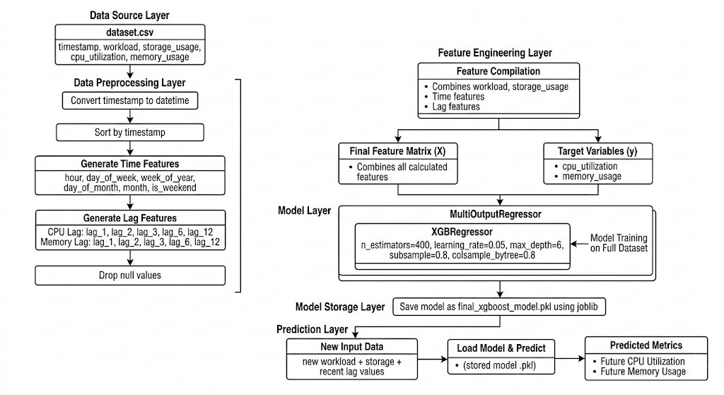
Proposed Architecture:

Slide 11

Implementation and Demo

Slide 12
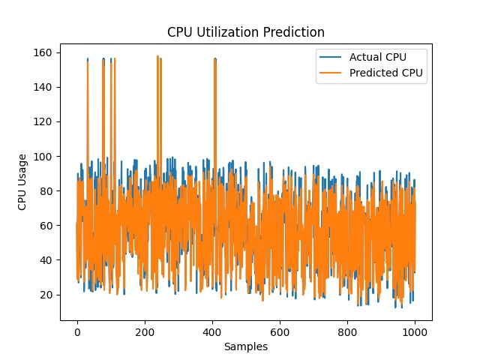
Results and Analysis
XGBoost:

Slide 13
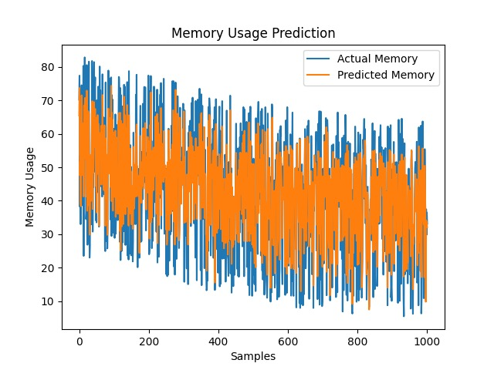

Slide 14
Conclusion:
This project presents an AI-driven intelligent cloud resource allocation framework that proactively predicts workload demand and dynamically optimizes resource distribution. By integrating predictive modeling, optimization techniques, and reinforcement learning, the system effectively balances SLA compliance and operational cost efficiency.
The proposed approach reduces resource over-provisioning, minimizes SLA violations, and enhances overall cloud performance.
This work establishes a foundation for autonomous, scalable, and cost-effective cloud resource management in modern dynamic cloud environments.

Slide 15
References:
Rossi, I., & Adu, E. (2026). AI-Powered Resource Management for Cost-Effective and SLA-Compliant Cloud Operations. AI2-1
Zhang, W., Chen, M., Li, L., & Zeng, L. (2020). AI-based predictive resource allocation for SLA compliance. Future Generation Computer Systems, 102, 140–153.
Singh, R., Gill, S. S., & Buyya, R. (2024). AI-powered adaptive resource management for SLA adherence. Journal of Cloud Computing, 13(1), 1–21.
Luo, Y., Yu, H., & Chen, X. (2024). Hybrid predictive-RL AI frameworks for cloud SLA compliance. IEEE Transactions on Services Computing, 17(2), 612–624.
Hassan, M. M., Lin, K., & Alamri, A. (2024). AI-driven cost-effective SLA management in cloud computing. Future Generation Computer Systems, 148, 102–115.

