Slide 1

DATA SCIENCE PROJECT GROUP 22
Flight Delay Prediction

Slide 2
Data set
TERMS | DESCRIPTION
DAY_OF_MONTH | Day of Month
DAY_OF_WEEK | Day of Week starting from Sunday
OP_UNIQUE_CARRIER | Unique Carrier Code
OP_CARRIER_AIRLINE_ID | An identification number assigned by US DOT to identify a unique airline (carrier).
OP_CARRIER | Code assigned by IATA and commonly used to identify a carrier
TAIL_NUM | Tail Number
ORIGIN_AIRPORT_ID | Origin Airport, Airport ID
ORIGIN_AIRPORT_SEQ_ID | Origin Airport, Airport Sequence ID

Slide 3
ORIGIN | Origin Airport
DEST_AIRPORT_ID | Destination Airport, Airport ID
DEST_AIRPORT_SEQ_ID | Destination Airport, Airport Séquence ID
DEST | Destination Airport
DEP_TIME | Actual Departure Time (local time: hhmm)
DEP_DEL15 | Departure Delay Indicator, 15 Minutes or More (1=Yes, 0=No)
DEP_TIME_BLK | Departure Time Block, Hourly Intervals
ARR_TIME | Actual Arrival Time (local time: hhmm)

Slide 4
ARR_DEL15 | Arrival Delay Indicator, 15 Minutes or More (1=Yes, 0=No)
CANCELLED | Cancelled Flight Indicator (1=Yes, 0=No)
DIVERTED | Diverted Flight Indicator (1=Yes, 0=No)
DISTANCE | Distance between airports (miles)
YEAR | Two years (2019,2020)

Slide 5
Data Collection

Slide 6
Collecting Data
#code
df_2019 = pd.read_csv('C:/Users/HAI/Desktop/Jan_2019_ontime.csv')
df_2020 = pd.read_csv('C:/Users/HAI/Desktop/Jan_2020_ontime.csv')
df_2019['year'] = 2019
df_2020['year'] = 2020
df1=df_2020.drop(['Unnamed: 21'],axis=1)
print(set(df_2019.columns) == set(df1.columns))
dataset = pd.concat([df_2019,df1])
data=dataset.drop(['OP_UNIQUE_CARRIER','OP_CARRIER_AIRLINE_ID','OP_CARRIER','TAIL_NUM', 'ORIGIN_AIRPORT_ID','ORIGIN_AIRPORT_SEQ_ID','DEST_AIRPORT_ID','DEST_AIRPORT_SEQ_ID'], axis=1)

Slide 7
Data Pre-processing and Cleaning

Slide 8
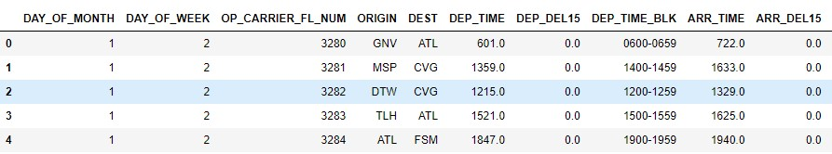
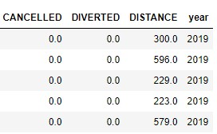
Processed Dataset

Slide 9
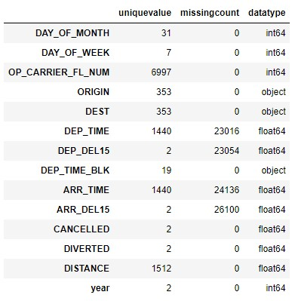
Data Cleaning
checking = { 'uniquevalue':data.nunique(), 'missingcount':data.isna().sum(), 'datatype':data.dtypes }
pd.DataFrame(checking)

Slide 10
Filling the missing value with ‘1’ in column ‘ARR_DEL15’ and removing all other rows which have any missing value.
data = data.fillna({'ARR_DEL15': 1})
data.dropna( axis=0, how='any', inplace= True)
checking = { 'uniquevalue':data.nunique(), 'missingcount':data.isna().sum(), 'datatype':data.dtypes }pd.DataFrame(checking)

Slide 11
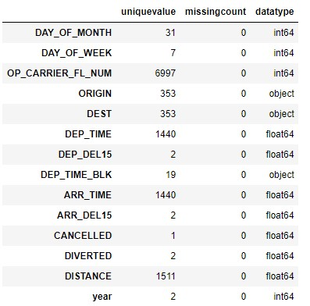

Slide 12
DATA VISUALISATION

Slide 13
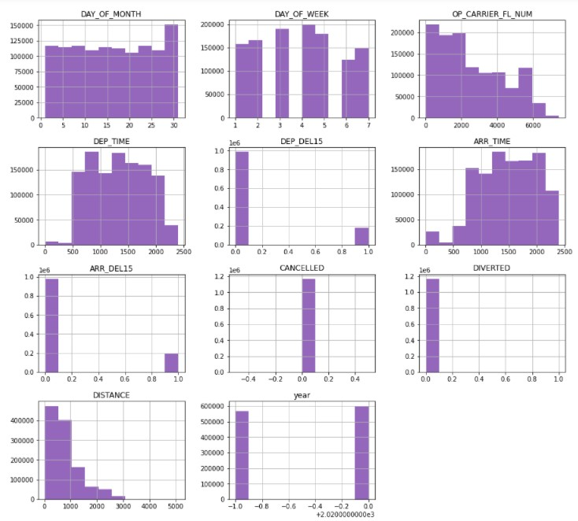
Frequency of Flight Delay corresponding to each column
#code
data.hist(figsize = (15,14),color = '#9467bd)

Slide 14
No of cancelled flights on each day of month
#code
plot1 = data.groupby('DAY_OF_MONTH')['CANCELLED'].count()fig = go.Figure()fig.add_trace(go.Bar(x=plot1.index, y=plot1.values, name='Cancel bar',opacity=0.9,marker_color='#a5afff'))fig.add_trace(go.Scatter(x=plot1.index, y=plot1.values, line=dict(color='red'), name='Cancel trend'))fig.update_layout( title="Cancelled flights vs day of month", xaxis_title="Day of month", yaxis_title="Cancel count",)fig.show()

Slide 15
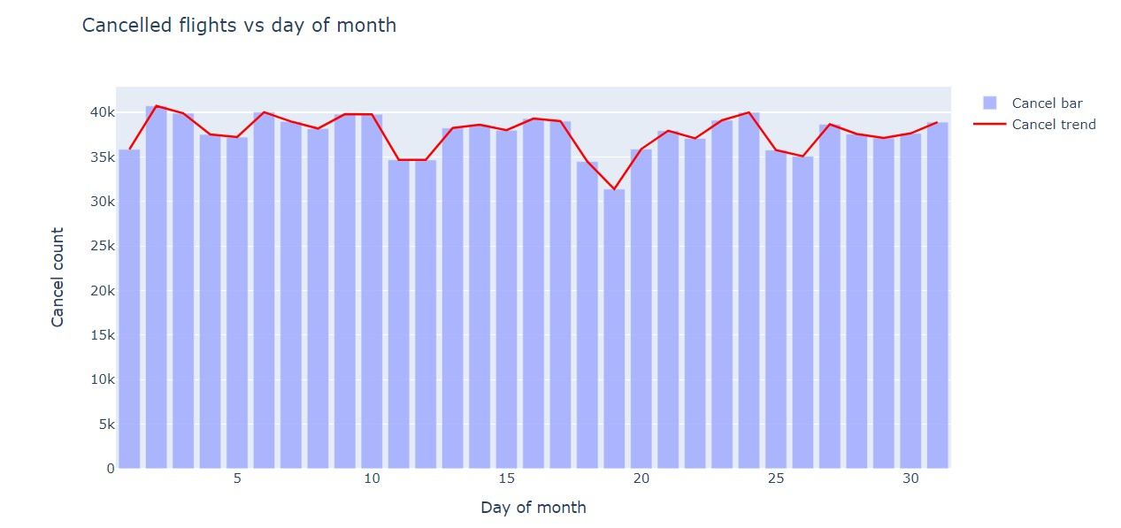
No of cancelled flights on each day of month

Slide 16
No. of cancelled flights by airport
#code
plot4 = data.groupby('DEST')['CANCELLED'].count().sort_values(ascending=False)#cap to above 400plot4 = plot4[plot4>400]fig4 = px.bar(plot4,x=plot4.index,y=plot4.values,color_discrete_sequence=['#1A7065'], title="Cancelled flights by destination airport",labels={"DEST":"Destination airport","y":"Count"})fig4.layout.template = 'plotly_white'fig4.update_xaxes(tickangle=45)fig4.show()

Slide 17
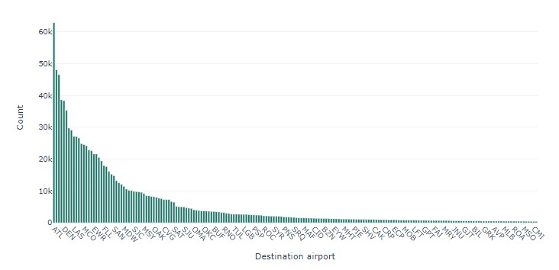

Slide 18
No. of flights delayed on departure and arrival
#code
f, (ax,ax1) = plt.subplots(1,2, figsize=(12,6))dep = sns.countplot(data['DEP_DEL15'], ax=ax)dep.set_title('Depatures',fontsize = 14)dep.set_xlabel('Labels',fontsize =14)dep.set_ylabel('Freq',fontsize =14)arr = sns.countplot(data['ARR_DEL15'], ax=ax1)arr.set_title('Arrivals',fontsize = 14)arr.set_xlabel('Labels',fontsize = 14)arr.set_ylabel('Freq',fontsize =14)

Slide 19
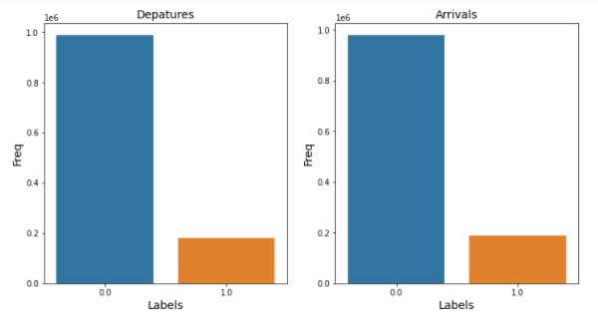

Slide 20
No. of flights diverted but not delayed
#code
f_delay_div_cal= data.groupby('DIVERTED').agg({ 'DEP_DEL15':sum, 'ARR_DEL15':sum}).head()f_delay_div_cal.plot(kind='bar',fontsize = 12)plt.title('No.of flights diverted but not delayed',fontsize = 14)plt.ylabel('Count',fontsize =14)

Slide 21
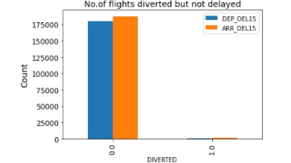

Slide 22
No of flights delayed per day in a week
#code
week = data[['DAY_OF_WEEK','ARR_DEL15']].groupby('DAY_OF_WEEK').sum().sort_values(by = 'DAY_OF_WEEK', ascending = True)week['PERCENTUAL'] = week['ARR_DEL15']/(week['ARR_DEL15'].sum())*100month = data[['DAY_OF_MONTH','ARR_DEL15']].groupby('DAY_OF_MONTH').sum().sort_values(by ='DAY_OF_MONTH',ascending= True)month['PERCENTUAL'] = month['ARR_DEL15']/(month['ARR_DEL15'].sum())*100plt.figure(figsize = (12,6))grade = ['Sun','Mon','Tue','Wed','Thu','Fri','Sat']exp = [0,0,0,0.1,0,0,0]cl = ['yellow', 'green', 'blue','red','violet','orange','indigo']plt.pie(week['PERCENTUAL'], labels = grade, explode = exp,autopct = '%2.2f%%', colors = cl)plt.show()plt.figure(figsize=(12, 6))ax = np.arange(1,32)cl = ['#1f77b4', '#ff7f0e','#d62728','#2ca02c', '#9467bd', '#8c564b', '#e377c2', '#7f7f7f', '#bcbd22', '#17becf']plt.bar( ax, month ['PERCENTUAL'], color= cl)plt.ylabel('Percent of Flights that Arrive Late',fontsize = 14)plt.xlabel('DAY_OF_MONTH',fontsize = 14) plt.title('Percentage of flight delay on DAY_OF_MONTH',fontsize = 16)

Slide 23
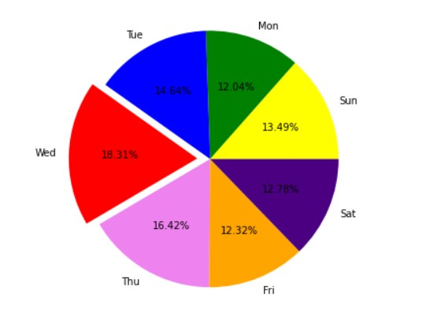
Flight delay percentage on each day in a week

Slide 24
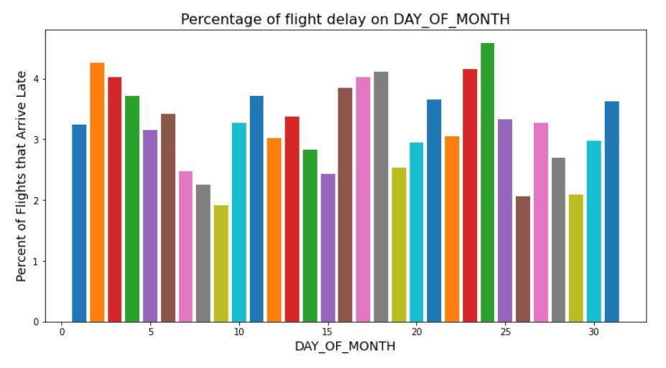

Slide 25
Frequency of flights delay due to DEP_TIME_BLK
Concentration of delays due to 'DEP_TIME_BLK'?
time_blk = data[['DEP_TIME_BLK','ARR_DEL15']].groupby('DEP_TIME_BLK').sum()time_blk['PERCENTUAL'] = time_blk['ARR_DEL15']/(time_blk['ARR_DEL15'].sum())*100ax=np.unique(data['DEP_TIME_BLK'])plt.figure(figsize=(12, 6))plt.xticks(rotation = 45)cl = ['#053752','#f29624','#f29624','#e5de44','#e5de44','#eae54b','#eae54b','#f5f259','#f5f259','#f5f259','#f8bd4c','#fbd063','#5595a9','#417c93','#2d647d','#1a4d68','#053752','#053752','#053752']plt.bar(ax , time_blk ['PERCENTUAL'],color = cl)plt.ylabel('Percent of Flights that Arrive Late', fontsize = 14)plt.xlabel('DEP_TIME_BLK',fontsize = 14)plt.title('Concentration of delay flights due to DEP_TIME_BLK', fontsize = 16)time_blk

Slide 26
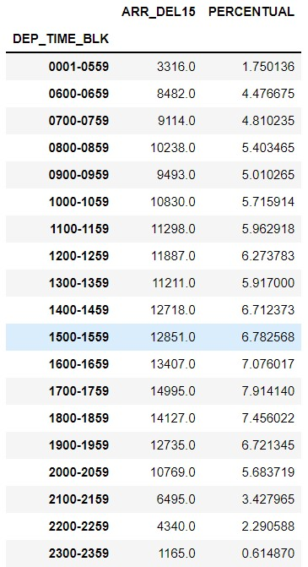

Slide 27
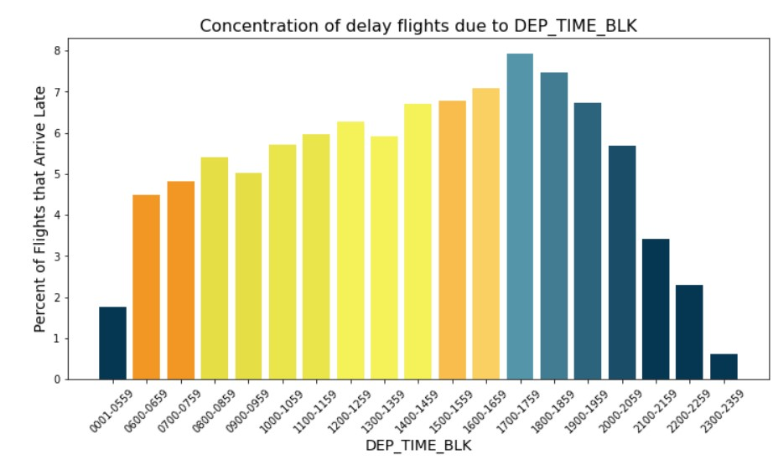

Slide 28
No of flights delayed per origin airport
Which 'Origin' airport stands out in delay?
origin_later = data[['ORIGIN','DEP_DEL15']].groupby('ORIGIN').sum().sort_values(by='DEP_DEL15',ascending = False)origin_later['PERCENTUAL'] = origin_later['DEP_DEL15']/(origin_later['DEP_DEL15'].sum
())*100pt = origin_later.head(10)plt.figure(figsize = (12,6))grade = ['ORD','ATL','DFW','LGA','DEN','LAX','SFO','CLT','EWR','BOS']exp = [0.2,0,0,0,0,0,0,0,0,0]plt.pie(pt['PERCENTUAL'], labels = grade, explode = exp, autopct = '%2.2f%%')plt.show()pt

Slide 29
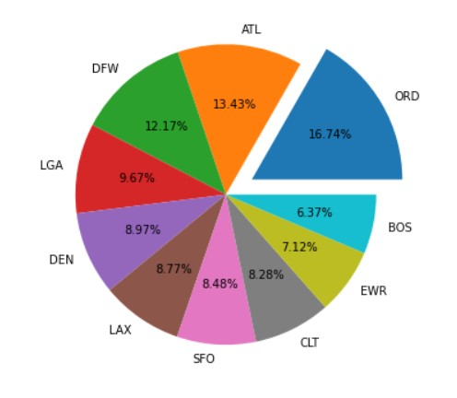
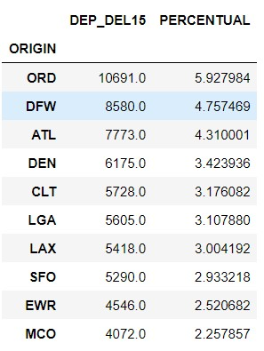
PIE CHART

Slide 30
No of flights delayed per destination airport
Which airport of Destination stands out in delays?
dest_later = data[['DEST','ARR_DEL15']].groupby('DEST').sum().sort_values(by='ARR_DEL15',ascending=False)
dest_later['PERCENTUAL']=dest_later['ARR_DEL15']/(dest_later['ARR_DEL15'].sum())*100
dest_later.head(10)pt1 = dest_later.head(10)plt.figure(figsize = (12,6))grade = ['ORD','LGA','DFW','ATL','SFO','EWR','LAX','DEN','BOS','CLT']exp = [0.2,0,0,0,0,0,0,0,0,0]plt.pie(pt1['PERCENTUAL'], labels = grade, explode = exp, autopct = '%2.2f%%')
plt.title('Delay percentage at the destination airport',fontsize = 14)plt.show()pt1

Slide 31
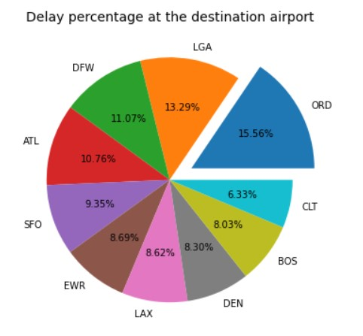
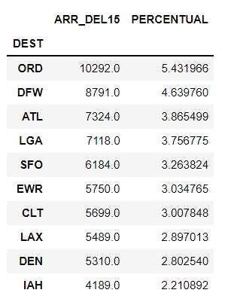
PIE CHART

Slide 32
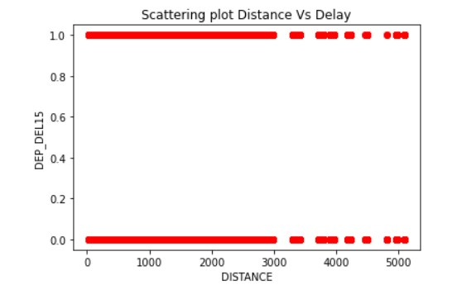
Scatter Plot Distance Vs Delay
plt.scatter(data["DISTANCE"],data["DEP_DEL15"], color = "red")
plt.title('Scattering plot Distance Vs Delay')
plt.xlabel("DISTANCE")
plt.ylabel("DEP_DEL15")plt.show()

Slide 33
DATA STATISTICS

Slide 34
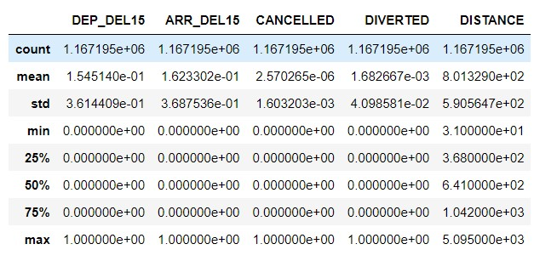
Statistics of each column

Slide 35
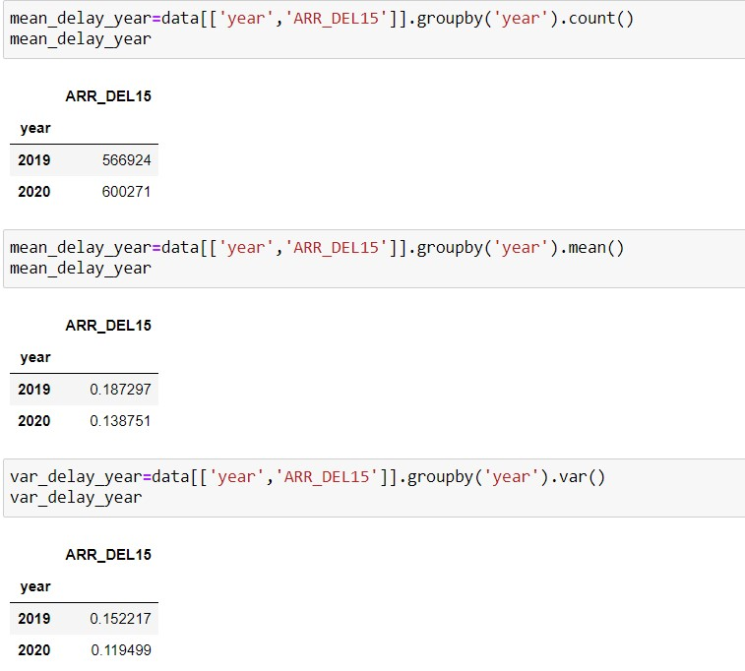

Slide 36
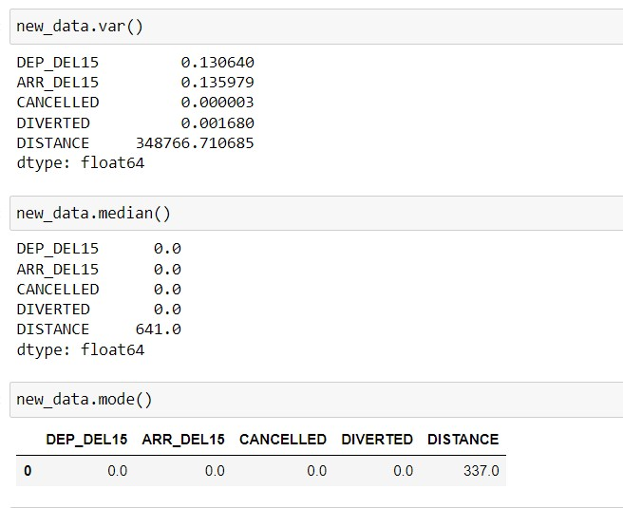

Slide 37
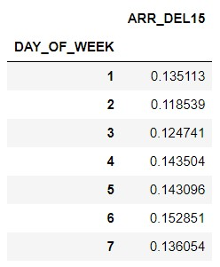
var_delay_week = data[['DAY_OF_WEEK','ARR_DEL15']].groupby('DAY_OF_WEEK').var()
var_delay_week

Slide 38
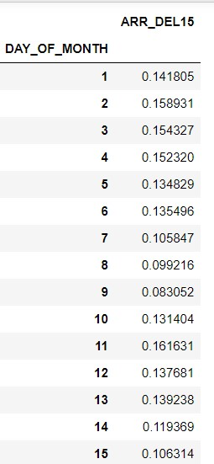
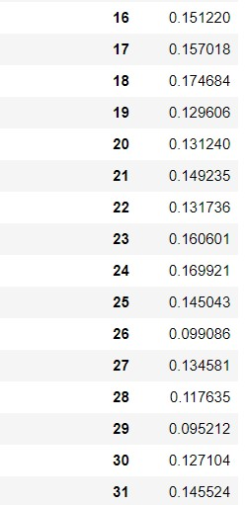
var_delay_month=data[['DAY_OF_MONTH','ARR_DEL15']].groupby('DAY_OF_MONTH').var()
var_delay_month

Slide 39
HYPOTHESIS TESTING

Slide 40
T-TEST
NULL HYPOTHESIS (H0):
Average no of flights delayed in first 12hours of day is equal to average no of flights delayed in second 12hours in a day
ALTERNATIVE HYPOTHESIS (H1):
Average no of flights delayed in first 12hours is not equal to average no of flights delayed in second 12hoours in a dayWe are storing no of flights delayed in each hour from midnight 12 to afternoon 12 in array1.We are storing no of flights delayed in each hour from afternoon 12 to midnight12 in array2.As both will be quantitative variables we apply T-Test to prove hypothesis part!

Slide 41
#code
array1 = [552.0,552.0,552.0,553.0,553.0,553.0,8482.0,9114.0,10238.0,9493.0,10830.0,11298.0]array2 = [11887.0,11211.0,12718.0,12851.0,13407.0,14995.0,14127.0,12735.0,10769.0,6495.0,4340.0,1165.0]
from scipy import statst_value,p_value=stats.ttest_ind(array1,array2)print('Test statistic is %f'%float("{:.6f}".format(t_value)))print('p-value for two tailed test is %f'%p_value)
alpha = 0.05
if p_value<=alpha: print("we can reject null hypothesis (μ1 != μ2)and can conclude that average flights delayed in first 12 hours is not equal to average flights delayed next 12hours in a day")
else: print("we dont reject the null hypothesis,we cannot say that μ1 != μ2")
Test statistic is -2.825704p-value for two tailed test is 0.009843
we can reject null hypothesis (μ1 != μ2)and can conclude that average flights delayed in first 12 hours is not equal to average flights delayed next 12hours in a day

Slide 42
Chi-square test of Independence
NULL HYPOTHESIS (H0):
Average no of flights delayed in each week is equal .
ALTERNATIVE HYPOTHESIS (H1):
Average no of flights delayed in each week is different.

Slide 43
Converting quantitative variables of arr_del15 ,day_of_week column into Categorical Variables
data['ARR_DEL15']=data['ARR_DEL15'].replace([0,1],['NOT_DELAYED','DELAYED'])
data[‘DAY_OF_WEEK']=data['DAY_OF_WEEK'].replace([1,2,3,4,5,6,7],['SUN','MON','TUE','WED','THU','FRI','SAT'])
contigencytable=pd.crosstab(data['DAY_OF_WEEK'],data['ARR_DEL15'])
chi_sq_Stat,p_value,deg_freedom,exp_freq = stats.chi2_contingency(contigencytable)
if p_value<0.05: print("we reject null")
else : print("we do not reject null")
Test statistic is -2.825704p-value for two tailed test is 0.009843
we can reject null hypothesis (μ1 != μ2)and can conclude that average no of flights delayed in a each week is different

Slide 44
Prediction Task
Using machine learning model

Slide 45
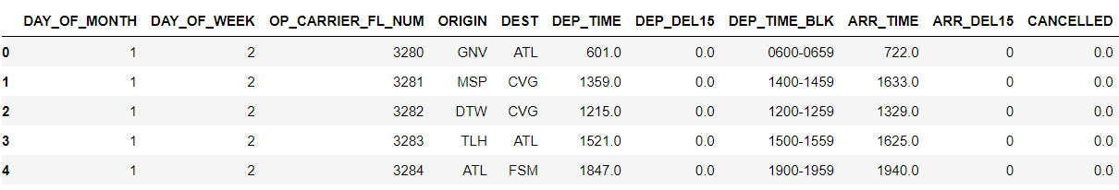
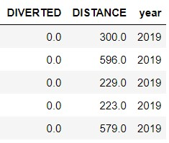
data.head()

Slide 46
Converting a string into integer
#code
UNQ = data.DEST.unique()
data['ORIGIN'] = data['ORIGIN'].replace(UNQ,np.arange(0,353,1))
data['DEST'] = data['DEST'].replace(UNQ,np.arange(0,353,1))
ERQ = data.DEP_TIME_BLK.unique()
data['DEP_TIME_BLK'] = data['DEP_TIME_BLK'].replace(ERQ,np.arange(0,19,1))
data.head()

Slide 47
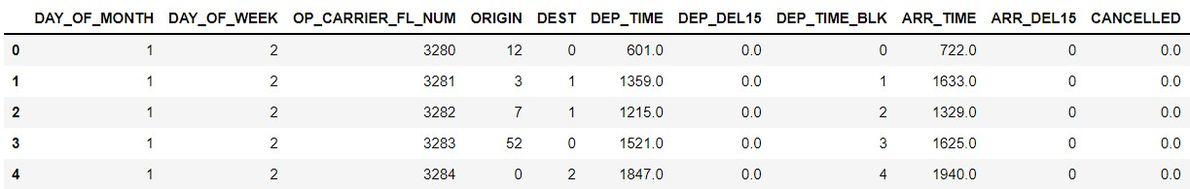
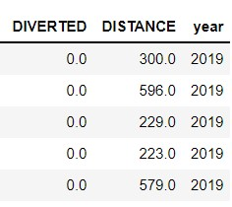
data.head()

Slide 48
This code imports scikit learn's train_test_split helper function. train_test_split function is used to split the dataframe into a training set containing 80% of the original data, and a test set containing remaining 20%.
#code
from sklearn.model_selection import train_test_split
train_x,test_x,train_y,test_y = train_test_split(data.drop('ARR_DEL15',axis = 1),data['ARR_DEL15'],test_size = 0.2,random_state= 42)

Slide 49
This code imports scikit learn's RandomForestClassifier helper function.
Randomforestclassifier is a meta estimator that fits a number of decision tree classifiers on various sub-samples of the dataset and uses averaging to improve the predictive accuracy and control over-fitting.
#code
from sklearn.ensemble import Ran
domForestClassifier
model = RandomForestClassifier(random_state = 13)
model.fit( train_x, train_y)

Slide 50
now, use the predict method using the values in test_x, followed by score method to determine the mean accuracy of the model. and we found mean accuracy as 93%
#code
predicted = model.predict(test_x)
model.score(test_x,test_y)
#output
0.930110221513971

Slide 51
roc_auc_score
"Area under receiver operating characteristic" curve("ROC AUC")
Now we generate an ROC AUC score from the probabilities using scikit-learn's "roc_auc_score" method and found ROC AUC score as 95%.
#code
from sklearn.metrics import roc_auc_score
probabilities = model.predict_proba(test_x)
roc_auc_score(test_y,probabilities[:,1])
#output
0.9582950905324223

Slide 52
Confusion matrix
This code imports scikit learn's confusion_matrix helper function.
The output from the score method quantifies the number of false positives, false negatives ,true positives , and true negatives
#code
from sklearn.metrics import confusion_matrix
confusion_matrix(test_y, predicted)
#output
array([[188857, 6399], [ 9916, 28267]], dtype=int64)

Slide 53
The precision is the ratio tp / (tp + fp) where tp is the number of true positives and fp the number of false positives.
Prescision score quantifies the number of positive class predictions that actually belong to the positive class
#code
from sklearn.metrics import precision_score
train_prediction= model.predict(train_x)
precision_score(train_y, train_prediction)
#output
1

Slide 54
Recall score represents the model's ability to correctly predict the positives out of actual positives.
Other measure of accuracy for a classification model include precision and recall
#code
from sklearn.metrics import recall_score
recall_score(train_y, train_prediction)
#output
0.99989424144677

Slide 55
Visualizing the output model
Execute the following code to show roc curve for the model
This roc curve shows True positive rate vs False positive rate
#code
from sklearn.metrics import roc_curve
fpr , tpr , _ = roc_curve(test_y,probabilities[:,1])
plt.plot(fpr,tpr)
plt.plot([0,1],[0,1],color='grey',lw=1,linestyle='--')
plt.xlabel('False Positive Rate')
plt.ylabel('True Positive Rate')

Slide 56
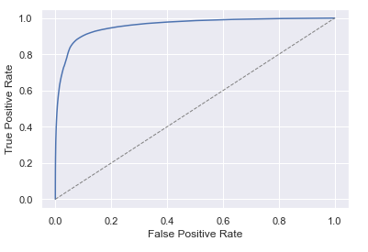

Slide 57
Thank You
Presented By
Group 22
Malraju Srivardhan Rao:
Vivek Kumar Shukla:
Kotagiri Tarunaditya:
K B P D Srinivas:
Rajat Jakkar:
Giduturi Shyam Sundar:
2nd part of Data Visualisation, Chi Square Test
1st part of Data Visualisation
Introduction and Data Collection
Data Pre-processing and cleaning
T – Test
Data Statistics

