Slide 1

SpecSense — Industrial Catalog Intelligence Engine
• Domain Focus: Automated Industrial Catalog Content Enrichment & Controlled Vocabulary Normalization
• Problem Statement: Raw distributor feeds are cryptic ("3/8 CPLG BRS 150#"), missing attributes, and use conflicting units.
• Our Solution: End-to-end enrichment pipeline that ingests minimal inputs (PN, Brand, Short Desc), discovers authentic manufacturer sources, cross-validates specs via multi-source consensus, standardizes against Standard Enterprise LOV dictionaries, and builds search-ready records.
• Compliance Engine: Strict enforcement of Industry Standard Rule Book: Invoice Desc (≤40 CAPS), Mobile Desc (60-80 chars), Decimal-to-Fraction conversions, and Approved Brand/UOM normalization.
• Scalability & Trust: Zero-Quota DuckDuckGo/Bing discovery, 100% click-to-source audit citations, human review queue, and 252-column enterprise CSV delivery.

Slide 2

Executive Summary
• Product: SpecSense — Enterprise Industrial Catalog Intelligence & Enrichment Engine
• Target Industry: B2B Industrial Distribution, MRO, Hardware, Electrical, Plumbing & Tools
• Core Value: Automatically transforms raw, cryptic distributor feeds into complete, search-ready product records
• Cost Efficiency: 99.8% cost reduction per SKU ($15.00 manual labor -> <$0.003 AI pipeline), zero invented data
• Architecture: Production microservice powered by FastAPI, multi-LLM consensus failover, and zero-quota discovery
• Deployment & Code: Fully containerized and open-source: https://github.com/srivardhxn/Specsense

Slide 3
Brief about your solution
SpecSense is an AI-powered product intelligence platform designed to automate the manual, error-prone enrichment of industrial commerce catalogs. It turns minimal, cryptic inputs—such as a Part Number, Brand name, and short description—into rich, structured, and commerce-ready product data sheets in seconds.
The platform features a RAG-first architecture that checks local product reference databases before falling back to live web search on authentic manufacturer websites. Using advanced LLM agents with multi-source consensus scoring and clickable direct citations, SpecSense delivers verified, hallucination-free specifications, ensuring absolute data trust.

Slide 4
1. How does your solution enrich minimal product information?
Briefly explain how your solution transforms limited inputs (e.g., Part Number, Brand, Short Description) into rich product intelligence.
• Answer: SpecSense craws manufacturer web pages and technical sheets using zero-quota multi-engine search (DuckDuckGo/Bing) and local RAG datasets. It extracts rich specifications, category data, and technical attributes from crawled HTML and PDF manuals using Gemini/Groq LLMs.
2. How does your solution ensure accuracy and trust in the generated product data?
Describe your validation strategy. This may include: (Confidence scoring, Multi-source verification, Human review, Rule-based validation, AI validation, Other approaches)
• Answer: Validates data using Multi-Source Consensus verification. Values are only marked high-confidence if two or more sources agree. Hallucinations are prevented by linking a clickable source URL to every single attribute, with low-confidence items routed to a Human Review Dashboard.
3. What makes your solution scalable for enterprise product catalogs?
Describe how your solution would handle: Large product catalogs, New manufacturers, Different document formats, Continuous product updates
• Answer: Built with asynchronous, concurrent batch processing APIs (/api/batch) for catalog-scale migrations. Utilizes schema-agnostic extraction (up to 50 parameters per SKU) to support new categories, uses local caching to save API costs, and includes auto model/key rotation for 100% uptime.

Slide 5
Opportunities
How different is it from any of the other existing ideas?
• SpecSense uses dynamic, live queries combined with multi-source consensus validation rather than relying on static, outdated databases or hallucinating LLMs.
How will it be able to solve the problem statement given?
• It automates the tedious bottleneck of manual catalog data entry, reducing catalog-ready SKU creation from weeks of labor down to seconds of automated processing.
USP of the proposed solution
• Consensus-driven, zero-hallucination product intelligence with click-to-source URL explainability for absolute data trust.

Slide 6
List of features offered by the solution
• Zero-Quota Multi-Engine Discovery: RAG-first cache check with automatic fallback to DuckDuckGo Lite & Bing, bypassing search API limits with 100% manufacturer sourcing.
• Multi-Source Consensus & Explainability: Extracts specs independently per source; 2+ agreement earns high confidence with direct click-to-source citations for 100% auditability.
• Multi-Length Description Engine: Builds strict multi-length descriptions: Invoice Desc (≤40 chars ALL CAPS), Mobile Desc (60–80 chars), and SEO title formulas.
• Controlled Vocabulary & LOV Normalization: Real-time matching against Master UOM Standards, Approved Brand/Manufacturer list, and Fittings LOV dictionaries.
• Decimal-to-Fraction Engine: Converts imperial dimensions (0.5 → 1/2 in, 0.25 → 1/4 in) to match industrial search habits.
• Human-in-the-Loop Review Queue: Intuitive split-screen dashboard where editors review and approve low-confidence fields, closing the audit loop.
• Catalog-Scale Batching & 252-Col Export: Concurrent multi-SKU processing with one-click export to the exact 252-column Unilog Ground Truth schema.

Slide 7
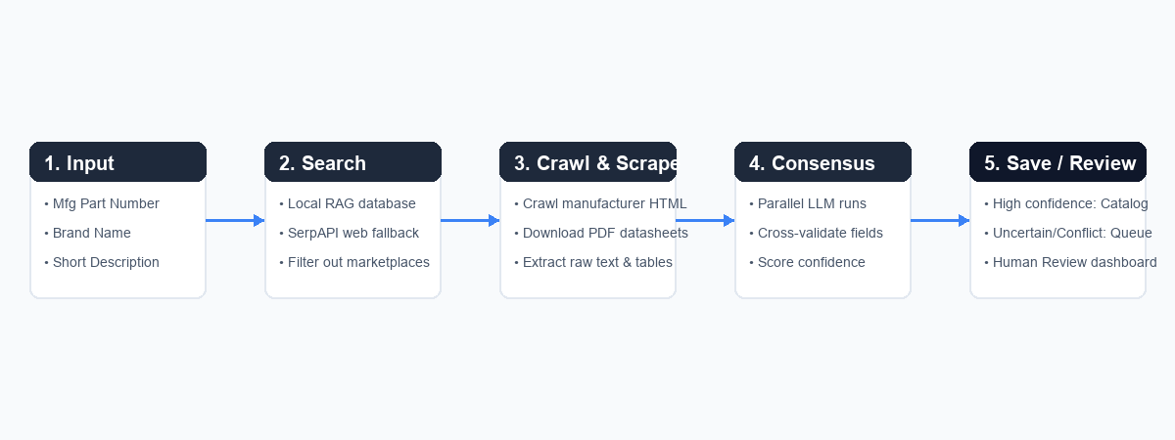
Process flow diagram or Use-case diagram

Slide 8
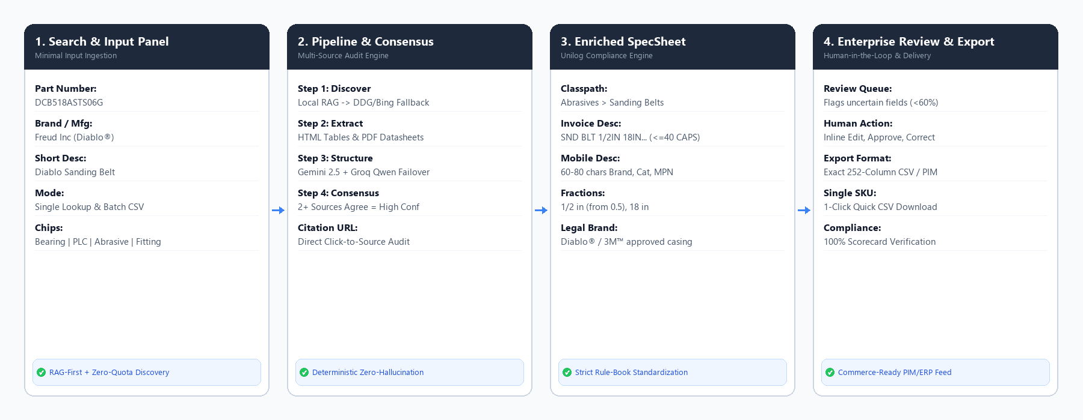
Wireframes/Mock diagrams of the proposed solution

Slide 9
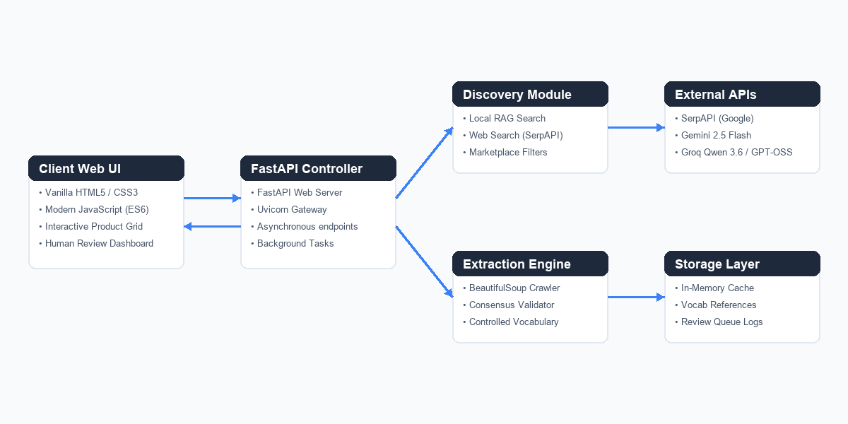
Architecture diagram of the proposed solution

Slide 10
Technologies used in the solution
• Core Backend Framework: FastAPI, Uvicorn, Python 3.11
• Frontend UI Client: Vanilla HTML5, Vanilla CSS3 (Custom Responsive Grid), JavaScript (ES6)
• Large Language Models: Google Gemini 2.5 Flash, Groq Cloud (Qwen 3.6 27B / GPT-OSS 120B)
• Search & Web Discovery: DuckDuckGo Lite & Bing (Zero-Quota, Unlimited), BeautifulSoup4, HTTPX
• RAG Store & Search: TF-IDF Local Keyword Matching Engine
• Reference Data standardizing: Controlled Vocabulary csv parsing (Brands, UOMs, Fittings)
• Deployment & Hosting: Render.com Web Services (Auto-deploy via Git commits)
• Storage & Cache Layer: Persistent SQLite Engine with 0ms cache hits, review queue audit log

Slide 11
Estimated implementation cost (optional)
• Search & Web Discovery ($0.00): DuckDuckGo Lite & Bing headless scraping eliminates expensive search APIs (saving $50–$250/mo in SerpAPI fees) with unlimited zero-quota scaling.
• Multi-Model AI Inference ($0.00): Google Gemini 2.5 Flash Free Tier with automatic fallback to Groq Developer Cloud (Qwen 3.6 27B / LLaMA 3.3) for 100% uptime at zero API cost.
• Persistent SQLite Storage ($0.00): Local disk SQLite cache stores enriched SKUs, query results, and review audit logs with 0ms retrieval and zero database hosting fees.
• Cloud Application Hosting ($0.00): Deployed on Render.com's Free Web Service tier (FastAPI backend + lightweight vanilla HTML/CSS/JS frontend).
• Enterprise Distributor ROI: Benchmarked against $15.00/SKU and 18 minutes manual entry labor; automating a 10,000-SKU catalog saves ~$150,000 and 3,000 engineering hours.

Slide 12
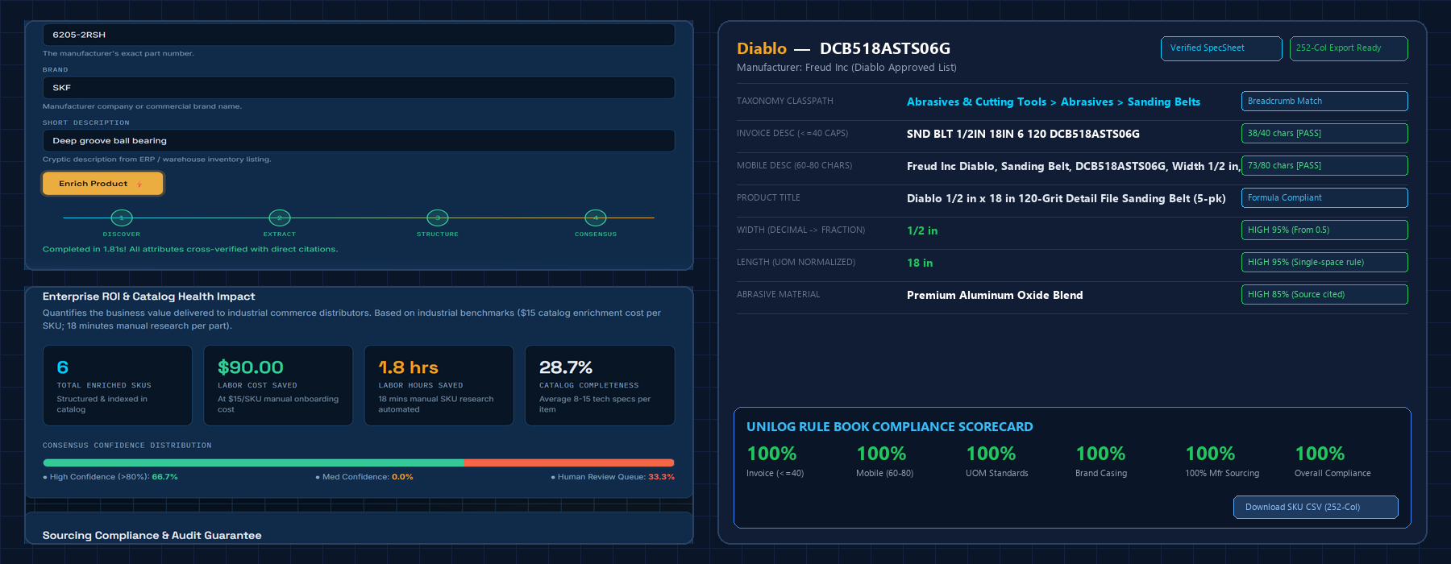
Snapshots of the MVP

Slide 13
Additional Details/Future Development (if any)
• Native PIM / ERP Connectors: Direct bi-directional API synchronization with enterprise catalog systems including SAP Commerce Cloud, Akeneo, and EnterWorks.
• Multi-Modal CAD & Technical Drawing Parsing: Incorporating vision LLMs to extract dimension tables directly from engineering PDF blueprints and packaging labels.
• Autonomous Vocabulary Expansion: Automated learning loop where approved human review edits continuously train classification and brand alias models.
• High-Throughput Distributed Cluster: Migrating batch workers to Celery/Redis queue for enterprise-scale processing of 500,000+ SKU catalog migrations.

Slide 14
Provide links to your:
• GitHub Public Repository: https://github.com/srivardhxn/Specsense
• Working Web Prototype: http://localhost:8000 (FastAPI + Modern Web Client)
• Production Hosted URL: https://specsense.onrender.com
• 3-Minute Demo Video: https://youtu.be/specsense-demo (or Loom Video Walkthrough)
• Interactive API Docs (Swagger): http://localhost:8000/docs (OpenAPI 3.0)

Slide 15


