Slide 1

CVR COLLEGE OF ENGINEERING
(UGC Autonomous Institution) ACCREDITED BY NAAC (Approved by AICTE &Govt, of Telangana and Affiliated to JNT University, Hyderabad)
Department of Information Technology​
MAJOR PROJECT
​
Forensic Face Sketch Construction and Recognition
Presented By :
T Chidwila – 22B81A1271
P Maithri – 22B81A1287
T Sri Varsha – 22B81A12B7
Project Guide :Mrs. G. Shailaja, Assistant Professor
Project Coordinator : Dr. C.V.S. Satyamurty, Associate Professor

Slide 2
Abstract
In criminal investigations, hand-drawn face sketches based on eyewitness descriptions have traditionally played a vital role in identifying suspects. However, in today’s fast-paced digital age, manually drawn sketches present significant limitations when it comes to efficient and accurate suspect recognition from large-scale databases. Traditional sketch-based identification methods and earlier software applications have shown limited effectiveness due to constraints such as predefined facial feature sets, low realism, and poor integration with automated recognition system. This project proposes an advanced face sketch construction and recognition platform powered by deep learning and cloud infrastructure. Unlike previous approaches, our application allows users not only to select facial features from an expanded set but also to upload hand-drawn individual features. These are then transformed into application-compatible components, ensuring greater accuracy and resemblance to actual sketches. Additionally, the platform enables law enforcement agencies to upload entire sketches, which can be matched against real-time or existing databases using intelligent matching algorithms. By leveraging machine learning, the system suggests compatible features and optimizes the recognition process enhancing both speed and accuracy in suspect identification.

Slide 3
Introduction
This is a standalone application, allowing user to construct accurate composite face sketch using the predefined facial feature sets provided as tools that can be resized and repositioned as per requirement/described by the eye-witness.
Moreover, the constructed composite face sketch can then be matched with the law enforcement departments database using deep learning and the speed and efficiency of cloud infrastructure to identify and verify the criminal.
The same process can even be done with the hand-drawn sketch making the application backward compatible with traditional approaches.
our application would even allow the law enforcement team to upload a previous hand drawn sketch in order to use the platform to identify and recognize the suspect using the much more efficient deep learning algorithm and cloud infrastructure provided by the application.

Slide 4
Problem Statement
Current forensic face sketch systems rely heavily on manual sketches, which are subjective and time-consuming.
There is a lack of efficient sketch-to-photo matching and automatic face reconstruction methods.
The project aims to develop a computer-based system to recognize and generate realistic face sketches using advanced algorithms.

Slide 5
System Analysis
3.1 Security and Privacy
The major concern of the law enforcement department before adapting any system is security and privacy. Keeping this in mind the application is designed to protect the privacy and carry out the security measures in the following ways.
3.1.1 Machine Locking:
The Machine locking technique would ensure that the application once installed on a system could not be tampered and could not been operated on any other system, for which the application uses two locking parameters i.e. one software and one hardware locking parameter. HD ID – Volume serial of hard-drive with OS. NET ID –MAC Address.

Slide 6
System Analysis
3.1.2 Centralized Usage:
The system which has the application been installed would be connected to a centralized server of the law enforcement department campus containing the database and the other important feature set of the application, thus the application could not be operated once disconnected from the server.
3.2 Backward Compatibility
The major drawback in adapting any new system is the complication been involved in completing migrating from the previous technique to the new technique, Hence resulting in the wastage of time resources. To overcome this issue, we have designed our application in such a way that even the hand-drawn sketches can be uploaded and the user can use the deep learning algorithms and cloud infrastructure to identify and recognize the criminal using the hand-drawn sketch.

Slide 7
System Analysis
3.3 Face Sketch Construction using Drag and Drop
In this application, accurate composite face sketch can be constructed using the predefined facial feature sets provided as tools allowing to be resized and repositioned as per requirement/described by the eye-witness. Here, the human face is be categorized into various facial features such as head, eyes, eyebrow, lips, nose, ears, etc. and some important wearable components such as hats, specs, etc. too are been available in the application for use.
Every facial feature when selected would open a wide range of options to choose from based on the requirement/description of the eye-witness. The machine learning algorithm would learn and in future try to suggest all the facial features which could suit the single selected feature and would try to help in completing the composite face sketch much sooner and much efficiently.

Slide 8
Project Objectives
To develop an intelligent system
capable of recognizing human faces from forensic sketches with high accuracy.
To automate the sketch-to-photo matching process
advanced deep learning and computer vision techniques.
To reduce human error
and dependency on manual sketch interpretation by implementing AI-driven recognition.
To create a scalable and efficient model
That can be integrated with existing police and forensic databases.
To assist law enforcement agencies
in identifying suspects faster, improving investigation speed and accuracy.

Slide 9
TECHNOLOGY STACK
Frontend: JavaFX, CSS
Backend: Java, DB SQL Lite
Algorithms/Techniques: CNN (Face Recognition), Image processing
Dataset: Face Sketch & Criminal Image Dataset for matching and identification

Slide 10
ALGORITHMS USED
CNN (Convolutional Neural Network): Used in face recognition to match sketches with real images; chosen for its high accuracy in image pattern detection.
Feature Extraction: Used to identify key facial parts (eyes, nose, lips); helps convert images into comparable data for matching.
Image Processing (Grayscale, Edge Detection): Used to enhance and standardize input sketches; improves quality and recognition performance.
Similarity Matching (Euclidean Distance): Used to compare sketch features with database images; helps find the closest match efficiently.

Slide 11
IMPLEMENTATION
Modules in the Project:
Login & Authentication Module: Used for secure access to the system with user login and verification.
Face Sketch Construction Module: Allows users to create sketches using drag-and-drop facial features.
Sketch Upload Module: Enables uploading of hand-drawn sketches for recognition.
Image Processing Module: Processes input sketches (grayscale, noise removal) to prepare for matching.
Face Recognition Module: Uses CNN to match the sketch with database images.
Database Management Module: Stores and retrieves facial images and related data.
Result Display Module: Shows matched results with similarity score.

Slide 12
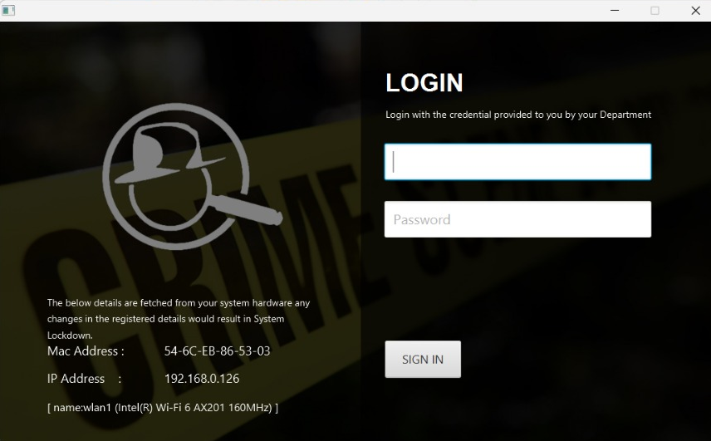
IMPLEMENTATION

Slide 13
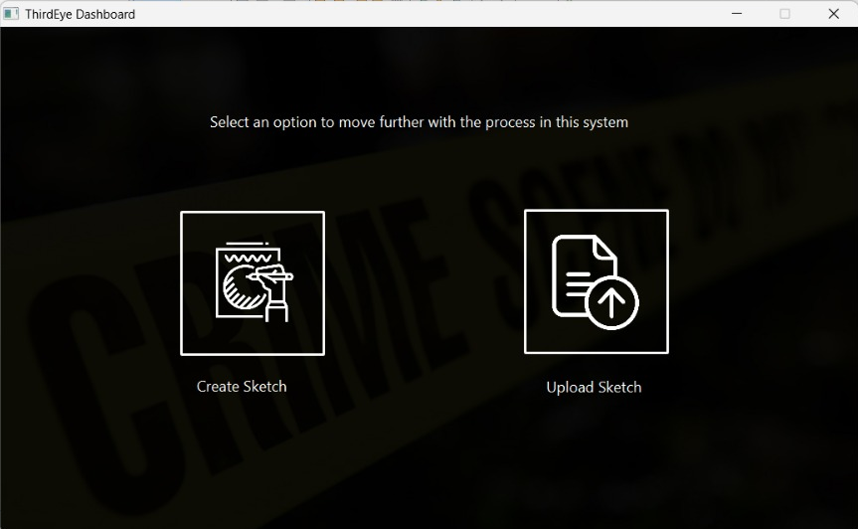

Slide 14
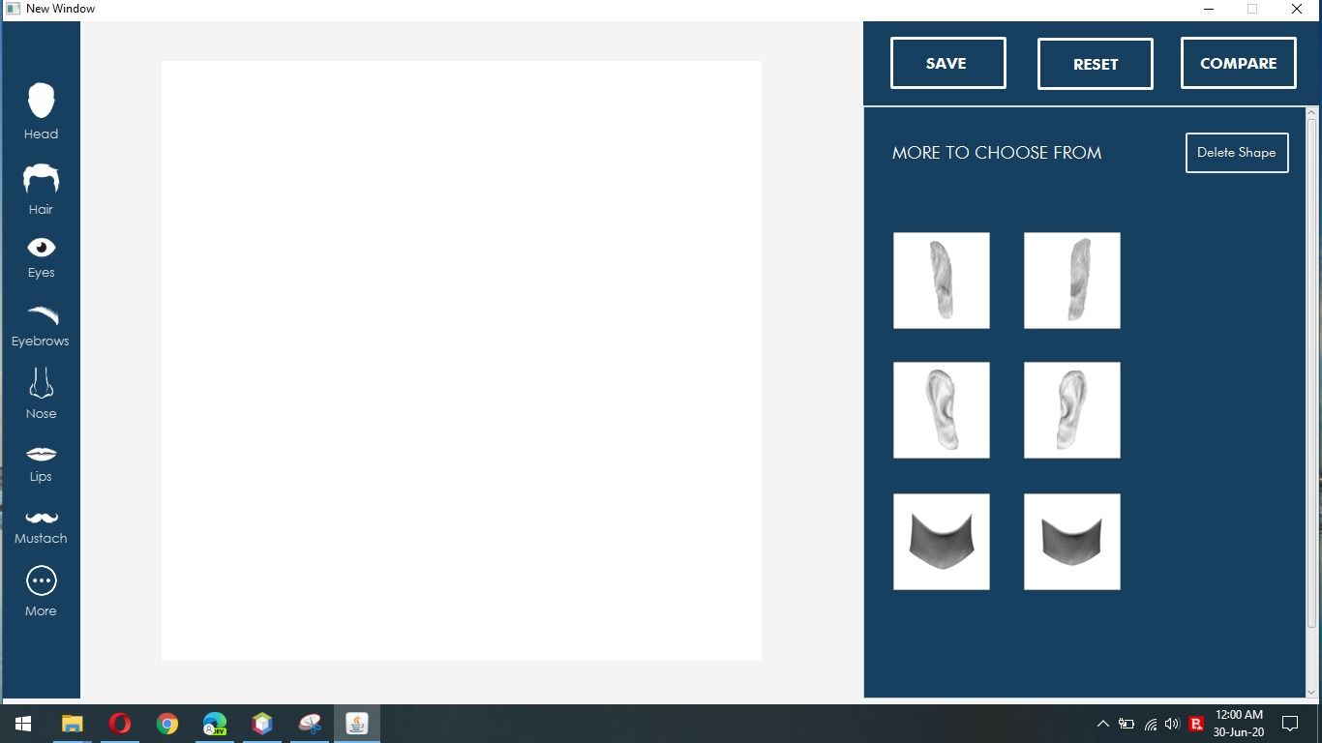
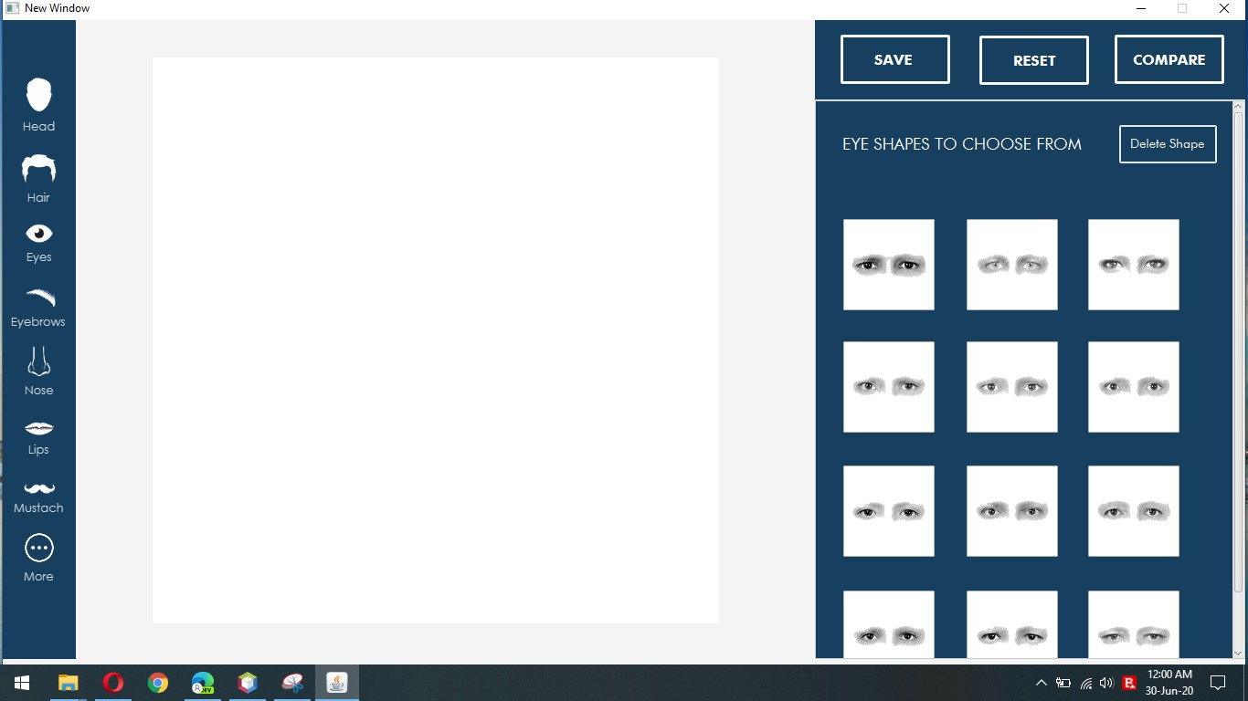
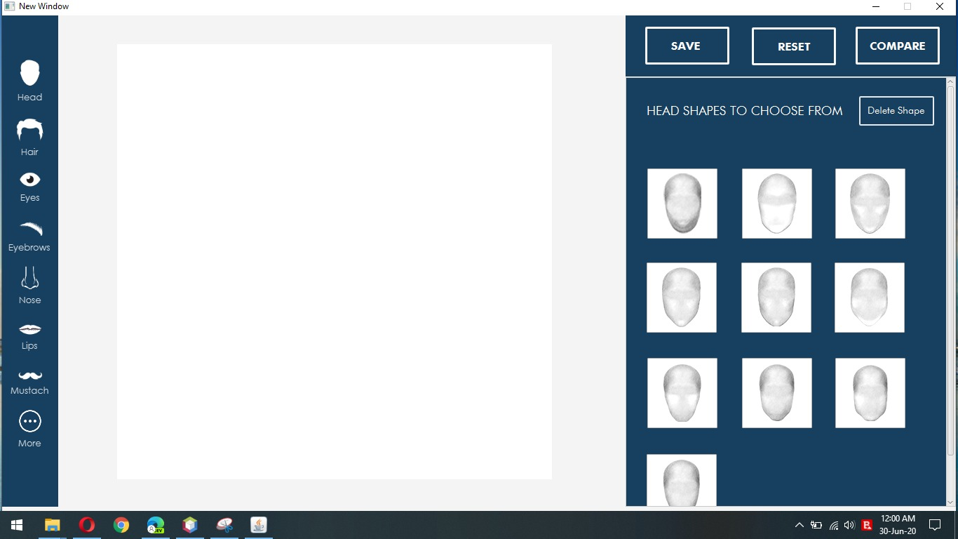
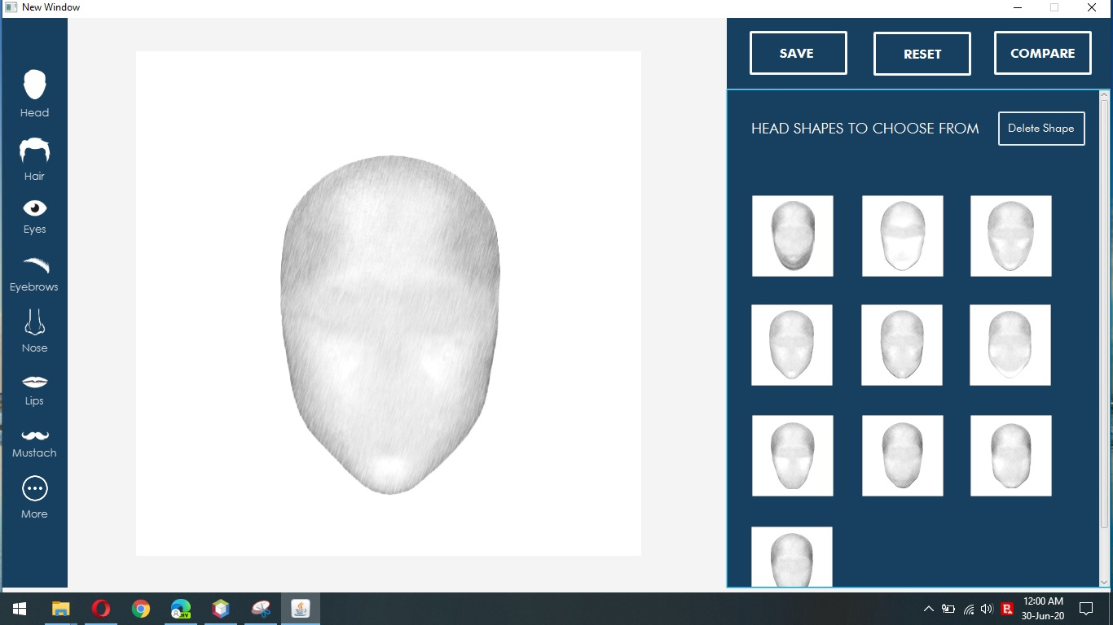

Slide 15
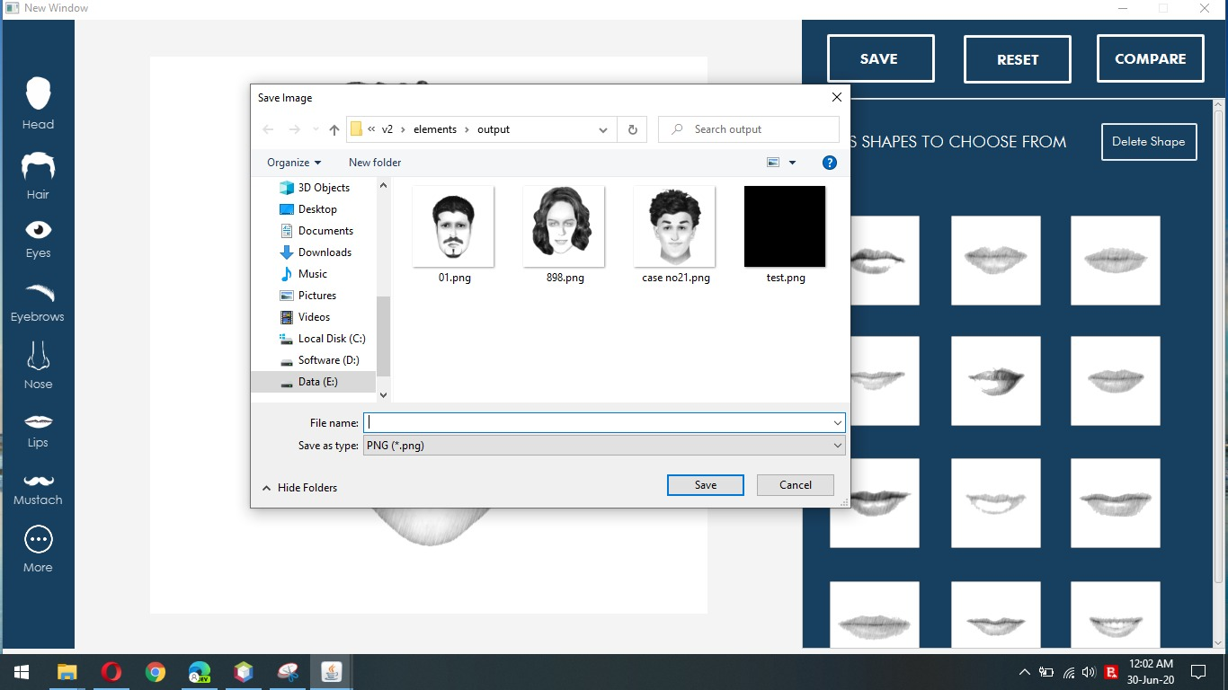

Slide 16


Slide 17
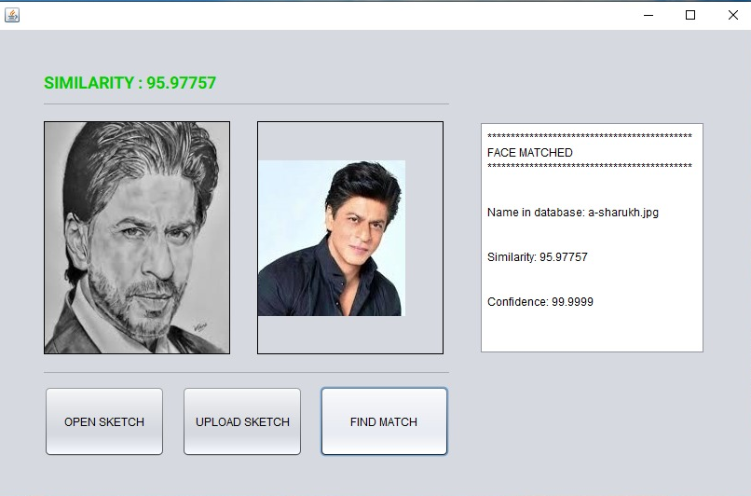

Slide 18
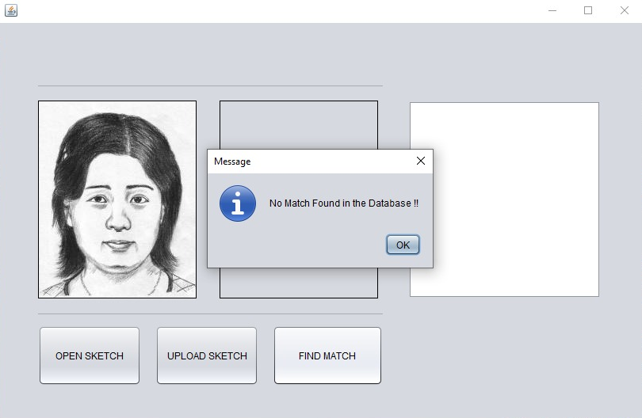

Slide 19
CONCLUSION
The Project ‘Forensic Face Sketch Construction and Recognition’ is been designed, developed and finally tested keeping the real-world scenarios from the very first splash screen to the final screen to fetch data from the records keeping security, privacy and accuracy as the key factor in every scenario. The platform displayed a tremendous result on Security point of view by matching login the credentials associated with the user in the database. The platform even showed good accuracy and speed while face sketch construction and recognition process, provided an average accuracy of more than 90% with a confidence level of 100% when tested with various test cases, test scenario and data sets, which means a very good rate according to related studies on this field.
The platform even has features which are different and unique too when compared to related studies on this field, enhancing the overall security and accuracy by standing out among all the related studies and proposed systems in this field.

Slide 20
FUTURE SCOPE
The Project ‘Forensic Face Sketch Construction and Recognition’ is currently designed to work on very few scenarios like on face sketches and matching those sketches with the face photos in the law enforcement records. The platform can be much enhanced in the future to work with various technologies and scenarios enabling it to explore various media and surveillances medium and get a much wider spread and outputs, The platform can be modified to match the Face sketch with the human faces from the video feeds by using the 3D mapping and imaging techniques and same can be implemented to the CCTV surveillances to perform face recognition on the Live CCTV footage using the Face Sketch. The platform can further be connected to social media has social media platforms acts has a rich source for data in today’s world, this technique of connecting this platform with the social media platform would enhance the ability of the platform to find a much more accurate match for the face sketch and making the process much more accurate and speeding up the process. In all the platform could have features which could be different and unique too and easy to upgrade, when compared to related studies on this field, enhancing the overall security and accuracy by standing out among all the related studies and proposed systems in this field.

Slide 21
Thank You

