Slide 1


Attention and All-or-none Conscious Perception
Howard Bowman, Patrick Craston and Srivas Chennu
Brad Wyble

Slide 2
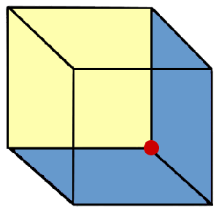
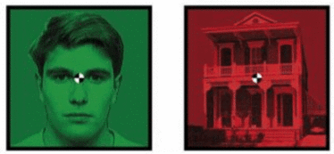
All-or-none Conscious Perception
In the everyday world, consciousness seems to be all-or-none
  We either see all, or nothing, of a stable mental percept, e.g.:
Left Eye
Right Eye
Necker Cube
Binocular Rivalry

Slide 3
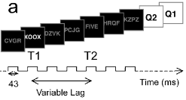

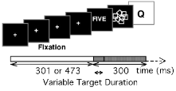

Attention and Perception
Attention
Unavailable
All-or-none
% of Trials
Subjective Visibility
Attention
Available
Graded
% of Trials
Subjective Visibility
Figures reproduced from [1].
1. Sergent & Dehaene (Psych. Sci.; 2004)

Slide 4
Why is conscious perception less graded in the absence of attention?

Slide 5
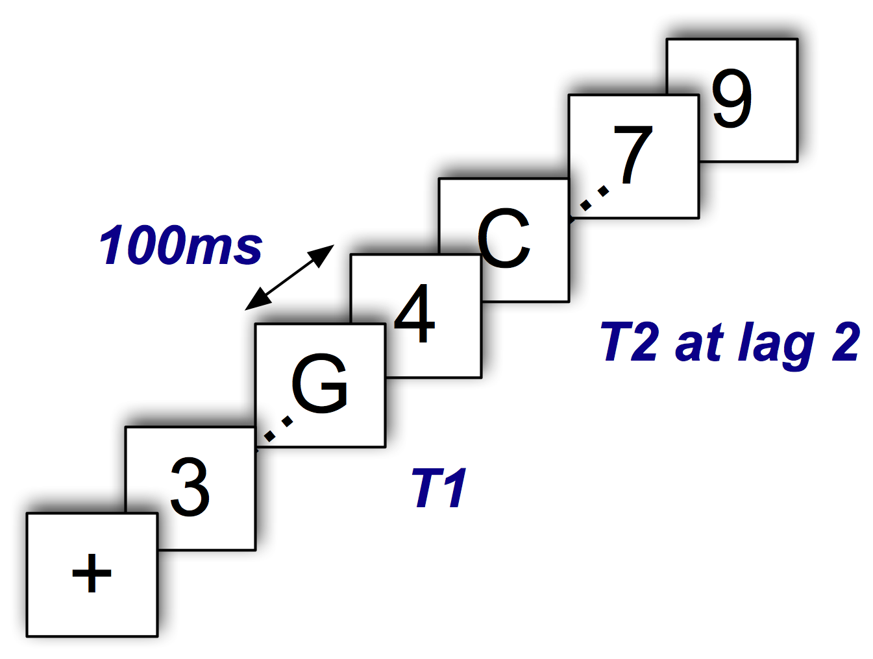
Why is the AB Interesting?
T2 suffers if presented 100-500ms after T1
Reflects a late-stage deficit
Missed T2s are nevertheless deeply processed¹
Enables independent manipulation of strength and attention
Perception without attention can be investigated²
T2 % Accuracy
T2 Lag Position
1. Vogel et al. (JEP:HPP; 1998)
2. Koch & Tsuchiya (TiCS; 2007)

Slide 6
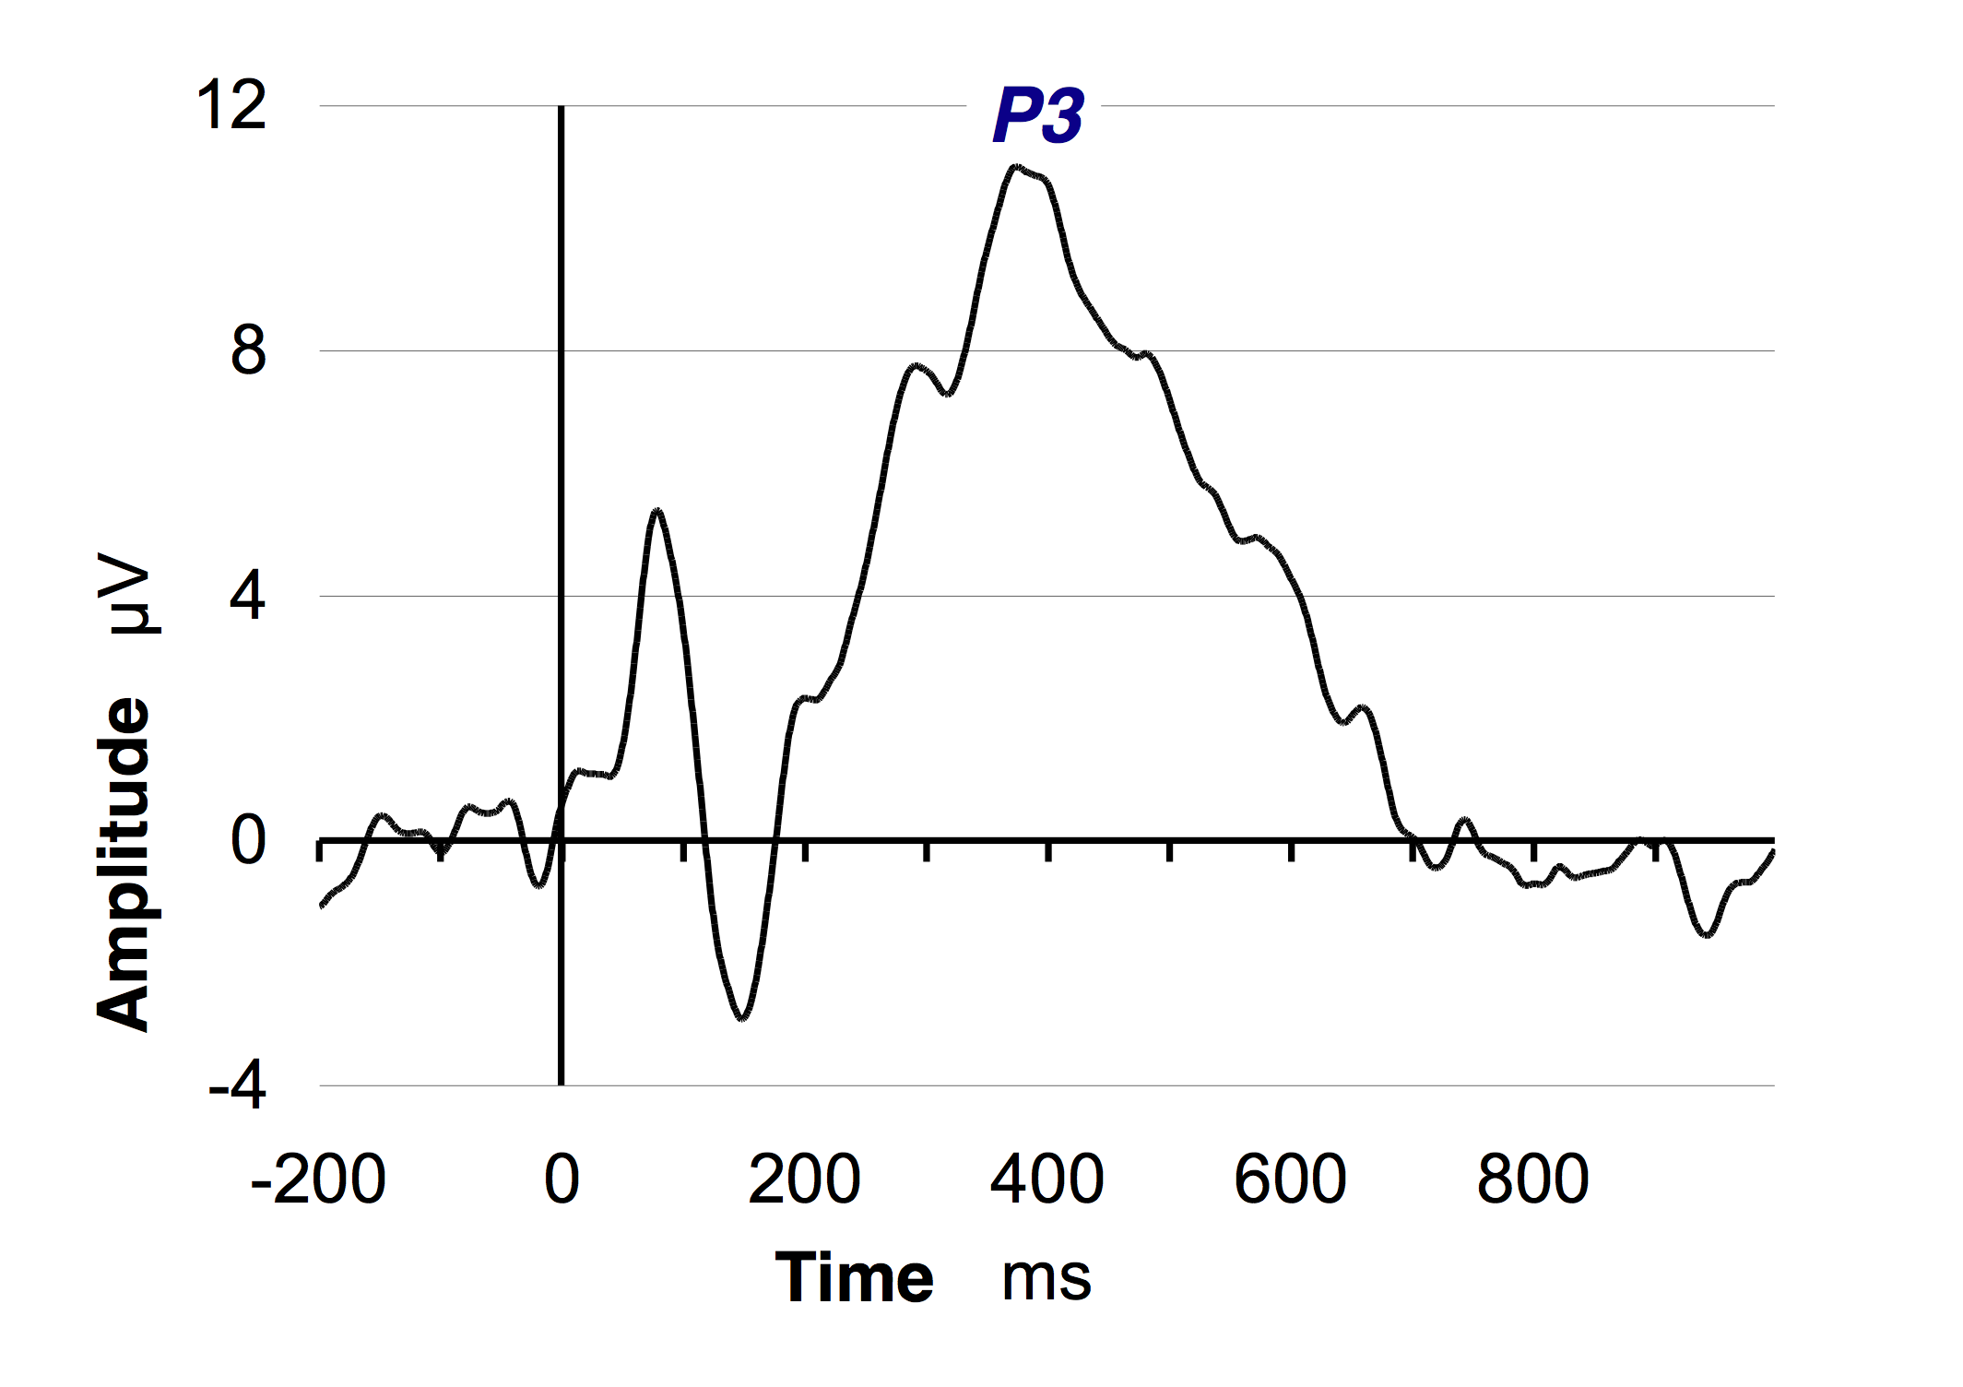
The P3: EEG Correlate of Perception
The P3 ERP serves as marker of conscious perception
Seen RSVP targets evoke P3¹, but missed targets do not
We can measure P3 parameters, (like amplitude & latency) to investigate how target strength and attention influence perception
1. Kranczioch et al. (Cog. Brain Res.; 2003)

Slide 7
Our Experiment
We compare the P3 evoked by letters-among-digits seen
  outside the AB (single target on its own)
  inside the AB (T2 presented 300ms after seen T1)
We also indirectly manipulate target strength
  By a priori division of letters into easy vs. hard
  based on previously reported accuracy scores

Slide 8
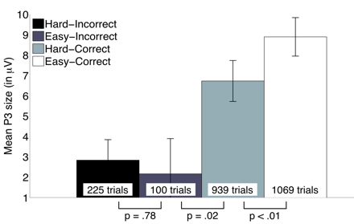
Targets seen outside the AB
Highly significant effect of target strength
  Accuracy 82% for easy vs. 62% for hard
Target strength also affects P3 size
For seen targets
  Strength has significant effect: Easy-Correct P3 larger than Hard-Correct P3
For missed targets
  Strength has no effect: Easy-Incorrect P3 = Hard-Incorrect P3

Slide 9
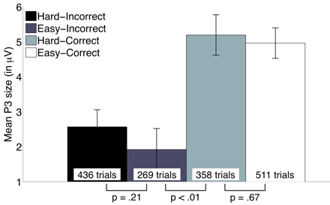
Targets seen inside the AB
Highly significant effect of target strength
  Accuracy 66% for easy vs. 46% for hard
Target strength has no influence on P3 size
For seen targets
  Strength has no effect: Easy-Correct P3 = Hard-Correct P3
For missed targets
  Strength has no effect: Easy-Incorrect P3 = Hard-Incorrect P3

Slide 10
Summary of Experimental Results
Our findings corroborate previous research
P3 (as an index of conscious perception) is
  strength-dependant outside the AB
  strength-independent inside it
But, accuracy is always strength dependant
We now propose a neural model that explains this pattern of data
  Builds upon principles central to the ST² model¹
1. Bowman et al. (Psych. Rev.; 2007)

Slide 11
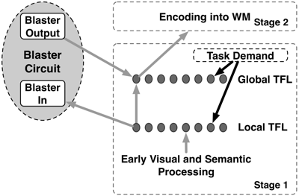
2-phase Strength Sensitivity Model
Models interaction between attention and perception
Task Filtered Layer (TFL)
  Enforces task demand
  Has two sub-layers
The local TFL (lTFL) is locally prescribed in the ventral stream
  triggers the blaster
The global TFL (gTFL) reflects global brain scale states¹
  receives attentional enhancement from blaster
  contributes to the P3
1. Dehaene et al. (PNAS; 2003)

Slide 12
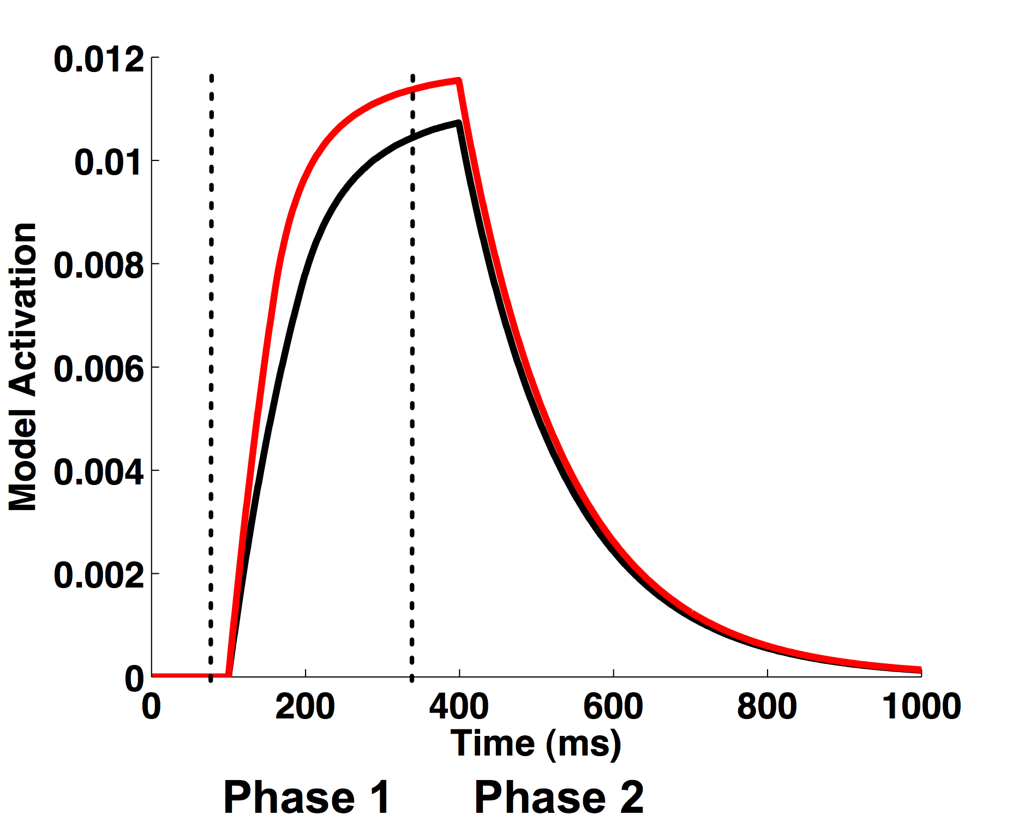
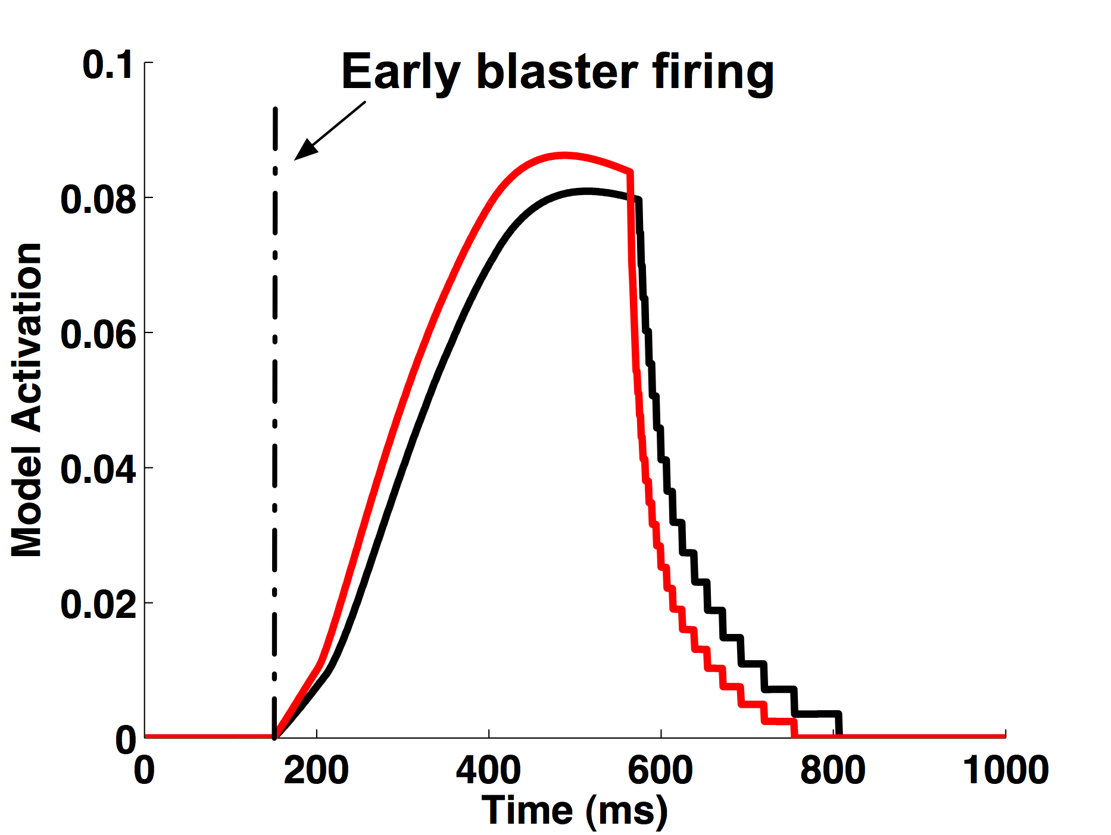
Targets seen outside the AB
Local TFL: In Phase 1
  Target strength drives activation dynamics
  Produces clear differences between easy and hard targets
Local TFL: In Phase 2
  Strength sensitivity gets carried over into Phase 2
Global TFL: Contributes to the P3
  Blaster is available and fires early
  gTFL inherits strength sensitivity
  Hence easy targets evoke larger P3
Behavioural Accuracy
  Easy targets more likely to exceed encoding threshold
  Hence generate higher accuracy
Easy Target
Hard Target
Local
TFL
Global
TFL

Slide 13
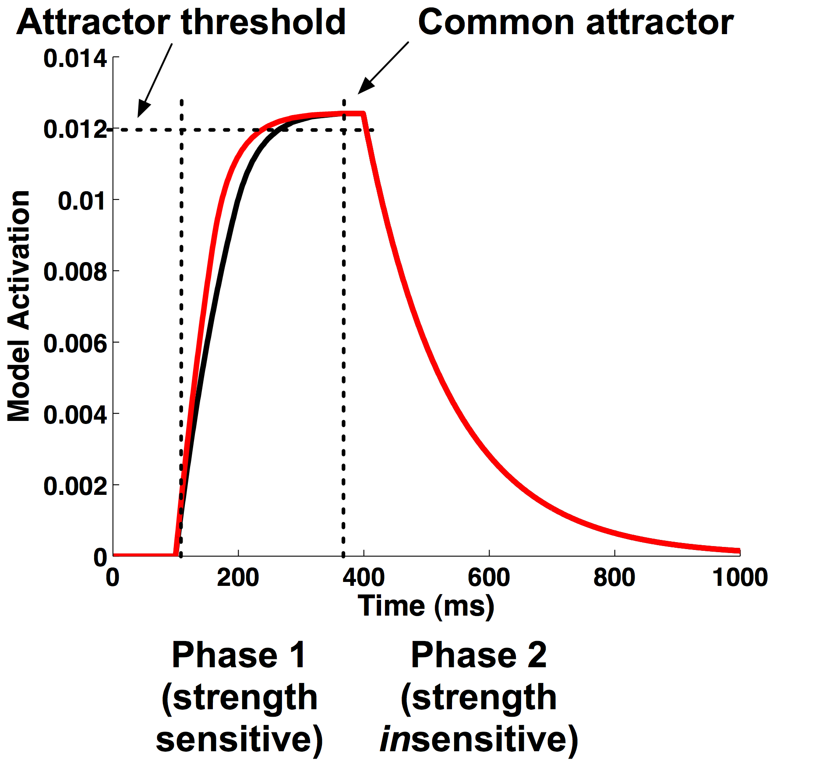
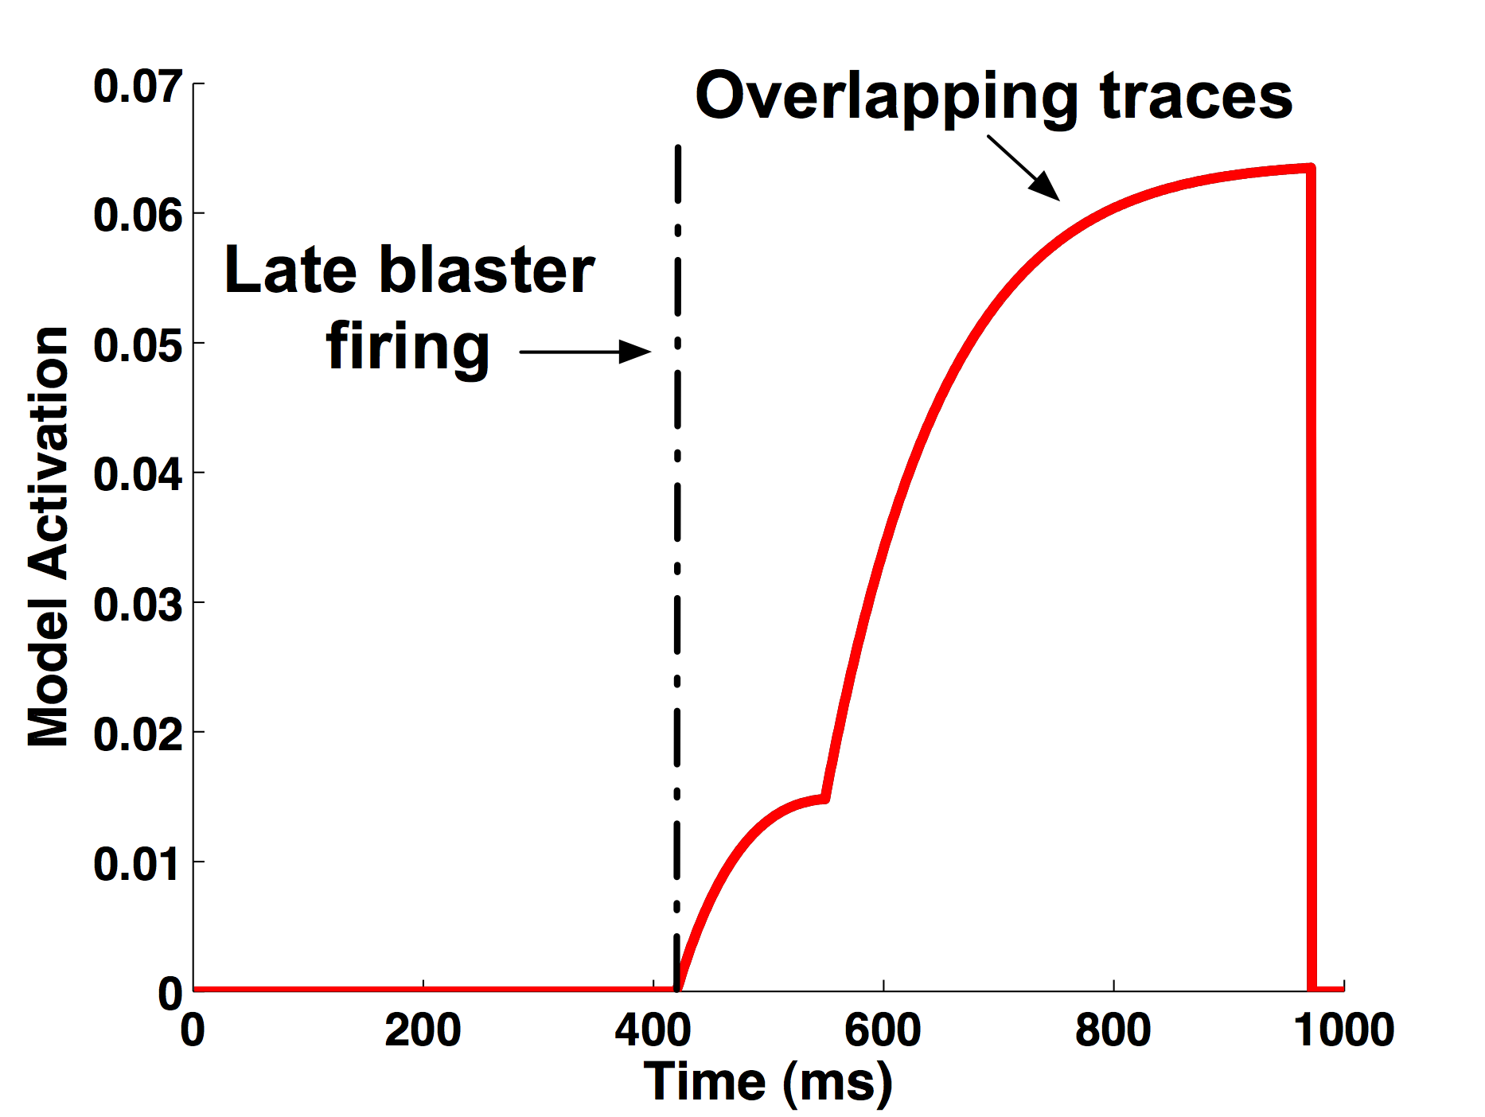
Targets seen inside the AB
Local TFL: Phase 1
  Initially retains strength sensitivity
Local TFL: Phase 2
  Common attractor saturation removes any strength sensitivity
Global TFL: P3
  Blaster fires late due to T1 suppression
  Encoding begins only after lTFL is saturated in Phase 2
  Easy and hard targets generate identical all-or-none P3s
Global TFL: Behaviour
  Easy targets more likely to saturate at lTFL than hard targets
  This results in accuracy differences seen in the human data
Easy Target
Hard Target
Local
TFL
Global
TFL

Slide 14
Summary of Modeling Results
Targets outside the AB
  Strength sensitivity in lTFL Phase 1 enhanced by early blaster
  Results in larger gTFL activation (P3) for easy targets
  Easy targets also more likely to exceed encoding threshold
Targets inside the AB
  Blaster fires late during lTFL Phase 2
    by which time activation has already saturated
  Easy/hard strength sensitivity is lost in gTFL activation (P3)
  Easy targets are nevertheless more likely to saturate at lTFL

Slide 15
Conclusions
Delay in attentional enhancement (rather than absence¹) causes lack of perceptual gradation during the AB
Target representations pass from a strength sensitive to a strength insensitive phase² in visual processing
  Outside the AB, encoding happens early, and targets are consolidated in the strength sensitive phase
  Inside the AB, encoding is delayed, and targets are consolidated in the strength insensitive phase
Question: Is delayed consolidation (and all-or-none patterns) observable in other experimental contexts?
1. Sergent et al. (Nature Neuro.; 2005)
2. Del Cul et al. (PLoS Bio.; 2007)

Slide 16
Thanks for your attention!
Howard Bowman, Patrick Craston and Srivas Chennu
Brad Wyble

Slide 17
2-phase Strength Sensitivity Model
Models the interaction between attention and target consolidation
Is based on these ST² principles:
  Simultaneous type representation
    Stage 1 extracts featural properties (types) of items
  Token-based working memory (WM)
    Stage 2 binds types to episodic tokens in WM
  Transient Attentional Enhancement (The Blaster)
    Enhances late Stage one when target type is detected

