Slide 1


Transient Attentional Enhancement during the Attentional Blink:
EEG correlates of the ST² model
Srivas Chennu, Patrick Craston
Brad Wyble and Howard Bowman
University of Kent at Canterbury, UK

Slide 2
Outline
The Attentional Blink paradigm
The ST² model and the Blaster
Connecting the model to EEG: The N2pc
Correlating the Blaster and the N2pc
Implications and conclusions

Slide 3
Outline
The Attentional Blink paradigm
The ST² model and the Blaster
Connecting the model to EEG: The N2pc
Correlating the Blaster and the N2pc
Implications and conclusions

Slide 4
The Attentional Blink (AB)
Paradigm:
  Rapid Serial Visual Presentation (RSVP)
  Fleeting visual stimuli
Two targets presented
  Second one at a specific lag after the first
  Embedded within a stream of task irrelevant distractors
Targets distinguished by
  Colour marking (X, B)
  Categorical difference (X, 4)
S - Stimulus
D – Distractors
T1– 1st Target
T2 – 2nd Target
S
D
S
D
S
T1
Time
S
D
S
T2
S
D
100
msec
Identity of T1 and T2 reported at end of stream

Slide 5
A Demonstration
A sample AB paradigm
  Targets are letters
  Distractors are digits
Your Task
  Concentrate on the stimulus stream
  Report the letters that you see

Slide 6
A Demonstration
T2 at Lag 7
5
6
N
2
5
7
3
4
2
V
9
4

Slide 7
A Demonstration
T2 at Lag 3
5
6
4
K
5
7
B
4
2
3
9

Slide 8
A Demonstration
T2 at Lag 1
5
6
4
8
F
R
4
4
2
3
9

Slide 9
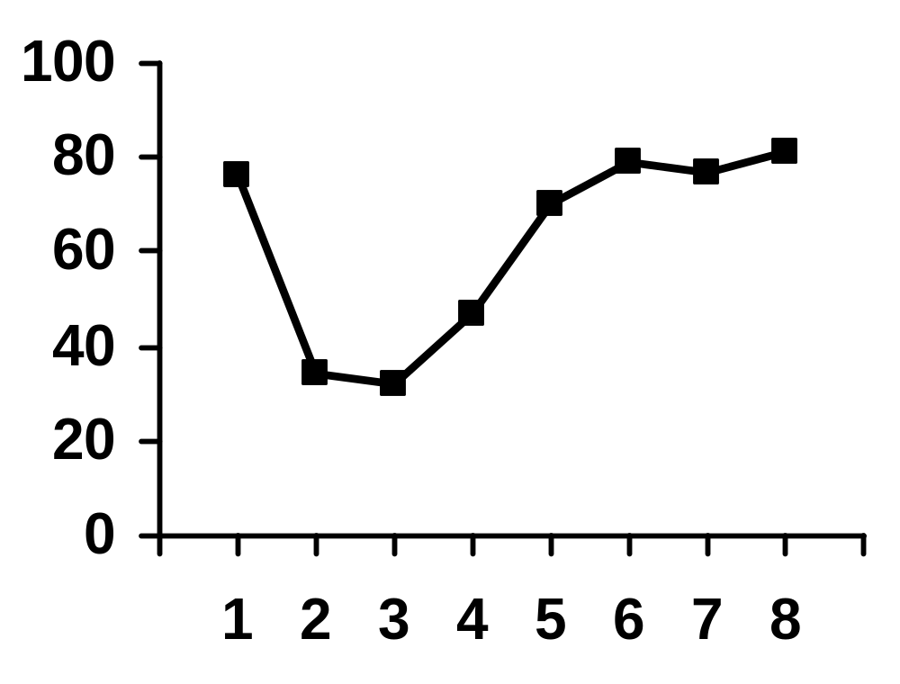
Behavioural Performance *
Significant dip at lags 2-3
Gradual return to baseline from lags 4-6
Surprisingly good at Lag 1 (sparing)
T2 % Accuracy
T2 Lag Position
* (Chun and Potter, 1995): A Two-Stage Model for Multiple Target Detection in Rapid Serial Visual Presentation. Journal of Experimental Psychology: Human Perception and Performance, 1995, 21, 109-127

Slide 10
Why is the AB interesting?
A suitable metaphor: the mind’s eye blinks
It explores the limits of temporal attention
Visual processing system hard-pressed to encode both targets into working memory
Lag 1 Sparing when T2 follows T1
Subliminal priming and masking effects

Slide 11
Outline
The Attentional Blink paradigm
The ST² model and the Blaster
Connecting the model to EEG: The N2pc
Correlating the Blaster and the N2pc
Implications and conclusions

Slide 12
The ST² Model
The Simultaneous-Type-Serial-Token model *
Models temporal attention and working memory
Computationally explicit neural network model with fixed weights
Episodic Distinctiveness Hypothesis
  The AB occurs because the visual system is trying to assign unique episodic contexts to targets
Two-stage design with late bottleneck
* (Bowman and Wyble, 2007): The Simultaneous Type, Serial Token Model of Temporal Attention and Working Memory. Psychological Review, 2007, 114(1), 38-70

Slide 13
Neural Implementation of ST²
Stage 2
(working
memory
The Blaster
encoding)
Stage 1
(extraction
of types)
excitatory
inhibitory

Slide 14
How the ST² Model Blinks
Blaster
T1 triggers the blaster
Blaster enhances T1 and subsequent item (Lag-1 Sparing)
Blaster is held offline during T1 encoding to prevent T2 from interfering with T1
If T2 arrives during this time, it does not get benefit of blaster
If it arrives after T1 encoding, blaster can fire again for T2
Binding Pool
Task Demand
(selects targets)
Task Layer
D
D
T1
T2
Item Layer
excitatory
inhibitory

Slide 15
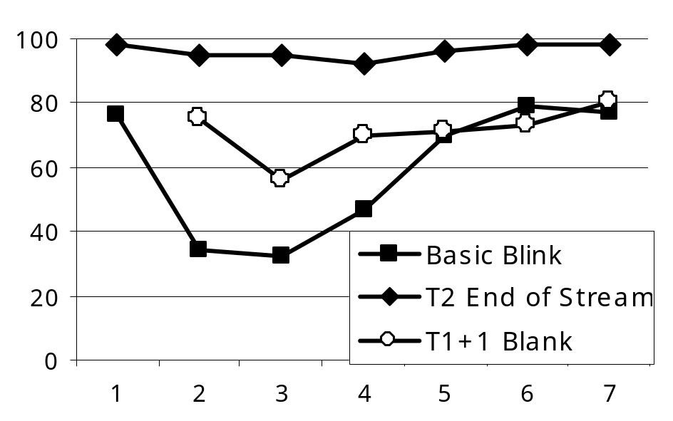

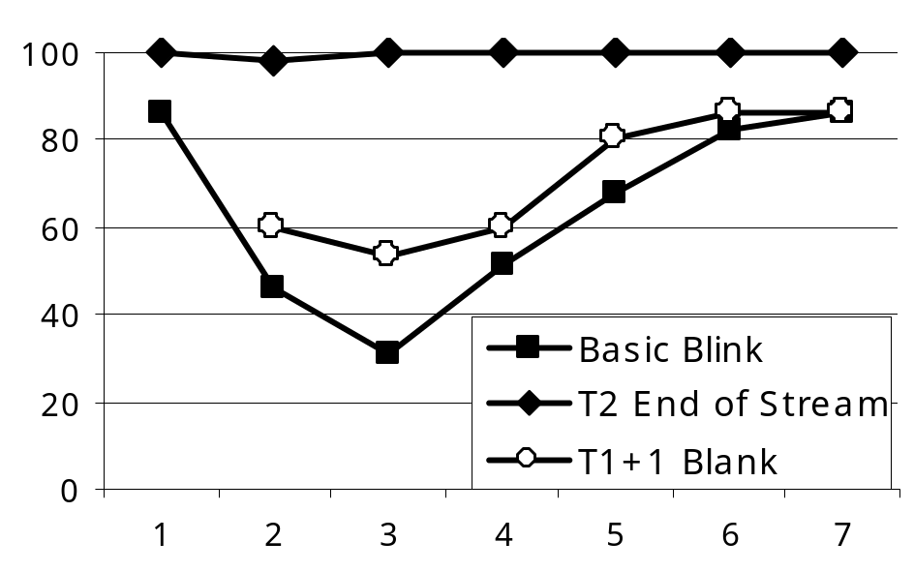

Model Performance
Human
The ST² model reproduces a wide range of behavioural data about the AB as found in humans
Some examples
  The basic blink curve
  T1s followed by a blank interval
  T2s at the end of the RSVP stream
Model
ST²

Slide 16
Outline
The Attentional Blink paradigm
The ST² model and the Blaster
Connecting the model to EEG: The N2pc
Correlating the Blaster and the N2pc
Implications and conclusions

Slide 17
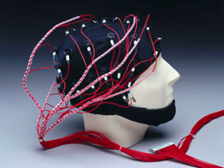
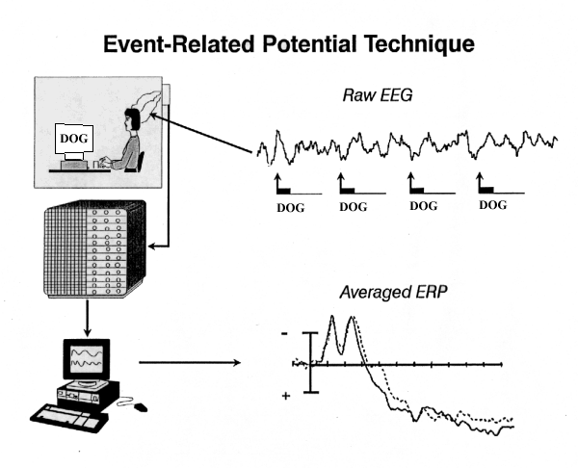
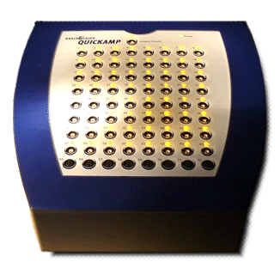
Recording EEG Activity
Stimuli Presentations
Voltage Amplifier
EEG Recorder

Slide 18
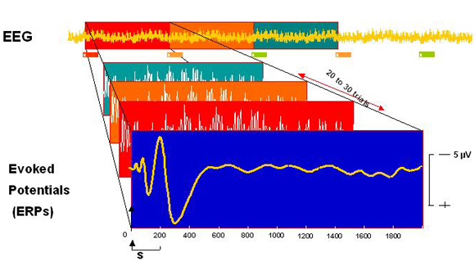
Event Related Potentials (ERP)
Raw EEG with unrelated activity
Segmentation &
Averaging
Event Related Potential

Slide 19
Connecting ERPs to Modelling
Cognitive modelling has focused on reproducing behavioural data
Virtual Components (VC) from neural models
  VCs are patterns of activation of model neurons that correlate to ERPs from human EEG recordings
Even with this simple approach, finding correlations between VCs and ERPs would be interesting…
membrane
potential
Postsynaptic Node
Postsynaptic activation
Weight *
Behavioural data about the AB from humans
Synapse
Build and configure ST² model to reproduce this data
Presynaptic activation
Can VCs be related to ERPs ?
output function
ERP data about the AB from humans
Generate Virtual Components from model neurons
Presynaptic Node
membrane
potential

Slide 20
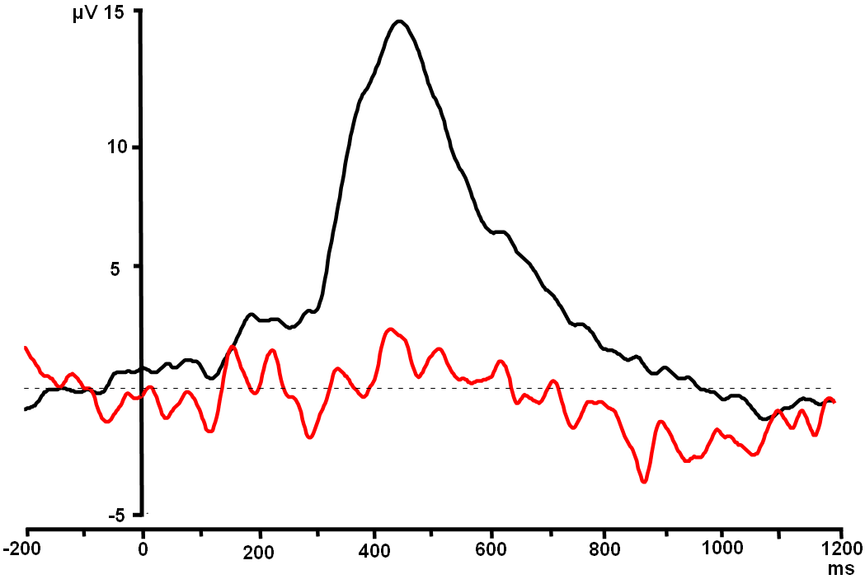
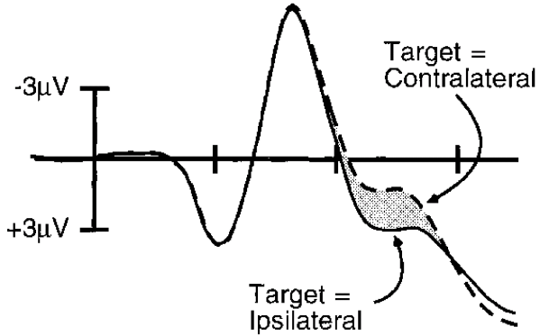
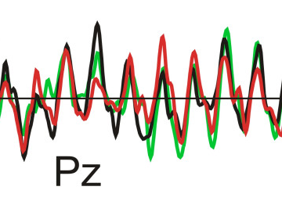
Virtual Components from ST²
Human P3
Stage 2
(working
memory
The Blaster
encoding)
Human SSVEP
Stage 1
(extraction
of types)
Human N2pc

Slide 21
The N2pc ERP Component
Negative deflection in the ERP waveform at around 200-300 ms
Shows up at posterior contralateral sites
Well studied in visual search paradigms: thought to reflect the locus of attentional filtering and focusing in spatial search and in RSVP *
* (Eimer, 1996): The N2pc component as an indicator of attentional selectivity. Electroencephalography and Clinical Neurophysiology, 1996, 99, 225-234

Slide 22
The Blaster and the N2pc
The Blaster provides the attentional burst necessary (but not sufficient) to encode targets
The N2pc reflects successful focus of selective attention to targets
Preliminary hypothesis
  The N2pc corresponds to the firing of the Blaster, and the VC generated from the Blaster is correlated to the N2pc ERP component
Key Prediction
  The N2pc is suppressed during the blink as the Blaster is held offline

Slide 23
Dual Stream AB Experiment
Two-stream letters-and-digits AB experiment designed to record EEG activity contralateral to target position
Participants report the identity of the targets they saw
T2
8
3
T1
…
…
9
6
K
5
5
|----------- 3706.5ms -----------|
7
L
4
…
4
2
…
2
9
|-- 200ms --|
<
|- 400ms -|
+
Time

Slide 24
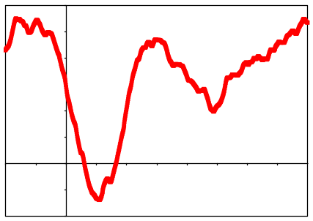
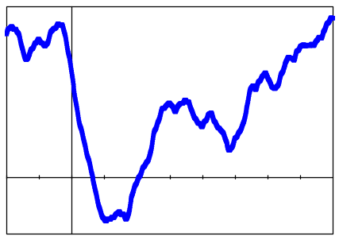
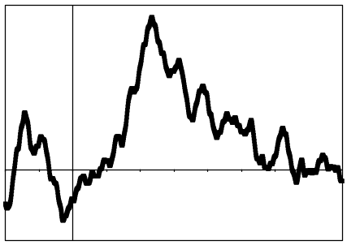
Calculating the N2pc
…
4
Fixation
P8
Time
<
+
…
P7
L
Covert AttentionalFocus
T1
N2pc
(Negative plotted upwards)
Difference Wave

Slide 25
Outline
The Attentional Blink paradigm
The ST² model and the Blaster
Connecting the model to EEG: The N2pc
Correlating the Blaster and the N2pc
Implications and conclusions

Slide 26
The Experiment
14 subjects (6 female)
400 lateralized trials per subject
Each trial
  contained either 0 or 2 targets
  T2 was presented at Lag 1, 3 or 8 after T1
EEG recorded from 20 electrode sites according the international 10/20 system

Slide 27
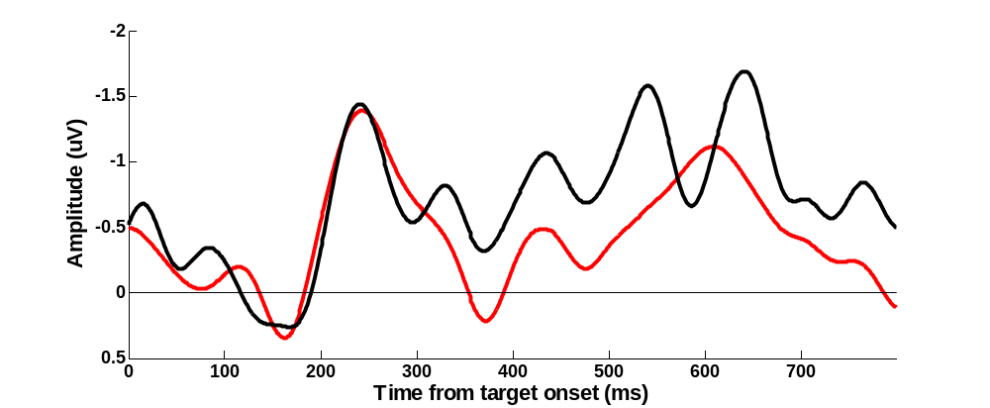
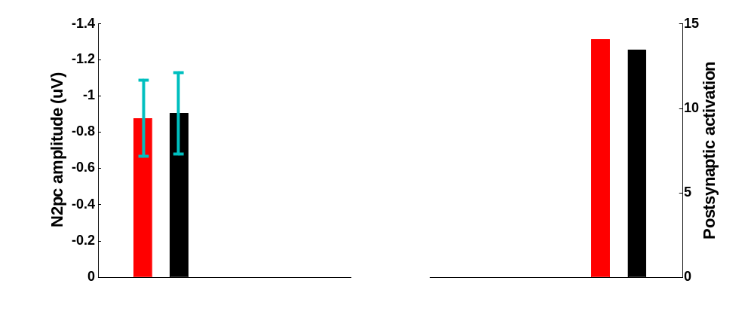
Comparing T1
N2pc window
T1 Seen
Difference statistically insignificant
T1 Missed
Human ERP
N2pc is present and Blaster fires regardless of whether T1 is seen or missed
T1 gets blasted even if missed
ST²
Human ERP
Blaster

Slide 28
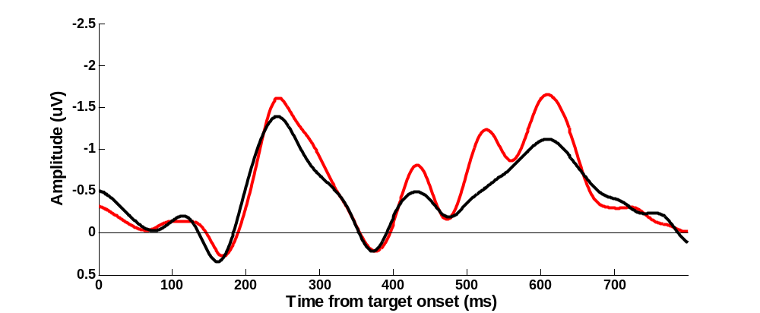
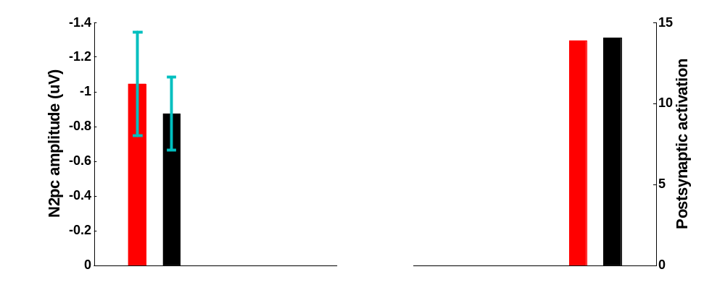
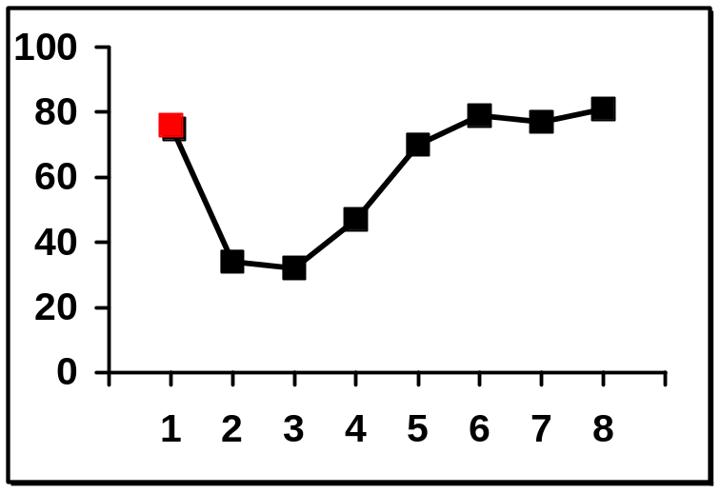
Comparing T2 at Lag 1
N2pc window
T2 at Lag 1
Difference statistically insignificant
T2 at Lag 8
Human ERP
One N2pc is present and Blaster fires once for T1 and T2
T1 and T2 get bound into the same episode
ST²
Human ERP
Blaster

Slide 29
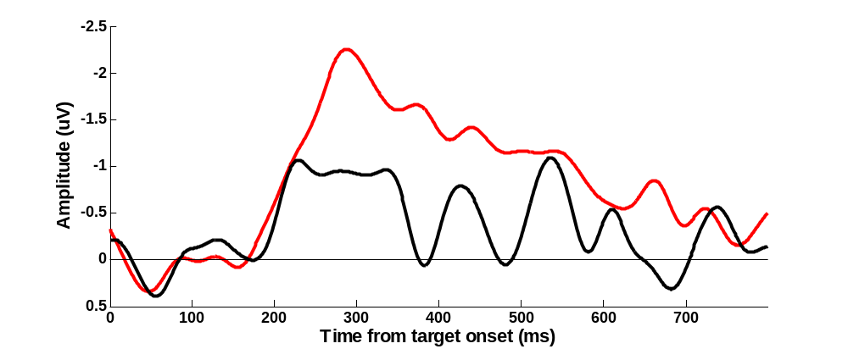
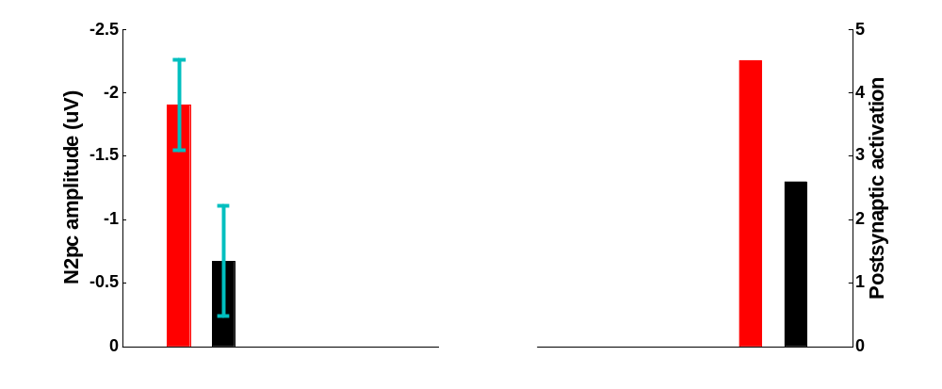
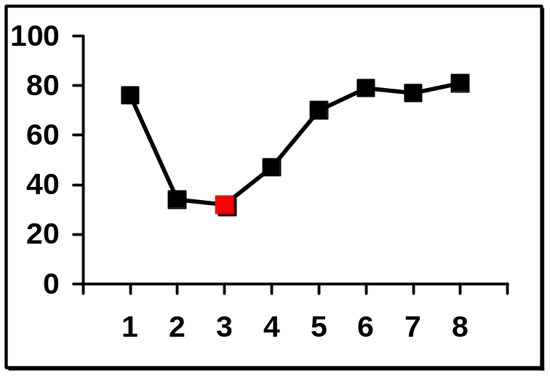
Comparing T2 at Lag 3
N2pc window
Difference statistically significant F(1, 14) = 9; p = 0.01
T2 Seen
T2 Missed
Human ERP
Larger N2pc is present and Blaster fires stronger for seen T2
T2 is missed because it doesn’t get blasted
ST²
Human ERP
Blaster

Slide 30
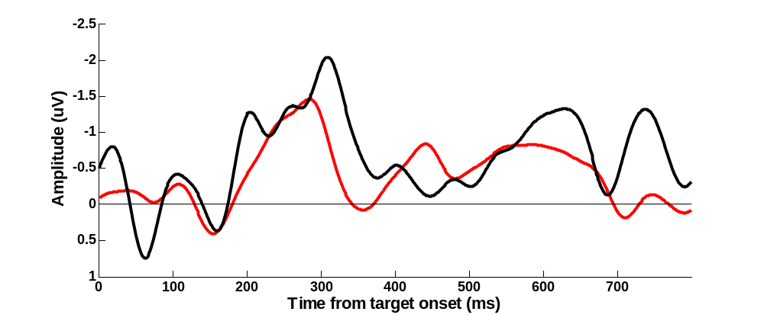
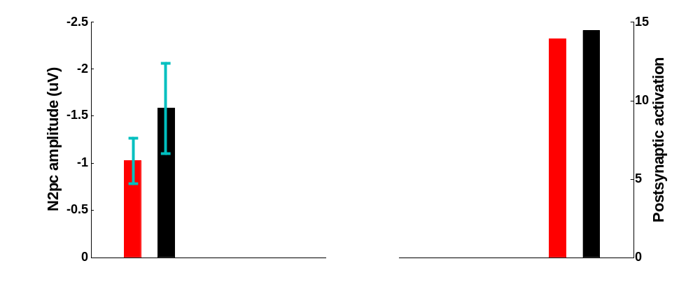
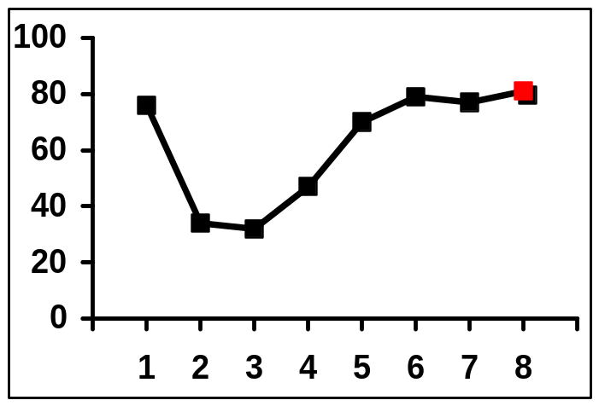
Comparing T2 at Lag 8
N2pc window
T2 Seen
Difference statistically insignificant
T2 Missed
Human ERP
N2pc is present and Blaster fires regardless of whether T2 is seen or missed
T2 gets blasted even if missed
ST²
Human ERP
Blaster

Slide 31
Drawing Conclusions
Preliminary hypothesis
  The N2pc corresponds to the firing of the Blaster
Key Prediction
  The N2pc and Blaster are suppressed during the blink
The comparisons point to a correlation
  Strength of Blaster and amplitude of N2pc covary for T1 and for T2 at different lags
As predicted, N2pc is suppressed during the blink window

Slide 32
Outline
The Attentional Blink paradigm
The ST² model and the Blaster
Connecting the model to EEG: The N2pc
Correlating the Blaster and the N2pc
Implications and conclusions

Slide 33
Implications for Modelling & ERPs
Neural models of cognitive processes can attempt to replicate more than just behavioural data
Generating Virtual Components serves as another dimension of model validation
This exercise also serves as a basis for understanding the ERPs themselves
Models can be used to predict ERPs and theorize about their neural sources

Slide 34
To Summarize
The AB paradigm provides a key insight into Transient Attentional Enhancement
The Blaster in the ST² model is the source of TAE during the AB
The N2pc reflects the selective focusing of attention in RSVP
Pattern of Blaster and N2pc covariation suggests a deeper connection between the two
This exploratory work fits within broader theme of connecting cognitive modelling and ERPs

Slide 35
Thank You!
Srivas Chennu, Patrick Craston
Brad Wyble and Howard Bowman
University of Kent at Canterbury, UK
email: sc315@kent.ac.uk
web: www.cs.kent.ac.uk/~sc315

Slide 36
A Pinch of Salt
Model complexity and tractability
  It can be difficult to build a model that can correctly reproduce behavioural and ERP data with the same set of parameters
Quality of data fit
  Perfectly matching up latencies and amplitudes of real and virtual ERPs has not always been possible
Level of modelling
  Current model simulates only grand average ERPs

Slide 37
Neural Implementation of ST²
Stage 1
  Parallel extraction of rapidly decaying types
  Filtering of task salient items
The Blaster
  Triggered by detection of targets at end of Stage 1
  Provides short (150ms) burst of activation
  Without it, most targets are too weak to be encoded
  Is necessary but not sufficient for successful encoding
Stage 2
  Limited-capacity serialized encoding of targets

Slide 38
Virtual Components from ST²
Stage 2
(working
memory
The Blaster
encoding)
Stage 1
(extraction
of types)
Human N2pc

