Slide 1
EE-603A Term Project
Instructor:
Prof. Vipul Arora
Submitted by:
Biswajita Panda (Roll No. 21116401)
Shivansh Srivastav(Roll No. 21116007)

Slide 2
Flow Chart
Introduction
Datasets
Data Preprocessing
Model Creation and Training
Model Testing

Slide 3
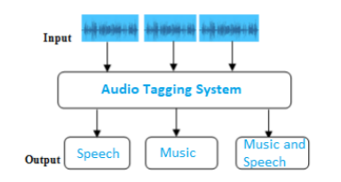
Datasets
50 Audio Datasets
Duration of each file = 10 seconds
Sampling Rate = fs = 16000

Slide 4
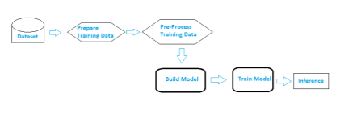
Data Preprocessing
Deep Learning Workflow

Slide 5
Data Preprocessing
Librosa Library
Mel-Frequency Cepstral Coefficients
Training Data Creation
- music: [1 0]
- speech: [0 1]
- music and speech: [1 1]

Slide 6
Model Creation and Training
Selected Model: ANN (Artificial Neural Network)
learning rate
Batch size
Dropout
Epochs

Slide 7
Thank You.

