Slide 1
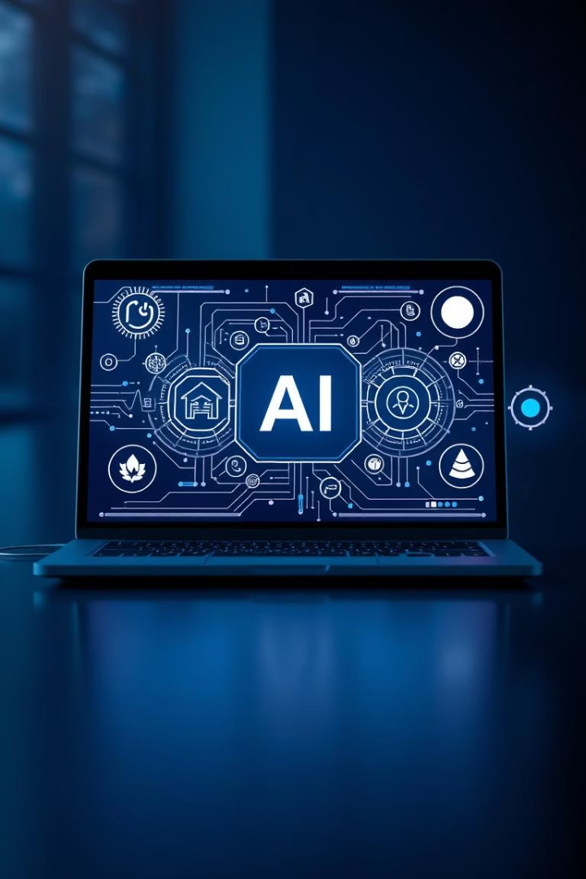
E-Commerce Reverse Image Search
Eshit Saini
Divyansh Rana
Aryan Mohapatra

Slide 2
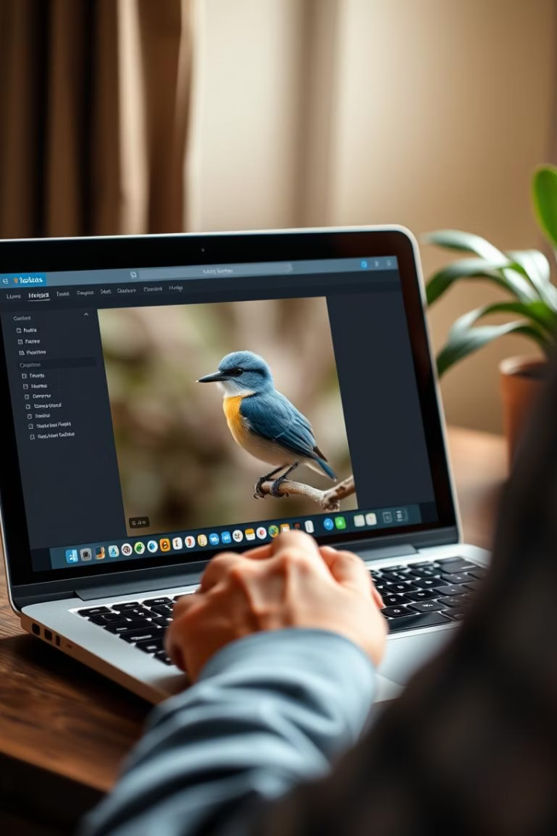
The Challenge: Bridging the Image-Text Gap
Traditional Search Limits
Project Goal
Enable web searches via user-uploaded images.
Mostly text-based, ignoring rich image content.
Example Scenario
User uploads a rare bird photo to identify it.

Slide 3
BLIP-2: Describing the Image
Vision-Language Model
Example Output
Performance
BLIP-2 converts image pixels into meaningful text descriptions.
A colorful bird perched on a branch.
Excels in image captioning with high R-Precision scores.

Slide 4

SerpAPI: Generating the Google Search Query
Query Formation
Example
BLIP-2's text becomes a tailored Google search query.
"A colorful bird perched on a branch" becomes "Identify colorful bird on branch".
Adjustable Settings
Customize search result quantity, region, and language.

Slide 5
Project Architecture: Python, Flask, and Web Frontend
Backend
Web Framework
Frontend
Scalability
Python handles model processing and API calls seamlessly.
Flask provides lightweight, efficient request handling.
HTML/CSS creates a clean, intuitive user interface.
Modular design supports easy growth from local to cloud.

Slide 6
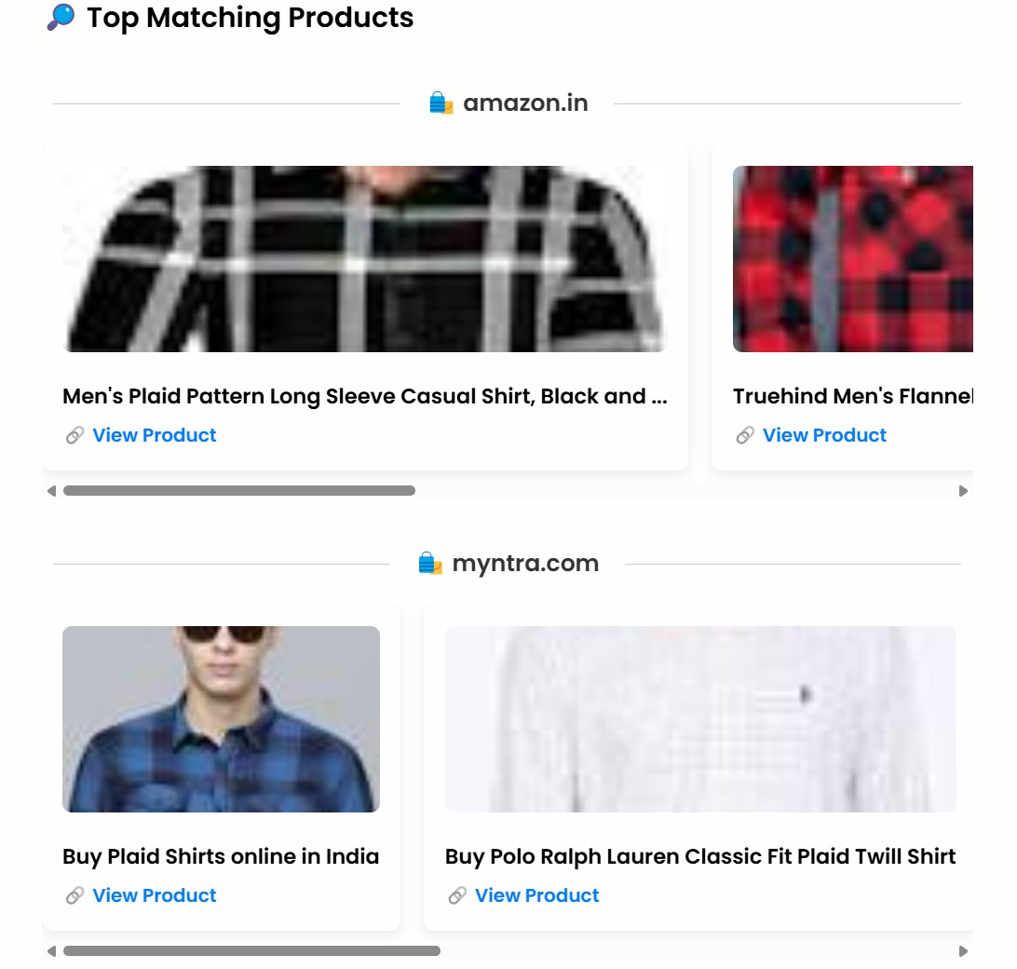
Visualizing the Results: Website UI
Image Thumbnail
Displays the uploaded image for user reference.
Search Query
Shows the generated Google search phrase clearly.
Relevant URLs
Presents curated web links extracted from SerpAPI results.
User Experience
Designed for intuitive navigation and quick insights.

Slide 7

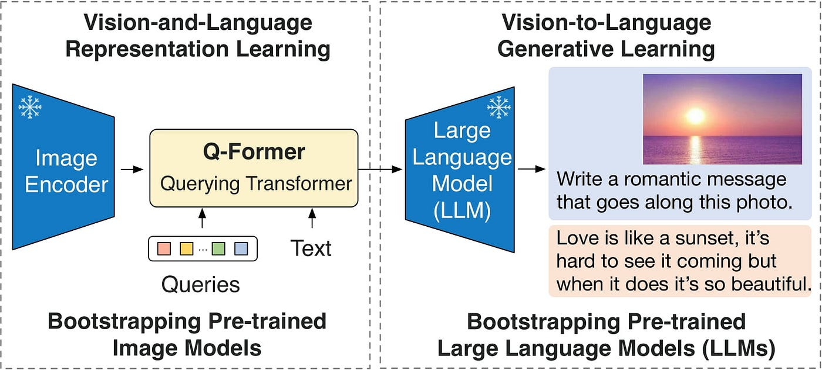



Example Use Cases & Demonstrations
Fashion
Find clothing items similar to your photo online.
Landmarks
Identify buildings and discover their history quickly.
Products
Snap a product photo, locate purchase options.
Live Demo
See the full process using sample images.

Slide 8




Conclusion: The Future of Image-Based Search
Powerful Integration
Scalable Design
Combines deep learning with web search APIs effectively.
1
Easily expands to handle complex queries and data loads.
2
Next Steps
Future Potential
Open-source release and encouraging community contributions.
4
3
Integration with e-commerce and advanced recognition APIs.

