Slide 1
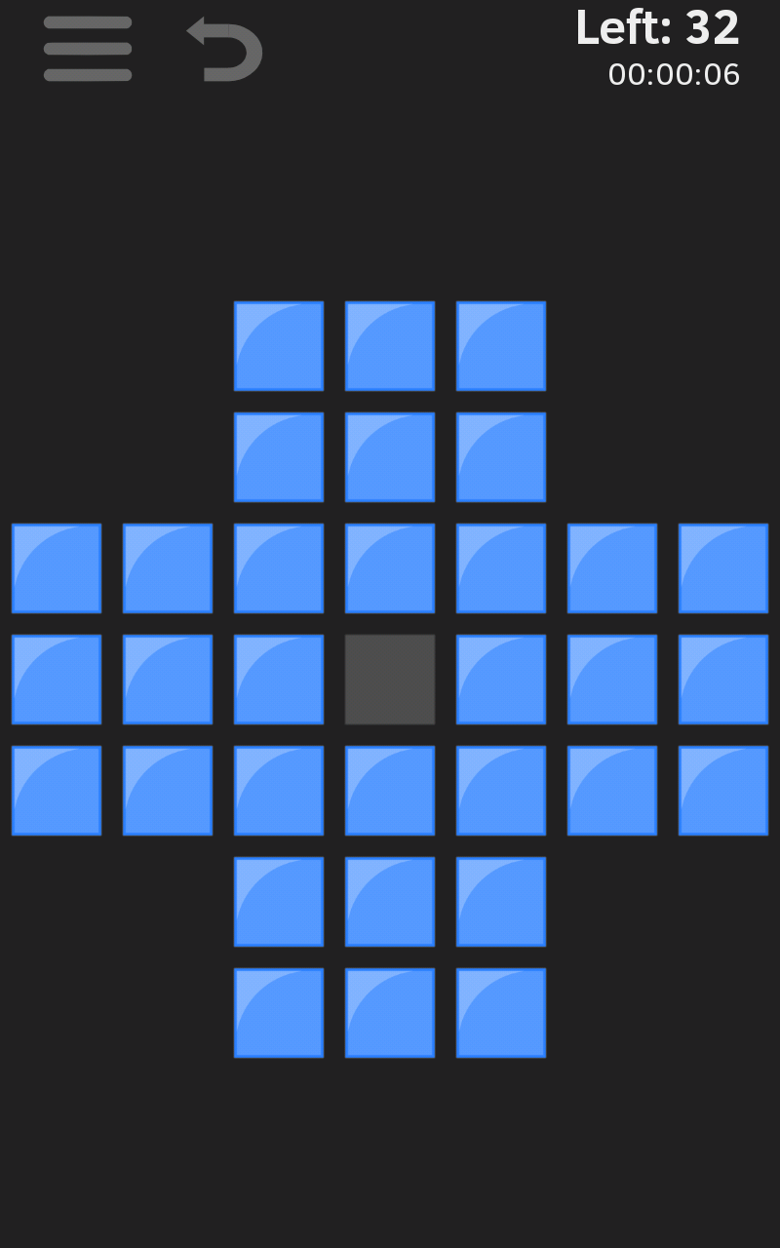
MARBLES CAN BE DRAG-JUMPED OVER MARBLES THAT ARE HORIZONTALLY OR VERTICALLY ADJACENT TO THE JUMPING MARBLE AND WHICH WILL REMOVE ADJACENT MARBLE
COMPLETE THE GAME BY JUMPING MARBLES SO THAT ONLY ONE MARBLE IS LEFT AT THE END

