Slide 1
Movie Recommendation System
P. Harish Reddy B22CN086

Slide 2
Abstract
A content-based movie recommendation system suggests movies to users based on their preferences by analyzing the features of movies, such as genres, tags, actors, and directors. Unlike collaborative filtering, which relies on user ratings and interactions, this approach focuses on the movie’s own characteristics to determine similarity. By utilizing techniques like TF-IDF and cosine similarity, the system provides personalized recommendations without requiring large amounts of user data. This method helps overcome challenges like the cold start problem and ensures more relevant movie suggestions tailored to individual interests.

Slide 3
Existing Model & Limitations
Existing Model: Collaborative Filtering: Suggests movies based on user ratings and watch history. User-Driven Approach: Requires large datasets to generate accurate recommendations
Limitations: Cold Start Problem: Struggles to recommend movies for new users with no prior data. Popularity Bias: Favors trending movies over personalized recommendations.

Slide 4
Proposed System & Advantages
Proposed System: Content-Based Filtering: Recommends movies based on their features like genres, tags, actors, and directors. Similarity Calculation: Uses techniques like TF-IDF and Cosine Similarity to find similar movies.
Advantages: Personalized Recommendations: Suggests movies based on individual user preferences. No Cold Start Problem: Works without requiring user ratings or large interaction datasets.

Slide 5
Problem Statement
Aim: Build a movie recommendation system based on ‘MovieLens’ dataset.
We wish to integrate the aspects of personalization of user with the overall features of movie such as genre, popularity etc.

Slide 6
DataSet
TMDB 5000 Movie Dataset
Ratings: 100k
Movies: 5k
Users: 600
Integrated the dataset with IMDB and TMDB data set publically available.

Slide 7
Models
Content based model
Collaborative Filtering
Hybrid model

Slide 8
Content-Based Recommendation
User profile based on item profiles
Genre
Year of release of movie
Movie - Movie similarity

Slide 9
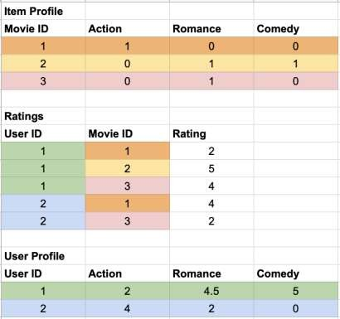
User and Item Vectors
Item Vector:
Vector of length total genres with 1 at
relevant indices
User Vector:
Vector of length total genres with the value of average rating for each genre based on ratings in train set

Slide 10
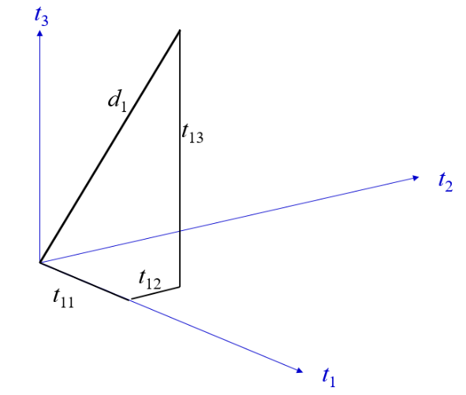
Represented in a 3-Dimensional Term Vector Space

Slide 11
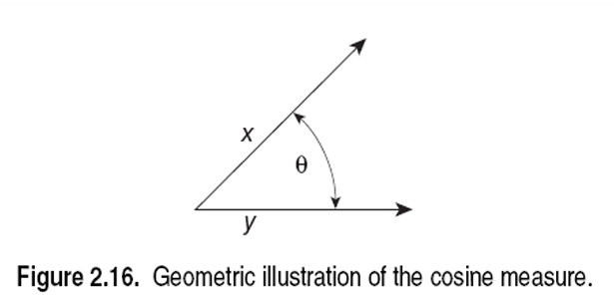
Cosine Similarity
• Sim(X,Y) = cos(X,Y)
• The cosine of the angle between X and Y
• If the vectors are aligned (correlated) angle is zero degrees and cos(X,Y)=1
• If the vectors are orthogonal (no common coordinates) angle is 90 degrees and cos(X,Y) = 0
• Cosine is commonly used for comparing documents, where we assume that the vectors are normalized by the document length.

Slide 12
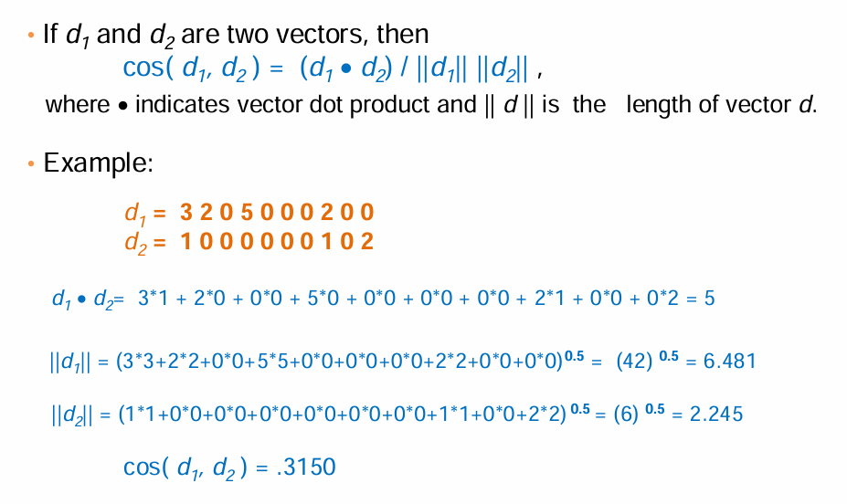
Cosine Similarity - math

Slide 13
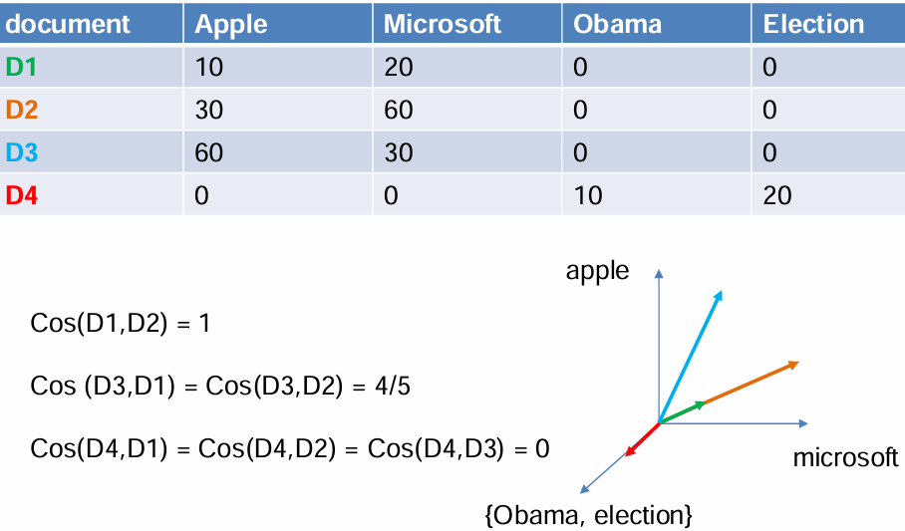
Example

Slide 14
Evaluation metrics
Metric | Content based (Genre)
RMSE | 0.9185
MAE | 0.7095
Metric | Content based (Genre)
Precision | 0.800932214
Recall | 0.495168862
F-Measure | 0.6119842046
NDCG | 0.945576877

Slide 15
Movie-Movie Similarity
TF-IDF using overview and tagline of movies (from TMDb)
Issue: This just gives movies having similar description.

Slide 16
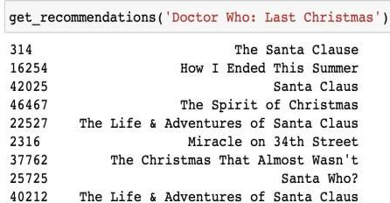
Movie-Movie Similarity (Cont.)
Overview of ‘Doctor Who: Last Christmas’
'The Doctor and Clara face their Last Christmas. Trapped on an Arctic base, under attack from terrifying creatures, who are you going to call?
Santa Claus!'

Slide 17
Improvement
Adding the genre two times to give more weightage
Changing TF-IDF to Count Vector
TF-IDF gives lesser weight to frequently occurring terms across
documents

Slide 18
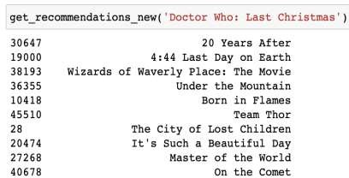
Movie 1: '20 Years After'
“In the middle of nowhere, 20 years after an apocalyptic
terrorist event that obliterated the face of the world!”
Genre: ['Drama', 'Fantasy', 'Sci-Fi']
Movie 2: '4:44 Last Day on Earth'
Doctor Who:
- 'The Doctor and Clara face their Last Christmas. Trapped on an Arctic base, under attack from terrifying creatures, who are you going to call? Santa Claus!'
Overview:
'A look at how a painter and a successful actor spend their
last day together before the world comes to an end.'
- ['Adventure', 'Drama', 'Fantasy', 'Sci-Fi']
Genre: ['Drama', 'Fantasy', 'Sci-Fi']

Slide 19
Takeaways:
Content based with genre is good when a user has less ratings.
Movie similarity metric based on features like overview, taglines and
genre.
Item-item collaborative filtering works better than user-user
collaborative filtering.
KNN based and SVD algorithms improve when global baselines are added.
Combining the predictions and recommendations of different models
gives better results in terms of accuracy and quality of
recommendations.

Slide 20
References:
Surprise library: https://surprise.readthedocs.io/en/stable/
Content based recommendation system: https://arxiv.org/pdf/1901.03888.pdf
Evaluating recommendation system: http://fastml.com/evaluating-recommender-systems/

Slide 21
Thank you!

