Slide 1
Poisson Regression

Slide 2
Predictive Models for “Count Data”

Slide 3
“Counting Data”
Positive Integer Target Variable: 0, 1, 2, 3, etc. (counting numbers)
The data follows either
“Poisson” Distribution
“Negative Binomial” Distribution

Slide 4
“Counting Numbers”
LINEAR REGRESSION Not usually a good choice because:
The relationship between INPUTS and TARGET are not linear
Linear Regression can yield a NEGATIVE prediction (Counts must be >0)
Errors distribution won’t be random (“heteroskedastic”)
INSTRUCTOR OPINION
Linear Regression is pretty simple to do and interpret. It can’t hurt to try a linear regression model and see how it performs.

Slide 5
Poisson Distribution

Slide 6
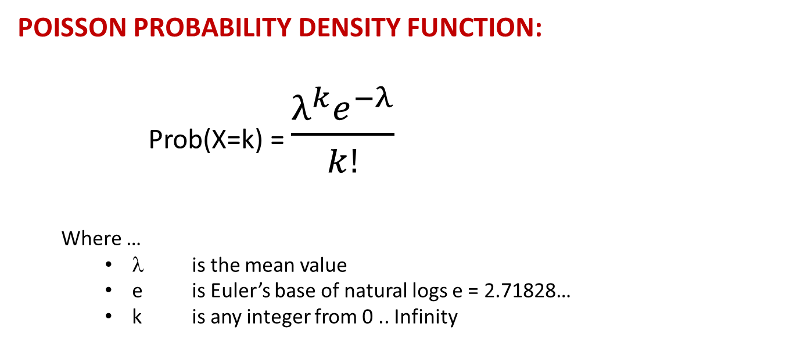
POISSON DISTRIBUTION
POISSON PROBABILITY DENSITY FUNCTION:
Prob(X=k) = $\frac{λ^{k}e^{−λ}}{k!}$
Where …
λ is the mean value
e is Euler’s base of natural logs e = 2.71828…
k is any integer from 0 .. Infinity

Slide 7
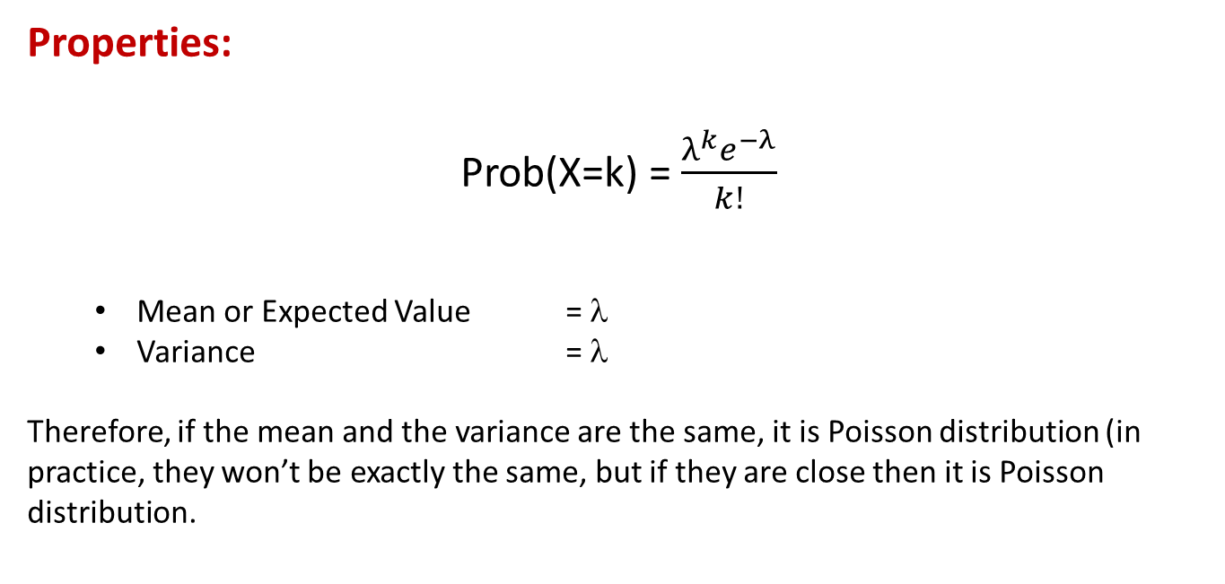
POISSON DISTRIBUTION
Properties:
Prob(X=k) = $\frac{λ^{k}e^{−λ}}{k!}$
Mean or Expected Value = λ
Variance = λ
Therefore, if the mean and the variance are the same, it is Poisson distribution (in practice, they won’t be exactly the same, but if they are close then it is Poisson distribution.

Slide 8
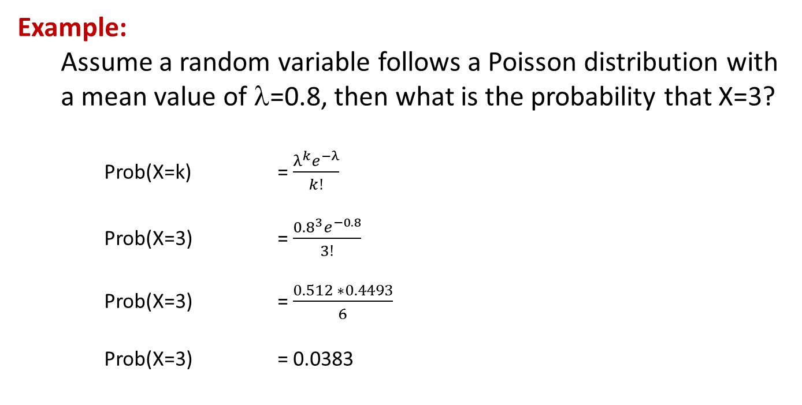
POISSON DISTRIBUTION
Example:
Assume a random variable follows a Poisson distribution with a mean value of λ=0.8, then what is the probability that X=3?
Prob(X=k) = $\frac{λ^{k}e^{−λ}}{k!}$
Prob(X=3) = $\frac{{0.8}^{3}e^{−0.8}}{3!}$
Prob(X=3) = $\frac{0.512 ∗0.4493}{6}$
Prob(X=3) = 0.0383

Slide 9
POISSON DISTRIBUTION
Example:
Assume a random variable follows a Poisson distribution with a mean value of λ=0.8, what are the probabilities of X=0.6?
K | Prob(x=K)
0 | 0.4493
1 | 0.3595
2 | 0.1438
3 | 0.0383
4 | 0.0077
5 | 0.0012
6 | 0.0002

Slide 10
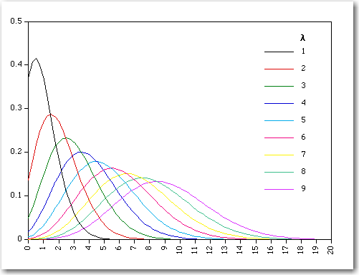
POISSON DISTRIBUTION
Graph:
This is a graph of the Poisson distribution of various values of λ
Notice that as λ gets larger, Poisson distribution looks like Normal distribution

Slide 11
POISSON REGRESSION
Poisson Transform:
Recall that target variable can be transformed prior to regression:
LINEAR REGRESSION: G(y) = y (Identity or “Do Nothing”)
LOGISTIC REGRESSION: G(y) = ln( y/(1-y) ) (LOGIT Transform)
POISSON REGRESSION: G(Y) = ln( Y ) (Log Transform)
Note: Commercially available software will handle the possibility that Y=0 for Poisson Regression and Y=0 or 1 for Logistic Regression. For Poisson, for example, Y can be replaced by a small number greater than 0 or else add 1 to the target and subtract 1 after the regression. There are other techniques, but they are beyond the scope of this course. Suffice it to say that you don’t need to worry about this.

Slide 12
POISSON REGRESSION
After the G(Y) = ln(Y) transformation, the regression is conducted using Maximum Likelihood.
The result of the regression will be the NATURAL LOG of the Count, so the Count value must be determined by taking the INVERSE “ln” function. In other words exponentiate the output.

Slide 13
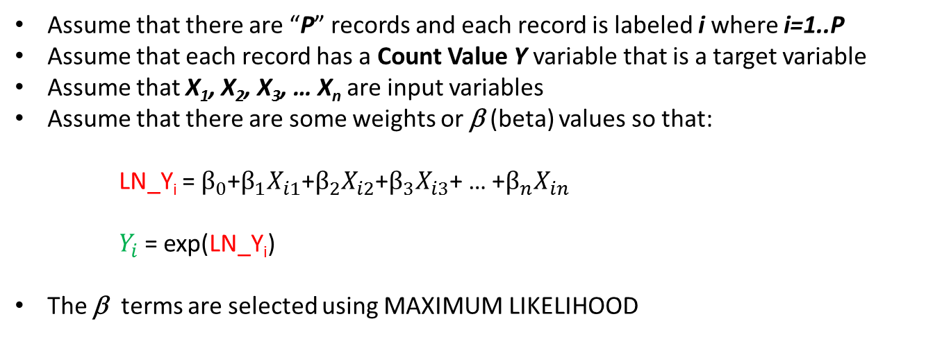
Poisson Regression Review
Assume that there are “P” records and each record is labeled i where i=1..P
Assume that each record has a Count Value Y variable that is a target variable
Assume that X₁, X₂, X₃, … X_{n} are input variables
Assume that there are some weights or β (beta) values so that:
LN_Y_{i} = $β_{0}$+$β_{1}X_{i1}\text{+}β_{2}X_{i2}$+$β_{3}X_{i3}$+ … +$β_{n}X_{in}$
$Y_{i}$= exp(LN_Y_{i})
The β terms are selected using MAXIMUM LIKELIHOOD

Slide 14
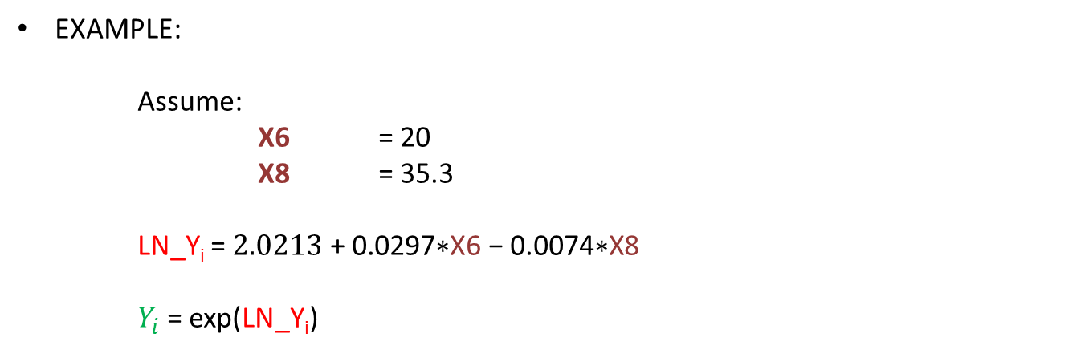
Poisson Regression Review
EXAMPLE:
Assume:
X6 = 20
X8 = 35.3
LN_Y_{i} = $2.0213\text{ + }\text{0.0297}\text{∗}\text{X}\text{6 − 0.0074∗}\text{X}\text{8}$
$Y_{i}$= exp(LN_Y_{i})

Slide 15
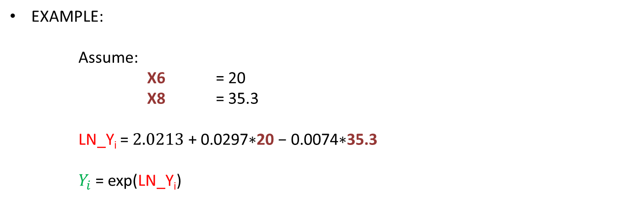
Poisson Regression Review
EXAMPLE:
Assume:
X6 = 20
X8 = 35.3
LN_Y_{i} = $2.0213\text{ + }\text{0.0297}\text{∗}\text{20} \text{− }\text{0.0074}\text{∗}\text{35.3}$
$Y_{i}$= exp(LN_Y_{i})

Slide 16
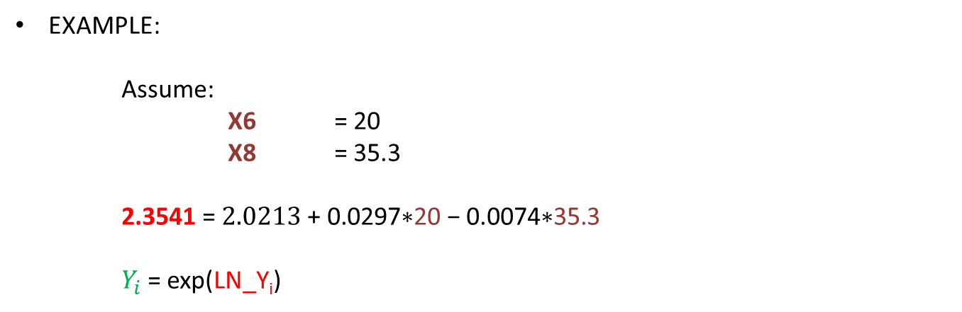
Poisson Regression Review
EXAMPLE:
Assume:
X6 = 20
X8 = 35.3
2.3541 = $2.0213\text{ + }\text{0.0297}\text{∗}\text{20} \text{− }\text{0.0074}\text{∗}\text{35.3}$
$Y_{i}$= exp(LN_Y_{i})

Slide 17
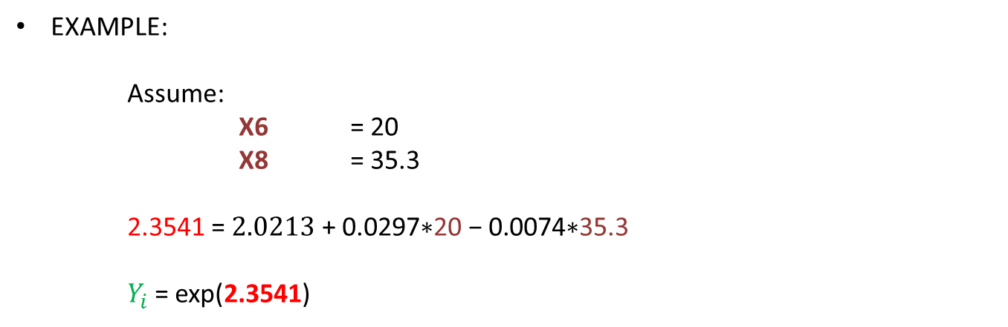
Poisson Regression Review
EXAMPLE:
Assume:
X6 = 20
X8 = 35.3
2.3541 = $2.0213\text{ + }\text{0.0297}\text{∗}\text{20} \text{− }\text{0.0074}\text{∗}\text{35.3}$
$Y_{i}$= exp(2.3541)

Slide 18
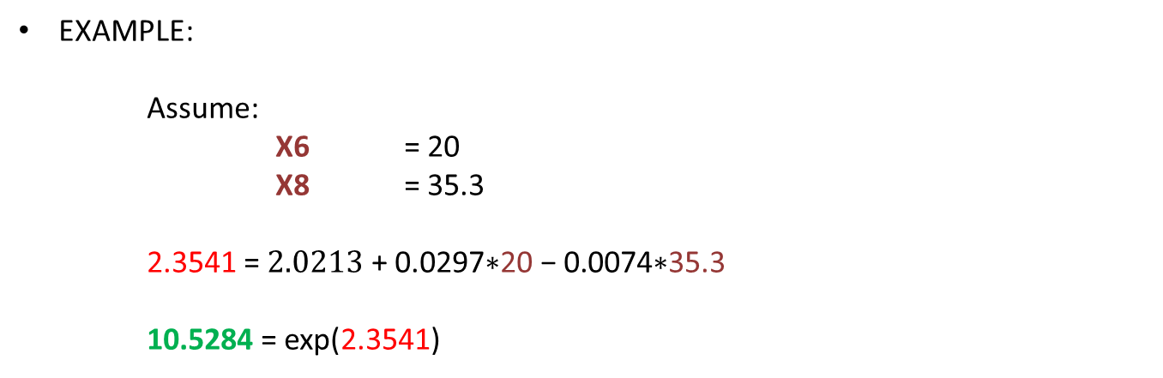
Poisson Regression Review
EXAMPLE:
Assume:
X6 = 20
X8 = 35.3
2.3541 = $2.0213\text{ + }\text{0.0297}\text{∗}\text{20} \text{− }\text{0.0074}\text{∗}\text{35.3}$
10.5284 = exp(2.3541)

Slide 19
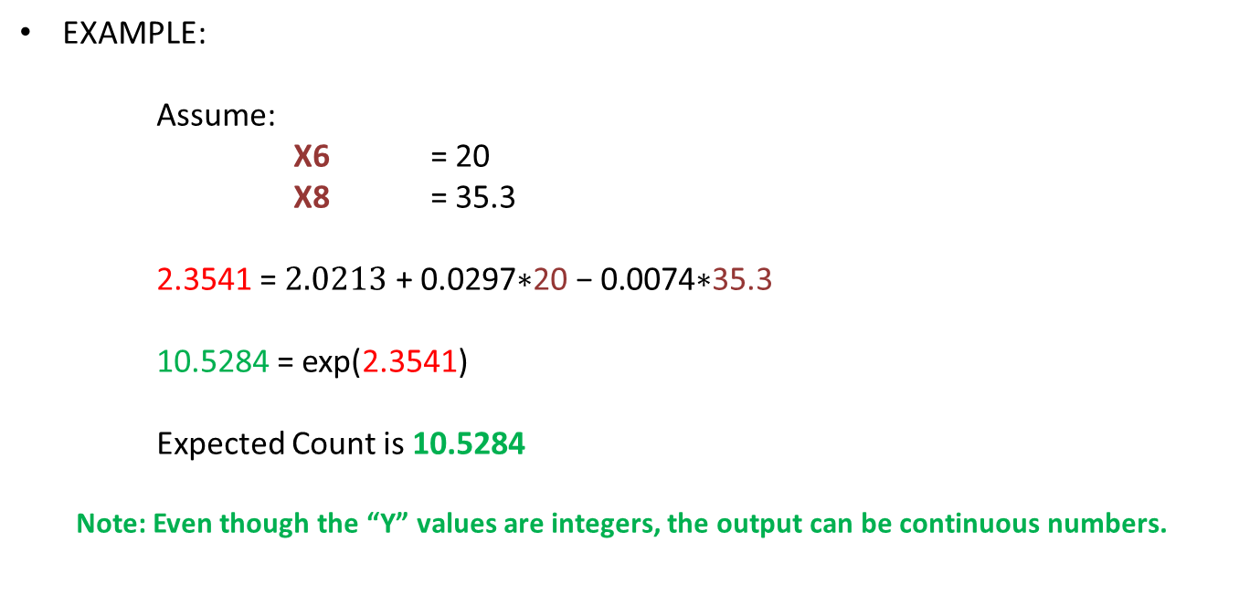
Poisson Regression Review
EXAMPLE:
Assume:
X6 = 20
X8 = 35.3
2.3541 = $2.0213\text{ + }\text{0.0297}\text{∗}\text{20} \text{− }\text{0.0074}\text{∗}\text{35.3}$
10.5284 = exp(2.3541)
Expected Count is 10.5284
Note: Even though the “Y” values are integers, the output can be continuous numbers.

Slide 20
Negative Binomial Distribution

Slide 21
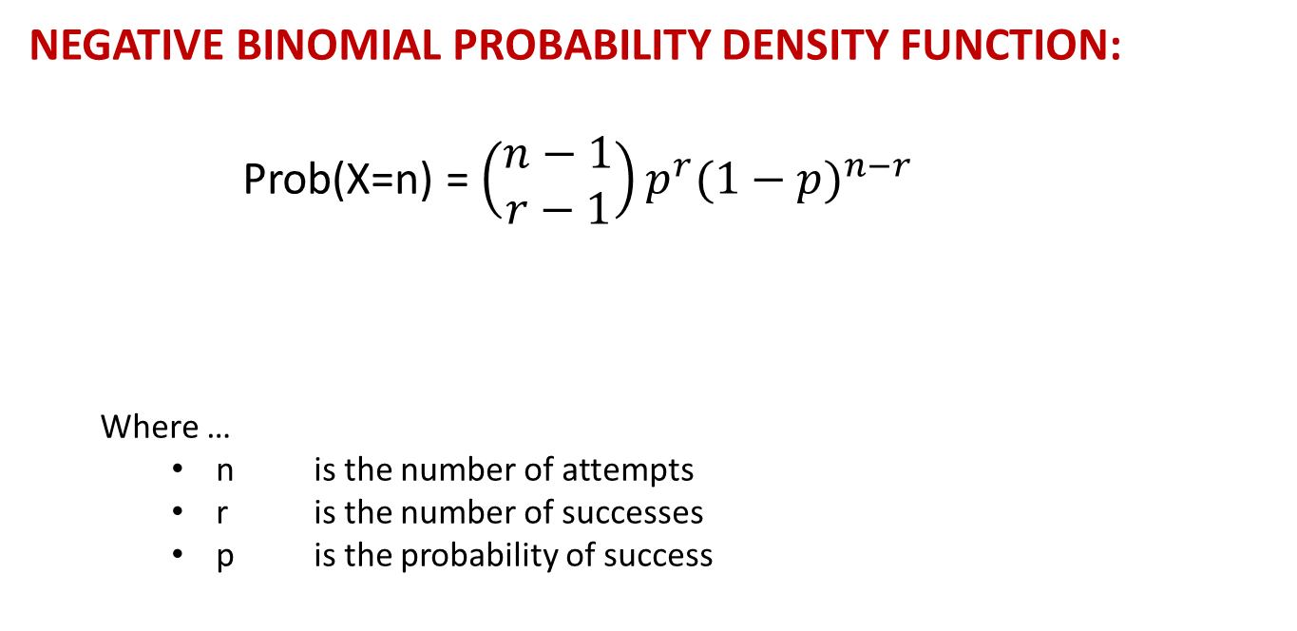
NEGATIVE BINOMIAL DISTRIBUTION
NEGATIVE BINOMIAL PROBABILITY DENSITY FUNCTION:
Prob(X=n) = $\left(\begin{matrix}n−1 \\ r−1\end{matrix}\right)p^{r}{(1−p)}^{n−r}$
Where …
n is the number of attempts
r is the number of successes
p is the probability of success

Slide 22
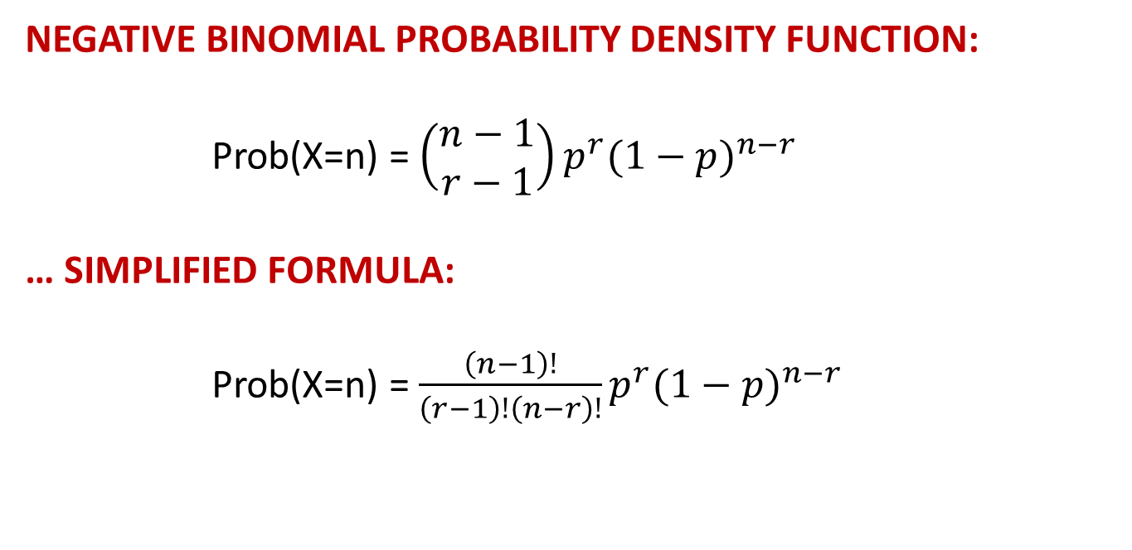
NEGATIVE BINOMIAL DISTRIBUTION
NEGATIVE BINOMIAL PROBABILITY DENSITY FUNCTION:
Prob(X=n) = $\left(\begin{matrix}n−1 \\ r−1\end{matrix}\right)p^{r}{(1−p)}^{n−r}$
… SIMPLIFIED FORMULA:
Prob(X=n) = $\frac{\left(n−1\right)!}{\left(r−1\right)!\left(n−r\right)!}p^{r}{(1−p)}^{n−r}$

Slide 23
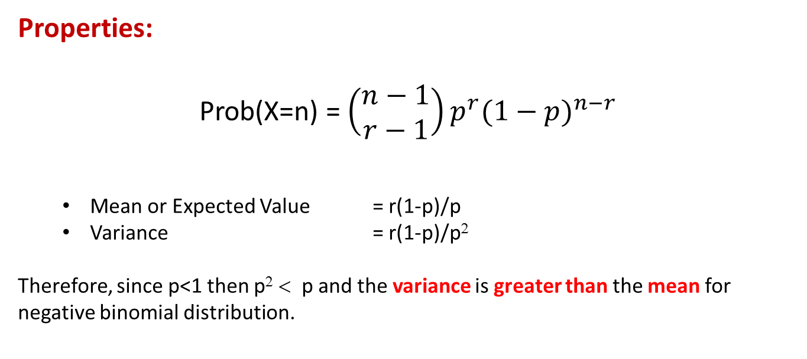
NEGATIVE BINOMIAL DISTRIBUTION
Properties:
Prob(X=n) = $\left(\begin{matrix}n−1 \\ r−1\end{matrix}\right)p^{r}{(1−p)}^{n−r}$
Mean or Expected Value = r(1-p)/p
Variance = r(1-p)/p²
Therefore, since p<1 then p² < p and the variance is greater than the mean for negative binomial distribution.

Slide 24
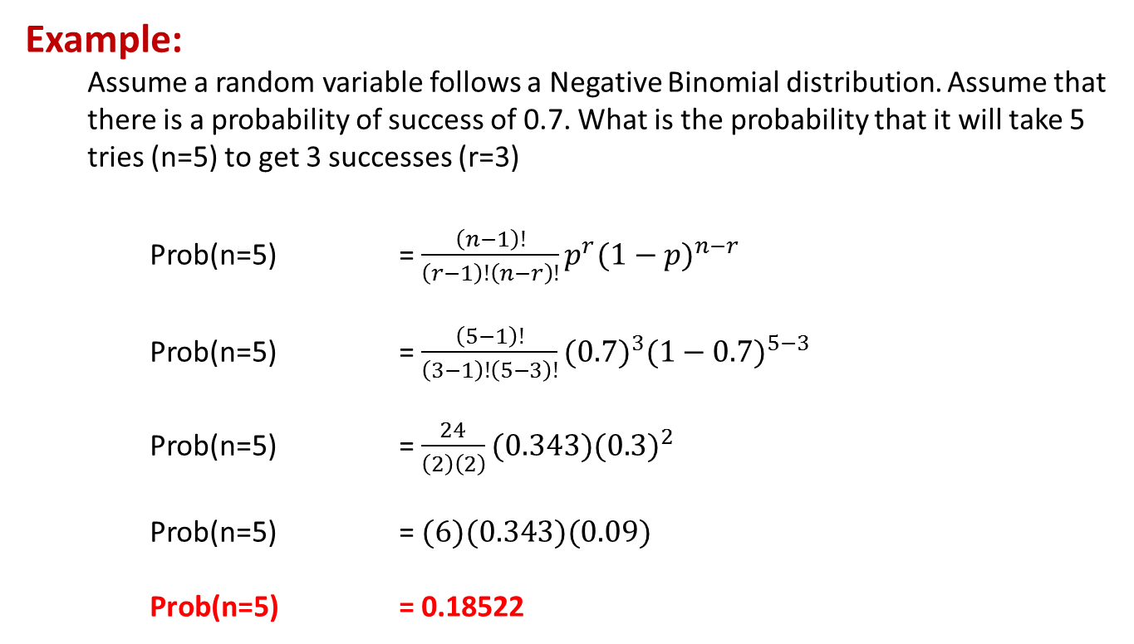
NEGATIVE BINOMIAL DISTRIBUTION
Example:
Assume a random variable follows a Negative Binomial distribution. Assume that there is a probability of success of 0.7. What is the probability that it will take 5 tries (n=5) to get 3 successes (r=3)
Prob(n=5) = $\frac{\left(n−1\right)!}{\left(r−1\right)!\left(n−r\right)!}p^{r}{(1−p)}^{n−r}$
Prob(n=5) = $\frac{\left(5−1\right)!}{\left(3−1\right)!\left(5−3\right)!}{(0.7)}^{3}{(1−0.7)}^{5−3}$
Prob(n=5) = $\frac{24}{\left(2\right)\left(2\right)}(0.343){(0.3)}^{2}$
Prob(n=5) = $(6)(0.343)(0.09)$
Prob(n=5) = 0.18522

Slide 25
NEGATIVE BINOMIAL DISTRIBUTION
Example:
Assume a random variable follows a Negative Binomial distribution with a probability of success of 0.7. What is the probability of that there will be “N” trials to achieve r=3 successes.
N | Prob(x=N)
3 | 0.343
4 | 0.309
5 | 0.185
6 | 0.093
7 | 0.042
8 | 0.018
9 | 0.007

Slide 26
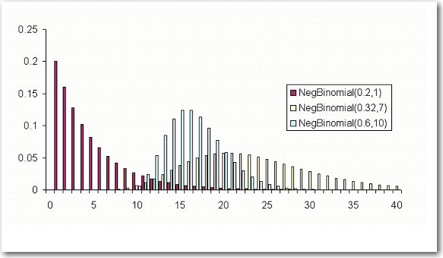
NEGATIVE BINOMIAL DISTRIBUTION
Graph:
This is a graph of the Negative Binomial distribution of various values of p and r.

Slide 27
NEGATIVE BINOMIAL REGRESSION
Negative Binomial Transform:
The Negative Binomial Transform is similar to Poisson Regression in that it uses the natural log transformation.
LINEAR REGRESSION: G(y) = y (Identity or “Do Nothing”)
LOGISTIC REGRESSION: G(y) = ln( y/(1-y) ) (LOGIT Transform)
POISSON REGRESSION: G(Y) = ln( Y ) (Log Transform)
NEGATIVE BINOMIAL REGRESSION: G(Y) = ln( Y ) (Log Transform)
Note: Poisson Regression is actually a special case of Negative Binomial Regression where the mean and the variance are equal. Many times, if the variance and the mean are similar, both Poisson and Negative Binomial Regressions will converge to the same result.

Slide 28
Poisson Regression
Example

Slide 29
Poisson Regression: Example
This example is taken from the previously mentioned Draper and Smith reference.
The data describes monthly steam usage in a manufacturing plant
YTEMP Monthly use of steam
Y round(YTEMP,1) Note: rounding YTEMP to the nearest “1” value
X6 Operating days per month
X8 Average temperature in degrees Fahrenheit
NOTE: Draper and Smith named their variables X6 and X8, don’t worry about that. The names of the variables are not important and don’t affect the formula.
Raw Data is given on the following slide.
SAS Code is provided to read data into SAS

Slide 30
Poisson Regression: Example
Raw Steam Usage Data
 | X6 | X8 | Y
1 | 20 | 35.3 | 10.98
2 | 20 | 29.7 | 11.13
3 | 23 | 30.8 | 12.51
4 | 20 | 58.8 | 8.4
5 | 21 | 61.4 | 9.27
6 | 22 | 71.3 | 8.73
7 | 11 | 74.4 | 6.36
8 | 23 | 76.7 | 8.5
9 | 21 | 70.7 | 7.82
10 | 20 | 57.5 | 9.14
11 | 20 | 46.4 | 8.24
12 | 21 | 28.9 | 12.19
13 | 21 | 28.1 | 11.88
14 | 19 | 39.1 | 9.57
15 | 23 | 46.8 | 10.94
16 | 20 | 48.5 | 9.58
17 | 22 | 59.3 | 10.09
18 | 22 | 70 | 8.11
19 | 11 | 70 | 6.83
20 | 23 | 74.5 | 8.88
21 | 20 | 72.1 | 7.68
22 | 21 | 58.1 | 8.47
23 | 20 | 44.6 | 8.86
24 | 20 | 33.4 | 10.36
25 | 22 | 28.6 | 11.08

Slide 31
Poisson Regression: Example
R Code to read in raw data
############ Setting up individual variables
############ This code assumes that the STEAM data was read in using a file called:
steam.csv summary(steam)
x6 <- steam$X6
x8 <- steam$X8
ytemp <- steam$Y
#################### Or data is read in directly as a column
x6<-c(20,20,23,20,21,22,11,23,21,20,20,21,21,19,23,20,22,22,11,23,20,21,20,20,22)
x8<c(35.3,29.7,30.8,58.8,61.4,71.3,74.4,76.7,70.7,57.5,46.4,28.9,28.1,39.1,46.8,48.5,59.3,70,70,74.5,72.1,58.1,44.6,33.4,28.6)
ytemp<c(10.98,11.13,12.51,8.4,9.27,8.73,6.36,8.5,7.82,9.14,8.24,12.19,11.88,9.57,10.94,9.58,10.09,8.11,6.83,8.88,7.68,8.47,8.86,10.36,11.08)
y<-round(ytemp,digits=0)
steam2 <- data.frame(x6,x8,y)
summary(steam2)
steam2
NOTE: y = round(YTEMP,digits=0) command will return an integer value of YTEMP rounded to the nearest “1” value.

Slide 32
Poisson Regression: Example
After the data has been read in and transformed, the data set looks like this:
 | X6 | X8 | Y
1 | 20 | 35.3 | 11
2 | 20 | 29.7 | 11
3 | 23 | 30.8 | 13
4 | 20 | 58.8 | 8
5 | 21 | 61.4 | 9
6 | 22 | 71.3 | 9
7 | 11 | 74.4 | 6
8 | 23 | 76.7 | 9
9 | 21 | 70.7 | 8
10 | 20 | 57.5 | 9
11 | 20 | 46.4 | 8
12 | 21 | 28.9 | 12
13 | 21 | 28.1 | 12
14 | 19 | 39.1 | 10
15 | 23 | 46.8 | 11
16 | 20 | 48.5 | 10
17 | 22 | 59.3 | 10
18 | 22 | 70 | 8
19 | 11 | 70 | 7
20 | 23 | 74.5 | 9
21 | 20 | 72.1 | 8
22 | 21 | 58.1 | 8
23 | 20 | 44.6 | 9
24 | 20 | 33.4 | 10
25 | 22 | 28.6 | 11

Slide 33
Poisson Regression: Example
Before doing a regression, it is usually a good idea to do some analysis on the data to determine the distribution of the data, the mean, and the variance. I used the CountAll and hs histogram function from the lessR library :
library(lessR)
CountAll(steam2)
hs(y,data=steam2)

Slide 34
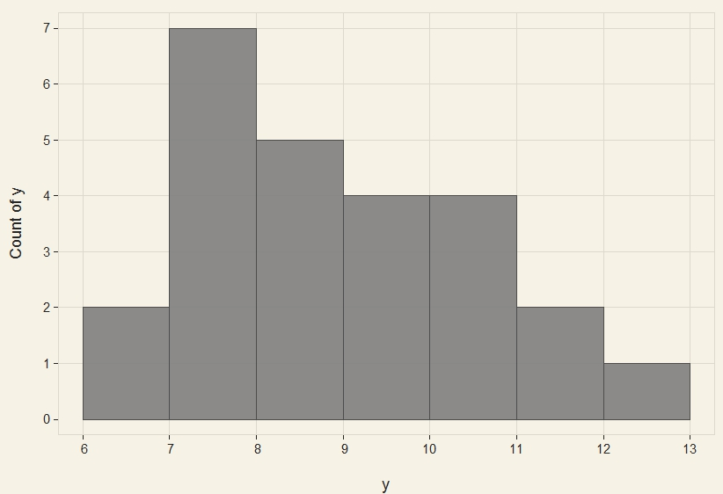
Poisson Regression: Example
The output from this basic analysis is given below. The histogram shows that the distribution could be Poisson or Negative Binomial. The data seems to follow a normal distribution which is a special case of Poisson or NB. There are no spikes at any value, such as 0 which might suggest using a Zero Inflated Model (more on that later).

Slide 35
Poisson Regression: Example
Continuing with the analysis, it is seen from the summary statistics that the variance is smaller than the mean. From this, we can conclude that this data does not actually fit a Poisson distribution or a Negative Binomial distribution. These distributions require that the variance be equal to the mean for Poisson and greater than the mean for Negative Binomial.
Even though this is not technically Poisson or NB, the analysis will continue for demonstration purposes. Also, distinguished statistician John Tukey taught that statistics are robust and can give good results even when assumptions are violated.

Slide 36
Poisson Regression: Example
R has many ways to model counting numbers. Here, we will look at:
reg (standard regression should always be tried, it’s easy and can work well)
reg using LN(Y) (transform Y by hand – run OLS on LN(Y) as response variable)
glm with POISSON distribution
glm with NEGATIVE BINOMIAL) distribution
########## OLS Regression
m0 <- reg(y~x6+x8, data=steam)
m0
########### GLM with Poisson Distribution
summary(m1 <- glm(y ~ x6 + x8, family="poisson", data=steam2))
########### GLM with Negative Binomial Distribution
install.package(MASS)
library(MASS)
summary(m2 <- glm.nb(y ~ x6 + x8, data = steam2))

Slide 37
Poisson Regression: Example
Using OLS regression
summary(m0 <- reg(y~x6+x8, data=steam2))
m0
Beta Values

Slide 38
Poisson Regression: Example
Using OLS regression on LN(Y)
ln_y <- log(y)
ln_y
steam4<-cbind.data.frame(steam2,ln_y)
m3<-reg(ln_y ~x6 + x8, data=steam4)
m3
Beta Values

Slide 39
Poisson Regression: Example
Using GLM and the POISSON distribution.
summary(m1 <- glm(y ~ x6 + x8, family="poisson", data=steam2))
Beta Values

Slide 40
Poisson Regression: Example
Using Negative Binomial Distribution:
library(MASS)
summary(m2 <- glm.nb(y ~ x6 + x8, data = steam2))
Beta Values

Slide 41
Poisson Regression: Example
Output:

Slide 42
Poisson Regression: Example
Comments:
The results from the OLS Linear Regression and OLS Linear Regression using the LN(Y) transformation are close to those of the Poisson and Negative Binomial regression. Linear regression can give good results for this type of data, so it should always be attempted. There’s no harm in seeing if it will work.
The Poisson and Negative Binomial models generated almost identical models. Occasionally, the two algorithms will converge to the same solution. This can happen when the variance is not significantly greater than that the mean.
The difference between the OLS LN(Y) and the Poisson Regression models and predicted is the difference between OLS estimation and Maximum Likelihood estimation.

Slide 43
Poisson Regression: Example SCORING or EXPORTING
When the parameter estimates are known for the POISSON or NEGATIVE BINOMIAL regression models, scoring can be easily accomplished by hard coding the model. The same code can be used for either of these models since the Y-transform is the same. Both use LN(Y).
temp = 2.083 + 0.0275*X6 – 0.00787*x8
P_SCORE_POISSON = exp(temp)
The exact same thing can be done for negative binomial.
Include P_SCORE_POISSON in the data frame
List the data frame
Export the results

Slide 44
Poisson Regression: Example
Comments:
The Poisson Score code was similar but clearly different from the output of the R function fitted values. The reason for the difference is that Poisson and Negative Binomial models must have their output exponentiated to convert from LN(Y) back into Y. Therefore, any rounding errors result in more significant variance.

