Slide 1
Zero Inflated Poisson Regression
“ZIP MODELS”

Slide 2
ZIP Models

Slide 3
“ZIP Counting Data”
Positive Integer Target Variable: 0, 1, 2, 3, etc. (counting numbers)
The data follows either
“Poisson” Distribution
“Negative Binomial” Distribution
… and a Large amount or “spike” of Zero values

Slide 4
“ZIP Counting Data”
EXAMPLE:
Note: The following data is synthetic in the sense that the data was constructed via a simulation process. But, it is based upon information found from a cursory internet search.
If a person took a shower, the average time spent in the shower followed a Poisson distribution with a mean value of 14 minutes.
However, approximately 12% of the people surveyed had not taken a shower the previous morning.
Note: The simulation process utilized these “parameter” and built in a pseudo random data collection process to construct the dataset.

Slide 5
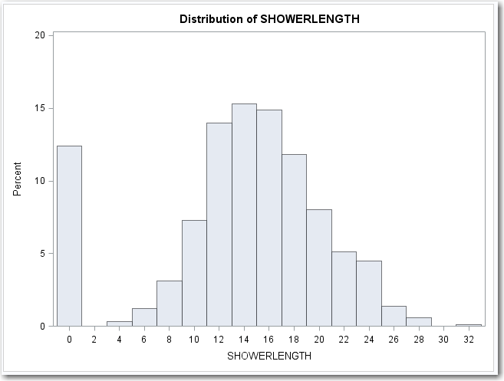
“ZIP Counting Data”
EXAMPLE: Distribution of the Synthetic Data Set representing length of time in the shower. Notice the large “spike” of zero values. The actual data will differ from this pattern due to randomness in the construction of the data.

Slide 6
Create Synthetic Data

Slide 7
SAS Code For Generating Synthetic Shower Data 1 of 2
Here is the R code I used to simulate sampling and to construct the Shower Data. You are welcome to run this code to make your own data – or use the resultant file that is provided.
howmany<- 1000
seed<-1
age <- matrix(2, nrow=howmany, ncol=1)
sex <- matrix(0, nrow=howmany, ncol=1)
average <- matrix(11, nrow=howmany, ncol=1)
noshower <- matrix(0.25, nrow=howmany, ncol=1)
income <- matrix(0,nrow=howmany,ncol=1)
bucket <- matrix(0,nrow=howmany,ncol=1)
showerlength <- matrix(0,nrow=howmany,ncol=1)
for(i in 1:howmany) {
if(runif(1)<0.5) sex[i]<- 1
if(sex[i]==0) {
average[i]<-average[i]+2
noshower[i]<-noshower[i]-0.1
}
if(runif(1)<0.4) age[i]<-1
if(runif(1)<0.2) age[i]<-3
if(age==1) average[i]<-average[i] - 2
if(age==3) {
average[i]<-average[i] + 2
noshower[i]<-noshower[i] - 0.1
}

Slide 8
SAS Code For Generating Synthetic Shower Data 2 of 2
income[i] <- 10000 + 50000*runif(10)
if(sex[i]==1) income[i]<- 1.2*income[i]
if(age[i]==1) income[i]<- 0.7*income[i]
if(age[i]==3) income[i]<- 0.9*income[i]
income[i]<-round(income[i],digits=0)
average[i]<-average[i] + 0.10*income[i]/1000
bucket[i]<-round(income[i]/10000,digits=0)
noshower[i]<-noshower[i] - bucket/100
income[i]<-round(income[i]/1000,digits=0)
showerlength[i]<-rpois(1,average[i])
if(runif(111)<noshower[i]) showerlength[i]<-0
}
mydata<-cbind.data.frame(age,sex,income,showerlength)
write.table(mydata,file="showerdata",append=FALSE, sep=" ", eol="\n")

Slide 9
Initial Analysis

Slide 10
Housekeeping Steps
It is a best practice to make a copy of the data set prior to doing any analytics on the data. This frees the analyst to alter the data set without worrying about destroying the original data set.
Another best practice is to print the data set, just to be certain that nothing went wrong when copying the data. The first 20 records are printed.
Note: INCOME is in thousands

Slide 11
Housekeeping Steps

Slide 12
Housekeeping Steps
If this is a Poisson distribution, the MEAN and the VARIANCE will be the same.
But, be careful, we want the MEAN and the VARIANCE for the data that is NOT zero. Recall that if people take showers, the data has a Poisson distribution, however, some people did not take showers so their values are 0.
We only want the MEAN and VARIANCE for records where SHOWERLENGTH>0

Slide 13
Housekeeping Steps
The MEAN and the VARIANCE values are similar to one another. They won’t be exact, because of the randomness (or error) but they are close.
This data can reasonably be considered to be either:
Poisson Distribution
Negative Binomial Distribution

Slide 14
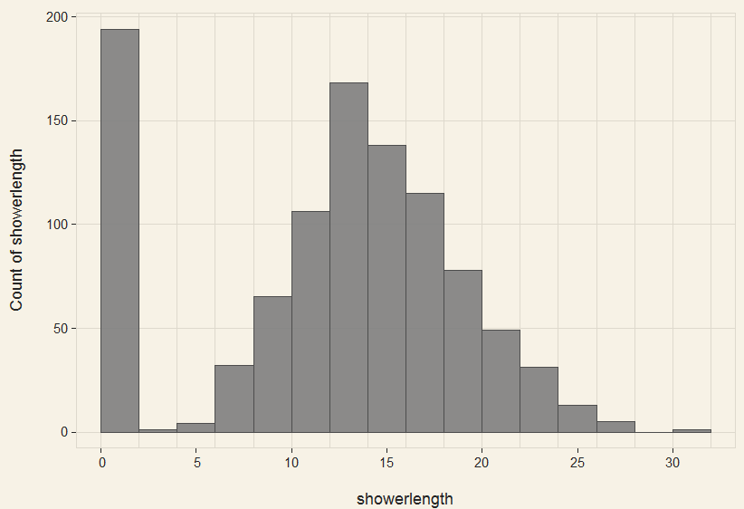
Housekeeping Steps
It is usually a good idea to print the distribution of the target variable to verify that the data appears to have a Poisson distribution. The data appears to have a Poisson distribution or a Negative Binomial distribution (with the exception of the spike at the ZERO values).

Slide 15
Modeling ZIP Data

Slide 16
Modeling ZIP Data
Method 1: Poisson and/or
Negative Binomial Regression

Slide 17
Method 1: Poisson/Negative Binomial Regression
Method:
Solve the problem exactly like any other Poisson and/or Negative Binomial Model
Advantages:
Simple and familiar
No harm in trying because it might work (and many times it will)
Disadvantages:
It might not work

Slide 18
Method 1: Poisson/Negative Binomial Regression
R Code:
########### GLM with Poisson Distribution
summary(m1 <- glm(showerlength ~ income + age + sex, family="poisson", data=mydata))
y_hat1<-fitted(m1)
mydata<-cbind.data.frame(mydata,y_hat1)
Histogram(y_hat1=NULL, data=mydata, bin.start=0, bin.width=2)
########### GLM with Negative Binomial Distribution
install.package(MASS)
library(MASS)
summary(m2 <- glm.nb(showerlength ~ income + age + sex, data=mydata))
y_hat2<-fitted(m2)
mydata<-cbind.data.frame(mydata,y_hat2)
Histogram(y_hat2=NULL, data=mydata, bin.start=0, bin.width=2)

Slide 19
Method 1: Poisson/Negative Binomial Regression
The distribution of the Poisson and Negative Binomial models are somewhat similar to the actual data. They won’t have the “spike” at zero because these models won’t account for that. Nonetheless, they do appear to have some similarity. The histograms below show the data and the predicted values for the Poisson and Negative Binomial Regression models.
The results may not necessarily look like it’s a great fit, it will be shown later in this deck that it is more accurate than simply selecting an average value.

Slide 20
Method 1: Poisson/Negative Binomial Regression

Slide 21
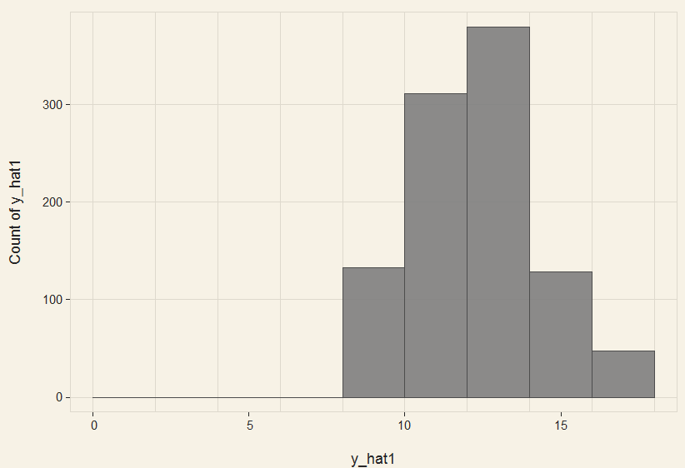
Method 1: Predicted Values from Poisson Regression

Slide 22

Method 1: Predicted Values from Negative Binomial Regression

Slide 23
Modeling ZIP Data
Method 2: Zero Inflated Poisson
“ZIP” Regression

Slide 24
Method 2: ZIP Regression
summary(m1 <- zeroinfl(count ~ child + camper | persons, data = zinb))
Method:
Use a pre-built function that can handle Zero Inflated distribution
Generally requires creating a secondary model to predict if a variable is ZERO (usually a LOGISTIC model)
Advantages:
Not significantly more difficult than simply doing Poisson Regression
Can be highly accurate, especially if the “zero values” are easily identified
Disadvantages:
Required to build multiple models: One for the Poisson and a Logistic to predict if the value is a “zero”.
The “logistic” model won’t have all the options that might be available in a stand along LOGISTIC model.
Implementing a “stand alone” score program is more complicated

Slide 25
Method 2: ZIP Regression
R Code:
install.packages(“pscl”)
library(pscl)
zeroinfl(formula = showerlength~income+age+sex | income+sex, data=mydata)
I’m being lazy here in that age is technically a categorical variable, so I should dummy code it. But, that is not the issue. Am simply showing the process.
The Code for a ZIP model is similar to a POISSON model or a Negative Binomial model. There are some minor differences:

Slide 26
Method 2: ZIP Regression
OUTPUT:
There are two outputs from the ZIP model:
The coefficients predicting the amount of time a person will spend in the shower.
The coefficients predicting the probability that a value will be zero.
Below the model call, you will find a block of output containing Poisson regression coefficients for each of the variables along with standard errors, z-scores, and p-values for the coefficients. A second block follows that corresponds to the inflation model. This includes logit coefficients for predicting excess zeros along with their standard errors, z-scores, and p-values.

Slide 27
Method 2: ZIP Regression
Poisson Regression Coefficients
Coefficients to predict the amount of time a person will spend in the shower *IF* they were to take a shower.

Slide 28
Method 2: ZIP Regression
Logit Coefficients
Coefficients to predict LOG ODDS that a person will *NOT* take a shower. This needs to be converted from LOG ODDS to ODDS to PROBABILITY.

Slide 29
Method 2: ZIP Regression
CONVERTING PARAMETERS INTO SCORE CODE:
In order to create stand alone score code, both models need to be implemented into a data step. The first model, predicts the amount of time in the shower assuming that the person takes a shower (no zero values).
STEP 1: Start with an empty script space

Slide 30
Method 2: ZIP Regression
CONVERTING PARAMETERS INTO SCORE CODE:
STEP 2: Use the parameters from Poisson Regression to estimate the Natural LOG (“LN”) of the Shower Length (call this value “TEMP”).
TEMP = 2.524 + 0.007*INCOME + 0.011*age – 0.125*sex
Coefficients come from top box of the ZIP regression printout.

Slide 31
Method 2: ZIP Regression
CONVERTING PARAMETERS INTO SCORE CODE:
STEP 3: Add code to convert TEMP into a variable representing the amount of time in the shower assuming a person takes a shower. Call this P_SCORE_ZIP_ALL.
TEMP = 2.524 + 0.007*INCOME + 0.011*age – 0.125*sex
P_SCORE_ZIP_ALL = exp(TEMP)

Slide 32
Method 2: ZIP Regression
CONVERTING PARAMETERS INTO SCORE CODE:
STEP 4: Use the parameters from the zero inflation to get the LOGIT value that the person does *NOT* take a shower (call this value “TEMP2”).
TEMP = 2.524 + 0.007*INCOME + 0.011*age – 0.125*sex
P_SCORE_ZIP_ALL = exp(TEMP)
TEMP2 = -1.961 + 0.002*income + 0.784*sex
Coefficients come from bottom box of the ZIP regression printout.

Slide 33
Method 2: ZIP Regression
CONVERTING PARAMETERS INTO SCORE CODE:
STEP 5: Convert the LOGIT (aka “TEMP2”) into the PROBABILITY that a person does NOT take a shower. Call this variable P_SCORE_ZERO.
TEMP = 2.524 + 0.007*INCOME + 0.011*age – 0.125*sex
P_SCORE_ZIP_ALL = exp(TEMP)
TEMP2 = -1.961 + 0.002*income + 0.784*sex
P_SCORE_ZERO = exp(TEMP2)/(1+exp(TEMP2))

Slide 34
Method 2: ZIP Regression
CONVERTING PARAMETERS INTO SCORE CODE:
STEP 6: Calculate the EXPECTED time in the shower. This will be the Time in the shower (assuming that a shower was taken) “P_SCORE_ZIP_ALL” multiplied by the probability that a person takes a shower (1 minus the probability that they don’t take a shower) “P_SCORE_ZERO”. Call this new value “P_SCORE_ZIP”
TEMP = 2.524 + 0.007*INCOME + 0.011*age – 0.125*sex
P_SCORE_ZIP_ALL = exp(TEMP)
TEMP2 = -1.961 + 0.002*income + 0.784*sex
P_SCORE_ZERO = exp(TEMP2)/(1+exp(TEMP2))
P_SCORE_ZIP = P_SCORE_ZIP_ALL * (1-P_SCORE_ZERO)

Slide 35
Method 2: ZIP Regression
You will want to check that the PROBABILITY OF NO SHOWER is the same as with the dataset on which the models were fit.
Provided that is the case, the variable:
P_SCORE_ZIP
will be your predicted outcome for exporting or scoring your ZIP regression model results.
Naturally, you can score this variable in the data on which the model is fit so that you can see how well the predicts compare to actuals.
NOTE: If you obtain the “fitted” values from the zeroinfl R function, the values are from the poisson regression part and do not contain the predicted 0’s. There may be a built in function that obtains fitted values for the overall ZIP model, but I’m kind of old school and usually just code it myself like was shown here.

Slide 36
Modeling ZIP Data
Method 3: Zero Inflated Negative Binomial “ZINB” Regression

Slide 37
Method 3: ZINB Regression
Method:
Exactly the same as Method 2: ZIP Regression, except that it is a different distribution utilizing the Negative Binomial. Use:
m4 <- zeroinfl(showerlength ~ sex+income | sex, data = mydata, dist="negbin", EM = TRUE)
Advantages:
Everything is the same as ZIP … including the advantages.
Since there are virtually no differences, why not try ZINB and see what happens.
Disadvantages:
Same as ZIP

Slide 38
Modeling ZIP Data
Method 4: Logistic Hurdle Model

Slide 39
Method 4: Logistic Hurdle Model
Method:
Build a Logistic Regression Model to predict if the count is “0” or “not 0”
Build a separate model to predict the count value (assuming it is not 0). In other words, conditioning on the records where there is positive count data
Multiply the probability of “not 0” by the count to get the expected count
Implement the exact same steps to export/score the model as given above
Advantages:
Flexible and Versatile:
Advantage of having access to specialized logistic regression software allowing for options such as FORWARD/BACKWARD/STEPWISE regression
The “0” and “Not 0” model can be any type of model (“Tree”, “Neural Net”, etc.)
Count model can be any type of model (“Regression”, “Tree”, “Neural Network”, etc.).
Can even use different types of software (“R”, “Python”,”SAS”, etc.)
Disadvantages:
This can make things a lot more complicated

