Slide 1
Logistic Regression
Interpreting Beta Values

Slide 2
Interpreting Beta Values
Given a Logistic Regression Formula, what will be the effects on the output if the input variables change? The change in output can be found by:
LOGIT: Predict Difference
ODDS: Predict Ratio
PROBABILITY: Impossible to Determine
The method will be given by way of example:

Slide 3
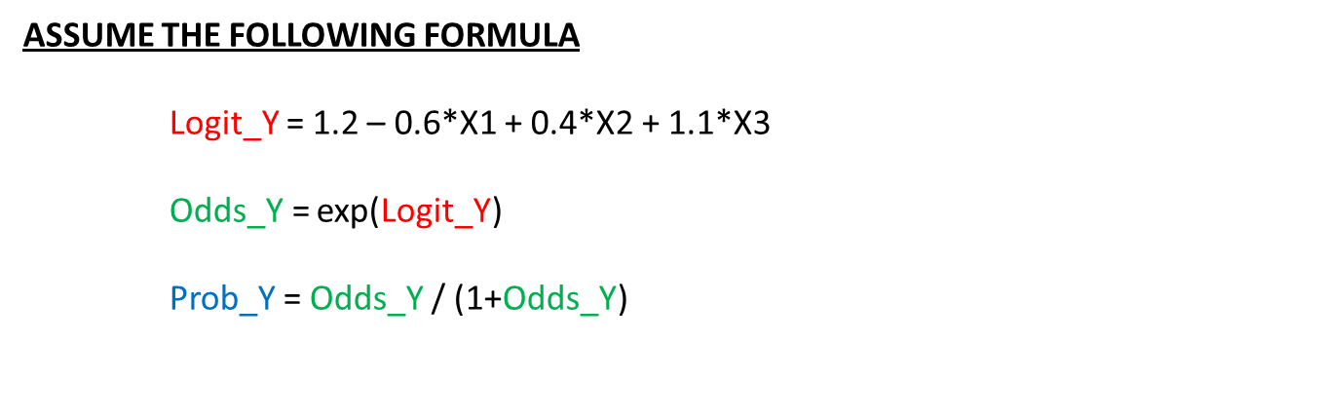
Interpreting Beta Values
ASSUME THE FOLLOWING FORMULA
Logit_Y = 1.2 – 0.6*X1 + 0.4*X2 + 1.1*X3
Odds_Y = exp(Logit_Y)
Prob_Y = Odds_Y / (1+Odds_Y)

Slide 4
Interpreting Beta Values
ASSUME THE FOLLOWING FORMULA
Logit_Y = 1.2 – 0.6*X1 + 0.4*X2 + 1.1*X3
DELTA_X1 : Any change in X1
DELTA_X2 : Any change in X2
DELTA_X3 : Any change in X3

Slide 5
Interpreting Beta Values
ASSUME THE FOLLOWING FORMULA
Logit_Y = 1.2 – 0.6*X1 + 0.4*X2 + 1.1*X3
DELTA_X1 : Any change in X1
DELTA_X2 : Any change in X2
DELTA_X3 : Any change in X3
CHANGE IN LOGIT VALUE: PREDICT DIFFERENCE
DELTA_LOGIT_Y = – 0.6* DELTA_X1 + 0.4* DELTA_X2 + 1.1* DELTA_X3

Slide 6
Interpreting Beta Values
ASSUME THE FOLLOWING FORMULA
Logit_Y = 1.2 – 0.6*X1 + 0.4*X2 + 1.1*X3
DELTA_X1 : 2
DELTA_X2 : 3
DELTA_X3 : -1
CHANGE IN LOGIT VALUE PREDICT DIFFERENCE
DELTA_LOGIT_Y = – 0.6* DELTA_X1 + 0.4* DELTA_X2 + 1.1* DELTA_X3

Slide 7
Interpreting Beta Values
ASSUME THE FOLLOWING FORMULA
Logit_Y = 1.2 – 0.6*X1 + 0.4*X2 + 1.1*X3
DELTA_X1 : 2
DELTA_X2 : 3
DELTA_X3 : -1
CHANGE IN LOGIT VALUE PREDICT DIFFERENCE
DELTA_LOGIT_Y = – 0.6* 2 + 0.4* 3 + 1.1* (-1)

Slide 8
Interpreting Beta Values
ASSUME THE FOLLOWING FORMULA
Logit_Y = 1.2 – 0.6*X1 + 0.4*X2 + 1.1*X3
DELTA_X1 : 2
DELTA_X2 : 3
DELTA_X3 : -1
CHANGE IN LOGIT VALUE PREDICT DIFFERENCE
DELTA_LOGIT_Y = – 0.6* 2 + 0.4* 3 + 1.1* (-1)
= -1.1

Slide 9
Interpreting Beta Values
ASSUME THE FOLLOWING FORMULA
Logit_Y = 1.2 – 0.6*X1 + 0.4*X2 + 1.1*X3
DELTA_X1 : 2
DELTA_X2 : 3
DELTA_X3 : -1
CHANGE IN LOGIT VALUE: -1.1
DELTA_LOGIT_Y = – 0.6* 2 + 0.4* 3 + 1.1* (-1)
= -1.1

Slide 10
Interpreting Beta Values
ASSUME THE FOLLOWING FORMULA
Logit_Y = 1.2 – 0.6*X1 + 0.4*X2 + 1.1*X3
DELTA_X1 : 2
DELTA_X2 : 3
DELTA_X3 : -1
CHANGE IN LOGIT VALUE: -1.1
No matter what values are used, for X1, X2, and X3 … changing them by 2,3,-1 respectively will cause the LOGIT value to change by -1.1. If you know how to work with exponential functions you should try to show why this is true.

Slide 11
Interpreting Beta Values
ASSUME THE FOLLOWING FORMULA
Logit_Y = 1.2 – 0.6*X1 + 0.4*X2 + 1.1*X3
 | X1 | X2 | X3 | LOGIT | DIFF
Original | 1 | 1 | 1 | 2.1
New
Original | -1 | 0 | 1 | 2.9
New
Original | 2 | 1 | 0 | 0.4
New

Slide 12
Interpreting Beta Values
ASSUME THE FOLLOWING FORMULA
Logit_Y = 1.2 – 0.6*X1 + 0.4*X2 + 1.1*X3
 | X1 | X2 | X3 | LOGIT | DIFF
Original | 1 | 1 | 1 | 2.1
New | 3 | 4 | 0
Original | -1 | 0 | 1 | 2.9
New | 1 | 3 | 0
Original | 2 | 1 | 0 | 0.4
New | 4 | 4 | -1

Slide 13
Interpreting Beta Values
ASSUME THE FOLLOWING FORMULA
Logit_Y = 1.2 – 0.6*X1 + 0.4*X2 + 1.1*X3
 | X1 | X2 | X3 | LOGIT | DIFF
Original | 1 | 1 | 1 | 2.1
New | 3 | 4 | 0 | 1.0
Original | -1 | 0 | 1 | 2.9
New | 1 | 3 | 0 | 1.8
Original | 2 | 1 | 0 | 0.4
New | 4 | 4 | -1 | -0.7

Slide 14
Interpreting Beta Values
ASSUME THE FOLLOWING FORMULA
Logit_Y = 1.2 – 0.6*X1 + 0.4*X2 + 1.1*X3
 | X1 | X2 | X3 | LOGIT | DIFF
Original | 1 | 1 | 1 | 2.1
New | 3 | 4 | 0 | 1.0 | -1.1
Original | -1 | 0 | 1 | 2.9
New | 1 | 3 | 0 | 1.8 | -1.1
Original | 2 | 1 | 0 | 0.4
New | 4 | 4 | -1 | -0.7 | -1.1

Slide 15
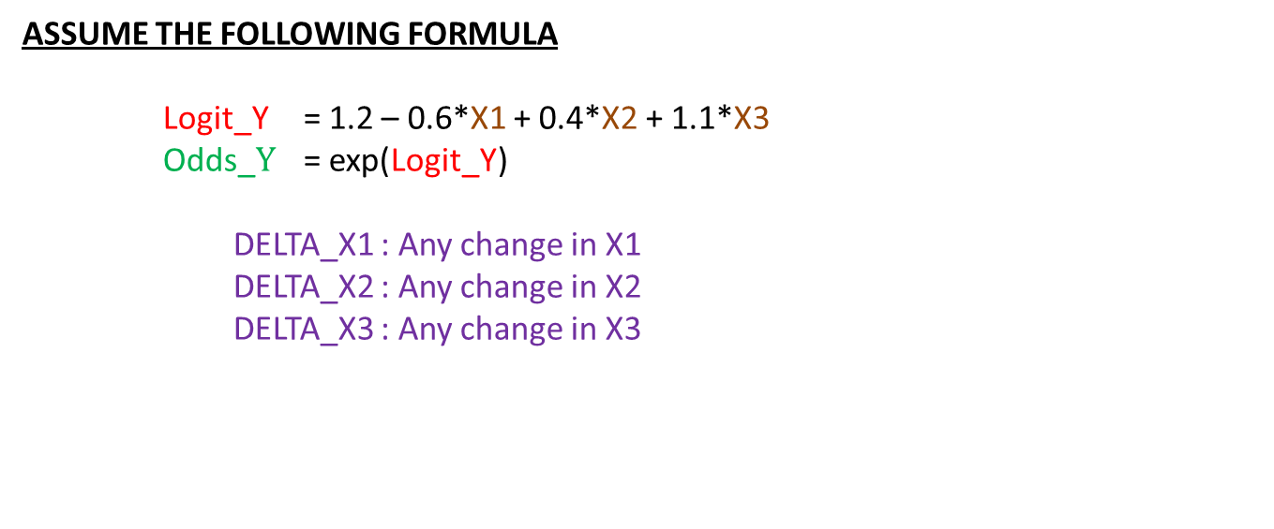
Interpreting Beta Values
ASSUME THE FOLLOWING FORMULA
Logit_Y = 1.2 – 0.6*X1 + 0.4*X2 + 1.1*X3
Odds_$Y$ = exp(Logit_Y)
DELTA_X1 : Any change in X1
DELTA_X2 : Any change in X2
DELTA_X3 : Any change in X3

Slide 16
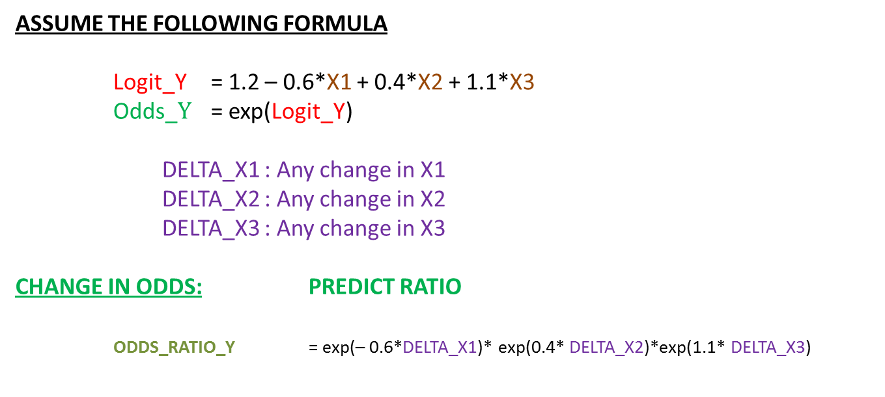
Interpreting Beta Values
ASSUME THE FOLLOWING FORMULA
Logit_Y = 1.2 – 0.6*X1 + 0.4*X2 + 1.1*X3
Odds_$Y$ = exp(Logit_Y)
DELTA_X1 : Any change in X1
DELTA_X2 : Any change in X2
DELTA_X3 : Any change in X3
CHANGE IN ODDS: PREDICT RATIO
ODDS_RATIO_Y = exp(– 0.6*DELTA_X1)* exp(0.4* DELTA_X2)*exp(1.1* DELTA_X3)

Slide 17
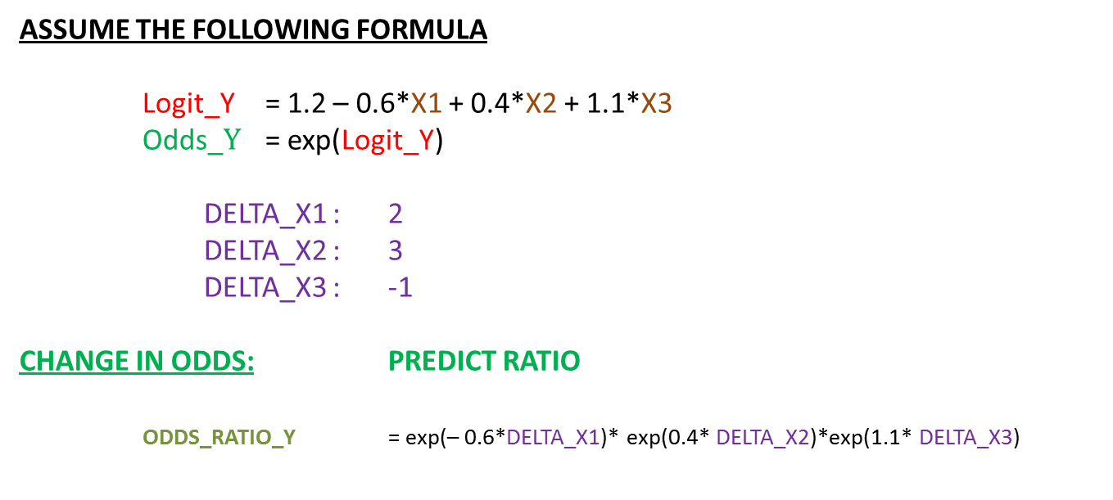
Interpreting Beta Values
ASSUME THE FOLLOWING FORMULA
Logit_Y = 1.2 – 0.6*X1 + 0.4*X2 + 1.1*X3
Odds_$Y$ = exp(Logit_Y)
DELTA_X1 : 2
DELTA_X2 : 3
DELTA_X3 : -1
CHANGE IN ODDS: PREDICT RATIO
ODDS_RATIO_Y = exp(– 0.6*DELTA_X1)* exp(0.4* DELTA_X2)*exp(1.1* DELTA_X3)

Slide 18
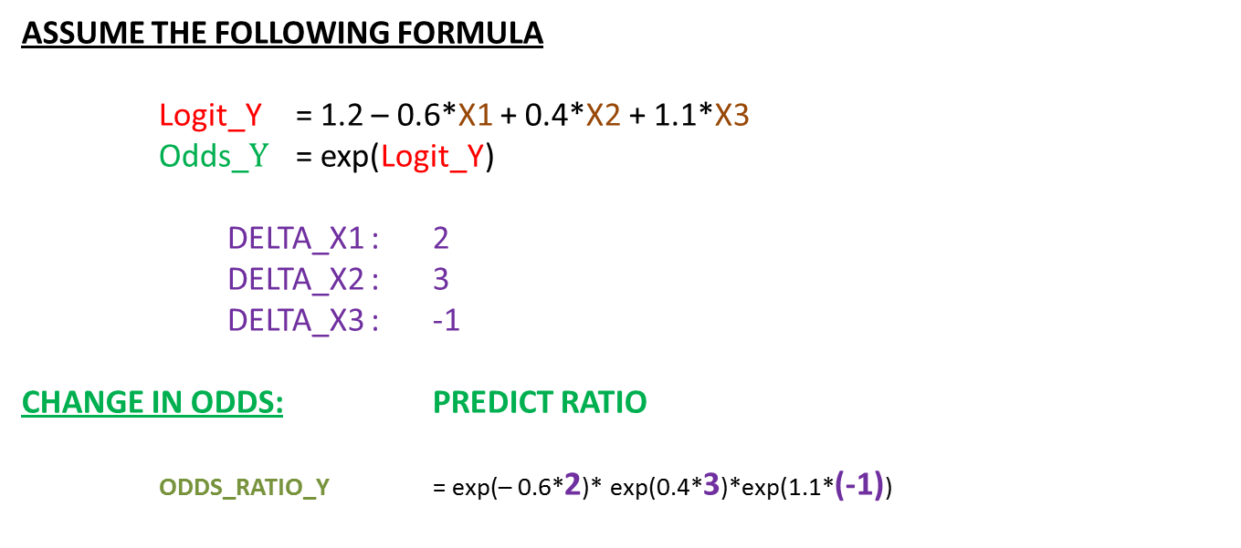
Interpreting Beta Values
ASSUME THE FOLLOWING FORMULA
Logit_Y = 1.2 – 0.6*X1 + 0.4*X2 + 1.1*X3
Odds_$Y$ = exp(Logit_Y)
DELTA_X1 : 2
DELTA_X2 : 3
DELTA_X3 : -1
CHANGE IN ODDS: PREDICT RATIO
ODDS_RATIO_Y = exp(– 0.6*2)* exp(0.4*3)*exp(1.1*(-1))

Slide 19
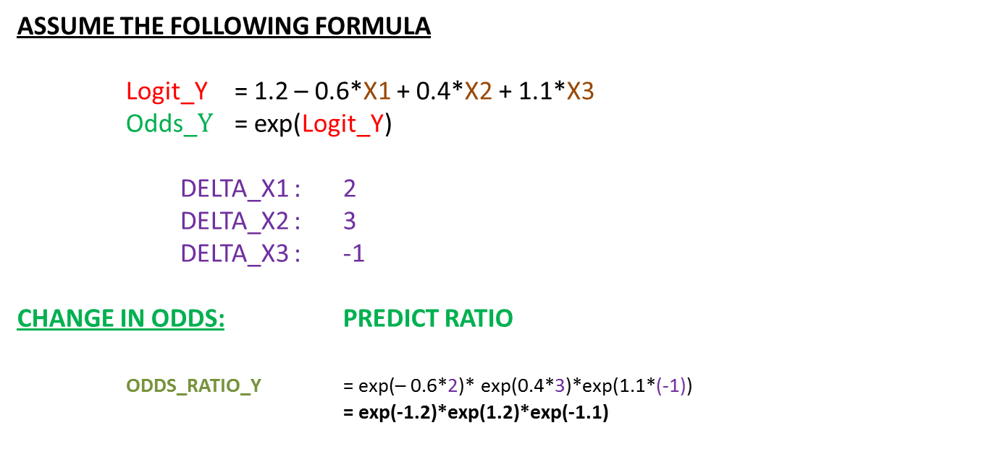
Interpreting Beta Values
ASSUME THE FOLLOWING FORMULA
Logit_Y = 1.2 – 0.6*X1 + 0.4*X2 + 1.1*X3
Odds_$Y$ = exp(Logit_Y)
DELTA_X1 : 2
DELTA_X2 : 3
DELTA_X3 : -1
CHANGE IN ODDS: PREDICT RATIO
ODDS_RATIO_Y = exp(– 0.6*2)* exp(0.4*3)*exp(1.1*(-1))
= exp(-1.2)*exp(1.2)*exp(-1.1)

Slide 20
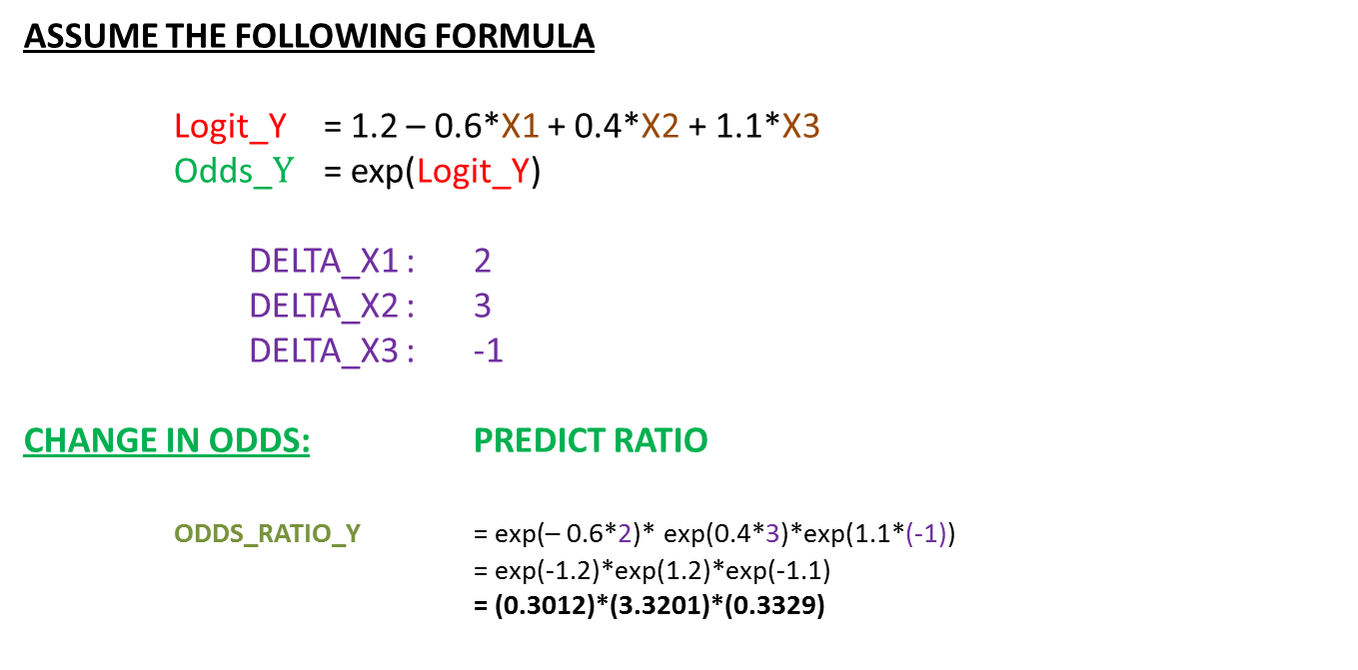
Interpreting Beta Values
ASSUME THE FOLLOWING FORMULA
Logit_Y = 1.2 – 0.6*X1 + 0.4*X2 + 1.1*X3
Odds_$Y$ = exp(Logit_Y)
DELTA_X1 : 2
DELTA_X2 : 3
DELTA_X3 : -1
CHANGE IN ODDS: PREDICT RATIO
ODDS_RATIO_Y = exp(– 0.6*2)* exp(0.4*3)*exp(1.1*(-1))
= exp(-1.2)*exp(1.2)*exp(-1.1)
= (0.3012)*(3.3201)*(0.3329)

Slide 21
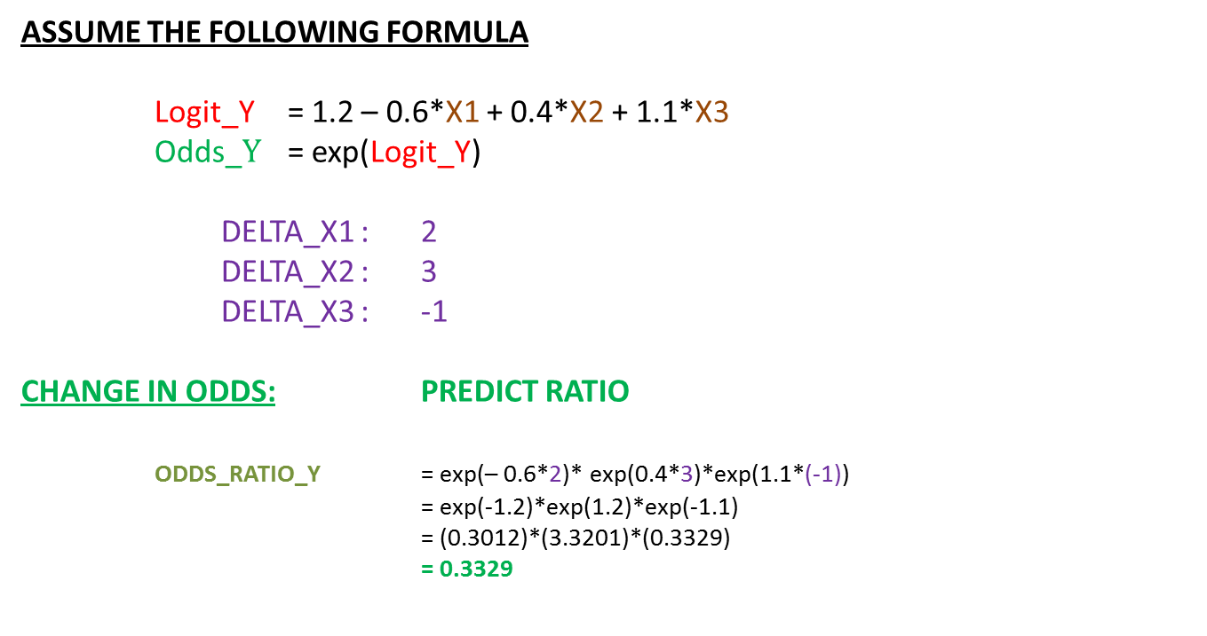
Interpreting Beta Values
ASSUME THE FOLLOWING FORMULA
Logit_Y = 1.2 – 0.6*X1 + 0.4*X2 + 1.1*X3
Odds_$Y$ = exp(Logit_Y)
DELTA_X1 : 2
DELTA_X2 : 3
DELTA_X3 : -1
CHANGE IN ODDS: PREDICT RATIO
ODDS_RATIO_Y = exp(– 0.6*2)* exp(0.4*3)*exp(1.1*(-1))
= exp(-1.2)*exp(1.2)*exp(-1.1)
= (0.3012)*(3.3201)*(0.3329)
= 0.3329

Slide 22
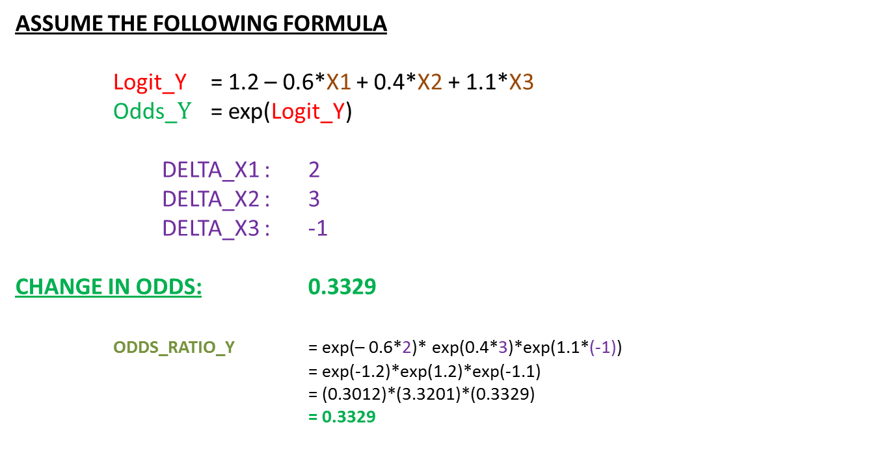
Interpreting Beta Values
ASSUME THE FOLLOWING FORMULA
Logit_Y = 1.2 – 0.6*X1 + 0.4*X2 + 1.1*X3
Odds_$Y$ = exp(Logit_Y)
DELTA_X1 : 2
DELTA_X2 : 3
DELTA_X3 : -1
CHANGE IN ODDS: 0.3329
ODDS_RATIO_Y = exp(– 0.6*2)* exp(0.4*3)*exp(1.1*(-1))
= exp(-1.2)*exp(1.2)*exp(-1.1)
= (0.3012)*(3.3201)*(0.3329)
= 0.3329

Slide 23
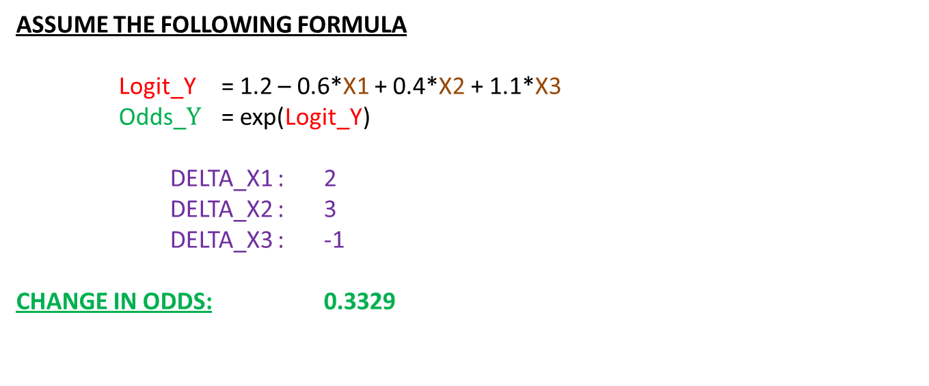
Interpreting Beta Values
ASSUME THE FOLLOWING FORMULA
Logit_Y = 1.2 – 0.6*X1 + 0.4*X2 + 1.1*X3
Odds_$Y$ = exp(Logit_Y)
DELTA_X1 : 2
DELTA_X2 : 3
DELTA_X3 : -1
CHANGE IN ODDS: 0.3329

Slide 24
Interpreting Beta Values
ASSUME THE FOLLOWING FORMULA
Logit_Y = 1.2 – 0.6*X1 + 0.4*X2 + 1.1*X3
 | X1 | X2 | X3 | LOGIT | ODDS | RATIO
Original | 1 | 1 | 1 | 2.1 | 8.1662
New
Original | -1 | 0 | 1 | 2.9 | 18.1741
New
Original | 2 | 1 | 0 | 0.4 | 1.4918
New

Slide 25
Interpreting Beta Values
ASSUME THE FOLLOWING FORMULA
Logit_Y = 1.2 – 0.6*X1 + 0.4*X2 + 1.1*X3
 | X1 | X2 | X3 | LOGIT | ODDS | RATIO
Original | 1 | 1 | 1 | 2.1 | 8.1662
New | 3 | 4 | 0
Original | -1 | 0 | 1 | 2.9 | 18.1741
New | 1 | 3 | 0
Original | 2 | 1 | 0 | 0.4 | 1.4918
New | 4 | 4 | -1

Slide 26
Interpreting Beta Values
ASSUME THE FOLLOWING FORMULA
Logit_Y = 1.2 – 0.6*X1 + 0.4*X2 + 1.1*X3
 | X1 | X2 | X3 | LOGIT | ODDS | RATIO
Original | 1 | 1 | 1 | 2.1 | 8.1662
New | 3 | 4 | 0 | 1.0
Original | -1 | 0 | 1 | 2.9 | 18.1741
New | 1 | 3 | 0 | 1.8
Original | 2 | 1 | 0 | 0.4 | 1.4918
New | 4 | 4 | -1 | -0.7

Slide 27
Interpreting Beta Values
ASSUME THE FOLLOWING FORMULA
Logit_Y = 1.2 – 0.6*X1 + 0.4*X2 + 1.1*X3
 | X1 | X2 | X3 | LOGIT | ODDS | RATIO
Original | 1 | 1 | 1 | 2.1 | 8.1662
New | 3 | 4 | 0 | 1.0 | 2.7183
Original | -1 | 0 | 1 | 2.9 | 18.1741
New | 1 | 3 | 0 | 1.8 | 6.0496
Original | 2 | 1 | 0 | 0.4 | 1.4918
New | 4 | 4 | -1 | -0.7 | 0.4966

Slide 28
Odds Ratio
ASSUME THE FOLLOWING FORMULA
Logit_Y = 1.2 – 0.6*X1 + 0.4*X2 + 1.1*X3
 | X1 | X2 | X3 | LOGIT | ODDS | RATIO
Original | 1 | 1 | 1 | 2.1 | 8.1662
New | 3 | 4 | 0 | 1.0 | 2.7183 | 0.3329
Original | -1 | 0 | 1 | 2.9 | 18.1741
New | 1 | 3 | 0 | 1.8 | 6.0496 | 0.3329
Original | 2 | 1 | 0 | 0.4 | 1.4918
New | 4 | 4 | -1 | -0.7 | 0.4966 | 0.3329

Slide 29
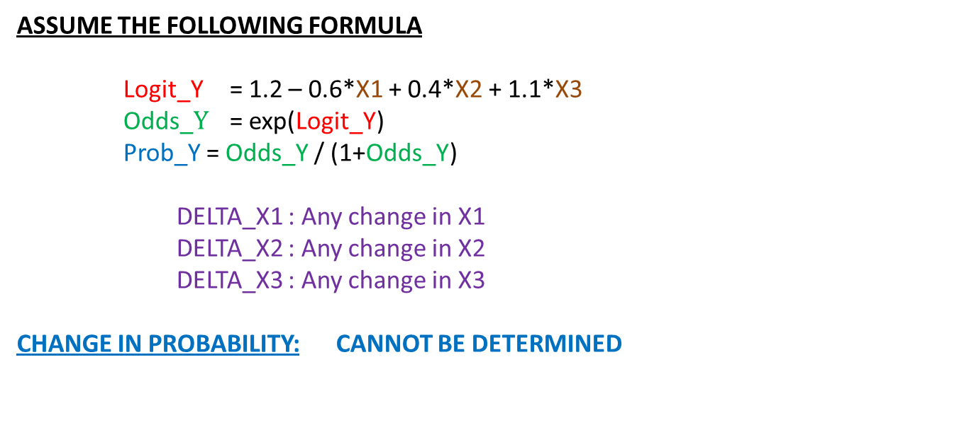
Interpreting Beta Values
ASSUME THE FOLLOWING FORMULA
Logit_Y = 1.2 – 0.6*X1 + 0.4*X2 + 1.1*X3
Odds_$Y$ = exp(Logit_Y)
Prob_Y = Odds_Y / (1+Odds_Y)
DELTA_X1 : Any change in X1
DELTA_X2 : Any change in X2
DELTA_X3 : Any change in X3
CHANGE IN PROBABILITY: CANNOT BE DETERMINED

Slide 30
Interpreting Beta Values
ASSUME THE FOLLOWING FORMULA
Logit_Y = 1.2 – 0.6*X1 + 0.4*X2 + 1.1*X3
 | X1 | X2 | X3 | LOGIT | ODDS | PROBABILITY
Original | 1 | 1 | 1 | 2.1 | 8.1662 | 0.8909
New | 3 | 4 | 0 | 1.0 | 2.7183 | 0.7311
Original | -1 | 0 | 1 | 2.9 | 18.1741 | 0.9478
New | 1 | 3 | 0 | 1.8 | 6.0496 | 0.8581
Original | 2 | 1 | 0 | 0.4 | 1.4918 | 0.5987
New | 4 | 4 | -1 | -0.7 | 0.4966 | 0.3318

Slide 31
Interpreting Beta Values
ASSUME THE FOLLOWING FORMULA
Logit_Y = 1.2 – 0.6*X1 + 0.4*X2 + 1.1*X3
 | LOGIT | ODDS | PROBABILITY | DIFF | RATIO
Original | 2.1 | 8.1662 | 0.8909 | No Pattern
New | 1.0 | 2.7183 | 0.7311 | -0.1598 | 0.8206
Original | 2.9 | 18.1741 | 0.9478 | No Pattern
New | 1.8 | 6.0496 | 0.8581 | -0.0897 | 0.9054
Original | 0.4 | 1.4918 | 0.5987 | No Pattern
New | -0.7 | 0.4966 | 0.3318 | -0.2669 | 0.5542

Slide 32
Odds Ratio

Slide 33
Odds Ratio
COMPUTER OUTPUT:
By convention, commercial software will give the ODDS ratio of each variable assuming that variable is increased by “1” and all the other variables are held constant.
This simplifies to exp(Beta)
Referring Back to the previous example …

Slide 34
Odds Ratio
ASSUME THE FOLLOWING FORMULA
Logit_Y = 1.2 – 0.6*X1 + 0.4*X2 + 1.1*X3
Odds Ratio for X1
Odds Ratio for X2
Odds Ratio for X3

Slide 35
Odds Ratio
ASSUME THE FOLLOWING FORMULA
Logit_Y = 1.2 – 0.6*X1 + 0.4*X2 + 1.1*X3
Odds Ratio for X1 = exp(-0.6) = 0.5488
Odds Ratio for X2 = exp(0.4) = 1.4918
Odds Ratio for X3 = exp(1.1) = 3.0042

Slide 36
Odds Ratio
ASSUME THE FOLLOWING FORMULA
Logit_Y = 1.2 – 0.6*X1 + 0.4*X2 + 1.1*X3
Odds Ratio for X1 = 0.5488
Odds Ratio for X2 = 1.4918
Odds Ratio for X3 = 3.0042

