Slide 1
TITLE PAGE
Problem Statement ID – 1
Problem Statement Title- Eco-Loop Building Agents
Theme- Clean & Green Technology
PS Category- Software
Student Name (Registered on portal)- Sirivolu Srivatsa
Student ID- 20522607

Slide 2
Eco-Loop Building Agents — Closed-Loop LLM Control for Building Energy
Proposed Solution (Describe your Idea/Solution/Prototype)
A closed-loop AI that reads a live EnergyPlus simulation and writes real HVAC setpoint decisions back into it every control step - proven live, not just simulated on paper.
Cuts building energy use while protecting occupant comfort, verified end-to-end with a real local LLM - not a rule engine or a spreadsheet estimate.
Detailed explanation of the proposed solution
Live EnergyPlus + a local LLM agent (Llama 3.1 8B) that reads sensor state every step via a real MCP server
Agent decides setpoints -> safety-clamped -> written straight back into the running simulation (EMS actuators)
How it addresses the problem
Rigid BMS schedules can't react to real-time weather, occupancy, or grid carbon intensity
Verified: 0.9% energy reduction, comfort held at 91.9% (vs. 97.5% baseline)
Innovation and uniqueness of the solution
Genuine MCP tool-calling agent, not a rules engine relabeled "AI" - open-source, fully local
Safety-first: clamped decisions + auto-fallback -> 0 crashes across 80+ live decisions

Slide 3
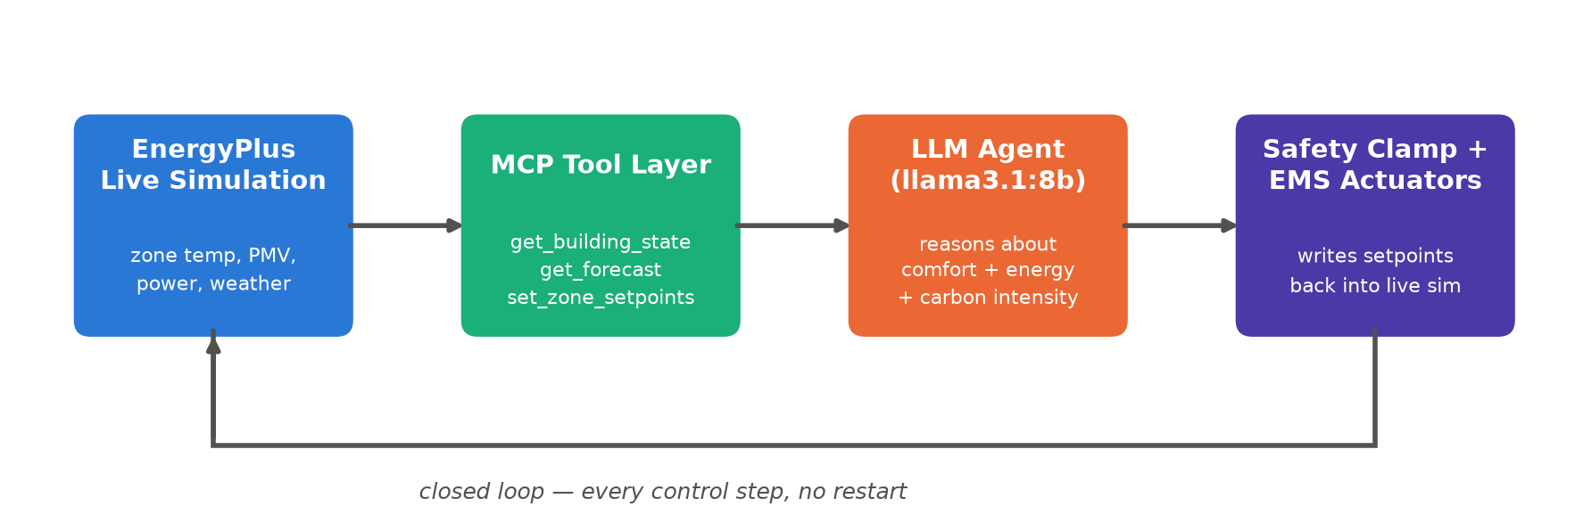
TECHNICAL APPROACH
Technologies to be used (e.g. programming languages, frameworks, hardware)
Python, EnergyPlus 26.1 (Python API / EMS), pandas, matplotlib
Ollama running Llama 3.1 8B (open-source LLM, fully local)
Model Context Protocol (MCP) for the agent's tool-calling layer
Methodology and process for implementation (Flow Charts/Images/ working prototype)
Built and verified end-to-end - see closed-loop flow below

Slide 4
FEASIBILITY AND VIABILITY
Analysis of the feasibility of the idea
Already built and verified end-to-end - real EnergyPlus + real LLM + real MCP, tested across multiple full runs
100% open-source, runs on one commodity machine - no cloud spend
Potential challenges and risks
LLM latency and variability (20-125s per decision on an 8B local model)
Small model doesn't always follow multi-step rules consistently
Strategies for overcoming these challenges
Hard timeout + fallback to last-known-good setpoints -> 0 crashes across 80+ decisions
Iteratively strengthened prompts lifted comfort compliance from 79% to 91%

Slide 5
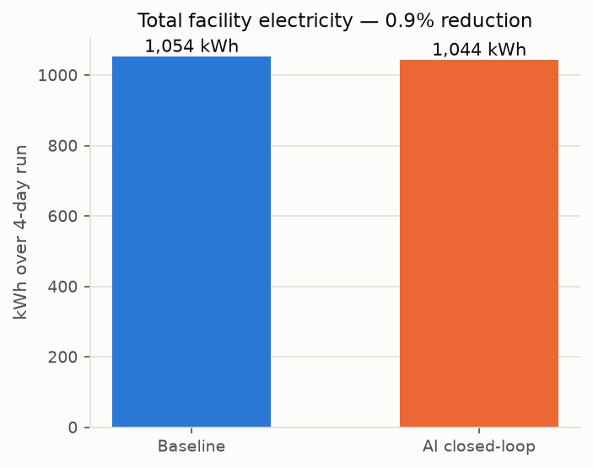
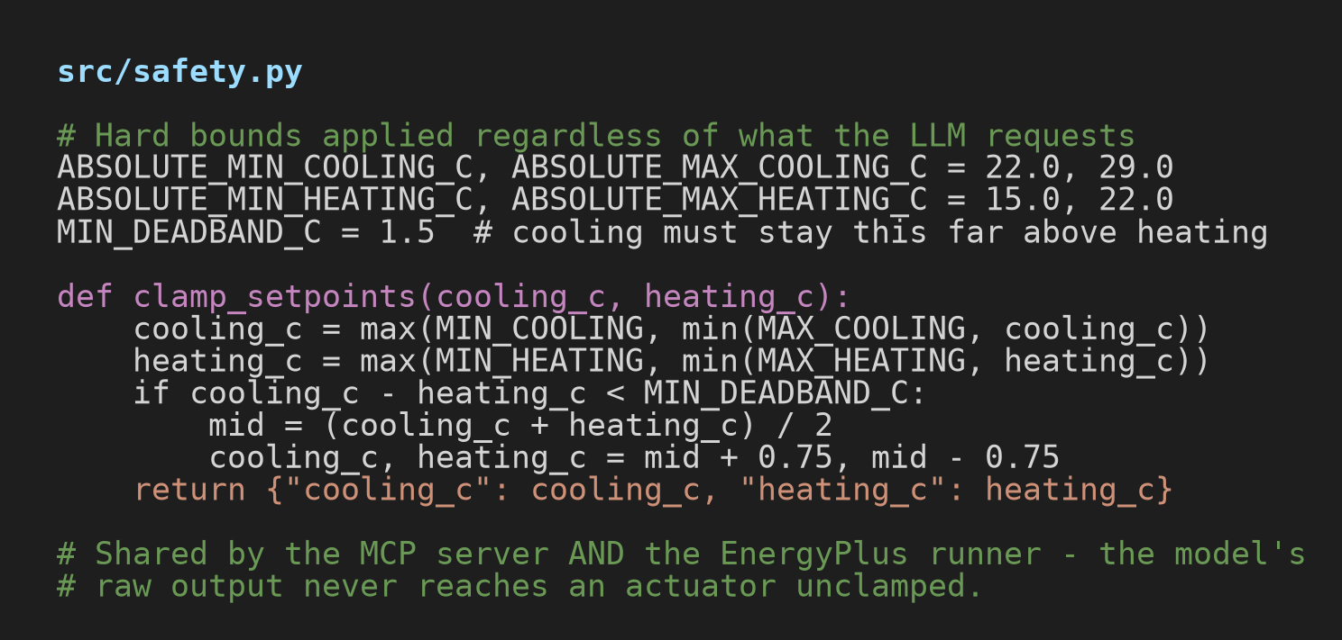
ARTIFACTS
Relevant artifacts, such as :
Copy of the Code Embedded - full source at github.com/srivatsa927/Eco-Loop-Building-Agents
Snaps of the solution proposal
Dashboard snaps
Energy savings — dashboard.html
Safety-clamped setpoints — src/safety.py

Slide 6
RESEARCH AND REFERENCES
Details / Links of the reference and research work
EnergyPlus & DOE reference building models - energyplus.net
Model Context Protocol specification - modelcontextprotocol.io
Meta Llama 3.1 (model card) served locally via Ollama - ollama.com
Prior art: EnergyPlus EMS Python API used for RL-based HVAC control research (e.g. RL-EmsPy, RL-BCA)
Project repo: github.com/srivatsa927/Eco-Loop-Building-Agents

