Slide 1

Sreyas Institute of Engineering and Technology
An Autonomous Institution
Approved by AICTE, Affiliated to JNTUH
Accredited by NAAC-A Grade, NBA (CSE, ECE & ME) & ISO 9001:2015 Certified
A
MAJOR PROJECT
On
INVISTA- INTELLIGENCE INVENTORY
FORECASTING AND ANALYTICS
DOMAIN: Artificial Intelligence & Data Analytics
REVIEW - II
BACHELOR OF TECHNOLOGY
IN
COMPUTER SCIENCE AND ENGINEERING
BY
ACADEMIC BATCH: (2022-2026)
Under the Guidance of
Dr.S.SOWJANYA – Assoc. Professor
BIRRU BHUVANESHWARI DEVI | 22VE1A0570
PUVVULA KISHAN | 22VE1A05A9
SRIVATSA V BAGGI | 22VE1A05B8
VUJJANI OM PRAKASH | 22VE1A05C8

Slide 2
Abstract
INVISTA – Intelligent Inventory Forecasting & Analytics is an AI-powered web platform designed to improve inventory management using predictive analytics and Agentic AI.
The system employs time-series forecasting models such as Prophet and LSTM to predict future product demand accurately.
An agentic AI framework enables autonomous decision-making by continuously analysing inventory levels, demand trends, and supplier behaviour.
Intelligent agents collaboratively optimize reorder decisions and detect anomalies like stock irregularities or supplier delays.
A human-in-the-loop mechanism allows managers to review and approve AI-generated decisions through interactive dashboards.
Built using a scalable MERN and Python microservices architecture, INVISTA provides a cost-effective and intelligent inventory solution.

Slide 3
Existing System
Manual or rule-based inventory tracking systems.
Traditional ERP tools with static reorder thresholds.
Forecasting based on historical averages.
Spreadsheet-based inventory handling.
Limited automation and intelligence.

Slide 4
Drawbacks of Existing System
No autonomous or intelligent decision-making
High risk of overstocking and stockouts
Cannot adapt to sudden demand or supply changes
Manual intervention required for reorder planning
No anomaly detection or predictive insights

Slide 5
Proposed System
AI-driven inventory management using Agentic AI architecture
Forecasting agents predict future demand dynamically
Optimization agents compute intelligent reorder strategies
Decision agents autonomously recommend or trigger actions
Interactive dashboards for monitoring and approvals

Slide 6
Merits of Proposed System
Accurate demand forecasting (85–95%)
Reduced inventory carrying costs
Fewer stockouts through proactive decisions
Early detection of anomalies and delays
Scalable, cloud-native, and cost-effective solution

Slide 7
Software and Hardware Requirements
Software Requirements
Frontend: React.js, Plotly.js
Backend: Node.js, Express
Database: MongoDB Atlas, Supabase
ML & Agents: Python, Prophet, LSTM, LangGraph/CrewAI
Hardware Requirements
Processor: Intel i5 or above
RAM: Minimum 8 GB
Stable Internet connection

Slide 8
Functional and Non-Functional Requirements
Functional Requirements
Non-Functional Requirements
Predict product demand using AI models
Autonomous reorder decision generation
Detect anomalies in inventory and suppliers
Visualize insights via dashboards
Admin and manager role management
Scalability through microservices
High availability and reliability
Secure API and database communication
Explainable AI decisions
Easy maintainability

Slide 9
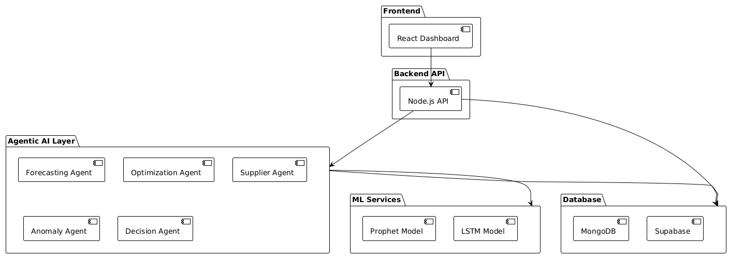
Architecture Diagram

Slide 10
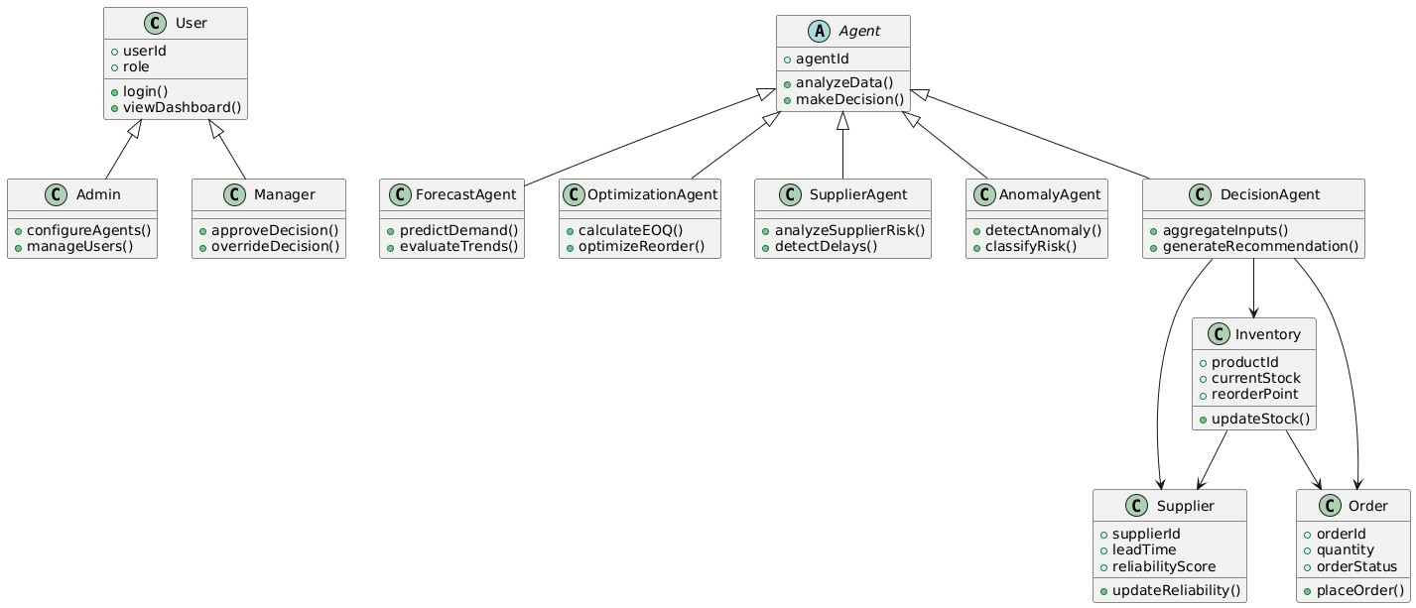
Class Diagram

Slide 11
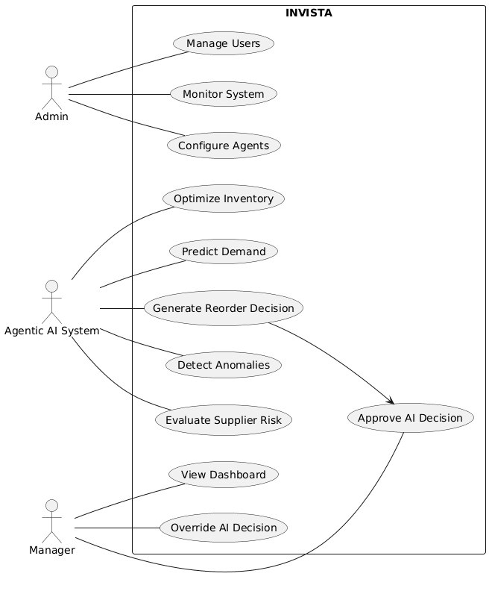
Use Case Diagram

Slide 12
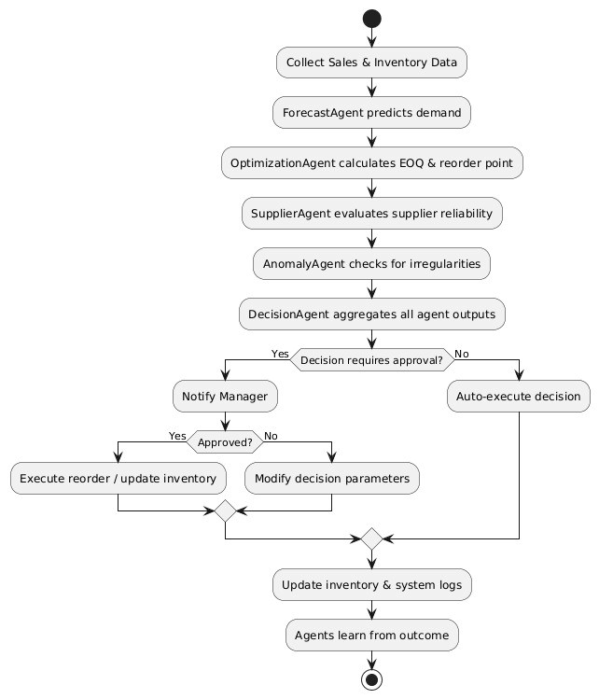
Activity Diagram

Slide 13
Project Modules
Admin Module
. User and role management
. Agent configuration control
. System monitoring
2. Inventory Management Module
. Product and stock tracking
. Order and reorder management
. Inventory lifecycle handling

Slide 14
Project Modules
3. Agentic Intelligence Module (Core)
. Demand Forecasting Agent
. Inventory Optimization Agent
. Autonomous Decision Agent
4. Analytics & Visualization Module
. Real-time dashboards
. AI decision explanations
. Reports and insights

Slide 15
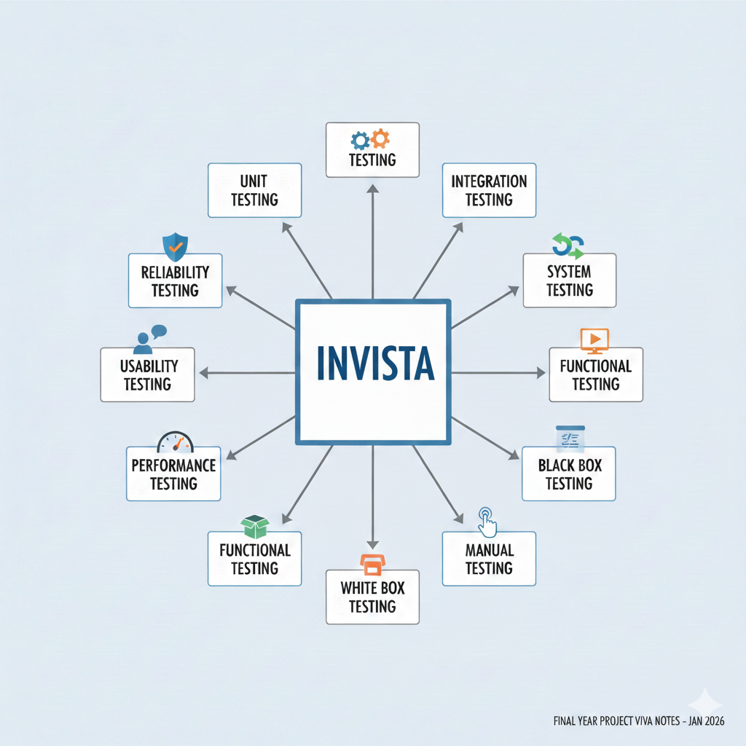
TESTING AND TYPES
Software Testing is the process of evaluating a system or its components to verify that it satisfies specified requirements, works as expected under different conditions, and is free from critical defects.
In INVISTA, testing ensures that:
AI agents behave correctly
Decisions are logical and explainable
APIs respond correctly
UI reflects backend state accurately

Slide 16
Test Cases
Test Case ID | Test Scenario | Input | Expected Output | Result
TC01 | Run decision with valid inventory data | SKU, stock, lead time | AI decision generated | Pass
TC02 | Forecast agent execution | Demand inputs | Avg daily demand shown | Pass
TC03 | Approve decision | Click Approve | Decision stored in history | Pass
TC04 | Reject decision | Click Reject | Decision marked rejected | Pass
TC05 | EOQ calculation | Demand + lead time | EOQ & ROP displayed | Pass

Slide 17
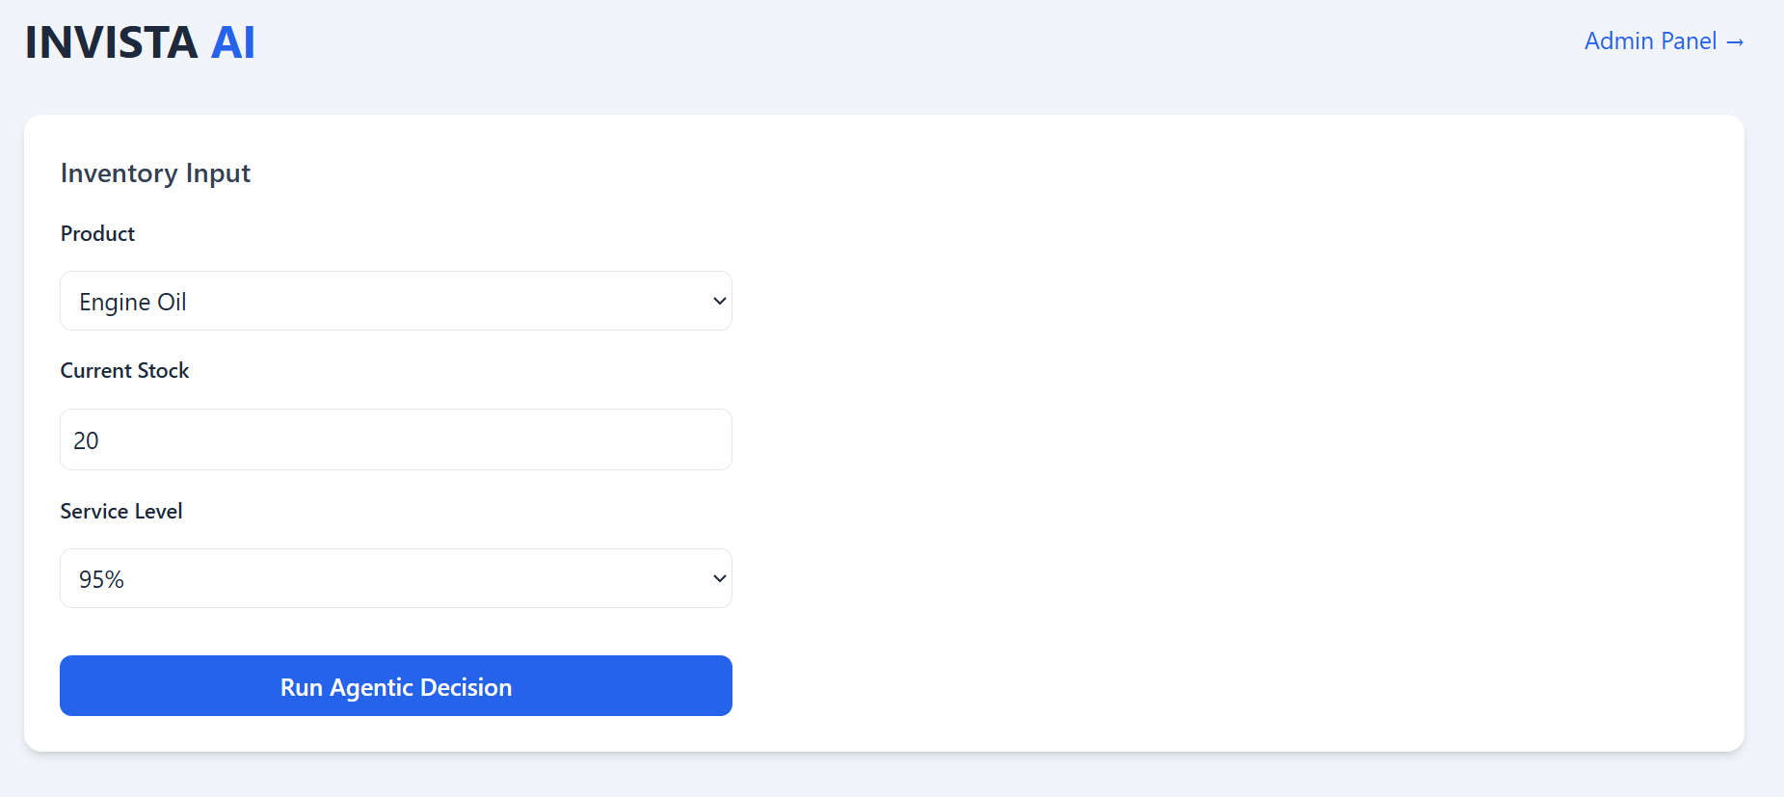
Output

Slide 18
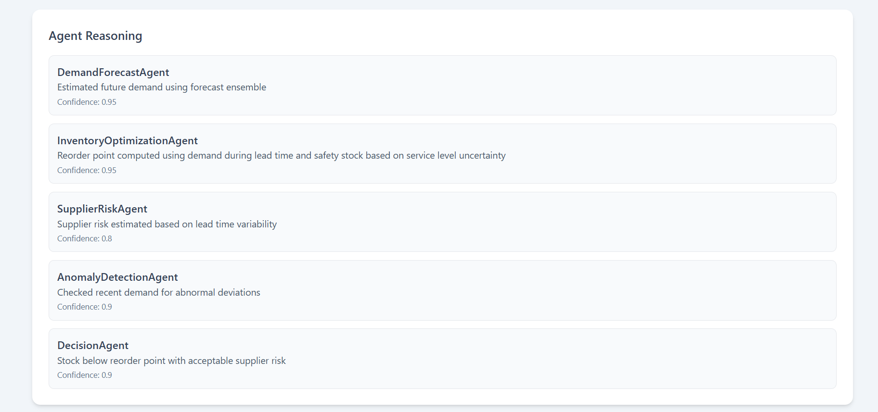
Output

Slide 19
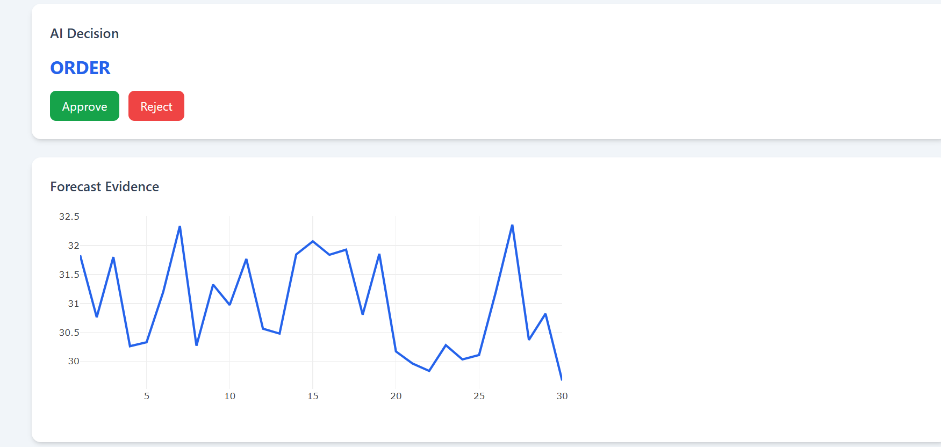
Output

Slide 20
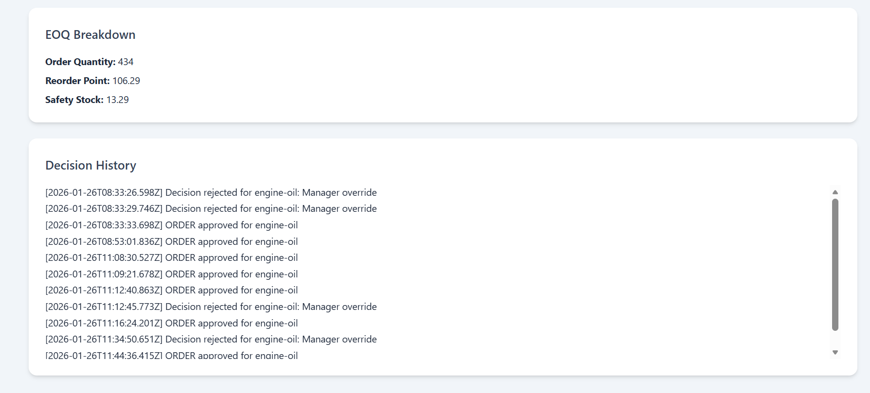
Output

Slide 21
Limitations
The system depends on limited historical data, which can affect forecast accuracy.
Inventory calculations use simplified assumptions for demand and lead time.
AI decisions are rule-based and do not learn automatically over time.
The current implementation supports only single-SKU analysis.
The system does not integrate with real-time ERP or supplier systems.
Testing is largely manual due to the dynamic nature of AI decisions.

Slide 22
Future Scope
The system can be extended to support multi-SKU and multi-warehouse inventory optimization.
Machine learning models can be enhanced to learn from past decisions and user feedback.
Real-time integration with ERP, supplier, and IoT systems can be implemented.
Advanced agents such as predictive maintenance and supplier negotiation agents can be added.
Automated decision confidence tuning and risk-aware decision making can be introduced.
The platform can be scaled for enterprise-level deployment using cloud and DevOps technologies.

Slide 23
Conclusion
INVISTA demonstrates a fully functional, agentic AI-driven inventory management system that integrates demand forecasting, inventory optimization, and autonomous decision-making.
The system provides real-time insights, visualizations, and explainable recommendations while keeping the human in the loop for approvals.
Through modular agent design, RESTful APIs, and an intuitive frontend, the project showcases how AI can enhance efficiency, reduce stockouts, and improve operational decision-making.
Although some limitations exist, the architecture is extensible for future improvements, including multi-SKU optimization, real-time integrations, and adaptive learning.

Slide 24
Queries ??

