Slide 1


AirResolve: AI-Powered Customer Resolution Agent
A Policy-Grounded Intelligent Agent for Airline Disruption Resolution
AIONOS ASSIGNMENT 3
PYTHON + STREAMLIT
AI / AUTOMATION PROTOTYPE
Made by: Srivatsan Raghavan (23csu302)
Notes:
1

Slide 2


Problem Statement
High-Volume Disruptions
Cancellations and delays generate multiple simultaneous customer requests — refunds, rebooking, hotels, lounge access, and compensation.
Policy Interpretation Burden
Support agents must interpret intent and apply airline policies consistently under time pressure, often with limited context.
Inconsistent Outcomes
Manual handling leads to inconsistent responses and unnecessary escalations, increasing operational cost and reducing customer trust.
The Goal
Build an intelligent resolution agent that automates policy-grounded decisions and escalates only what requires human authority.
Notes:
2

Slide 3
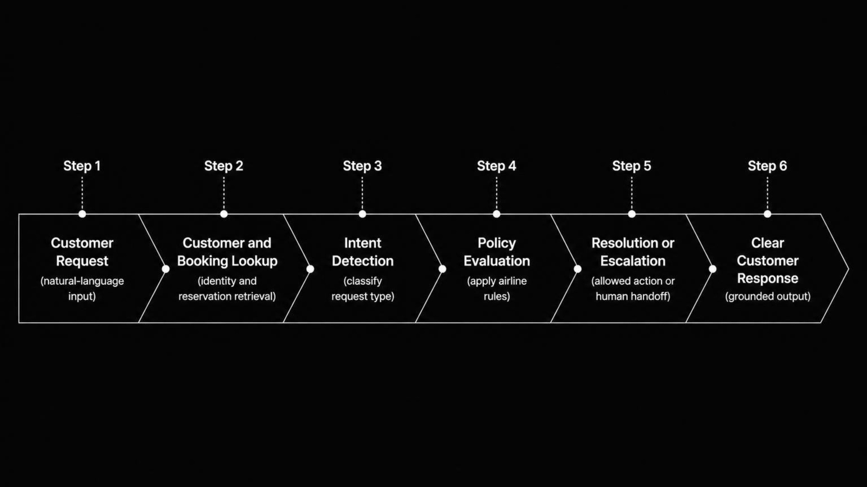
AirResolve Solution
A structured, policy-grounded pipeline that transforms a natural-language customer request into a clear, justified resolution — without inventing unavailable flights or unsupported compensation.
Notes:
3

Slide 4
Inputs, Data Sources & Assumptions
Inputs
Core Assumptions
  Customer identity & booking reference
  Flight status, delay duration & cancellation reason
  Loyalty tier & fare difference (when provided)
  Natural-language customer request
  The agent uses only the supplied assignment data — no external APIs
  Alternative flight availability is not assumed when not provided
  Policy limits determine whether an action can be automated
  Requests outside agent authority are escalated to humans
Data Sources
  Assignment 3 customer & booking data
  Supplied policy / rules data
  data.json used by the prototype
Notes:
4

Slide 5


AI & Intelligent Decision-Making
Intent Detection
Context-Aware Policy Reasoning
Python text processing classifies requests: refund, rebooking, meal voucher, lounge access, hotel, upgrade, fare difference, or formal complaint.
Combines customer status, flight status, delay duration, cancellation reason, and requested action to evaluate applicable rules.
Controlled Resolution
Determines allowed action with explanation, or escalates when the request exceeds agent authority.
This is a Python-based policy and intent engine — no external LLM, OpenAI API, Gemini, or LangChain is used in this prototype.
Notes:
5

Slide 6
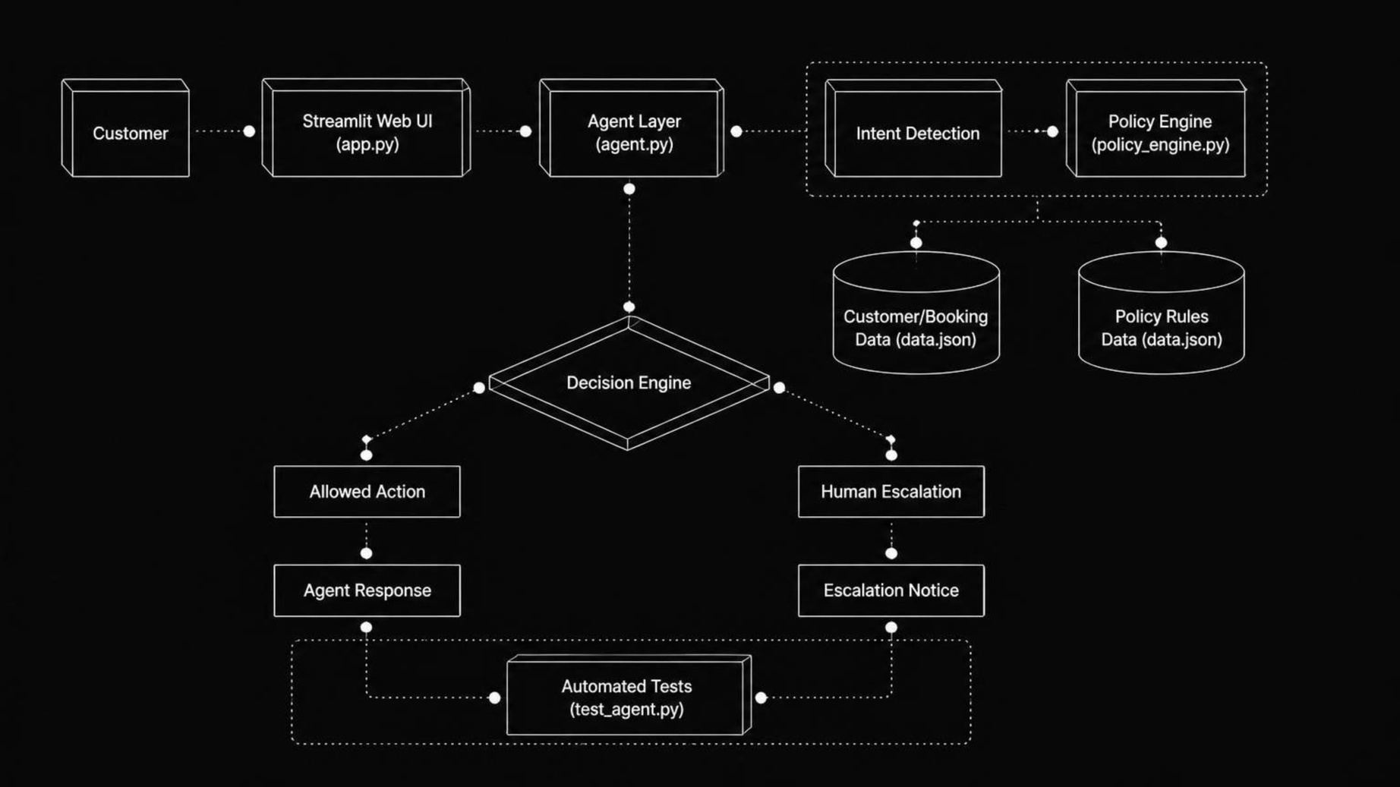
Complete Solution Architecture
Component Breakdown
Design Principles
  app.py — Streamlit UI
  agent.py — Orchestration layer
  policy_engine.py — Intent detection & policy decisions
  data.json — Customer, booking & policy data
  test_agent.py — Automated test scenarios
  requirements.txt — Dependencies
  Modular, testable components
  Policy logic isolated from UI
  JSON data layer — no external database
  Clear separation of automation vs. escalation
Notes:
6

Slide 7
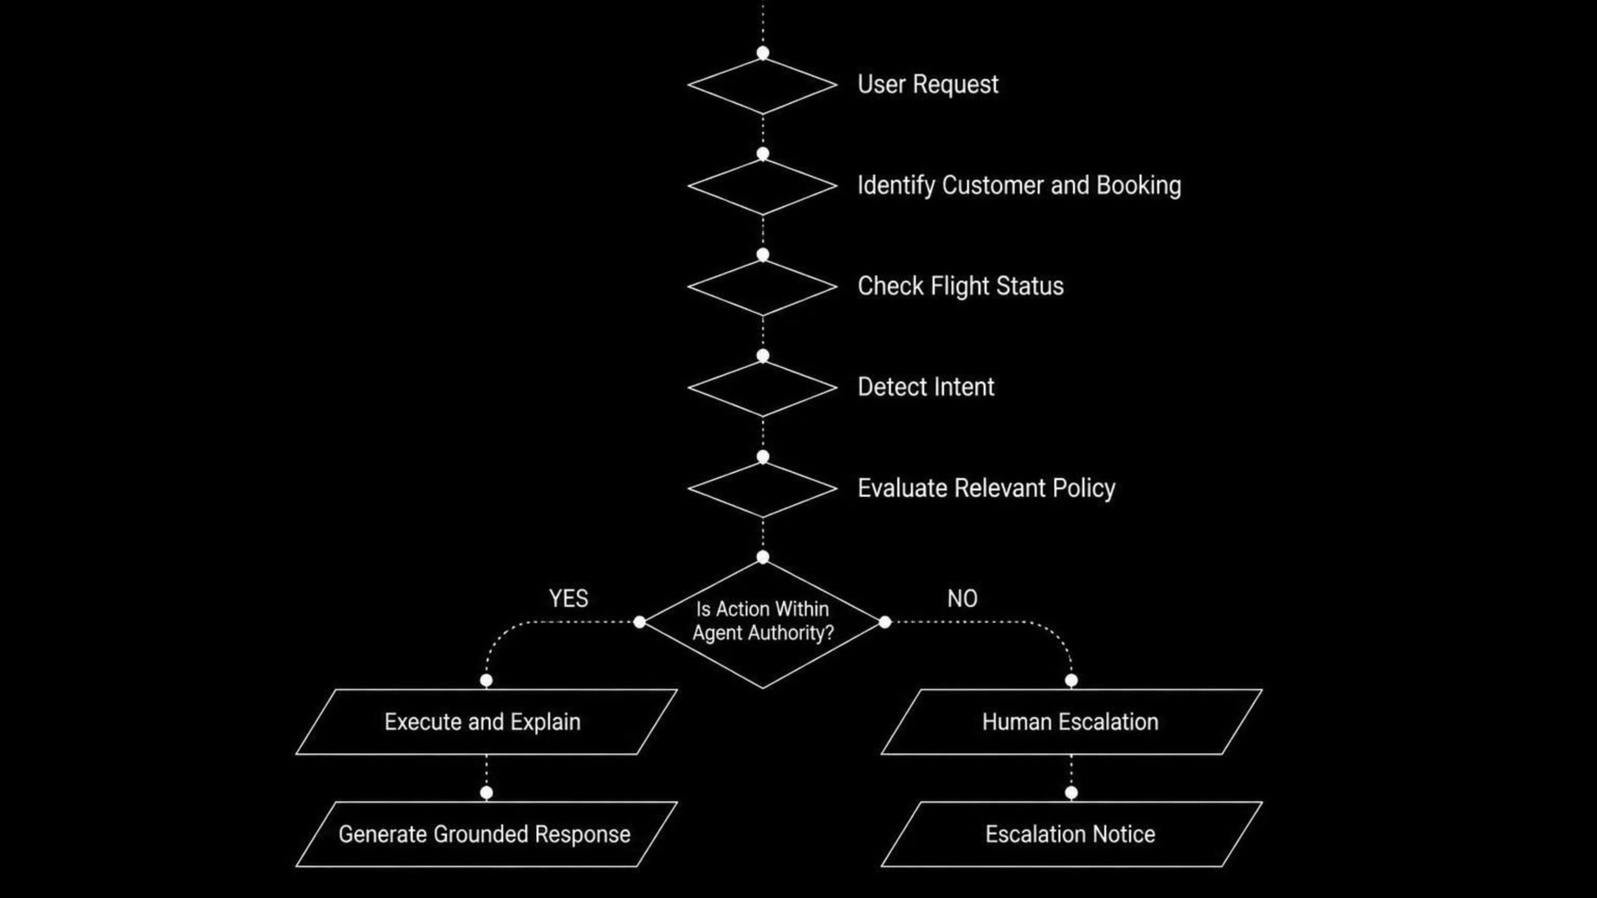
Policy Evaluation & Resolution Flow
Cancellation Policy
Delay Policy
  Full refund can be initiated automatically
  Refund processed within 7 business days
  Business-class upgrade → requires human review
  Delay >3 hours: meal voucher + lounge access
  Delay >5 hours: hotel for delayed hours only
  Fare waiver >₹1,500: supervisor approval required
Notes:
7

Slide 8
Implementation & Validation
Test 1 - Priya Nair
Test 2 - Arvind Kulkarni
Cancelled flight → Full refund eligibility confirmed. Business-class upgrade escalated (outside agent authority).
4-hour delay → Meal voucher + lounge access eligible. Hotel not eligible — delay does not exceed 5 hours.
Test 3 - Meher Kaur
6-hour delay → Lounge + hotel for delayed hours. Rebooking recognized. ₹2,000 fare waiver escalated — exceeds ₹1,500 limit.
Python implementation · Streamlit interactive interface · Modular policy engine · JSON data layer · Automated test scenarios · Deployed on Streamlit Community Cloud
Notes:
8

Slide 9

Working Prototype
An interactive Streamlit web application demonstrating the full resolution pipeline — from customer selection and booking lookup to natural-language intent handling and policy-grounded responses with human escalation indicators.
Prototype Features
  Customer selection & booking display
  Flight status & disruption context shown
  Quick test scenario buttons
  Natural-language request input
  Resolution chat with grounded responses
  Human escalation indicators
Live Demo
Launch AirResolve Prototype
Source Code
View on GitHub
Notes:
9

Slide 10
Conclusion & Future Scope
What Was Delivered
Future Scope
  Working airline customer-resolution prototype
  Automates policy-based resolution of common disruption requests
  Supports multiple customer intents in a single conversation
  Clearly separates automated actions from human escalation
  Grounded responses — no invented flights or unsupported compensation
  Integration with real airline APIs
  Real-time flight & seat availability
  LLM-powered conversational understanding
  RAG-based policy & document retrieval
  CRM / ticketing system integration
  Analytics & monitoring dashboard
  Multilingual customer support
Notes:
10

