Slide 1

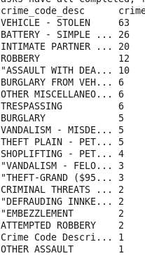
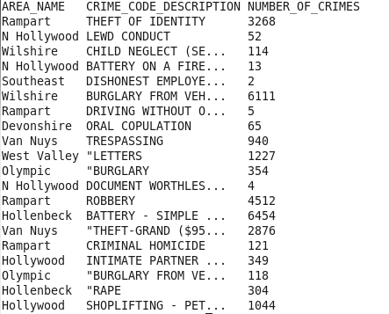
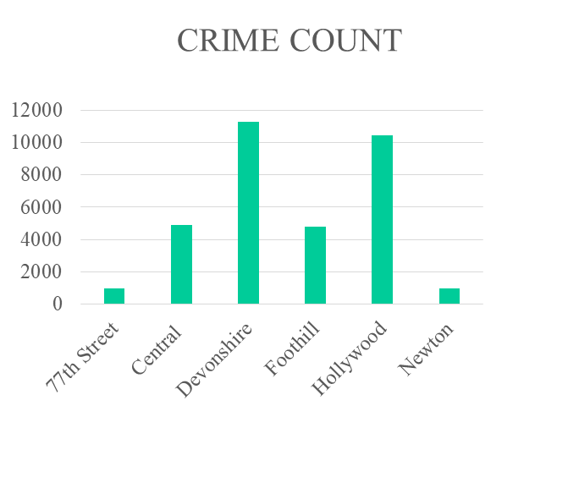
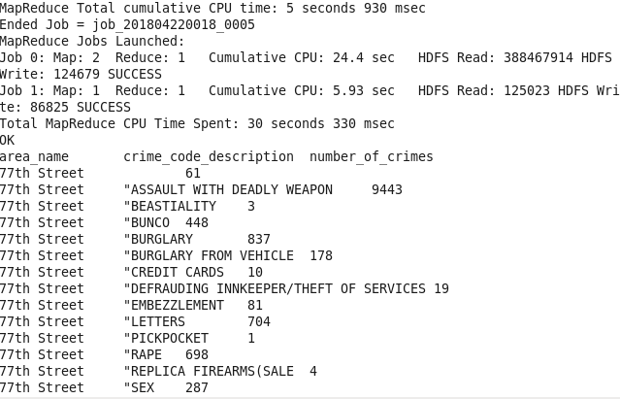
Analysis of Safety measures and Crime prevention in LA city
Srivatsan Ananthakrishnan
Department of Computer Science
University of Bridgeport, Bridgeport, CT
Abstract
Analysis of total number of crimes in each type from 2010-present using Spark ( pyspark ). (fig.3)
[fig.3] [fig.3]
4. Analyzing total number of crimes area wise and which crime has occurred the most in each area using Spark ( pyspark ). (fig.4)
Top 5 number of crimes occurred in each type from 2010- present by using Google BigQuery
6. Top 10 type of crimes happened to women's in the year 2017 is analyzed using Google BigQuery.
7. Number of crimes that has involved theft of $950.01 and over every year is analyzed and solved using Google BigQuery.
8. Analysis of number of crimes occurred in a particular area in the years 2017 and 2018 using Google BigQuery.
Los Angeles (LA) Police Department provides open datasets showing their progress of city’s performance and services in terms of crime rate and safety. This dataset was created by LA Police Department and it is updated on a regular basis. The crime data was obtained from the US government website as csv format.
In this project, we present an analysis of crime data which comprises over 2 million records and we analyze solutions to various problems in terms of multiple factors. The solutions for those problems has been analyzed using some of the BigData solution techniques like MapReduce(using python), Hive, Spark(pyspark) and Big query in Google Cloud Platform(GCP).
Introduction
In any society the most concerning facet is Crime. The rate at which the crimes increase is one of the cause for the alarm. Analyzing the crime data of a city and getting an insight is always an interesting topic[1]. Several studies have discovered number of techniques to analyze the crime data.
The analysis of the crime dataset helps in gaining knowledge about in what all aspects a particular crime detail has been recorded. It has details about the date, time, area, victim details, location, crime description etc.,
This study is carried out in order to explore the Big Data problem solving techniques that can solve different kinds of problem statements depending on the performance of each techniques. Here the modules like MapReduce, Hive, Spark, BigQuery has been used to solve the problems.
This study is structured as follows. The Crime Data Analysis and Modeling describes the various problem statements that has been driven from the dataset and solutions for the same by considering the following criteria: (1) Problem statements, (2) Solutions, (3)Techniques / Technologies used to solve, (4) Challenges faced. The next section describes the evaluation of results from the BigData solutions. Followed by Conclusion and References.
Results and Evaluation
The Analysis of all the problem solving techniques which is discussed in previous section is being evaluated based on the time taken to process the BigData that produces results for those problem statements.
Apache Spark has more advanced cluster compute engine than MapReduce and MapReduce limits to batch processing, thus Spark runs bit faster than MR.
MapReduce: 4minutes 43 seconds
HiveQL: 196.882 seconds
Spark: 2 minutes 15 seconds
BigQuery: 35-50 seconds
Conclusion
Crime Data Analysis and Modeling
In this study, we obtained a statistical report on the safety measures and crime preventions in LA city which is rated high amongst other US major cities. I expect to gain knowledge in setting up HDFS, uploading the data to the HDFS, solving the computations over the data using the MapReduce and spark programming, Hive and Google BigQuery. Other than the technical skills, this will improve the analytical skills too.
The Crime Data has been analyzed through a set of problem statements as follows,
Analyzing how safe the city is for Asian Women to live. This Problem statement is solved using Hadoop MapReduce.(fig1)
      [fig.1] [fig.2]
Analyzing number of crimes in each and every crime category of all the areas in the city. This Problem statement is solved by HiveQL. (fig.2)
References
[1] Sarpreet Kaur, Dr. Williamjeet Singh, Department of Computer Engineering, Punjabi University, Patiala, India “Systematic Review of Crime Data Mining”, ISSN No. 0976-5697.
CPSC 651 – Big Data and Data Analytics

