Slide 1
Big Data Systems & Analysis CPSC-651 Analysis of Safety Measures and Crime Prevention in LA City
Srivatsan Ananthakrishnan
1021022

Slide 2
Abstract
Los Angeles (LA) Police Department provides open datasets showing their progress of city’s performance and services in terms of crime rate and safety. This dataset was created by LA Police Department and it is updated on a regular basis. The crime data was obtained from the US government website as csv format.
In this project, we present an analysis of crime data which comprises over 2 million records and we analyze solutions to various problems in terms of multiple factors. The solutions for those problems has been analyzed using some of the BigData solution techniques like MapReduce(using python), Hive, Spark(pyspark) and Big query in Google Cloud Platform(GCP).

Slide 3
Implementation- Modeling MapReduce Programming
Step 1: Download the data in csv format from the following link.
https://data.lacity.org/A-Safe-City/Crime-Data-from-2010-to-Present/y8tr-7khq/data
Step 2: Upload the downloaded data to HDFS.
Step 3: MapReduce:
The mapper and the reducer program will be written in Python language.
The mapper code will be reading each and every line and will be selecting the rows which satisfies all the following conditions.
Gender = F
Age <= 25
Victim descent = A (Asian)

Slide 4
Implementation- Modeling MapReduce Programming cont.…
Step 4: Mapper sends all records that satisfies the above condition to the Reducer along with city name.
Step5: Records are sorted based on area names after shuffling.
Step 6: Then, Reducer group all the records and rank the crime rate based on area names.
Step 7: Statistical Analysis on most and least safest area for Asian Young Women's in LA city.
Step 8: With the analysis result, we can also predict the approximate time period of the future occurrence of the crime in that area and demise.

Slide 5
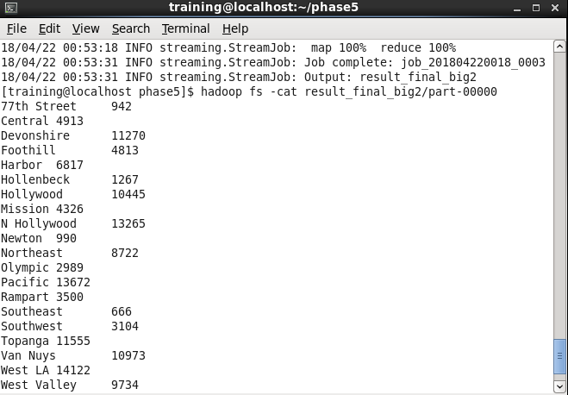
Implementation- Modeling MapReduce Programming cont.….
Result: To run the MapReduce Python job:
[training@localhost phase5] hadoop jar hadoop-streamimg.jar -input Crime_Data_from_2010_to_Present.csv -output actual_result3 -file mapper1.py -file reducer1.py -mapper mapper1.py -reducer reducer1

Slide 6
Implementation- Modeling Hive Query Language
Hive essentially allows us to use tables within Hadoop which allows us to load the .csv dataset into Hadoop as Table using flowing Load command which comprises of the table structure.
[training@localhost phase5] load data local inpath 'Crime_Data_from_2010_to_Present.csv' into table crime_data;
To run the Hive Query - > [training@localhost phase5] hive -f hquery.hql
The Problem statement which is solved by Hive is to “Analyze the total number of crimes in each and every crime category of all the areas in the city
The Solution to the above mentioned problem statement is as follows,

Slide 7
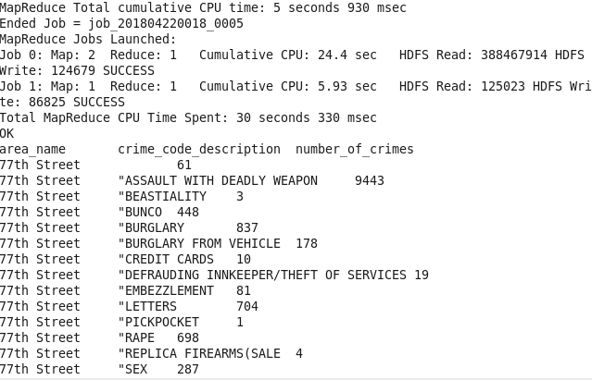
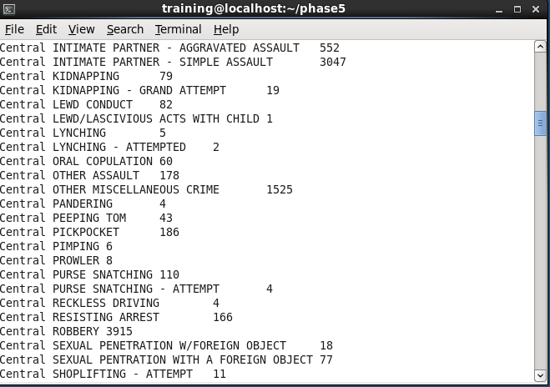
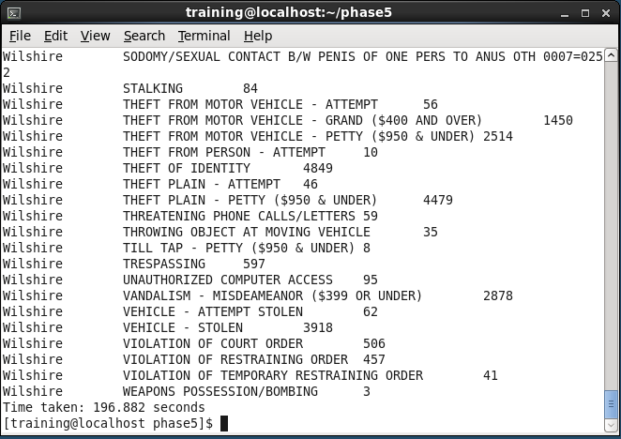
Results

Slide 8
Implementation- Modeling Spark Programming
Spark provides efficient in-memory computation for large data sets. To distribute computation , Spark API which is used in this project is pyspark, which is basically Spark implemented in Python language.
In this Project, two problem statements has been solved using Spark API by using pyspark.
First check for pyspark in your terminal by the following command,
[training@localhost phase4] pyspark
The script to run the pyspark program is,
[training@localhost phase4] spark-submit spark_1.py
[training@localhost phase4] spark-submit spark_5.py
The above mentioned 2scripts holds the code for the problem statements which is followed in the next slide

Slide 9
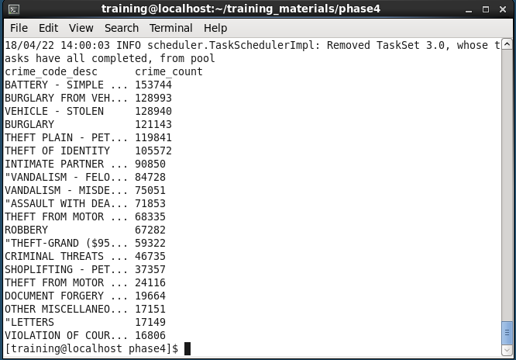
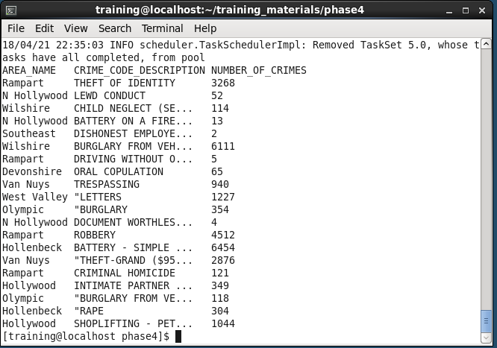
Results
Analysis of total number of crimes in each type from 2010-present
Analyzing total number of crimes area wise and which crime has occurred the most in each area

Slide 10
Implementation- Google BigQuery
Google BigQuery is one of the most efficient and easiest way of storing and querying massive datasets that are time consuming. Google BigQuery is an enterprise data warehouse that solves querying such massive datasets by enabling super-fast SQL.
In this Project, Four different problem statements has been solved using Google BigQuery.
BigQuery is performed in Google Cloud Platform (GCP) and in order to load the dataset to BigQuery,
1. First create a BigQuery project in GCP.
2. Select the Google Drive Link option for loading the table and select automatic schema. (in my case)
Link: https://drive.google.com/open?id=11fQ2iQopovjY3yYHOaP8oU1uQhMGt2db
Once table structure is created and the values are populated , in the query editor pane we can start entering the sql queries as per the problem statements

Slide 11
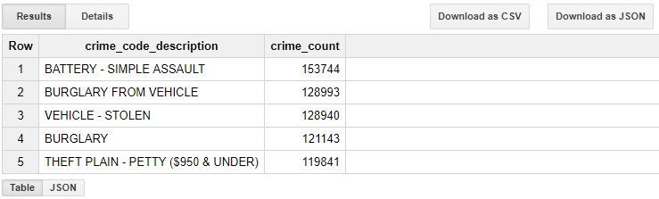
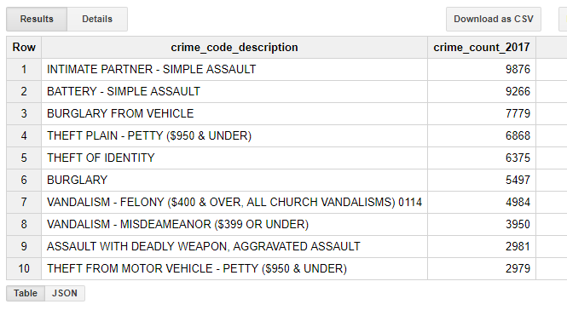
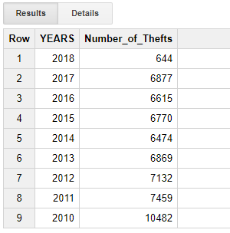
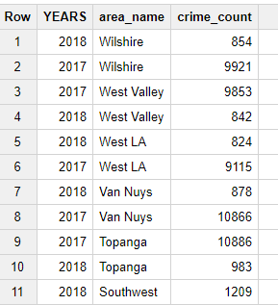
Results
Top 5 number of crimes occurred in each type from 2010- present
Top 10 type of crimes happened to women's in the year 2017 is analyzed
Number of crimes that has involved theft of $950.01 and over every year is analyzed and solved
Analysis of number of crimes occurred in a particular area in the years 2017 and 2018

Slide 12
Conclusion
In this project, we obtained statistical report on the safety measures and crime preventions in LA city which is rated high amongst other US major cities. I expect to gain knowledge in setting up HDFS, uploading the data to the HDFS, solving the computations over the data using the MapReduce and spark programming, Hive and Google BigQuery. Other than the technical skills, this will improve the analytical skills too.
Thank You !!!

