Slide 1
Web Page Key-Phrase Extractor
Project By
Srivatsan Ananthakrishnan
( 1021022 )

Slide 2
Introduction
Analyzes a web page and extract keywords.
Took the idea from the following developer blog:
https://moz.com/devblog/machine-learning-approach-to-keyword-extraction/

Slide 3
Use Cases
Helps to tag and summarize a web page.
It will help websites to push recommendations to a reader.

Slide 4
Algorithm
Step 1: Content Extraction
Step 2: HTML Parser
Step 3: Identify nouns as candidates (Noun Chunker)
Step 4: Rank the candidates
Step 5: Remove similar candidates to bring diversity to the candidates (K-Means)

Slide 5
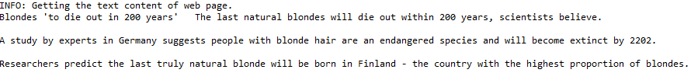
Step 1: Content Extraction
Extracts the text content of a given web page.
Example:

Slide 6
Step 2: HTML Parsing
parses the web page’s HTML/XHTML contents and provides the required information.
Beautiful Soup package and get its metatags, h1 tags and title/heading content.

Slide 7
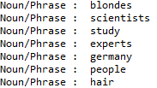
Step 3: Noun chunking
Extracts nouns from text as possible keyword candidate.
For each noun, search Wikipedia articles. If any search result is contained in content, that is also a possible keyword candidate.
Example:

Slide 8
Step 4: Ranking
Where it occurred? Title, URL, H1, Meta tags
Frequency of occurrence
Number of words in a keyword phrase
Is proper noun?

Slide 9

Step 5: Grouping
Uses K-means clustering for grouping similar words.
Example:

Slide 10
K-means Clustering
Cluster Analysis in Data Mining
Partitions n observations to k clusters.
Word2vec
Used Pre-trained dataset of Google News

Slide 11
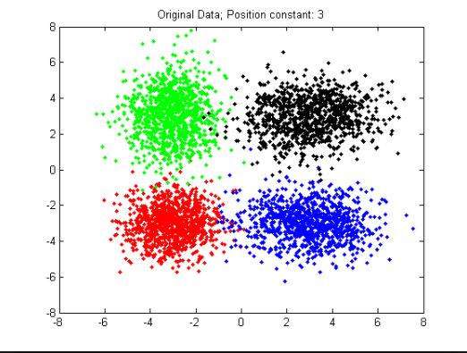
K-means Clustering

Slide 12
Challenges
Availability of recommended third party libraries in Python 3.
Availability of good pre-trained data set.
Content extraction library had some bugs.

Slide 13
Demo

Slide 14
THANK YOU

