Slide 1
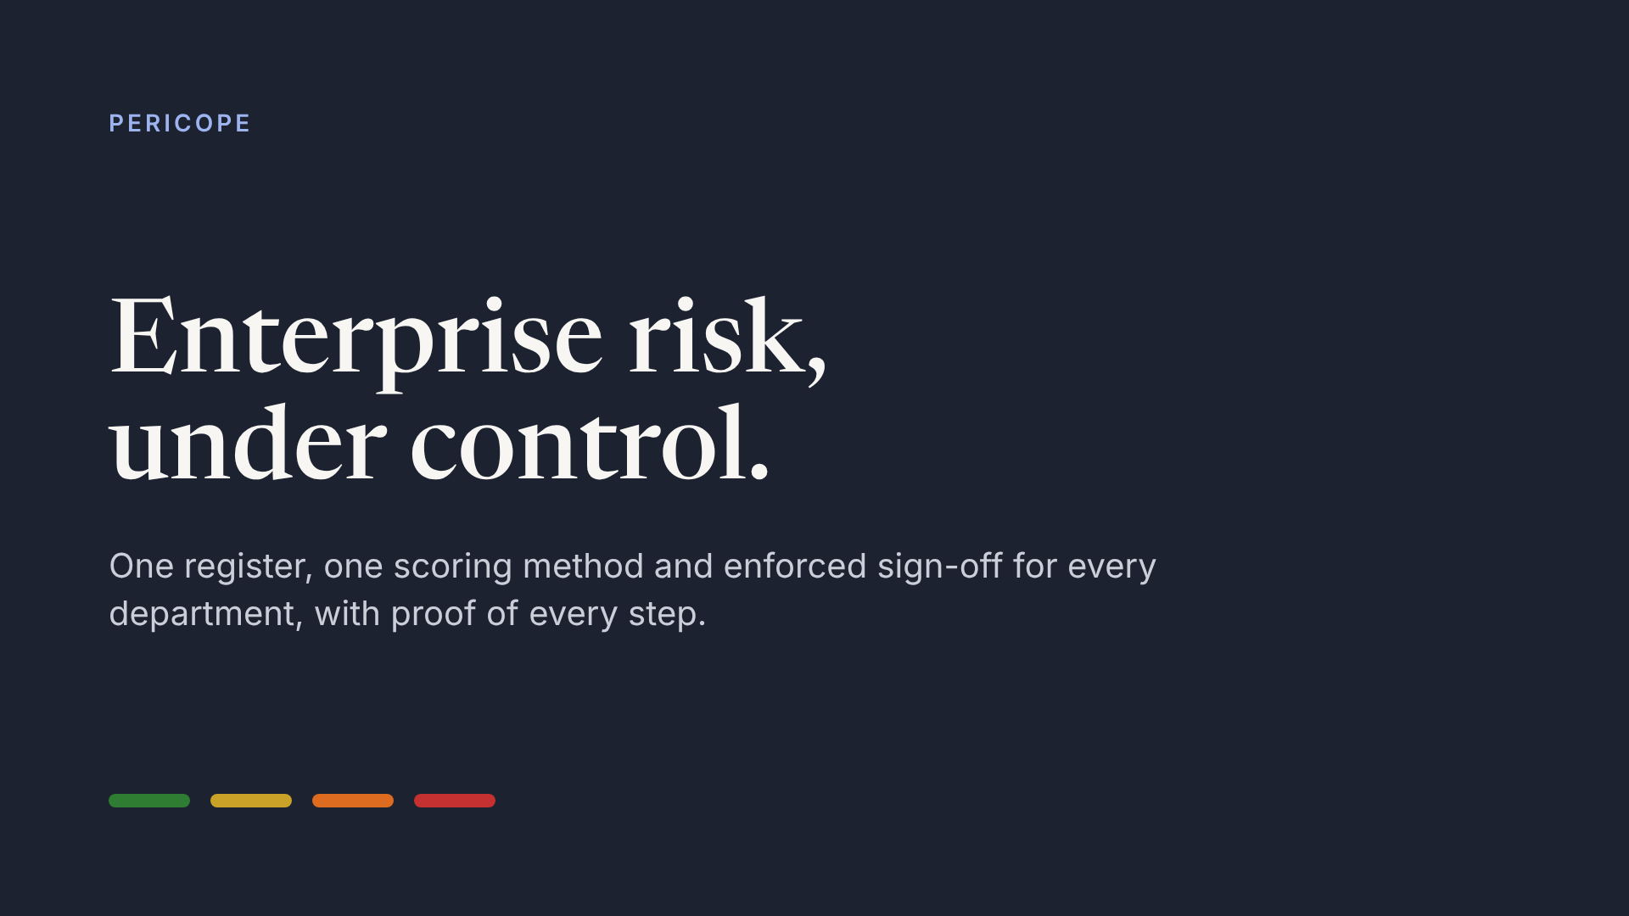
Notes:
Open with the one-line promise: one register, one method, enforced sign-off, proof of every step. The four colours are the four risk bands you will see all through the product.

Slide 2
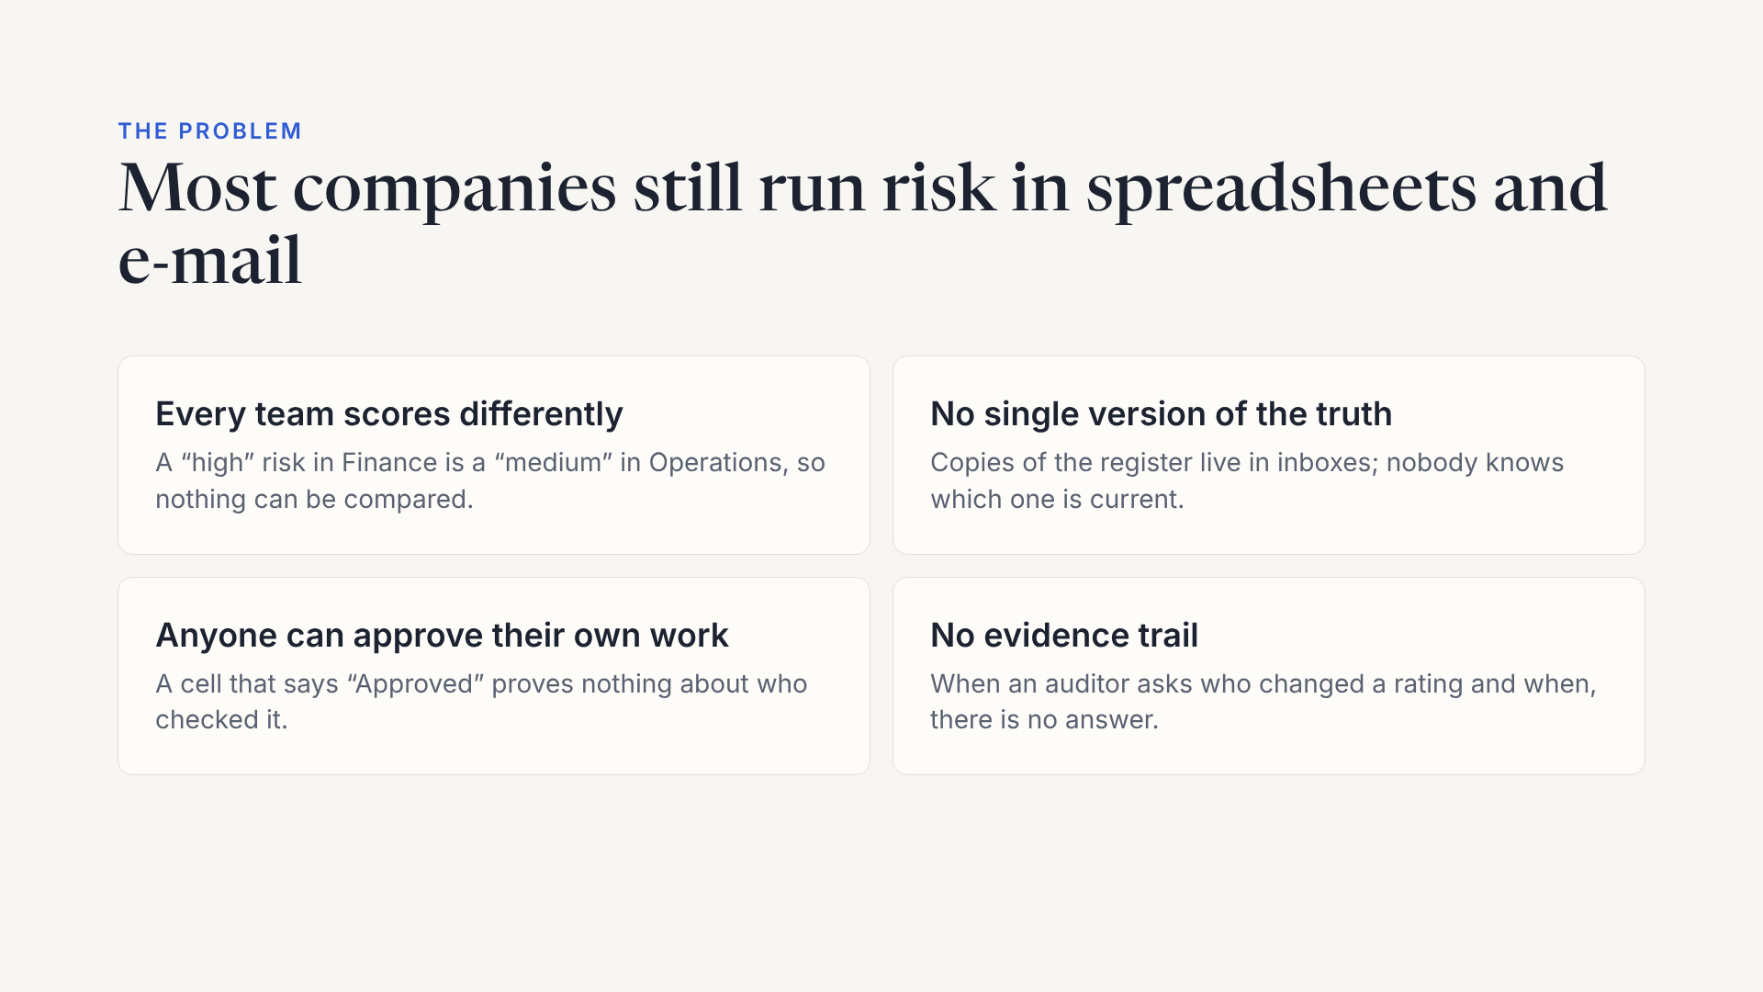
Notes:
Ask the guest how their company manages risk today. Most will recognise at least two of these four. Keep it to their experience, not statistics.

Slide 3
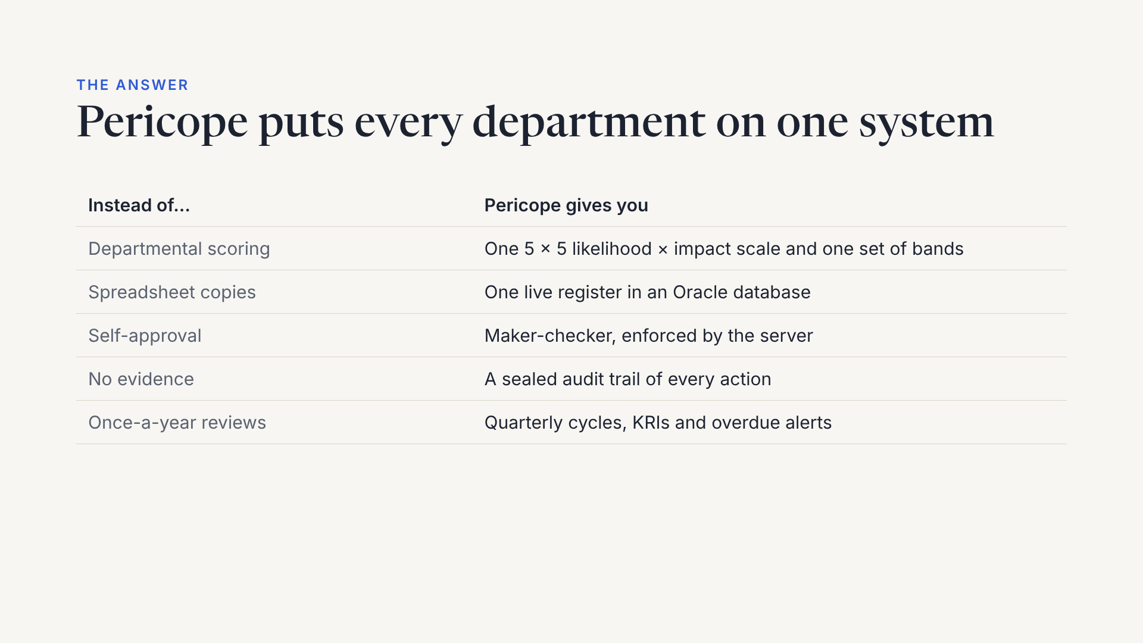
Notes:
Map each pain from the previous slide to its fix. The last row is the shift from an annual exercise to a living process.

Slide 4
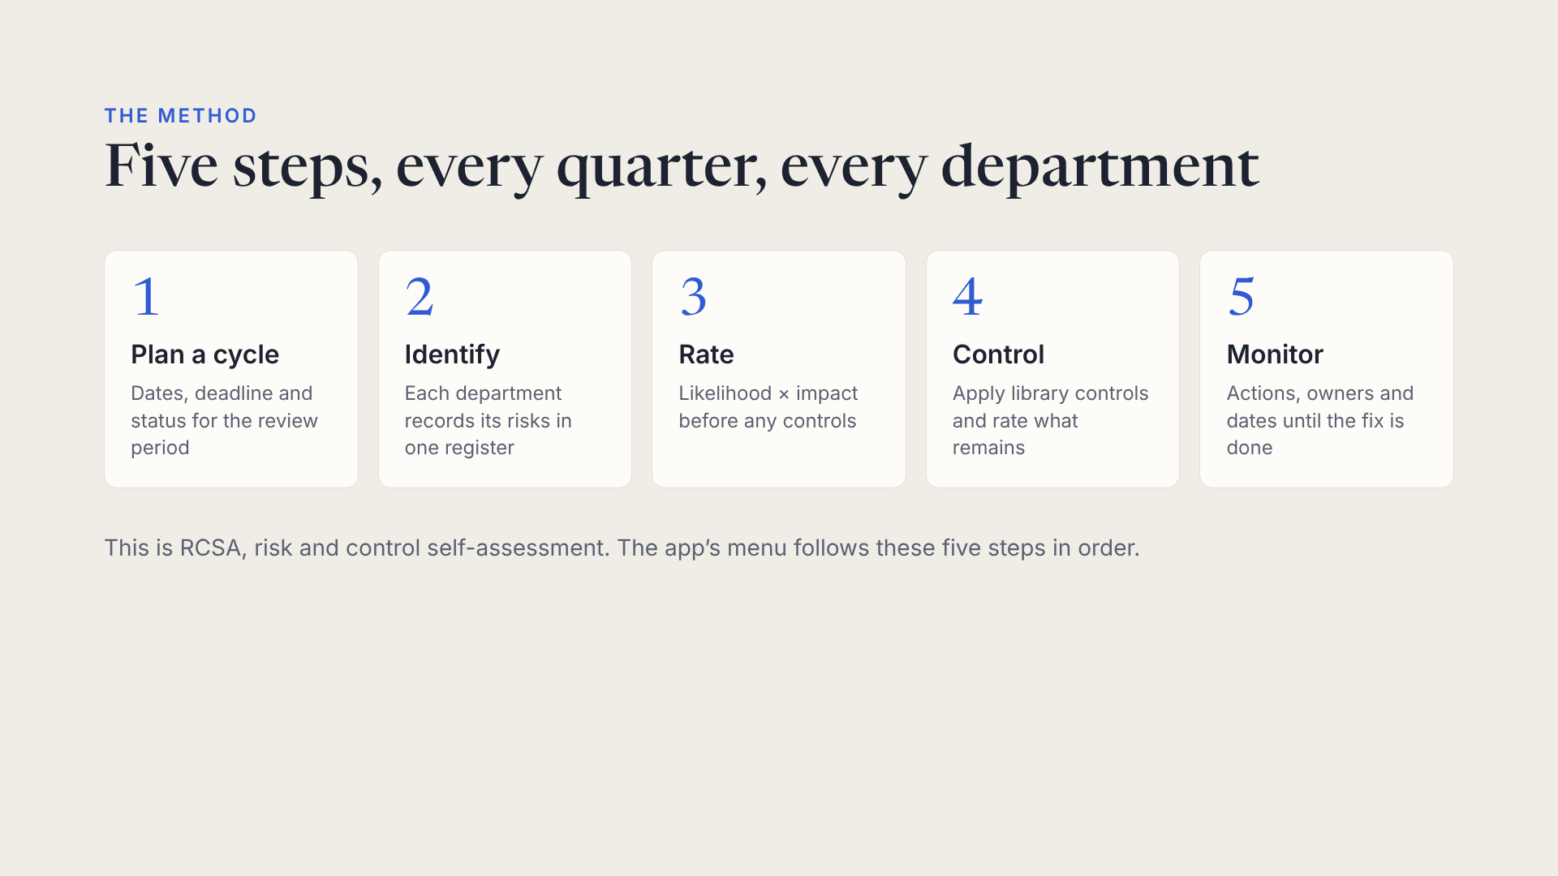
Notes:
Walk the five steps quickly. The point: the method is built into the menu, so users learn it by using the product.

Slide 5
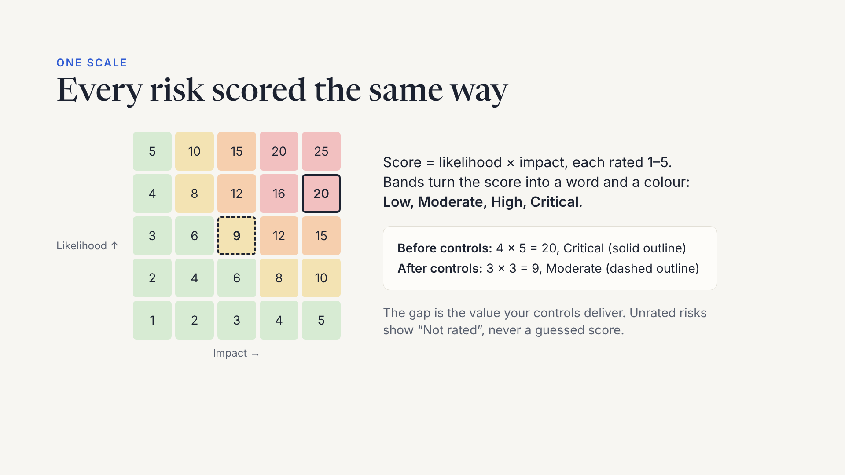
Notes:
The example is the demo company’s top risk: an ERP outage that stops order processing. Inherent 20 Critical, residual 9 Moderate after the incident playbook and tested backups. Band thresholds are set once by the administrator.

Slide 6
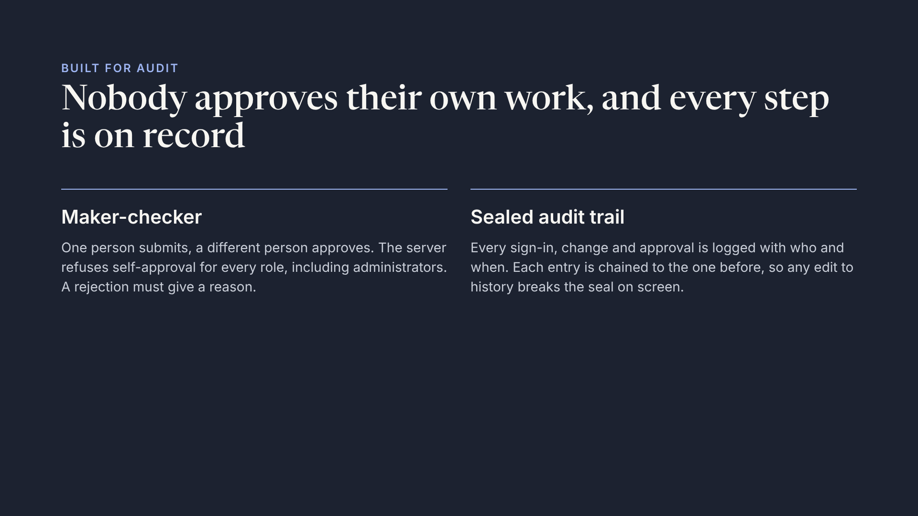
Notes:
This is the slide for auditors and compliance people. In the demo you will show both: an Assessor who has no Approve button, and the audit trail’s integrity seal.

Slide 7
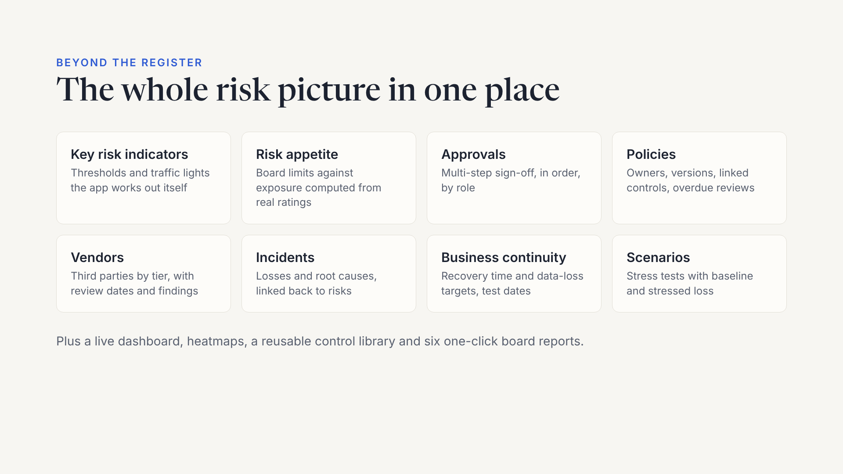
Notes:
Do not demo all eight. Ask which matter to the guest and open one or two of those after the main story.

Slide 8
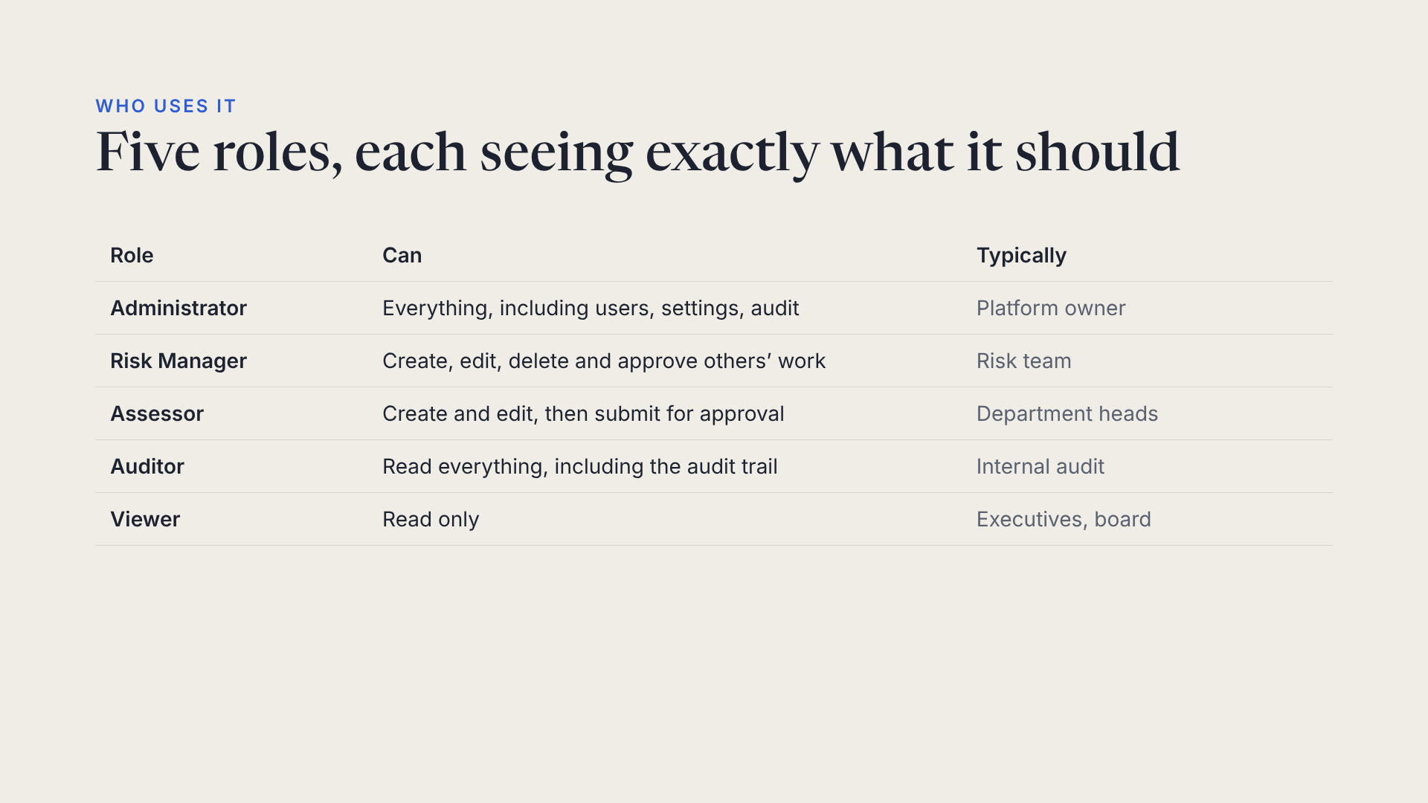
Notes:
Roles are enforced by the API, not just hidden in the screens. Changing someone’s role or deactivating them signs them out at once.

Slide 9
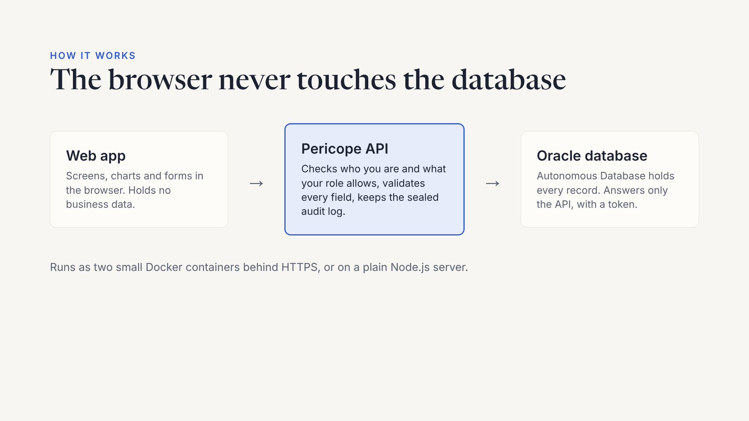
Notes:
This is why the rules cannot be bypassed: even a tampered browser can only ask the API, and the API applies the same checks to everyone.

Slide 10
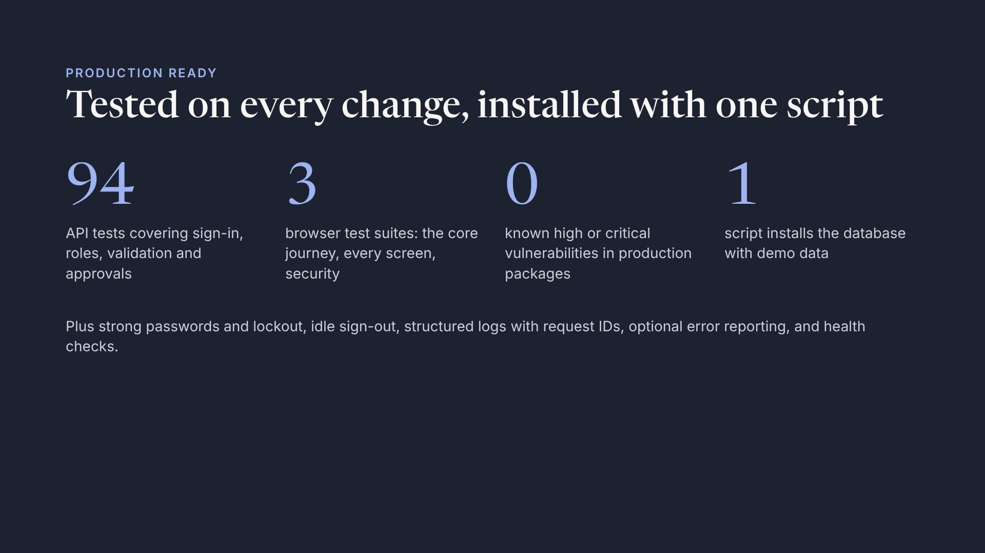
Notes:
Figures are from the current release: 94 API tests, three end-to-end browser suites run in CI on every push, and npm audit reporting no high or critical issues in production dependencies at release time.

Slide 11
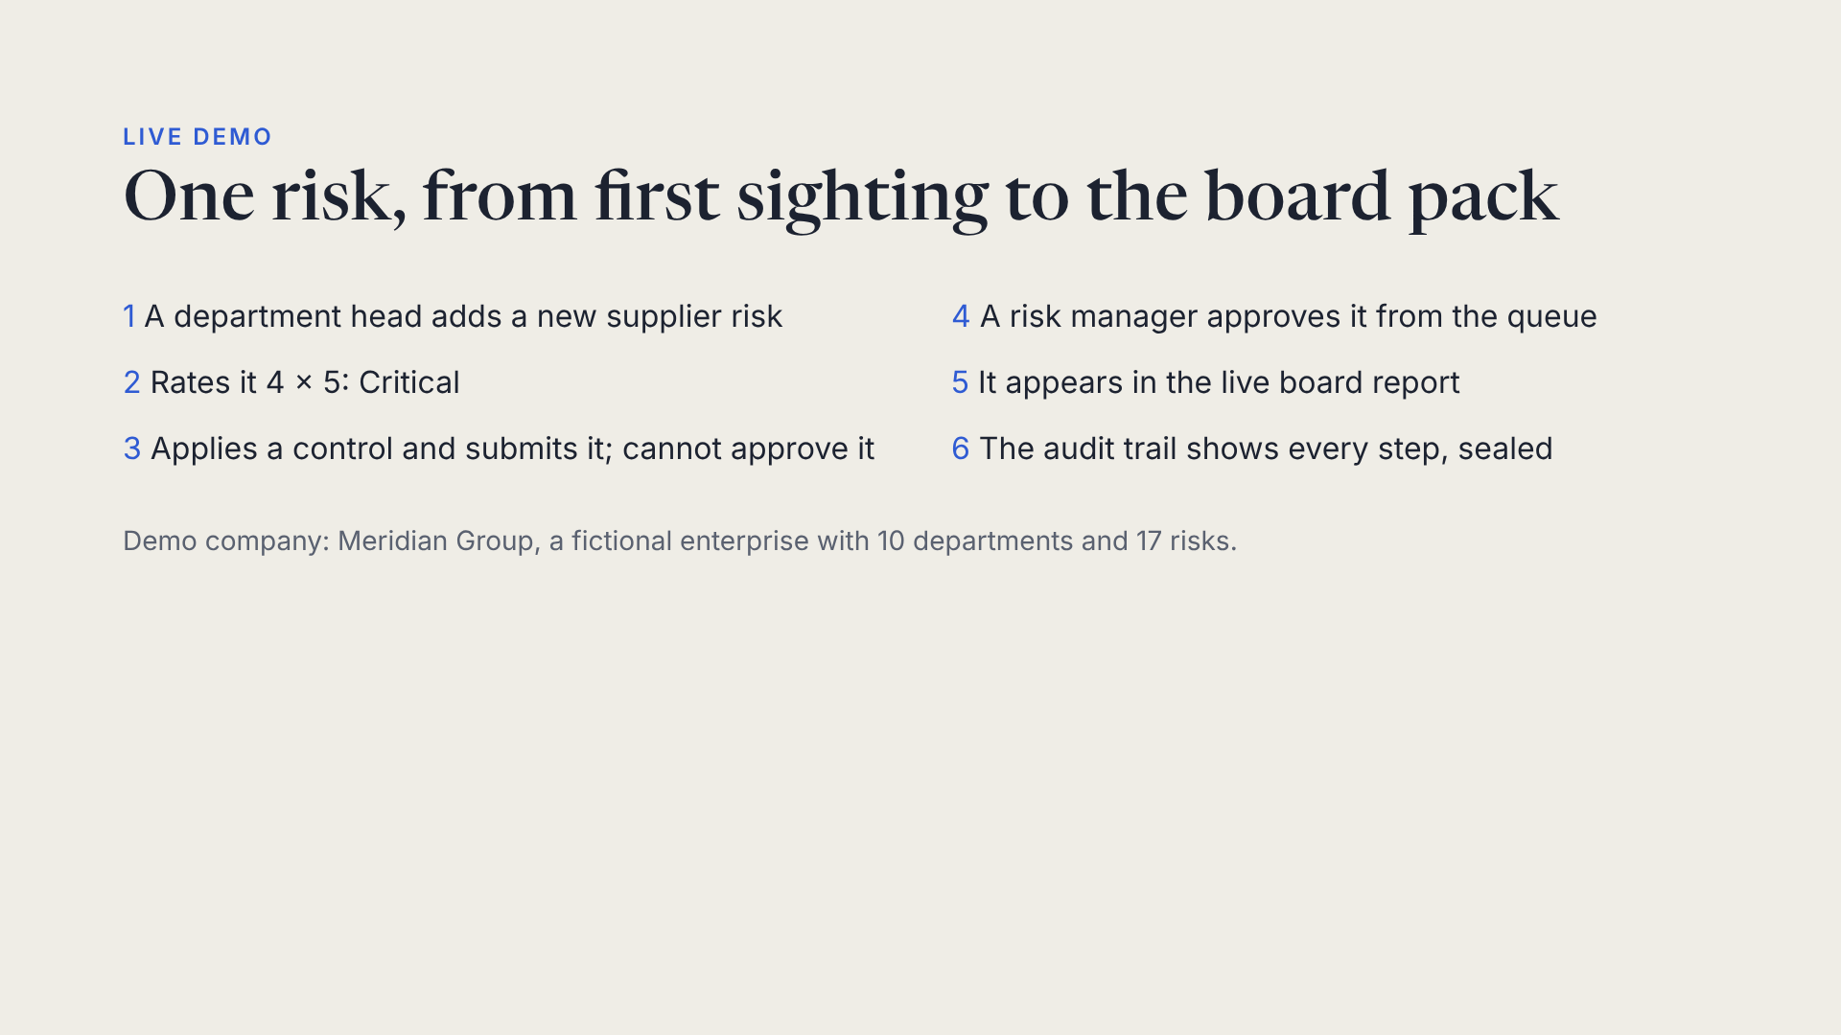
Notes:
Switch to the app now. Follow the 20-minute script in the runbook: Dashboard, heatmap, risk page, then the six steps above with an Assessor and a Risk Manager window.

Slide 12
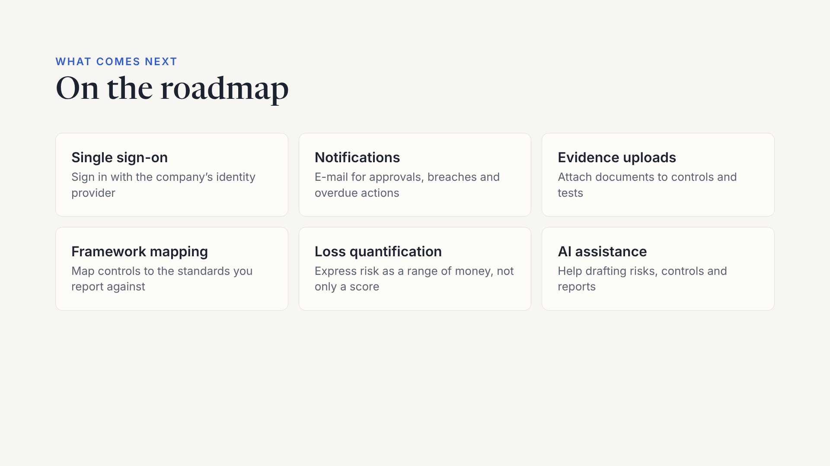
Notes:
Be clear these are planned, not built. Ask which matters most to the guest: that shapes the priority.

Slide 13
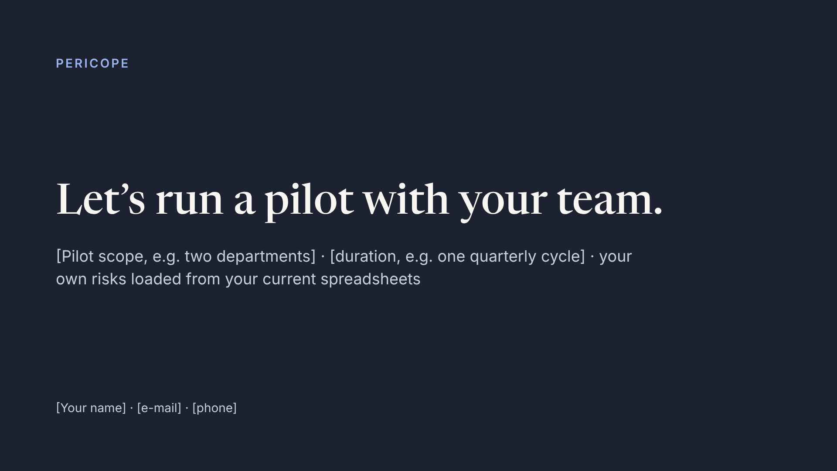
Notes:
End with a concrete ask. Fill in the placeholders before the meeting.

