Slide 1

Bus Ticketing Solution
Srivatsan KR

Slide 2
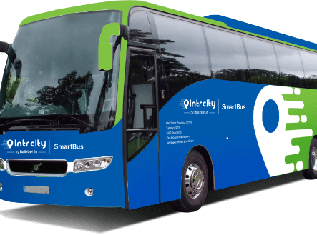
TABLE OF CONTENTS
User Story Information
High Level Architecture
Actors/Persona
Proposed Data Model
Data Model - Explained
Sharing and Security
Integrations
Archival Strategy and Reporting
User Story - Solutions
Salesforce Evergreen
Platform Tools/Principles
Thank you

Slide 3

USER STORY INFORMATION
As an end-user, I should be able to book tickets between 2 cities from a mobile app
As an end-user, I should be able to select the seat and pay for the ticket
As an end-user, I should see the auto-populated payment preference options.
As an admin, I should be able to create bus trips and see the list of customers
As an admin, I should be able to cancel any bus trip.
Also, write a serverless evergreen function in a Salesforce DX project, which sends a push notification to the customers on canceling a bus trip. *

Slide 4

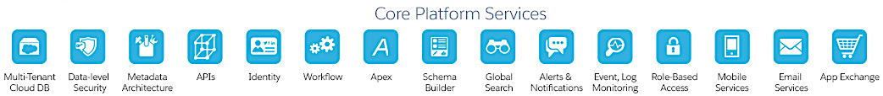

HIGH LEVEL SOLUTION ARCHITECHTURE
End Users
SF Mobile Publisher
Assumptions
Mulesoft is the assumed middleware
SF Mobile Publisher will be used for mobile app and the same community will be used in desktop view for clients
For operators we can either use customer or partner community
Admins will use backend Lighting experience application
External payment gateway will be used for clients to make payments
A very basic pricing for tickets has been used as part of this use case
Service Cloud
Lightning Experience
Customer Community
Core Modules: Operators, Payments, Bookings, Routes, Trip booking management
Customer/Partner Community
Operators(Partners)
– Future State
Admins – LEX App
Reports & Dashboards
System 1
Legacy Operator Systems
ESB
API Layer,
Data Services
Business Logic
Legacy Connectors & Adapters
System 2
MPI – Person Index
System 3
Data Warehouse

Slide 5
ACTORS/PERSONA
Actors | Functions | Proposed License
End User(Current State) | Ticket Booking Ticket Notifications Ticket Payment through preferred payment method | Customer Community(Login based License)
Admin(Current State) | 1. Create Bus Trips and create list of customers 2. Cancel Bus Trip | Platform License(Lightning Experience App)
Operator Users(Future State) | 1. Manage Operator Routes 2. Manage Operator Stops 3. Manage Operator Bus Types | Customer Community Plus or Partner Community based on requirements.

Slide 6
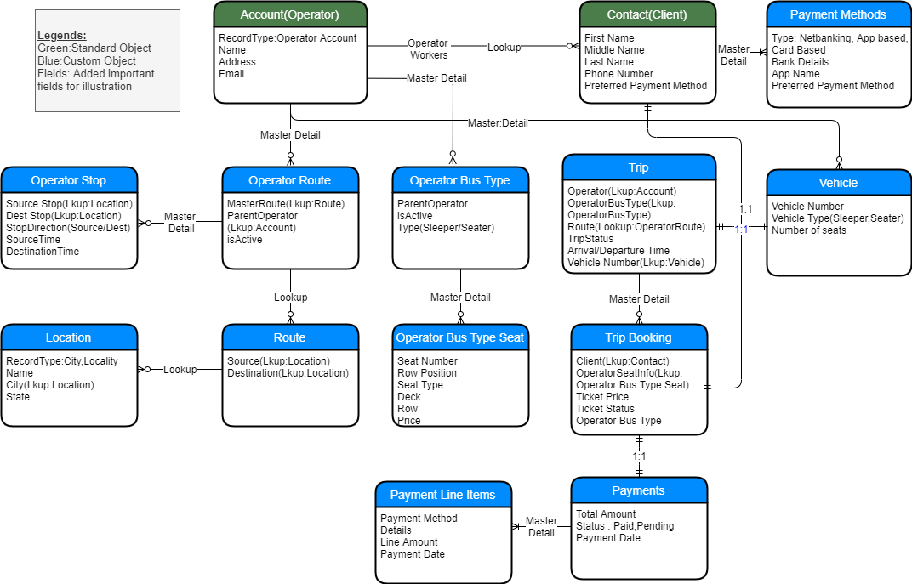
PROPOSED DATA MODEL

Slide 7
DATA MODEL - EXPLAINED
Object Name | Sharing Model | Functional Description | Object Rationale
Account(Operator) | Private | Holds all Operator Account(KPN,SRM etc..) | Using standard object instead of custom will help drive visibility for communities
Contact(Client/Operators) | Private | Will store client information and operator information | Using standard object will help drive visibility for communities and control access to clients only their transactions and operators to only look at their operator information
Location | Public Read/Write | Stores all possible locations including city, locality | Custom object to store all locations. Access only for admins
Route | Private | Stores all possible routes | Custom object to store all different routes. Access only for admins to edit it. Read access for operators
Operator Route | Master Detail to Operator(Account) | Object which stores route and operator information | Object to store which all routes the operators fly their buses. Access to Admins and Operators

Slide 8
DATA MODEL - EXPLAINED
Object Name | Sharing Model | Functional Description | Object Rationale
Operator Stops | Master Detail to Operator Route | Capture Source and Destination Stops for each operator Route | Object to capture the places where bus will stop in source and destination route which each operator is plying. Access to Admins and Bus Operator
Operator Bus Type | Master Detail to Operator(Account) | Stores Operator bus type(Sleeper, Seater ) information | Typically buses have a finite set of templates they work off of(A.C Seater, Sleeper, Semi-Sleeper). By maintaining a template and seat information it becomes easy to copy them over when a new trip is created. Access to Admins and Bus Operators
Operator Bus Type Seat | Master Detail to Operator Bus Type | Store bus type seat template information | Object to store different seat number based on bus template. Access to Admins and Bus Operators
Trip | Private | Object to capture each transactional trip | Object to capture each bus trip, time, operator, bus type. Access only to admins
Trip Booking | Master Detail to Trip | Capture all client bookings for any trip | Object to Store booked seats and client information for any trip. Access to Admins

Slide 9
DATA MODEL - EXPLAINED
Object Name | Sharing Model | Functional Description | Object Rationale
Payment Methods | Master detail to Client(contact) | Capture different payment methods of each client | Object to capture different payment methods for each client. Access to Clients and Admins
Vehicle | Master detail to operator(Account) | Capture Vehicle information for each operator | Object to capture Vehicle information managed by each operator. Access to Operators and Admins
Payments | Private | Payments made by clients for bookings | Object to store payments associated to each booking made by clients. Access to Admins and Clients
Payment Line Items | Master detail to Payments | Different payment methods used to complete bus booking | Object to store different payment lines under a single payment. Access to Admins and Clients

Slide 10

SHARING AND SECURITY
Core Objects(Operator, Contact, Trip) are in private sharing model which allows visibility to be controlled. It can be scaled in the future to onboard many operators
Private sharing model with master detail helps to manage privacy of data between operators
External sharing settings should be enabled to ensure separate sharing model exists between community and internal users
Sharing sets can be used to provide access to Operators and Clients to only see their data in customer community or partner community(only for partners)

Slide 11
Integrations: Below are some of the integrations assumed as part of the ticketing solution.
System | Description | Integration Pattern
Payment Gateway | Integration with payment gateway to manage client payments and refunds | Canvas Integration or Integrating Payment Gateway using their web URL’s
Data Warehouse | Integration with data ware house to do historical reporting | Change Data Capture or daily ETL jobs to pull data from salesforce
Operator Source Systems | Integration with any operator legacy systems if source of truth is the operator systems | Platform event based or async rest/SOAP based callout
MPI | Integration with master person index to validate if the client is valid citizen of the mentioned country | Realtime call-out to check client status
Address AutoComplete | Integration with Address auto complete system to show address suggestions based on user entry | Realtime API call to get address auto complete suggestions

Slide 12

ARCHIVAL STRATEGY AND REPORTING
Archival:
Trip booking object will become a LDV object in the future since every day there could be 200 trips and each trip could have upto 30 passengers(approx.)
Payment and line items will also be LDV in the future so archival strategy needs to be applied on them
To avoid issues with slow queries, reports its recommended to only keep trips and payments for the last 1 month and archive the test.
Reporting:
Use salesforce reports for daily reporting
Use Tableau/Salesforce Einstein for historical reports by pulling data from a warehouse

Slide 13
USER STORY - SOLUTIONS
User Story | High Level Solution
As an end-user, I should be able to book tickets between 2 cities from a mobile app | SF Mobile Publisher will expose customer community through which ticket booking can be handled based on user search parameters : From/to location, date and bus type. Custom LWC component to be built for handling search and display of
As an end-user, I should be able to select the seat and pay for the ticket | Based on Operator and Bus Type selected seat information will be shown, End Users can select and pay the amount through integrated third party payment gateway. Third Party javascript library can be used to display the bus layout
As an end-user, I should see the auto-populated payment preference options. | Preferred Payment option(Card based vs app based vs net banking) will be stored at contact level and will automatically be pre-selected when users try to make payments
As an admin, I should be able to create bus trips and see the list of customers | Admins can create trips from trip object in the lightning experience application.
As an admin, I should be able to cancel any bus trip. | Admin can set the status of trip to cancelled by setting the status field on trip object. Alternatively a lightning quick action can also be provided to do the same
Also, write a serverless evergreen function in a Salesforce DX project, which sends a push notification to the customers on canceling a bus trip. * | Salesforce evergreen is not available for public use. I have updated my findings in the next slide.

Slide 14
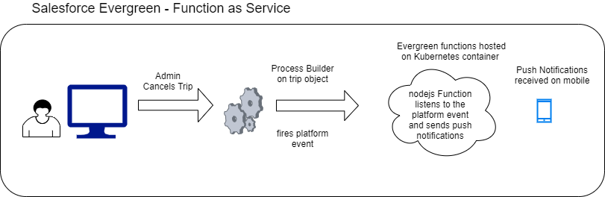
SALESFORCE EVERGREEN
Please note evergreen is still not available for even Proof of concepts. Below is just a conceptual architecture and the code in the GitHub repository is to just illustrate its capability. Its not fully functional and complete. The information has been put together looking at dreamforce videos and what salesforce has made available on the net.

Slide 15
PLATFORM TOOLS/PRINCIPLES TO USED
Configuration over customization
Salesforce communities to be used for providing access to clients and operators
OOTB sharing configuration to be used to control visibility
Role based access to be used for Lightning experience users to provide record access and Security
Platform events to be used as core integration pattern to leverage pub sub model and avoid point to point apex rest/Soap Patterns
Flows/Process Builders to be used to avoid apex wherever possible.

Slide 16

GitHub Link:
https://github.com/srivatsankr/AXDemo

