Slide 1
Botnets

Slide 2

Botnet Threat
Botnets are a major threat to the Internet because:
  Consist of a large pool of compromised computers that are organized by a master.
    a.k.a., Zombie Armies
  Carry out sophisticated attacks to disrupt, gather sensitive data, or increase armies
  Armies are in the 1000’s to aggregate computing power
  Communication network allows bots to evolve on a compromised host

Slide 3

Evolution of Botnets
Motivation change in computer hacking
  Vandalism → Financial gains
  Loss of $67.2 billion (2006 figure)

Slide 4








eCrime Market Operation
Raw Materials
Goods
(Re)Application
Goal
Wealth
Market
S
S
S
Buy, Sell, & Trade
Notes:
Step back a bit…talk about market enabling specialization, overview of process
Miscreants buy, sell, and trade goods procured through hacking, social engineering, etc.
Some employ new techniques to perpetrate old crimes
Ex: Using form-grabbing trojans to steal online credentials for identity theft and financial fraud
Others perpetrate sophisticated electronic crimes
Using off-the-shelf goods and services acquired at market
Ex: Spear phishing with “store bought” bank email lists, mailers, scam pages, and hosting
Goods produced include:
online credentials (online banking, payment services)
offline credentials (cc nums, SSNs)
hosts themselves
Applications:
Bots
Cashiers credentials to funds
Send more phish, spam

Slide 5
Sensitive Data and Market Significance
Credit Card #s
Percentage of Labeled Data
SSNs
Bank Account #s
Sensitive Data Type
Notes:
Idea: More sensitive data means more potential fraud and monetary loss

Slide 6
Botnet Architecture
Botmaster
Bot
Bot
Bot
Recruiting
Recruiting
Recruiting

Slide 7
Botnet Taxonomy
A taxonomy model is necessary to develop the intelligence to identify, detect, and mitigate the risk of an attack.
Classification Scheme
Attacking Behavior
C&C Models
Rally Mechanisms
Communication Protocols
Observable botnet activities
Evasion Techniques

Slide 8
Attacking Behaviors
Infecting new hosts
    Social engineering and distribution of malicious emails or other electronic communications (i.e. Instant Messaging)
    Example - Email sent with botnet diguised as a harmless attachment.
Stealing personal information
    Keylogger and Network sniffer technology used on compromised systems to spy on users and compile personal information
Phishing and spam proxy
    Aggregated computing power and proxy capability make allow spammers to impact larger groups without being traced.
Distributed Denial of Service (DDoS)
    Impair or eliminate availability of a network to extort or disrupt business

Slide 9

Command and Control (C&C)
Essential for operation and support of botnet
3 Styles – Centralized, P2P and Randomized
Weakest link of the botnet because:
  Elimination of botmaster takes out the botnet
  High level of activity by botmaster makes them easier to detect than their bots

Slide 10
C&C Centralized Model
    Simple to deploy, cheap, short latency for large scale attacks
    Easiest to eliminate

Slide 11
C&C Centralized Model Example
3 Steps of Authentication
Bot to IRC Server
IRC Server to Bot
Botmaster to Bot
(*) : Optional Step

Slide 12
Peer to Peer Model
    Resilient to failures, hard to discover, hard to defend.
    Hard to launch large scale attacks because P2P technologies are currently only capable of supporting very small groups (< 50 peers)

Slide 13
P2P Botnet Example: Storm
The Overnet network Storm uses is extremely dynamic. Peers come and go and can change OIDs frequently. In order to stay “well connected” peers must periodically search for themselves to find nearby peers:
Storm Node

Slide 14
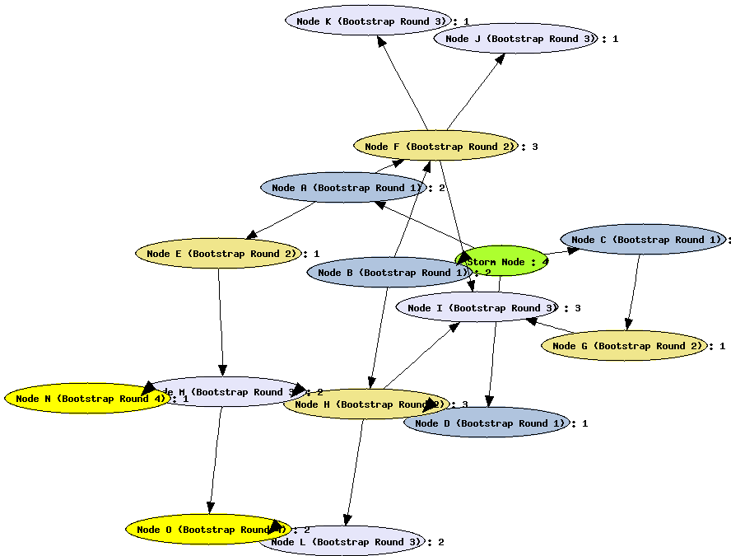
Round 3
Bootstrapping Peer
Round 1
Round 4
Round 2

Slide 15
Overnet Message Passing:
Overnet has three basic message types to facilitate proper function of the network:
Connect:
A peer uses connect messages to report their OID to other peers and to receive a list of peers somewhat close to the peer.
Search:
A peer uses search messages to find resources and other nodes based on OID.
Publicize:
A peer uses publicize messages to report ownership of network resources (OIDs) so that other peers can find the resource later.

Slide 16

Random Mechanisms
    Theoretical architecture: Evan Cooke, et al describe the model
    Easy implementation and resilient to discovery and destruction
    Scalability limitations make it impractical for large scale attacks.
    Bots sleep and are not activated until Bot Master is ready to attack

Slide 17

Communication Protocols
In most cases botnets use well defined and accepted Communication Protocols. Understanding the communication protocols used helps to:
  Determine the origins of a botnet attack and the software being used
  Allow researchers to decode conversations happening between the bots and the masters
There are two main Communication Protocols used for bot attacks:
  IRC
  HTTP

Slide 18
IRC Protocol
IRC Botnets are the predominant version
IRC mainly designed for one to many conversations but can also handle one to one
Most corporate networks due not allow any IRC traffic so any IRC requests can determine and external or internal bot
  Outbound IRC requests means an already infected computer on the network
  Inbound IRC requests mean that a network computer is being recruited

Slide 19
HTTP Protocol
Due to prevalence of HTTP usage it is harder to track a botnet that uses HTTP Protocols
Using HTTP can allow a botnet to skirt the firewall restrictions that hamper IRC botnets
Detecting HTTP botnets is harder but not impossible since the header fields and the payload do not match usual transmissions
Some new options emerging are IM and P2P protocols and expect growth here in the future

Slide 20
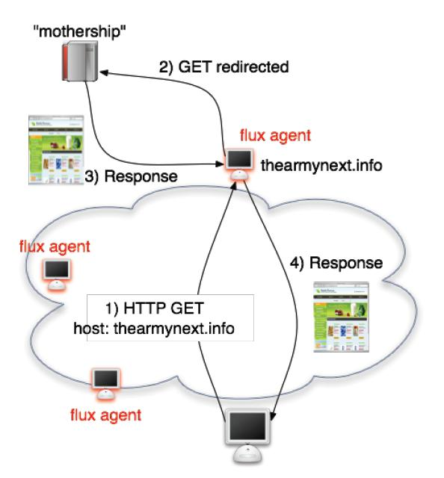
HTTP Botnet Example: Fast-flux Networks
Commonly used scheme
Used to control botnets w/ hundreds or even thousands of nodes

Slide 21
Observable Behaviors
Three categories of observable Botnet behaviors:
  Network-based
  Host-based
  Global Correlated
Notes:
1. In order to detect and possibly defeat botnets, we need to discover the abnormal behaviors exhibited by botnets.

Slide 22
Network-Based
Network patterns can be used to detect Botnets
  IRC & HTTP are the most common forms of Botnet communications
  Detectable by identifying abnormal traffic patterns.
    IRC communications in unwanted areas
    IRC conversations that human’s can not understand
DNS domain names
  DNS queries to locate C&C server
  Hosts query improper domain names
  IP address associated with a domain name keeps changing periodically
Traffic
  Bursty at times, and idle the rest of the time
  Abnormally fast responses compared to a human
  Attacks (eg: Denial of Service) - Large amounts of invalid TCP SYN Packets with invalid source IP addresses
Notes:
IRC & HTTP traffic detectable by identifying abnormal traffic patterns. Examples can be IRC traffic in a part of a network that does not allow it or IRC conversations that consist of syntax that humans do not understand.
Botnets use DNS queries to locate C&C Server
Host query strange domain names like cheese.dns4biz.org. This normally indicates that a host has been compromised.
IP addresses are assigned to domain names. If an IP address keeps changing, then it normally indicates presence of a botnet.
Network traffic can burst at certain times and remain idle the rest of the time.
Botnets respond abnormally fast compared to a human surfing the web.
Attacking Traffic
Denial of Service Attacks
Invalid source IP Addresses
Large number of Invalid TCP SYN Packets

Slide 23
Host-Based
Botnet behavior can be observed on the host machine.
  Exhibit virus like activities
  When executed, Botnets run a sequence of routines.
    Modifying registries
    Modifying system files
    Creating unknown network connections
    Disabling Antivirus programs

Slide 24
Global Correlated
Global characteristics are tied to the fundamentals Botnets
  Not likely to change unless Botnets are completely redesigned and re-implemented
  Most valuable way to detect Botnets
Behavior the same regardless if the Botnets are communicating via IRC or HTTP
  Global DNS queries increase due to assignment of new C&C servers
  Network Flow disruptions
Notes:
Global correlated behaviors are one of the most value ways to detect botnets
DNS queries increase when a bots are disconnected from an old C&C server and try to locate the new C&C server. Botmasters try to change the location of the C&C servers to avoid detection

Slide 25
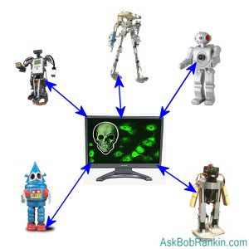
Evasion Techniques
Sophistication of Botnets allow them to evade
  AV Engines
  Signature base intrusion detection systems (IDS)
  Anomaly-based detection systems
Techniques
  Executable packers
  Rootkits
  Protocols

Slide 26
Evasion Techniques
Moving away from IRC
Taking control of
  HTTP
  VoIP
  IPV6
  ICMP
  Skype protocols

Slide 27
Evasion Techniques
Skype, the best botnet ever??
  Very popular, 9M+ users, average 4M+ connected
  Very good firewall ”punching” capabilities
  Obfuscated and persistent network flow
  Provides network API
  Skype provides network connectivity and obfuscation
  Skype is resilient by design
  Just need nickname(s) for communications
Things are easy
  Exploit Skype
  Install bot as Skype plugin
  Generate plugin authorization token and execute

Slide 28
Beating Evasion Techniques
Prevention
  Find C&C servers and destroying them
Most effective method for prevention and cure:
  Combining traditional detection mechanisms with those based on anomaly network behavior

Slide 29

Thank You
Copyright Nava 2012

Slide 30

Conclusion
By using the taxonomy and accurately identifying what type of botnet you are dealing with it will be easier to use the correct evasion technique.

