Slide 1
PHP MySQL
Image Upload Contest Project
By
Srivatsan Muralidharan
srivatsa.gog@gmail.com

Slide 2
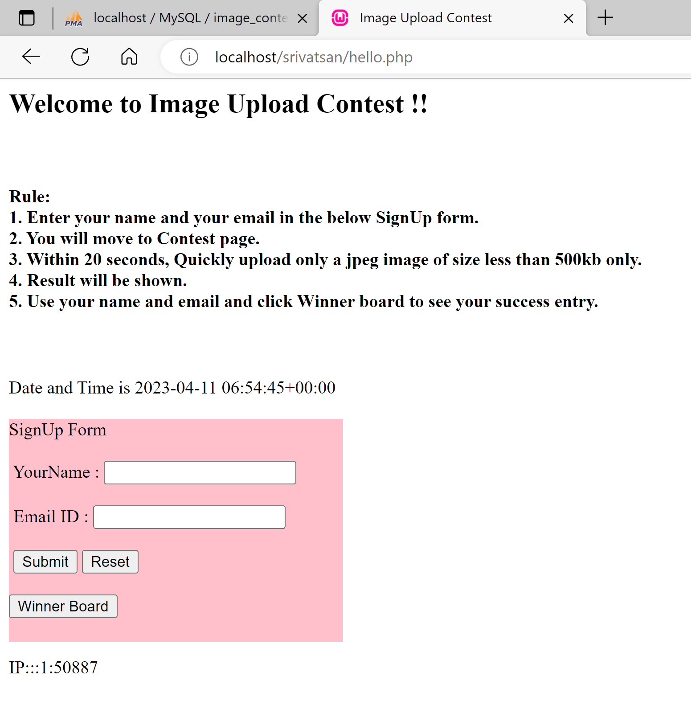
Home Page

Slide 3
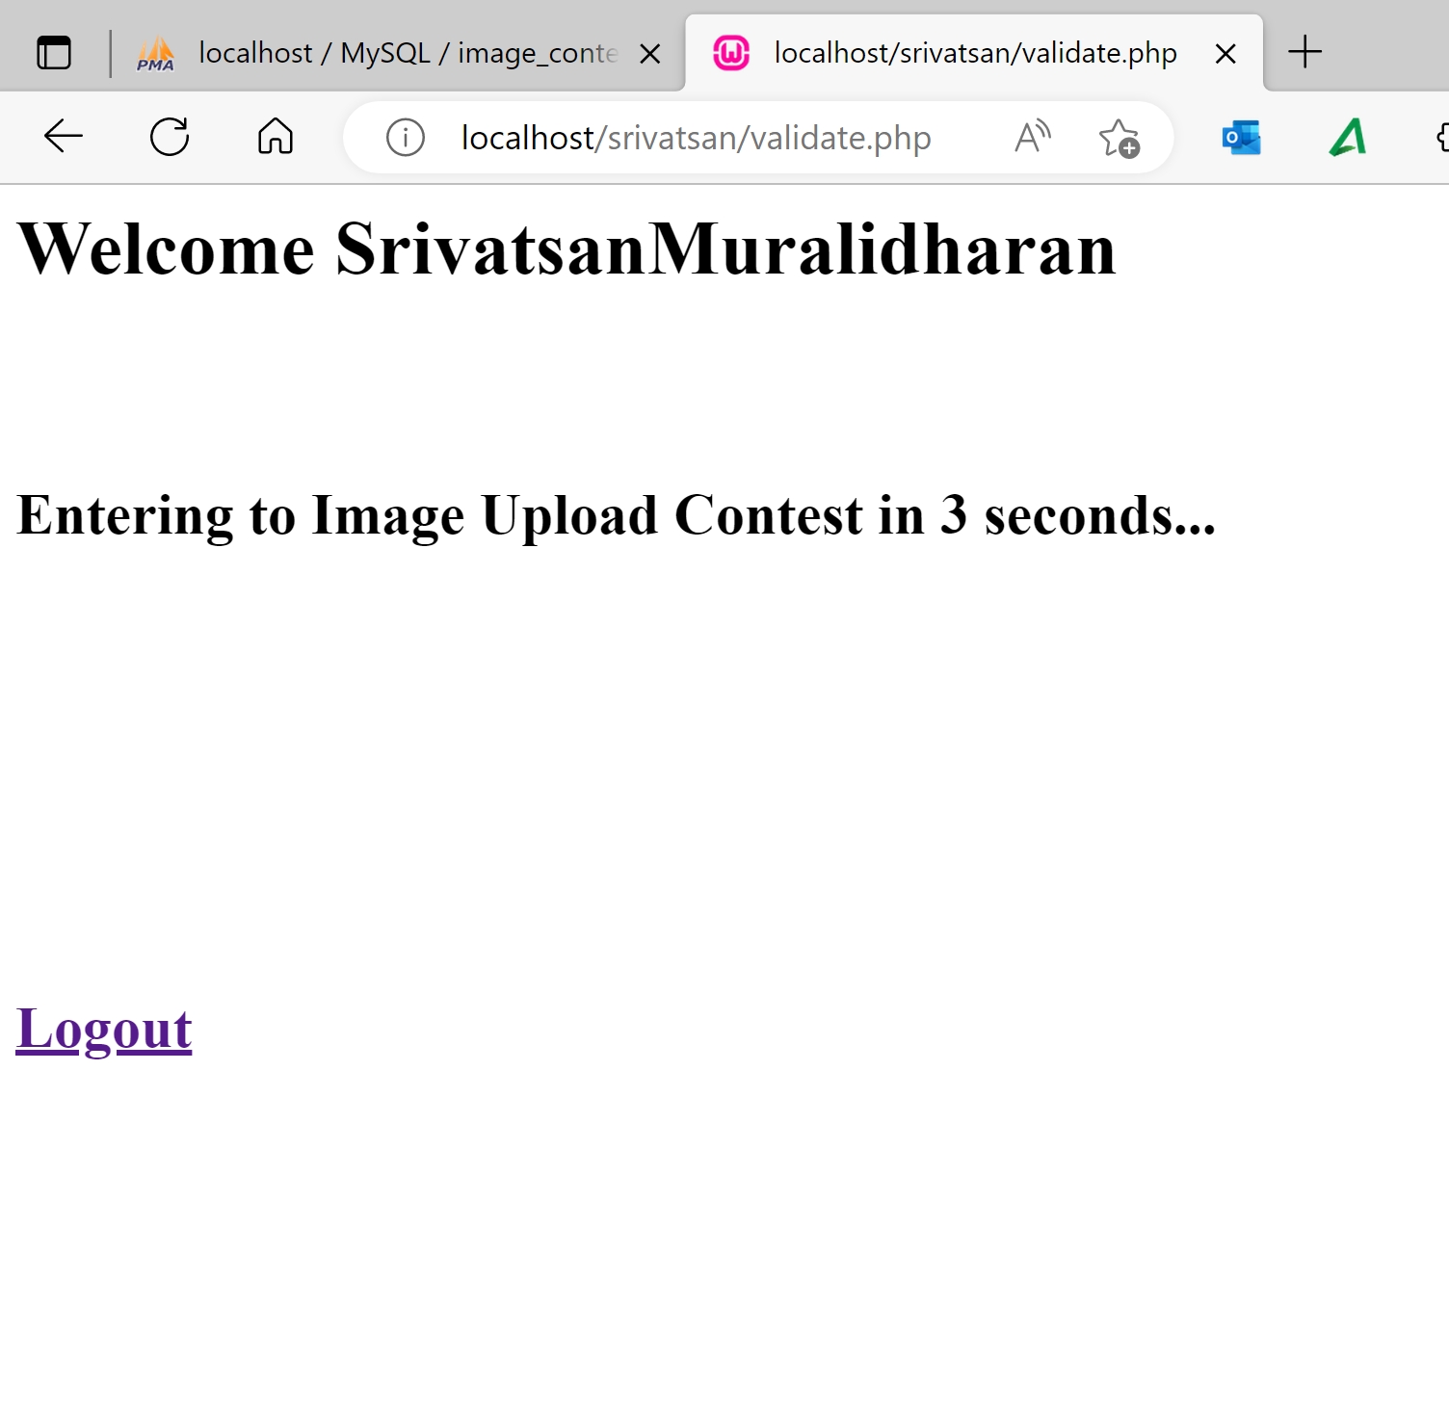
Welcome

Slide 4
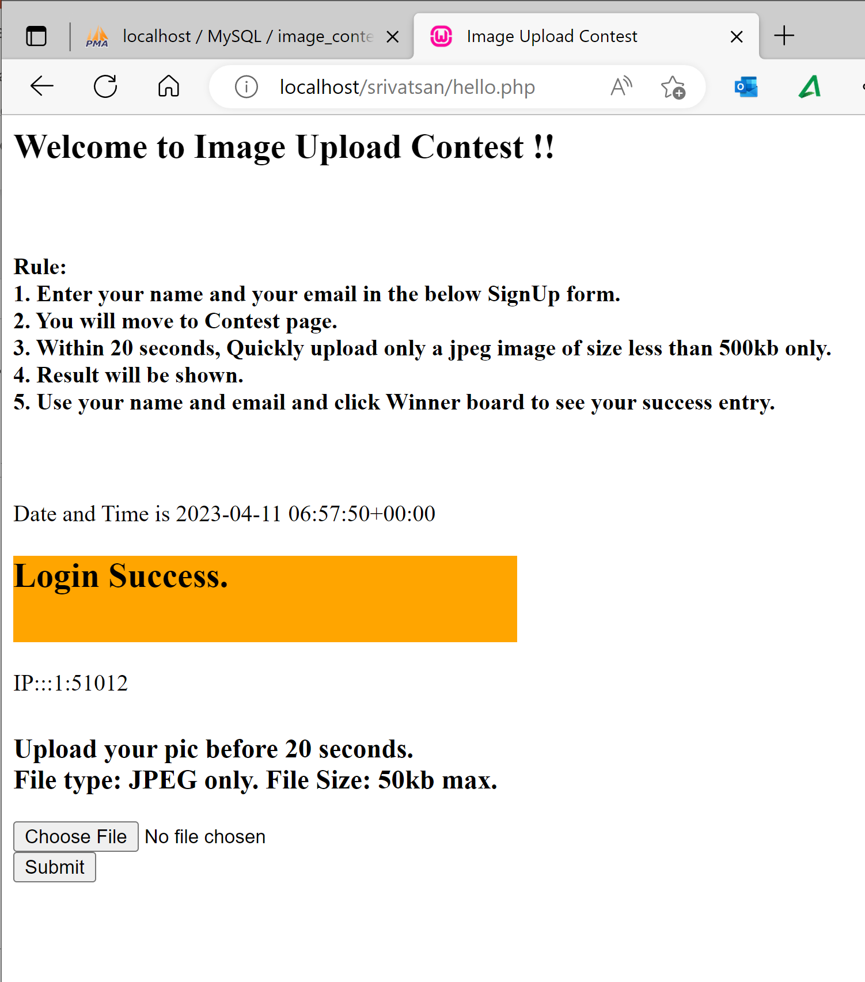
Contest Page

Slide 5
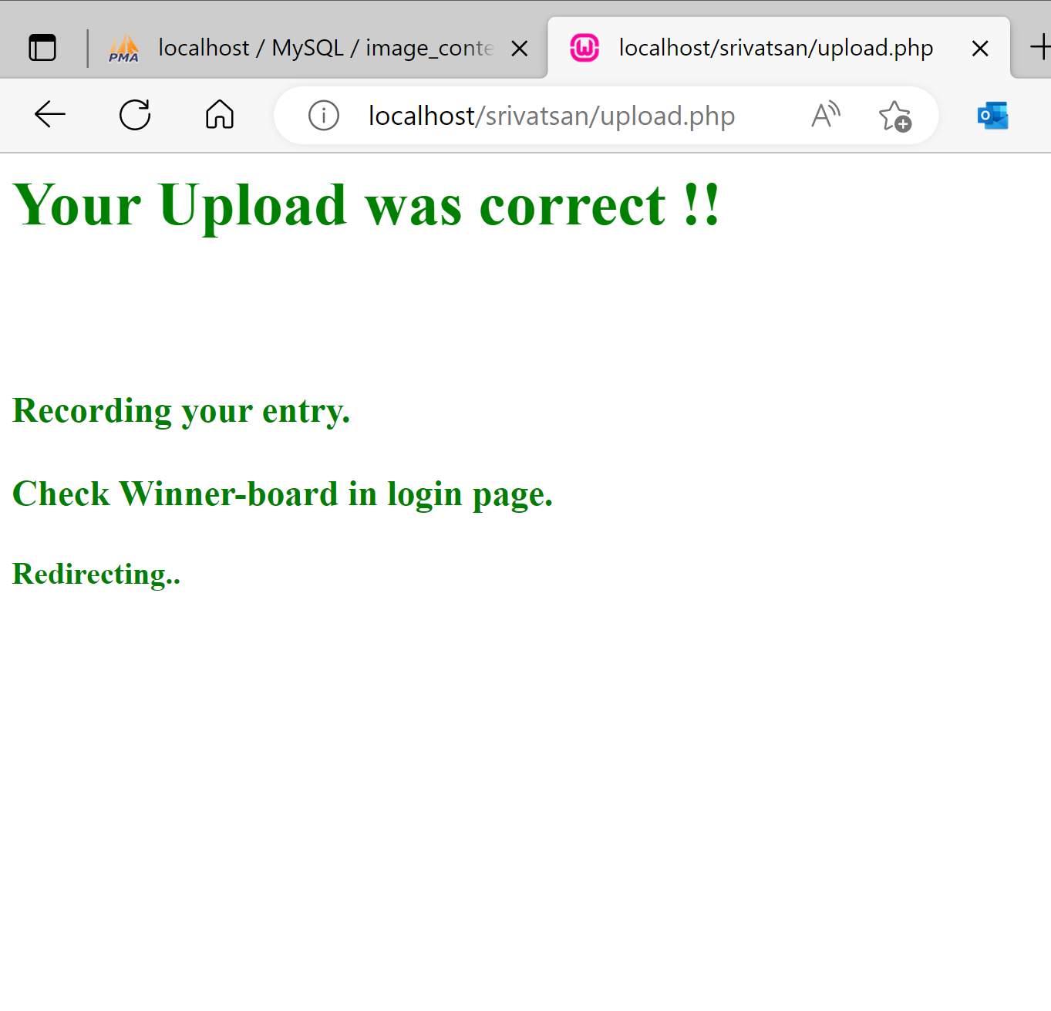
Success

Slide 6
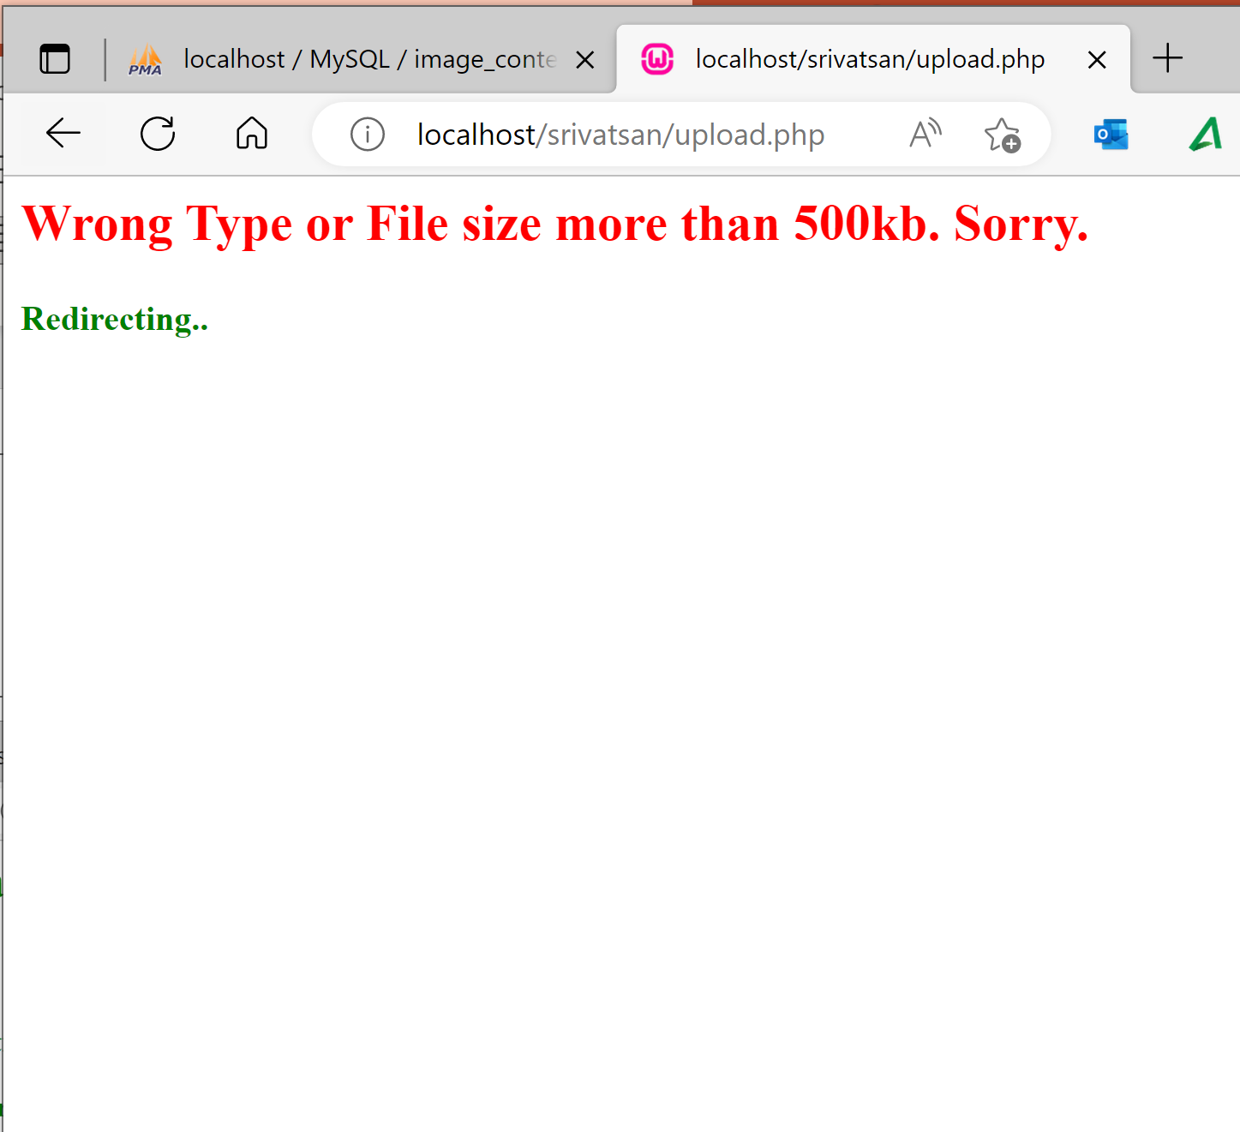
Failure

Slide 7
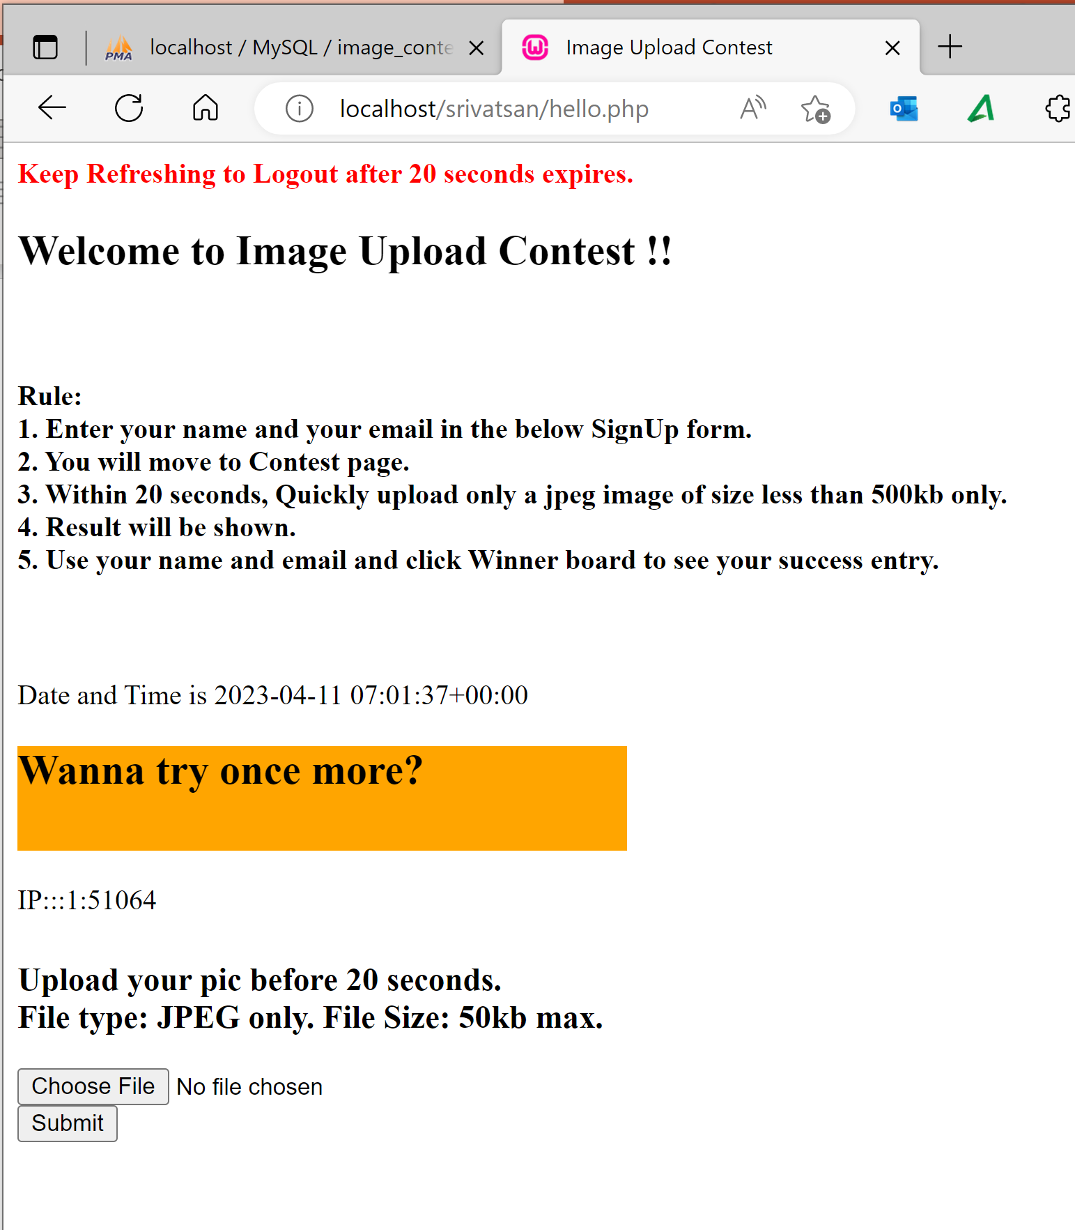
Success & Failure Redirect

Slide 8
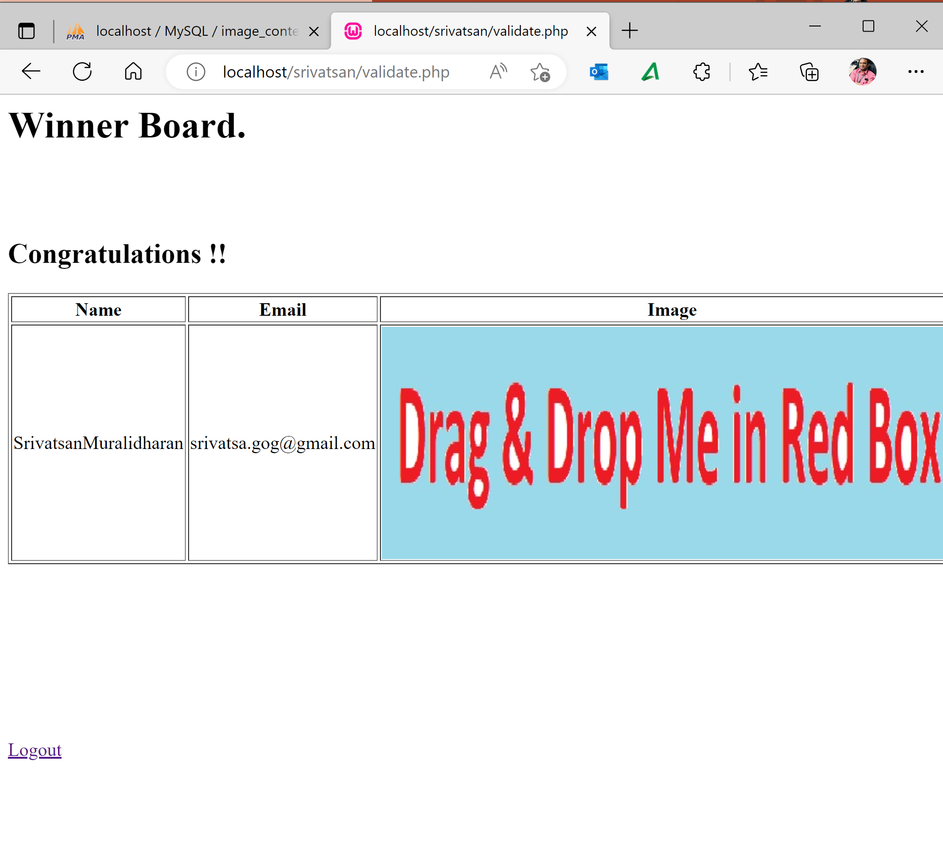
Winner Board

Slide 9
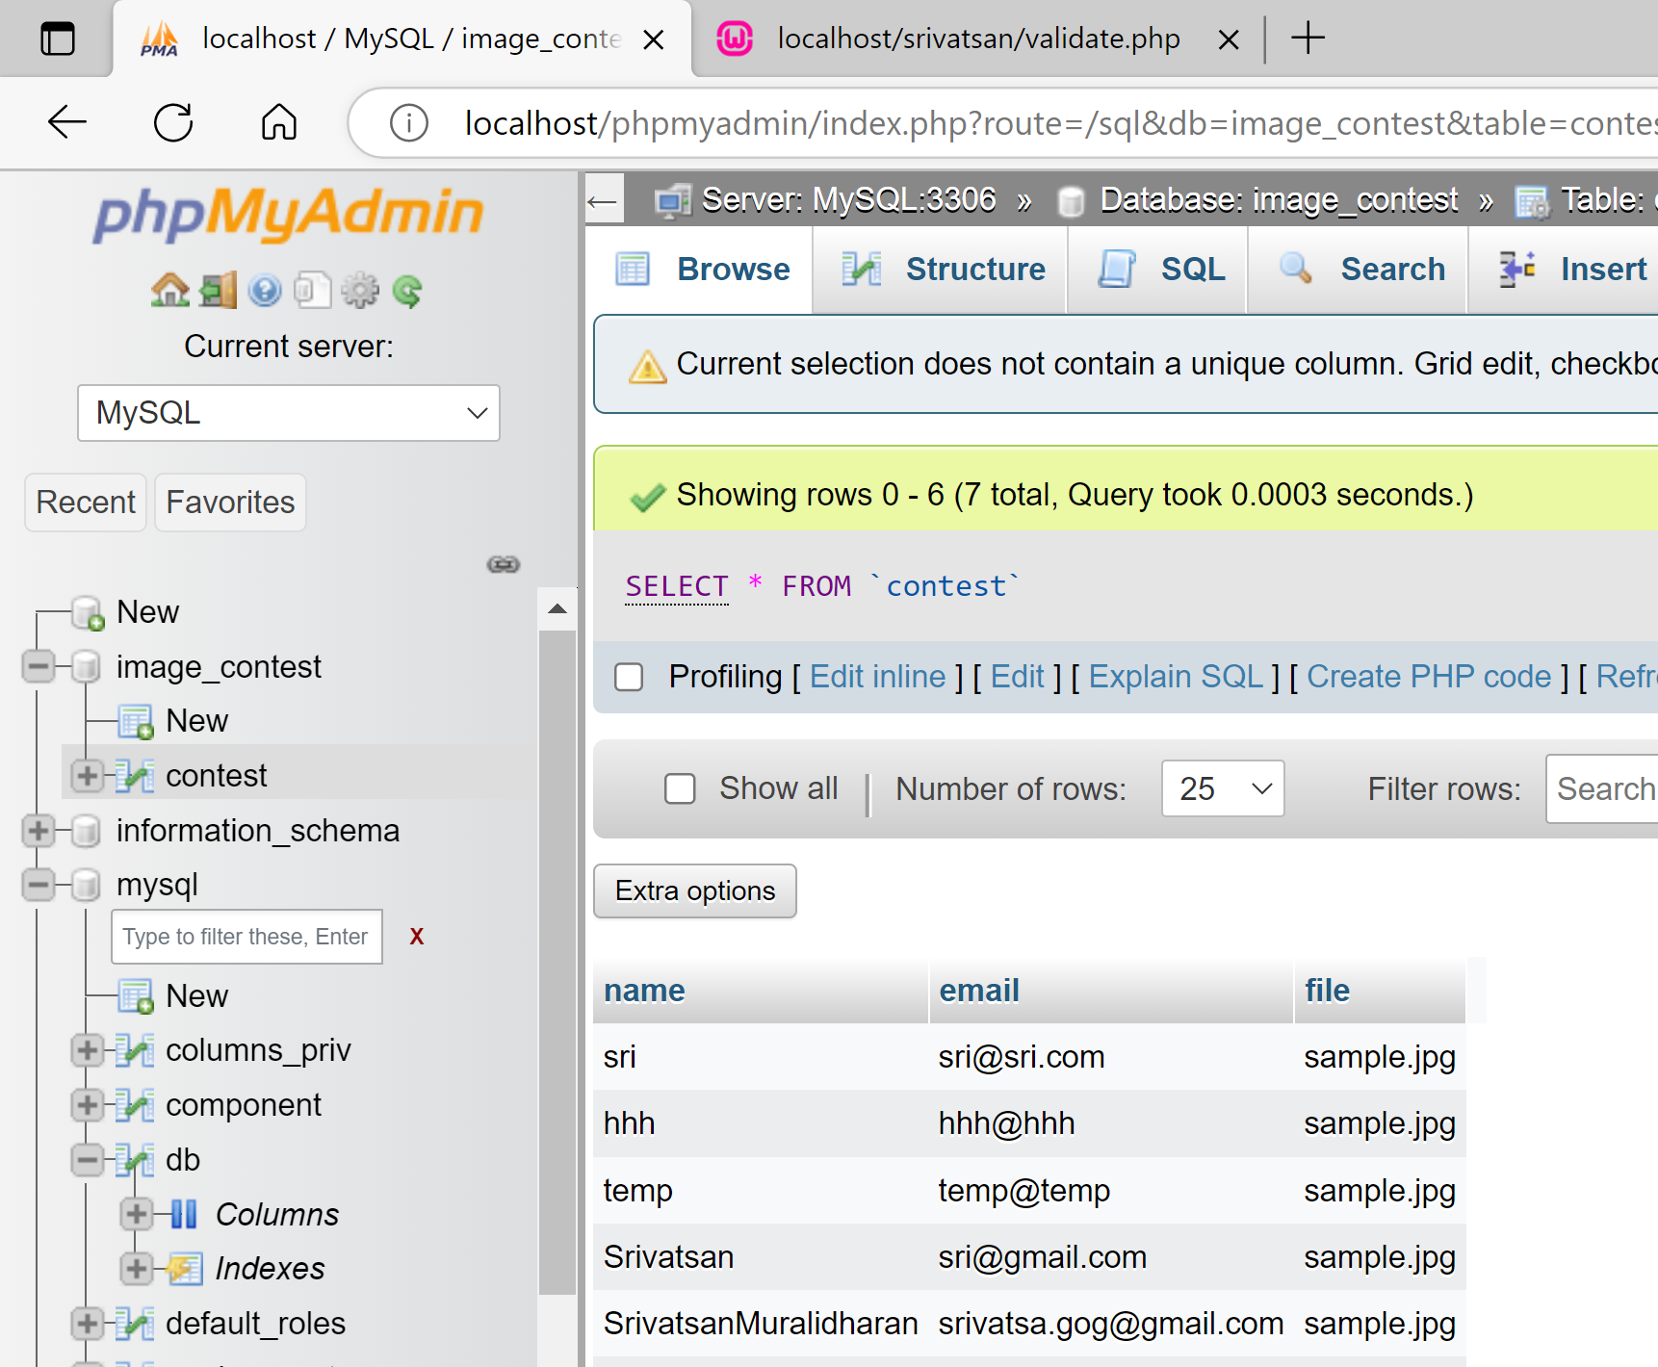
Database

