Slide 1
HTML JavaScript CSS jQuery Ajax
Home Page
By
Srivatsan Muralidharan
srivatsa.gog@gmail.com

Slide 2
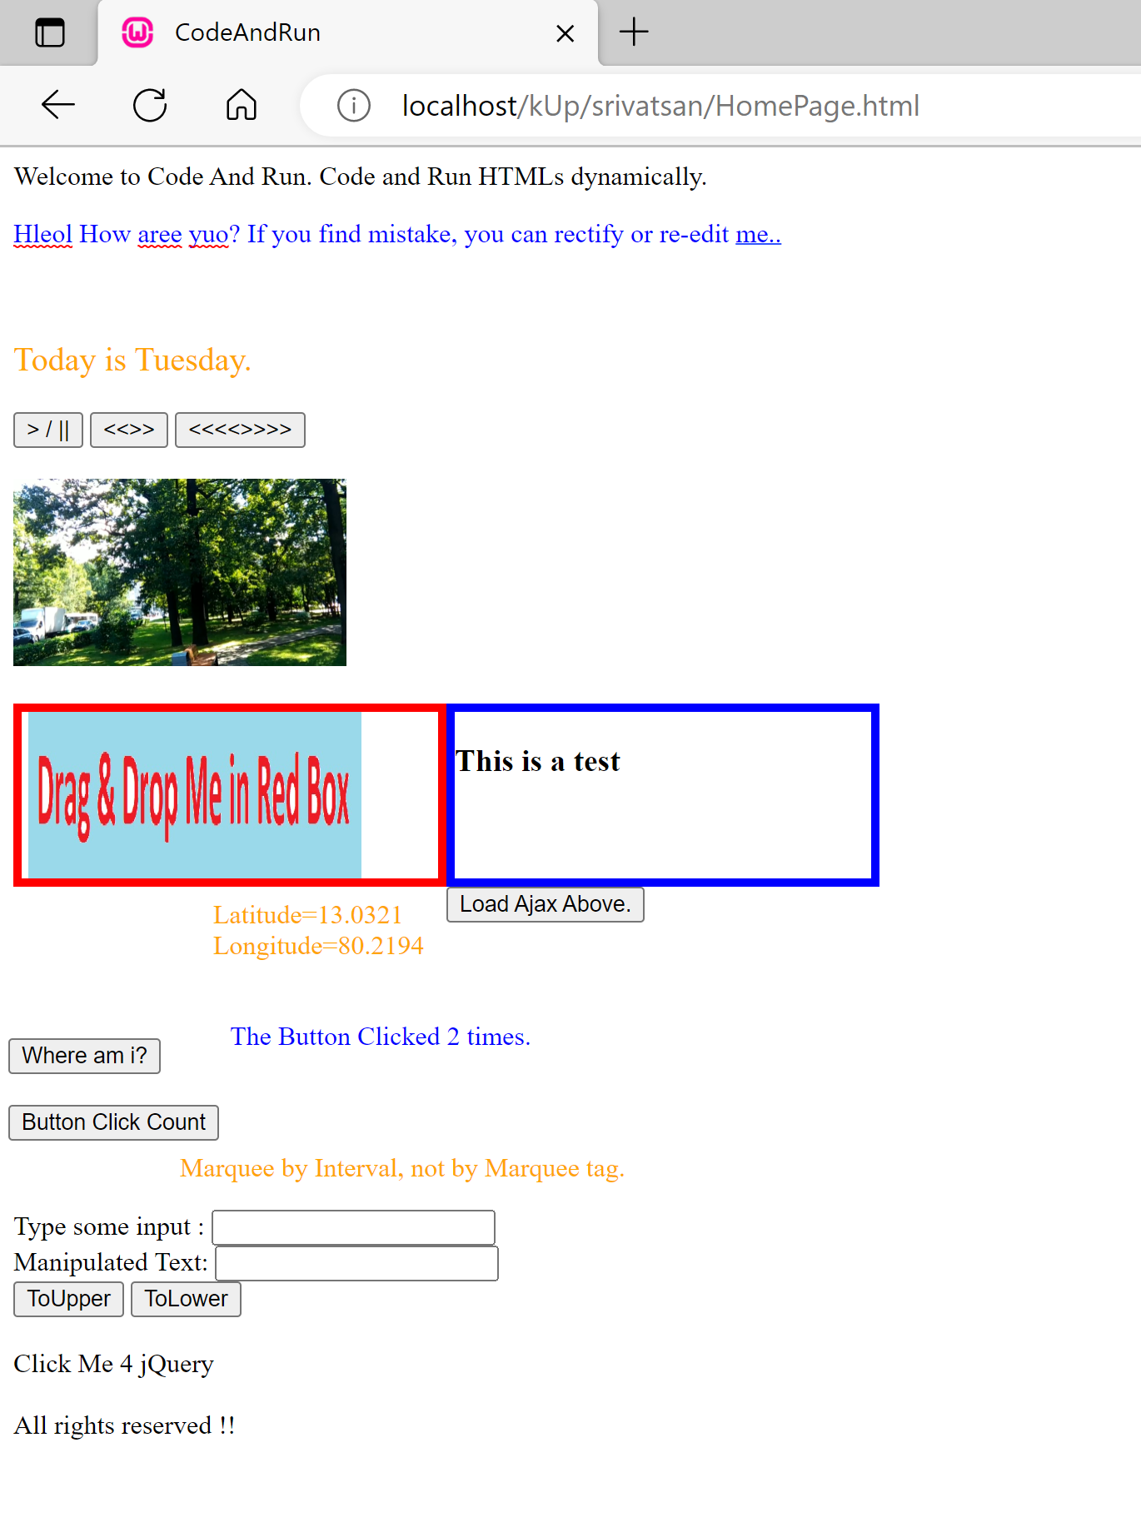
IIS Server hosted page
Editable/SpellCheck label
Date function and CSS
Play/Pause Expand Minimise
Video
Drag Drop Image
Dynamic Page Load Ajax
geolocation
Session variables
setInterval and change color and scroll
Text Manipulations
jQuery Page load

Slide 3
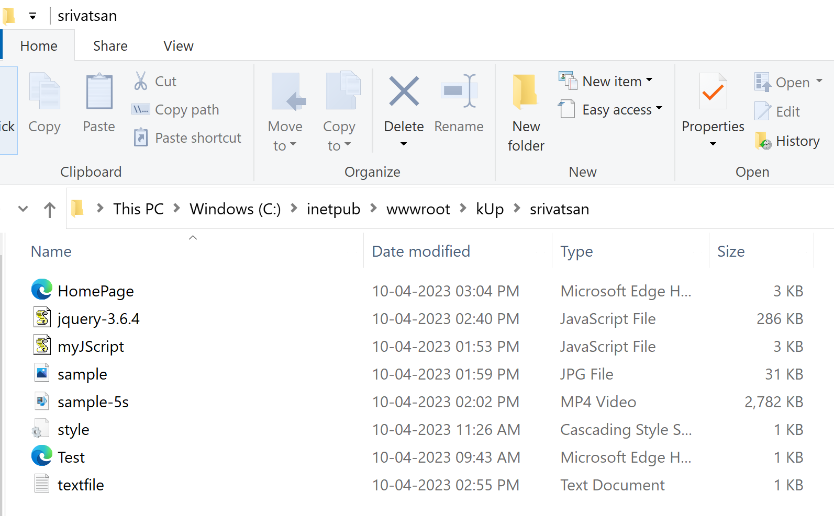
Artifacts

