Slide 1
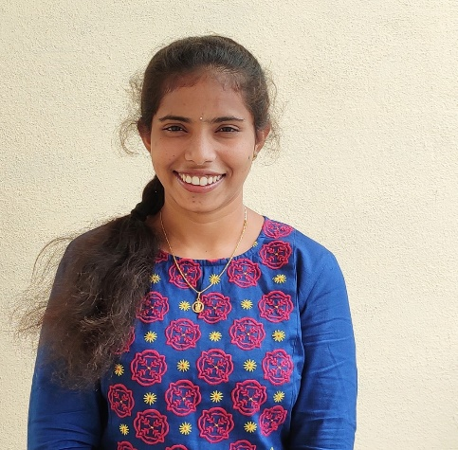

SRIVIDHYA AKULA
Analyst/Software Engineer
Bachelor of Technlogy, Electrical and Electronics Engineering : 2017 - 2020
Skills
Java​ | Java Basics,OOPS,Generics,​ Collections, Array, Loops​
Spring | Spring Boot, Spring Rest Services, Spring Restful Services
React​ | Components, Hooks, Virtual DOM, Routing, Forms & Validation​
Database​ | Postgre SQL
UI Tech​ | HTML 5 & CSS, Bootstrap 4, JavaScript, ES6
Tools | Eclipse, STS, GitHub, Postman, Swagger, Sonarlint, Visual Studio Code, Pg Admin 4, SQL Shell
Add On skills​ ​ | Immersive Learning​
Bangalore
akula.srividhya@capgemini.com
+91 9502546431
A4
Full Stack Developer
Hands on experience on Core Java, Postgre Sql, Spring Restful Services
Proficient in creating Single page Web Application in React with Authentication with routing
Hands on experience in developing web pages using HTML5, CSS, Object TypeScript, Good understanding of Document Object Model (DOM) and DOM Functions
Ready to learn new technologies and implement them for the future knowledge improvement.
Asset Management System
Case study of Asset Management is a system for managing the asset movement between the warehouses. This application is used by equipment Room Managers, Warehouse Managers and the individuals who request the movement of assets.
Degreed :Successfully completed the degreed training in GIT, HTML, CSS, SQL, React.
Check out my work on GitHub

