Slide 1




NEXT GEN EMPLOYABILITY PROGRAM
Creating a future-ready workforce
Team Members
College Name
Student Name :S.Srividhya
Student ID :au912421104044
SEC

Slide 2

CAPSTONE PROJECT SHOWCASE
Project Title
Voting Application using Django Framework-Srividhya-(4044,SEC)
Abstract | Problem Statement | Project Overview | Proposed Solution | Technology Used | Modelling & Results | Conclusion

Slide 3
Abstract : Django Online Voting System
Casting a ballot is a fundamental concept in our democratic structure. We consider voting to be one of the most essential rights in our society. The proposed e-voting system facilitates users in making their choices without physically visiting polling stations. This system leverages the power of the internet to enable eligible voters to cast their votes remotely.
Source :

Slide 4
Problem Statement
The primary objective of the Python Django online voting system is
to provide a convenient and efficient method for eligible voters to cast their votes using the internet.
Voters can access the voting process through a secure website or a dedicated voting application.
Aim to build a web application that facilitate voting on various questions . User can select their preferred choice for each question and t6he system will calculate and display the total votes
Source :

Slide 5
Project Overview
Application name : Voting Application
Category :Web application
Features :
1)conduct polls with questions and multiple choices
2)Allow user to vote for their preferred choice
3)Display the votes for each questions
4)admin panel for adding and managing questions
Technologies Used:
Django Framework to create a backend and handle database
SQLite Database Django come with sqlite by default
Source :

Slide 6
Proposed Solution
.
Project Setup:
Start a new Django project: django-admin startproject voting_app.
Create a new Django app for the voting functionality: python manage.py startapp vote.
Models:
Define models for your voting system. For example, you might have a Poll model to represent each poll and a Choice model to represent the choices for each poll.
Source :

Slide 7
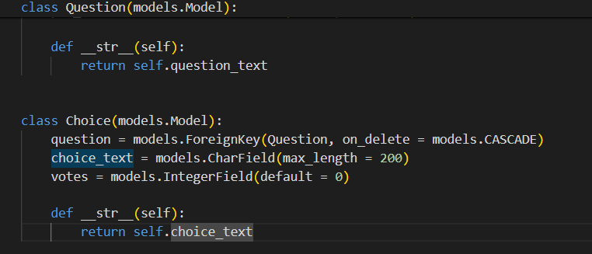
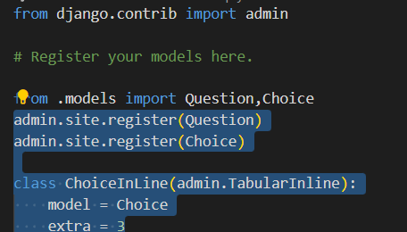
Models.py
Admin.py
Source :

Slide 8
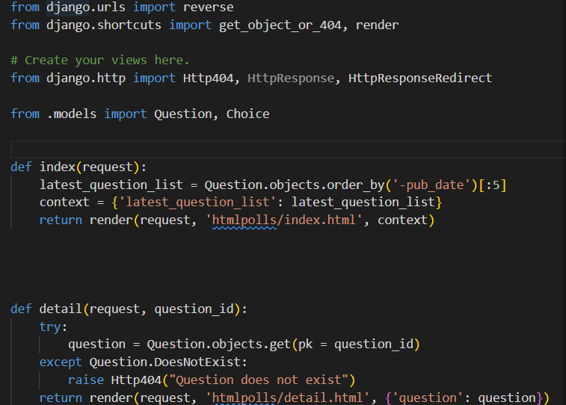
Views.py
Create view to handle displaying polls and submitting
votes
Source :

Slide 9


Technology Used
Front-end
Back-end
Source :

Slide 10
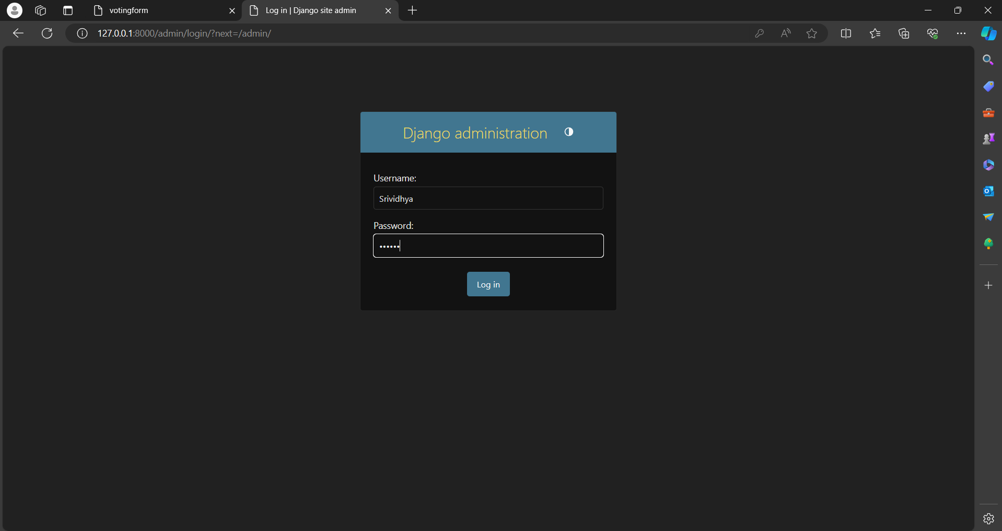
Admin
Source :

Slide 11
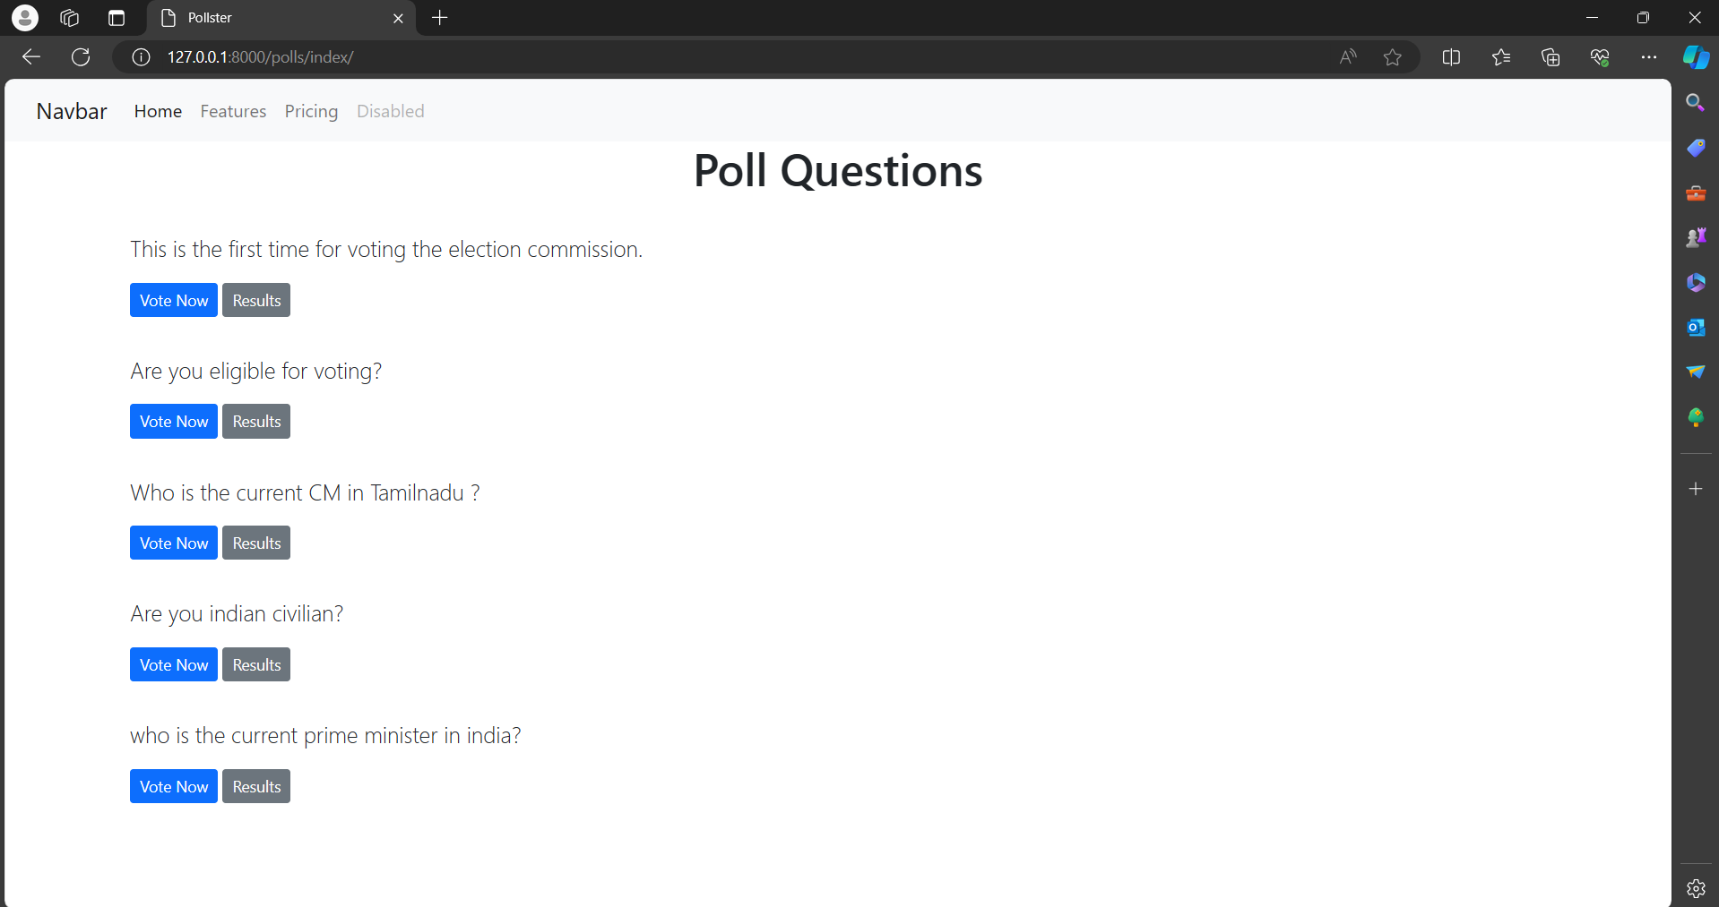
Home page

Slide 12
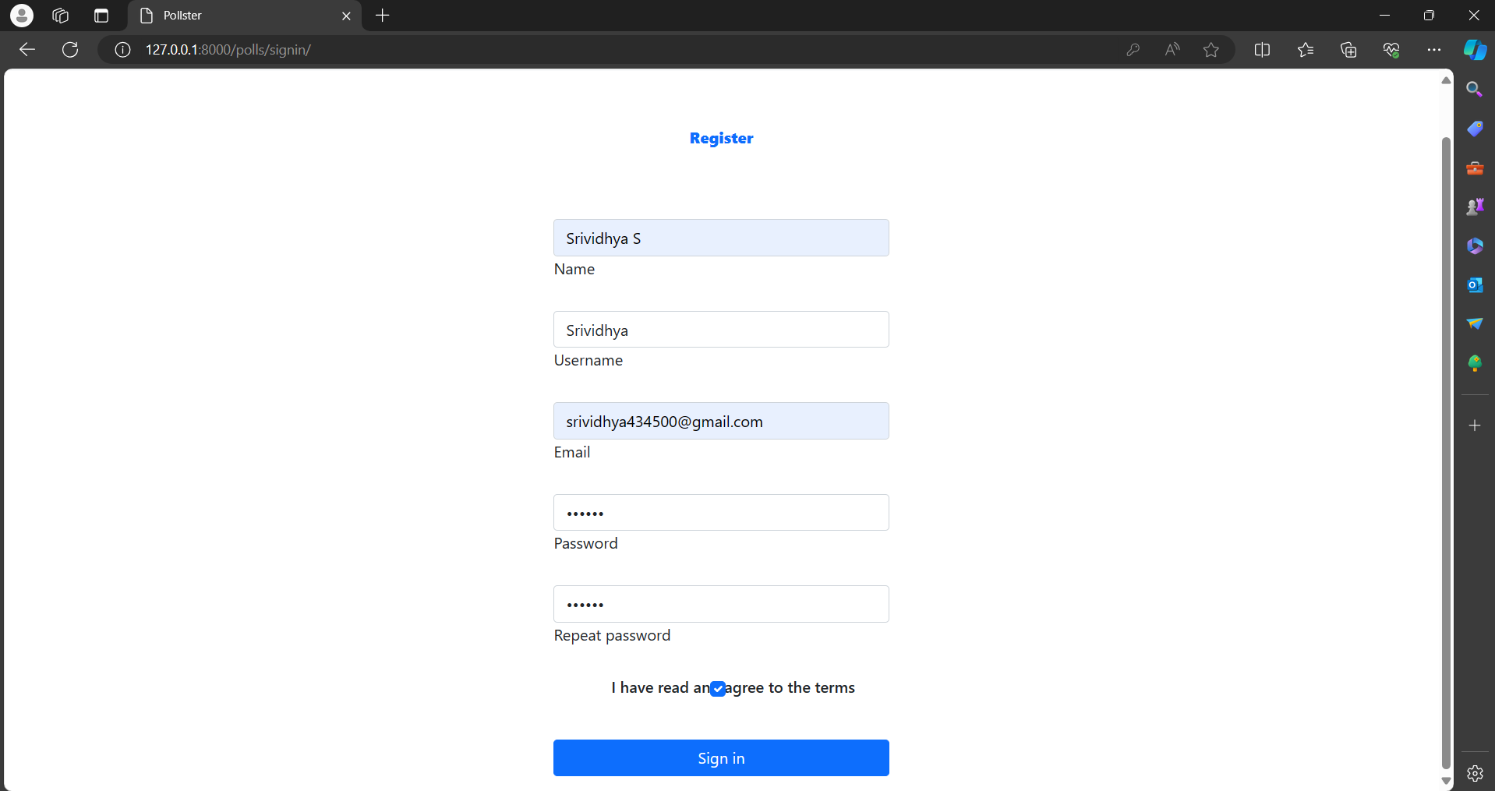
Register page
.

Slide 13
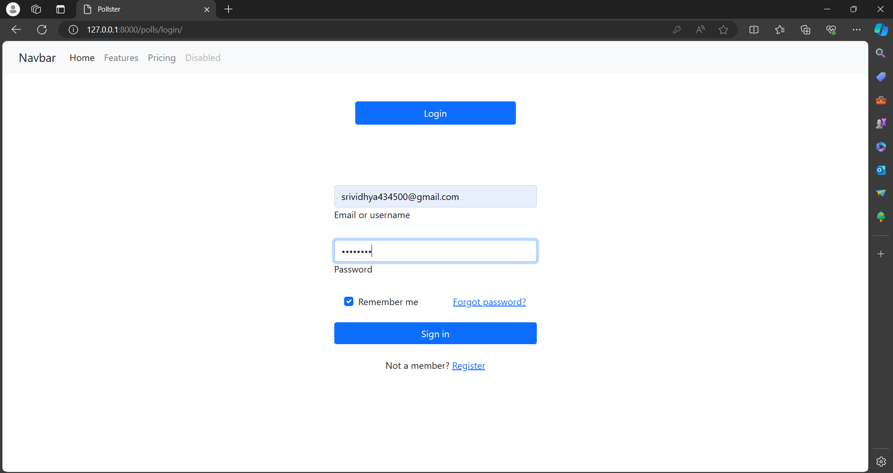
Login page

Slide 14
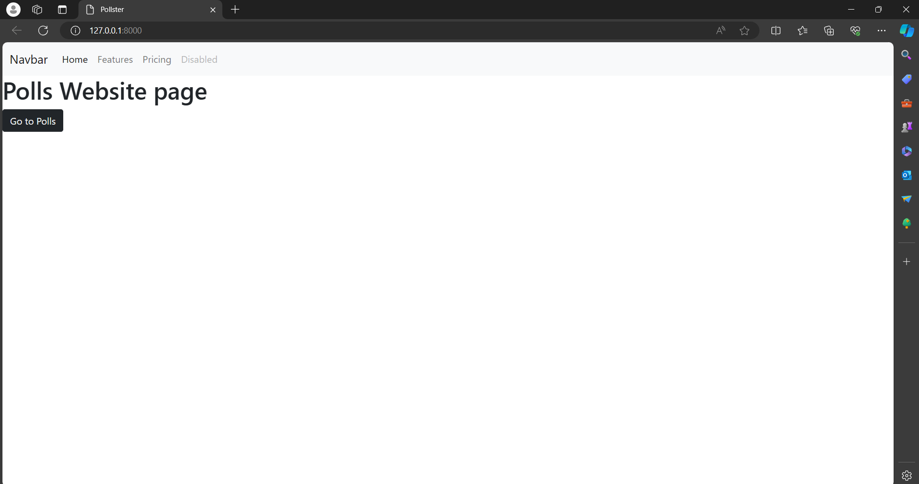
Go to polls

Slide 15
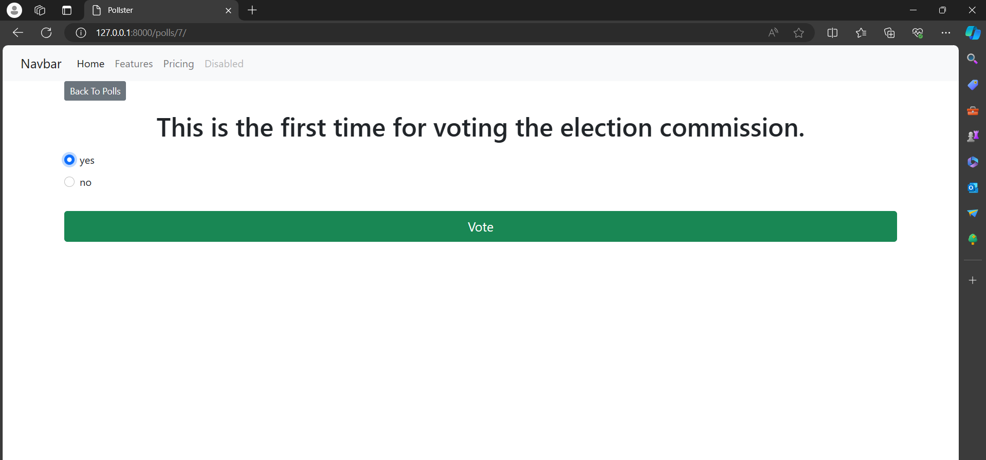
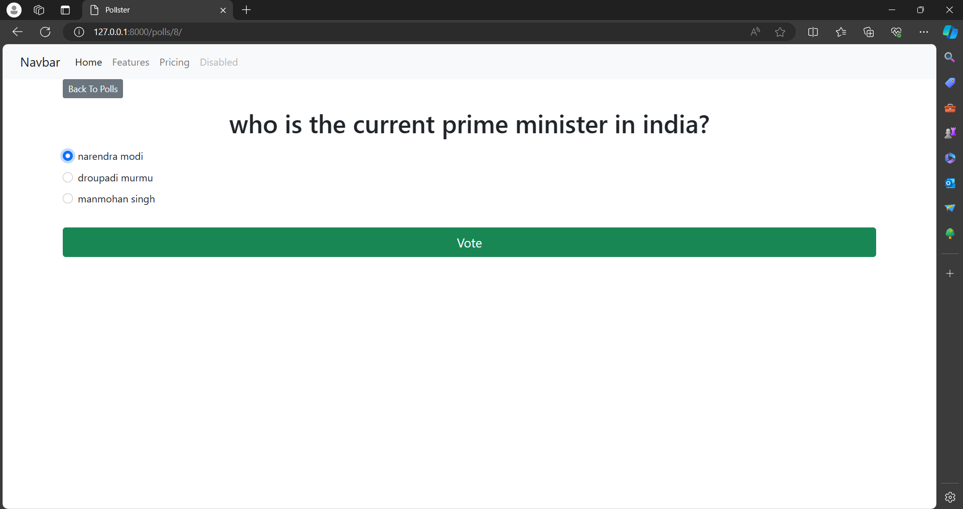
Question-page

Slide 16
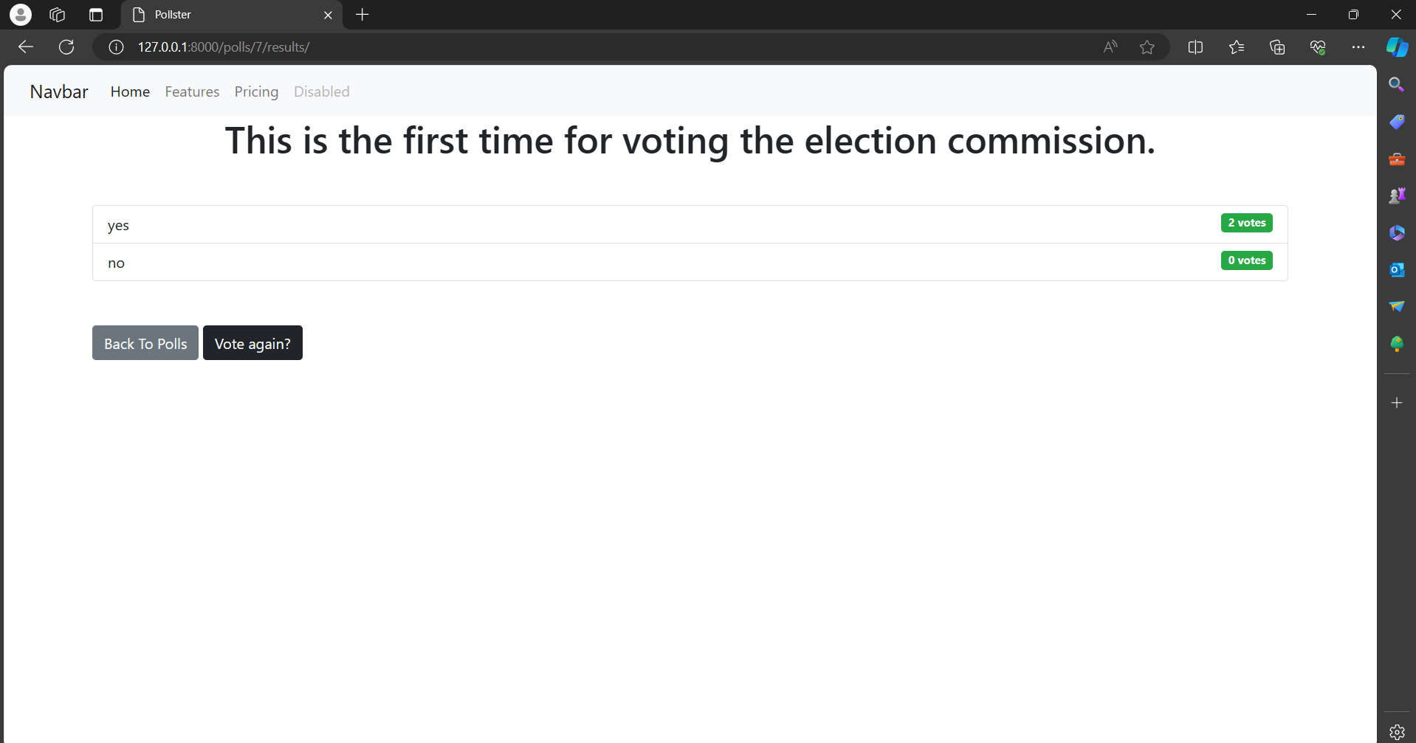
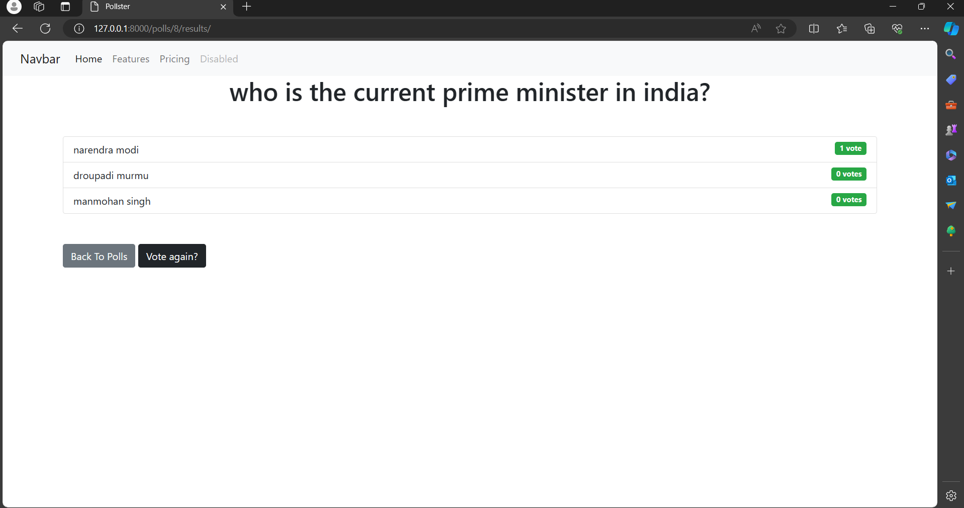
Result-page

Slide 17
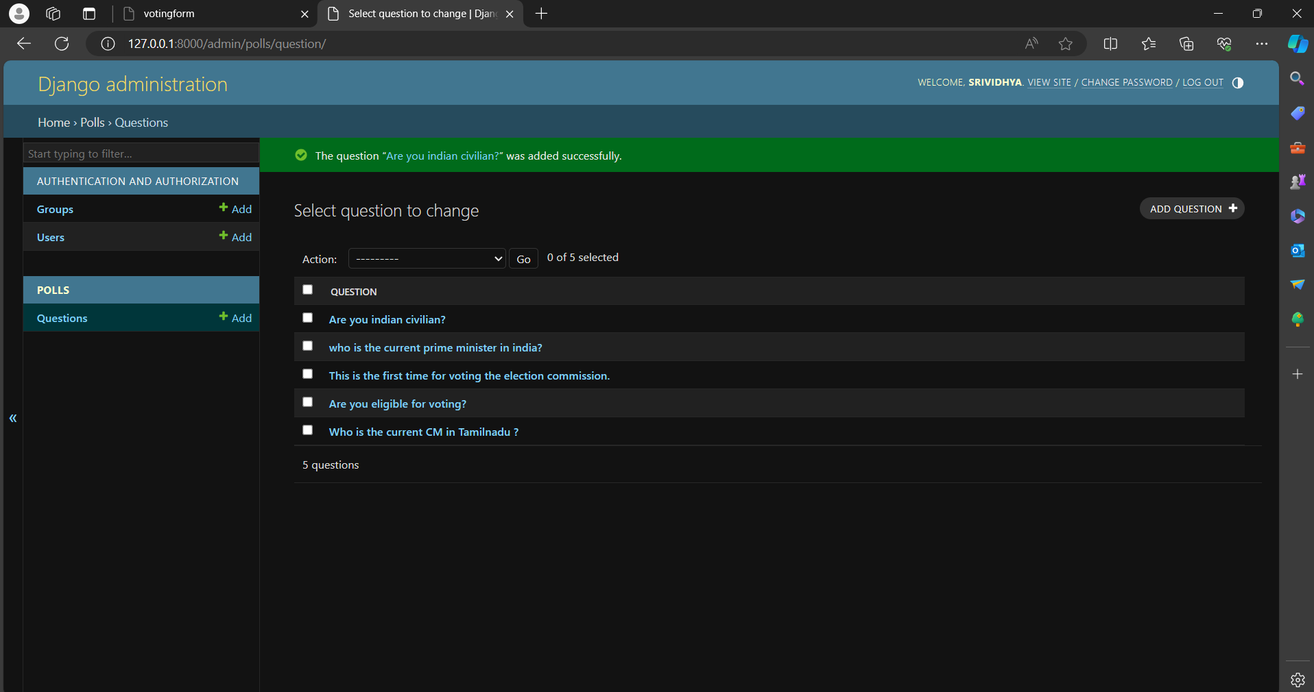

Slide 18
Title: "Empowering Democracy: Introducing Our Innovative Voting Application" Introduction: In an age where technology is reshaping every aspect of our lives, it's time for democracy to catch up. Our voting application represents a leap forward in how we engage with the democratic process. In this blog post, we're thrilled to introduce you to our innovative voting application and explore how it's revolutionizing the way we participate in elections. The Need for Change: Traditional voting methods are often cumbersome, time-consuming, and inaccessible to many. Long lines at polling stations, logistical challenges, and concerns about security and fraud have led to disenchantment with the electoral process. Our voting application seeks to address these issues by providing a modern, convenient, and secure way to cast your vote.
Blog-Page

Slide 19
Future Enhancements:
User Authentication:
Implement user authentication to allow only registered users to vote.
Associate each vote with a user to prevent duplicate voting.
Multiple Choice Options:
Allow users to select multiple choices for a single poll.
Implement validation to ensure users do not exceed the allowed number of choices.
Real-Time Updates:
Use WebSockets or server-sent events to provide real-time updates of poll results without requiring page refreshes.
Improved UI/UX:
Enhance the user interface with modern design principles and responsive layouts.
Implement client-side validation for a smoother user experience. polls.

Slide 20
Conclusion
In conclusion, the Django polling application offers a comprehensive solution for conducting polls with various advanced features to enhance user experience and functionality. By leveraging Django's powerful framework, along with modern frontend technologies and third-party services, we've created a robust platform for managing polls and engaging users.
With user authentication in place, only registered users can vote, and each vote is associated with a specific user, preventing duplicate voting. The application allows users to select multiple choices for a single poll, with validation ensuring they do not exceed the allowed number of choices. Real-time updates are facilitated through WebSockets or server-sent events, providing users with instant feedback on poll results without requiring page refreshes.
Source :

Slide 21
Thank You!
Notes:
Thank You !!

