Slide 1
Design of Speedometer Interface using MSP430 and Hall Sensor
Siddharth D Srinivas - PES1UG21EC283
Srividya Prasad - PES1UG21EC297
Gaurav Sai Palasari - PES1UG21EE030

Slide 2
Objective
The purpose of this modularized code is to provide a C library for MSP430 and Hall Sensor with services to measure RPM, Pulse per second, and Speed in m/s of any rotary object with a magnet and a sample user application.
It also blinks LED to indicate detection of magnet.
The code is divided into three modules:
HAL (Hardware Abstraction Layer)
DRV (Hardware Driver Layer), and
main (Application)

Slide 3
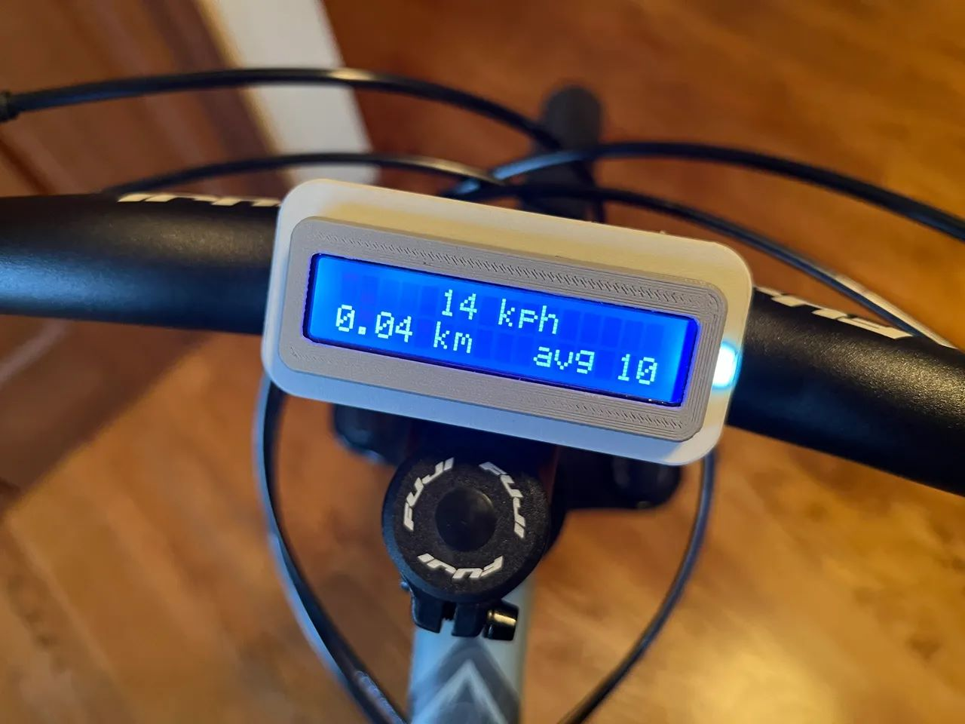
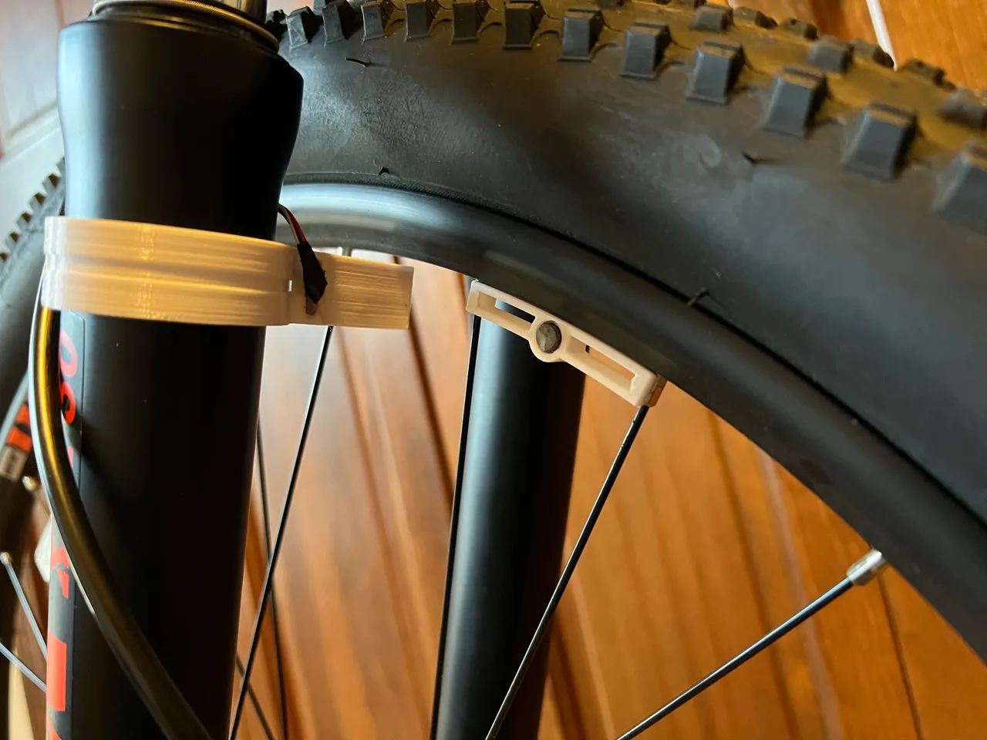
Reference Images

Slide 4
Module: main.c
The main application is where the user can invoke the services provided by the HAL and DRV layers.
Configures the LED and Hall Sensor, sets the wheel diameter, and initializes the necessary components.
Also handles the Hall Sensor interrupt and periodically calculates RPM, PPS, and speed.

Slide 5
Module: hal.c, hal.h
hal.c/hal.h: Hardware Abstraction Layer
The HAL module acts as an interface between the Hardware Driver Layer (DRV) and the main application.
It provides functions to:
initialize the LED and Hall Sensor,
set the wheel diameter,
reset pulse count, calculate RPM, PPS, and speed, and
manage the Hall Sensor interrupt callback. This module interacts with the DRV layer to control the hardware.

Slide 6
Module: drv.c, drv.h
drv.c/drv.h: Hardware Driver Layer
The DRV module directly interacts with the hardware to configure the LED and Hall Sensor pins as input/output.
It defines the:
LED blinking function
sets up the Hall Sensor interrupt service routine.
The DRV layer is tightly coupled with the hardware and provides low-level control.

Slide 7
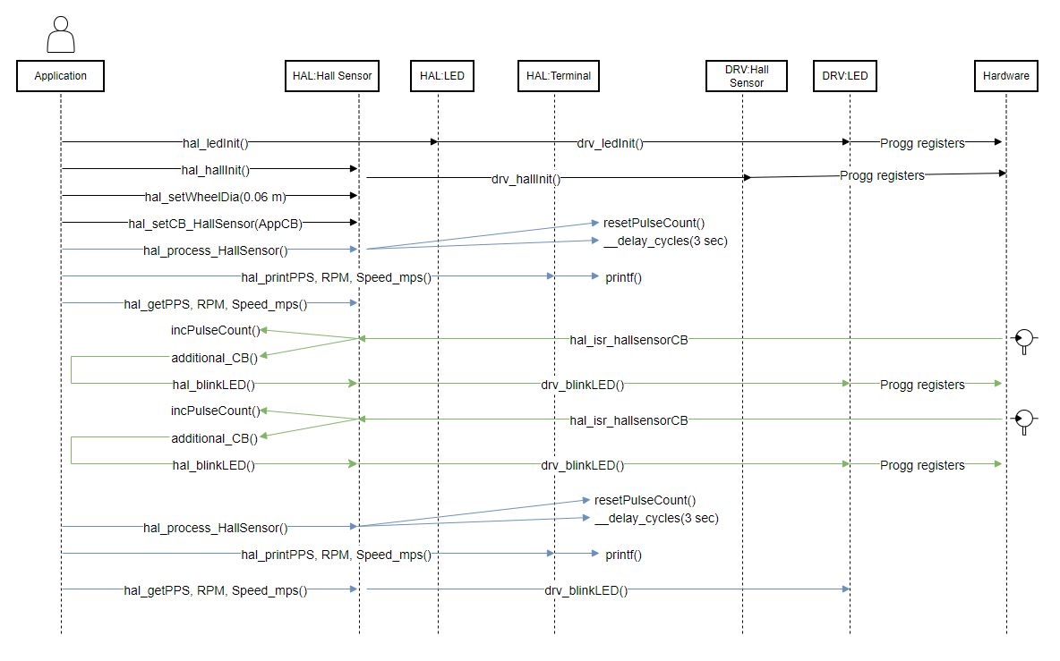
Control Flow Diagram
https://drive.google.com/file/d/1_VnPdndJS8WpIyg9Ratq0rTvKH1edjGV/view?usp=sharing

Slide 8
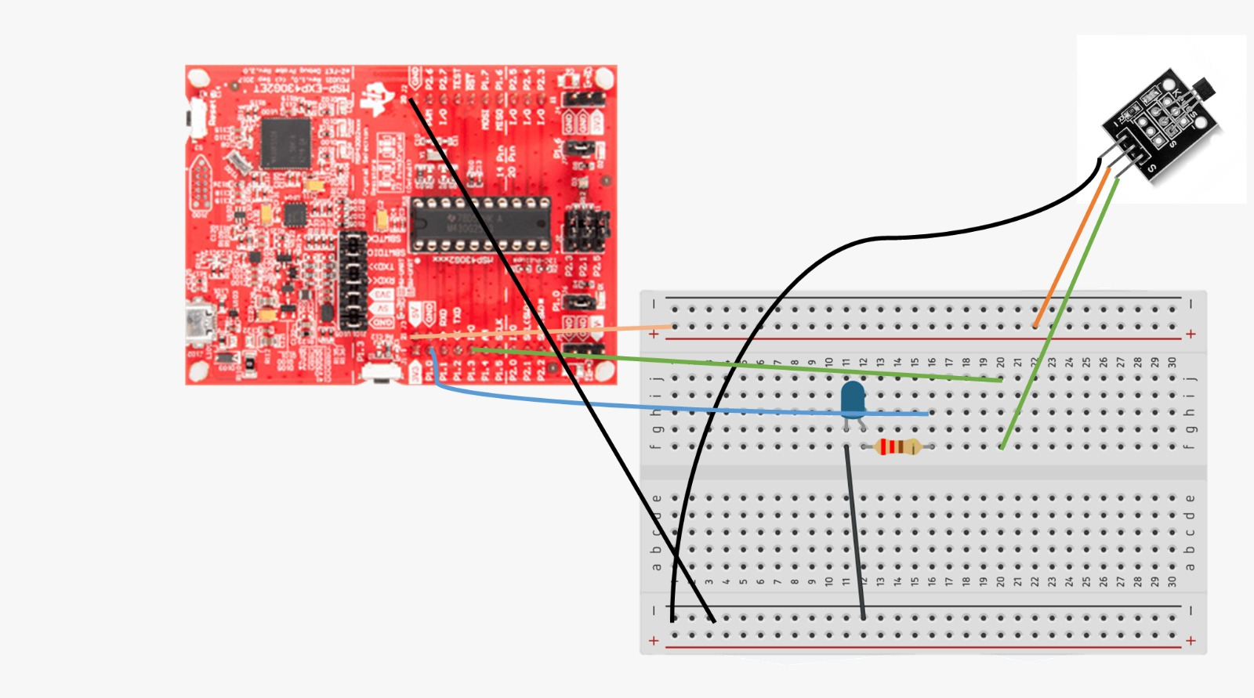
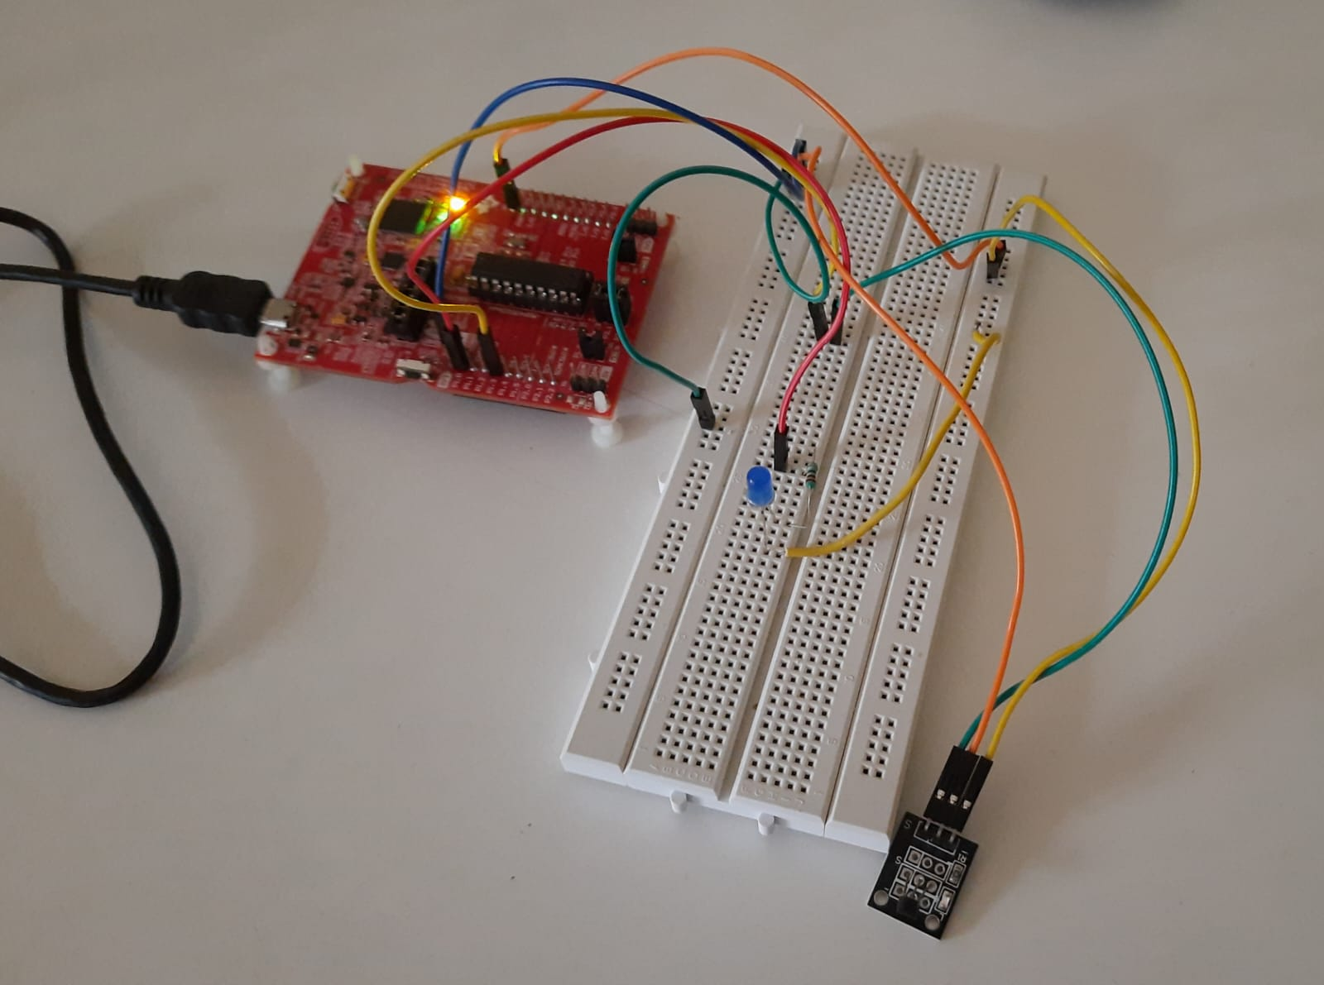
Circuit Schematic

Slide 9
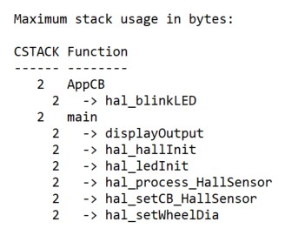
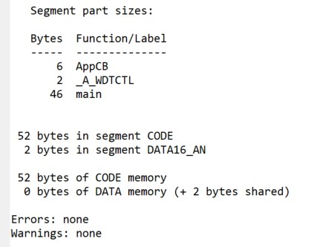
Screenshots from .lst file

Slide 10
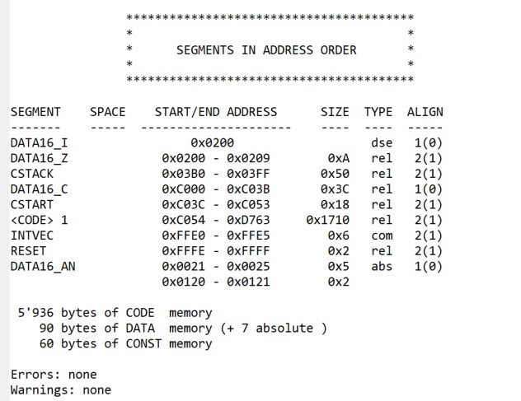
Screenshot from .map file

Slide 11
Thank You
We are now open for questions!

