Slide 1
MONGODB
P.srivignesh

Slide 2
ONE TO ONE RELATIONSHIP

Slide 3
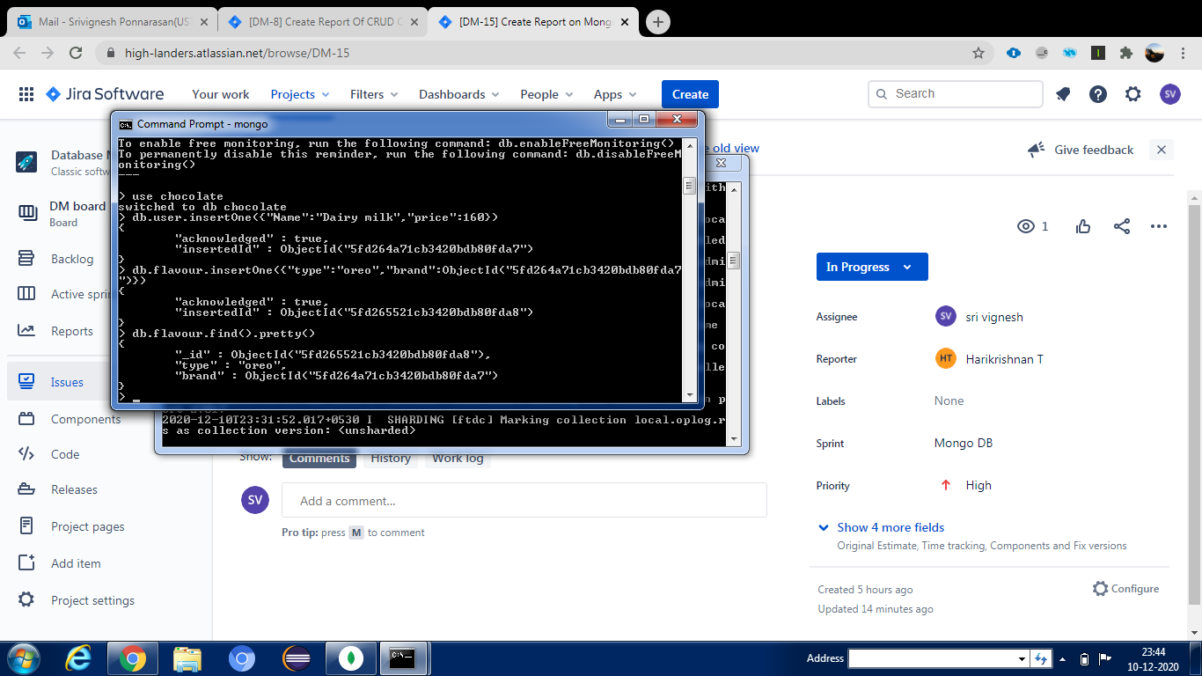

Slide 4
ONE TO MANY RELATIONSHIP

Slide 5
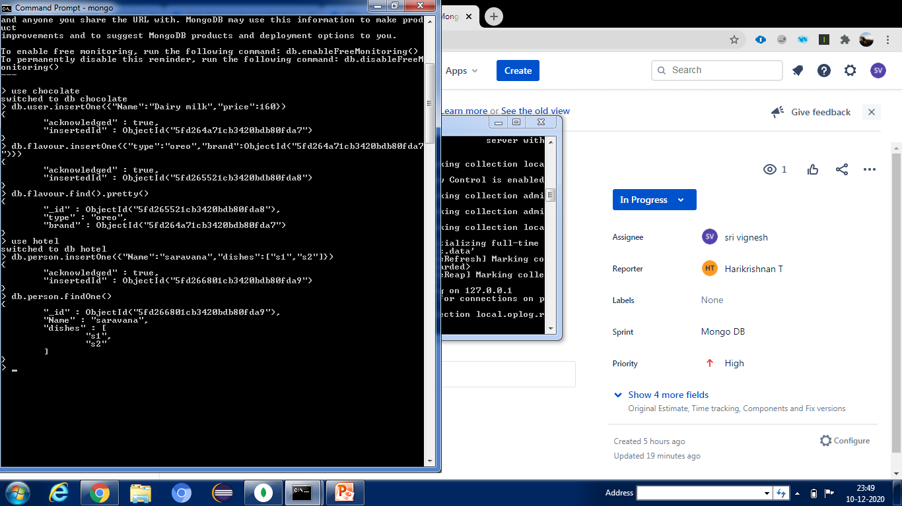

Slide 6
MANY TO MANY

Slide 7
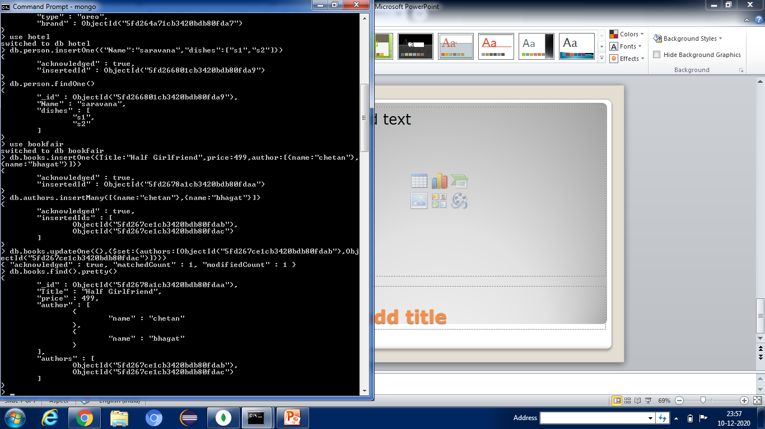

Slide 8
Join using lookup

Slide 9
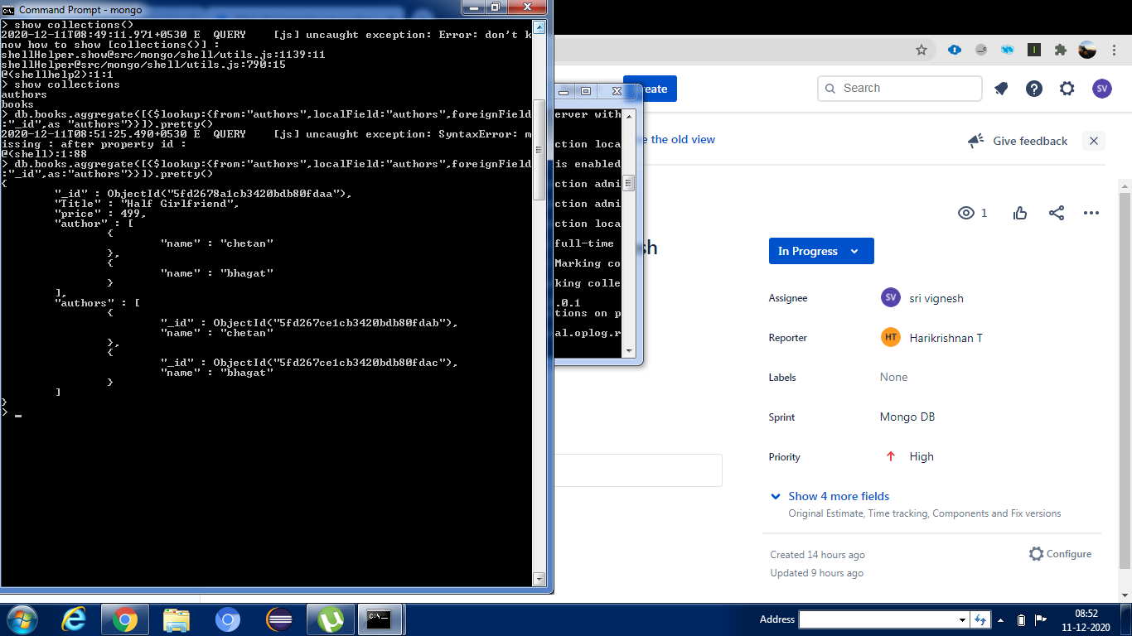

Slide 10
INSERT Write concern

Slide 11
