Slide 1
A Two-way Communication Bus Architecture for the e-Health System

Slide 2
TEAM - 06
GUIDE
Dr. BHUVANESWARI A
20MX107 CHANDEESH S
20MX223 SRIVIJAYRAM NB

Slide 3
Consult doctors Virtually and Securely with Health Level 7 Protocol.
HL7 provide a framework for the exchange, integration, sharing and retrieval of electronic health information.

Slide 4
PROJECT OVERVIEW
1

Slide 5
PATIENTS AND DOCTORS
UPLOAD and DOWNLOAD HEALTH ISSUES
Files will be in .pdf format
Consult app for doctors and patients

Slide 6
PROTOTYPE
2

Slide 7
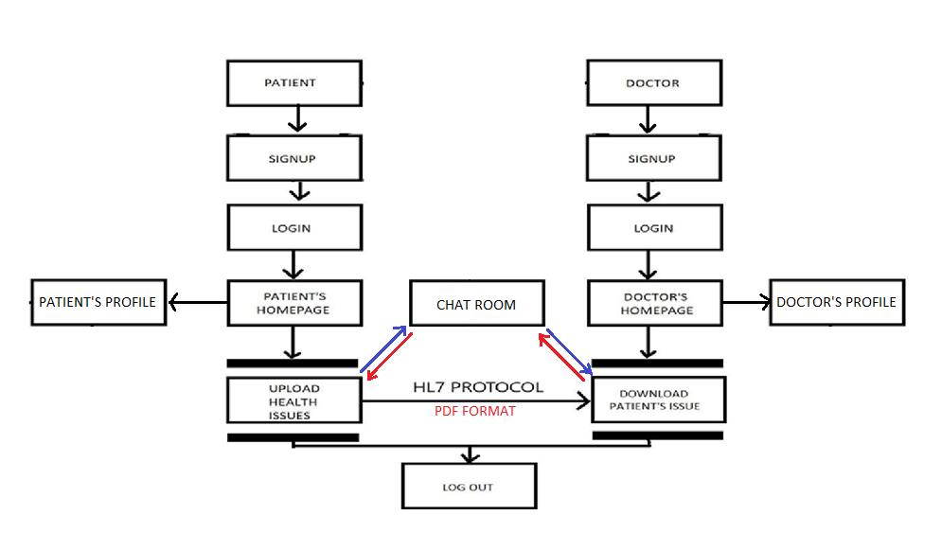

Slide 8
MODULES COMPLETED FOR REVIEW 1
3

Slide 9
CREATION OF ACCOUNT AND LOGIN - DOCTORS - PATIENTS
SEND DOCUMENTS

Slide 10
MODULES COMPLETED FOR REVIEW 2
4

Slide 11
PROFILE - VIEW, EDIT DELETE PROFILES (SEPARATE FOR DOCTORS AND PATIENTS) CONSULT(chat) - EASY CONSULTATIONS AND QUERIES
PATIENTS - UPLOAD HEALTH ISSUES
DOCTORS
- DOWNLOAD PATIENTS ISSUES

Slide 12
TECHNOLOGIES USED AND LEARNT
5

Slide 13






Slide 14
TIMELINE
6

Slide 15
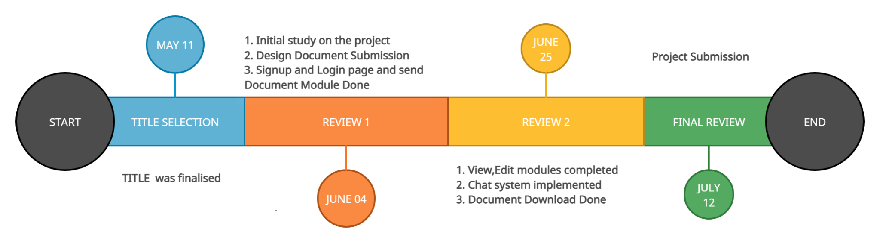

Slide 16
GO TO DEMO
7

Slide 17
THANK YOU

